Slide 1

CSCE 5218
Deep Learning
Recurrent Neural Networks
Slides adapted from Adriana Kovashka

Slide 2
Plan for this lecture
Recurrent neural networks
Basics
Training (backprop through time, vanishing gradient)
Recurrent networks with gates (GRU, LSTM)
Applications in NLP and vision
Neural machine translation
Image/video captioning

Slide 3
Applications

Slide 4
Neural Machine Translation
Neural Machine Translation (NMT) is a way to do Machine Translation with a single neural network
The neural network architecture is called sequence-to-sequence (aka seq2seq) and it involves two RNNs.
Abigail See

Slide 5
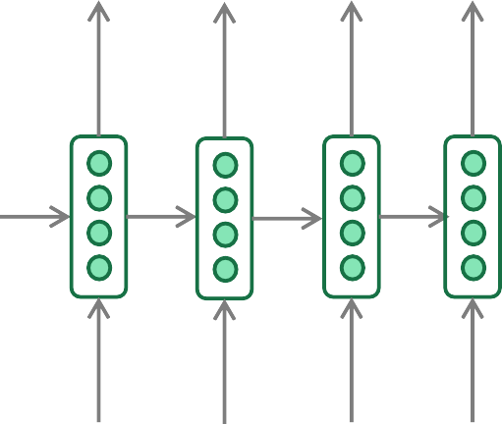
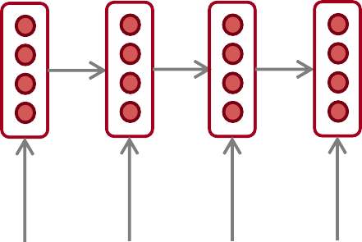
Neural Machine Translation (NMT)
The sequence-to-sequence model
Encoding of the source sentence.
Target sentence (output)
Provides initial hidden state
for Decoder RNN.
he
hit
me
with
a
pie <END>
argmax
argmax
argmax
argmax
argmax
argmax
argmax
Encoder RNN
Decoder RNN
il
a
m’ entarté
<START> he hit me with a pie
Source sentence (input)
Decoder RNN is a Language Model that generates target sentence, conditioned on encoding.
Encoder RNN produces an encoding of the source sentence.
Note: This diagram shows test time behavior:
decoder output is fed in as next step’s input
Abigail See

Slide 6
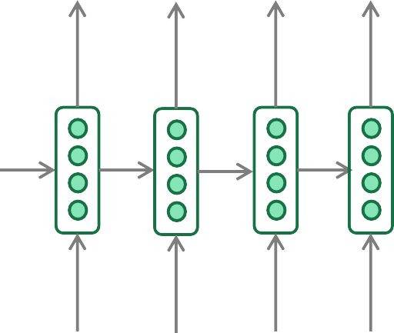
Greedy decoding
We saw how to generate (or “decode”) the target sentence by
taking argmax on each step of the decoder
he hit me with a pie <END>
argmax
argmax
argmax
argmax
argmax
argmax
argmax
<START> he hit me with a pie
This is greedy decoding (take most probable word on each step)
Problems with this method?
Abigail See

Slide 7
Problems with greedy decoding
Greedy decoding has no way to undo decisions!
Input: il a m’entarté
→ he
→ he hit
→ he hit a
(he hit me with a pie)
(whoops! no going back now…)
How to fix this?
Abigail See

Slide 8
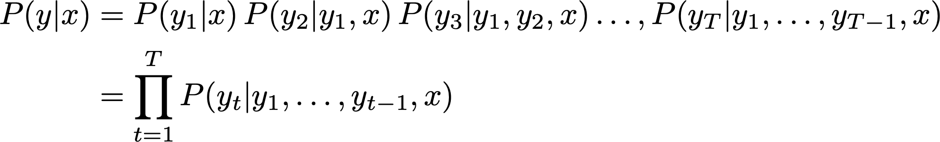
Exhaustive search decoding
Ideally, we want to find a (length T) translation y that maximizes
We could try computing all possible sequences y
This means that on each step t of the decoder, we’re tracking V^{T} possible partial translations, where V is vocabulary size
This O(V^{T}) complexity is far too expensive!
Abigail See

Slide 9

Beam search decoding
Core idea: On each step of decoder, keep track of the k most probable partial translations (hypotheses)
k is the beam size (in practice around 5 to 10)
A hypothesis has a score which is its log probability:
Scores are all negative, and higher score is better
We search for high-scoring hypotheses, tracking top k on each step
Beam search is not guaranteed to find optimal solution
But much more efficient than exhaustive search!
Abigail See

Slide 10
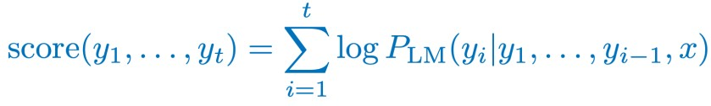
Beam search decoding: example
Beam size = k = 2. Blue numbers =
<START>
Calculate prob
dist of next word
Abigail See

Slide 11
Beam search decoding: example
Beam size = k = 2. Blue numbers =
-0.7 = log P_{LM}(he|<START>)
he
<START>
I
-0.9 = log P_{LM}(I|<START>)
Take top k words and compute scores
Abigail See

Slide 12
Beam search decoding: example
Beam size = k = 2. Blue numbers =
-1.7 = log P_{LM}(hit|<START> he) + -0.7
-0.7
hit
he
struck
-2.9 = log P_{LM}(struck|<START> he) + -0.7
<START>
-1.6 = log P_{LM}(was|<START> I) + -0.9
was
I
got
-0.9
-1.8 = log P_{LM}(got|<START> I) + -0.9
For each of the k hypotheses, find
top k next words and calculate scores
Abigail See

Slide 13
Beam search decoding: example
Beam size = k = 2. Blue numbers =
-1.7
-0.7
hit
he
struck
-2.9
<START>
-1.6
was
I
got
-0.9
-1.8
Of these k² hypotheses,
just keep k with highest scores
Abigail See

Slide 14
Beam search decoding: example
Beam size = k = 2. Blue numbers =
-2.8 = log P_{LM}(a|<START> he hit) + -1.7
-1.7
a
-0.7
hit
he
me
struck
-2.5 = log P_{LM}(me|<START> he hit) + -1.7
-2.9
<START>
-2.9 = log P_{LM}(hit|<START> I was) + -1.6
-1.6
hit
was
I
struck
got
-0.9
-3.8 = log P_{LM}(struck|<START> I was) + -1.6
-1.8
For each of the k hypotheses, find
top k next words and calculate scores
Abigail See

Slide 15
Beam search decoding: example
Beam size = k = 2. Blue numbers =
-2.8
-1.7
a
-0.7
hit
he
me
struck
-2.5
-2.9
<START>
-2.9
-1.6
hit
was
I
struck
got
-0.9
-3.8
-1.8
Of these k² hypotheses,
just keep k with highest scores
Abigail See

Slide 16
Beam search decoding: example
Beam size = k = 2. Blue numbers =
-4.0
tart
-2.8
pie
-1.7
a
-0.7
hit
-3.4
he
me
-3.3
struck
-2.5
with
-2.9
<START>
-2.9
on
-1.6
hit
-3.5
was
I
struck
got
-0.9
-3.8
-1.8
For each of the k hypotheses, find
top k next words and calculate scores
Abigail See

Slide 17
Beam search decoding: example
Beam size = k = 2. Blue numbers =
-4.0
tart
-2.8
pie
-1.7
a
-0.7
hit
-3.4
he
me
-3.3
struck
-2.5
with
-2.9
<START>
-2.9
on
-1.6
hit
-3.5
was
I
struck
got
-0.9
-3.8
-1.8
Of these k² hypotheses,
just keep k with highest scores
Abigail See

Slide 18
Beam search decoding: example
Beam size = k = 2. Blue numbers =
-4.0
-4.8
tart
in
-2.8
pie
with
-1.7
a
-0.7
hit
-3.4
-4.5
he
me
-3.3
-3.7
struck
-2.5
with
a
-2.9
<START>
-2.9
on
one
-1.6
hit
-3.5
-4.3
was
I
struck
got
-0.9
-3.8
-1.8
For each of the k hypotheses, find
top k next words and calculate scores
Abigail See

Slide 19
Beam search decoding: example
Beam size = k = 2. Blue numbers =
-4.0
-4.8
tart
in
-2.8
pie
with
-1.7
a
-0.7
hit
-3.4
-4.5
he
me
-3.3
-3.7
struck
-2.5
with
a
-2.9
<START>
-2.9
on
one
-1.6
hit
-3.5
-4.3
was
I
struck
got
-0.9
-3.8
-1.8
Of these k² hypotheses,
just keep k with highest scores
Abigail See

Slide 20
Beam search decoding: example
Beam size = k = 2. Blue numbers =
-4.0
-4.8
tart
in
-2.8
-4.3
pie
with
-1.7
a
pie
-0.7
hit
-3.4
-4.5
he
me
-3.3
-3.7
tart
struck
-2.5
with
a
-4.6
-2.9
<START>
-2.9
on
one
-5.0
-1.6
hit
pie
-3.5
-4.3
was
I
struck
tart
got
-0.9
-3.8
-5.3
-1.8
For each of the k hypotheses, find
top k next words and calculate scores
Abigail See

Slide 21
Beam search decoding: example
Beam size = k = 2. Blue numbers =
-4.0
-4.8
tart
in
-2.8
-4.3
pie
with
-1.7
a
pie
-0.7
hit
-3.4
-4.5
he
me
-3.3
-3.7
tart
struck
-2.5
with
a
-4.6
-2.9
<START>
-2.9
on
one
-5.0
-1.6
hit
pie
-3.5
-4.3
was
I
struck
tart
got
-0.9
-3.8
-5.3
-1.8
This is the top-scoring hypothesis!
Abigail See

Slide 22
Beam search decoding: example
Beam size = k = 2. Blue numbers =
-4.0
-4.8
tart
in
-2.8
-4.3
pie
with
-1.7
a
pie
-0.7
hit
-3.4
-4.5
he
me
-3.3
-3.7
tart
struck
-2.5
with
a
-4.6
-2.9
<START>
-2.9
on
one
-5.0
-1.6
hit
pie
-3.5
-4.3
was
I
struck
tart
got
-0.9
-3.8
-5.3
-1.8
Backtrack to obtain the full hypothesis
Abigail See

Slide 23
How do we evaluate Machine Translation?
BLEU (Bilingual Evaluation Understudy)
BLEU compares the machine-written translation to one or several human-written translation(s), and computes a similarity score based on:
n-gram precision (usually for 1, 2, 3 and 4-grams)
Plus a penalty for too-short system translations
BLEU is useful but imperfect
There are many valid ways to translate a sentence
So a good translation can get a poor BLEU score because it has low n-gram overlap with the human translation ☹
Abigail See
Source: ” BLEU: a Method for Automatic Evaluation of Machine Translation", Papineni et al, 2002.

Slide 24
MT progress over time
[Edinburgh En-De WMT newstest2013 Cased BLEU; NMT 2015 from U. Montréal]
Phrase-based SMT Syntax-based SMT Neural MT
25
20
15
10
5
0
2013
2014
2015
2016
Source: http://www.meta-net.eu/events/meta-forum-2016/slides/09_sennrich.pdf
Abigail See

Slide 25
NMT: the biggest success story of NLP Deep Learning
Neural Machine Translation went from a fringe research activity in 2014 to the leading standard method in 2016
2014: First seq2seq paper published
2016: Google Translate switches from SMT to NMT
This is amazing!
SMT systems, built by hundreds of engineers over many years, outperformed by NMT systems trained by a handful of engineers in a few months
Abigail See

Slide 26
So is Machine Translation solved?
Nope!
Many difficulties remain:
Out-of-vocabulary words
Domain mismatch between train and test data
Maintaining context over longer text
Further reading: “Has AI surpassed humans at translation? Not even close!”
https://www.skynettoday.com/editorials/state_of_nmt
Abigail See

Slide 27
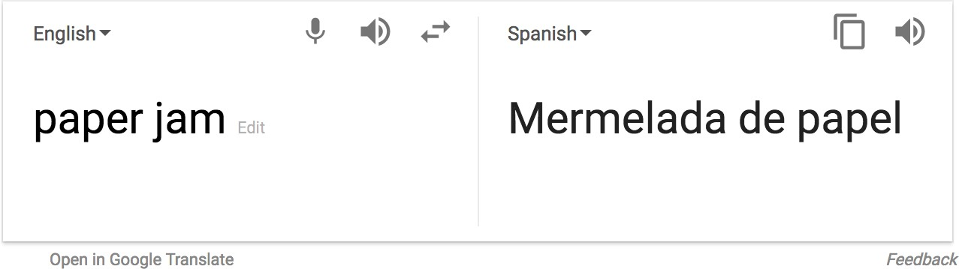

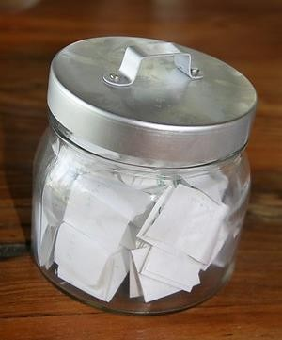
So is Machine Translation solved?
Nope!
Using common sense is still hard
?
Abigail See

Slide 28
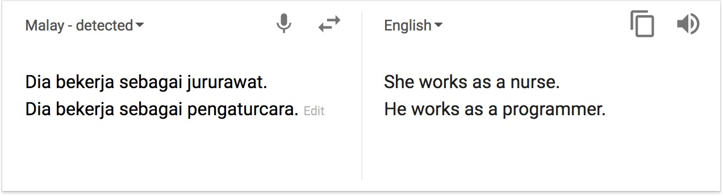
So is Machine Translation solved?
Nope!
NMT picks up biases in training data
Didn’t specify gender
Source: https://hackernoon.com/bias-sexist-or-this-is-the-way-it-should-be-ce1f7c8c683c
Abigail See

Slide 29
NMT research continues
NMT is the flagship task for NLP Deep Learning
NMT research has pioneered many of the recent innovations of NLP Deep Learning
In 2019: NMT research continues to thrive
Researchers have found many, many improvements to the “vanilla” seq2seq NMT system
But one improvement is so integral that it is the new vanilla…
ATTENTION
Abigail See

Slide 30
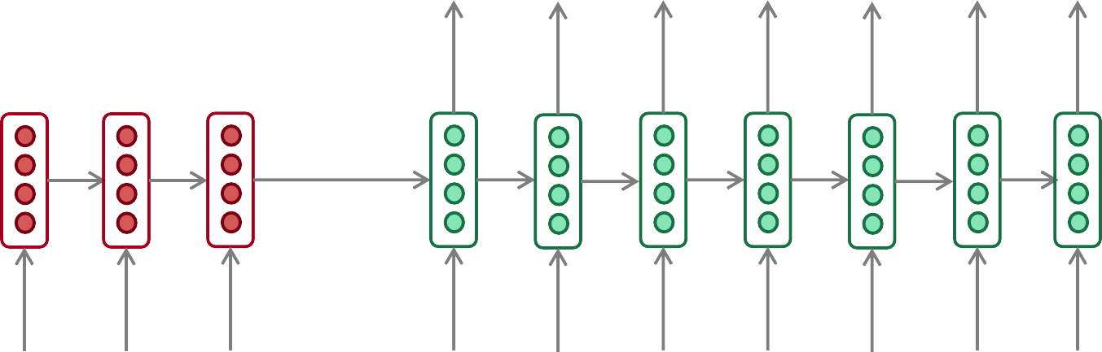
Sequence-to-sequence: the bottleneck problem
Encoding of the
source sentence.
This needs to capture all information about the source sentence.
Information bottleneck!
Target sentence (output)
he
hit
me with
a
pie <END>
Encoder RNN
Decoder RNN
il
a
m’ entarté
<START> he
hit
me with
a
pie
Source sentence (input)
Abigail See

Slide 31

Attention
Attention provides a solution to the bottleneck problem.
Core idea: on each step of the decoder, use direct connection to the encoder to focus on a particular part of the source sequence
First we will show via diagram (no equations), then we will show with equations
Abigail See

Slide 32
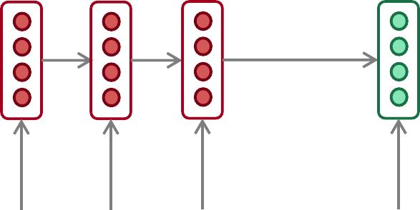
Sequence-to-sequence with attention
dot product
Attention
scores
Decoder RNN
Encoder
RNN
il
a
m’ entarté
<START>
Source sentence (input)
Abigail See

Slide 33
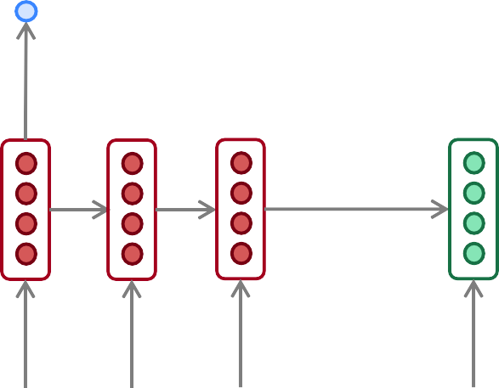
Sequence-to-sequence with attention
dot product
Attention
scores
Decoder RNN
Encoder
RNN
il
a
m’ entarté
<START>
Source sentence (input)
Abigail See

Slide 34
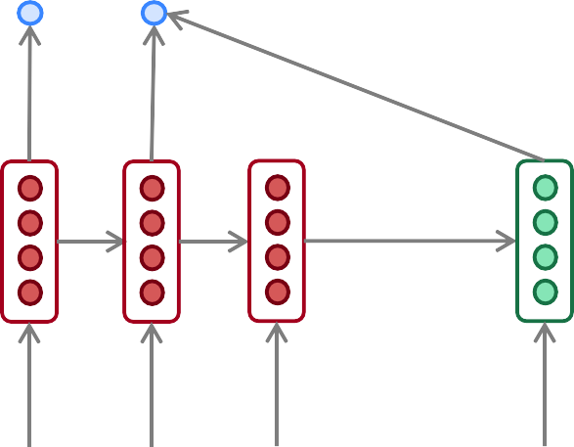
Sequence-to-sequence with attention
dot product
Attention
scores
Decoder RNN
Encoder
RNN
il
a
m’ entarté
<START>
Source sentence (input)
Abigail See

Slide 35
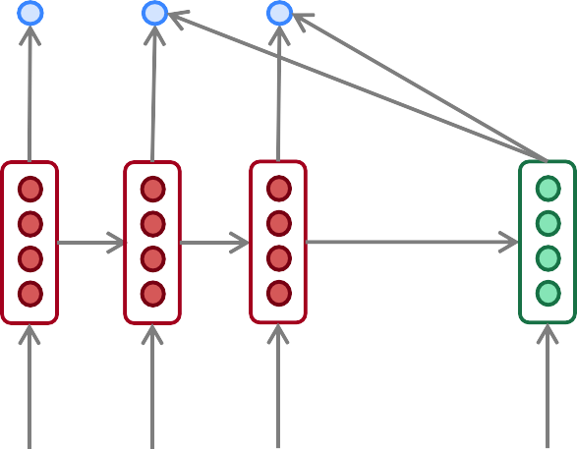
Sequence-to-sequence with attention
dot product
Attention
scores
Decoder RNN
Encoder
RNN
il
a
m’ entarté
<START>
Source sentence (input)
Abigail See

Slide 36
Sequence-to-sequence with attention
On this decoder timestep, we’re mostly focusing on the first encoder hidden state (”he”)
Attention
distribution
Take softmax to turn the scores into a probability distribution
Attention
scores
Decoder RNN
Encoder
RNN
il
a
m’ entarté
<START>
Source sentence (input)
Abigail See

Slide 37
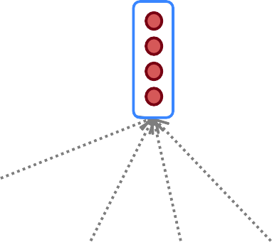
Sequence-to-sequence with attention
Attention output
Use the attention distribution to take a weighted sum of the encoder hidden states.
The attention output mostly contains information from the hidden states that received high attention.
Attention
distribution
Attention
scores
Decoder RNN
Encoder
RNN
il
a
m’ entarté
<START>
Source sentence (input)
Abigail See

Slide 38
Sequence-to-sequence with attention
Attention output
he
Concatenate attention output with decoder hidden state, then use to compute 𝑦₁ as before
Attention
distribution
𝑦₁
Attention
scores
Decoder RNN
Encoder
RNN
il
a
m’ entarté
<START>
Source sentence (input)
Abigail See

Slide 39
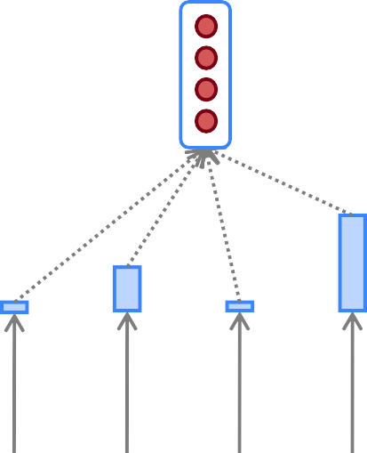
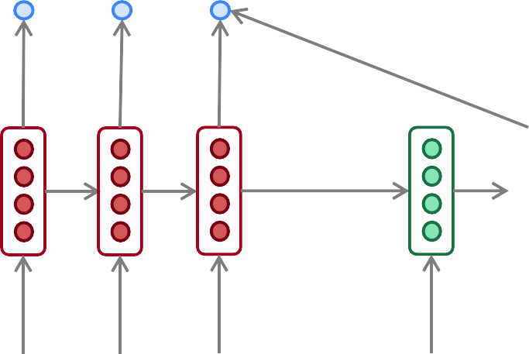
Sequence-to-sequence with attention
Attention output
hit
Attention
distribution
𝑦₂
Attention
scores
Decoder RNN
Encoder
RNN
Sometimes we take the attention output from the previous step, and also feed it into the decoder (along with the usual decoder input).
il
a
m’ entarté
<START> he
Source sentence (input)
Abigail See

Slide 40
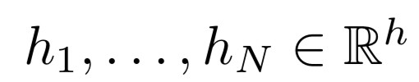






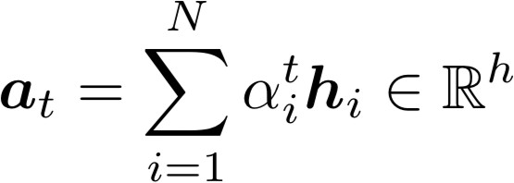



Attention: in equations
We have encoder hidden states
On timestep t, we have decoder hidden state
We get the attention scores for this step:
We take softmax to get the attention distribution
a probability distribution and sums to 1)
for this step (this is
We use to take a weighted sum of the encoder hidden states to get the attention output
Finally we concatenate the attention output with the decoder hidden state and proceed as in the non-attention seq2seq model
Abigail See

Slide 41
Attention is great
Attention significantly improves NMT performance
It’s very useful to allow decoder to focus on certain parts of the source
Attention solves the bottleneck problem
Attention allows decoder to look directly at source; bypass bottleneck
Attention helps with vanishing gradient problem
Provides shortcut to faraway states
Attention provides some interpretability
By inspecting attention distribution, we can see what the decoder was focusing on
We get (soft) alignment for free!
This is cool because we never explicitly trained an alignment system
The network just learned alignment by itself
he | hit | me | with | a | pie
il
a
m’
entarté
Abigail See

Slide 42
Attention is a general Deep Learning technique
We’ve seen that attention is a great way to improve the
sequence-to-sequence model for Machine Translation.
However: You can use attention in many architectures (not just seq2seq) and many tasks (not just MT)
More general definition of attention:
Given a set of vector values, and a vector query, attention is a technique to compute a weighted sum of the values, dependent on the query.
We sometimes say that the query attends to the values.
For example, in seq2seq + attention model, each decoder hidden state (query) attends to all encoder hidden states (values).
Abigail See

Slide 43
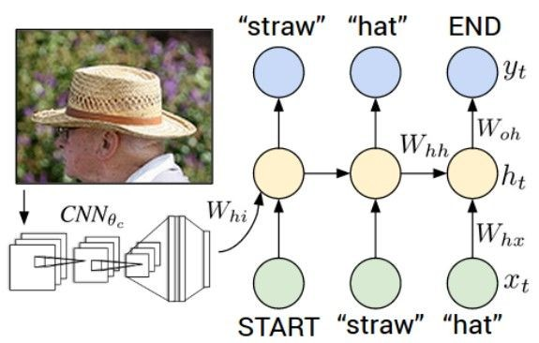
Image Captioning
CVPR 2015:
Deep Visual-Semantic Alignments for Generating Image Descriptions, Karpathy and Fei-Fei Show and Tell: A Neural Image Caption Generator, Vinyals et al.
Long-term Recurrent Convolutional Networks for Visual Recognition and Description, Donahue et al. Learning a Recurrent Visual Representation for Image Caption Generation, Chen and Zitnick
Adapted from Andrej Karpathy

Slide 44
Recurrent Neural Network
Image Captioning
Convolutional Neural Network
Andrej Karpathy

Slide 45
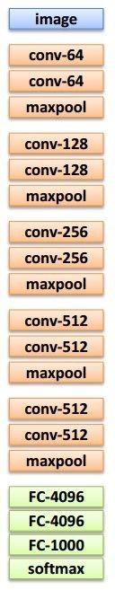

test image
Image Captioning
x0
<START>
<START>
Andrej Karpathy

Slide 46
Image Captioning
test image
y0
before:
h = tanh(W_{xh} * x + W_{hh} * h)
h0
Wih
now:
h = tanh(W_{xh} * x + W_{hh} * h + W_{ih} * im)
x0
<START>
im
<START>
Andrej Karpathy

Slide 47
test image
Image Captioning
y0
sample!
h0
x0
<START>
straw
<START>
Andrej Karpathy

Slide 48
test image
Image Captioning
y0
y1
h0
h1
x0
<START>
straw
<START>
Andrej Karpathy

Slide 49
test image
Image Captioning
y0
y1
sample!
h0
h1
x0
<START>
straw
hat
<START>
Andrej Karpathy

Slide 50
test image
Image Captioning
y0
y1
y2
h0
h1
h2
x0
<START>
straw
hat
<START>
Andrej Karpathy

Slide 51
test image
Image Captioning
Caption generated:
“straw hat”
y0
y1
y2
sample
<END> token
=> finish.
h0
h1
h2
x0
<START>
straw
hat
<START>
Adapted from Andrej Karpathy

Slide 52
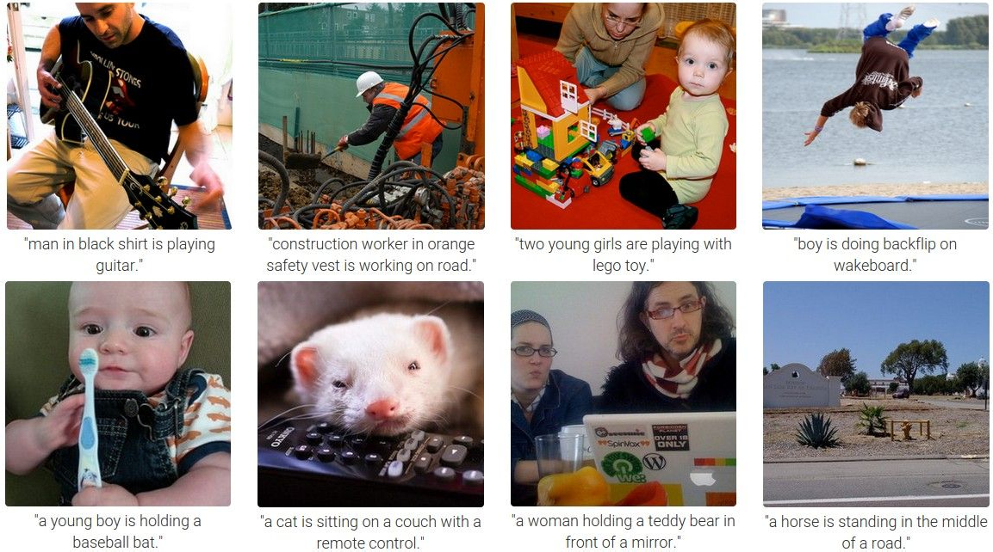
Image Captioning
Andrej Karpathy

