Slide 1








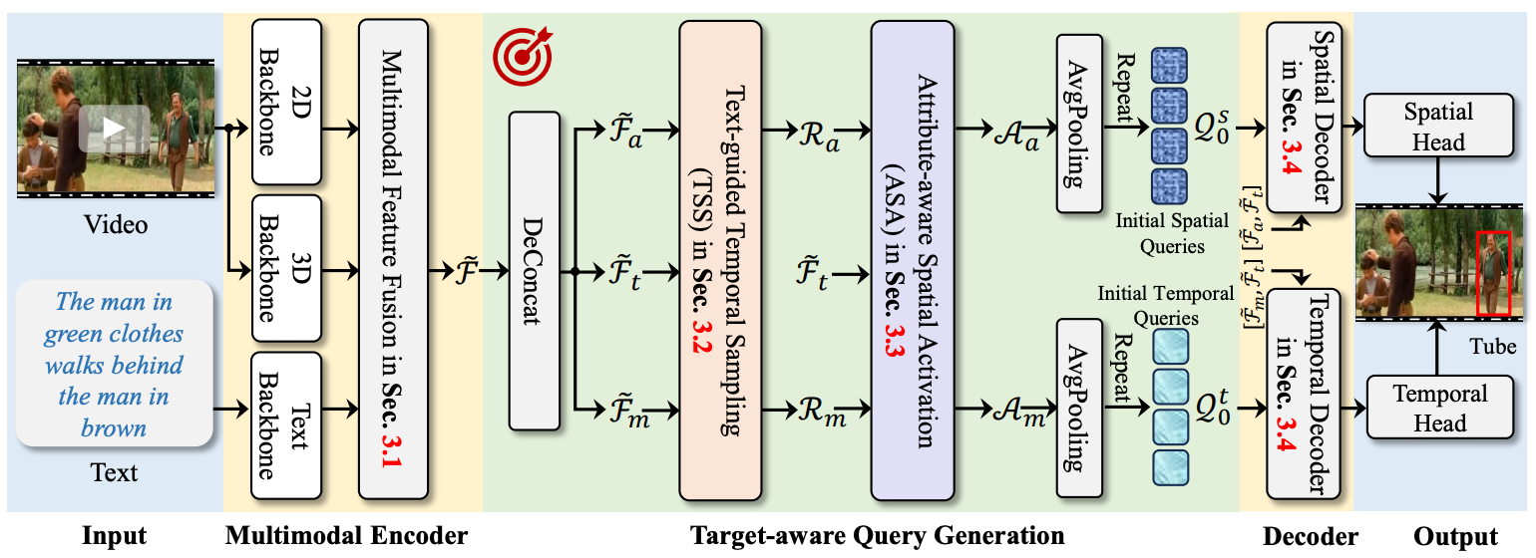
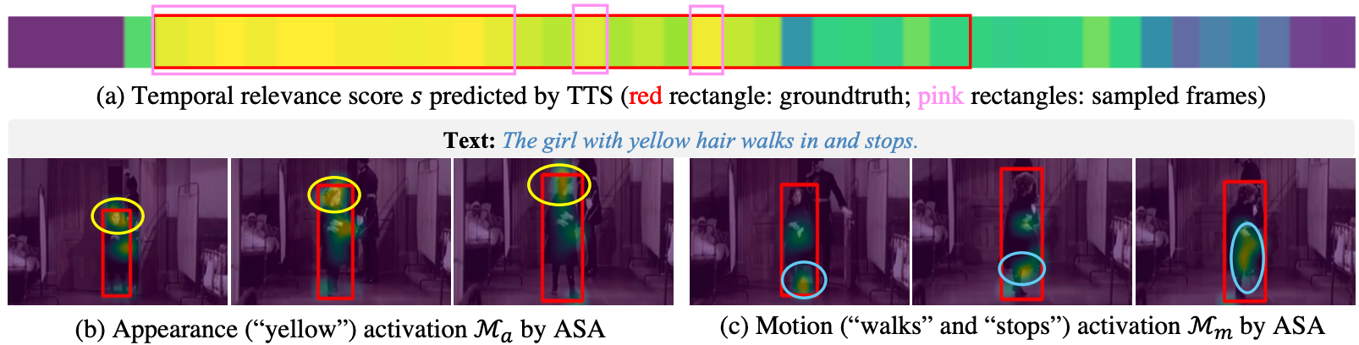
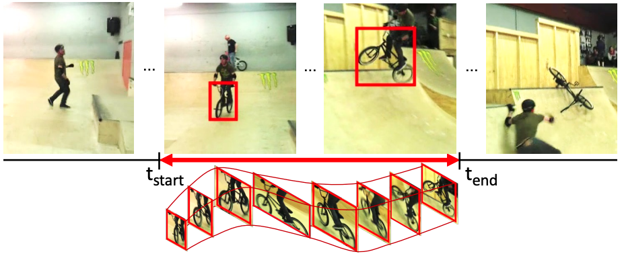
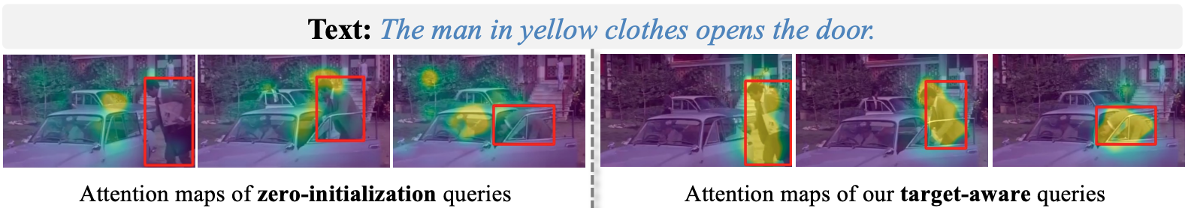
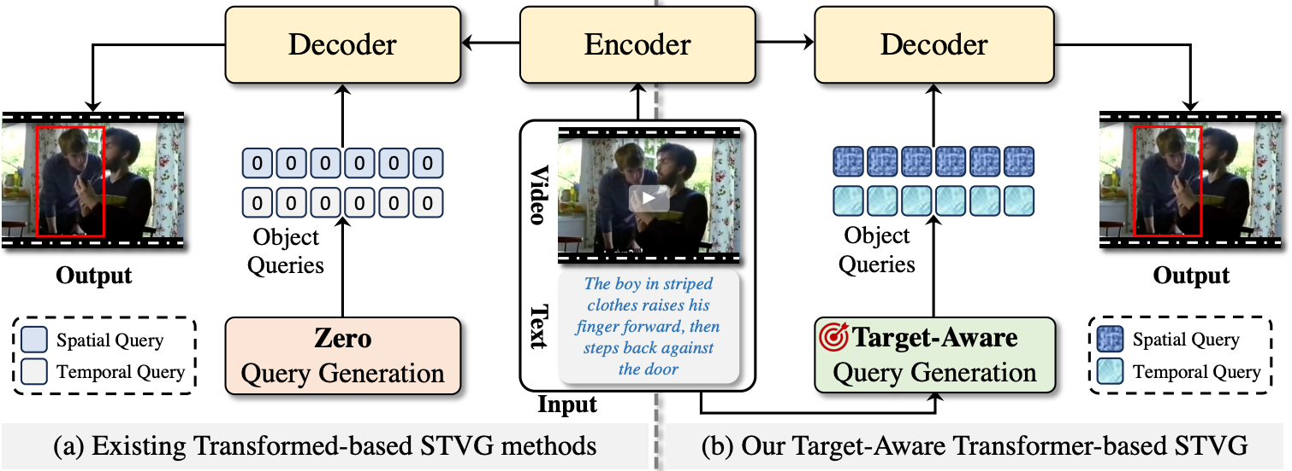
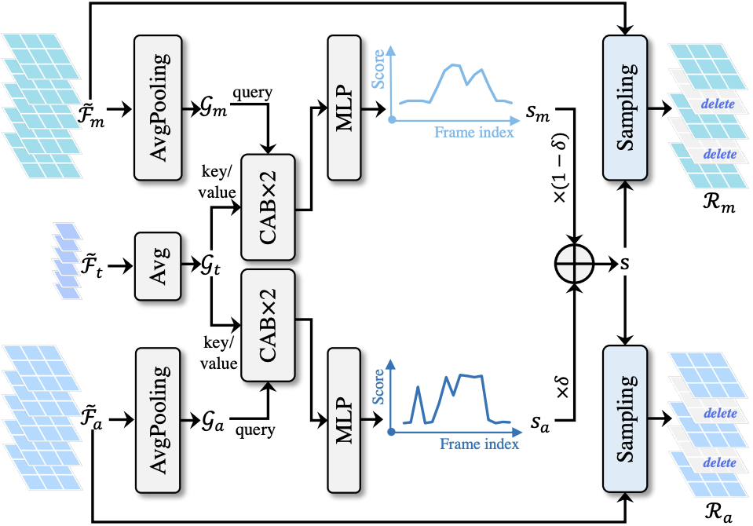
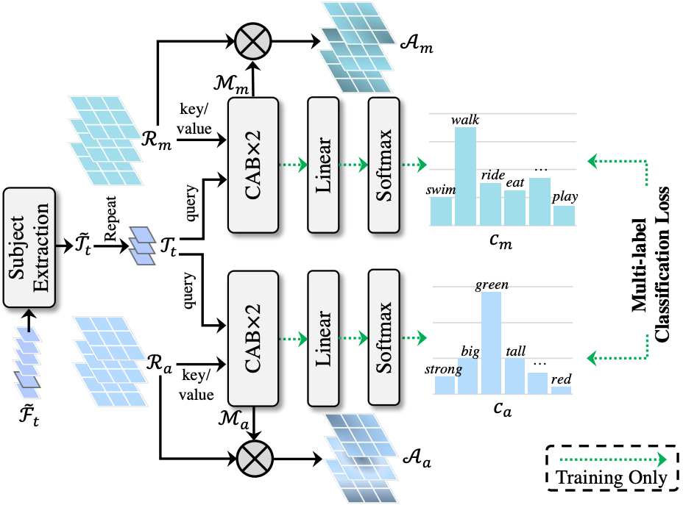
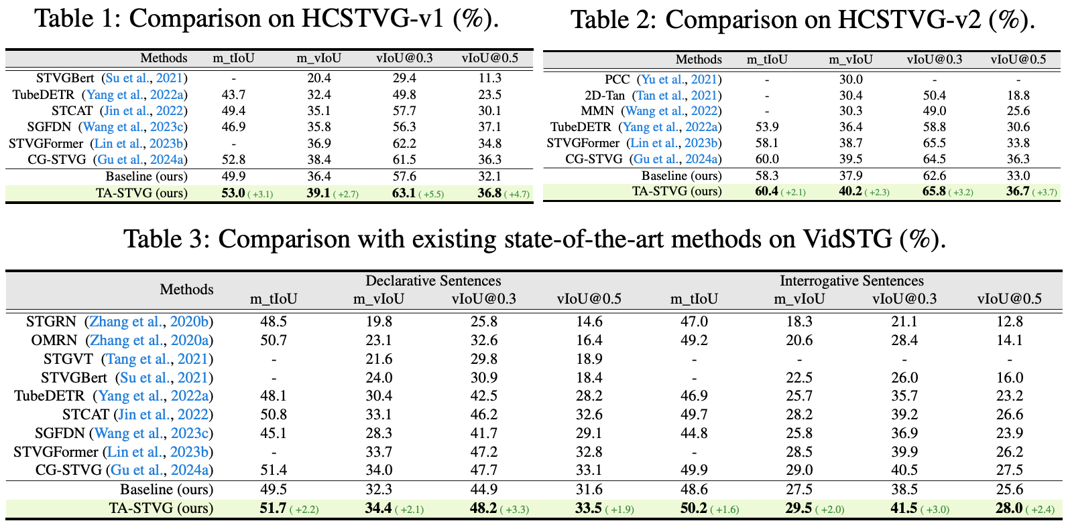
Knowing Your Target : Target-Aware Transformer Makes Better Spatio-Temporal Video Grounding
[Oral]
Xin Gu Yaojie Shen Chenxi Luo Tiejian Luo Yan Huang Yuewei Lin Heng Fan* Libo Zhang* (*equal advising and co-last authors)
Spatio-Temporal Video Grounding
The Proposed Methodology
Analysis of TA-STVG
What is spatio-temporal video grounding (STVG)?
Illustration of TTS and ASA
STVG aims to localize the object of interest in an untrimmed video with a spatio-temporal tube given a free-form textual query
Input text query:
What does the adult ride in the playground?
Output:
A spatio-temporal tube
(a): TTS accurately selects target-relevant frames from the video.
(b-c): ASA localizes attributes, e.g., color “yellow” and action “walks ”.
(image from Yang et al, CVPR’2022)
spatio-temporal tube
Attention maps
Motivation
Red box: target of interest
Fig. 2: Overview of TA-STVG, which exploits target-specific cues from video and text for generating object queries for STVG.
Target-Aware Transformer for Spatio-Temporal Video Grounding (TA-STVG)
Multimodal Encoder: Feature extraction and interaction for video (appearance and motion features) and text.
Target-aware Query Generation: Generating queries with target-specific semantic cues using target-guided temporal sampling (TTS) and attribute-aware spatial activation (ASA).
Decoder: Target-aware query-based spatial and temporal decoding for target localization.
Comparison of attention maps for zero-initialized object queries and the proposed target-aware object queries in video frames in the spatial decoder. We can clearly observe that the attention maps of our target-aware object queries by TTS and ASA can better focus on the target for localization.
Experimental Results
Target-guided Temporal Sampling (TTS) and Attribute-aware Spatial Activation (ASA)
Fig. 1: Illustration of existing methods (a) and our target-aware STVG (b).
Existing Transformer-based STVG Methods (Fig. 1 (a))
Zero-initialized queries: Difficult in learning discriminative target position in complicated scenarios, e.g., with distractors or occlusion, due to lack of target-specific semantic cues.
Our Target-Aware Transformer STVG Model (Fig. 1 (b))
Target-aware queries: Explore target-specific cues from the given video-text pair for object queries for improving STVG
TTS: identify and sample frames relevant to the target guided by holistic textual features.
ASA: mine fine-grained visual semantic cues from coarse-grained temporal features for object queries.

