Slide 1
嵌入式影像處理
姓名: 官恒廷
系級: 電子系三甲
學號: 0652017

Slide 2
Requirements
Convert an image to a grayscale image, then set 128 as the threshold value,
if the pixel value is greater than 128 will be assigned to 255, else will be assigned to 0.
Then run morphological operations with opening and closing,
the kernel should be between 3*3 and 9*9, recording the execution speed of the operations.
Compare the differences with the items below
Running without AVX
Running with AVX
Search for multi thread (map and reduce) to speed up

Slide 3
Analysis
Convert input RGB image to grayscale image
Set 128 as the threshold value
Running with/without AVX
Run morphological operations with opening and closing
recording the execution speed of the operations

Slide 4
Design
Image
Turn on/off
AVX
Grayscale
Threshold
Start time
Execution speed
Morphology
Open/close
x100
End time
Result

Slide 5
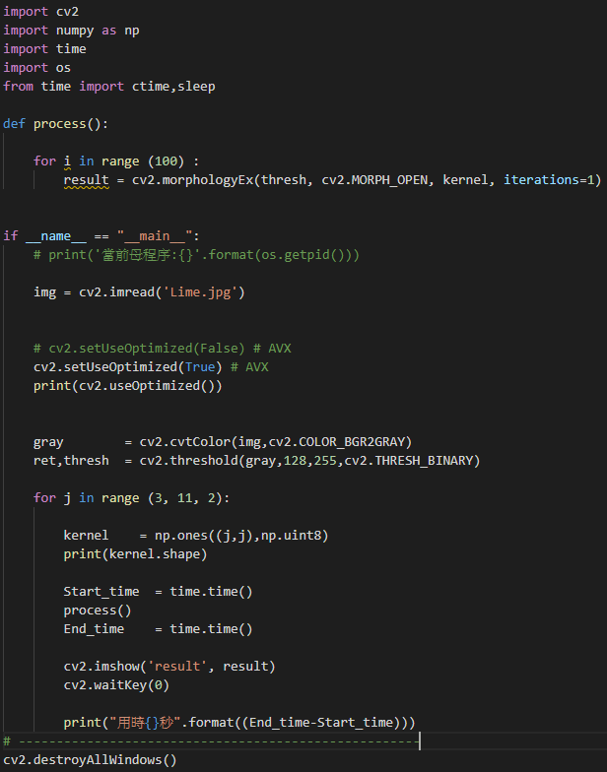
Refinement and Coding
Isolate the parts that needs to be compared

Slide 6
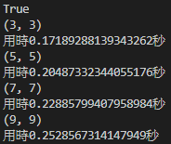
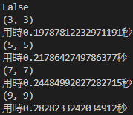
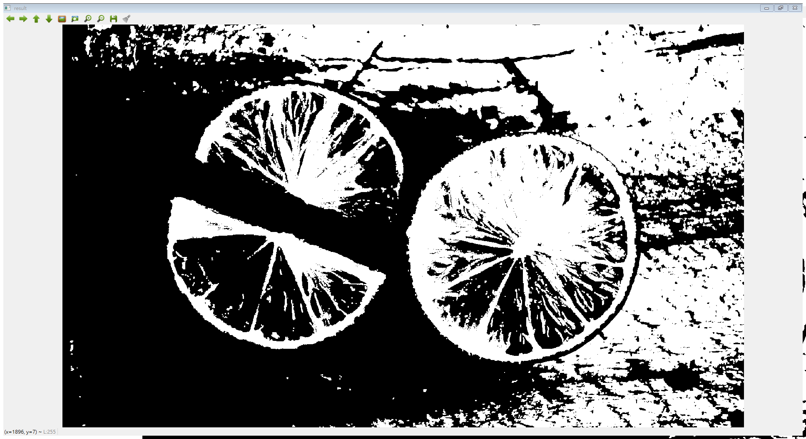

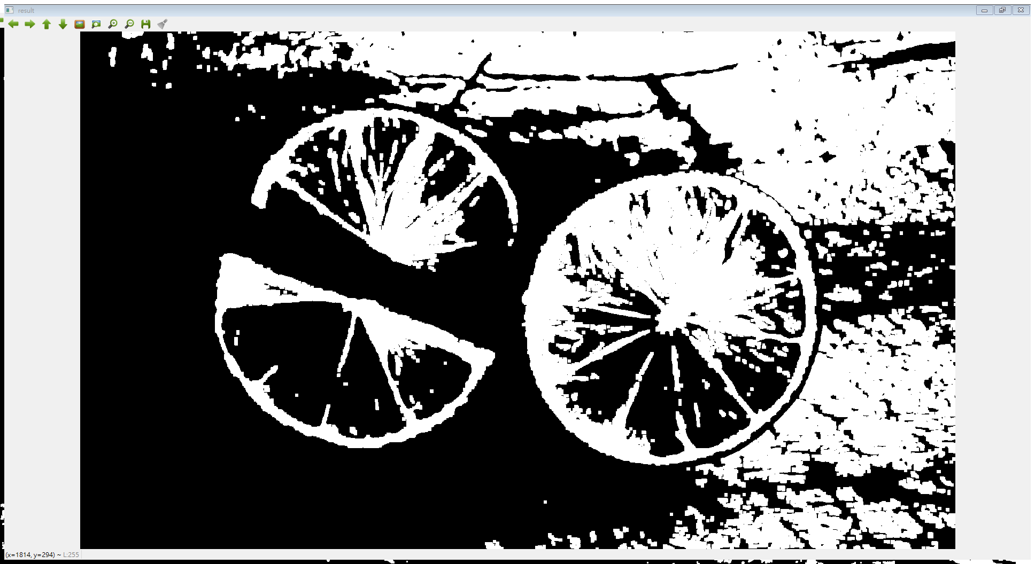
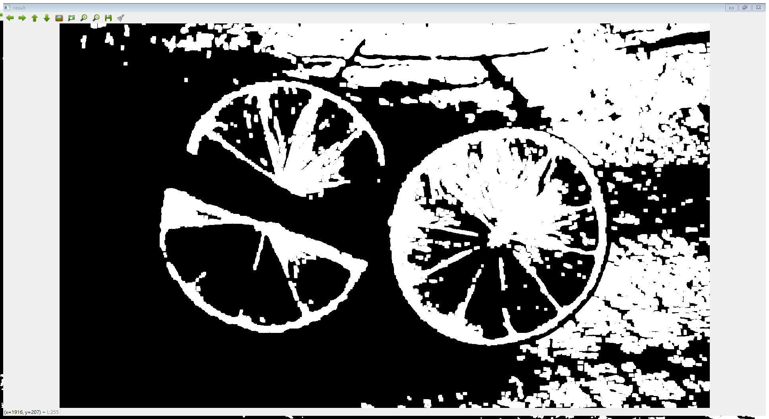
Verification
Kernel Size | AVX Enable | AVX Disable
3 | 0.167896 s | 0.213865 s
5 | 0.204883 s | 0.221862 s
7 | 0.242850 s | 0.266954 s
9 | 0.272829 s | 0.319801 s
3*3
5*5
7*7
9*9

Slide 7
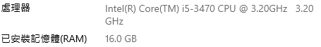
Environments

