Slide 1
# Bad things can happen when interacting with our environment!
# The data set injuries contains 255k emergency room entries in the US
# with a diganosis (diag), the injured body part (body_part)
# and where it happened (location)
# For each injury there is also a product code in the products table. This has to be linked to the injuries table!
# For the app we want to create three tables
# 1. The diagnosis
# 2. The body part
# 3. And where it happened
#
#Additionally we want a plot of risk vs age for both sexes
#
#There are three data sets
#1. Injuries: All injuries with diagnosis and location and body part
#2. Products: Product code and the associated Name
#3. Population demographics
# Remember to use reactive expressions!
3 Difficulty levels
High: Start from scratch and do not use any premade file except for data files
Medium: Use SkeletonApp.R as a starter
Still not easy: Use SkeletonApp.R and the R_basic_code.R

Slide 2
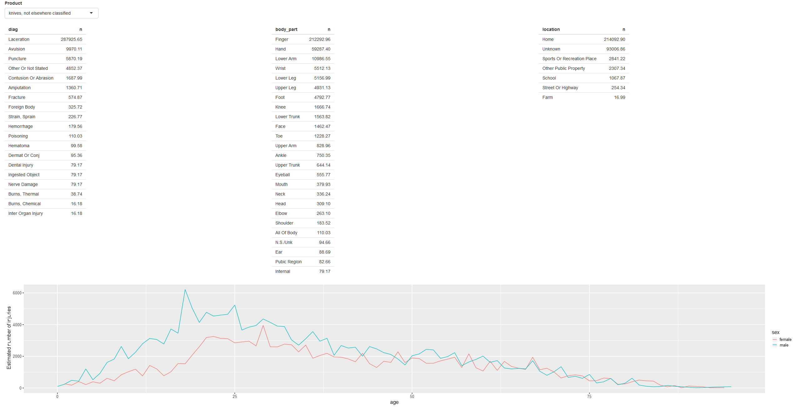

Slide 3
Some Resources:
https://bookdown.org/weicheng/shinyTutorial/
https://github.com/rstudio/shiny-examples
https://shiny.rstudio.com/tutorial/
http://zevross.com/blog/2016/04/19/r-powered-web-applications-with-shiny-a-tutorial-and-cheat-sheet-with-40-example-apps/

