Slide 1
🛡️
NOC ENABLEMENT · HANDS-ON LAB
DP WAF & Load Balancer Security & Resilience Training
Why we run a WAF and load balancing in front of our origins — and what it looks like when we don't.
Presenter: Leng BunHeng · For the NOC team
1 / 12
Notes:
Hands-on, not slideware. Two halves: WAF (attacks) + LB/DDoS (uptime). ~45 min. You run the demos; their one hands-on moment = the capacity test (slide 9).

Slide 2
AGENDA
What we'll cover
🛡️
Part 1 — WAF
⚖️
Part 2 — Load Balancer
ATTACKS
UPTIME
SQL Injection — login bypass
Stored XSS → session theft → takeover
DDOS Protection
Why a single origin falls over
Live capacity wall (real HTTP 503)
DP load balancing across origins
Types of Load balancer algorithms
2 / 12
Notes:
Roadmap. Two angles: security (Part 1) + availability (Part 2), each ending in a live demo. Lab on http://<host>:6060.

Slide 3
WHY THIS MATTERS TO NOC
You are the ones who see it first
NOC = the first responders. You see the 503 spikes, the single-IP floods, the injection strings in the logs — before anyone else knows there's a problem.
The fix lives at the edge: a WAF + load balancer handles both security and availability before the origin is touched.
📈
503 spikes
🌊
Single-IP floods
🧬
Injection strings
capacity overload
DDoS pattern
SQLi / XSS attempts
3 / 12
Notes:
Hook. Ask: who's taken a 3am slow-site page? Many 'outages' = capacity or attack, fixed at the edge. Goal: recognize the signatures — 503 spikes, single-IP floods, injection strings.

Slide 4
PART 1 · CONCEPT
What is a WAF?
Sits in front of the web app — first line of defense.
Works at the application layer (HTTP/HTTPS).
Inspects each request — URL, headers, body — and blocks malicious ones.
Catches what a traditional network firewall can't see: SQLi, XSS, and friends.
👤 User / Attacker
↓
🛡️ DP WAF — inspect & filter
↓
🖥️ Origin web app
4 / 12
Notes:
Keep short. Network firewall = L3/4 (IP/port); WAF = L7, reads the HTTP payload. Analogy: door lock vs. guard reading the envelope.

Slide 5
THE LAB
Your training environment
Open http://<host>:6060 — a deliberately vulnerable-by-design app. Two scenarios:
🔓 Web attack chain
⚖️ Live capacity test
Login → dashboard → feedback → attacker console. SQLi bypass + stored XSS session theft.
Each origin serves only 2 IPs. Watch it fall over, then load-balance it.
⚠ Vulnerable on purpose. Local, authorized training only — never expose it publicly.
5 / 12
Notes:
You've set it up. Web-attack chain (next 2 slides) = you demo on projector. Capacity test (slide 9) = the only hands-on part — hand out the URL there, not now. Share the real LAN IP later.

Slide 6
PART 1 · ATTACK 1
● LIVE DEMO
SQL Injection — login bypass
The login builds its query by gluing your input into SQL text:
Demo steps
SELECT * FROM users
WHERE user = '' OR 1=1 --' AND pass = ''
1
Go to /login.html
Payload ' OR 1=1 -- (the lab's click-to-fill chip) makes the query return every row — -- comments out the password check. Alt: admin' -- skips straight to the admin row.
2
Username: ' OR 1=1 -- (chip) · password blank → Sign in
3
Show the returned executedSql
6 / 12
Notes:
DEMO: 1) login guest/guest (works) 2) login ' OR 1=1 -- + blank password → admin 3) point at executedSql panel. Real fix = parameterized queries; edge fix = DP WAF.

Slide 7
PART 1 · ATTACK 2
● LIVE DEMO
Stored XSS → session theft → takeover
Public feedback form
→
Admin opens dashboard
→
Payload steals cookie
→
Attacker replays it
<script>new Image().src='/api/collect?c='+encodeURIComponent(document.cookie)</script>
A public form + an admin who just views the data = full account takeover. No password, no phishing.
DP WAF blocks both at the edge — the origin never sees the attack. → Part 2: keeping the site up under load.
7 / 12
Notes:
DEMO (showpiece): 1) open /attacker.html (collector) 2) submit script payload on /feedback.html 3) admin views dashboard → payload runs, beacons cookie 4) attacker console → Replay as admin. Cookie not HttpOnly on purpose.

Slide 8
PART 1 · DDOS
DP WAF DDoS protection
The presenter runs a flood script from their own IP — a burst of requests at DP WAF.
DP WAF DDoS protection detects the abnormal volume and blocks that IP.
The presenter opens the site in their browser → can no longer access it — DP WAF blocked their real IP.
Against the real DP WAF, the flood comes from the presenter's real client IP — it ignores fake X-Forwarded-For headers, so the block is genuine, not a simulation.
Per-IP awareness, applied defensively: spread the good, drop the bad — at the edge.
11 / 12
Notes:
DEMO: run the flood script from your own IP. DP WAF detects the volume and blocks you. Open the site in your browser → it's now inaccessible to you. Key point: real client IP, not a spoofed header — the block is real. NOC sees: spike from one IP → flatlines once blocked.

Slide 9
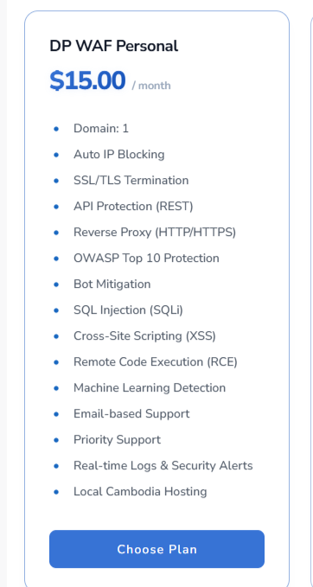
Domain: Amount of domain/site can be added per plan.
Auto IP Blocking: DDOS protection demo-ed
SSL/TLS Termination: We are the decryption point, The encrypted connection from a user ends there, and the traffic is sent as unencrypted data to the final web application
API Protection (REST): POST/GET/PUT/PATCH request methods are all protected
Reverse Proxy: We redirect their user to the origin server
OWASP TOP 10: We protect against it
Bot Mitigation: Malicious bots are blocked
Machine Learning: We use ML in backend to train and catch attacks
Email-based Support: We offer other too, telegram, calls..
Real-time Logs & Security Alerts: Dashboard we offer

Slide 10
PART 2 · CONCEPT
What is load balancing?
Spreading incoming traffic across multiple origin servers so no single one is overwhelmed.
Many users
DP WAF load-balances across 2 VPS origins using Load balancing algorithm.
↓
⚖️ DP WAF load balancer
↓ ↓
VPS-1
→
VPS-2
8 / 12
Notes:
Quick concept. IP Hash = same client → same origin (sticky); we'll demo it. DP WAF model: give us origin URLs, we balance — no extra infra.

Slide 11
PART 2 · DEMO — PHASE 1
● LIVE DEMO
One origin hits the wall
With only one VPS origin active, that origin's 2-IP capacity limit is the whole ceiling.
Run it
Everyone opens /capacity.html from their own device. The 3rd person sees:
Everyone opens http://<host>:6060/capacity.html
1
HTTP 503
2
First 2 IPs: ✅ connected
A real overload — their own IP, rejected. Single origin = single capacity ceiling.
3
3rd+ IPs: ❌ 503 overloaded
Note the "Served by origin" field.
9 / 12
Notes:
DEMO (the ONE hands-on moment): hand out the /capacity.html URL. 3rd real IP gets the 503. Solo/flaky Wi-Fi → /capacity-simulated.html. Shared-NAT IPs → segue to IP Hash (Phase 2).

Slide 12
PART 2 · DEMO — PHASE 2
● LIVE DEMO
Put DP Load Balancer in front → everyone's back in
With both VPS origins behind DP WAF, the load balancer spreads participants across them:
How it works
Participants
DP Load Balancer distributes each client to a VPS by Selected Algorithm. Two origins = double the capacity; the wall is gone.
↓
⚖️ DP Load Balancer
↓
VPS-1
→
VPS-2
Now up to 4 IPs get in — 2 per VPS — and "Served by origin" shows the spread.
10 / 12
Notes:
DEMO: both VPS origins are live behind DP WAF. Have the 503 person reload → now connects, 'Served by origin' differs per person. Message: horizontal scale = answer to capacity spikes.

Slide 13
PART 2 · DEMO — PHASE 2
● LIVE DEMO
Load Balancing Algorithm
Algorithm | How the Host Decides | Best Used When...
Weighted Round Robin | Take turns based on server strength | You have some big, fast servers and some small, weak ones
Least Connections | Pick whoever is currently helping the fewest people | Tasks take unpredictable amounts of time
IP Hash | Use math on the user's address to lock them to one server | You need a user to stick with the same server every visit
10 / 12
Notes:
DEMO: both VPS origins are live behind DP WAF. Have the 503 person reload → now connects, 'Served by origin' differs per person. Message: horizontal scale = answer to capacity spikes.

Slide 14
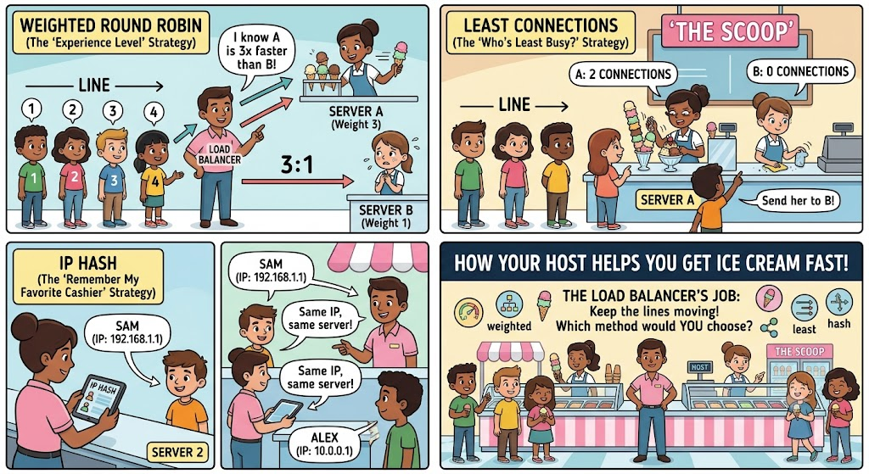
PART 2 · DEMO — PHASE 2
● LIVE DEMO
Load Balancing Algorithm Visual
10 / 12
Notes:
DEMO: both VPS origins are live behind DP WAF. Have the 503 person reload → now connects, 'Served by origin' differs per person. Message: horizontal scale = answer to capacity spikes.

Slide 15
WRAP-UP
Takeaways for NOC
🛡️
WAF = layer-7 guard.
Blocks SQLi & XSS — injections the network firewall can't see.
⚖️
Load balancing = availability.
Horizontal scale removes the single-origin wall.
🚧
Per-IP control = DDoS defense.
Spread the good, drop the bad, at the edge.
👀
You're the first responders.
Now you know the signatures: 503 spikes, single-IP floods, injection strings in logs.
12 / 12
Notes:
One-liner: the edge (WAF + LB) enforces both security + availability before the origin. Encourage replaying the lab. Invite questions.

