Slide 1
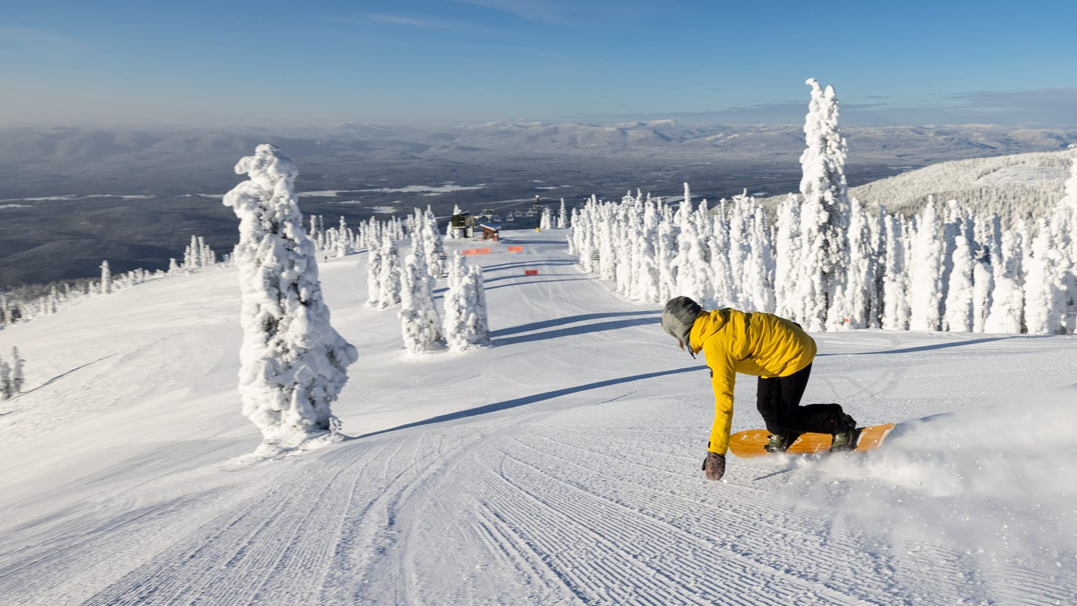
1. Problem statement
What opportunities exist to increase the revenue by $1.54 million for the Big Mountain Resort through selecting a higher ticket price or cutting costs with keeping the current price?
Additional chairlift to increases their operating costs by $1.54 million for this reason.
New price strategy (two options):
1. higher price
2. keeping the current price with cutting costs)
Set the price to market average price?
(current price strategy)
To increase revenue for the coming season
(at least increase by $1.54 million)

Slide 2
2. Recommendation and key findings
1. Permanently closing to 10 of the least used runs. This doesn't impact any other resort statistics.
Runs and Vertical drop features are the most important to our price strategy.
Recommendation
2. Increase the vertical drop by adding a run to a point 150 feet lower down but requiring the installation of an additional chair lift to bring skiers back up, without additional snow making coverage. Increasing price by $1.99 can increase $3474638 on revenue.

Slide 3
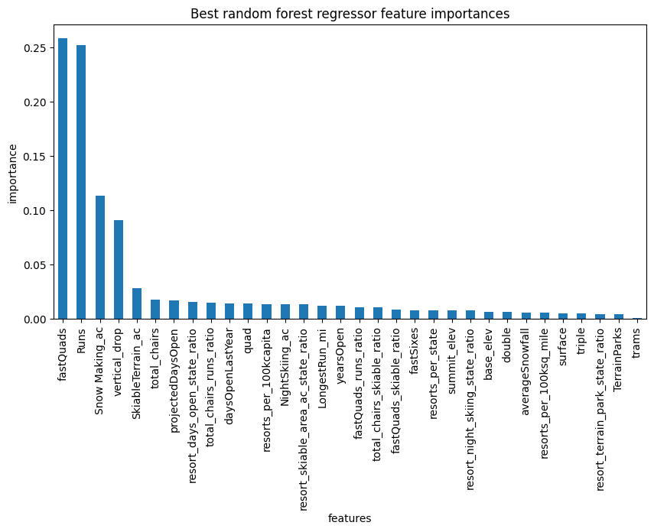
3. Modeling results and analysis
Figure 1. Top features of random forest method.
Random forest model, train split and test split score are consistent, and have less variability ($1) by cross-validation.
Random forest is winning model.
The top 5 features of random forest method:
vertical drop, Snow Making ac, fast Quads, Runs, total chairs.

Slide 4
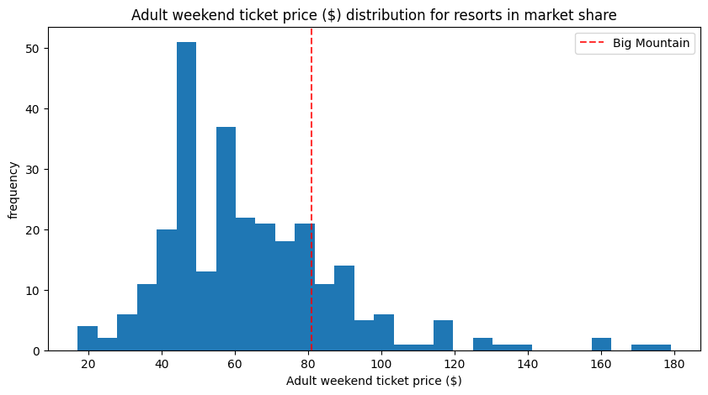
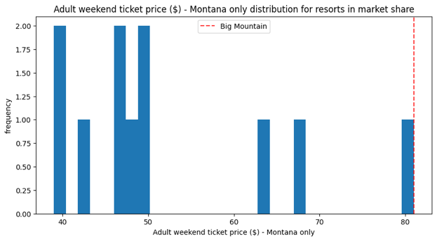
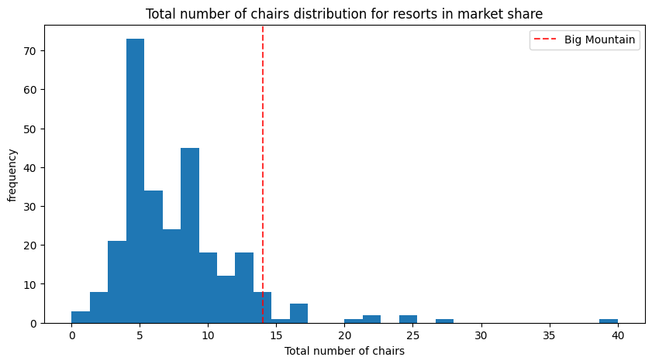
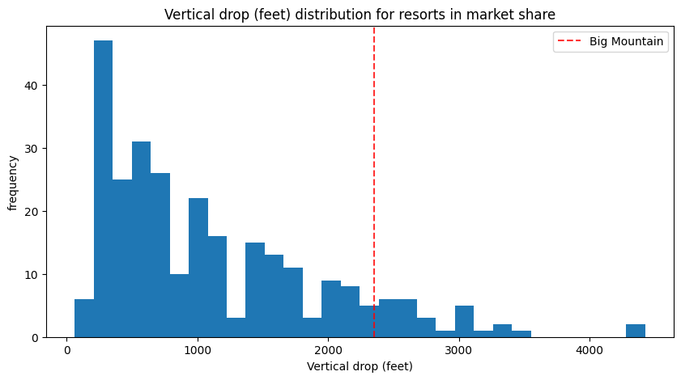
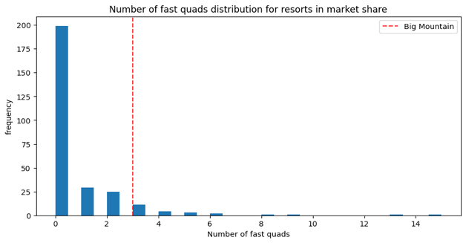
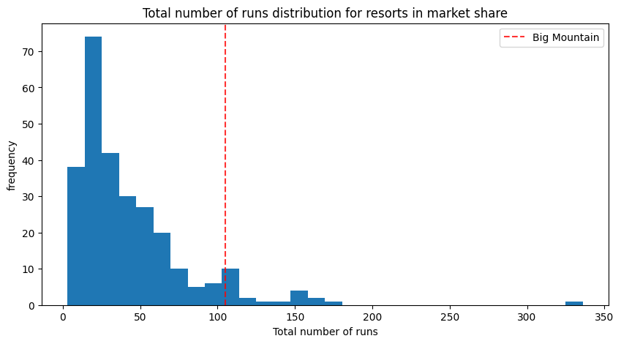
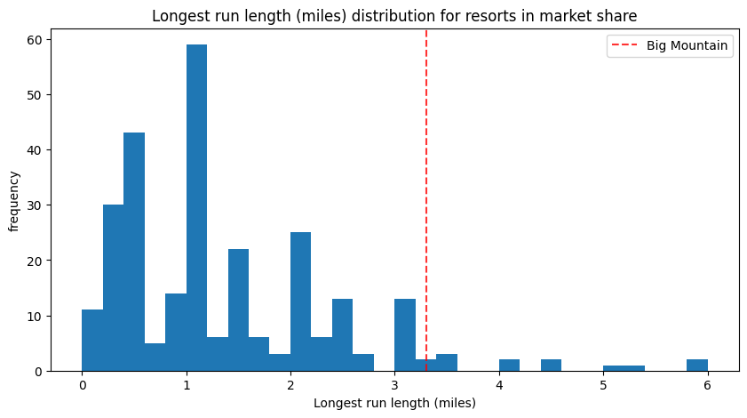
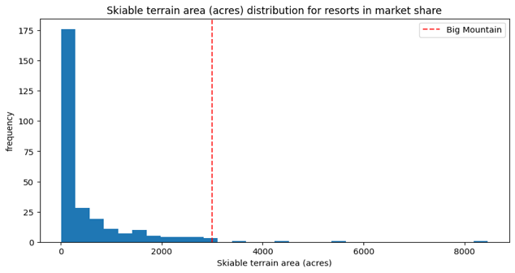
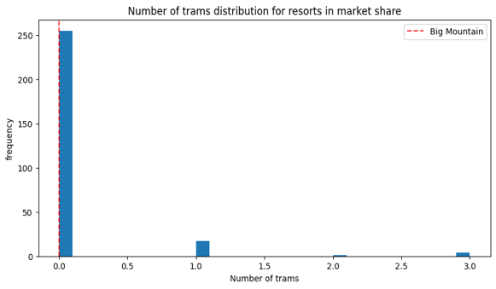
3. Modeling results and analysis
We found that Big Mountain resort key features are all on the top left among the resorts. So, it's reasonable to increase the price of Big Mountain.
the predicted price $95.87 is $14.87 more than actual price $81.00

Slide 5
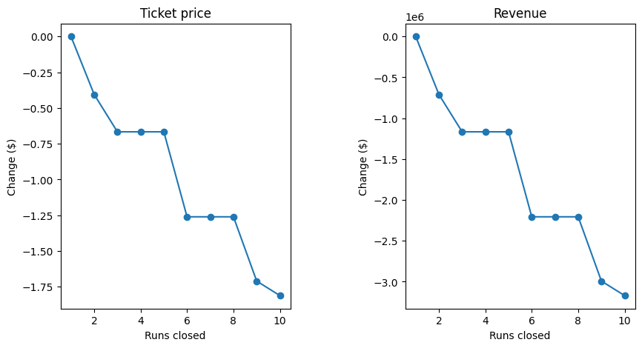
3. Modeling results and analysis
Closing to 10 of the least used runs. This doesn't impact any other resort statistics.

Slide 6
3. Summary and conclusion
We found that the predicted price $95.87 is $14.87 more than actual price $81.00, which suggests there is room for we found that Big Mountain resort key features are all on the top left among the resorts. So, it's reasonable to increase the price of Big Mountain.
I suggest option 1 and option 2: Option 1: may close 4 or 5 runs to make well on cutting cost without hurting revenue. But we don't know the additional operating cost data, it's hard to say how much the revenue could increase. For this reason, we need to get operating cost data. Option 2: increasing price by $1.99 can increase $3474638 on revenue, but it needs additional installation of chair lift. We need to know this additional cost to calculate how many vertical we need to drop.
Future scope of work First, we missed three important data: Ticket Price in weekdays, visitors of weekday and visitors of weekend, operating cost. We should consider if increase on weekday price will hurt the number of visitors. Or decrease on this price will attract more visitors. And without visitors of weekday and visitors of weekend data, we don't know revenue distribution which can help us to make better strategies on price change. The final one is operating cost. Without operating cost for each chair lift, we cannot calculate the accuracy revenue increase and how many runs to close. And why Big Mountain's current price is much lower than the predicted model. Maybe some superior facilities have lower operating cost.

