Slide 1

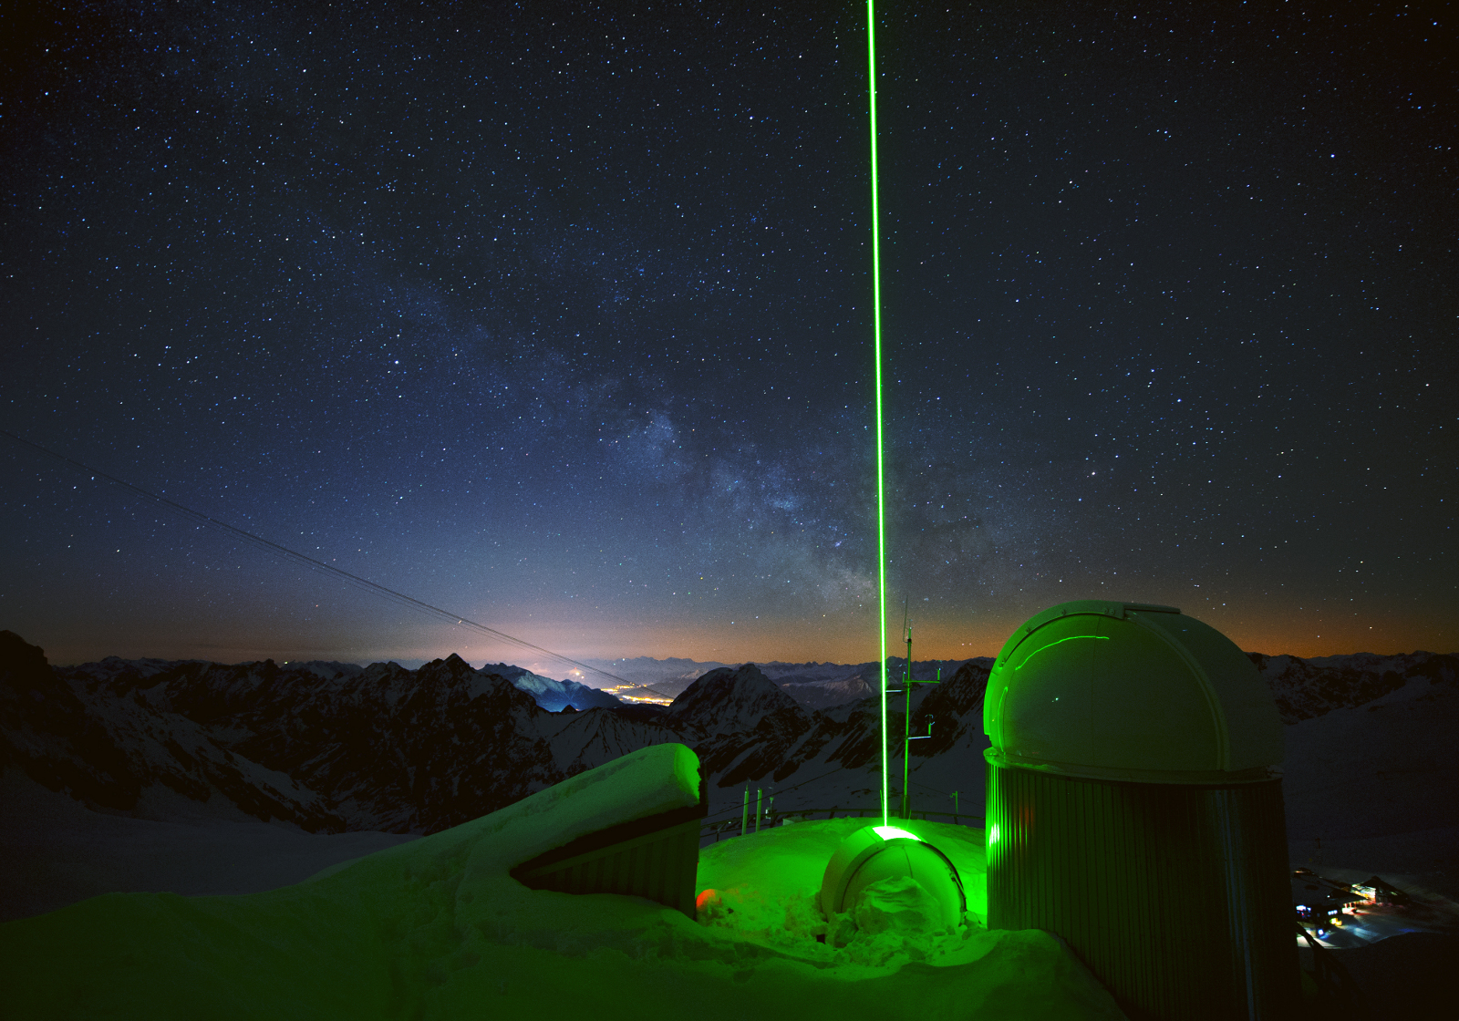
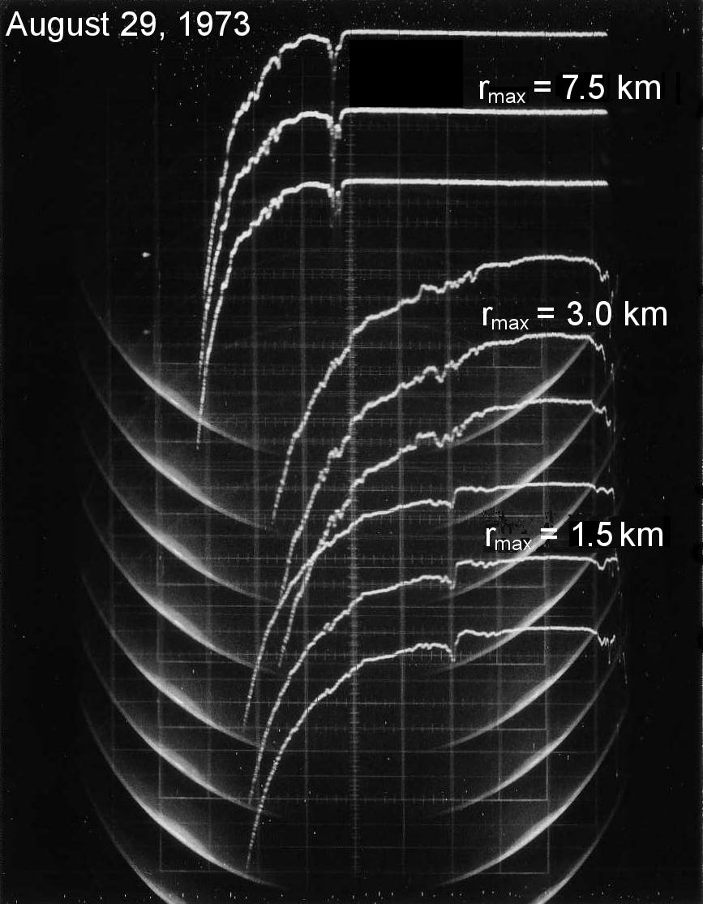
Stratospheric Aerosol - 45 Years of Lidar Measurements at Garmisch-Partenkirchen
Thomas Trickl, Hannes Vogelmann, Helmuth Giehl, Horst Jäger, Matthias Perfahl
Karlsruhe Institute of Technology, IMK-IFU, 82467 Garmisch-Partenkirchen, Germany, thomas@trickl.de, hannes.vogelmann@kit.edu
Aerosol lidar measurements at Garmisch-Parten-kirchen since 1973 (almost 50 years)
Stratosphere: Since 1976 (start of photon counting)
2016: System moved to Schneefernerhaus station (UFS, Garmisch-Partenkirchen, 2675 m a.s.l.))
Raman lidar
DIAL

Slide 2
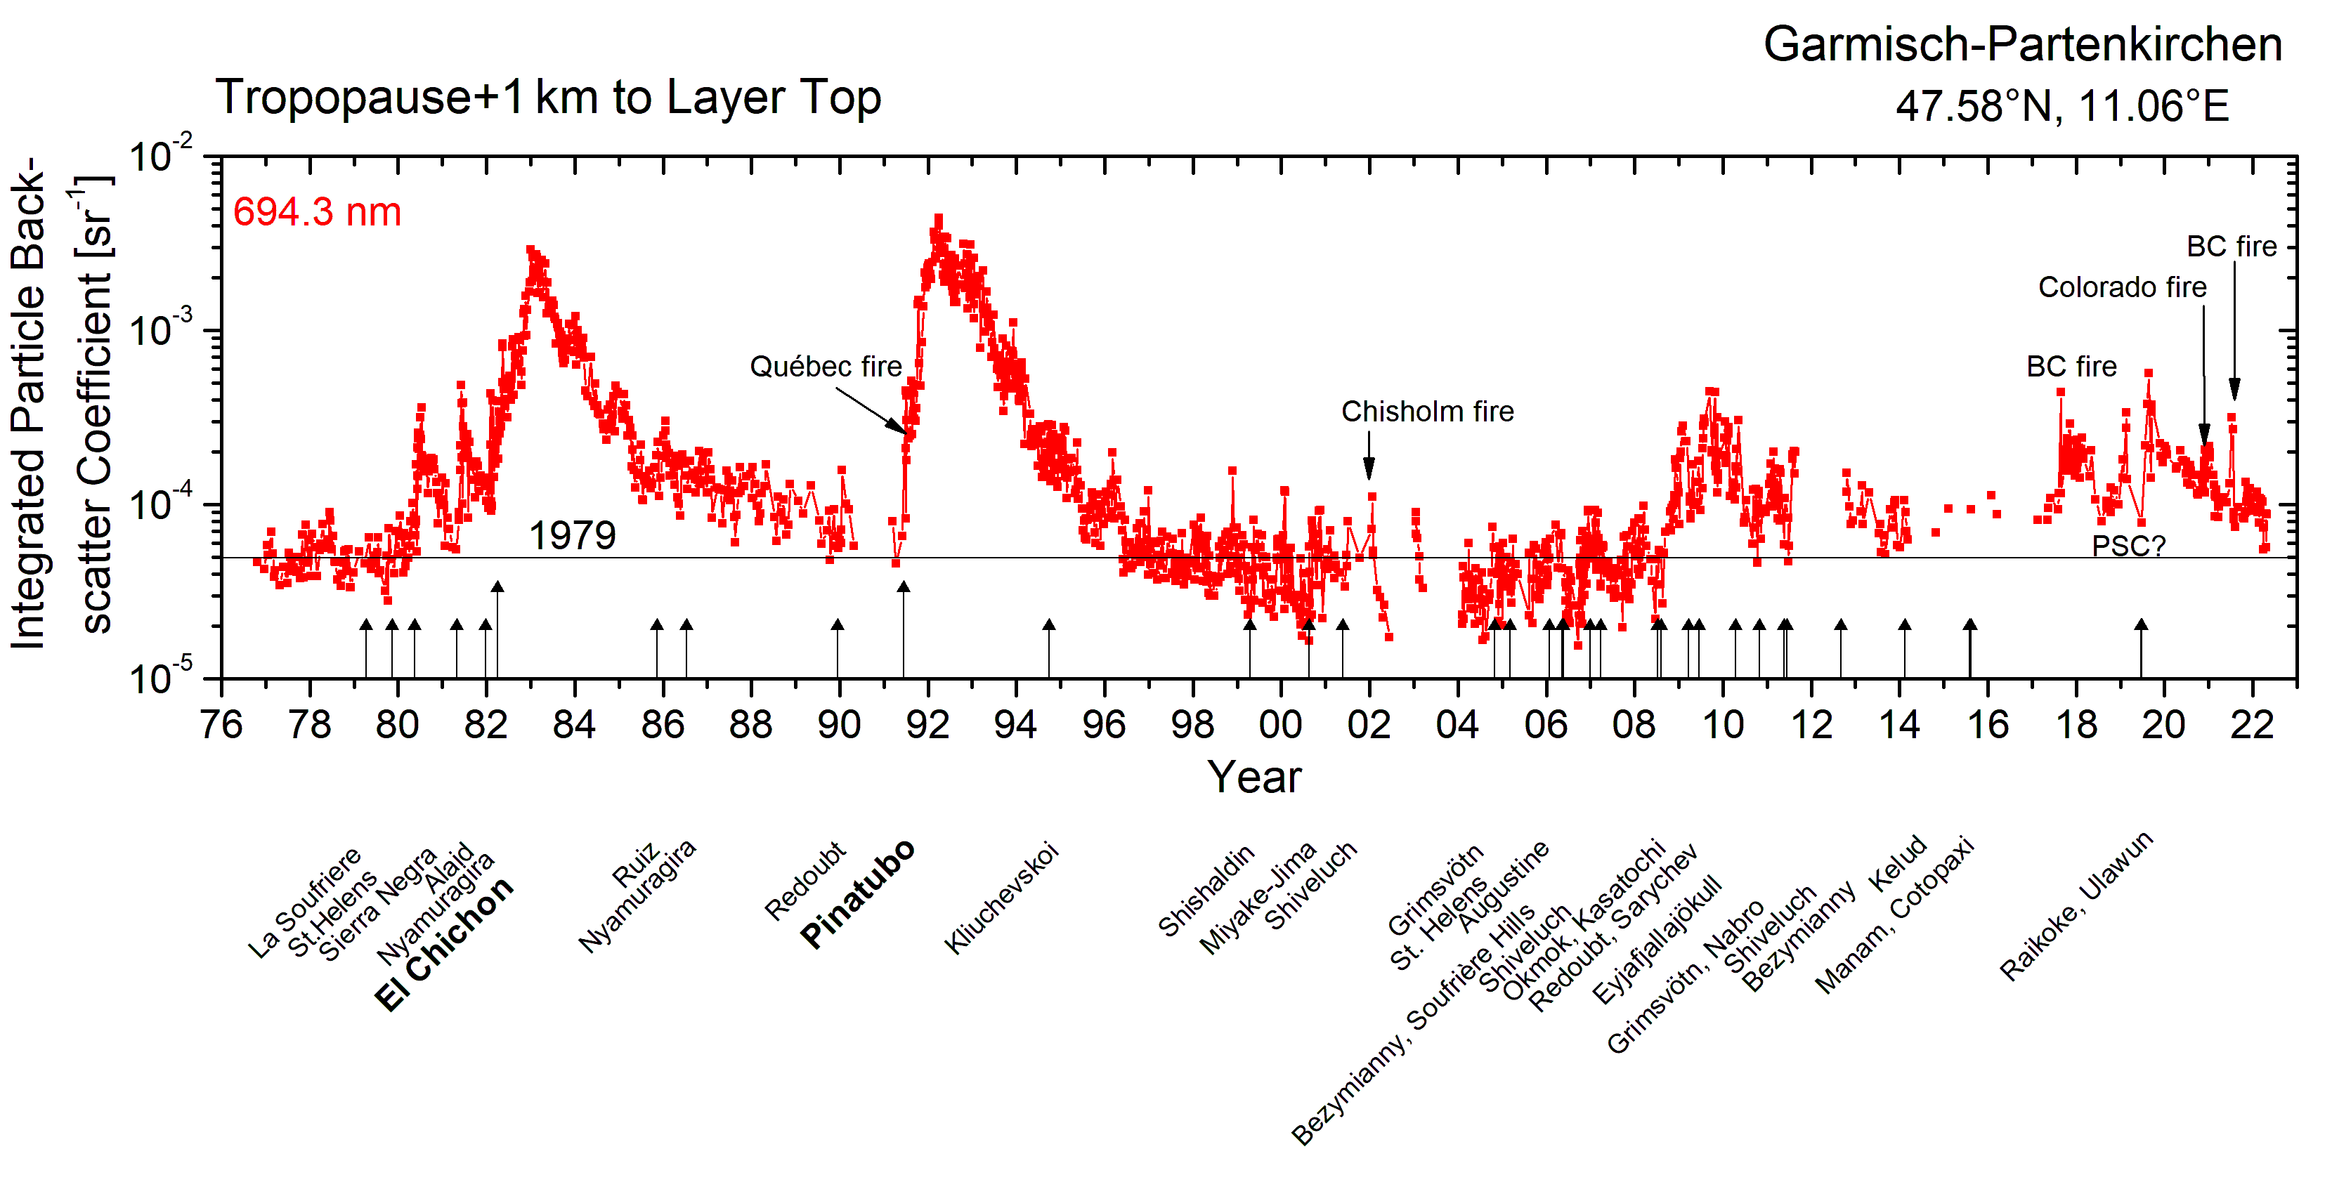
New system: Integrated into big water-vapour DIAL; two ana-logue and one photon-counting channels; 0.5-nm spectral filter
100-Hz Nd:YAG laser: 120 mJ at 532.24 nm; this means increase from 7 W to 12 W
100000 laser shots in 16.7 min ⇒ high S/N even for 7.5-m bins
4. Much higher signal at UFS; +50 % even at 25 km
5. More clear nights
5. Backscatter profiles retrieved up to 50 km (NCEP limited)
6. Remote control (several measurements started from U.S.!)
October 1976 to April 2022

Slide 3
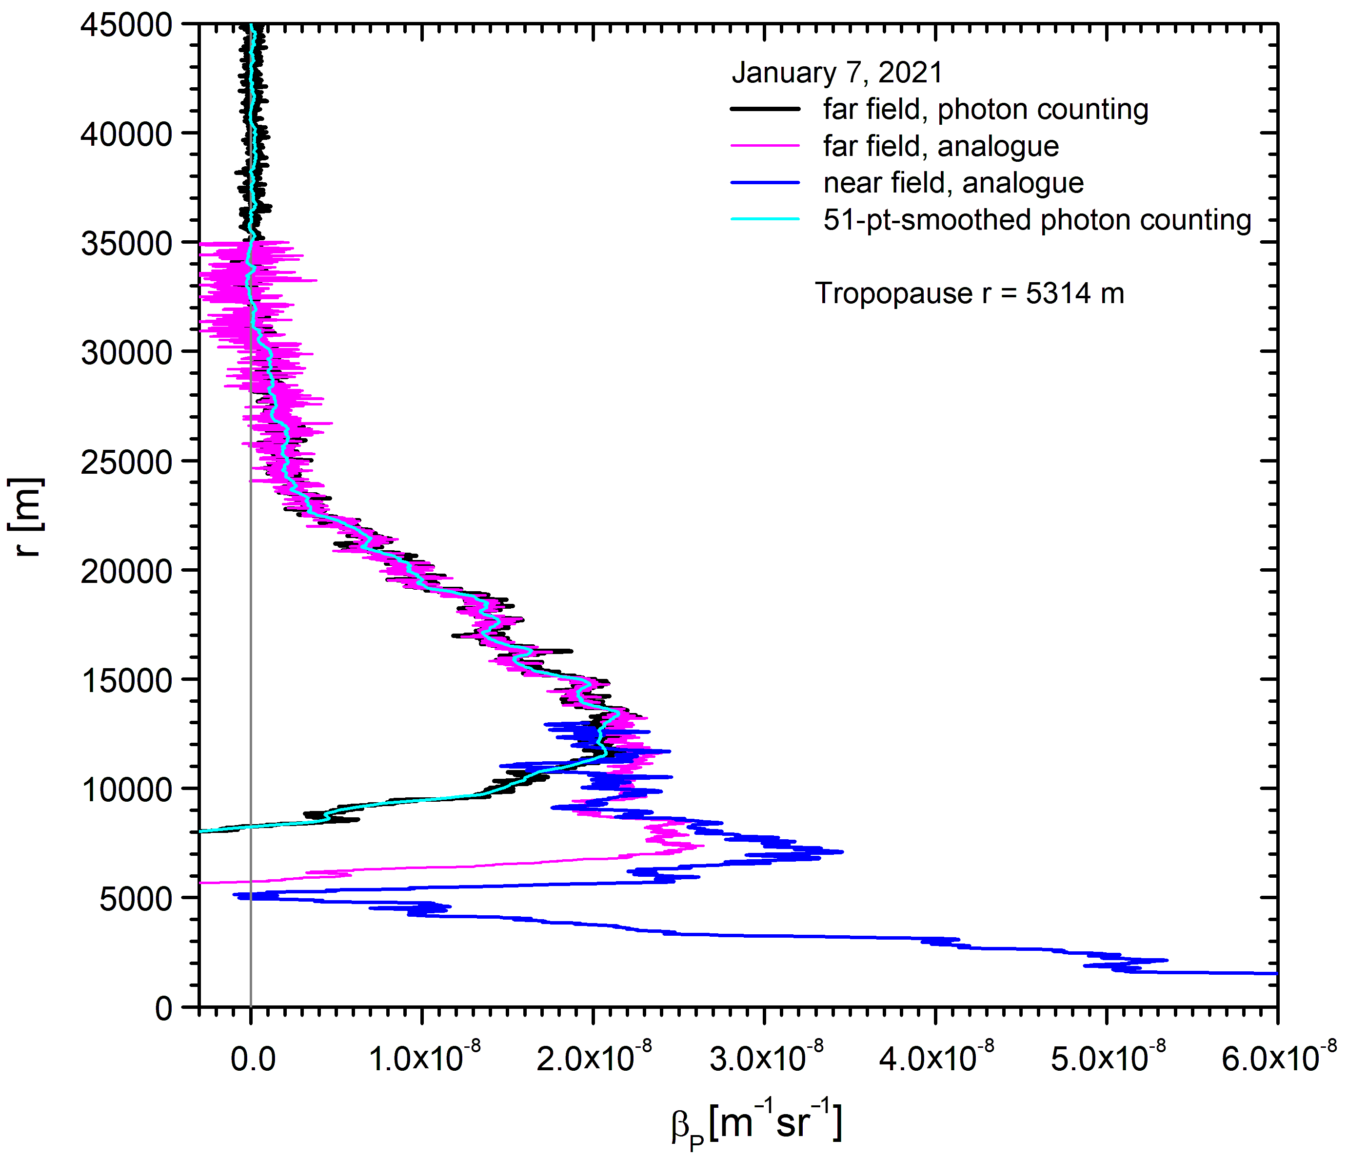
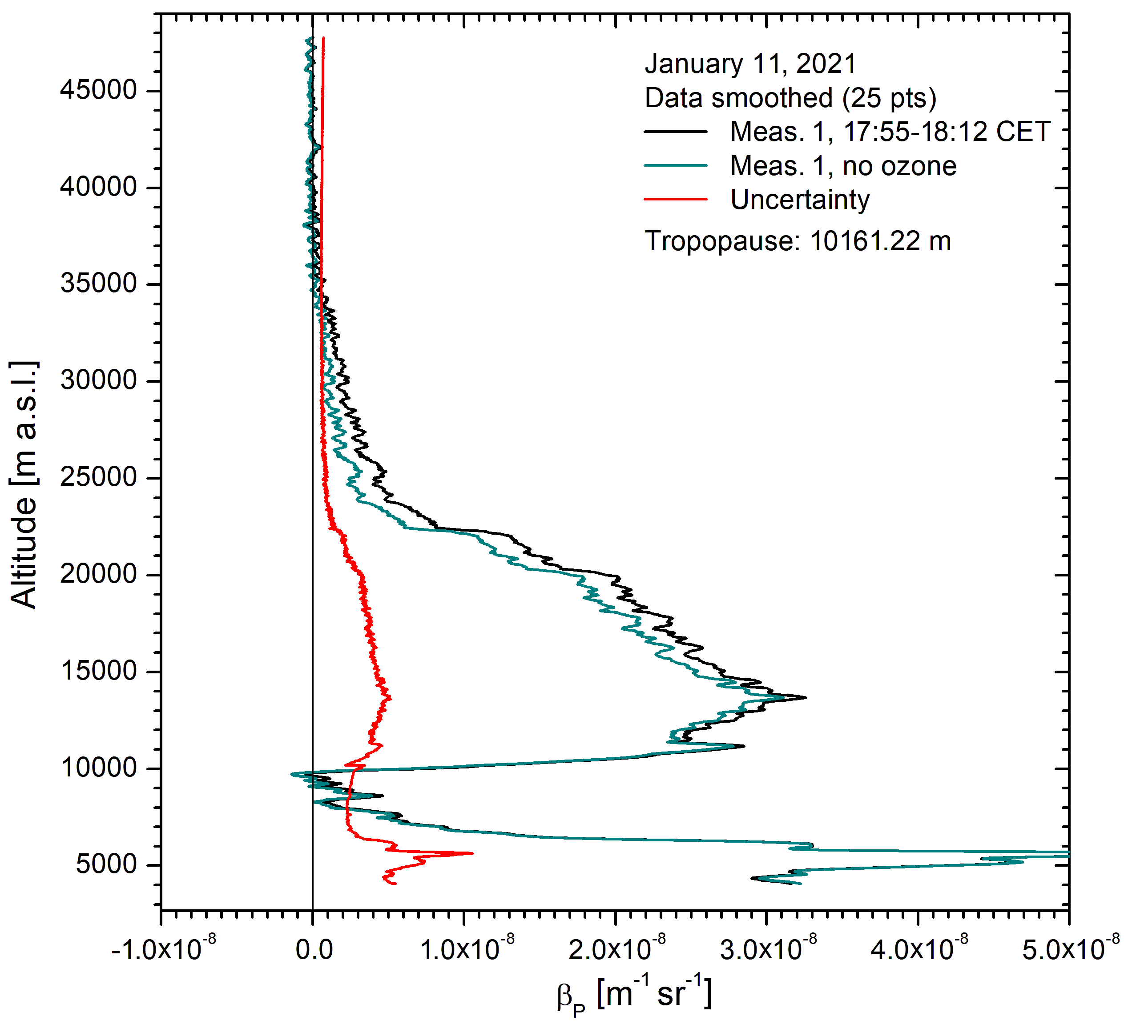
Klett-type retrieval for all three data channels; photon counting noise is the lowest because of the N^{1/2} scaling law for the shot noise.
The high quality of the analogue signal allows us to evaluate stratospheric aerosol backscatter coefficients even during daytime (> 25 km; 2017 data).
An extinction correction for ozone is mandatory at 532.24 nm; all our measurements sonce 1976 have been O₃-corrected. The uncertainty curve is given for the unsmoothed data.

Slide 4
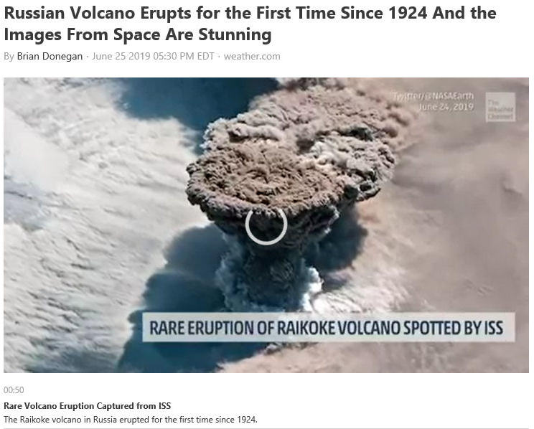
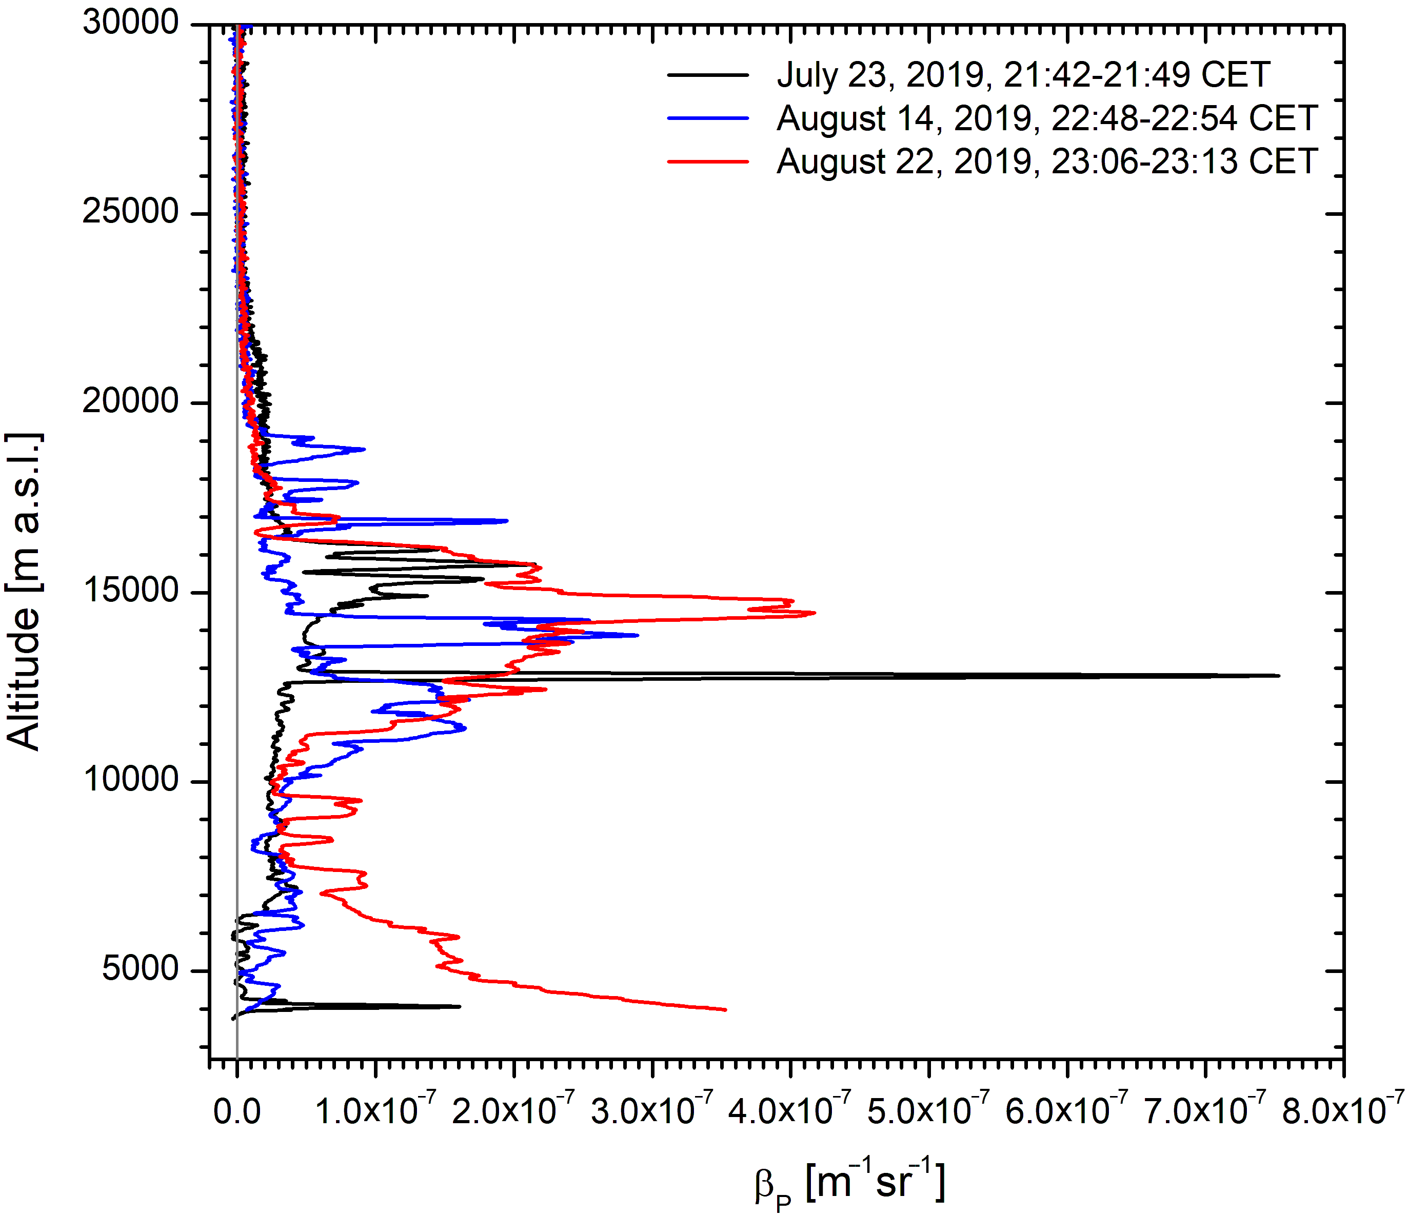
The Raikoke plume passed over Garmisch-Parten-kirchen a few weeks after the eruption. The back-scatter coefficients reached tropospheric values.

Slide 5
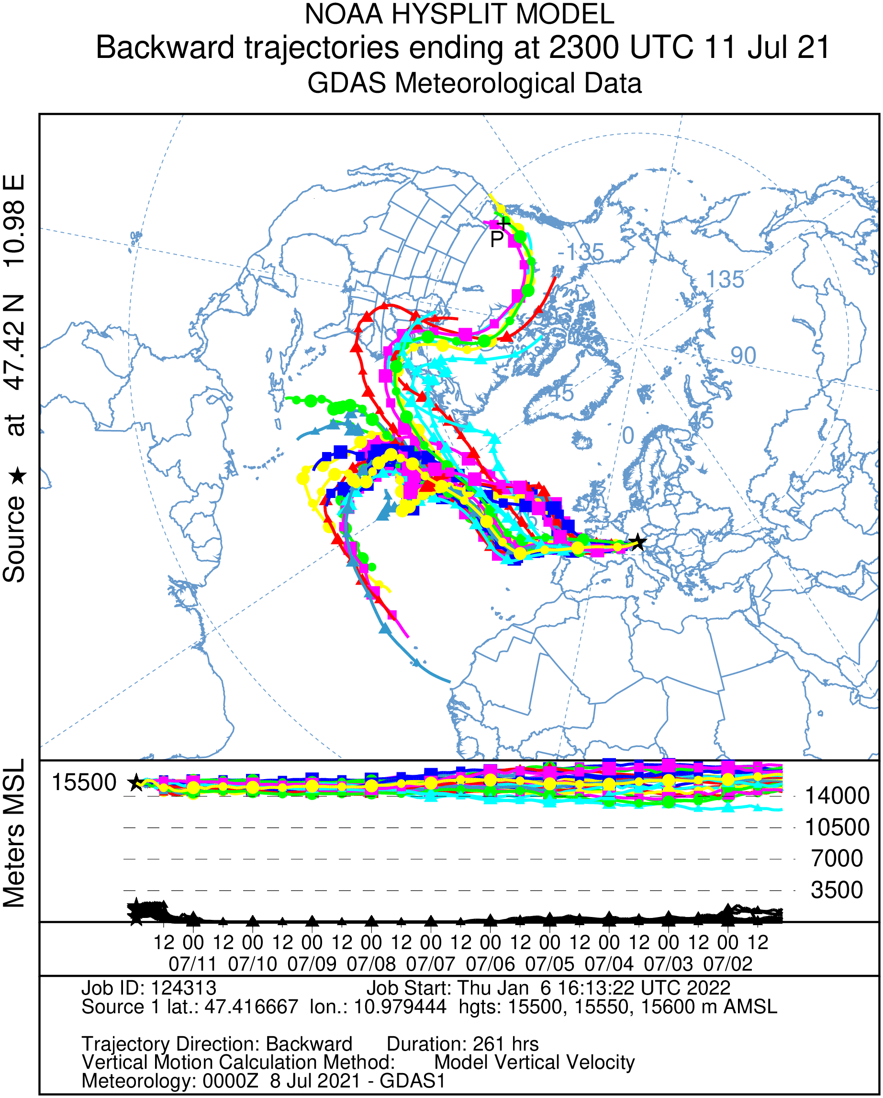
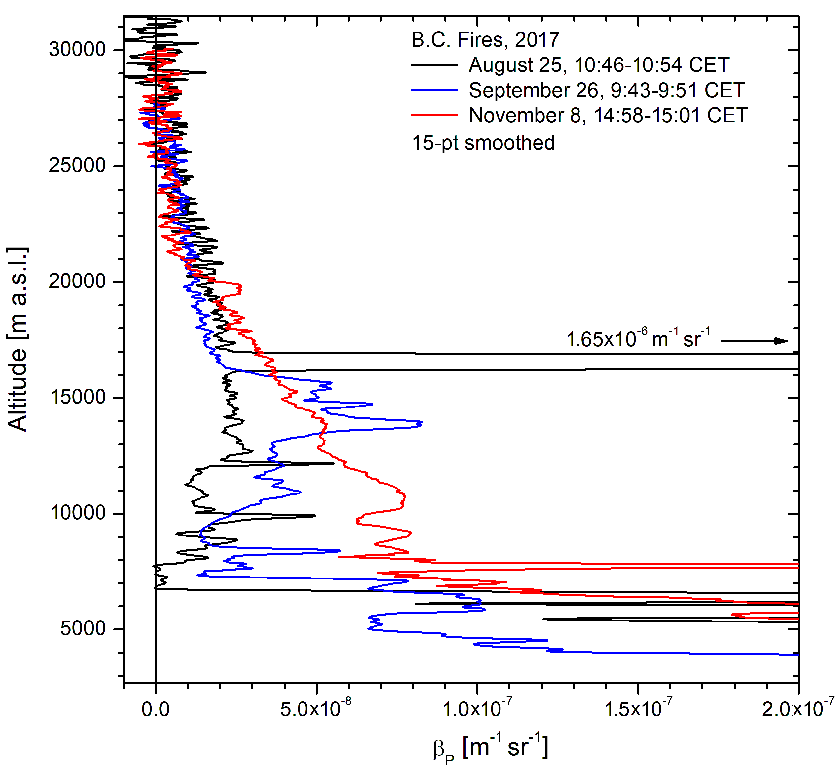
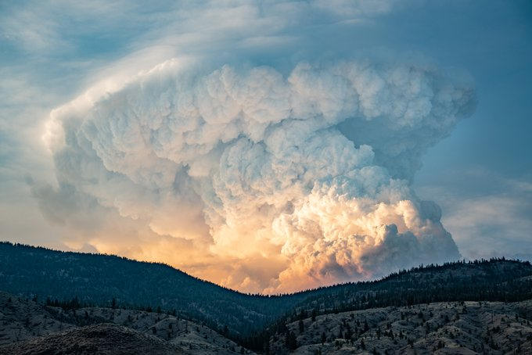
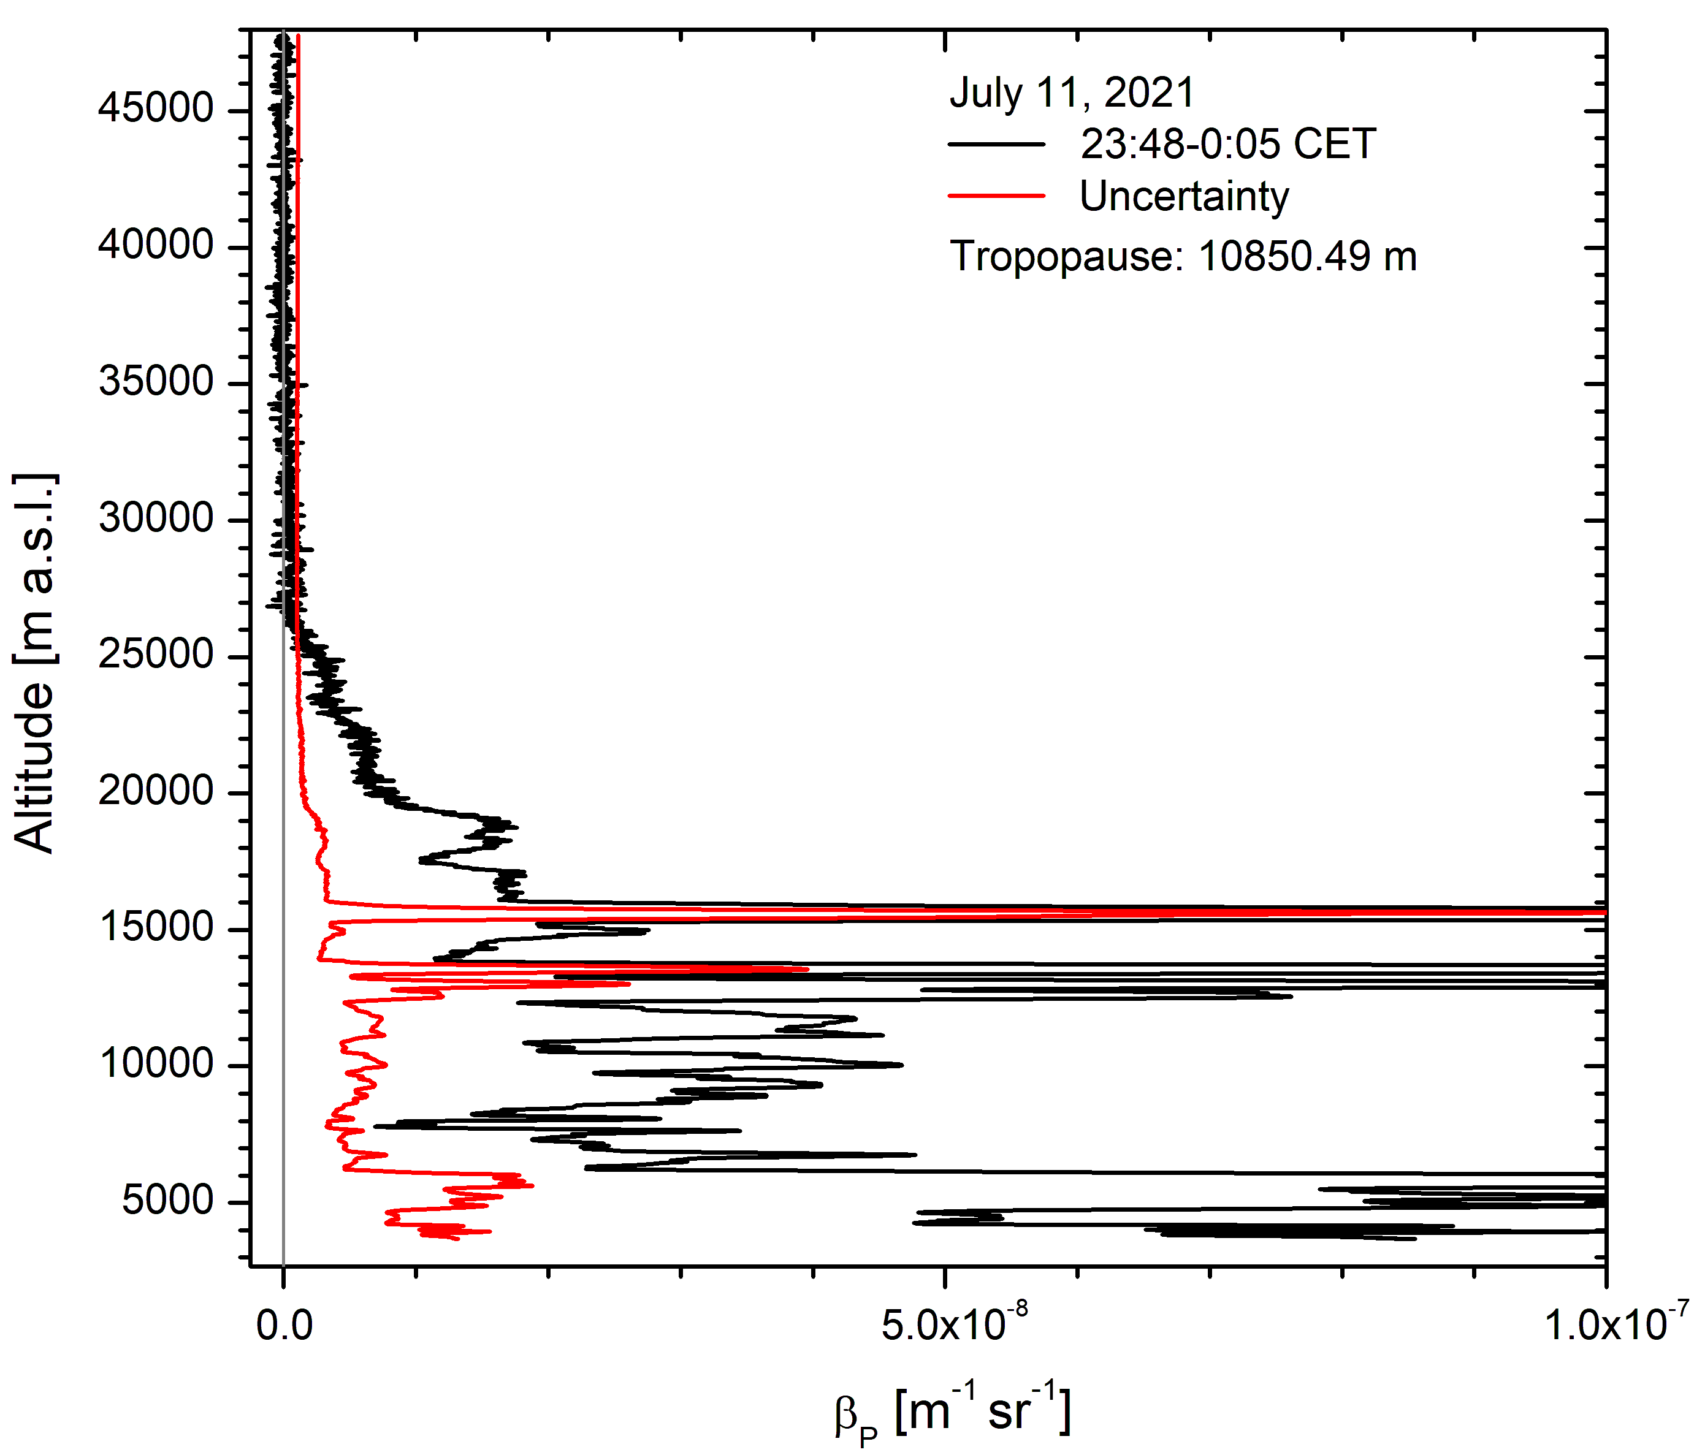
New system became available in time for busy period since summer 2017
The observed peaks are mostly caused by smoke (up to 22 km!). This sudden increase in pyro-Cb frequency is difficult to explain by a gradual transistion to a drier climate.
6.53×10⁻⁷ m⁻¹ sr⁻¹
Giant pyroCb activity in British Columbia gave rise to the highest backscatter coefficient since the maximum of the Pinatubo plume (August 25, 2017)
Second extreme British Columbia pyroCb case (June 21, 2021)

Slide 6
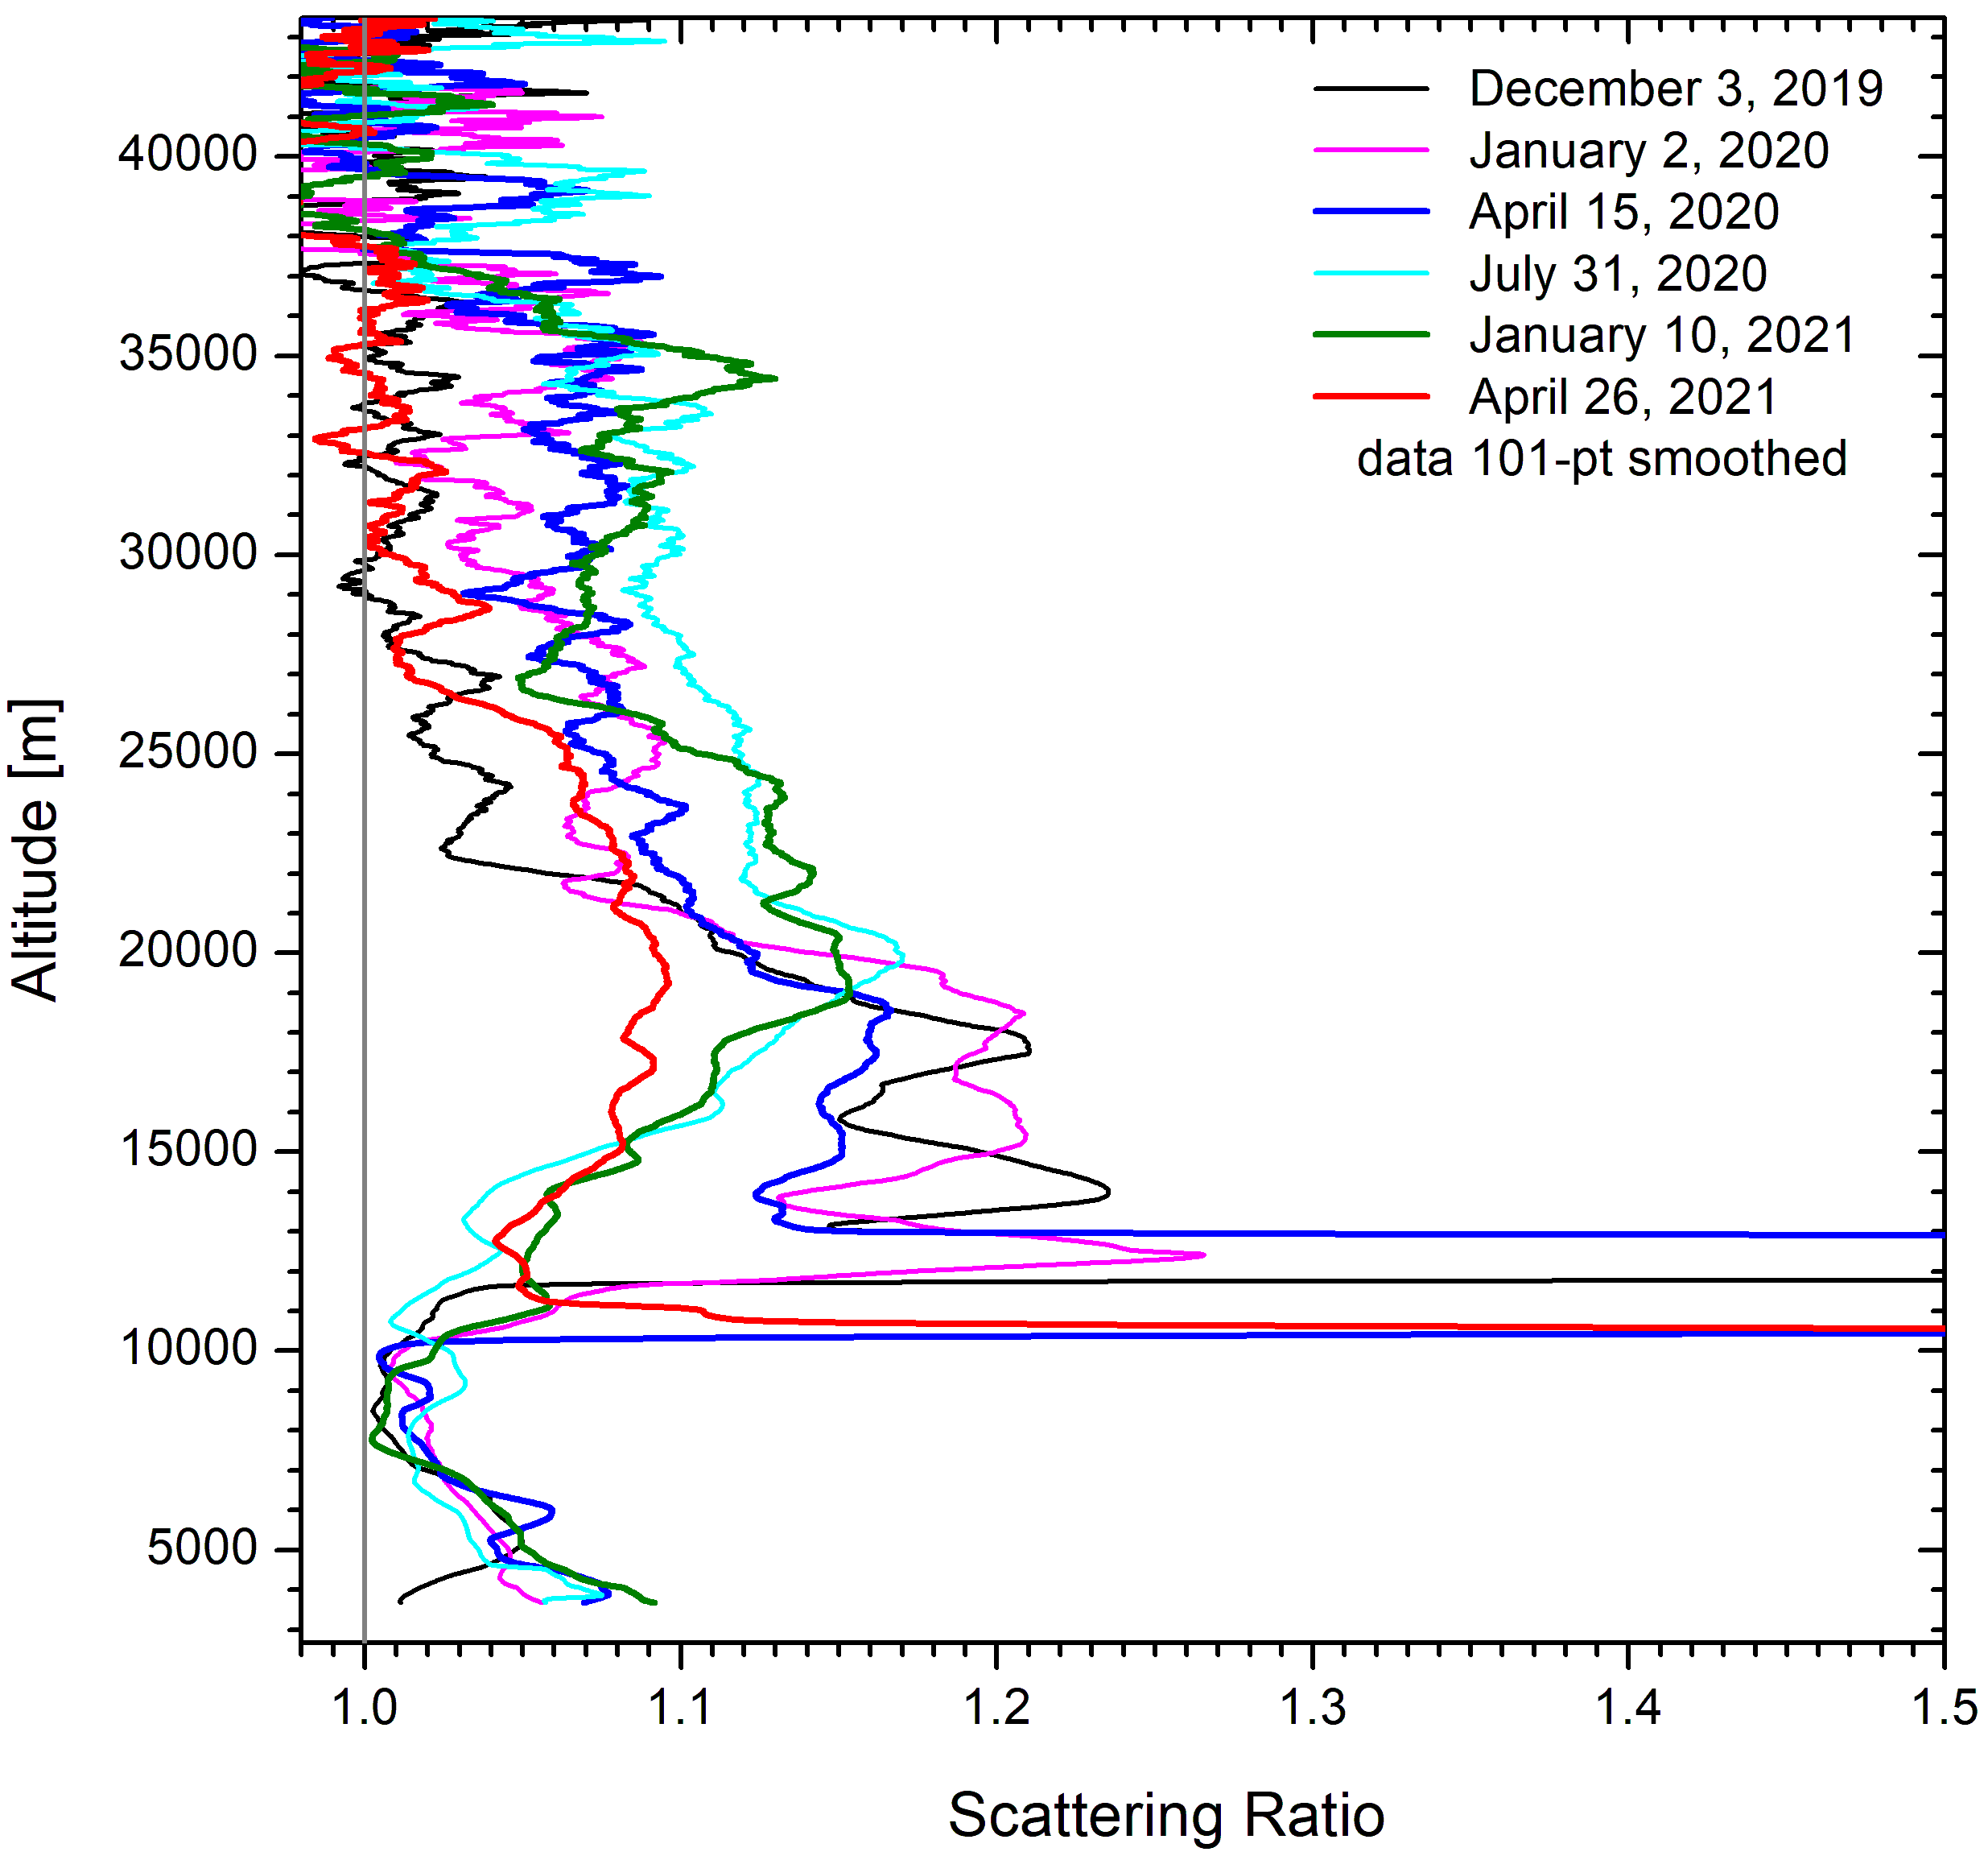
Half a year after the Raikoke eruption the aerosol started to expand beyond the typical top altitude of 25 to 27 km. This small contribution reached at least 37 km. The layer disappeared in late April 2021.
We tentatively ascribe this weak layer to delayed advection of the tropical eruption of Ulawun (June 26, 2019) , lifted in the Brewer-Dobson circulation.
No similar effect was observed after the Pinatubo eruption.
This example demonstrates that stratosphe-ric aerosol lidar systems must feature a ver-tical range significantly exceeding 40 km a.s.l.

