Slide 1
Pollynet_Processing_Chain
Zhenping Yin
2019-07-21

Slide 2
Outline
Workflow
Programs
Products and Configurations
Installation and setup
Future Plan

Slide 3
rsd server
lacroshome
pollyhome
cloudnet
ceilo
Bertha
Martha
pollydata
Bildermacher
Picasso
Watervapor
lacroswww
pollynet

Slide 4
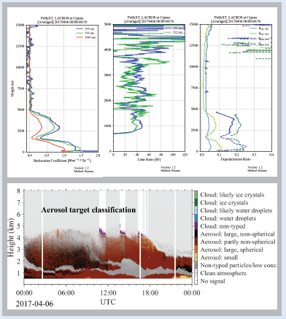

Workflow
PollyNET Measurements
PollyNET Data Server
PollyNET processing program

Slide 5
PollyNET Processing Program
Automatic calibration
lidar calibration
water vapor calibration
depolarization calibration
Integrated conventional retrieving algorithms
Extensible programming structure

Slide 6
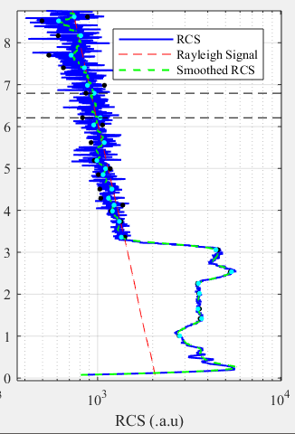
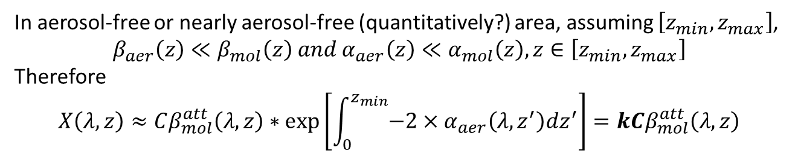
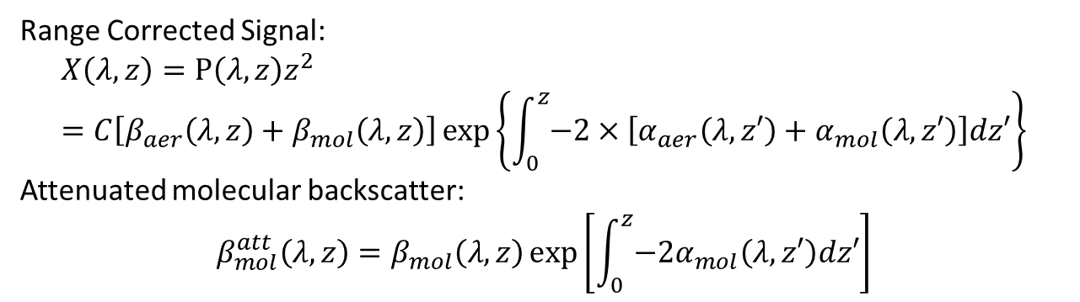
Rayleigh Fit
Range Corrected Signal:
$$X\left(λ,z\right)=P\left(λ,z\right)z^{2}=C\left[β_{aer}\left(λ,z\right)+β_{mol}\left(λ,z\right)\right]\exp\left\{\int_{0}^{z}{−2×\left[α_{aer}\left(λ,z′\right)+α_{mol}\left(λ,z′\right)\right]dz′}\right\}$$
Attenuated molecular backscatter:
$$β_{mol}^{att}\left(λ,z\right)=β_{mol}\left(λ,z\right)\exp\left[\int_{0}^{z}{{−2α}_{mol}\left(λ,z′\right)dz′}\right]$$
In aerosol-free or nearly aerosol-free (quantitatively?) area, assuming $\left[z_{min},z_{max}\right]$,
$$β_{aer}\left(z\right)≪β_{mol}\left(z\right) and α_{aer}\left(z\right)≪α_{mol}\left(z\right), z∈\left[z_{min},z_{max}\right]$$
Therefore
$$X\left(λ,z\right)≈Cβ_{mol}^{att}\left(λ,z\right)∗\exp\left[\int_{0}^{z_{min}}{−2×α_{aer}\left(λ,z^{′}\right)dz^{′}}\right]=kCβ_{mol}^{att}\left(λ,z\right)$$
Main task is to search the most linear correlated area

Slide 7

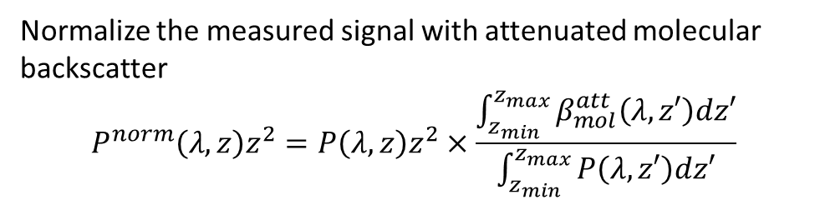
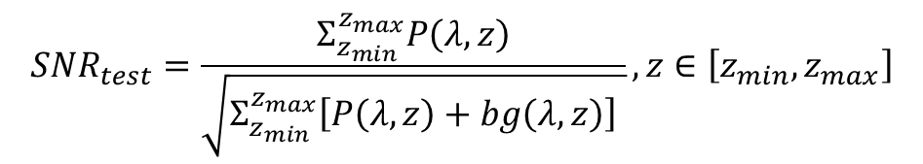
Rayleigh Fit
Normalize the measured signal with attenuated molecular backscatter
$$P^{norm}\left(λ,z\right)z^{2}=P\left(λ,z\right)z^{2}×\frac{\int_{z_{min}}^{z_{max}}{β_{mol}^{att}\left(λ,z′\right)dz′}}{\int_{z_{min}}^{z_{max}}{P\left(λ,z′\right)dz′}}$$
(Baars et al, AMT, 2016)
$$α_{aer}≈−\frac{1}{2}\frac{d}{dz}\left[\ln{\frac{P^{norm}\left(λ,z\right)}{β_{mol}^{att}\left(λ,z\right)}}\right]$$
Test 1: Pure Rayleigh Conditions
Test 2: Near and far range cross criteria
if no other absorptive aerosol layers above it
$$P^{norm}\left(λ,z\right)>β_{mol}^{att}\left(λ,z\right), z∈\left[z_{min},z_{max}\right]$$
Test 3: White-Noise criterion
$$Residual=P^{norm}\left(λ,z\right)z^{2}−β_{mol}^{att}\left(λ,z\right), z∈\left[z_{min},z_{max}\right]$$
$$SNR_{test}=\frac{Σ_{z_{min}}^{z_{max}}P\left(λ,z\right)}{\sqrt{Σ_{z_{min}}^{z_{max}}\left[P\left(λ,z\right)+bg\left(λ,z\right)\right] }}, z∈\left[z_{min},z_{max}\right]$$
Test 4: SNR constrain

Slide 8
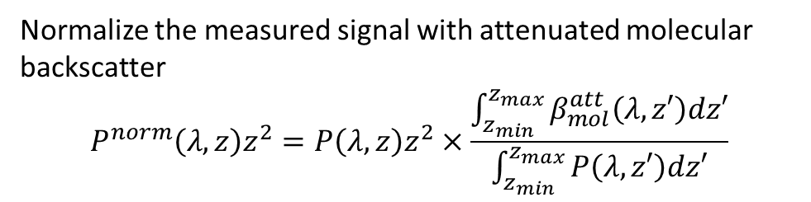

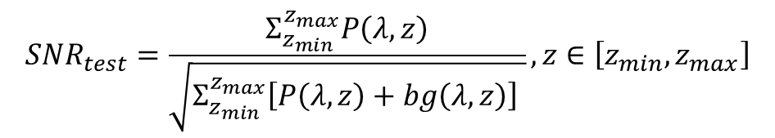
Rayleigh Fit
Normalize the measured signal with attenuated molecular backscatter
$$P^{norm}\left(λ,z\right)z^{2}=P\left(λ,z\right)z^{2}×\frac{\int_{z_{min}}^{z_{max}}{β_{mol}^{att}\left(λ,z′\right)dz′}}{\int_{z_{min}}^{z_{max}}{P\left(λ,z′\right)dz′}}$$
Smaller the mean of the residual is and more Gauss distribution alike the residual is, more possible it could be aerosol-free.
$$α_{aer}≈−\frac{1}{2}\frac{d}{dz}\left[\ln{\frac{P^{norm}\left(λ,z\right)}{β_{mol}^{att}\left(λ,z\right)}}\right]$$
Test 1: Pure Rayleigh Conditions
Test 2: Near and far range cross criteria
$$P^{norm}\left(λ,z\right)>β_{mol}^{att}\left(λ,z\right), z∈\left[z_{min},z_{max}\right]$$
Test 3: White-Noise criterion
$$Residual=P^{norm}\left(λ,z\right)z^{2}−β_{mol}^{att}\left(λ,z\right), z∈\left[z_{min},z_{max}\right]$$
$$SNR_{test}=\frac{Σ_{z_{min}}^{z_{max}}P\left(λ,z\right)}{\sqrt{Σ_{z_{min}}^{z_{max}}\left[P\left(λ,z\right)+bg\left(λ,z\right)\right] }}, z∈\left[z_{min},z_{max}\right]$$
Test 4: SNR constrain

Slide 9
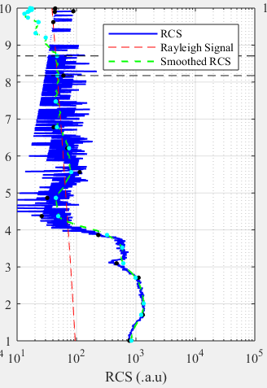
Shortage of sliding fixed window
More computation: all the sub-areas with a fixed width will be tested.
Omission: This possible interval will not be found if a large fixed window (like 1 km) was used, since the width of aerosol-free area is only 450m.

Slide 10
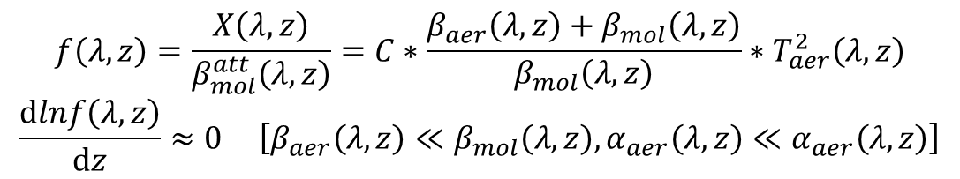
Rayleigh Fit – area decomposition
Interested area:
Not intersected
Nearly aerosol-free
$$f\left(λ,z\right)=\frac{X\left(λ,z\right)}{β_{mol}^{att}\left(λ,z\right)}=C∗\frac{β_{aer}\left(λ,z\right)+β_{mol}\left(λ,z\right)}{β_{mol}\left(λ,z\right)}∗T_{aer}^{2}\left(λ,z\right)$$
$$\frac{dlnf\left(λ,z\right)}{dz}≈0 \left[β_{aer}\left(λ,z\right)≪β_{mol}\left(λ,z\right), α_{aer}\left(λ,z\right)≪α_{aer}\left(λ,z\right)\right]$$
Which means the slope of the interested area should be 0 and the shape of interested area should be nearly linear

Slide 11
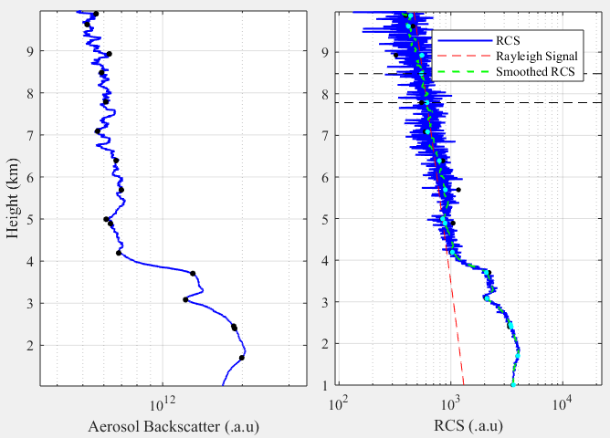
Rayleigh Fit - Douglas-Peucker Algorithm
Gifs to show how Douglas- Peucker Algorithm works
Each interval is not intersected.
Each interval is nearly linear, but slope of each interval is still varied.

Slide 12
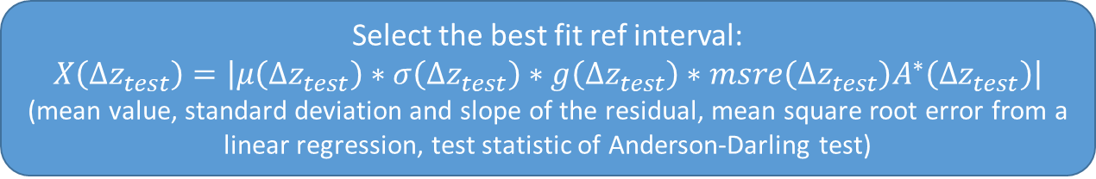
Rayleigh Fit
Douglas-Peucker Algorithm
[[z_min1, z_max1], [z_min2, z_max2], … [z_mink, z_maxk]]
Test 1: Slope check
Test 2: Near and far range cross criteria
Test 3: White-Noise criterion
Test 4: SNR constrain
Select the best fit ref interval:
$$X\left(Δz_{test}\right)=\left|μ\left(Δz_{test}\right)∗σ\left(Δz_{test}\right)∗g\left(Δz_{test}\right)∗msre\left(Δz_{test}\right)A^{∗}\left(Δz_{test}\right)\right|$$
(mean value, standard deviation and slope of the residual, mean square root error from a linear regression, test statistic of Anderson-Darling test)

Slide 13
Installation and setup

Slide 14
Workflow
Check the ‘pollynet_places_history.txt’ file to ensure the existence of your campaign info
Setup a polly config file under ‘../config’.
Example
Add a new entry for this campaign to link the processing modules with the corresponding config file
Run the ‘pollynet_process_day’
Pollynet_places_history.txt
Search the campaign info: lat, lon, …
Task from todolist file
Each line represents a task
Pollynet_processing_config_history.txt
Search the processing module and config file. (Each polly has its own processing module)
Load the config and activate the processing module
The procedure is valid for (pollyxt_noa, pollyxt_fmi, pollyxt_uw, pollyxt_tjk, pollyxt_lacros, pollyxt_tropos, Arielle, polly_1v2)

