Slide 1
Pollynet_Processing_Chain
Zhenping Yin
2019-07-21

Slide 2
Outline
Workflow
Programs
Products and Configurations
Installation and setup
Future Plan

Slide 3
rsd server
lacroshome
pollyhome
cloudnet
ceilo
Bertha
Martha
pollydata
Bildermacher
Picasso
Watervapor
lacroswww
pollynet

Slide 4
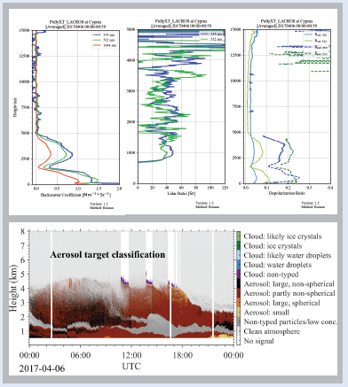

PollyNET Workflow
PollyNET Measurements
PollyNET Data Server
PollyNET processing program

Slide 5
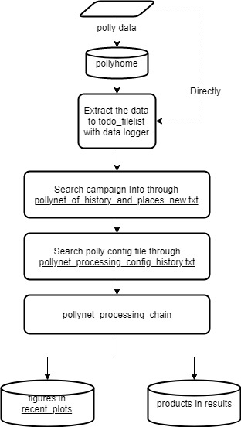
PollyNET Processing Program
Automatic calibration
lidar calibration
water vapor calibration
depolarization calibration
Integrated conventional retrieving algorithms
Extensible programming structure

Slide 6
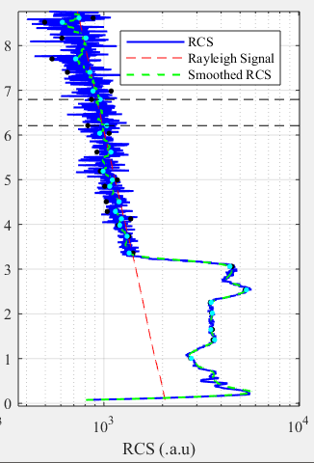
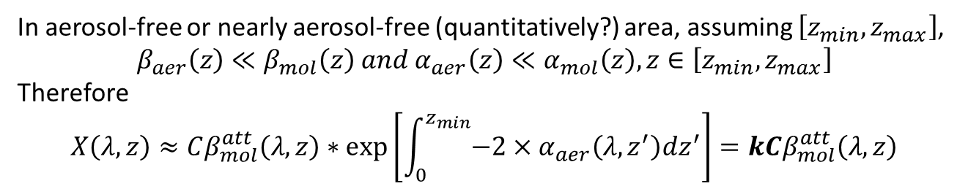
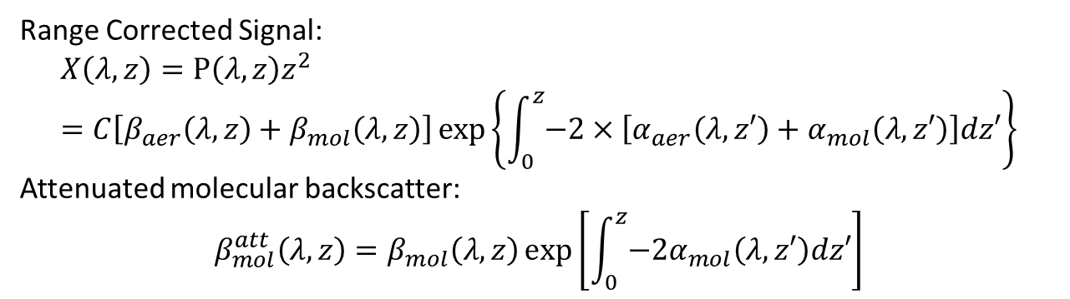
Rayleigh Fit
Range Corrected Signal:
$$X\left(λ,z\right)=P\left(λ,z\right)z^{2}=C\left[β_{aer}\left(λ,z\right)+β_{mol}\left(λ,z\right)\right]\exp\left\{\int_{0}^{z}{−2×\left[α_{aer}\left(λ,z′\right)+α_{mol}\left(λ,z′\right)\right]dz′}\right\}$$
Attenuated molecular backscatter:
$$β_{mol}^{att}\left(λ,z\right)=β_{mol}\left(λ,z\right)\exp\left[\int_{0}^{z}{{−2α}_{mol}\left(λ,z′\right)dz′}\right]$$
In aerosol-free or nearly aerosol-free (quantitatively?) area, assuming $\left[z_{min},z_{max}\right]$,
$$β_{aer}\left(z\right)≪β_{mol}\left(z\right) and α_{aer}\left(z\right)≪α_{mol}\left(z\right), z∈\left[z_{min},z_{max}\right]$$
Therefore
$$X\left(λ,z\right)≈Cβ_{mol}^{att}\left(λ,z\right)∗\exp\left[\int_{0}^{z_{min}}{−2×α_{aer}\left(λ,z^{′}\right)dz^{′}}\right]=kCβ_{mol}^{att}\left(λ,z\right)$$
Main task is to search the most linear correlated area

Slide 7

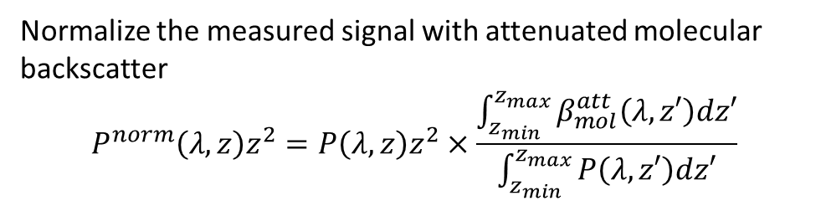
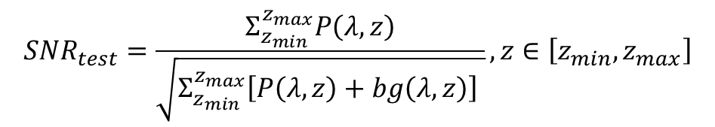
Rayleigh Fit
Normalize the measured signal with attenuated molecular backscatter
$$P^{norm}\left(λ,z\right)z^{2}=P\left(λ,z\right)z^{2}×\frac{\int_{z_{min}}^{z_{max}}{β_{mol}^{att}\left(λ,z′\right)dz′}}{\int_{z_{min}}^{z_{max}}{P\left(λ,z′\right)dz′}}$$
(Baars et al, AMT, 2016)
$$α_{aer}≈−\frac{1}{2}\frac{d}{dz}\left[\ln{\frac{P^{norm}\left(λ,z\right)}{β_{mol}^{att}\left(λ,z\right)}}\right]$$
Test 1: Pure Rayleigh Conditions
Test 2: Near and far range cross criteria
if no other absorptive aerosol layers above it
$$P^{norm}\left(λ,z\right)>β_{mol}^{att}\left(λ,z\right), z∈\left[z_{min},z_{max}\right]$$
Test 3: White-Noise criterion
$$Residual=P^{norm}\left(λ,z\right)z^{2}−β_{mol}^{att}\left(λ,z\right), z∈\left[z_{min},z_{max}\right]$$
$$SNR_{test}=\frac{Σ_{z_{min}}^{z_{max}}P\left(λ,z\right)}{\sqrt{Σ_{z_{min}}^{z_{max}}\left[P\left(λ,z\right)+bg\left(λ,z\right)\right] }}, z∈\left[z_{min},z_{max}\right]$$
Test 4: SNR constrain

Slide 8
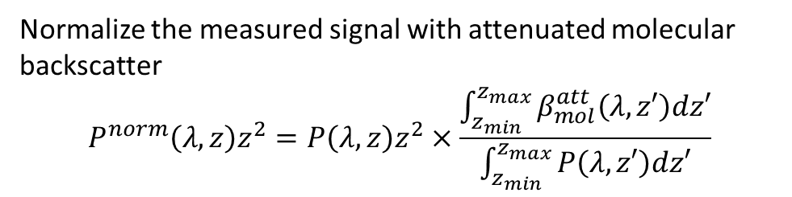

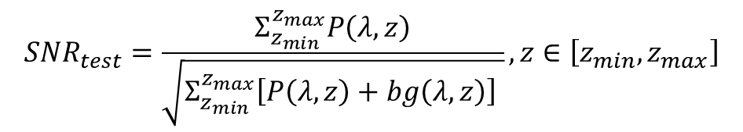
Rayleigh Fit
Normalize the measured signal with attenuated molecular backscatter
$$P^{norm}\left(λ,z\right)z^{2}=P\left(λ,z\right)z^{2}×\frac{\int_{z_{min}}^{z_{max}}{β_{mol}^{att}\left(λ,z′\right)dz′}}{\int_{z_{min}}^{z_{max}}{P\left(λ,z′\right)dz′}}$$
Smaller the mean of the residual is and more Gauss distribution alike the residual is, more possible it could be aerosol-free.
$$α_{aer}≈−\frac{1}{2}\frac{d}{dz}\left[\ln{\frac{P^{norm}\left(λ,z\right)}{β_{mol}^{att}\left(λ,z\right)}}\right]$$
Test 1: Pure Rayleigh Conditions
Test 2: Near and far range cross criteria
$$P^{norm}\left(λ,z\right)>β_{mol}^{att}\left(λ,z\right), z∈\left[z_{min},z_{max}\right]$$
Test 3: White-Noise criterion
$$Residual=P^{norm}\left(λ,z\right)z^{2}−β_{mol}^{att}\left(λ,z\right), z∈\left[z_{min},z_{max}\right]$$
$$SNR_{test}=\frac{Σ_{z_{min}}^{z_{max}}P\left(λ,z\right)}{\sqrt{Σ_{z_{min}}^{z_{max}}\left[P\left(λ,z\right)+bg\left(λ,z\right)\right] }}, z∈\left[z_{min},z_{max}\right]$$
Test 4: SNR constrain

Slide 9
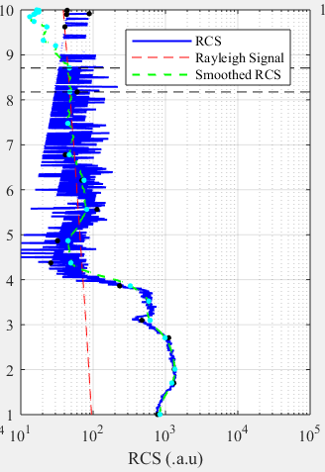
Shortage of sliding fixed window
More computation: all the sub-areas with a fixed width will be tested.
Omission: This possible interval will not be found if a large fixed window (like 1 km) was used, since the width of aerosol-free area is only 450m.

Slide 10
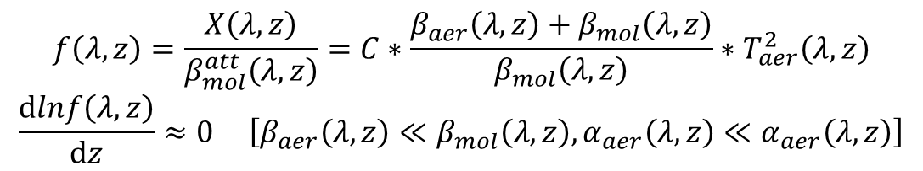
Rayleigh Fit – area decomposition
Interested area:
Not intersected
Nearly aerosol-free
$$f\left(λ,z\right)=\frac{X\left(λ,z\right)}{β_{mol}^{att}\left(λ,z\right)}=C∗\frac{β_{aer}\left(λ,z\right)+β_{mol}\left(λ,z\right)}{β_{mol}\left(λ,z\right)}∗T_{aer}^{2}\left(λ,z\right)$$
$$\frac{dlnf\left(λ,z\right)}{dz}≈0 \left[β_{aer}\left(λ,z\right)≪β_{mol}\left(λ,z\right), α_{aer}\left(λ,z\right)≪α_{aer}\left(λ,z\right)\right]$$
Which means the slope of the interested area should be 0 and the shape of interested area should be nearly linear

Slide 11
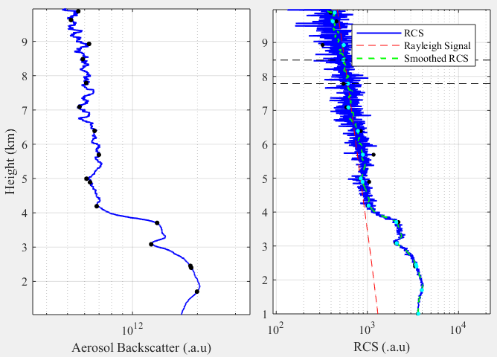
Rayleigh Fit - Douglas-Peucker Algorithm
Gifs to show how Douglas- Peucker Algorithm works
Each interval is not intersected.
Each interval is nearly linear, but slope of each interval is still varied.

Slide 12
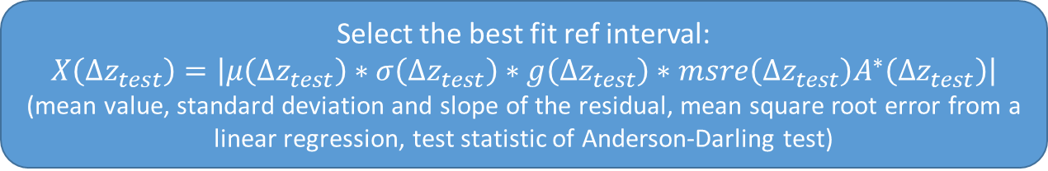
Rayleigh Fit
Douglas-Peucker Algorithm
[[z_min1, z_max1], [z_min2, z_max2], … [z_mink, z_maxk]]
Test 1: Slope check
Test 2: Near and far range cross criteria
Test 3: White-Noise criterion
Test 4: SNR constrain
Select the best fit ref interval:
$$X\left(Δz_{test}\right)=\left|μ\left(Δz_{test}\right)∗σ\left(Δz_{test}\right)∗g\left(Δz_{test}\right)∗msre\left(Δz_{test}\right)A^{∗}\left(Δz_{test}\right)\right|$$
(mean value, standard deviation and slope of the residual, mean square root error from a linear regression, test statistic of Anderson-Darling test)

Slide 13
Installation and setup
git clone https://github.com/ZPYin/Pollynet_Processing_Chain
This command will download the code from the remote GitHub repository
setup the global config with editing: Pollynet_Processing_Chain/config/pollynet_processing_chain_config.json
You can go to ‘template_pollynet_processing_chain_config.json’ to see how to configure it
Add the campaign information with editing:
Pollynet_Processing_Chain/todo_filelist/pollynet_of_history_places_new.txt
Take care about the format of the settings, best way is to copy the line before and then edit it according to your own demands
Specify the polly settings with editing:
Pollynet_Processing_Chain/config/{polly}_config_{date}.json
Add a new config history with editing:
Pollynet_Processing_Chain/config/pollynet_Processing_config_history.txt

Slide 14
Installation and setup
Check the ‘pollynet_places_history.txt’ file to ensure the existence of your campaign info
Setup a polly config file under ‘../config’.
Add a new entry for this campaign to link the processing modules with the corresponding config file
Run the ‘pollynet_process_day’
Pollynet_places_history.txt
Search the campaign info: lat, lon, label
Task from todolist file
Each line represents a task
Pollynet_processing_config_history.txt
Search the processing module and config file. (Each polly has its own processing module)
Load the polly config according the ‘Pollynet_processing_config_history.txt’ and activate the processing module
The procedure is valid for (pollyxt_noa, pollyxt_fmi, pollyxt_uw, pollyxt_tjk, pollyxt_lacros, pollyxt_tropos, Arielle, polly_1v2)

