Slide 1
Pollynet_Processing_Chain
Zhenping Yin
2019-07-21

Slide 2
Outline
Workflow
Programs
Products and Configurations
Installation and setup
Future Plan

Slide 3
rsd server
lacroshome
pollyhome
cloudnet
ceilo
Bertha
Martha
pollydata
Bildermacher
Picasso
Watervapor
lacroswww
pollynet

Slide 4
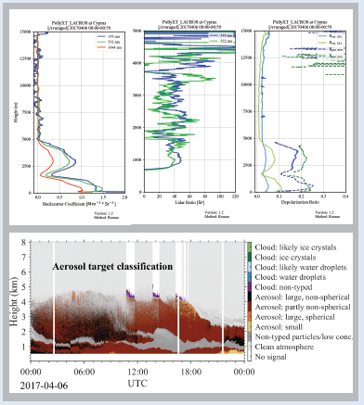

PollyNET Workflow
PollyNET Measurements
PollyNET Data Server
PollyNET processing program

Slide 5
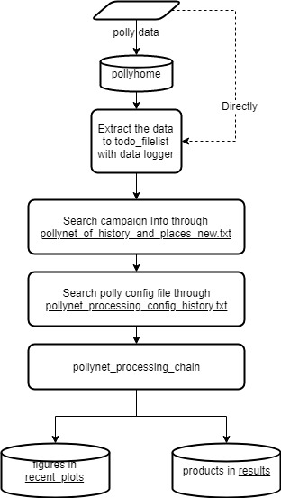
PollyNET Processing Program (PPP)
Automatic calibration
lidar calibration
water vapor calibration
depolarization calibration
Integrated conventional retrieving algorithms
Extensible programming structure

Slide 6
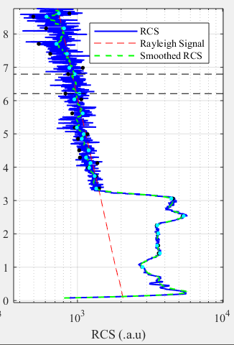
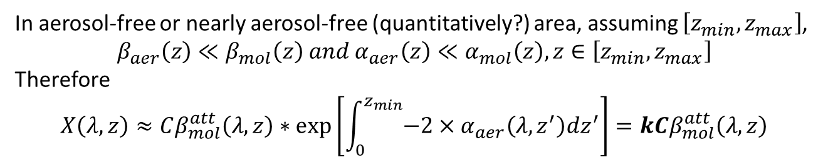
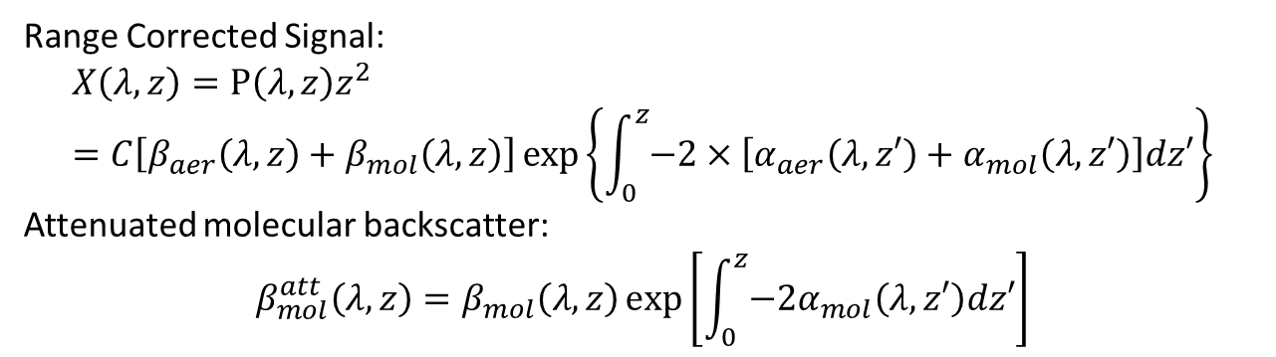
Rayleigh Fit
Range Corrected Signal:
$$X\left(λ,z\right)=P\left(λ,z\right)z^{2}=C\left[β_{aer}\left(λ,z\right)+β_{mol}\left(λ,z\right)\right]\exp\left\{\int_{0}^{z}{−2×\left[α_{aer}\left(λ,z′\right)+α_{mol}\left(λ,z′\right)\right]dz′}\right\}$$
Attenuated molecular backscatter:
$$β_{mol}^{att}\left(λ,z\right)=β_{mol}\left(λ,z\right)\exp\left[\int_{0}^{z}{{−2α}_{mol}\left(λ,z′\right)dz′}\right]$$
In aerosol-free or nearly aerosol-free (quantitatively?) area, assuming $\left[z_{min},z_{max}\right]$,
$$β_{aer}\left(z\right)≪β_{mol}\left(z\right) and α_{aer}\left(z\right)≪α_{mol}\left(z\right), z∈\left[z_{min},z_{max}\right]$$
Therefore
$$X\left(λ,z\right)≈Cβ_{mol}^{att}\left(λ,z\right)∗\exp\left[\int_{0}^{z_{min}}{−2×α_{aer}\left(λ,z^{′}\right)dz^{′}}\right]=kCβ_{mol}^{att}\left(λ,z\right)$$
Main task is to search the most linear correlated area

Slide 7

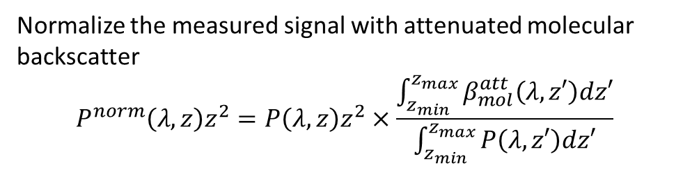
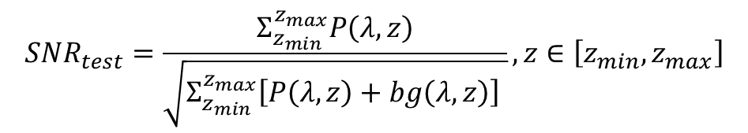
Rayleigh Fit
Normalize the measured signal with attenuated molecular backscatter
$$P^{norm}\left(λ,z\right)z^{2}=P\left(λ,z\right)z^{2}×\frac{\int_{z_{min}}^{z_{max}}{β_{mol}^{att}\left(λ,z′\right)dz′}}{\int_{z_{min}}^{z_{max}}{P\left(λ,z′\right)dz′}}$$
(Baars et al, AMT, 2016)
$$α_{aer}≈−\frac{1}{2}\frac{d}{dz}\left[\ln{\frac{P^{norm}\left(λ,z\right)}{β_{mol}^{att}\left(λ,z\right)}}\right]$$
Test 1: Pure Rayleigh Conditions
Test 2: Near and far range cross criteria
if no other absorptive aerosol layers above it
$$P^{norm}\left(λ,z\right)>β_{mol}^{att}\left(λ,z\right), z∈\left[z_{min},z_{max}\right]$$
Test 3: White-Noise criterion
$$Residual=P^{norm}\left(λ,z\right)z^{2}−β_{mol}^{att}\left(λ,z\right), z∈\left[z_{min},z_{max}\right]$$
$$SNR_{test}=\frac{Σ_{z_{min}}^{z_{max}}P\left(λ,z\right)}{\sqrt{Σ_{z_{min}}^{z_{max}}\left[P\left(λ,z\right)+bg\left(λ,z\right)\right] }}, z∈\left[z_{min},z_{max}\right]$$
Test 4: SNR constrain

Slide 8
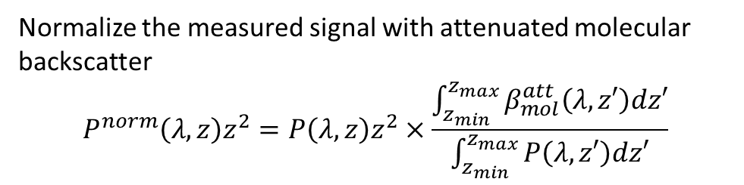

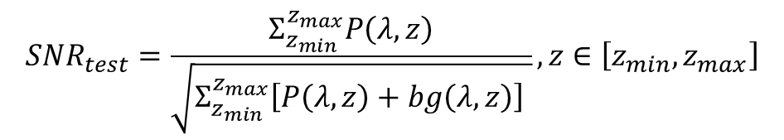
Rayleigh Fit
Normalize the measured signal with attenuated molecular backscatter
$$P^{norm}\left(λ,z\right)z^{2}=P\left(λ,z\right)z^{2}×\frac{\int_{z_{min}}^{z_{max}}{β_{mol}^{att}\left(λ,z′\right)dz′}}{\int_{z_{min}}^{z_{max}}{P\left(λ,z′\right)dz′}}$$
Smaller the mean of the residual is and more Gauss distribution alike the residual is, more possible it could be aerosol-free.
$$α_{aer}≈−\frac{1}{2}\frac{d}{dz}\left[\ln{\frac{P^{norm}\left(λ,z\right)}{β_{mol}^{att}\left(λ,z\right)}}\right]$$
Test 1: Pure Rayleigh Conditions
Test 2: Near and far range cross criteria
$$P^{norm}\left(λ,z\right)>β_{mol}^{att}\left(λ,z\right), z∈\left[z_{min},z_{max}\right]$$
Test 3: White-Noise criterion
$$Residual=P^{norm}\left(λ,z\right)z^{2}−β_{mol}^{att}\left(λ,z\right), z∈\left[z_{min},z_{max}\right]$$
$$SNR_{test}=\frac{Σ_{z_{min}}^{z_{max}}P\left(λ,z\right)}{\sqrt{Σ_{z_{min}}^{z_{max}}\left[P\left(λ,z\right)+bg\left(λ,z\right)\right] }}, z∈\left[z_{min},z_{max}\right]$$
Test 4: SNR constrain

Slide 9
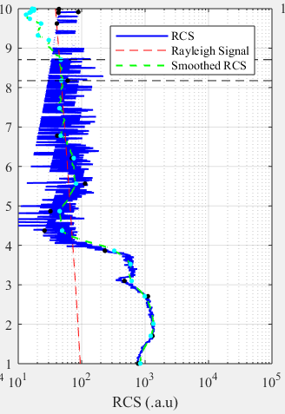
Shortage of sliding fixed window
More computation: all the sub-areas with a fixed width will be tested.
Omission: This possible interval will not be found if a large fixed window (like 1 km) was used, since the width of aerosol-free area is only 450m.

Slide 10
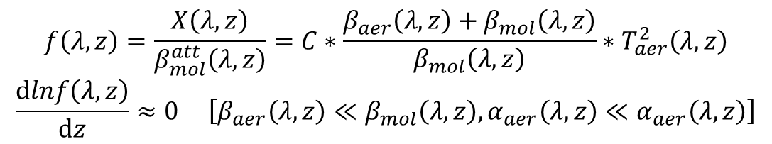
Rayleigh Fit – area decomposition
Interested area:
Not intersected
Nearly aerosol-free
$$f\left(λ,z\right)=\frac{X\left(λ,z\right)}{β_{mol}^{att}\left(λ,z\right)}=C∗\frac{β_{aer}\left(λ,z\right)+β_{mol}\left(λ,z\right)}{β_{mol}\left(λ,z\right)}∗T_{aer}^{2}\left(λ,z\right)$$
$$\frac{dlnf\left(λ,z\right)}{dz}≈0 \left[β_{aer}\left(λ,z\right)≪β_{mol}\left(λ,z\right), α_{aer}\left(λ,z\right)≪α_{aer}\left(λ,z\right)\right]$$
Which means the slope of the interested area should be 0 and the shape of interested area should be nearly linear

Slide 11
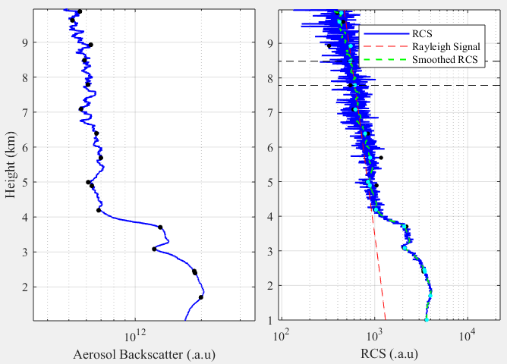
Rayleigh Fit - Douglas-Peucker Algorithm
Gifs to show how Douglas- Peucker Algorithm works
Each interval is not intersected.
Each interval is nearly linear, but slope of each interval is still varied.

Slide 12
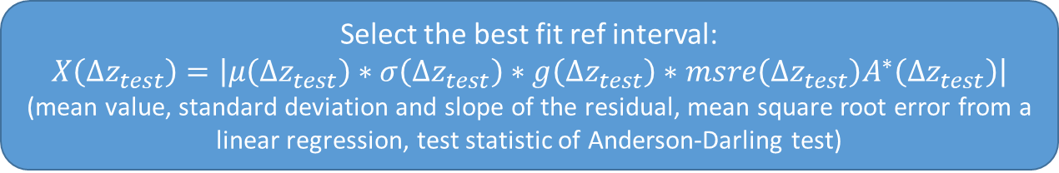
Rayleigh Fit
Douglas-Peucker Algorithm
[[z_min1, z_max1], [z_min2, z_max2], … [z_mink, z_maxk]]
Test 1: Slope check
Test 2: Near and far range cross criteria
Test 3: White-Noise criterion
Test 4: SNR constrain
Select the best fit ref interval:
$$X\left(Δz_{test}\right)=\left|μ\left(Δz_{test}\right)∗σ\left(Δz_{test}\right)∗g\left(Δz_{test}\right)∗msre\left(Δz_{test}\right)A^{∗}\left(Δz_{test}\right)\right|$$
(mean value, standard deviation and slope of the residual, mean square root error from a linear regression, test statistic of Anderson-Darling test)

Slide 13

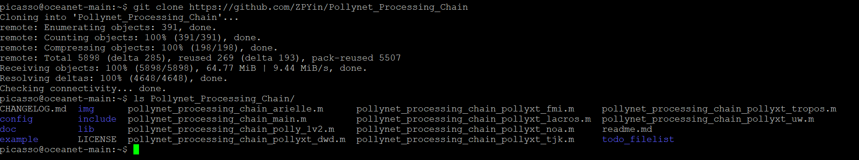
Installation and setup: Download
git clone https://github.com/ZPYin/Pollynet_Processing_Chain
This command will download the code from the remote GitHub repository
If you want to develop new features, we recommend you to pull the ‘dev’ branch:
git fetch origin dev:dev
(Detailed information about how to play with `git`, please go to ../doc/git_workflow.pptx).

Slide 14
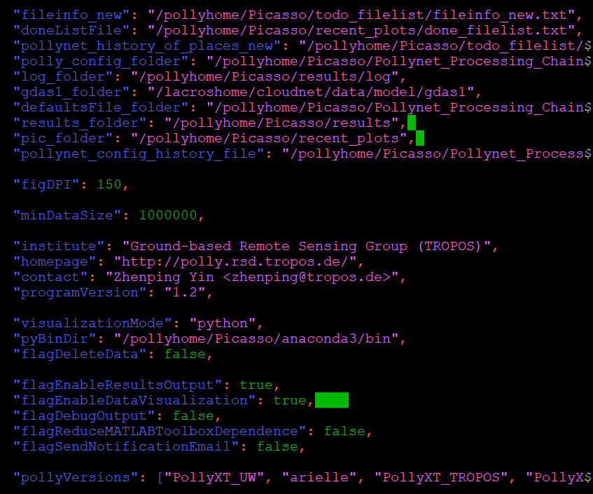
Installation and setup: config
PPP global config:
1. setup the global config file from the template
2. edit the global config file
- directories: according to your own requirements.
- ‘fileinfo_new’, ‘doneListFile’, ‘log_folder’, ‘results_folder’ and ‘pic_folder’ will be created automatically
- ‘pollynet_history_of_places_new’, ‘pollynet_config_history_file’ can be found inside the PPP
python 3 folder: PPP uses python3 for data visualization if ‘visualizationMode’was set ‘python’
to control whether to delete the unzipped polly data after each processing.

Slide 15
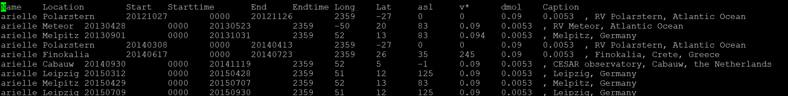
Installation and setup: config
PPP add campaign:
Normally, this file was generated from the database. But if there is no connection to the database, you need to add new campaign info manually.
(Be careful about the character of the ‘space’, actually it consists of ‘tab’. So better way is to copy the line before and edit it according to your campaign.)

Slide 16
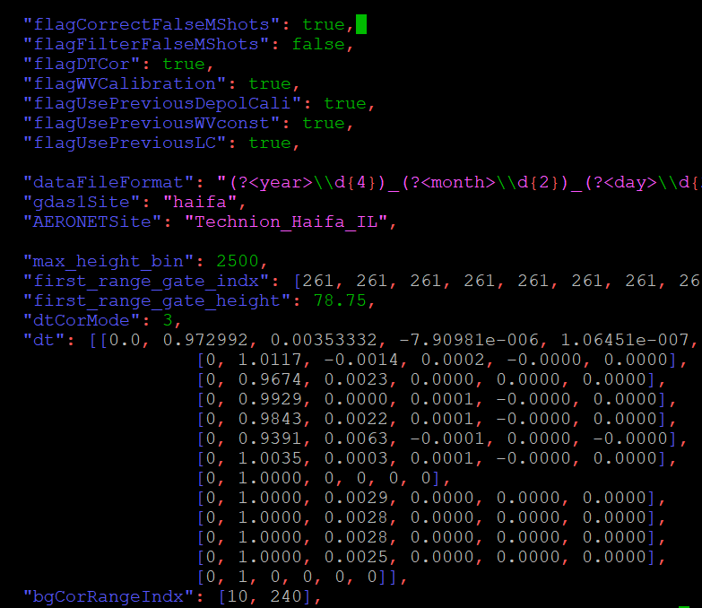
Installation and setup: config
PPP add polly config:
Copy the ‘template_config.json’ to a new polly config file with the naming of ‘{polly-type}_config_{date}.json’
You may need to change the settings of:
gdas1Site
AERONETSite
depol_cal_ang_p_time
depol_cal_ang_n_time
meteorDataSource
IWV_instrument
intNProfiles
minIntNProfiles
radiosondeFolder
logbookFile
You can find detailed info about the polly config in /doc/polly_config.md

Slide 17
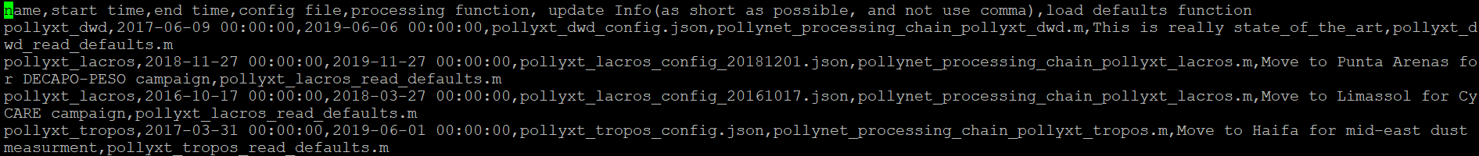
Installation and setup: config
PPP create config history: (make sure you setup the info in global file correctly)
PPP edit config history:
config history file works as a lookup table for PPP to search the corresponding polly config file.
better way to do is to copy the line before and then edit it according to your demands.

Slide 18
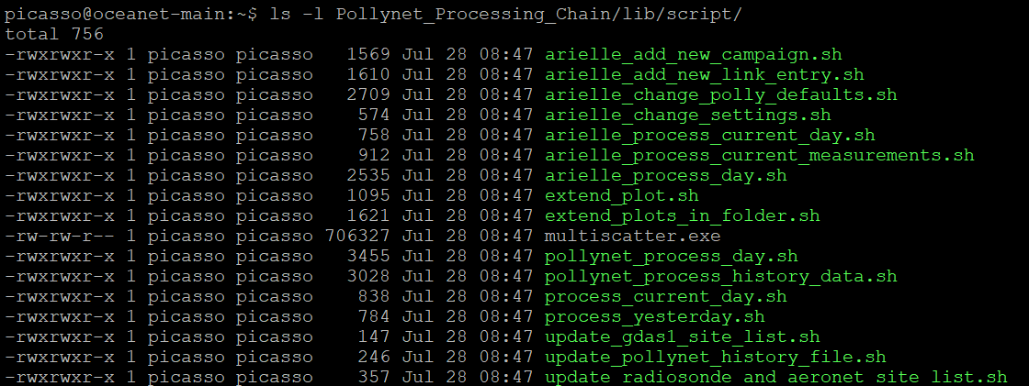
Installation and setup: run
Process the measurement results at this moment
Process the measurement results at given day

Slide 19
Installation and setup
Check the ‘pollynet_places_history.txt’ file to ensure the existence of your campaign info
Setup a polly config file under ‘../config’.
Add a new entry for this campaign to link the processing modules with the corresponding config file
Run the ‘pollynet_process_day’
Pollynet_places_history.txt
Search the campaign info: lat, lon, label
Task from todolist file
Each line represents a task
Pollynet_processing_config_history.txt
Search the processing module and config file. (Each polly has its own processing module)
Load the polly config according the ‘Pollynet_processing_config_history.txt’ and activate the processing module
The procedure is valid for (pollyxt_noa, pollyxt_fmi, pollyxt_uw, pollyxt_tjk, pollyxt_lacros, pollyxt_tropos, Arielle, polly_1v2)

