Slide 1

Do I need to renew the Unity license to remove the unity logo?
And would this help the distortation on the RP logo?

Slide 2

Capitalize the a

Slide 3

Add Master Volume below Settings, and moving the list down.
Check to see if Directions and Credits are the same size
Center Directions and Credits
Directions
Credits

Slide 4
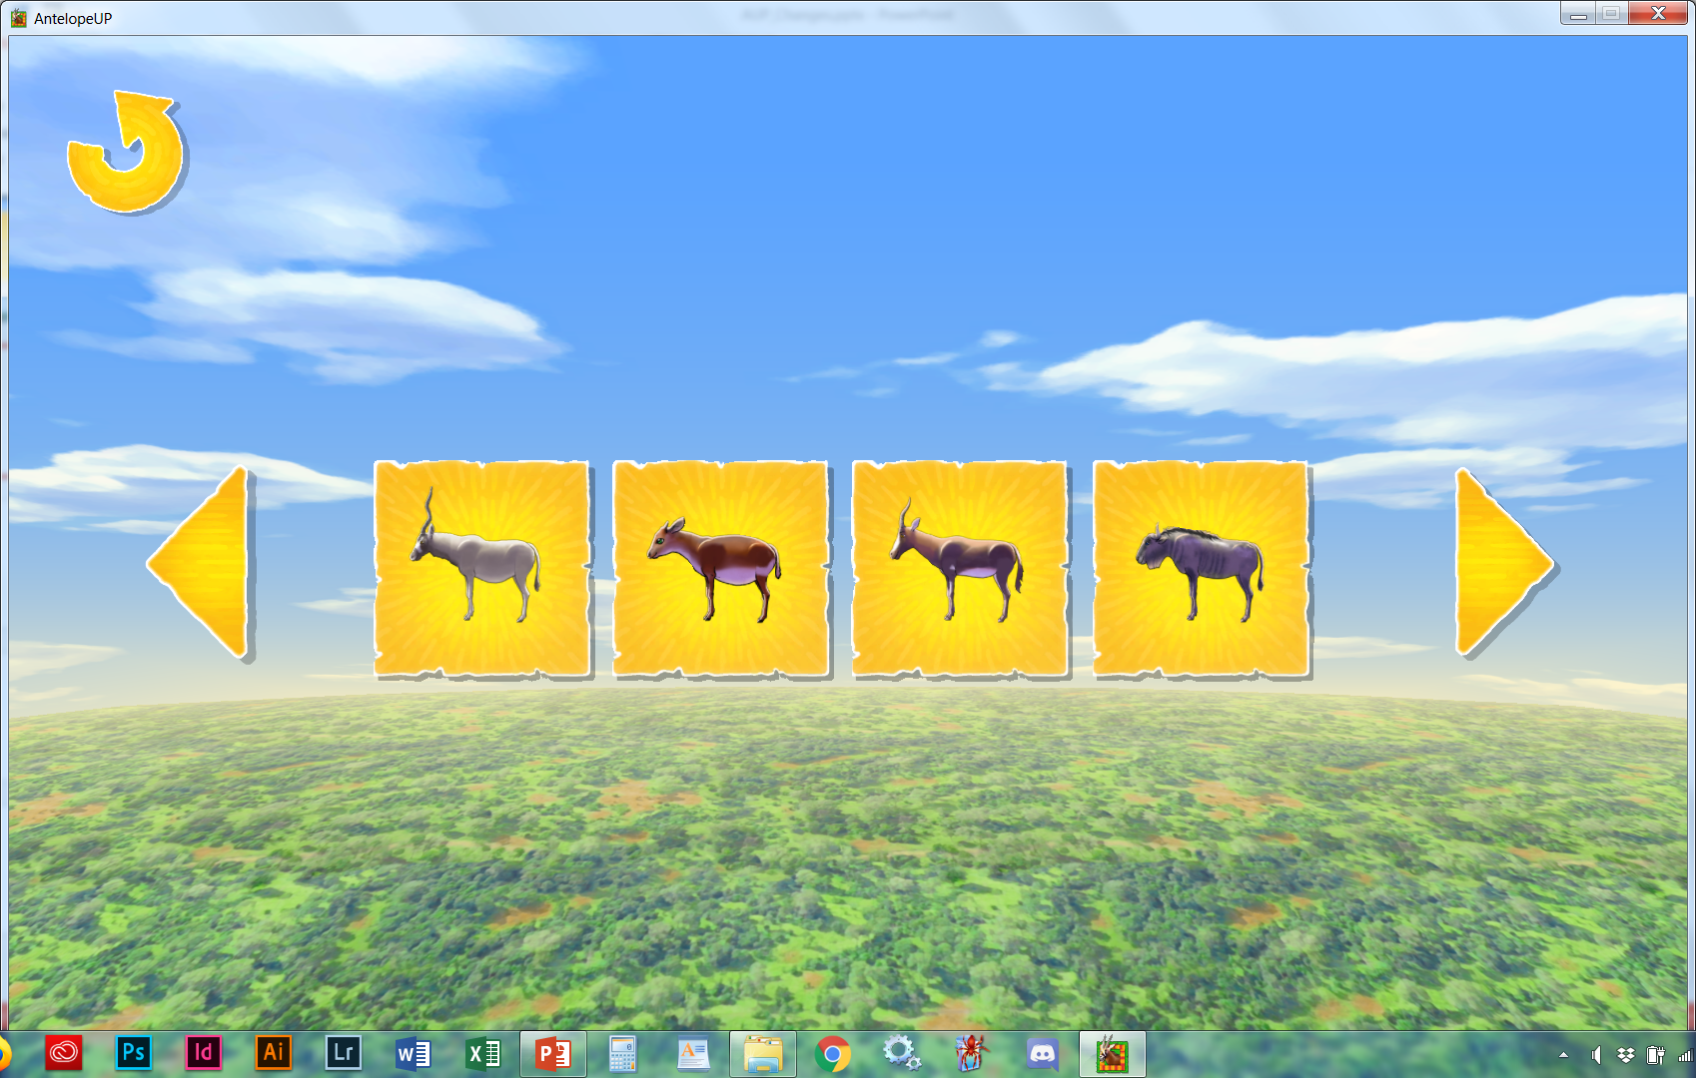
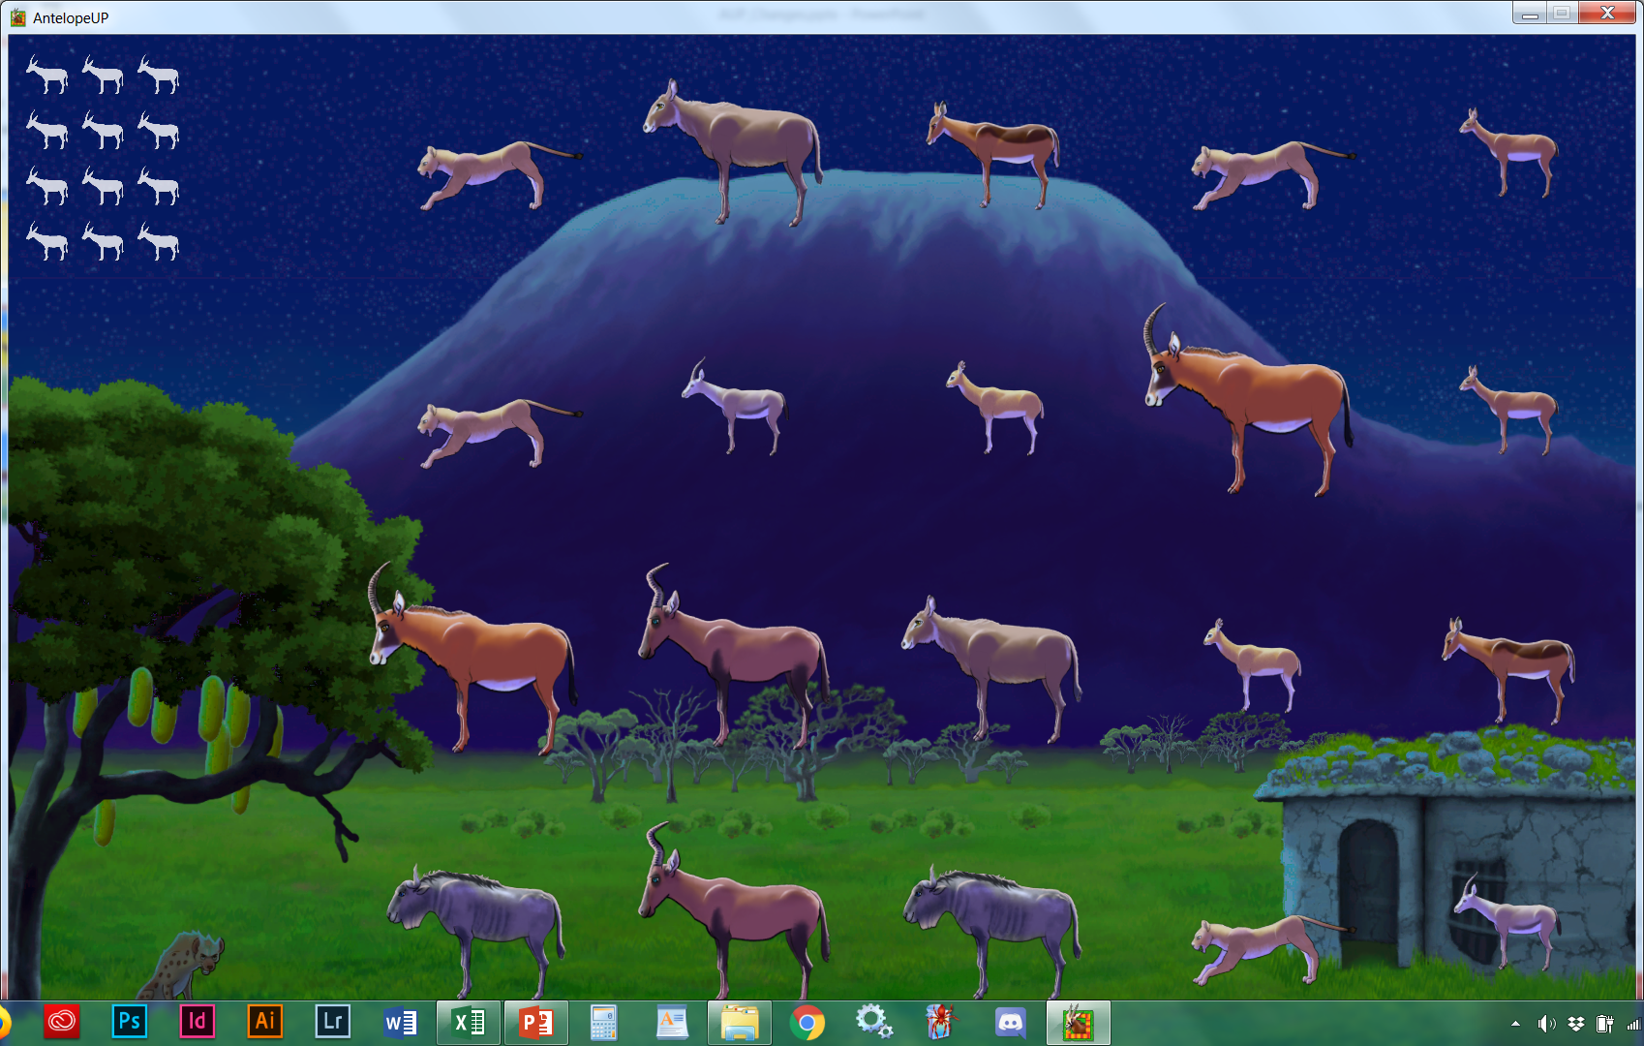
Aders’ Duiker
Add lion and hyena

Slide 5
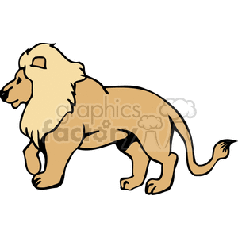
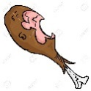
Need to lower the music when the names are activated
Lion
Vulnerable
VU
Females lions,
called lioness,
do the hunting.
Carnivore
Uses:
Family: Felidae
Genus: Panthera
Species: leo
Males 3.9 feet, Female 3.6 feet, at shoulders.
Get David to record Genus Panthera and Lion / Lioness
Need lion sound – check to see of Maya did this

Slide 6
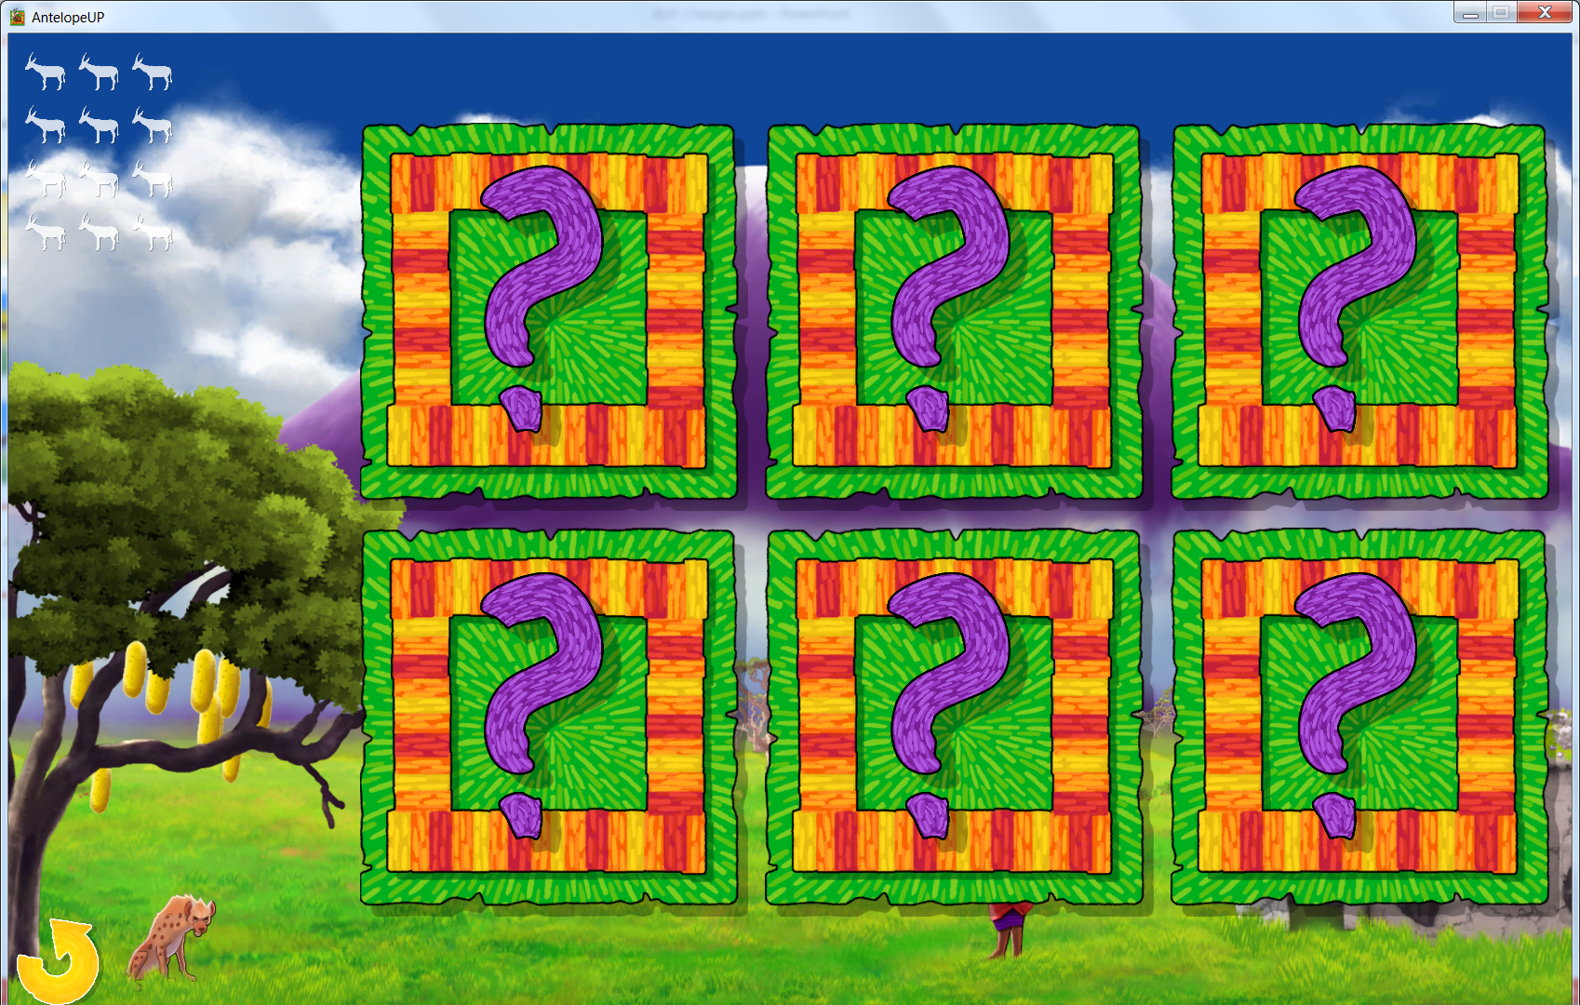
Need to lower the music when the names are activated
Adult male spotted hyenas in the Serengeti weigh 40.5–55.0 kg (89–121 lb), while females weigh 44.5–63.9 kg (98–141 lb). 2.3-3 feet tall, at shoulders.
Spotted Hyena
Least Concern
LC
These Laughing Hyenas
are predators, not
scavengers.
Carnivore
Uses:
Family: Hyaenidae
Genus: Crocuta
Species: C. crocuta
Get David to record Genus Crocuta and Spotted Hyena

Slide 7
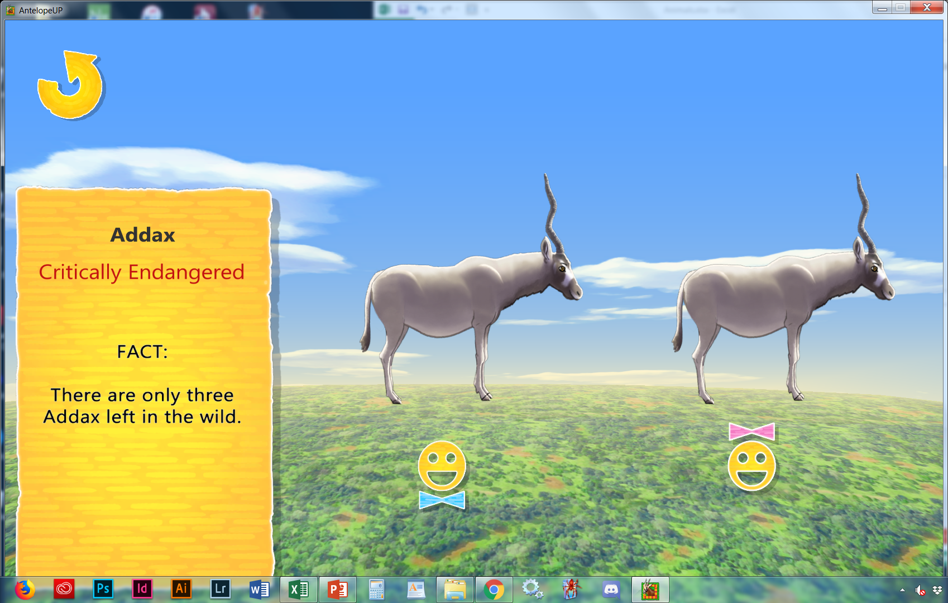


1
Need to lower the music when the names are activated
Size: Head and body length: 150 to 170 cm (59.1 to 66.9 in.)
WeightMale: 99 to 123.75 kg (220 to 275 lbs.)
Female: 60 to 125 kg (132 to 275 lbs.)
They are sexually dimorphic, as the females are smaller than males.
Make smaller
(CR)
These desert antelope have flat hooves and soles to prevent sinking in sand.
Herbivore
Family: Bovidea
Genus: Addax
Species: A. nasomaculatus

Slide 8
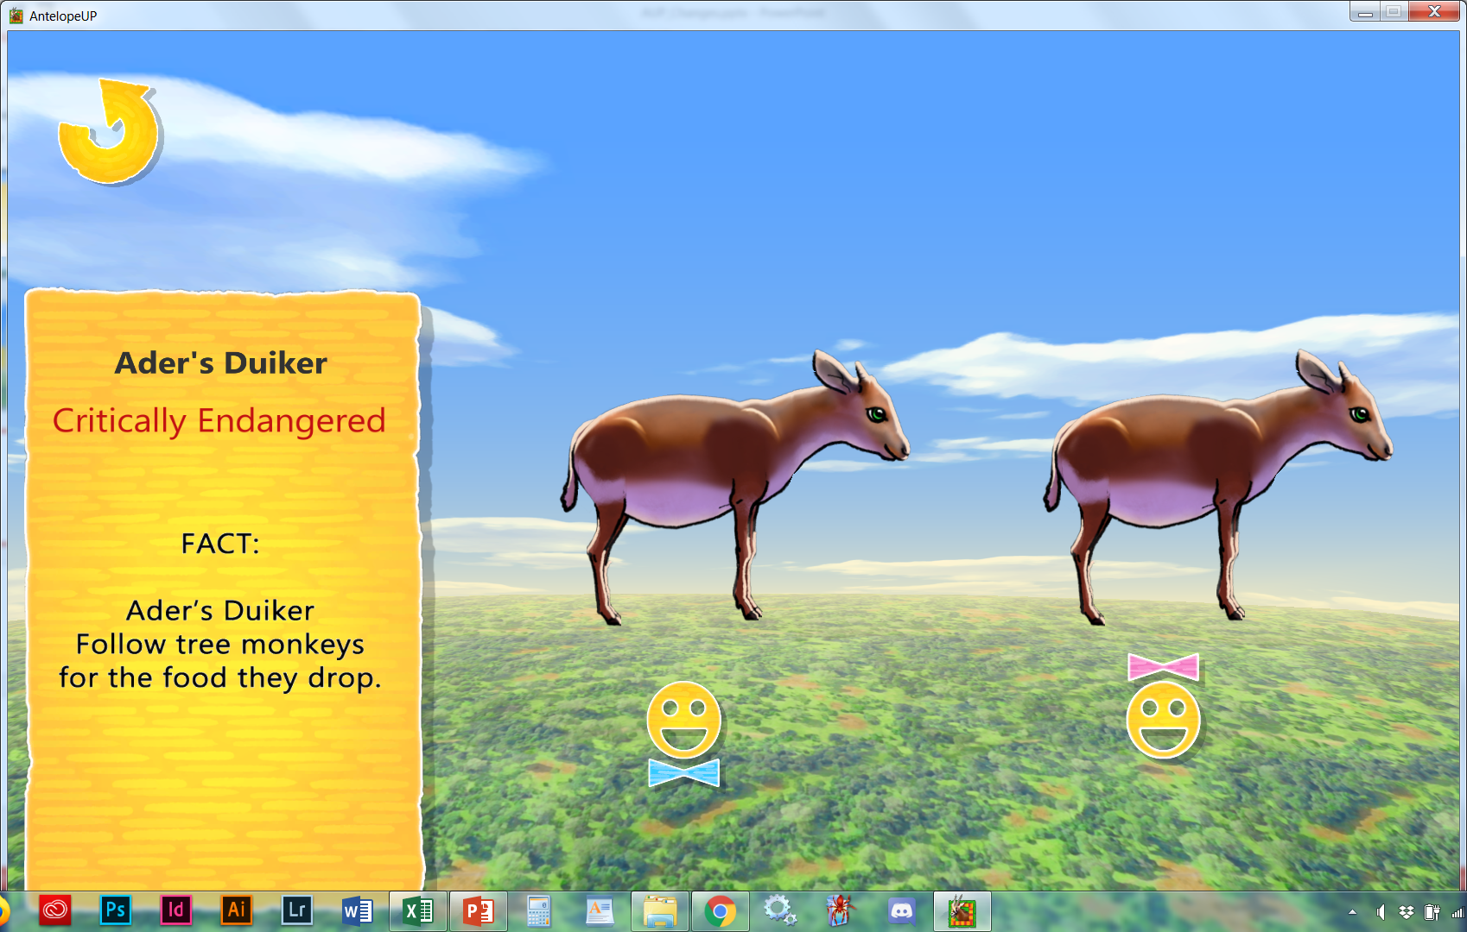
2
Need to lower the music when the names are activated
Vunerable
(VU)
These little slinkers follow tree monkeys around, eating what they drop.
Omnivore
Add pic Insect (ant), frog/lizard, birds
Family: Bovidea
Genus: Cephalophus
Species: C. adersi

Slide 9
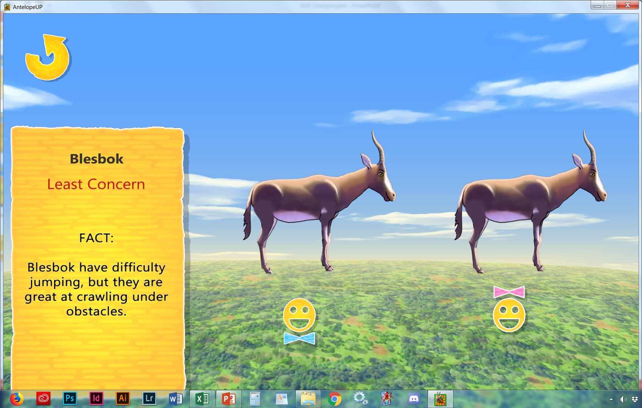
3
Need to lower the music when the names are activated
Size 85 to 100 cm (34 to 40 in.)
Weight Male: 65 to 80 kg (143 to 176 lbs.)
Female: 55 to 70 kg (121 to 154 lbs.)
Make smaller
(LC)
The common name derives from Afrikaans words for blazed antelope
Herbivore
Family: Bovidea
Genus: Damaliscus
Species: D. pygargus
Get David to record Genus Damaliscus and Blesbok

Slide 10
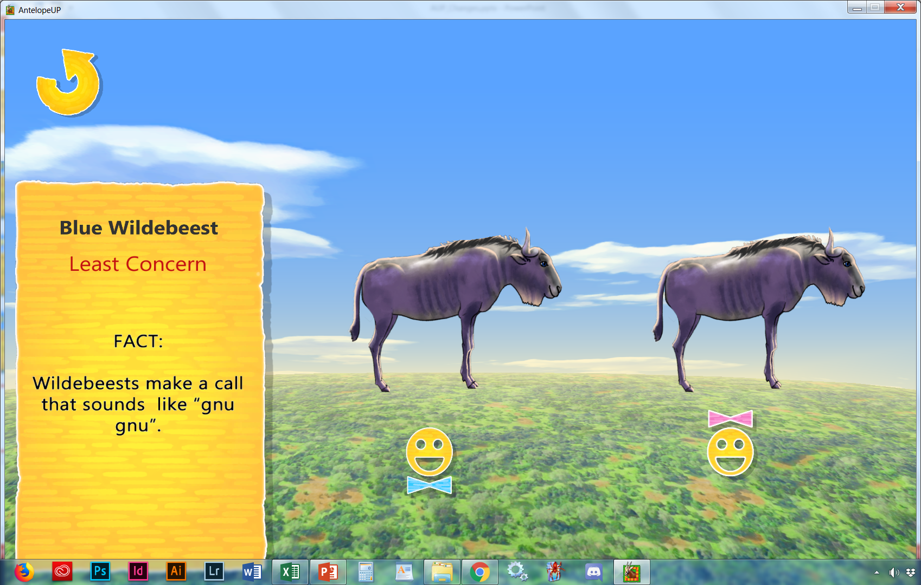
4
Need to lower the music when the names are activated
Description
This subspecies of wildebeest has a white beard, unlike most other subspecies which have black beards; both sexes have smooth, cowlike horns.
Size
Male: 1.25 to 1.45 m (50 to 58 in.) at the shoulder
Female: 1.15 to 1.42 m (46 to 57 in.) at the shoulder
Weight
Male: 165 to 274 kg (360 to 600 lbs.)
Female: 140 to 230 kg (308 to 510 lbs.)
Make smaller
(LC)
These migrating
wildebeest make a sound like Gnu Gnu
Herbivore
Family: Bovidea
Genus: Connochaetes
Species: C. taurinus
Get David to record Genus Connochaetes and Blue Wildebeest

Slide 11
4
Need to lower the music when the names are activated
Description
This subspecies of wildebeest has a white beard, unlike most other subspecies which have black beards; both sexes have smooth, cowlike horns.
Size
Male: 1.25 to 1.45 m (50 to 58 in.) at the shoulder
Female: 1.15 to 1.42 m (46 to 57 in.) at the shoulder
Weight
Male: 165 to 274 kg (360 to 600 lbs.)
Female: 140 to 230 kg (308 to 510 lbs.)
Make smaller
(LC)
These migrating
wildebeest make a sound like Gnu Gnu
Herbivore
Family: Bovidea
Genus: Connochaetes
Species: C. taurinus
Get David to record Genus Connochaetes and Blue Wildebeest

Slide 12
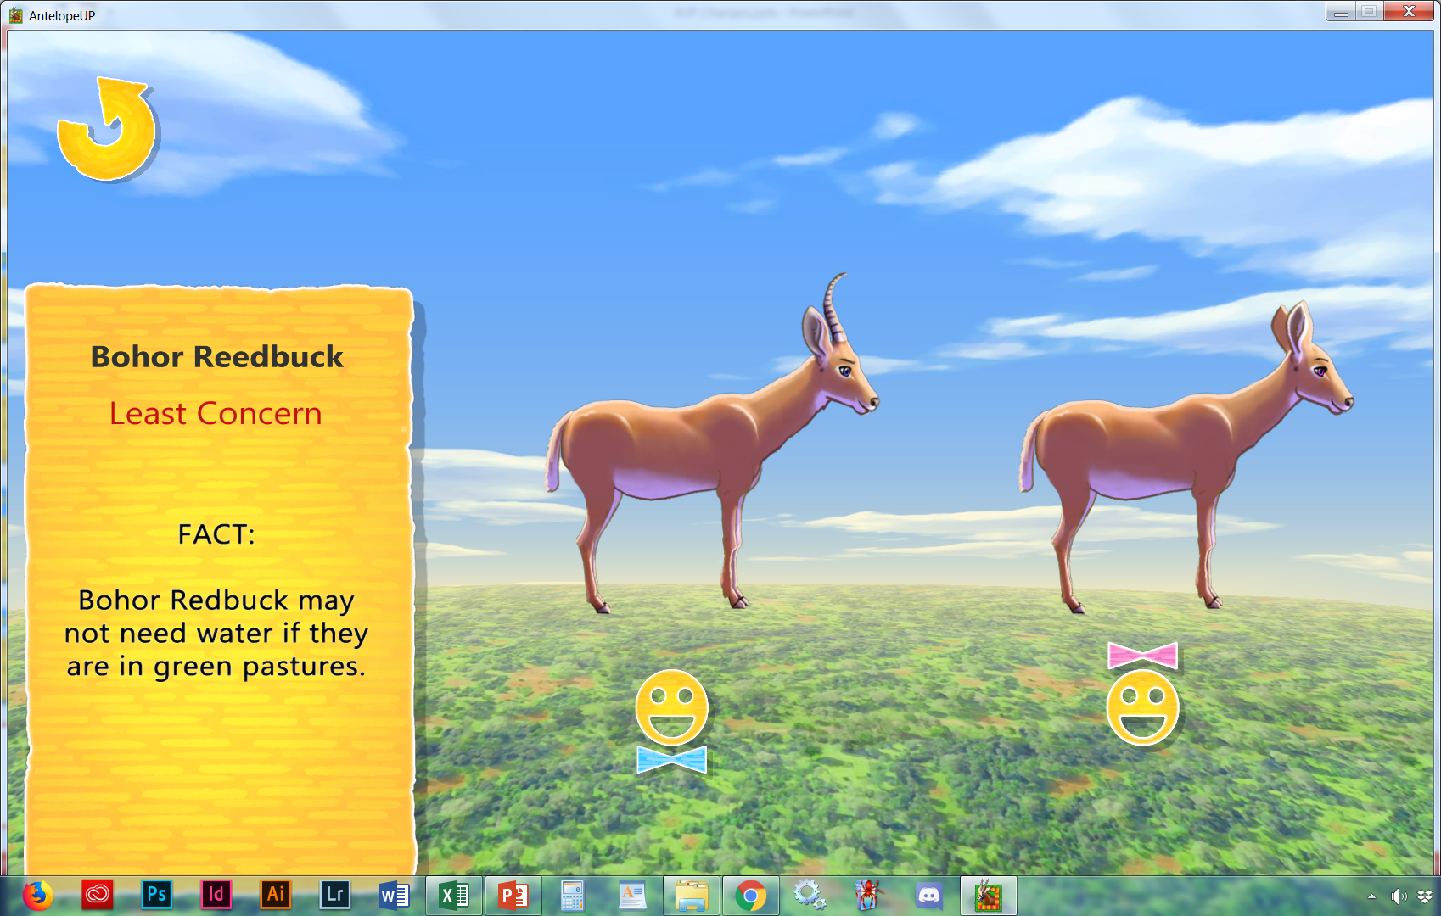
5
Need to lower the music when the names are activated
Males reach approximately 75–89 cm (30–35 in) at the shoulder, while females reach 69–76 cm (27–30 in). Males typically weigh 43–65 kg (95–143 lb) and females 35–45 kg (77–99 lb). Only the males possess horns which measure about 25–35 cm (9.8–13.8 in) long.
Make smaller
(LC)
These antelope mark
their boundary
with a shrill whistle
Herbivore
Family: Bovidea
Genus: Redunca
Species: R. redunca

Slide 13
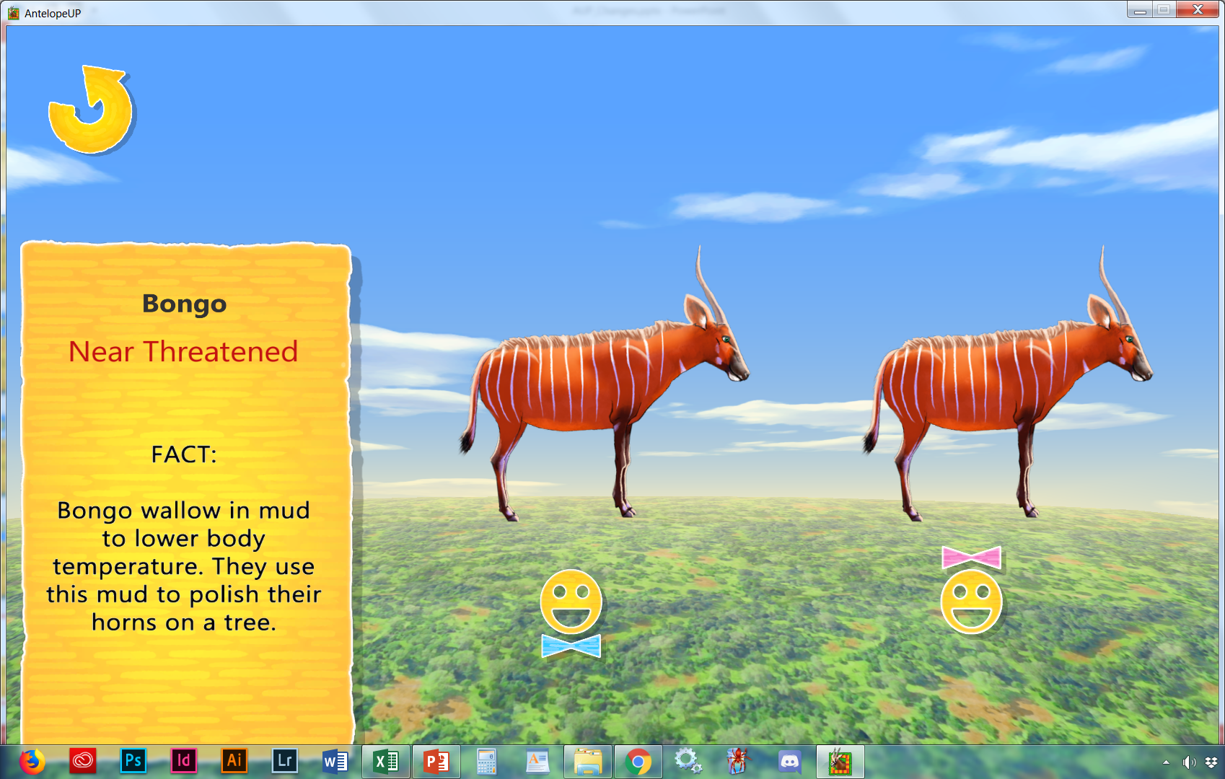
6
Need to lower the music when the names are activated
Size 110 to 130 cm (44 to 54 in.)
Male: Males slightly larger than females
Weight
Male: 240 to 405 kg (528 to 891 lbs.)
Female: 210 to 253 kg (462 to 557 lbs.)
Make smaller
(NT)
Herbivore
Family: Bovidea
Genus: Tragelaphus
Species: T. eurycerus

Slide 14
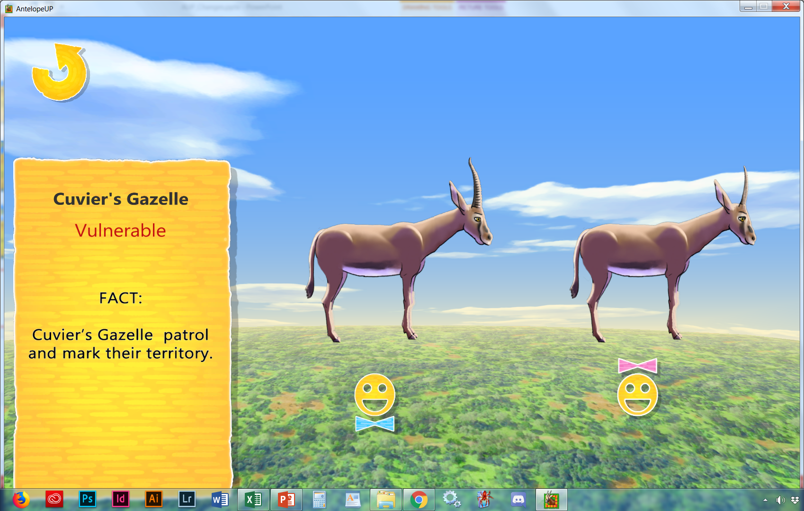
7
The Cuvier's gazelle is one of the darkest and smallest of the gazelle species, standing 60–69 cm (1.97–2.26 ft) tall, with an average weight of 35 kg (77 lb). It is characterized by a distinctive wide, dark band that runs along the sides of the animal, which separates the brown dorsal parts from the white ventral parts. While both sexes have horns between 10 and 15 cm (3.9 and 5.9 in) long, the males' are more ribbed and have greater mass. Also they possess long, slender ears.[3]
Need to lower the music when the names are activated
Make smaller
(VU)
Cuvier's gazelles are found in the Atlas Mountain in North Africa
Herbivore
Family: Bovidea
Genus: Gazella
Species: G. cuvieri

Slide 15
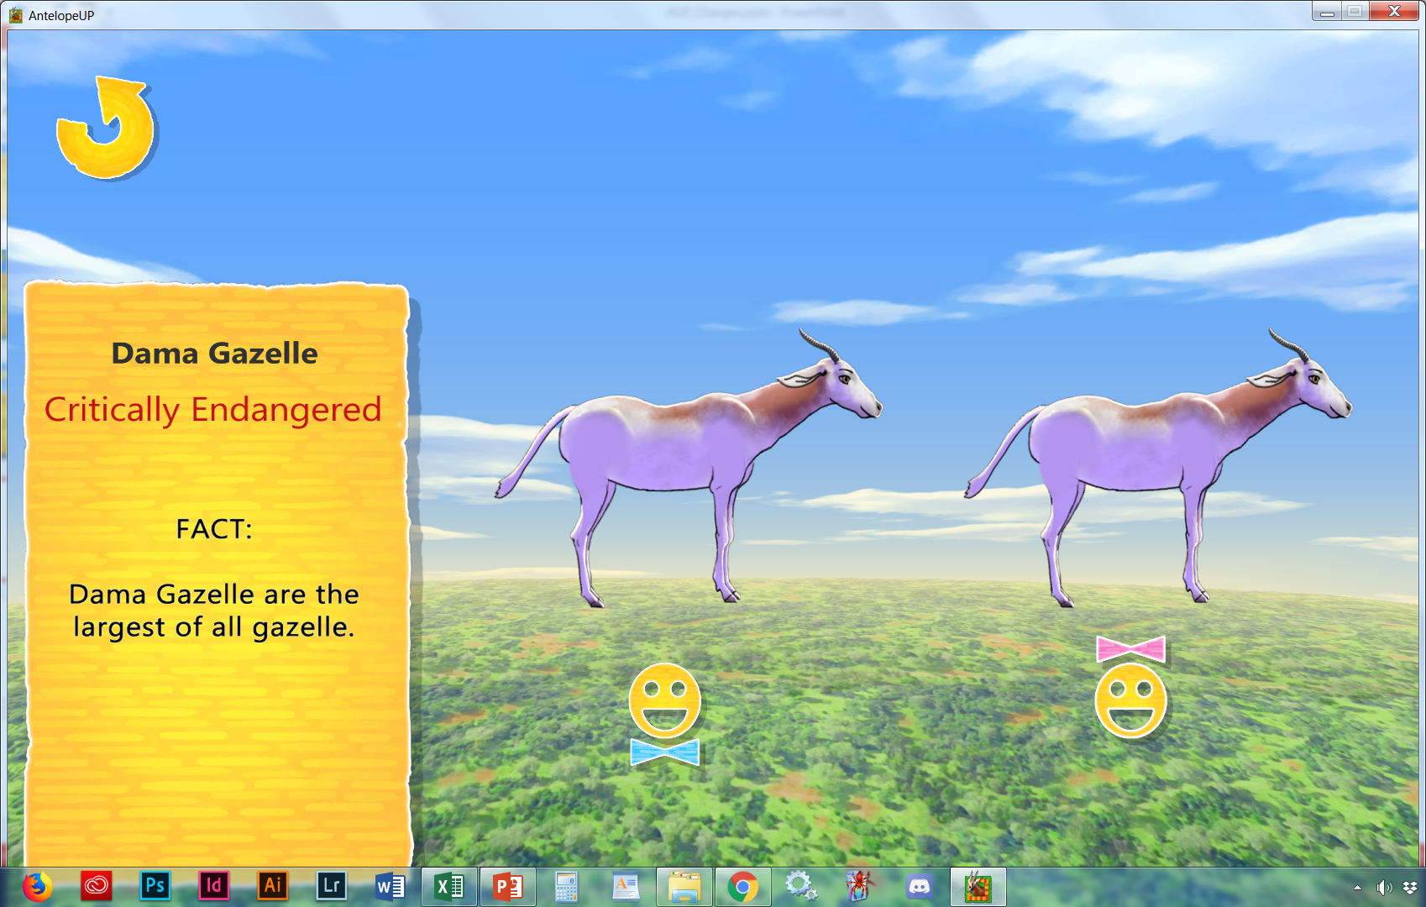
8
Both sexes usually have medium-length ringed horns curved like an "S". Males' horns are about 35 cm (14 in) long, while females' horns are much shorter.
Make horns shorter
(CR)
The largest gazelle is known hopping up and down, called pronking, to warn of danger.
Herbivore
Family: Bovidea
Genus: Nanger
Species: N. dama

Slide 16
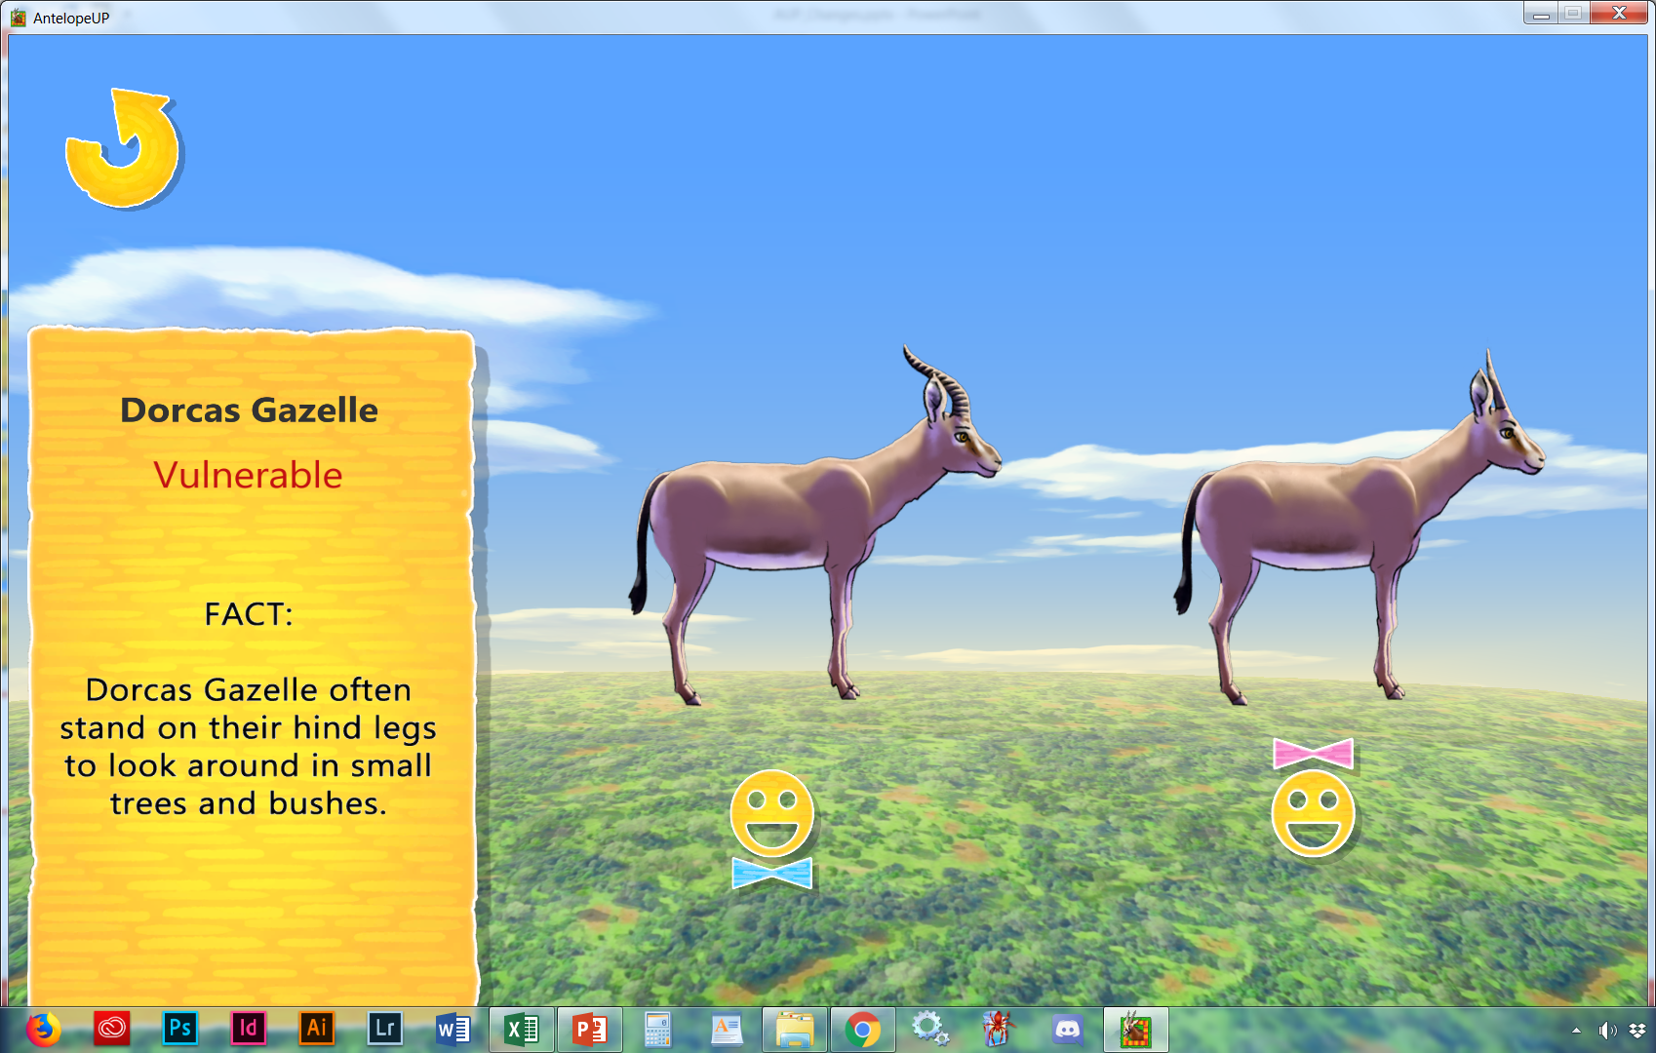
9
Need to lower the music when the names are activated
(VU)
The smallest gazelle can go their entire lives without drinking
Herbivore
Family: Bovidea
Genus: Gazella
Species: G. dorca

Slide 17
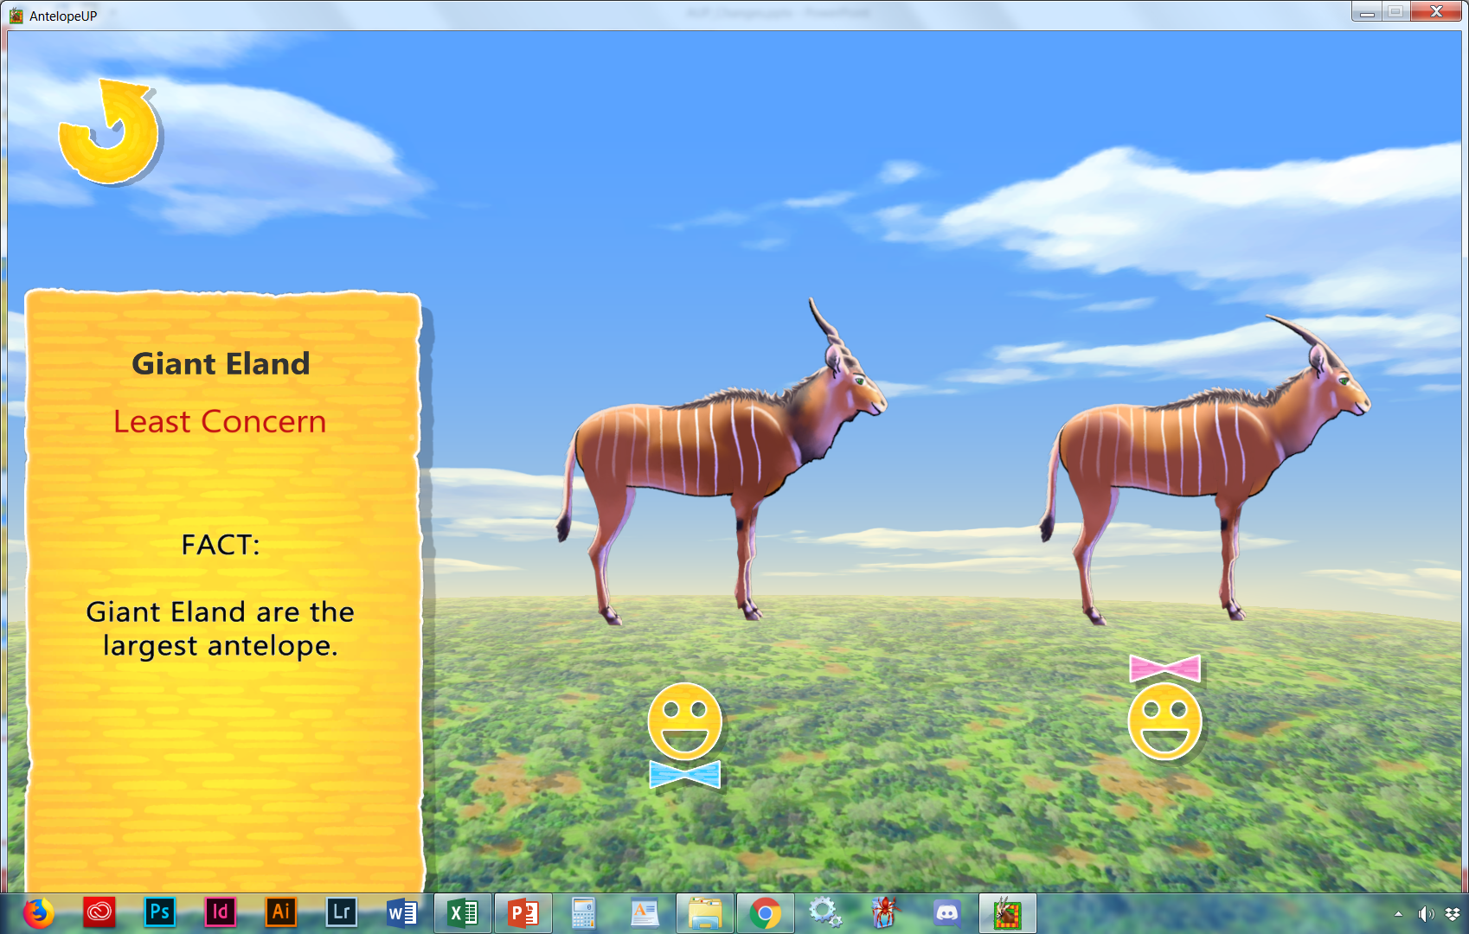
10
Need to lower the music when the names are activated
Giant elands exhibit sexual dimorphism, as males are larger than females.
The males weigh 400 to 1,000 kg (880 to 2,200 lb) and females weigh 300 to 600 kg (660 to 1,320 lb)
Make smaller
(VU)
The largest of antelope like to eat fruit,
such as plums.
Herbivore
Family: Bovidea
Genus: Taurotragus
Species: T. derbianus

Slide 18
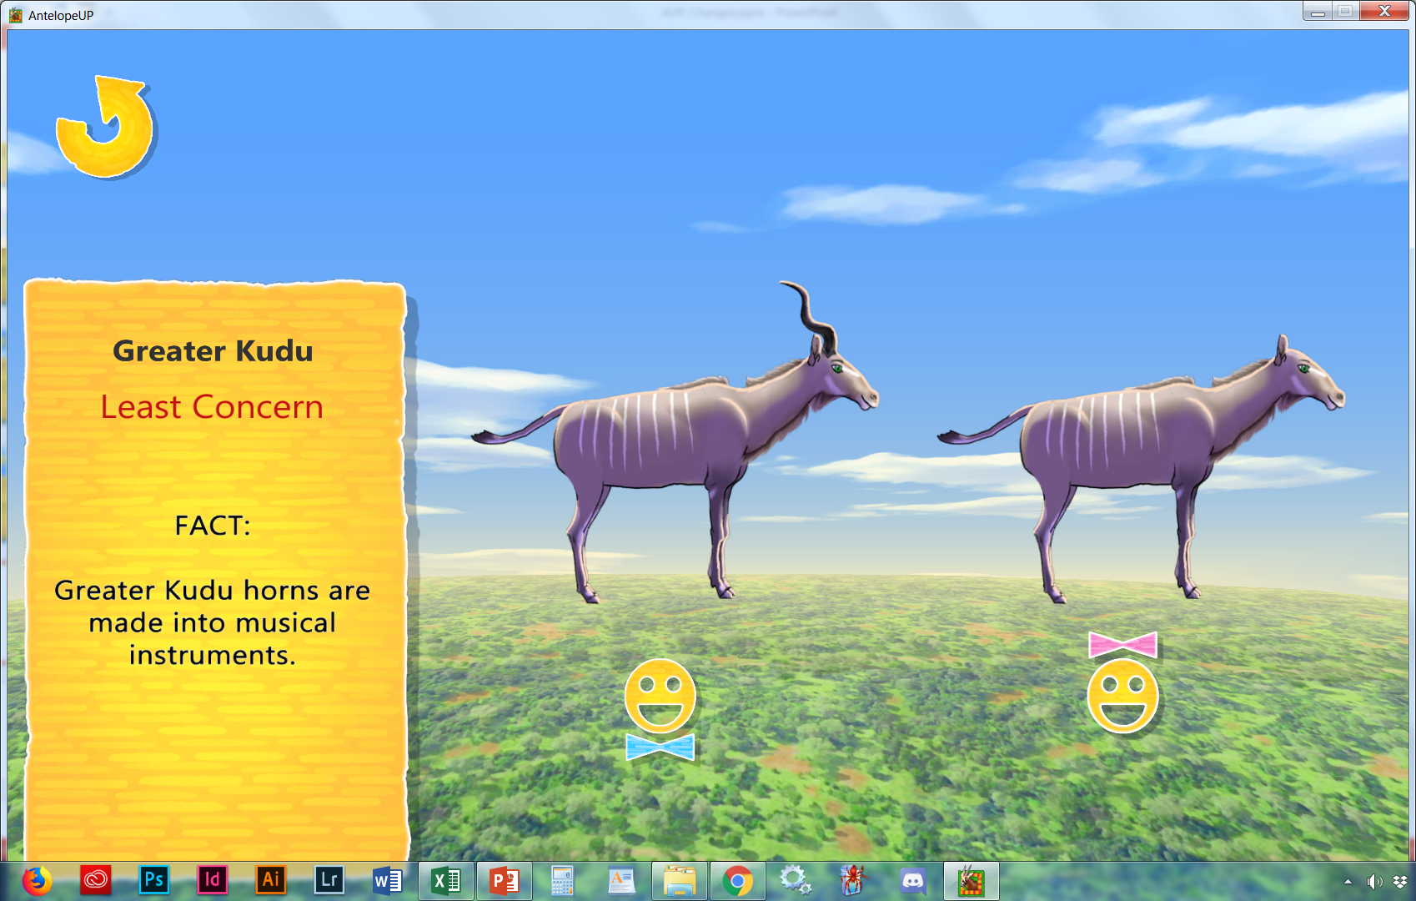
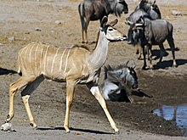
11
Need to lower the music when the names are activated
Bulls weigh 190–270 kg (420–600 lb), with a maximum of 315 kg (694 lb), and stand up to 160 cm (63 in) tall at the shoulder. The ears of the greater kudu are large and round.
Cows weigh 120–210 kg (260–460 lb) and stand as little as 100 cm (39 in) tall at the shoulder; they are hornless, without a beard or nose markings. The head-and-body length is 185–245 cm (6.07–8.04 ft), to which the tail may add a further 30–55 cm (12–22 in)
Make smaller – lose throat mane
(LC)
Herbivore
Family: Bovidea
Genus: Tragelaphus
Species: T. strepsiceros

Slide 19
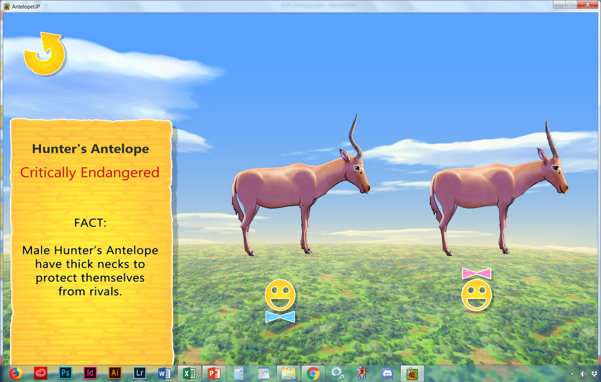
12
Need to lower the music when the names are activated
(CR)
Less the 500 left in the wild and 0 in captivity, extinction looms.
Herbivore
Family: Bovidea
Genus: Beatragus
Species: B. hunteri
Get David to record Genus Beatragus and Hunter’s Antelope

Slide 20
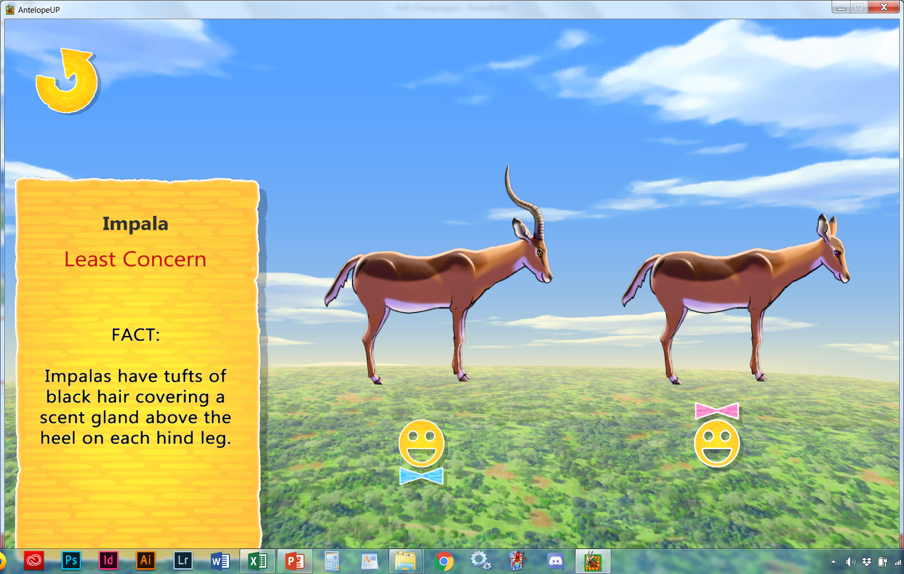
13
Need to lower the music when the names are activated
Male: Only the males have horns
Male: 58 to 70 cm (23 to 28 in.)
Female: 58 tp 64 cm (23 to 25 in.)WeightMale: 45.5 to 79.5 kg (100 to 175 lbs.)
Female: Smaller and lighter than males
Make smaller
(LC)
These amazing jumper can span 40 feet and reach 10 feet high.
Herbivore
Family: Bovidea
Genus: Aepyceros
Species: A. melampus

Slide 21
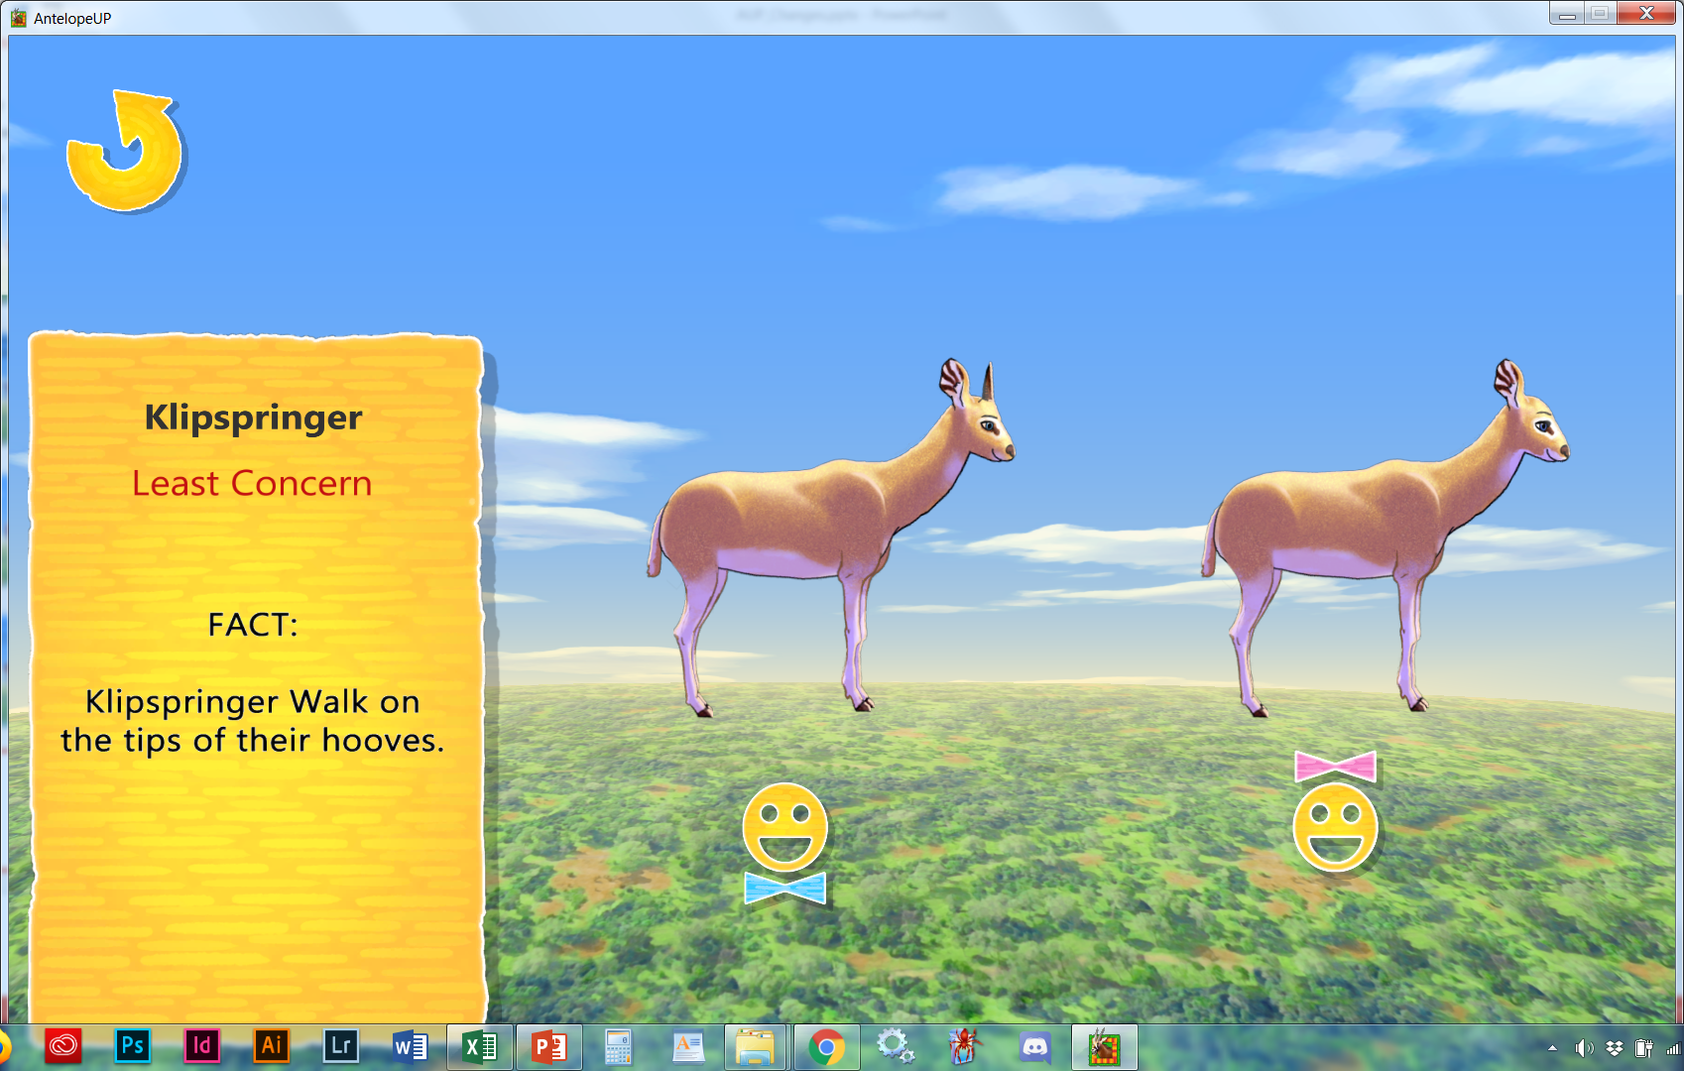
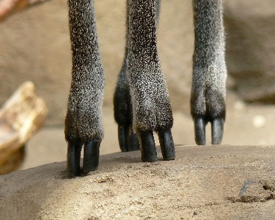
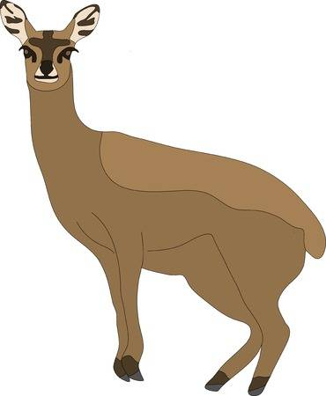
14
Weighing 11-13 Kg and standing 500-600mm high at the shoulders, this is a small and stocky antelope. Ewes are slightly larger than the rams.
Make smaller
(CR)
These rock jumpers
walk on the
tips of their hooves.
Herbivore
Family: Bovidea
Genus: Oreotragus
Species: O. oreotragus

Slide 22
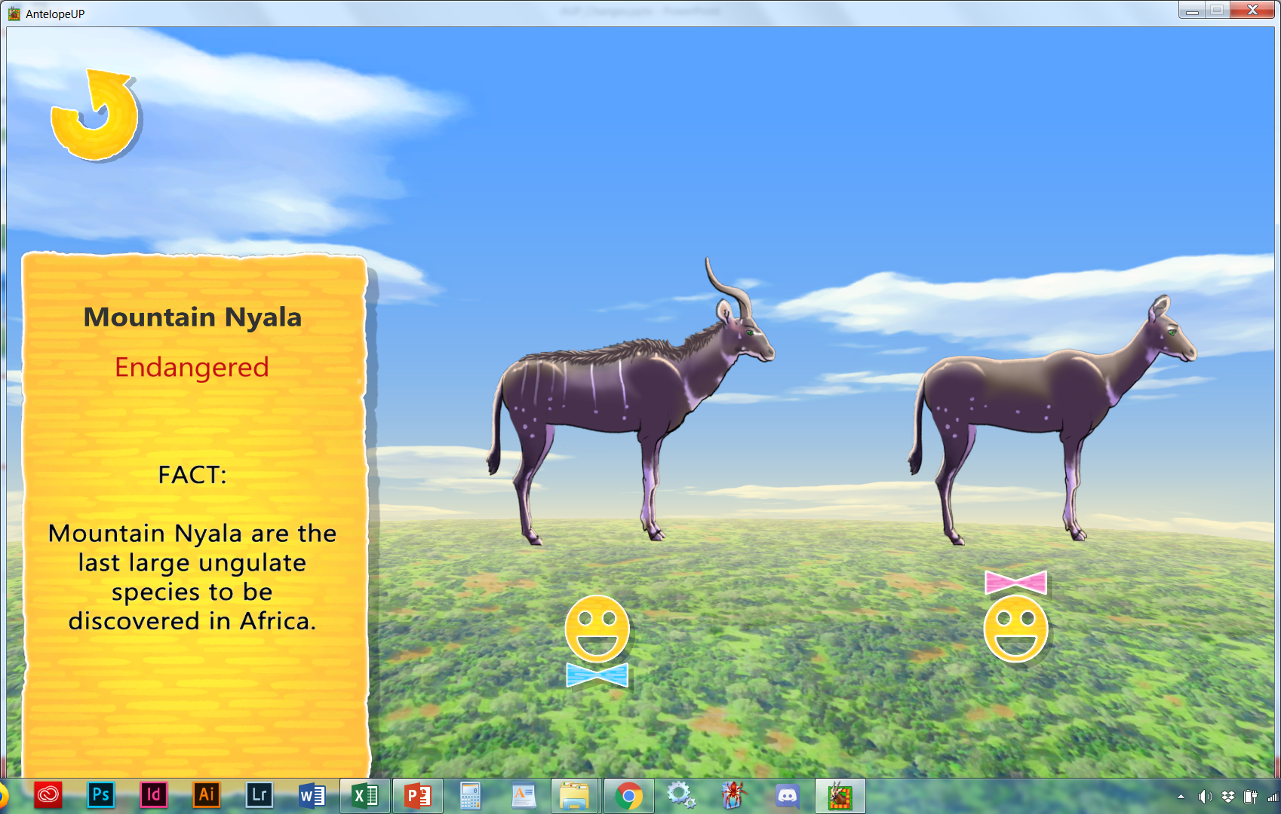
15
Need to lower the music when the names are activated
The mountain nyala is a large sexually dimorphic bovid. The head-and-body length is approximately 240–260 cm (94–102 in) in males and 190–200 cm (75–79 in) in females. The males are typically 120–135 cm (47–53 in) tall while females stand 90–100 cm (35–39 in) at the shoulder. Males weigh 180–300 kg (400–660 lb) and females weigh 150–200 kg (330–440 lb). The bushy tail reaches the heel, and is 20–25 cm (7.9–9.8 in) long.[12] The sensitive ears are large and lined with white hair.[5]
Make smaller
(EN)
Found only in the Ethiopian highlands, east of the Rift Valley.
Herbivore
Family: Bovidea
Genus: Tragelaphus
Species: T. buxtoni

Slide 23
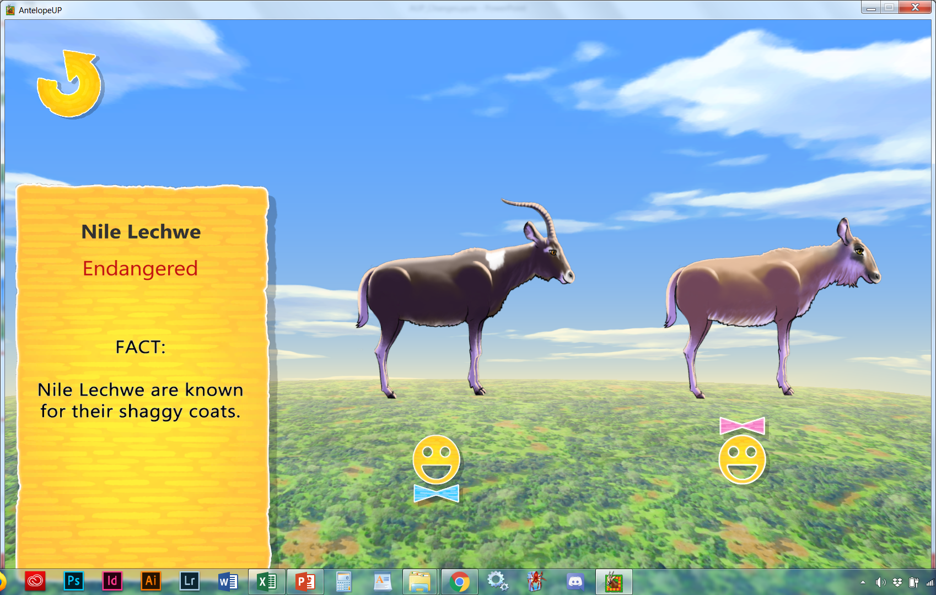
16
Need to lower the music when the names are activated
Length: Females, 4.2 to 5.6 feet; males, 5.2 to 5.9 feet
Height: Females, 2.6 to 2.8 feet; males, 3.2 to 3.4 feet tall at the shoulder
Weight: Females, 132 to 198 pounds; males, 198 to 265 pounds
Make smaller
(EN)
Born the same color, it is the male that changes his markings as he matures.
Herbivore
Family: Bovidea
Genus: Kobus
Species: K. megaceros

Slide 24
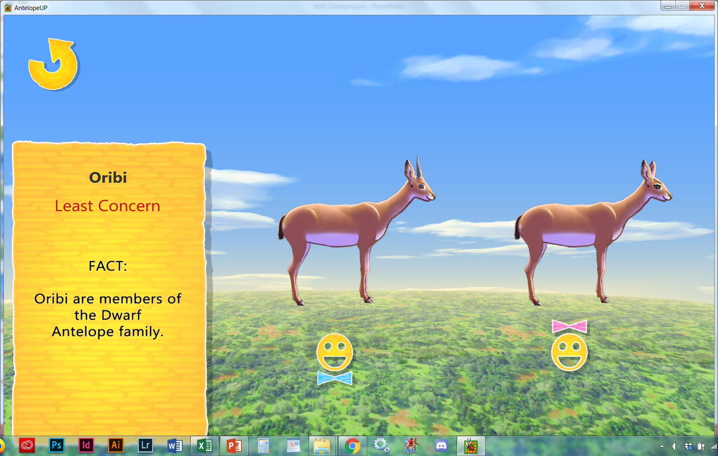
17
Need to lower the music when the names are activated
Adult rams measure 600 mm at the shoulders and weighs 14 kg. Ewes are slightly larger than rams.
(LC)
Make smaller
This dwarf antelope
can be water independent if water is scarce.
Herbivore
Family: Bovidea
Genus: Ourebia
Species: O. ourebi

Slide 25
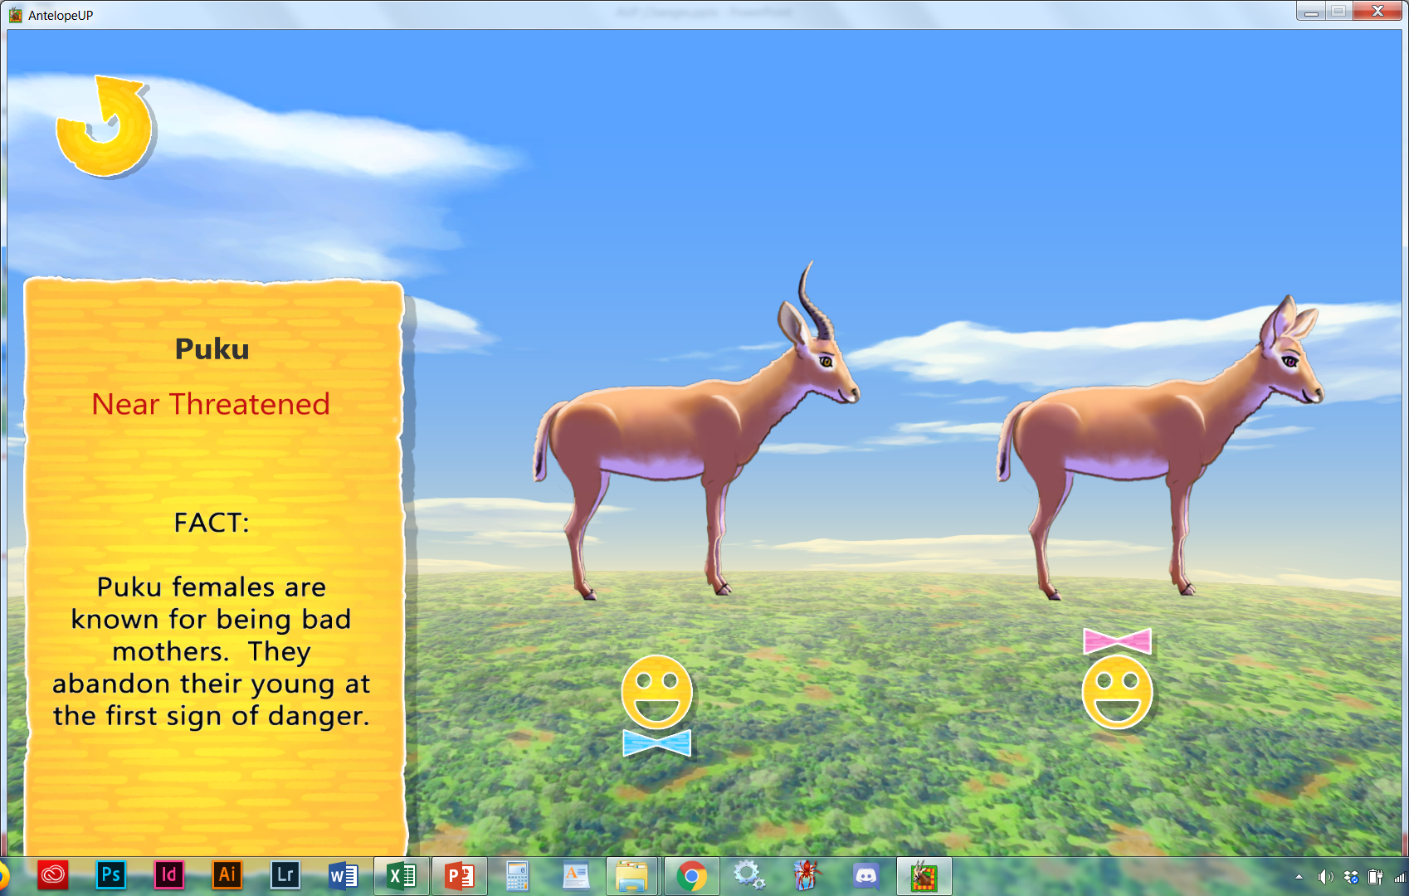
18
Need to lower the music when the names are activated
(NT)
These grass eaters
repeat a shrill whistle
when in danger.
Herbivore
Family: Bovidea
Genus: Kobus
Species: K. vardonii

Slide 26
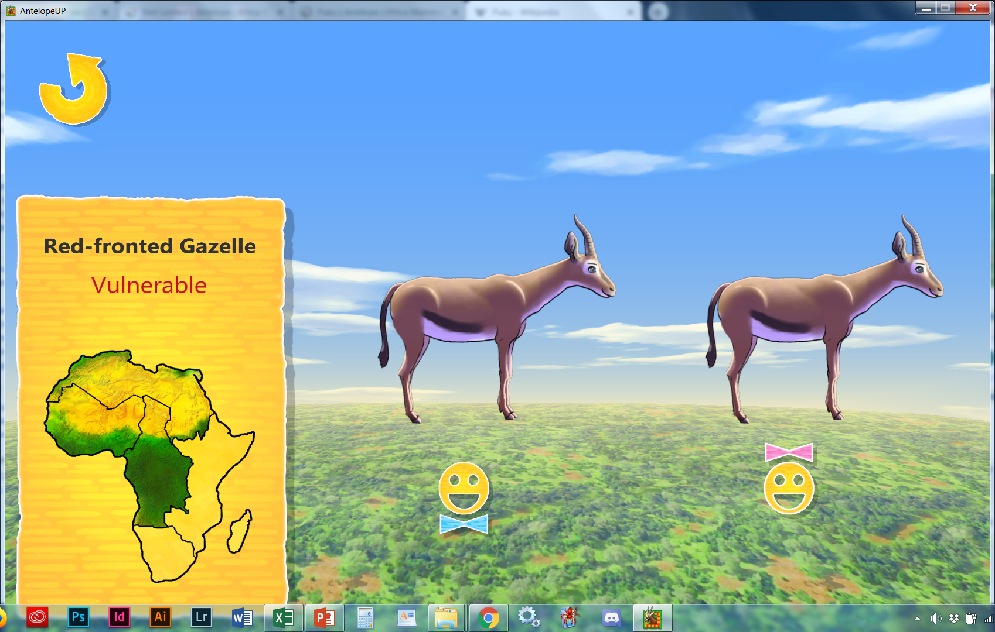
19
Need to lower the music when the names are activated
(VU)
These Sahel dwellers live between the Saraha and the savannah and migrate to find water.
Herbivore
Family: Bovidea
Genus: Eudorcas
Species: E. rufifrons

Slide 27
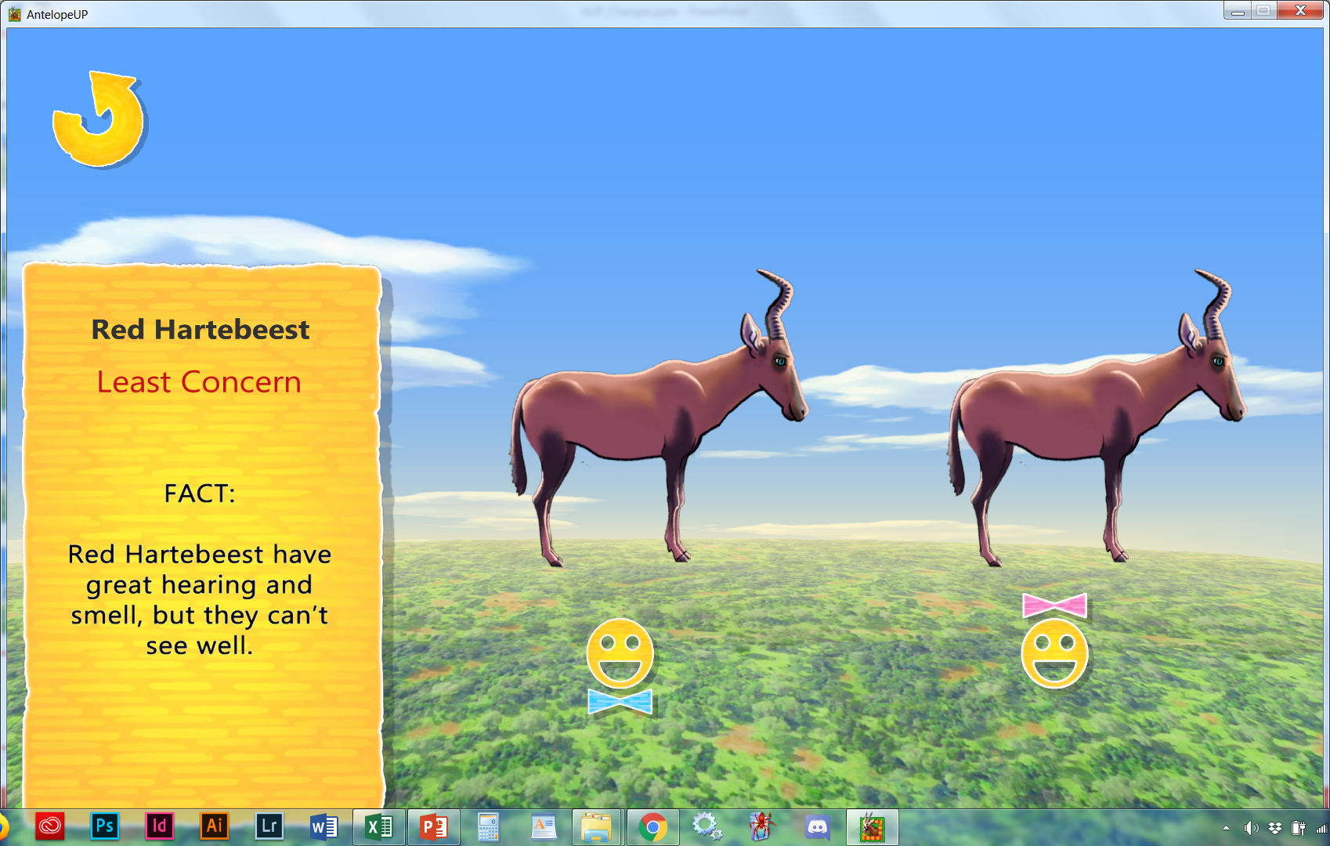
20
Need to lower the music when the names are activated
(LC)
These antelope rely on their sense of smell and good hearing to make up for their poor vision.
Herbivore
Family: Bovidea
Genus: Alcelaphus
Species: A. b. caama
Get David to record Genus Alcelaphus and Red Hartebeest

Slide 28
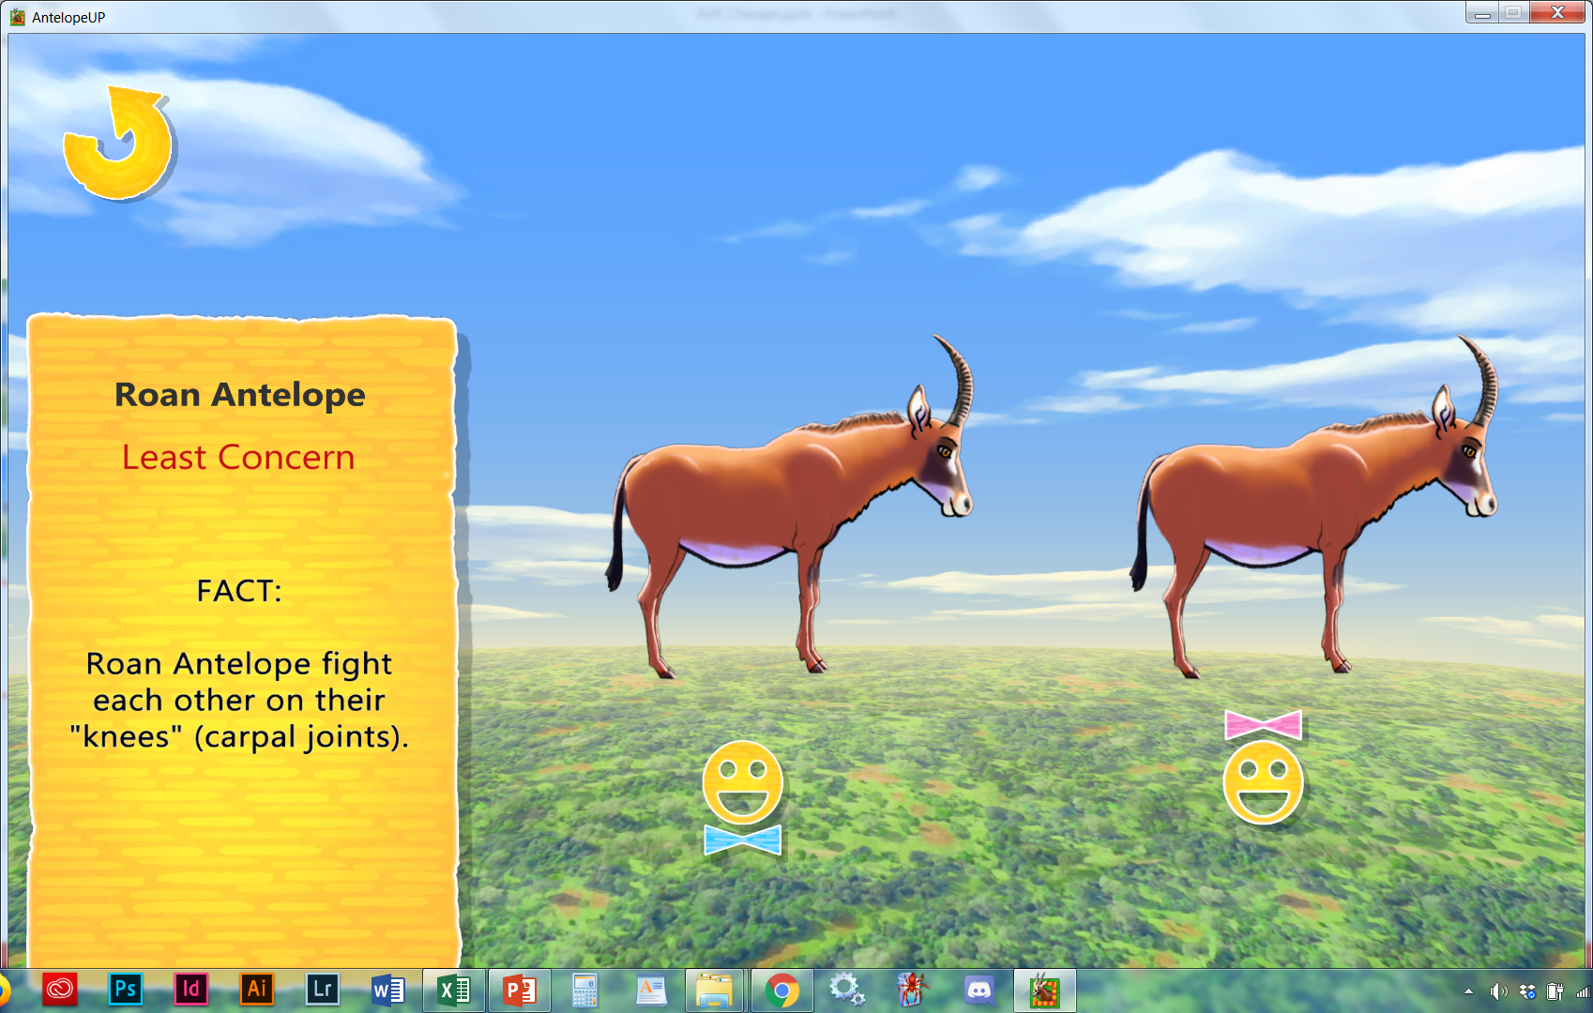
21
Need to lower the music when the names are activated
The sexes look much alike, standing 126–150 cm (50–59 inches), but males are heavier (280 kg [620 pounds] versus 260 kg [570 pounds] for females) and have thicker, sickle-shaped horns 55–99 cm (22–39 inches) long, 10–20 percent longer than those of females
Make horn shorter, slightly body thinner
(LC)
The so-called horse antelopes fight each other on their “knees”.
Herbivore
Family: Bovidea
Genus: Hippotragus
Species: H. equinus

Slide 29
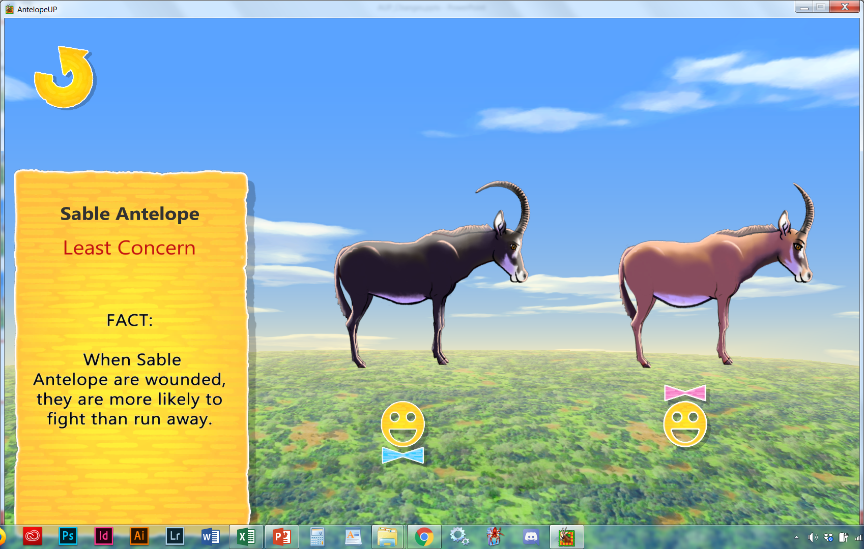
22
Need to lower the music when the names are activated
The sable antelope is sexually dimorphic, with the male heavier and about one-fifth taller than the female.[9] The head-and-body length is typically between 190 and 255 cm (75 and 100 in).[10] Males reach about 117–140 cm (46–55 in) at the shoulder, while females are slightly shorter. Males typically weigh 235 kg (518 lb) and females 220 kg (490 lb).[11]
(LC)
Make smaller
These salt licking, bone chewing antelope do it for the minerals.
Herbivore
Family: Bovidea
Genus: Hippotragus
Species: H. niger

Slide 30
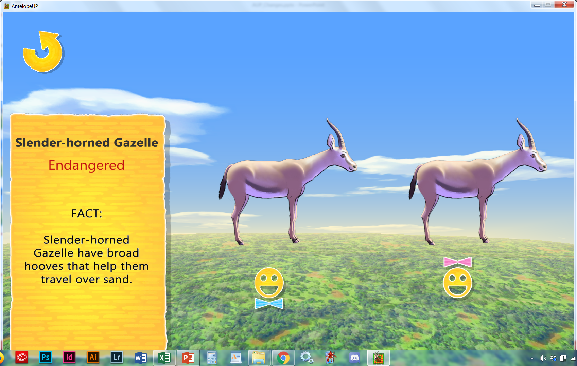
23
Need to lower the music when the names are activated
(EN)
These desert loving species
have flat hooves to
walk on sand.
Herbivore
Family: Bovidea
Genus: Gazella
Species: G. leptoceros

Slide 31
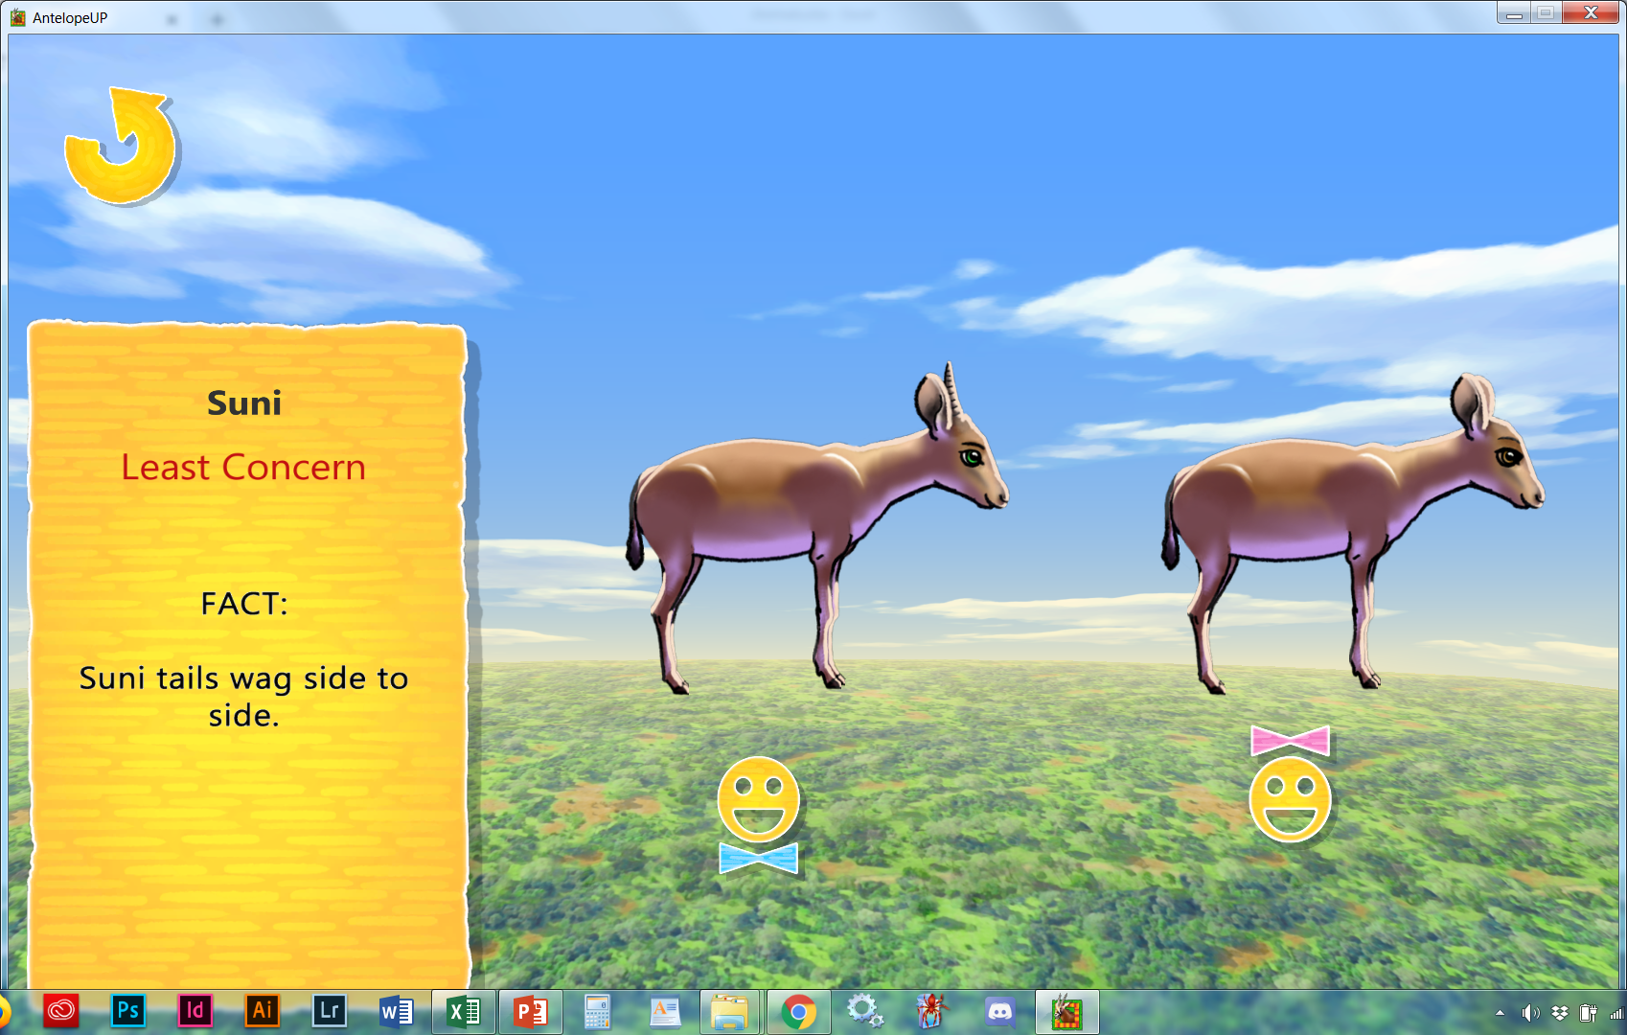
24
Need to lower the music when the names are activated
(LC)
These tiny antelope have a BIG smell due to a gland located on their heads.
Herbivore
Family: Bovidea
Genus: Neotragus
Species: N. moschatus

Slide 32
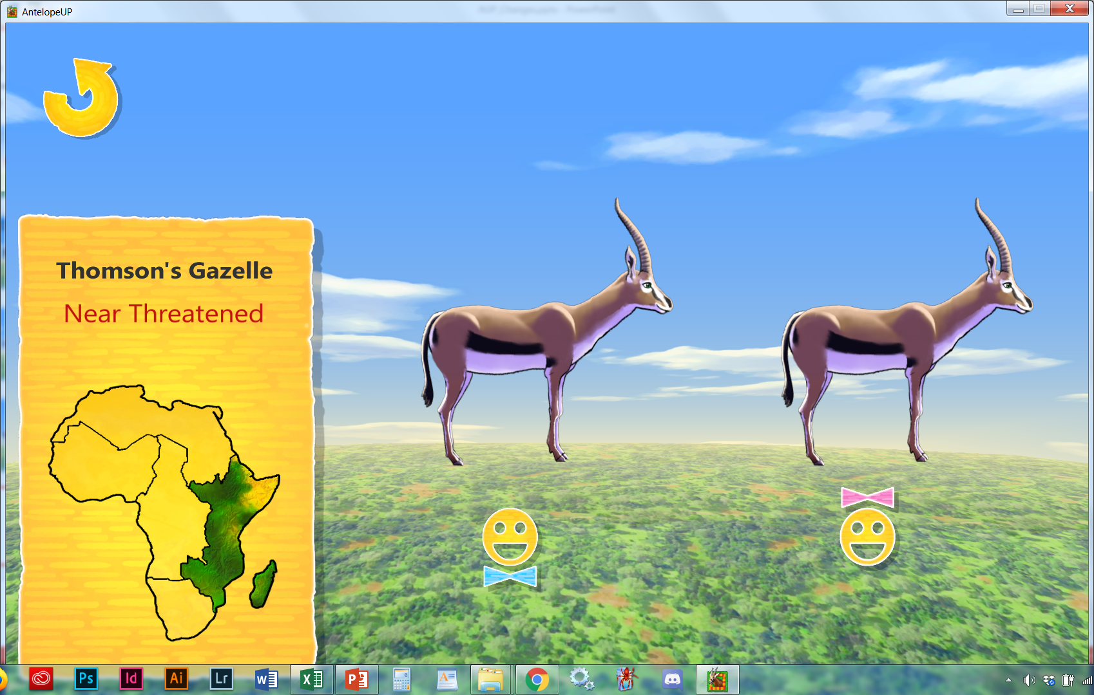
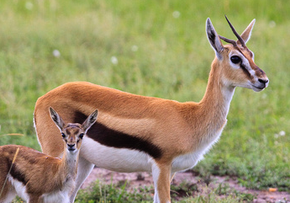
25
Male: Males have ridged horns.
Female: Females have short and more often broken or deformed horns.
Make horns
smaller
Can we get the tails to swing sideways?
Least Concern
(LC)
Tommies swing their tails from side to side, like a windshield wiper.
Herbivore
Family: Bovidea
Genus: Eudorcas
Species: E. thomsonii

Slide 33
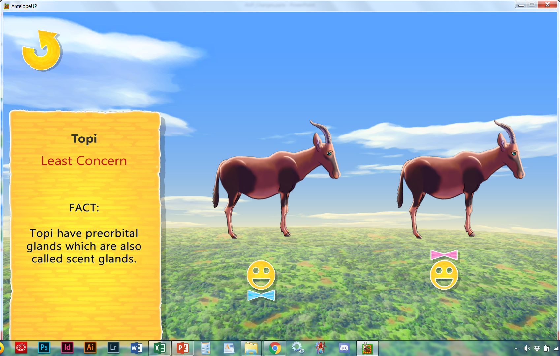
26
Need to lower the music when the names are activated
They are a tall species, ranging in height from 100 to 130 cm (39 to 51 in) at the shoulder.[5][6] Males tend to be larger and darker than females.
(LC)
Make smaller, lighter?
These mud rolling antelope rub their heads on the ground to spread their scent from their facial glands.
Herbivore
Family: Bovidea
Genus: Damaliscus
Species: D. lunatus
Get David to record Topi

Slide 34
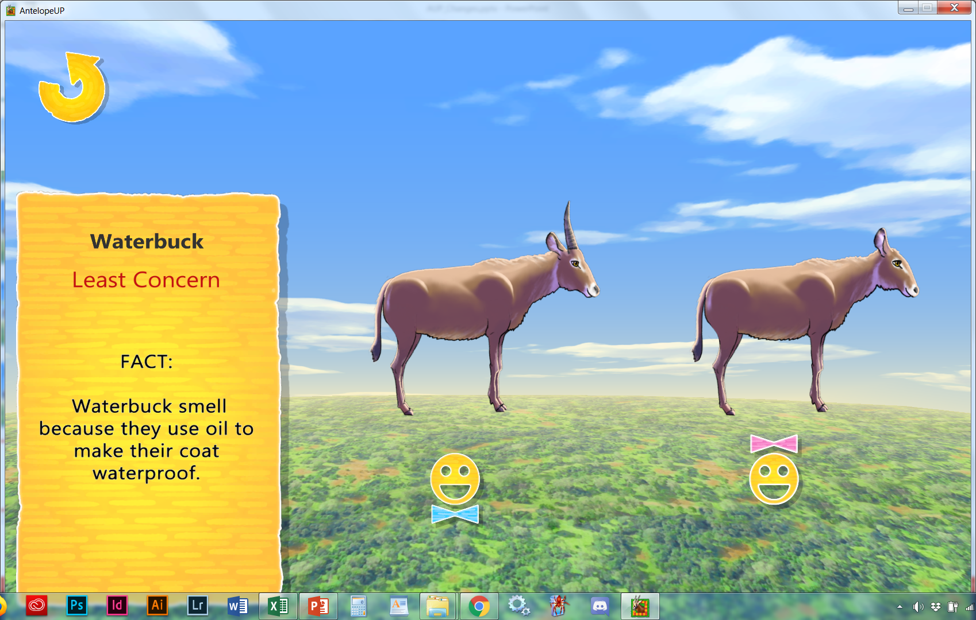
27
Need to lower the music when the names are activated
males are generally about 25 percent larger than the females.
(LC)
Make smaller
Waterproofing the coats with oil from glands leave them a bit smelly.
Herbivore
Family: Bovidea
Genus: Kobus
Species: K. ellipsiprymnus

Slide 35
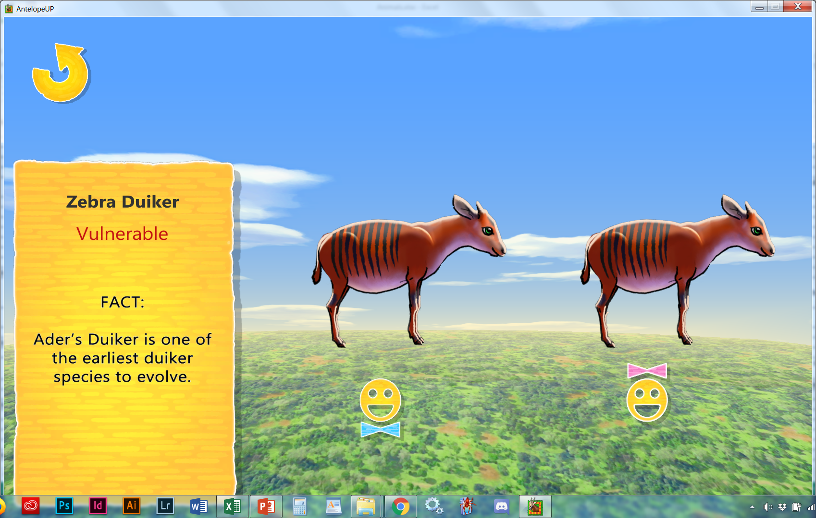
28
Need to lower the music when the names are activated
Their horns are short and round with sharp pointed tips. They are about 4.5 - 5.0 cm long in males, and half that in females. Female body size is larger than males, possibly due to long gestation periods.
Make horns shorter and body larger
(VU)
Duikers have large, complex brain and can be considered the smartest of the bovids.
Omnivore
Add pic Insect (ant), frog/lizard, birds
Family: Bovidea
Genus: Cephalophus
Species: C. zebra

