Slide 1
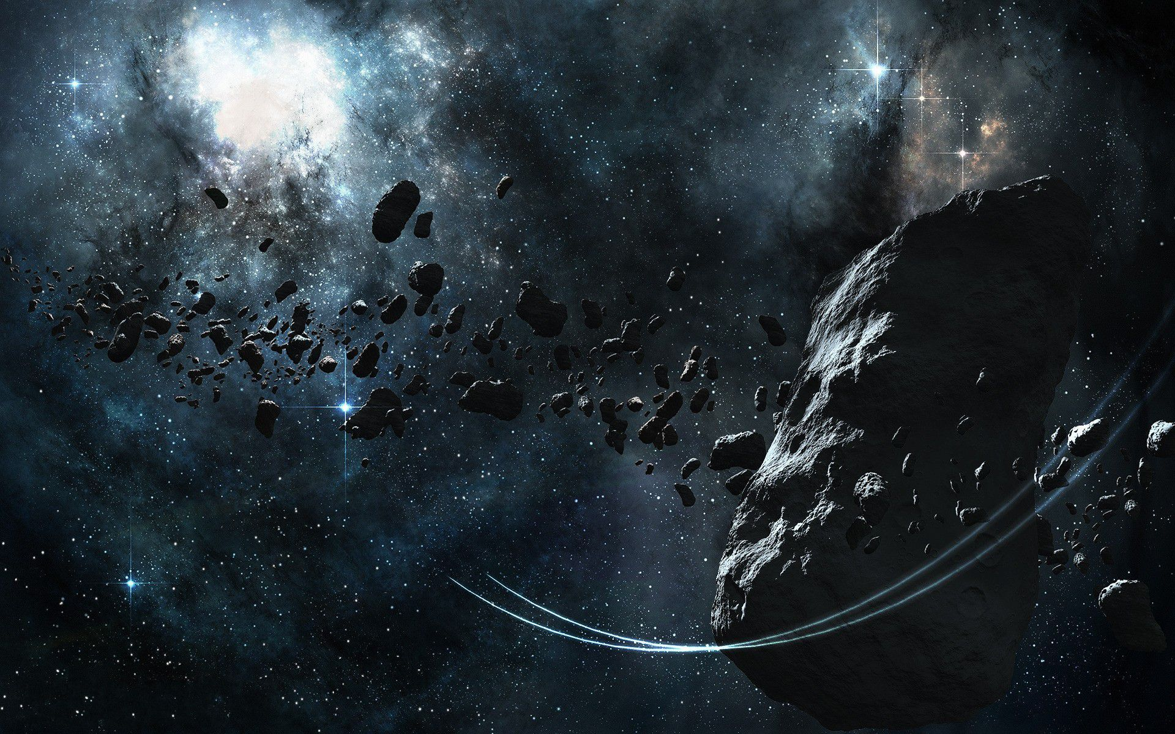
Mining Battle
Alexandre Sachs Charles Descoust Damien Cosson Kellian Cipierre

Slide 2



Project description

Slide 3
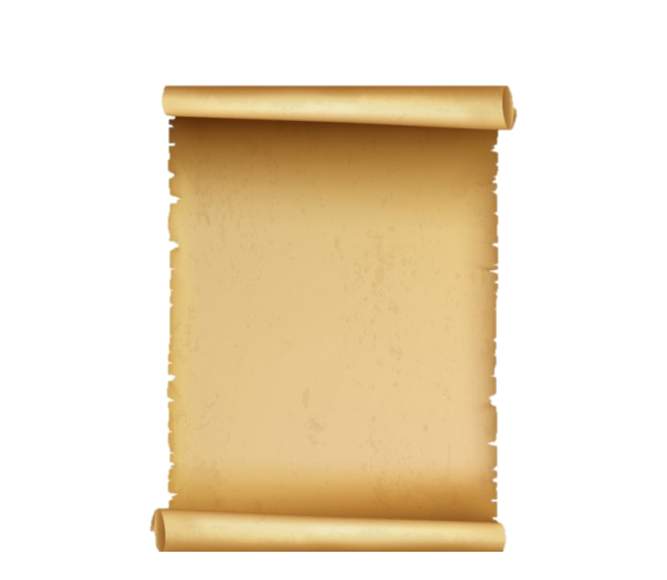
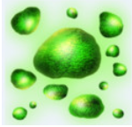
Story
Daegunium

Slide 4
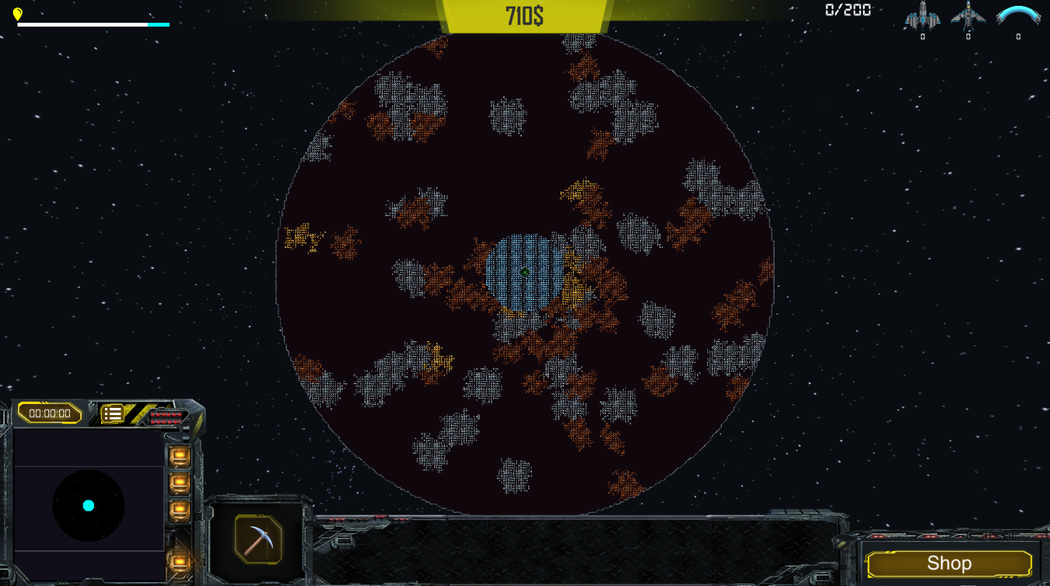
World

Slide 5
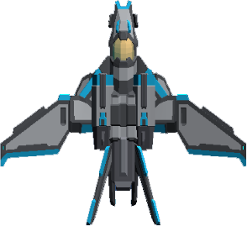
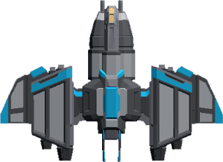
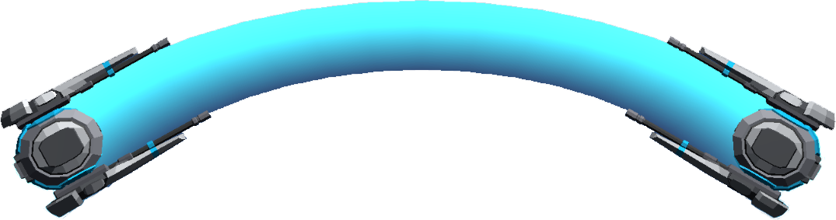



Spaceships

Slide 6
Unique Selling Points
RTS meets mining game !
Find the perfect balance between mining, attack and defence !
Fast 4X game !
Each type of spaceship has its own role and abilities !

Slide 7
The future of Mining Battle…
Spaceships defined formations
Player’s statistics & Trophies
Spaceships skins
And more…

Slide 8
Technical challenges
Spaceships AI (Flow field)
FOG
Networking
Asteroïd (procedural generation)

Slide 9
Project’s learnings
Better understanding of UNITY
Networking
Importance of testing
Time management

Slide 10
Mining Battle
Join the battle now !
Alexandre Sachs Charles Descoust Damien Cosson Kellian Cipierre

