Slide 1


Missing & None
钱康来
2018.4.21

Slide 2

Missing & None
Debug.Log(t1.name)
Debug.Log(t2.name)

Slide 3
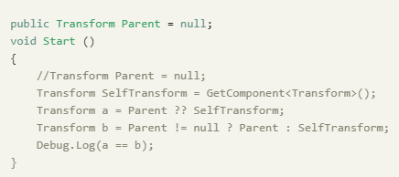
Missing & None
http://qiankanglai.me/2016/10/21/fake-null/
UnityEngine.Object里的迷之null

Slide 4
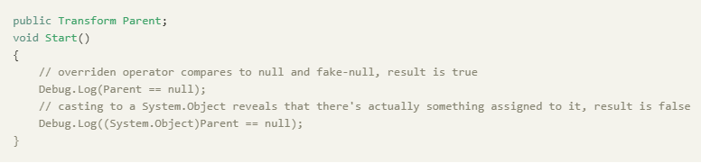
UnityEngine.Object
Editor下有pseudo-null, 从而区分Missing&None
重载了!=和==
没有重载??

Slide 5
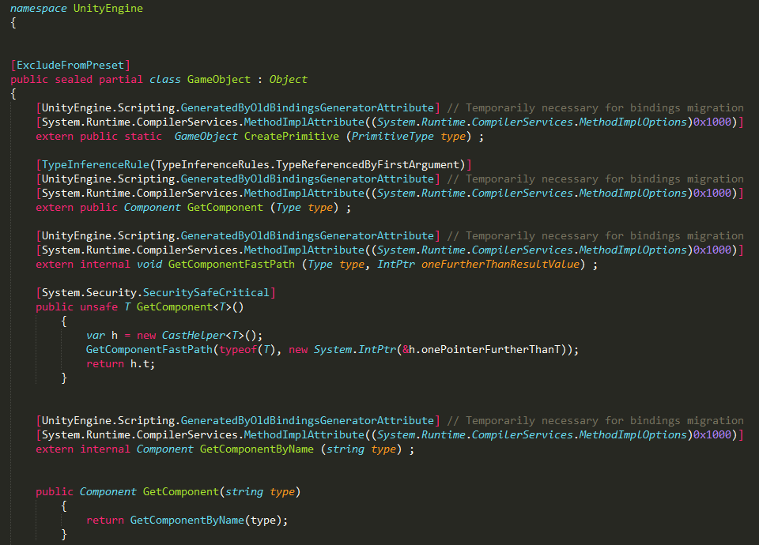
Custom ==
https://blogs.unity3d.com/2014/05/16/custom-operator-should-we-keep-it/
Custom == operator, should we keep it?
编辑器下MonoBehaviour的fields指向了fake-null
触发NullReferenceException时候有更多信息
GameObject的C#部分本质上是一个空壳
Wrapper层
Object.Destroy销毁的是C++层资源
C#层空壳靠GC

Slide 6
资源泄露
private GameObject go;
// 创建
go = Instantiate(xxx);
// 销毁
Destroy(go);
go = null;

Slide 7
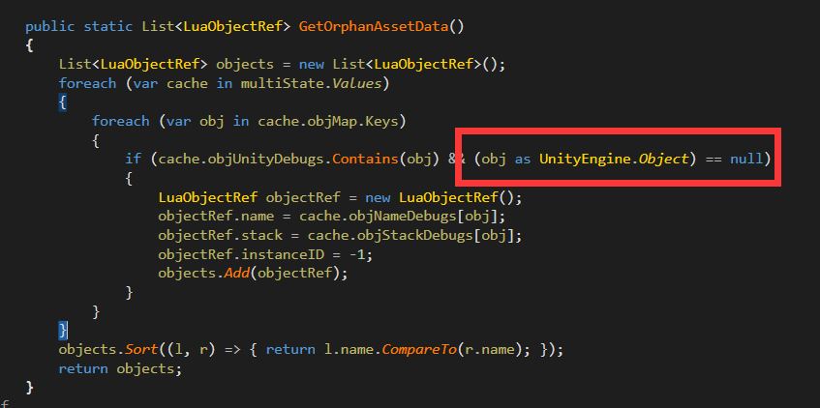
Slua资源泄露
销毁资源之后引用依然存在，导致C#部分无法释放(wrapper层)
相比C#反而好查：
所有引用都存在ObjectCache里
扫一遍Orphan就行了

Slide 8
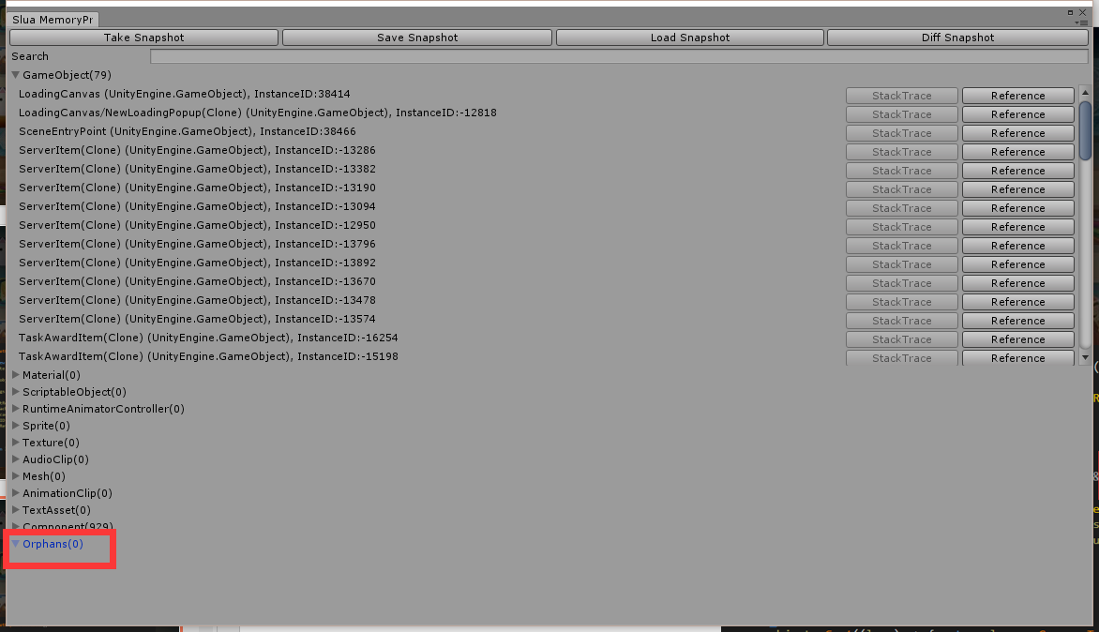

Slide 9
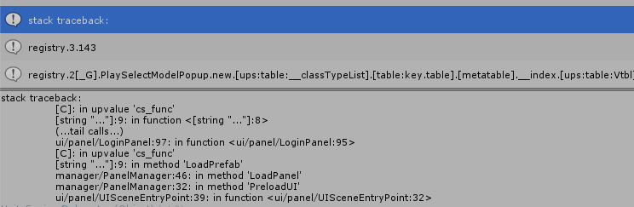
Bonus: Slua反向查找
https://github.com/yaukeywang/LuaMemorySnapshotDump
抓取内存dump之后遍历搜索
加入ObjectCache时调用debug.traceback()保存起来
会拖慢游戏，开关切换

Slide 10
Thanks for listening
Feedback & Discussion

