Slide 1

ORIE 5741 Project Presentation Pair Trading Strategy
Xiyao Fu, Kelvin Jiang, Hengli Zhu

Slide 2
Motivation – Pair Trading
Market-Neutral Strategy
Exploits price inefficiencies between two correlated stocks, allowing for profit regardless of market direction.
Risk Mitigation
Reduces exposure to broad market movements and enhances stability through diversification.
Exploiting Market Inefficiencies
Capitalizes on temporary mispricings caused by varied reactions to market events.

Slide 3
Introduction
Develop a pairs trading strategy using machine learning techniques ​
Applied Principal Component Analysis(PCA) and K-Means clustering algorithm to identify pairs of assets that have a strong cointegration​
Employ the rolling regression with a lookback window and Kalman Filter to estimate the hedging ratio between pairs​
Back-test our model using various modules and P&L metrics to evaluate its performance

Slide 4
Data Collection for finding pairs
The datasets are provided by Wharton Research Data Services (WRDS). We mainly obtained the daily stock files from file from CRSP.
The raw data contains 3000 stocks which are constituents of Russell 3000. we obtain their prices, stock identifiers, sector, volume.
The data collection spans 10 years, from 2014-01-01 to 2023-12-31.
We choose stocks from energy sector and financials sector ( 296 stocks) because stocks in these sectors always move together and may imply higher correlation.

Slide 5
Data Processing
A threshold-based approach to remove rows (stocks) where more than 0.01% of the values were missing.
Missing values: Time-weighted interpolation. Emphasize nearby data points.
Stock returns data: Standardized the return data using the StandardScaler from scikit-learn.

Slide 6
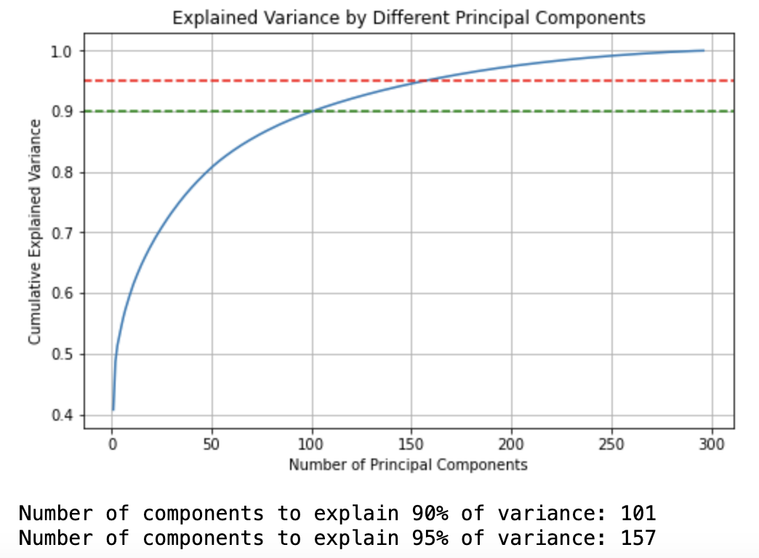
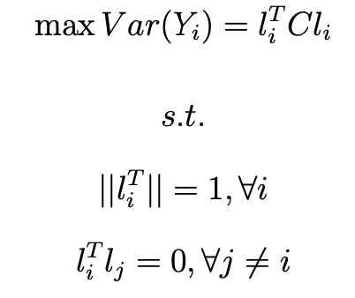
PCA
Principal Component Analysis
Dimensionality reduction. Identify hidden patterns in the data
157 components.

Slide 7
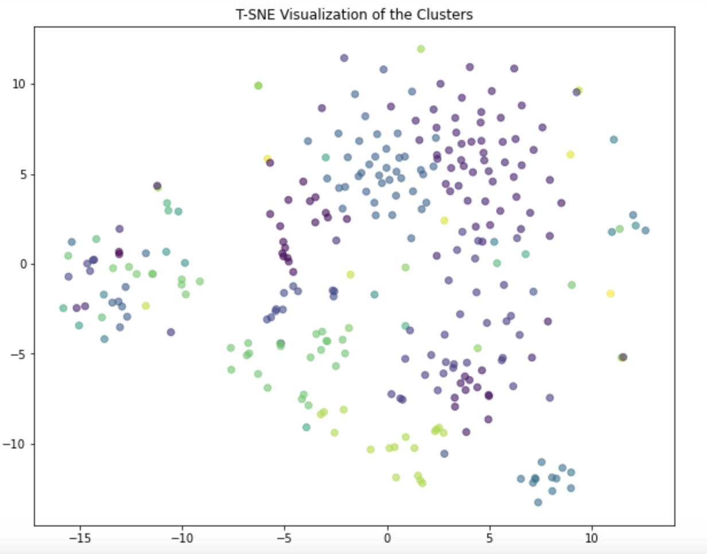
K-Means Cluster
Determined the optimal number of clusters using the elbow method and silhouette analysis
Group similar stocks together based on their price movements

Slide 8
Cointegration and Pair Selection
CV
Find pairs in each cluster
Engle-Granger two-step approach
ADF test
Asset 1 | Asset 2
DX | IVR
STWD | ARI
STWD | TWO
BAC | PNC
MS | GS
MRO | MUR
PXD | EOG
CV
We choose our pairs based on the cointegration result and fundamental analysis of the chosen companies

Slide 9

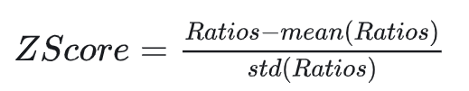
Rolling Regression
CV
We allow β to float within a range, β is simply the price ratio of two Stocks
β | Y_t | X_t | Strategy
> Higher Band | Too expensive | Too Cheap | Short Y_t + Long X_t
< Lower Band | Too Cheap | Too expensive | Long Y_t + Short X_t
CV
Trading Strategy:​
In every trade, we trade one share of Y and β share of X to hedge in the opposite direction
* Higher Band = mean + 1 x std
* Lower Band = mean – 1 x std

Slide 10
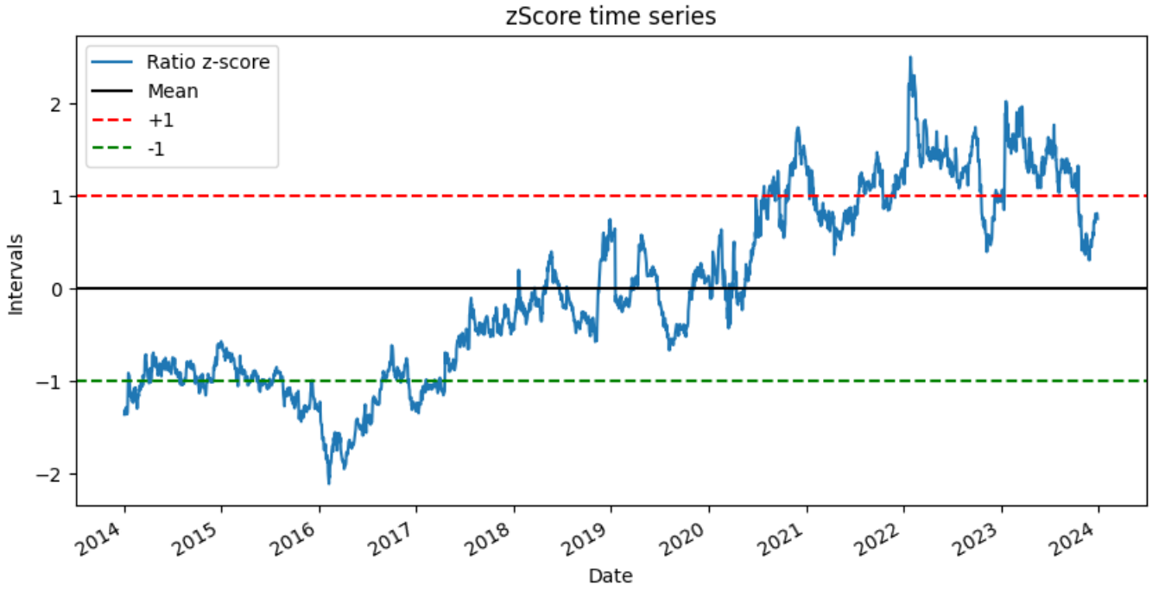
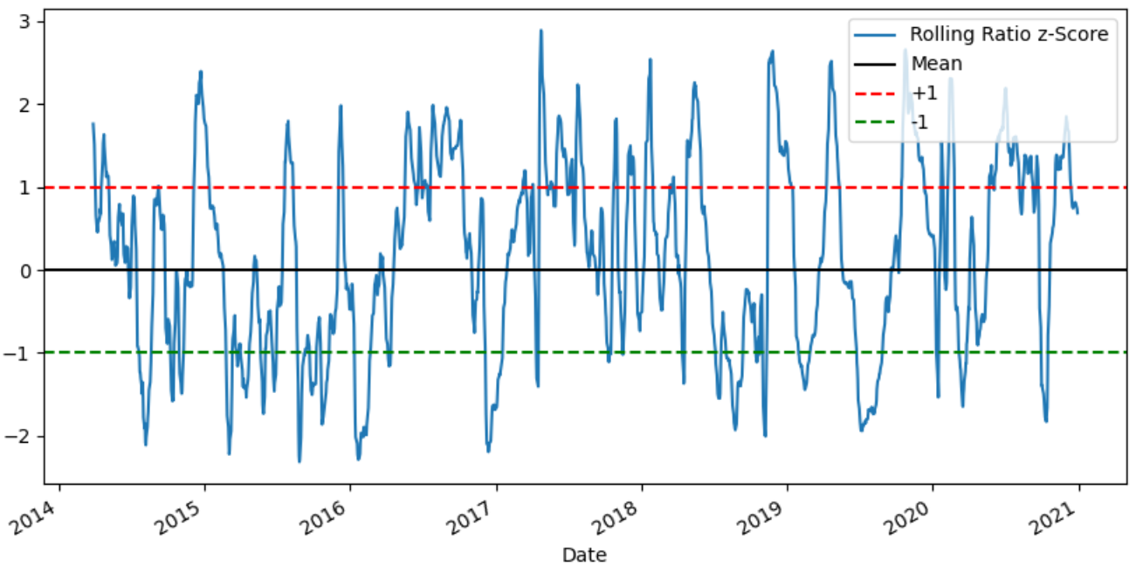
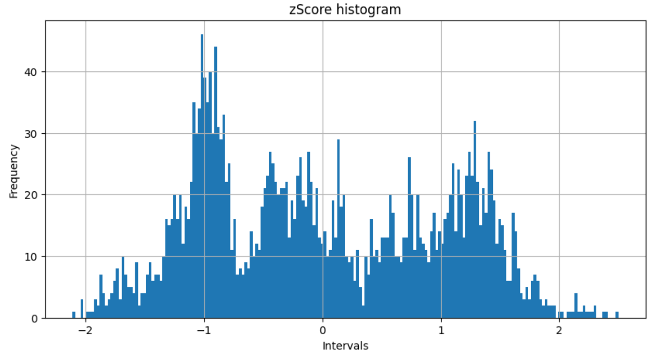
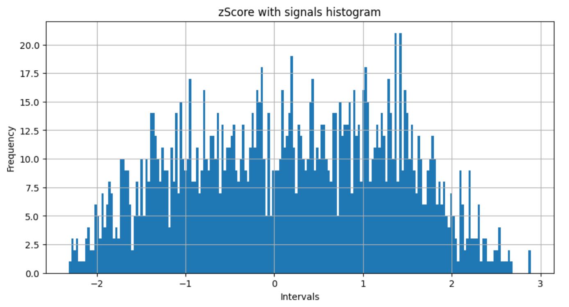
Rolling Regression-Sample Pair [MS, GS]
Before
After
Adding Rolling Signal
& Train-test Split

Slide 11
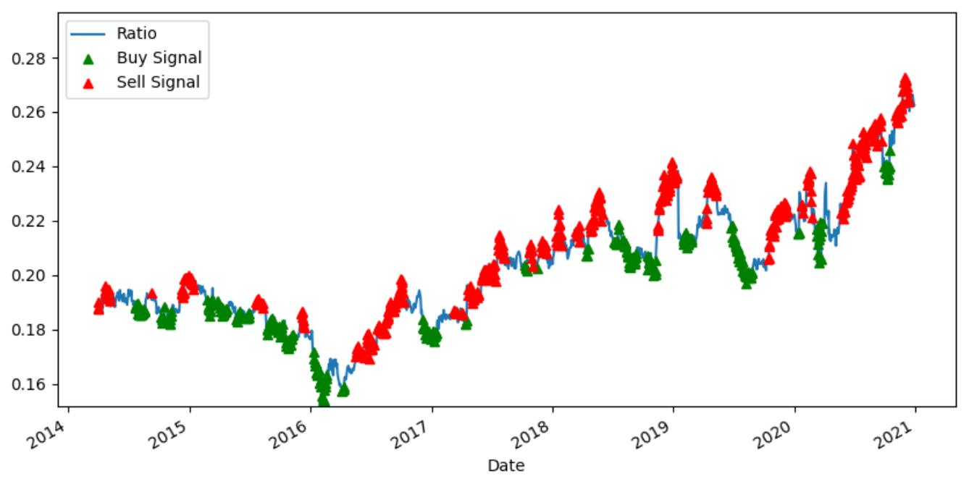
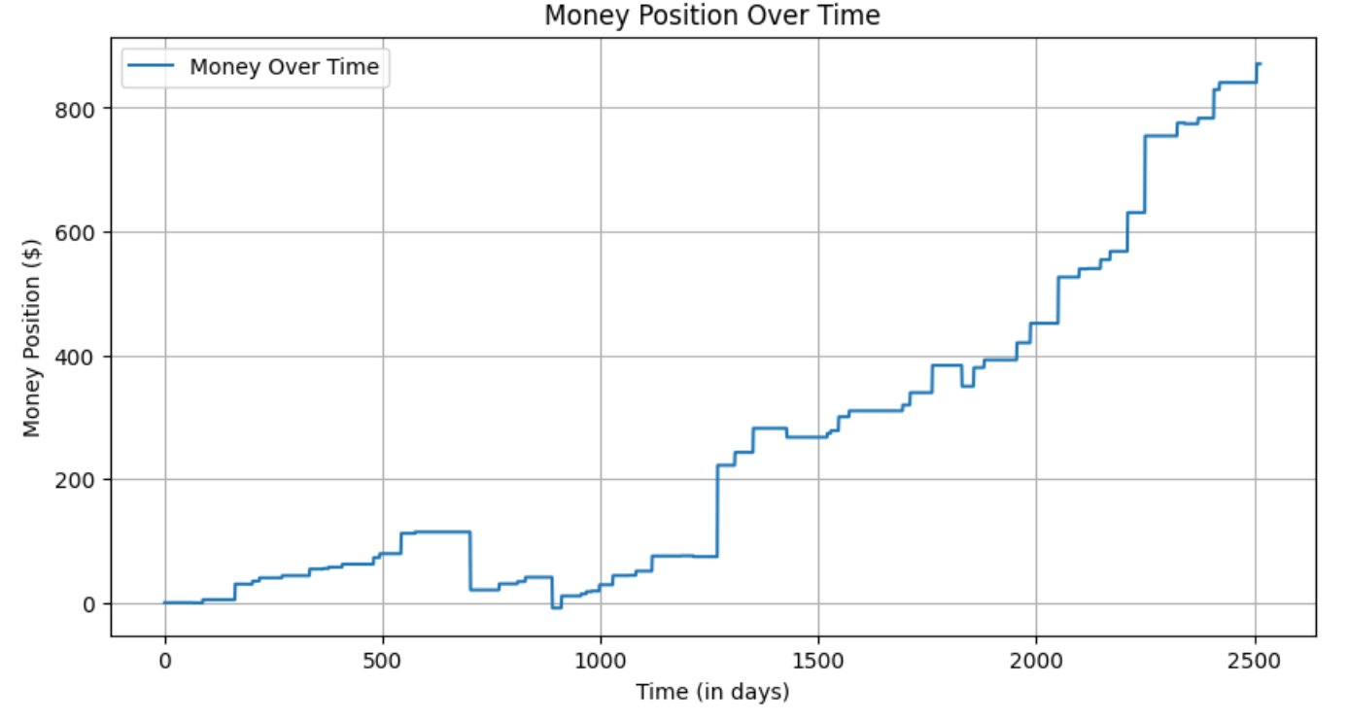
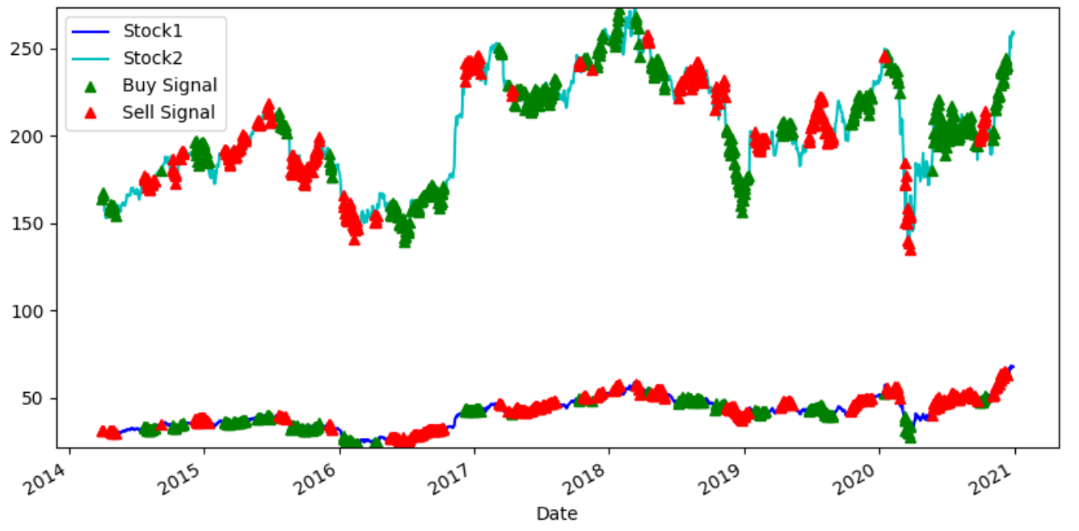
Rolling Regression-Sample Pair [MS, GS]
Performance of Self-Financing Strategy
Trading Signal Across Time

Slide 12
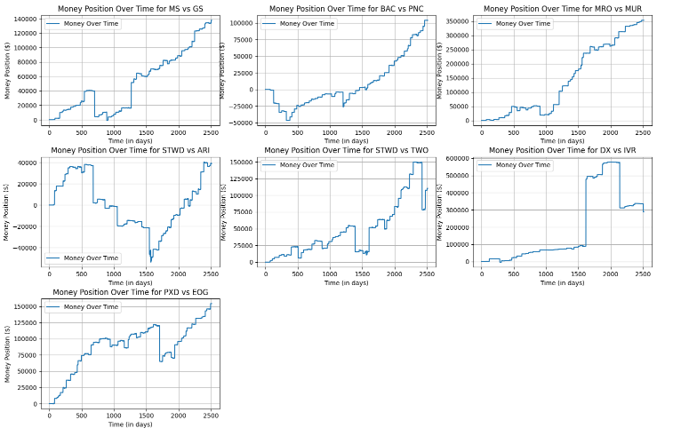
Rolling Regression-All Pairs

Slide 13
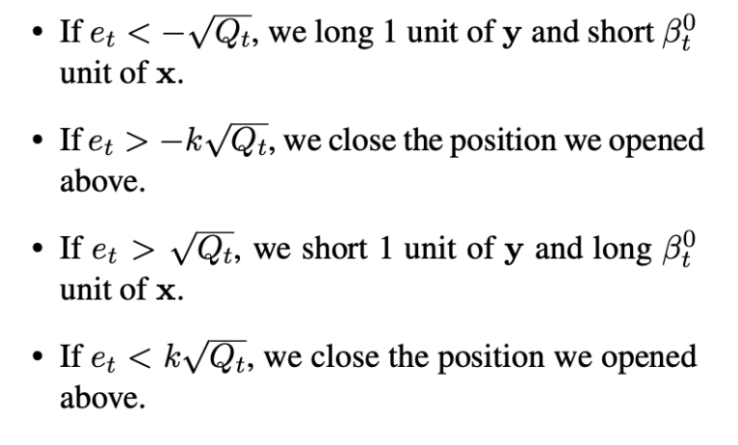
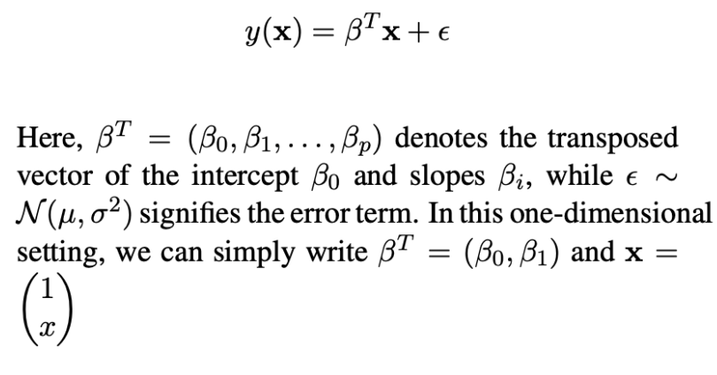
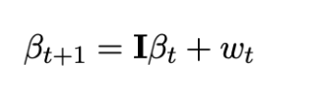
Rolling Regression-Kalman Filter
A recursive algorithm used to estimate the state of a dynamic system with noisy measurements
Trading Signal
CV
Theory
CV

Slide 14
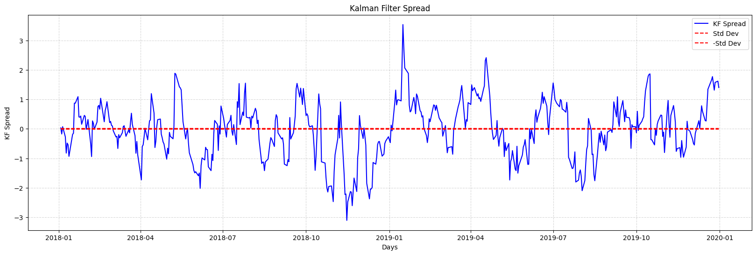
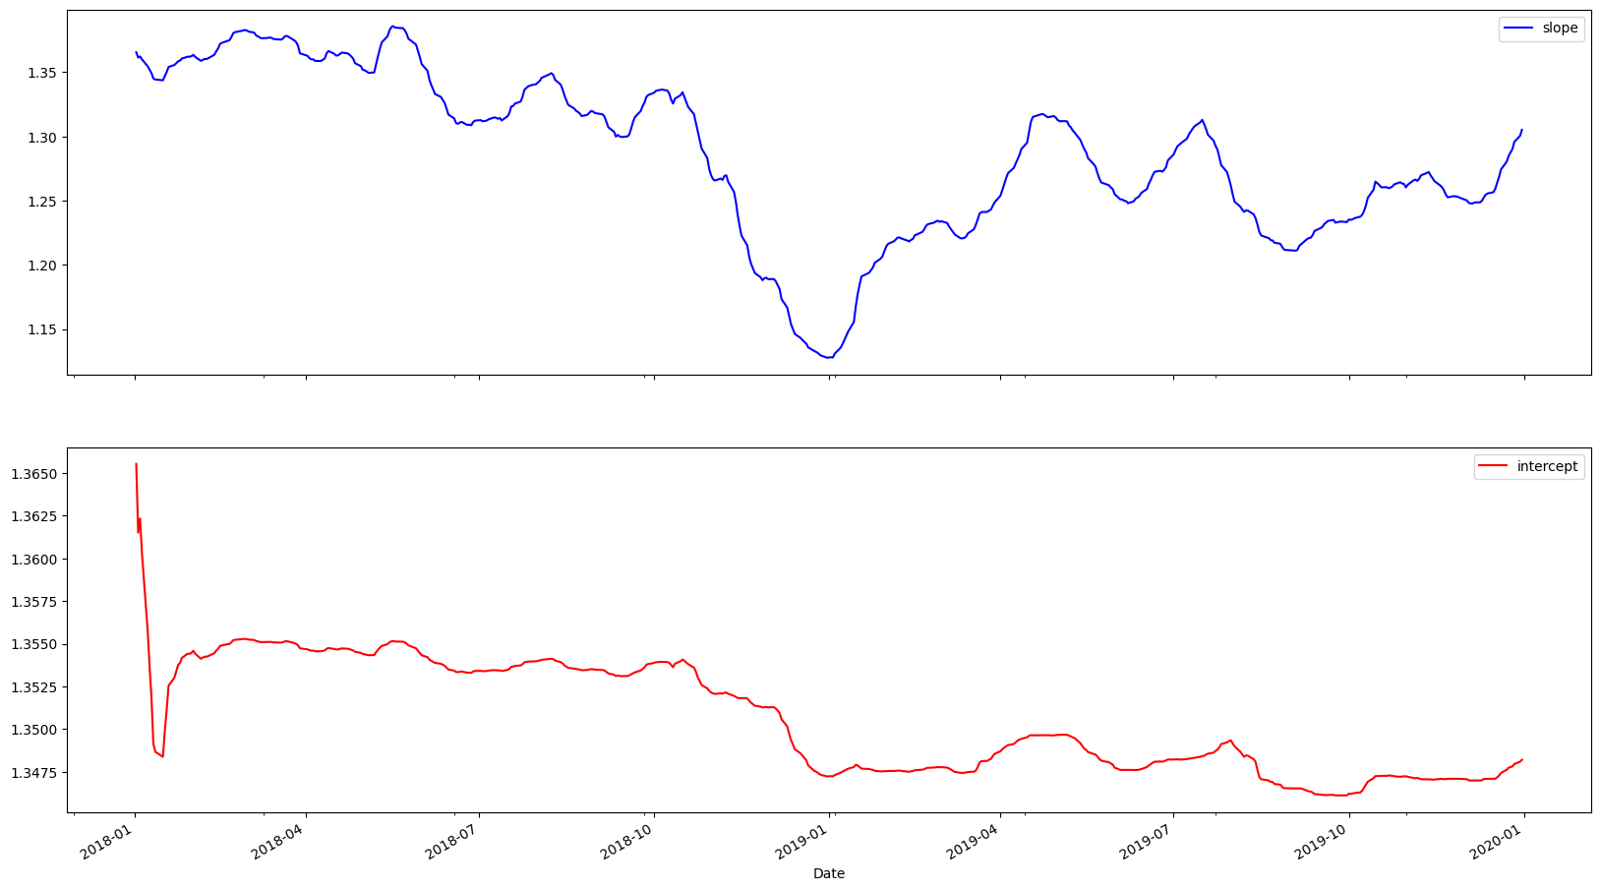
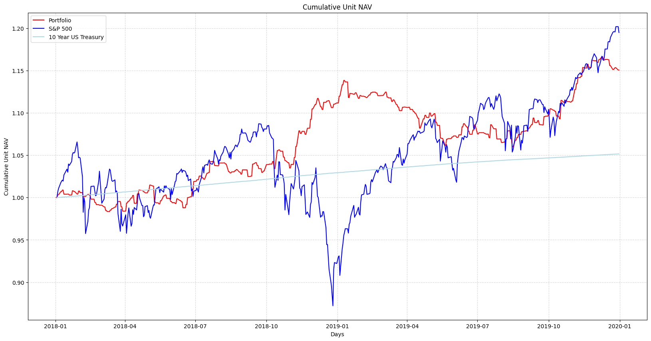
Kalman Filter-Sample Pair [BAC, PNC]
Performance of Trading Strategy
Slope and Intercept

Slide 15
Thank You

