Slide 1
볼링(Bowling)
실감나조 (Team SilGamNa)
고려대학교 2011년 1학기
Computer Graphics
컴퓨터학과 05 김현식
컴퓨터학과 05 홍종찬

Slide 2
Contents
System Environment
Object Modeling
Physics
Reflection

Slide 3
System Environment
IDE
Visual Studio 2010
Language
C++, OpenGL

Slide 4
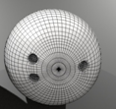
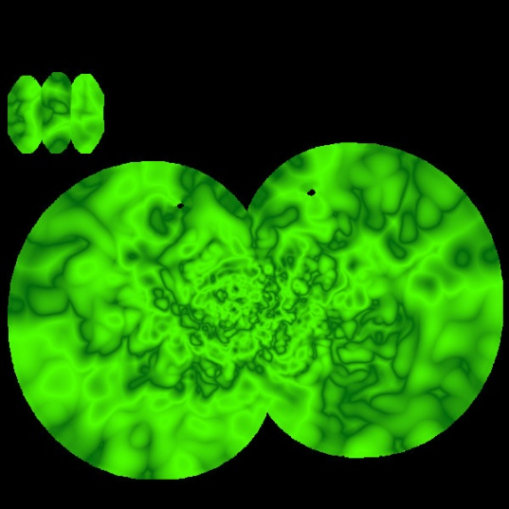
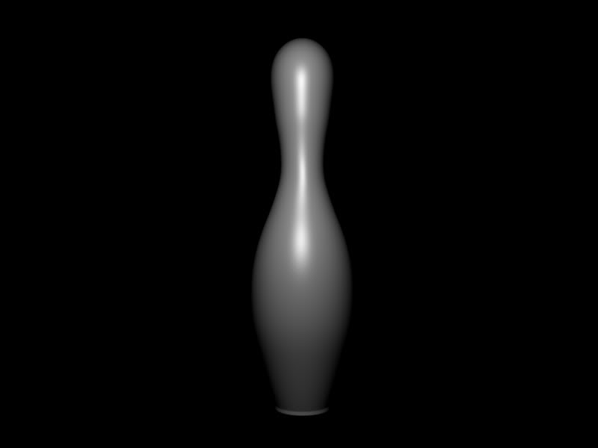
Object Modeling
Ball
Mesh Loader(obj)
Texture Mapping
Surrounded by glWireSphere
Bowling Pin
Mesh Loader(obj)
Surrounded by glWireCube
Increase 10 pin

Slide 5
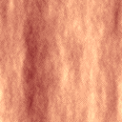
Object Modeling(continued)
Lane
Texture Mapping
Reflections and Shadows only shown on this area

Slide 6
Collision Detection & Response
Assume that bowling pins are similar to cube

Slide 7
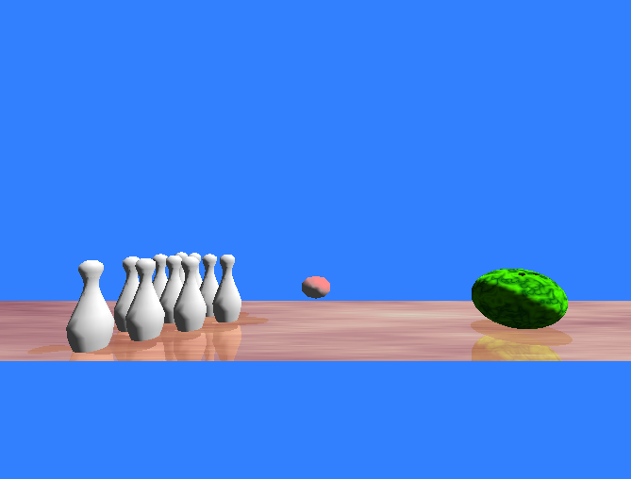
Reflections and Shadows
Stencil Buffer
Calculate shadow matrix correlated with Plane and Light Position
Designate area where we’d like to display reflections and shadows

Slide 8
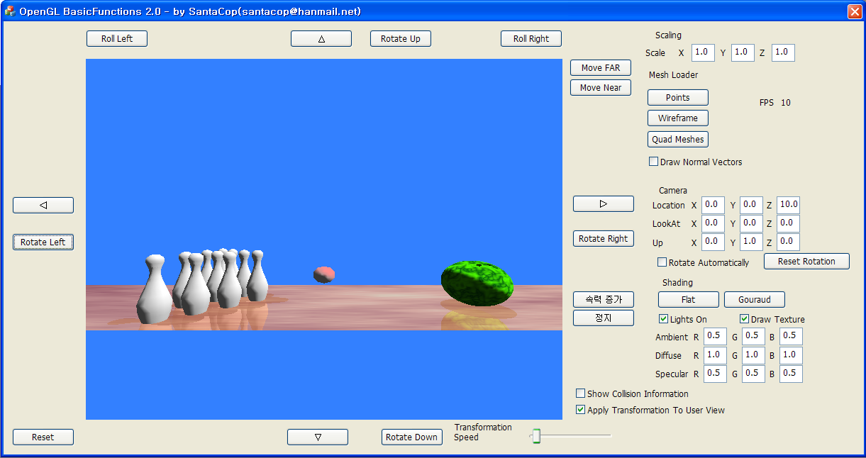
DEMO

Slide 9
Reference
NeHe Production(http://nehe.gamedev.net)
Physics for Game Developers by David M Bourg
Beginning Math and Physics for Game Programmers by Wendy Stahler
Real-time rendering by Tomas Möller
Improving Shadows and Reflections via the Stencil Buffer by Mark J. Kilgard
http://www.turbosquid.com/3d-models/free-3ds-mode-bowling-pins/597006

