Slide 1
GLOBAL HAPPINESS
INSIGHTS 2025
Country rankings, explanatory components, and an interactive exploration
A reproducible data analysis using the supplied World Happiness Report workbook
147 countries / Report period 2022–2024
Repository: [add URL after publication] · Author: [add name]
Notes:
Dataset: user-supplied WHR_2025.xls, sheet Sheet1. Analysis results were calculated by this reconstructed project and are not claimed to reproduce the original internship analysis.
World Happiness Report 2025, Country Rankings and Figure 2.1 (Gallup World Poll, 2022–2024): https://files.worldhappiness.report/WHR25.pdf

Slide 2
GLOBAL HAPPINESS INSIGHTS 2025
Questions this project answers
A clear country ranking is a starting point. The analysis also compares six report components and quantifies how they associate with Ladder score.
Which countries sit at the top and bottom of the 2025 ranking?
How do Finland and India compare in rank and score?
Which available factors show the strongest country-level association with Ladder score?
How do the top 10 and bottom 10 differ on the report components?
Scope: descriptive analysis of 147 country aggregates. No causal effects or year-to-year trends are estimated.
02
Notes:
Dataset: user-supplied WHR_2025.xls, sheet Sheet1. Analysis results were calculated by this reconstructed project and are not claimed to reproduce the original internship analysis.
World Happiness Report 2025, Country Rankings and Figure 2.1 (Gallup World Poll, 2022–2024): https://files.worldhappiness.report/WHR25.pdf

Slide 3
GLOBAL HAPPINESS INSIGHTS 2025
Dataset and source
WHR_2025.xls · Sheet1 · 147 rows · 11 columns
The workbook contains one country-level record per country. Ladder score is the ranking measure. The six “Explained by” fields are report components used here as explanatory indicators.
KEY FIELDS
COVERAGE AND LIMITS
Country name and Ladder score
The workbook has no year, region, or income-level columns. Its ranking structure and values align with the report’s 2022–2024 country ranking.
GDP per capita and social support
Healthy life expectancy and freedom
Generosity and perceptions of corruption
Source: World Happiness Report 2025, Figure 2.1, Gallup World Poll 2022–2024. Citation in speaker notes.
03
Notes:
Dataset: user-supplied WHR_2025.xls, sheet Sheet1. Analysis results were calculated by this reconstructed project and are not claimed to reproduce the original internship analysis.
World Happiness Report 2025, Country Rankings and Figure 2.1 (Gallup World Poll, 2022–2024): https://files.worldhappiness.report/WHR25.pdf
The official source documents the ranking period and report context. The file itself has no year column.

Slide 4
GLOBAL HAPPINESS INSIGHTS 2025
Data cleaning and validation
147 → 147
0
No imputation
Rows retained
Duplicate countries
Missing values kept as missing
VALIDATION CHECKS
SOURCE MISSING VALUES
Required country and Ladder score fields
Explained by: Healthy life expectancy: 1
Numeric types for all source indicator columns
Explained by: Freedom to make life choices: 1
Unique, nonempty country names
Explained by: Perceptions of corruption: 1
Finite Ladder scores within 0–10
Dystopia + residual: 3
Correlations use pairwise complete rows. Means use available observations. No rows or outliers were removed.
04
Notes:
Dataset: user-supplied WHR_2025.xls, sheet Sheet1. Analysis results were calculated by this reconstructed project and are not claimed to reproduce the original internship analysis.
World Happiness Report 2025, Country Rankings and Figure 2.1 (Gallup World Poll, 2022–2024): https://files.worldhappiness.report/WHR25.pdf

Slide 5
GLOBAL HAPPINESS INSIGHTS 2025
Tools and methodology
The workflow keeps source loading, validation, statistics, charts, and dashboard transformations reusable.
01
Python 3.12
Runtime
02
pandas + NumPy
Load, validate, transform
03
SciPy
Pearson and Spearman tests
04
Matplotlib + Seaborn
Static analysis figures
05
Streamlit + Plotly
Interactive dashboard
Pearson measures linear association. Spearman measures rank-based monotonic association. Both report p-values and pairwise sample sizes.
05
Notes:
Dataset: user-supplied WHR_2025.xls, sheet Sheet1. Analysis results were calculated by this reconstructed project and are not claimed to reproduce the original internship analysis.
World Happiness Report 2025, Country Rankings and Figure 2.1 (Gallup World Poll, 2022–2024): https://files.worldhappiness.report/WHR25.pdf

Slide 6
GLOBAL HAPPINESS INSIGHTS 2025
Country rankings
Highest: Finland 7.736 Lowest: Afghanistan 1.364 Gap: 6.372
Ladder score is the life-evaluation measure used to order countries. The list reports values from the supplied workbook.
06
Notes:
Dataset: user-supplied WHR_2025.xls, sheet Sheet1. Analysis results were calculated by this reconstructed project and are not claimed to reproduce the original internship analysis.
World Happiness Report 2025, Country Rankings and Figure 2.1 (Gallup World Poll, 2022–2024): https://files.worldhappiness.report/WHR25.pdf

Slide 7
GLOBAL HAPPINESS INSIGHTS 2025
Finland and India
FINLAND
INDIA
#1
#118
7.736 Ladder score
4.389 Ladder score
Score difference: 3.347
Both ranks and scores are recalculated from the supplied Ladder score column.
07
Notes:
Dataset: user-supplied WHR_2025.xls, sheet Sheet1. Analysis results were calculated by this reconstructed project and are not claimed to reproduce the original internship analysis.
World Happiness Report 2025, Country Rankings and Figure 2.1 (Gallup World Poll, 2022–2024): https://files.worldhappiness.report/WHR25.pdf

Slide 8
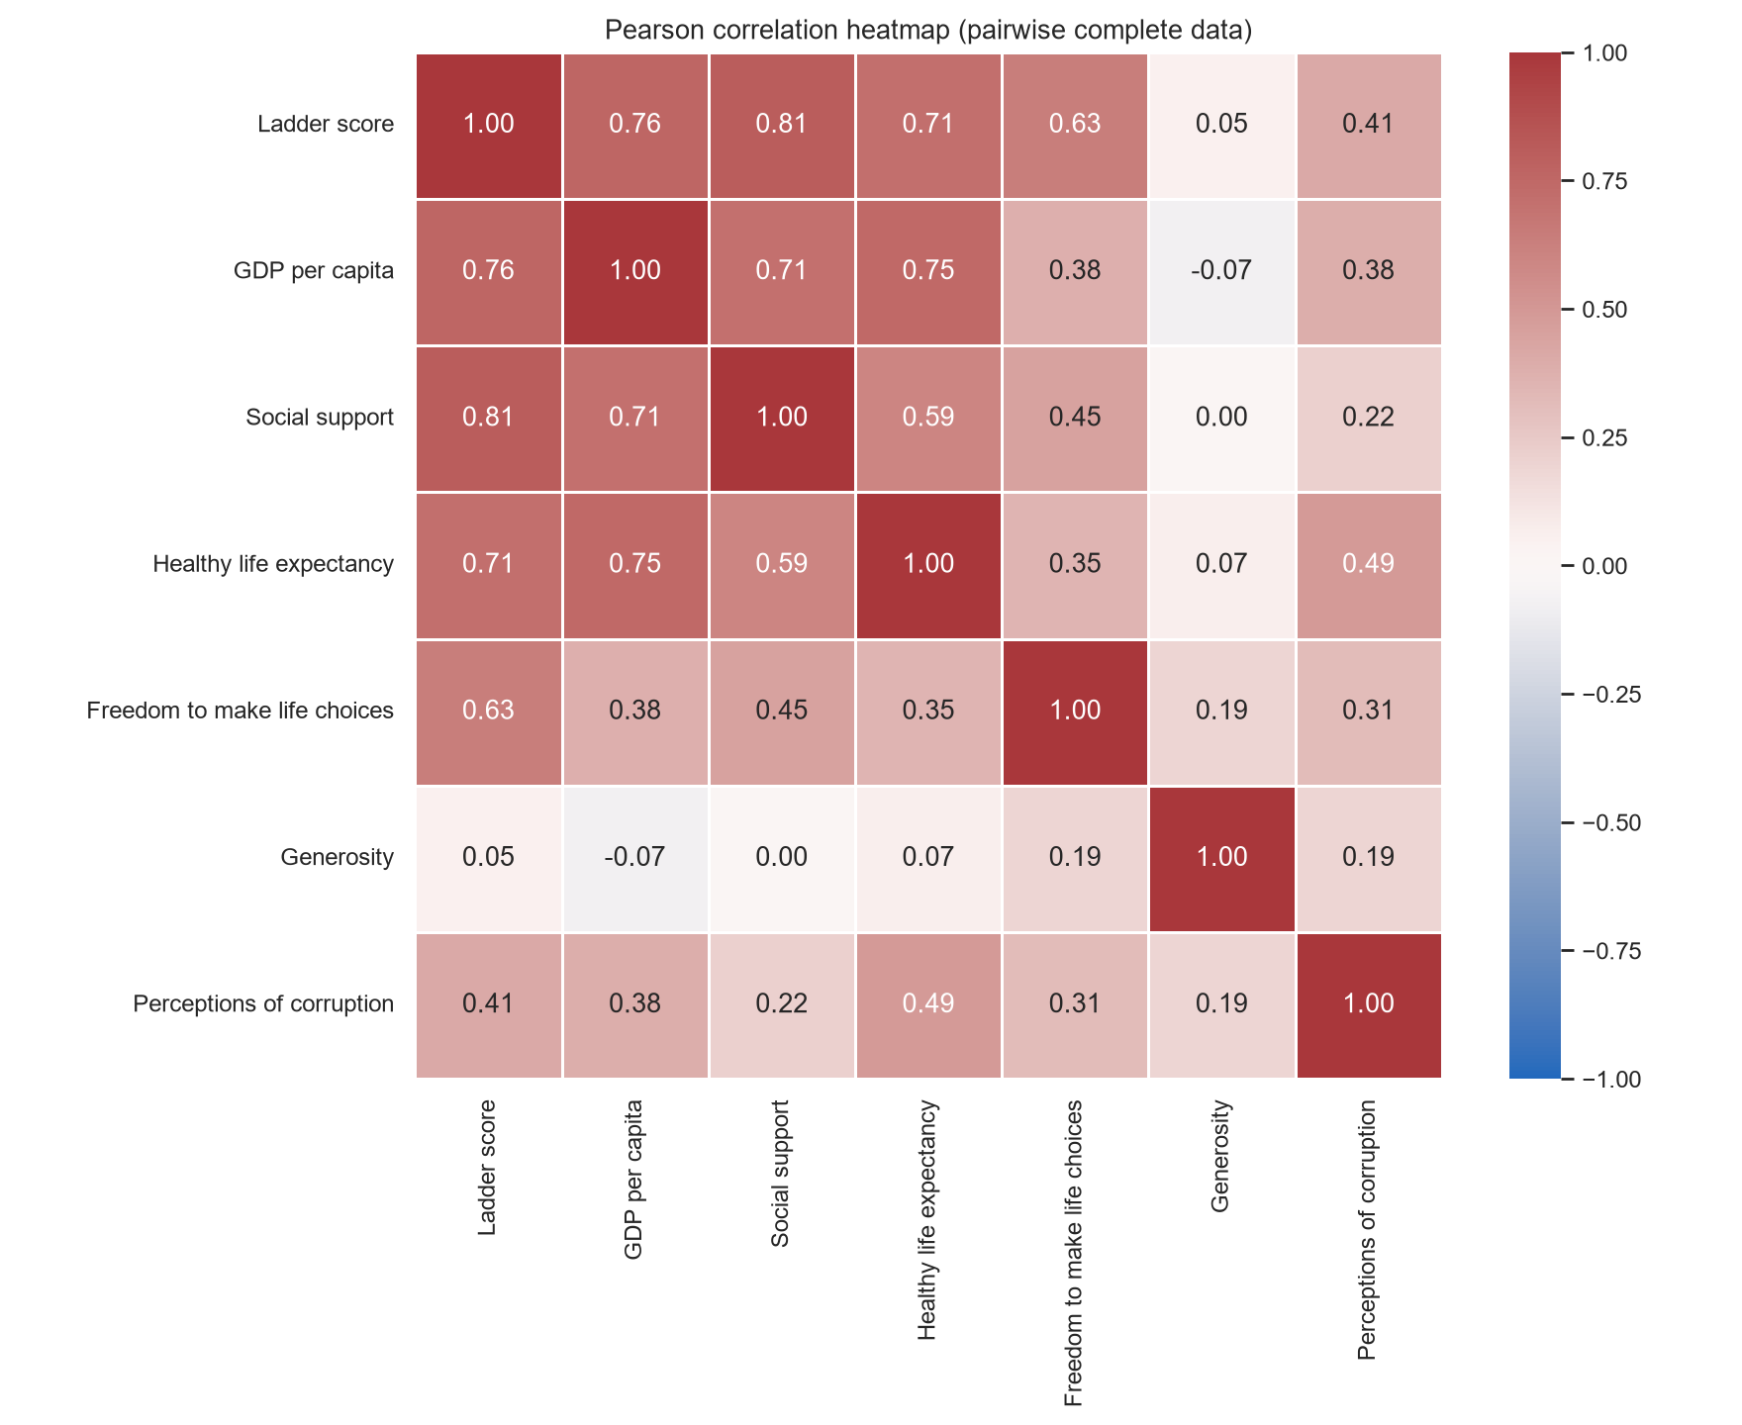
GLOBAL HAPPINESS INSIGHTS 2025
Correlation findings
Correlation heatmap
STATISTICAL DETAIL
Social support
Pearson r=0.812 p=9.636e-36 n=147
Spearman ρ=0.811 p=1.490e-35 n=147
GDP per capita
Pearson r=0.763 p=2.675e-29 n=147
Spearman ρ=0.810 p=1.925e-35 n=147
Healthy life expectancy
Pearson r=0.712 p=7.387e-24 n=146
Spearman ρ=0.725 p=4.466e-25 n=146
Freedom to make life choices
Pearson r=0.634 p=8.196e-18 n=146
Spearman ρ=0.620 p=7.302e-17 n=146
Perceptions of corruption
Pearson r=0.412 p=2.303e-7 n=146
Spearman ρ=0.370 p=4.425e-6 n=146
Generosity
Pearson r=0.054 p=0.5132 n=147
Spearman ρ=0.099 p=0.2345 n=147
Strongest positive Pearson association: Social support, r=0.812.
No negative Pearson coefficients were observed among valid results. Weakest absolute Pearson association: Generosity, r=0.054.
08
Notes:
Dataset: user-supplied WHR_2025.xls, sheet Sheet1. Analysis results were calculated by this reconstructed project and are not claimed to reproduce the original internship analysis.
World Happiness Report 2025, Country Rankings and Figure 2.1 (Gallup World Poll, 2022–2024): https://files.worldhappiness.report/WHR25.pdf
p-values are two-sided tests as returned by SciPy. Each factor uses its own complete-case sample.

Slide 9
GLOBAL HAPPINESS INSIGHTS 2025
Top 10 versus bottom 10
FACTOR
TOP − BOTTOM MEAN
GDP per capita
0.932
Social support
0.854
Healthy life expectancy
0.548
Freedom to make life choices
0.441
Generosity
0.049
Perceptions of corruption
0.224
Bars show both group means; the table adds only the top-minus-bottom difference. Percent differences are omitted because component ratios are not meaningful.
09
Notes:
Dataset: user-supplied WHR_2025.xls, sheet Sheet1. Analysis results were calculated by this reconstructed project and are not claimed to reproduce the original internship analysis.
World Happiness Report 2025, Country Rankings and Figure 2.1 (Gallup World Poll, 2022–2024): https://files.worldhappiness.report/WHR25.pdf

Slide 10
GLOBAL HAPPINESS INSIGHTS 2025
Interactive dashboard
A local Streamlit application loads and validates the same supplied workbook at launch.
RANKINGS
Search country names, sort the table, filter the score range, and switch between all countries, top 10, and bottom 10.
GENUINE DASHBOARD SCREENSHOT
RELATIONSHIPS
SCREENSHOT PLACEHOLDER
Choose any of six factors for a scatter plot. Switch the heatmap between Pearson and Spearman.
After running Streamlit, capture a real browser screenshot and replace this panel. No screenshot is embedded until a genuine capture is available.
COUNTRY DETAIL AND DATA QUALITY
View country rank, score, component values, and dataset-average differences. Missingness and outlier summaries are available; missing values remain blank.
Dashboard verified in Streamlit AppTest and launched locally.
10
Notes:
Dataset: user-supplied WHR_2025.xls, sheet Sheet1. Analysis results were calculated by this reconstructed project and are not claimed to reproduce the original internship analysis.
World Happiness Report 2025, Country Rankings and Figure 2.1 (Gallup World Poll, 2022–2024): https://files.worldhappiness.report/WHR25.pdf

Slide 11
GLOBAL HAPPINESS INSIGHTS 2025
What the results can and cannot say
Strongest positive Pearson association: Social support, r=0.812.
No negative Pearson coefficients were observed among valid results.
Weakest absolute Pearson association: Generosity, r=0.054.
Top-10 averages exceed bottom-10 averages across the six available components.
These are country-level associations and report decomposition values, not causal effects.
The workbook provides no region, income category, or annual country series.
The report ranking is a multi-year country summary. It cannot support within-country change analysis or explain why an individual is happier.
11
Notes:
Dataset: user-supplied WHR_2025.xls, sheet Sheet1. Analysis results were calculated by this reconstructed project and are not claimed to reproduce the original internship analysis.
World Happiness Report 2025, Country Rankings and Figure 2.1 (Gallup World Poll, 2022–2024): https://files.worldhappiness.report/WHR25.pdf

Slide 12
GLOBAL HAPPINESS
INSIGHTS 2025
Finland leads with 7.736. Afghanistan ranks last with 1.364.
Finland: rank 1, 7.736 India: rank 118, 4.389
Next steps
Add reliable regional or income metadata for grouped comparisons. Use additional years to study trends. Keep this project’s analysis distinct from the original internship presentation.
Reconstructed project results · source workbook preserved unchanged
Repository: [add URL after publication] · Author: [add name]
Notes:
Dataset: user-supplied WHR_2025.xls, sheet Sheet1. Analysis results were calculated by this reconstructed project and are not claimed to reproduce the original internship analysis.
World Happiness Report 2025, Country Rankings and Figure 2.1 (Gallup World Poll, 2022–2024): https://files.worldhappiness.report/WHR25.pdf

