Slide 1

Microsoft Fair-learn
Henil V.

Slide 2
Table of Contents
Introduction.
Fairness & its definition’s.
Goal of the Project.
Experimental Setup.
Results.
Discussion/ Future scope/ Closing remarks.

Slide 3
Introduction:
Decisions made by computers after a machine-learning process may be considered unfair if they were based on variables considered sensitive. i.e individual’s eligibility should not be dependent on its sensitive feature. (Ex. Just because population is of a certain race it should not be cut-off because of its race).
Algorithmic decisions based on datasets that include biased human decisions will learn making biased decisions rather than fair decisions.
When dealing with sensitive features (ex. gender, age, nationality, etc.), it is crucial to to ensure fairness of a model before deploying it in a real-world environment.
Microsoft open-source Python package called fairlearn can be used for analyzing the model's fairness and mitigating any observed unfairness issues.
The question this project tends to answer is if the model has any discriminative behavior and mitigate it.

Slide 4
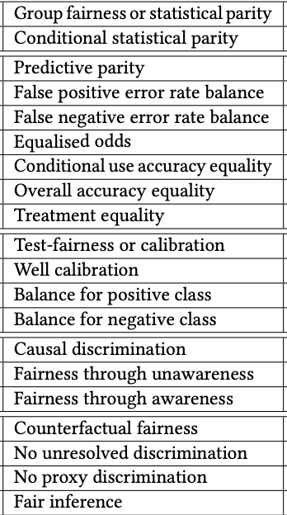
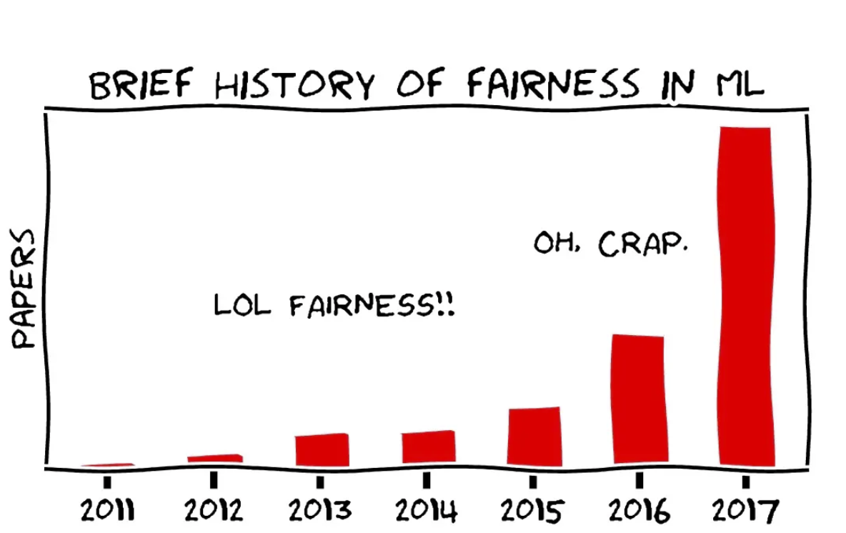
Fairness & it’s definition’s :
Laws typically evaluate the fairness of a decision making process using two distinct notions disparate treatment and disparate impact.
These two definitions, however, are too abstract for the purpose of computation. As a result, there is no consensus on the mathematical formulations of fairness.
Notes:
A decision making process suffers from disparate treatment if its decisions are (partly) based on the subject’s sensitive attribute, and it has disparate impact if its outcomes disproportionately hurt (or benefit) people with certain sensitive attribute values (e.g., females, blacks).

Slide 5
About Microsoft Fair-learn
Which techniques are supported by Fair learn?
1- Model bias detection- In Model bias detection- Supported fairness metrics:
Demographic Parity: This metric states that the proportion of each segment of a protected feature (e.g. gender) should receive the positive outcome at equal rates. Equalized Odds: This metric states that the model should correctly identify the positive outcome at equal rates across groups, but also miss-classify the positive outcome at equal rates across groups (creating the same proportion of False Positives across groups).
2- Model bias mitigation- supported methods: Model estimation approaches:
Exponentiated Gradient Reduction: The reduction approach for achieving fairness in a binary classification setting. Underlying classification method is treated as a black box. Grid Search: The reduction approach for achieving fairness in a binary classification and regression settings. If the protected attribute is non-binary, then grid search is not feasible.
3- Post-processing approaches:
Threshold Optimizer: The postprocessing approach in which the classifier is obtained by applying group-specific thresholds to the provided estimator. The thresholds are chosen to optimize the provided performance objective (e.g. accuracy score) subject to the provided fairness constraints (e.g. demographic parity).

Slide 6
Goal of the project:
I will use the HR's promotion dataset to predict employees that are likely to be promoted based on their personal and performance parameters.
This is the binary classification task with the target is promoted. The target can be equal to 0 or 1. When is promoted is equal to 0, an employee is not promoted. Otherwise, an employee is considered for the promotion.
The dataset contains potentially sensitive features, such as gender, age, region and department.
Compare the results we will get using the fairness unaware and the fairness aware ML models.
Notes:
Explain how underlying math of auc curve roc false negative positive will equal for most imp. Feature so we say that if main attribute has equalized opportunity than there is parity.
Explain promotion of employee, select main attribute and achieve fairness on it.

Slide 7
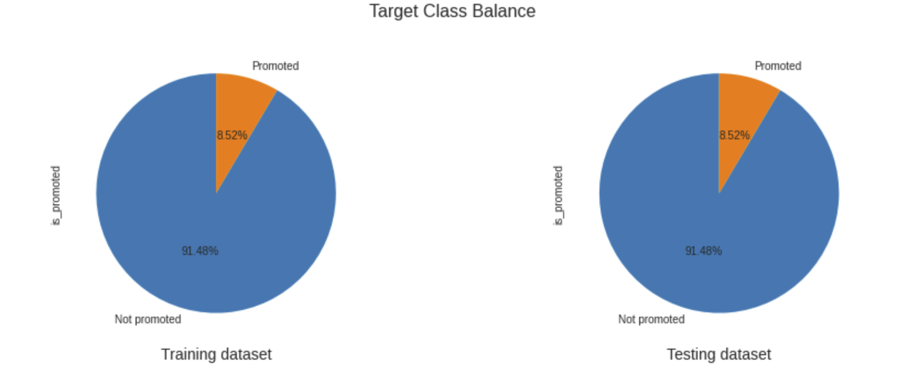
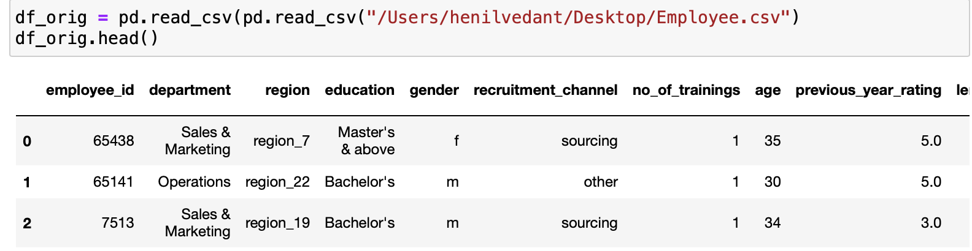
Experimental Setup
Dataset has various features such as region, gender, education etc.
First, we will encode categorical features: department, region, education, gender, recruitment channel.
It was observed that the promotion dataset is imbalanced: 91.48% and 8.52% employees were not promoted and promoted, accordingly.
This aspect will be considered when splitting the data into training and testing datasets, as well as we will take it into account during the model development.
Notes:
To split the promotion dataset into training and testing sets, we will use train_test_split function with stratify=y. The stratify parameter makes a split so that the proportion of values in the training and testing sets is the same as the proportion of values in y (i.e. is_promoted).
As mentioned above, y (is_promoted) is a binary categorical variable and there are 91.48% of zeros and 8.52% of ones. Thus, stratify=y will make sure that a random split has 91.48% of 0's and 8.52% of 1's.

Slide 8
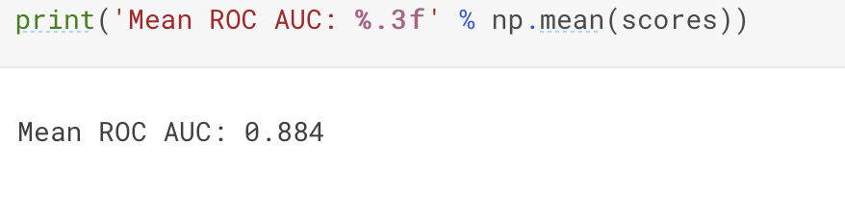
Predictive Model
Let's start with building a fairness unaware ML model.
The imbalanced-learn library provides a classifier called Balanced Bagging Classifier that implements a random under-sampling strategy on the majority class within a bootstrap sample in order to balance the two classes.
To evaluate the performance of the model, the mean ROC AUC score across all folds and repeats will be used.
Next: We check global importance of features used by the model.
To do so, we will calculate the mean importance across the estimators of the Balanced Bagging Classifier.
The mean ROC AUC is acceptable, and we can fit the whole training data to the estimator.
Notes:
We will evaluate this model using a repeated stratified k-fold cross-validation with 3 repeats and 10 folds

Slide 9
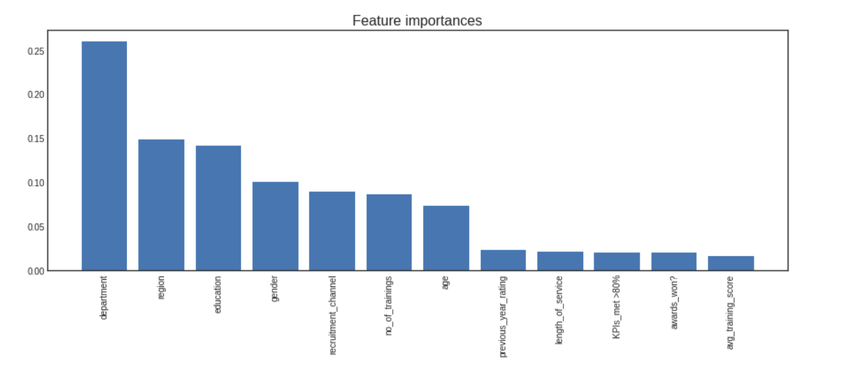
According to the global importance plot, the 5 main features are: department, region, education, gender and recruitment channel.
It means that these features will have highest impact in predicting employees that are likely to be promoted.
To avoid any bias in promotions, it's important to validate that, for example, all departments and regions are treated equally.

Slide 10
BIAS DETECTION in UNFAIR MODEL
The fairlearn package provides fairness-related metrics that can be compared between groups and for the overall population.
The goal is to assure that neither of the departments has substantially larger false-positive rates or false-negative rates than the other groups.
Therefore, as a protected (sensitive) feature we will set department that has a highest impact on predictions of the trained model.
Using existing metric definitions from scikit-learn we can evaluate metrics to get a group summary.
As the overall performance metric we will apply the area under ROC curve (AUC), which is suited to classification problems with a large imbalance between positive and negative examples.
As the fairness metric we will use equalized odds and demographic parity which is supported in Fairlearn.

Slide 11
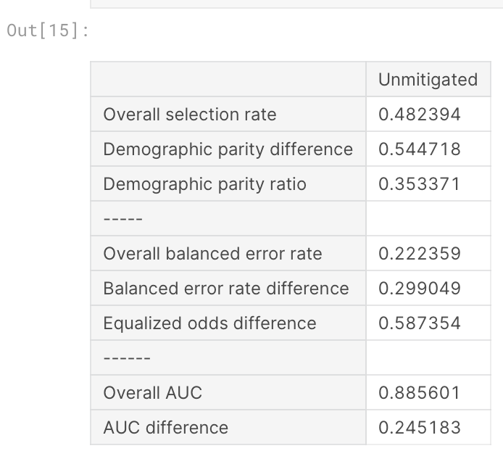
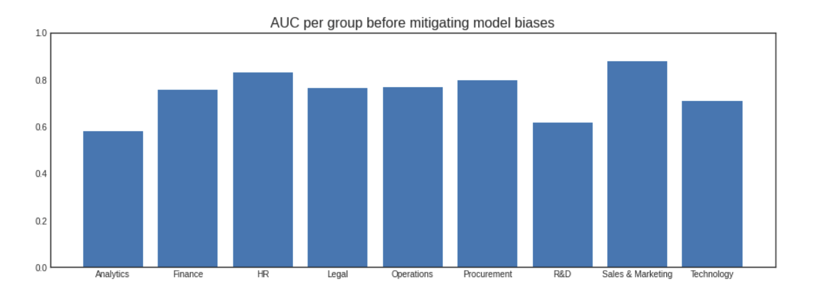
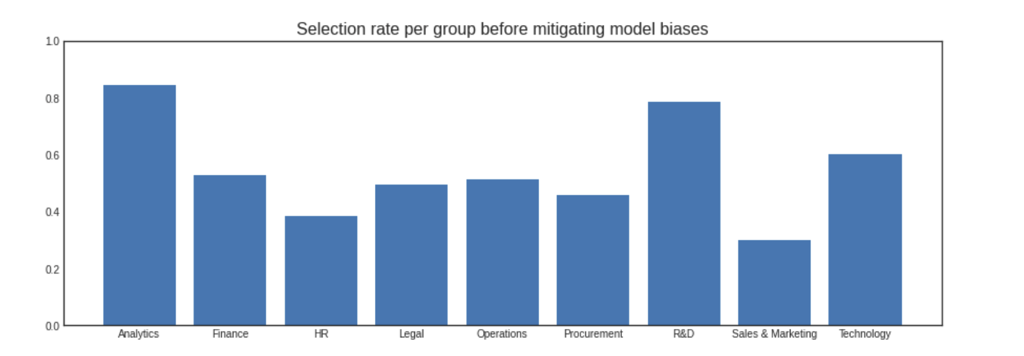
In addition, we can also analyze AUC and selection rate per each department as shown below.
The table above shows the overall AUC of 0.89 and the overall balanced error rate of 0.23.
Both of these are satisfactory in our application context.
However, there is a considerable disparity in accuracy rates (as indicated by the balanced error rate difference) and even larger when we consider the equalized-odds difference.
Notes:
It can be noticed that some of the departments have significantly higher AUC values and higher selection rate in comparison to others.
We can conclude that the model is likely to overpredict (predict 1 when the true label is 0) and underpredict (predict 0 when the true label is 1). Therefore, the application of such model in a real-world environment may cause discrimination of employees based on departments.

Slide 12
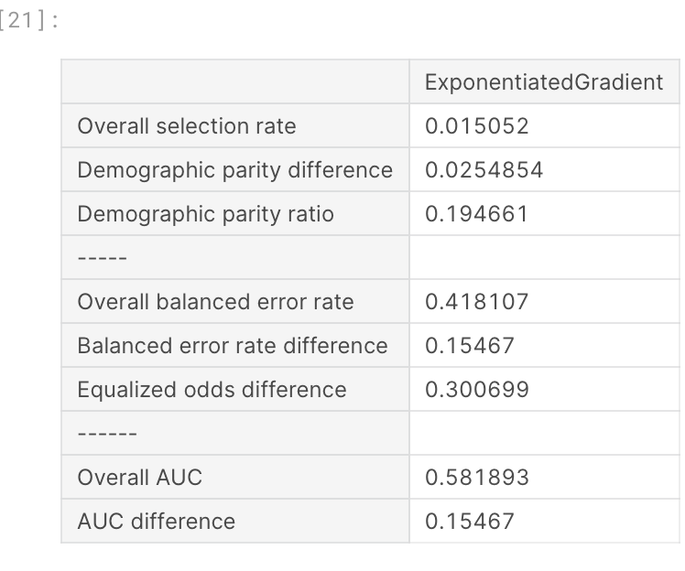
Fair Model
Achieving non-discrimination with Fairlearn
The fairlearn package supports different techniques for mitigating model bias (see 2.2). Examples of these techniques can be found in this notebook.
In our case, we will create a new model while specifying the fairness constraint called Demographic Parity, because there are disparities between groups of department. The Exponentiated Gradient mitigation technique developed by Microsoft fits the provided classifier using Demographic Parity as the objective, leading to a vastly reduced difference in selection rate.
Note that unlike the unmitigated model, Exponentiated Gradient produces 0/1 predictions, so its balanced error rate difference is equal to the AUC difference, and its overall balanced error rate is equal to 1 - overall AUC.
Notes:
Since BalancedBaggingClassifier of imbalanced-learn is not yet supported in fairlearn, we will use LGBMClassifier as a base model.

Slide 13
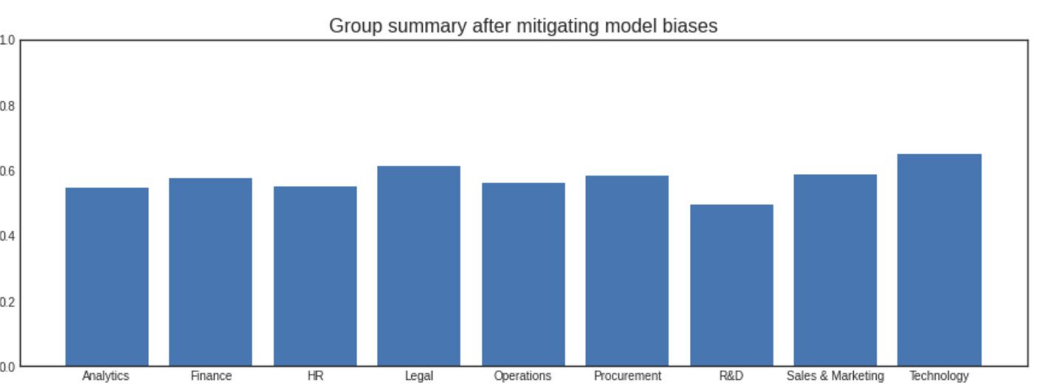
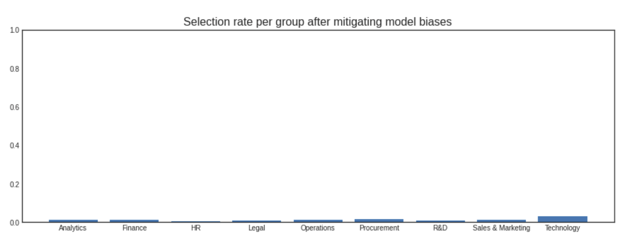
Group Summary & Selection rate for Fair Model
Group Summary, Selection rate for Unfair Model
Notes:
The Exponentiated Gradient algorithm significantly reduces the disparity according to multiple metrics. However, the performance metrics (balanced error rate as well as AUC) get worse. Before deploying such a model in practice, it would be important to analyze why we observe such a performance descrease. One of the reasons might be the lack of informativeness of available features for one of the groups of a protected feature department

Slide 14
Discussion
Fairness-aware Data Collection - It is important that we look at dataset as well for checking biases and producing fair results and not just the algorithm.
Challenges Due to Blind Spots - It is important to analyze and consider all sub-population and members along with domain expert so mathematical constraints reflect just and unjust choices for the participants.
Fairness needs evaluation over time and based on future decisions should be accounted.
Algorithmic transparency and accountability.
Moving beyond binary classification.

Slide 15
Conclusion
Identify fairness considerations and approaches up front, and ensure appropriate voices (i.e. experts in the relevant domain and across disciplines) are included and empowered in the conversation.
Instead of trying to make an ML system completely fair (or “de-biasing” it), the goal can be to detect and mitigate fairness-related harms as much as possible. Questions that should always be asked include: fair to whom? In what context?
There aren’t always clear-cut answers, so document processes and considerations (including priorities and trade offs).
Use quantitative and qualitative approaches and tools to help facilitate these processes. Tools do not guarantee fairness! They are a good practice within the larger holistic approach to mitigating bias.
Fairness doesn’t stop once an AI system is developed. Ensure users and stakeholders can see, understand and appeal choices made by AI systems.
Fairness is task and context specific.

Slide 16
References:
Fairness Through Awareness- Cynthia Dwork, Moritz Hardt, Toniann Pitassi, Omer Reingold, Rich Zemel.
[AAL] AALIM. http://www.almaden.ibm.com/cs/projects/aalim/. [AAN+98] Miklos Ajtai, James Aspnes, Moni Naor, Yuval Rabani, Leonard J. Schulman, and Orli
Waarts. Fairness in scheduling. Journal of Algorithms, 29(2):306–357, November 1998.
[ABC+05] IttaiAbraham,YairBartal,HubertT.-H.Chan,Kedar Dhamdhere,Anupam Gupta, JonM. Kleinberg, Ofer Neiman, and Aleksandrs Slivkins. Metric embeddings with relaxed guarantees. In FOCS, pages 83–100. IEEE, 2005.
[BS06] Nikhil Bansal and Maxim Sviridenko. The santa claus problem. In Proc. 38th STOC, pages 31–40. ACM, 2006.
[Cal05] Catarina Calsamiglia. Decentralizing equality of opportunity and issues concerning the equality of educational opportunity, 2005. Doctoral Dissertation, Yale University.
[CG08] T.-H. Hubert Chan and Anupam Gupta. Approximating TSP on metrics with bounded global growth. In Proc. 19th Symposium on Discrete Algorithms (SODA), pages 690–699. ACM-SIAM, 2008.
[CKNZ04] Chandra Chekuri, Sanjeev Khanna, Joseph Naor, and Leonid Zosin. A linear programming formulation and approximation algorithms for the metric labeling problem. SIAM J. Discrete Math., 18(3):608–625, 2004.
[DMNS06] Cynthia Dwork, Frank McSherry, Kobbi Nissim, and Adam Smith. Calibrating noise to sensitivity in private data analysis. In Proc. 3rd TCC, pages 265–284. Springer, 2006
Fairness through awareness slides – Moritz Hardt.
Dataset and libraries – Microsoft fairlearn.
Julia Angwin, Jeff Larson, Surya Mattu, and Lauren Kirch- ner. Machine bias. ProPublica, May, 23:2016, 2016.
Solon Barocas, Moritz Hardt, and Arvind Narayanan. Fairness and Machine Learning. fairmlbook.org, 2019. http://www.fairmlbook.org.
Flavio P Calmon, Dennis Wei, Bhanukiran Vinzamuri, Karthikeyan Natesan Ramamurthy, and Kush R Varsh- ney. Optimized pre-processing for discrimination preven- tion. In Proceedings of the 31st International Conference on Neural Information Processing Systems, pages 3995– 4004, 2017

