Slide 1
Coursera Battle of the Neighborhoods -Final
Henk van der Merwe
11 July 2020

Slide 2
Agenda
Introduction
Data and Sources
Methodology
Results
Discussion
Conclusion

Slide 3
Introduction
Business Problem
A client is looking to open a new restaurant in Dallas TX, but she is not sure about the best location for this new venue.
The Client wants to opening either a pizza restaurant, cafe or wings restaurant.
The Client has an apartment in Irving, Texas and want the new restaurant to, preferably, be within 10 kilometers from her home.

Slide 4
Introduction
Objective
To find the zip codes, within 10 kilometers that have few to non, cafes, pizza- and wings restaurants.

Slide 5
Introduction
Audience
This information provided by this report would be useful for people who are interested in opening a restaurant in Dallas Texas.
Although this report will focus on café, pizza and wings restaurants, the venue category can be modified to any category that is in Foursquare

Slide 6
Data and Sources
Dallas Zip code Data with longitude and Latitude:
  Source: The data is available at Dallas Opendata.
  The geospacial data was downloaded in CSV format.
Data for each restaurant category in Dallas, TX:
  Data for each restaurant category (Pizza, wing and café) will be extracted via Foursquare API

Slide 7
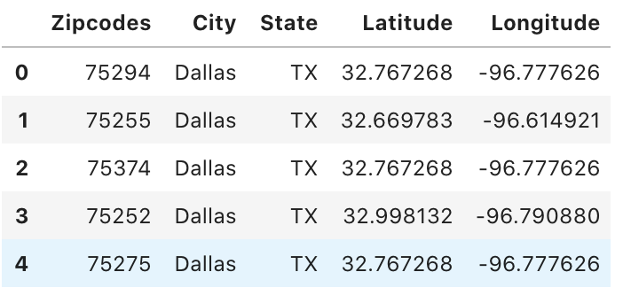
Methodology and Execution
Import the zip code data and convert to a pandas data frame.
Remove not needed attribute and remove any non-Dallas Zipcodes.

Slide 8
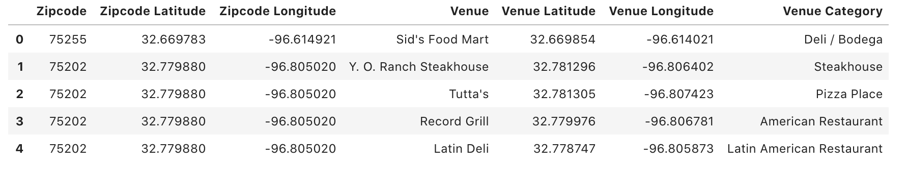
Methodology and Execution
Get all Dallas Restaurants via Foursquare API.
Limit the results to 100 Venues
Explore the data

Slide 9
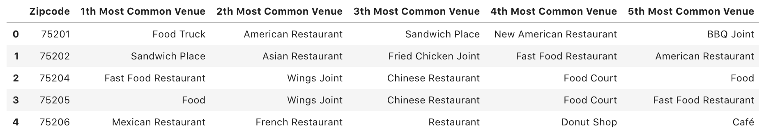
Methodology and Execution
We use One Hot Encoding to group data, and find out the top five venue categories present in each zip code.
Then implement unsupervised machine learning algorithms, k-Means clustering (kclusters = 5)

Slide 10
Results
The Final results is in the form of a Folium map that combines the Zip Code clusters and radius circles at 5 kilometers around the client's home city (Irving, Tx.
As will be seen on the next slide there are only two zip codes that fall inside the 10 km radius (75220 and 75235)

Slide 11
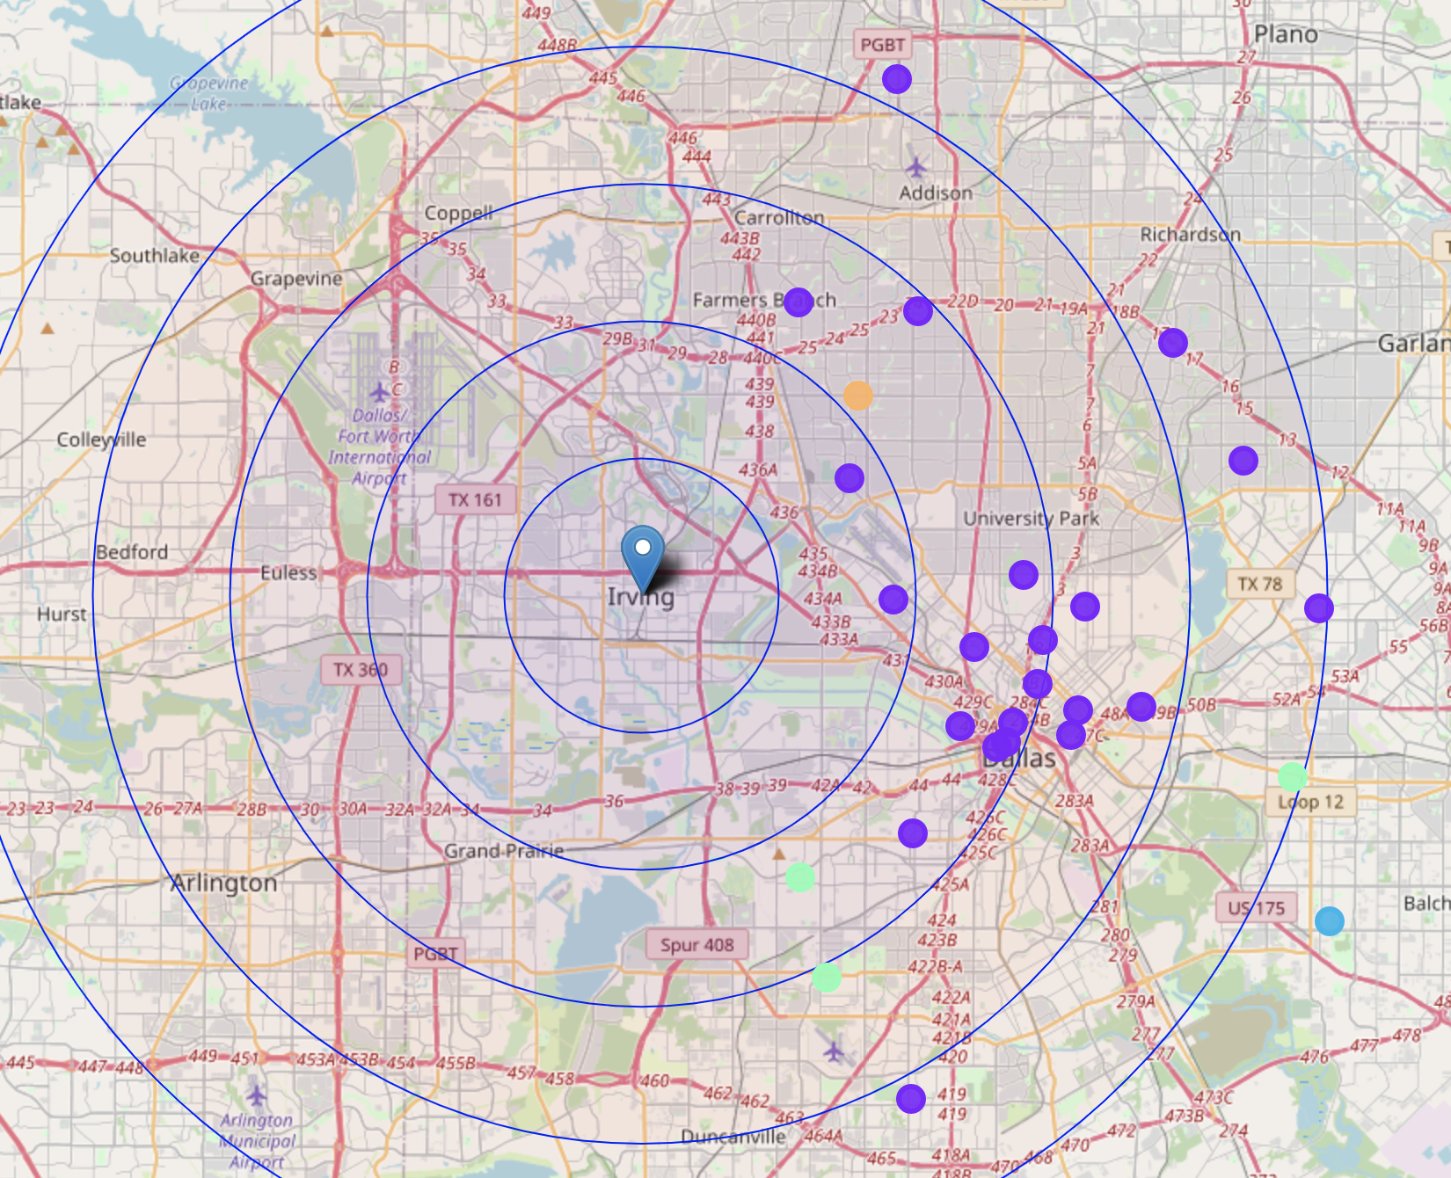
Results (Map)

Slide 12
Results (Secondary Analysis)
More analysis was needed to determine if both or only one of the zip codes fall inside the requirements.(75220 and 75235)
Zip code 75220’s most common venue is Pizza place, while café and Wings restaurants are not in the top 5 venues.
Zip code 75235 has none of the three preferred restaurants types in the top 5.

Slide 13
Recommendation
From our analysis is is clrear that, based on the criteria, the client can :
  Open either a Café or a Wings restaurant in zip code 75220
  or
  Open a Café, Pizza or Wings restaurant in zip code 75235

Slide 14
Conclusion
As seen in the example above, data was used to cluster neighborhoods in Dallas based on the most common venues in those zip codes and then narrowing down the zip codes based on distance from a central point.
The solution can also be used to solve other problems, and it is quite easy to change the Foursquare Category and cluster zip codes, or change the center of base (home location).

