Slide 1
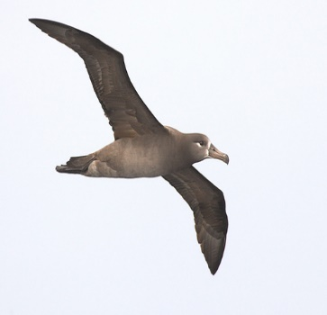
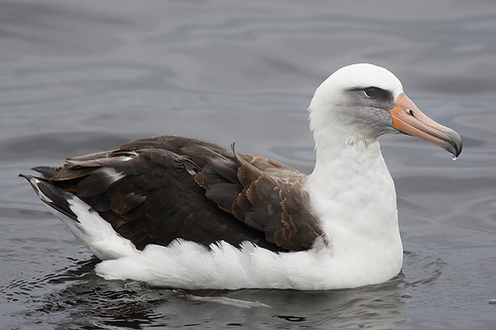
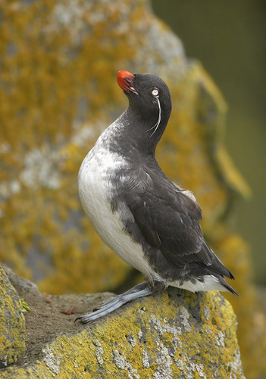
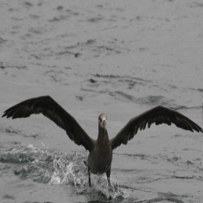
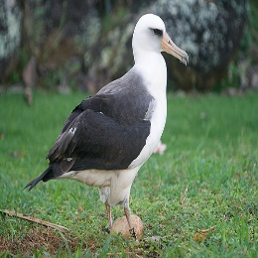
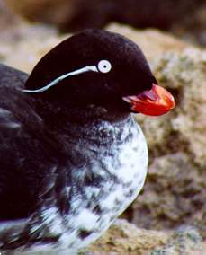
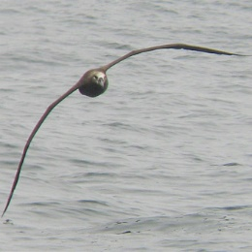
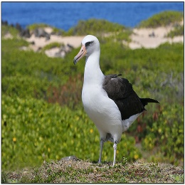
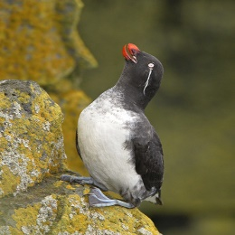
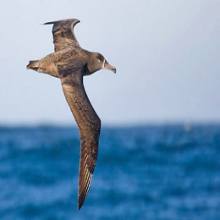
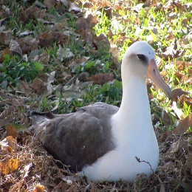
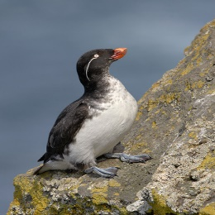



Inputs
Dual-Stream Attention Module
Complementary Loss Coupling Module
Support Set Samples
Support Tensor Feature
Similarity Score Calculation
Support Vector Feature
Support
Query
CNN
Few-shot Loss
Softmax
Function
L$few$
Black footed Albatross
Laysan Albatross
Parakeet Aukletss
Support
Query
Dual-Stream Attention
Global Average
Pooling
Weight Sharing
Center Loss
Dual-Stream Attention
Global Average
Pooling
$$\text{L}center$$
Black footed Albatross
Laysan Albatross
Parakeet Aukletss
CNN
Feature Center
Linear Transformation
Softmax
Function
L$global$
Query Set Samples
Query Vector Feature
Query Tensor Feature
Global Loss

Slide 3
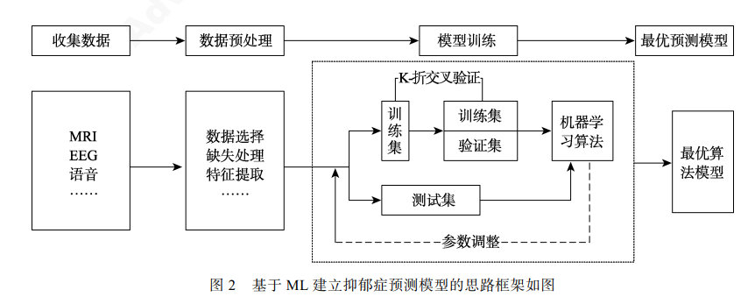

Slide 4

Student Stress Data Acquisition
Data Preprocessing
Intelligent Computing Model Traing
Optimal Prediction Model
Psychological Data Physiological Data
Social Data
Environmental Data
Academic Data
Standardization of Data Features
Training Set
Intelligent Computing Algorithm
Optimal Algorithm Model
Model Parameter Adjustment
Testing Set

