Slide 1
Predicting Diabetes Outcomes
with Logistic Regression and Deep Learning
Presentation #11
Henley (Tian Yu) Hwang
1st Year M.S. in Mathematical Sciences

Slide 2
Problem Statement
This study seeks to create logistic regression and deep learning model for predictive analysis of diabetes outcomes using specific health measurements from the Pima Indians Diabetes Database.
https://www.kaggle.com/datasets/uciml/pima-indians-diabetes-database

Slide 3
Outline
Data Preprocessing
Cross Validation
Logistic Regression
Deep Learning Model
Final Evaluation
Conclusion

Slide 4
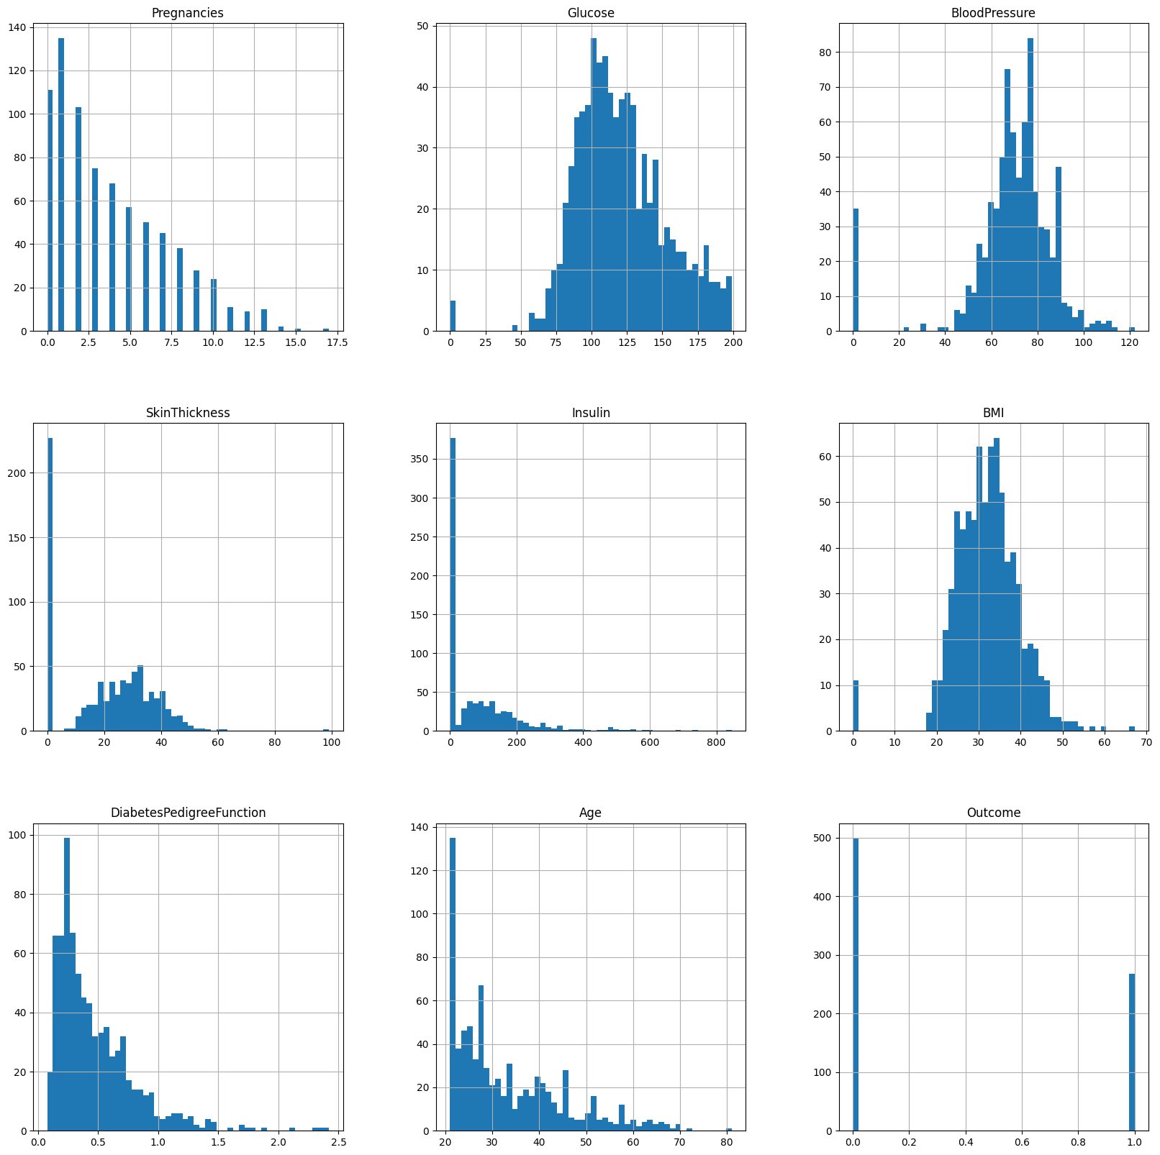
Data Preprocessing
Invalid data are replaced with mean
Features are standardized (with training data)
https://www.kaggle.com/code/shrutimechlearn/step-by-step-diabetes-classification-knn-detailed

Slide 5

Cross Validation
Train:Valid = 8:2
Stratification is applied
https://scikit-learn.org/stable/modules/cross_validation.html

Slide 6
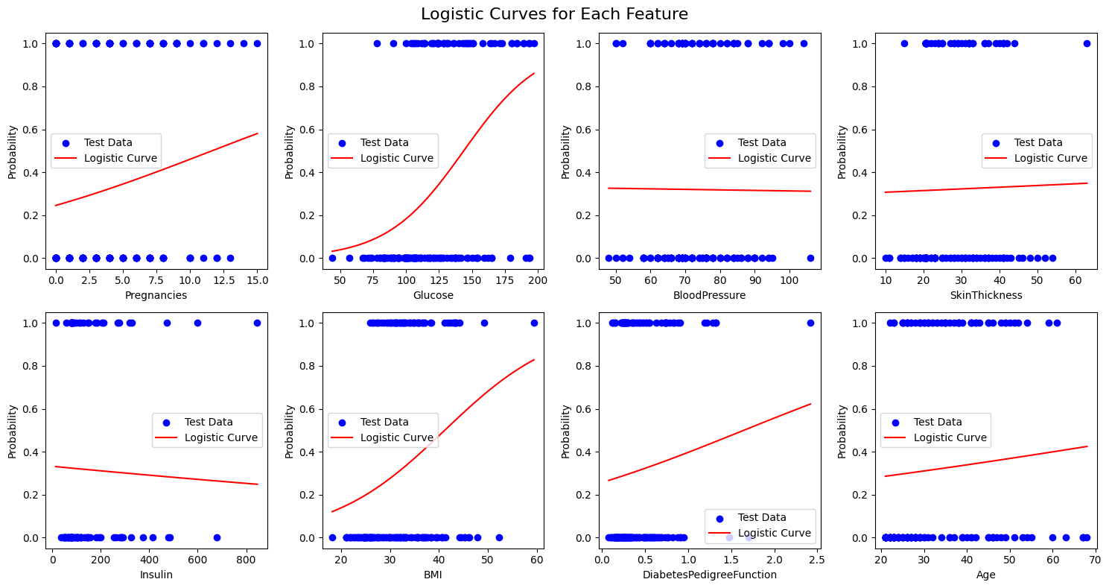
Logistic Regression
Grid search hyperparameters for best AUROC from
Solver: [newton-cg, lbfgs, liblinear]
Penalty: L2
C: [0.01, 0.1, 1, 10, 100]
Result
Solver: liblinear
Penalty: L2
C: 0.1
Accuracy: 0.791 ± 0.016
AUROC: 0.844 ± 0.016
Threshold by Youden
0.3306

Slide 7
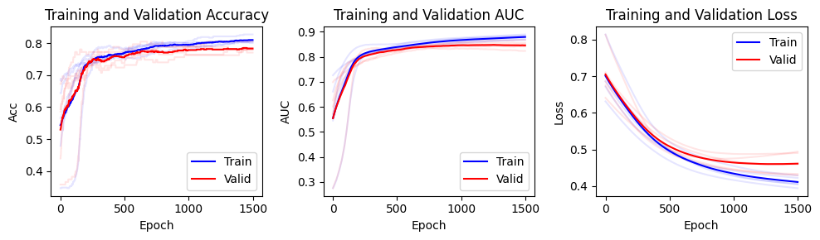
Deep Learning Model
Hyperparameters
Model: Linear(8, 16) -> ReLU -> Linear(16, 1) -> Sigmoid
Loss: BCELoss
Optimizer: Adam(lr=3e-4, weight_decay=1e-5)
LR scheduler: ReduceLROnPlateau
Max epochs: 1500
Validation result
Accuracy: 0.7834 ± 0.0114
AUROC: 0.8462 ± 0.0146
Threshold by Youden
0.3719

Slide 8
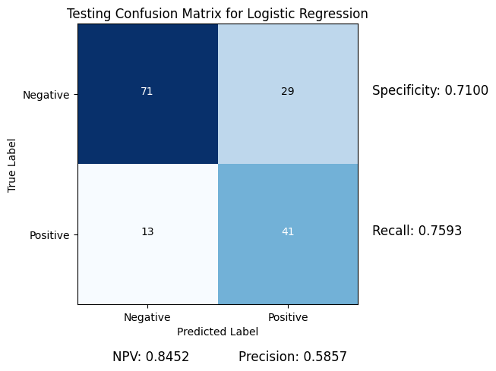
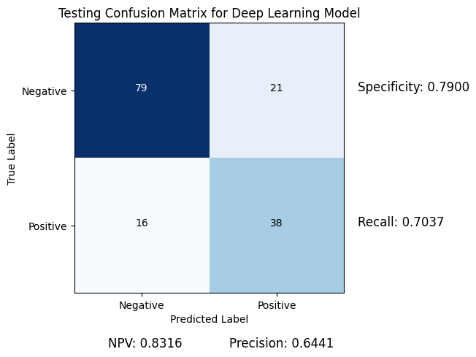
Final Evaluation
Logistic regression
Accuracy: 0.7273
AUROC: 0.8107
Deep learning model
Accuracy: 0.7597
AUROC: 0.8222

Slide 9
Conclusion
Both the deep learning model and logistic regression demonstrated comparable performance in fitting the training data
However, the deep learning model exhibited superior generalization to the test data
On the other hand, logistic regression excels in explanatory power, highlighting the significance of features such as BMI and glucose

Slide 10
Thank You

