Slide 1

Understanding Phishing
Risks and Prevention in Organizations
Definition: Phishing is a cyber attack that uses disguised email as a weapon. The goal is to trick the email recipient into believing that the message is something they want or need — a request from their bank, for instance, or a note from someone in their company — and to click a link or download an attachment.
Impact on Organizations: Phishing attacks can lead to significant financial loss, data breaches, and damage to organizational reputation. They often serve as the entry point for more sophisticated cyber attacks.
Importance of Awareness: Educating employees about phishing and implementing robust security measures are critical to safeguarding an organization's assets and information.
Photo by Hossam M. Omar on Unsplash

Slide 2
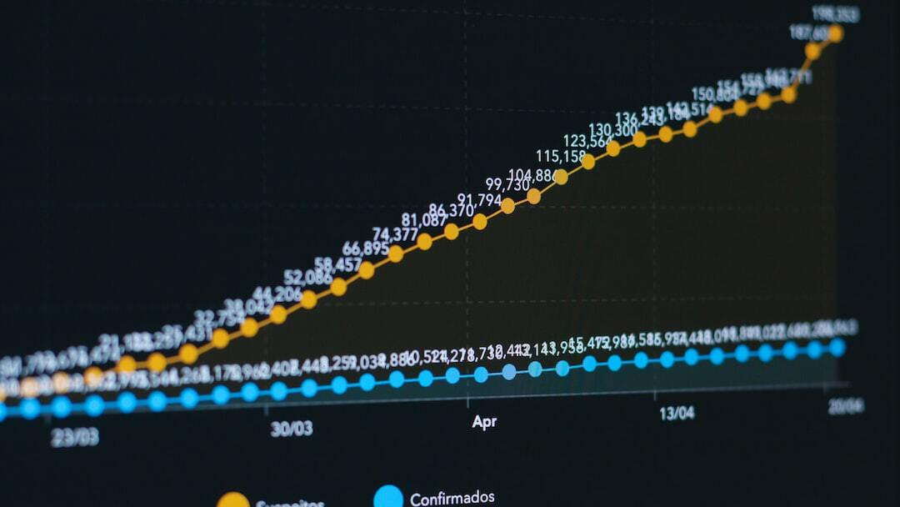
History of Phishing
Evolution and Current Trends
Origins of Phishing: Phishing originated in the mid-1990s among hackers aiming to steal AOL user account information. Initially, it was termed as 'phishing' due to the analogy of 'fishing' for user information.
Evolution Over Time: Phishing has evolved from simple deceptive emails to sophisticated attacks involving spear phishing, whaling, and social engineering tactics across various communication channels.
Current Trends: Recent trends in phishing include the use of artificial intelligence to create more convincing fake messages, the targeting of mobile users through smishing, and the exploitation of current events for themed phishing campaigns.
Rising Threats: Phishing remains a significant threat, with attackers continually developing new methods to evade detection and trick victims, making it imperative for organizations to stay vigilant and proactive in their security measures.
Photo by KOBU Agency on Unsplash

Slide 3
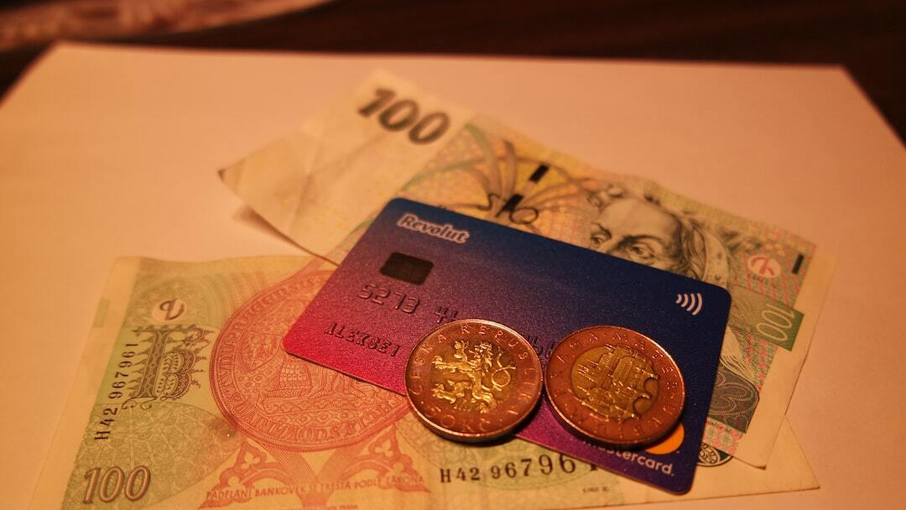
Types of Phishing Attacks
Varieties and Tactics
Email Phishing: The most common type, where attackers send fraudulent emails mimicking legitimate sources to steal sensitive information.
Spear Phishing: Targeted attacks aimed at specific individuals or organizations, often using personal information to increase credibility.
Whaling: A form of spear phishing that targets high-profile individuals like executives, with the intent to steal large sums or sensitive company information.
Smishing and Vishing: Phishing conducted via SMS (smishing) or voice calls (vishing), exploiting human psychology to obtain confidential information.
Clone Phishing: Involves creating a nearly identical copy of a legitimate email with malicious links or attachments to deceive the recipient.
Photo by Aleksei Tertychnyi on Unsplash

Slide 4
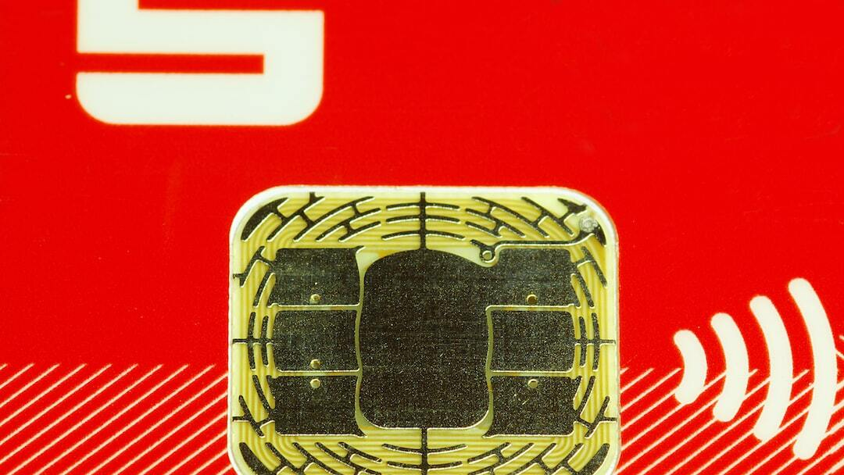
Common Phishing Attacks
Techniques and Examples
Deceptive Phishing: The attacker impersonates a legitimate company to steal personal information. Example: Fake bank email alerts urging immediate action.
CEO Fraud: Attackers pose as company executives and urge employees to transfer funds or provide confidential information. Example: Fraudulent requests for wire transfers.
Pharming: Redirecting users from legitimate websites to fraudulent ones to steal sensitive data. Example: Manipulating DNS server settings to redirect users.
Man-in-the-Middle (MitM) Phishing: Intercepting communication between two parties to steal or manipulate data. Example: Attacks on unsecured Wi-Fi networks to capture user login details.
Photo by Immo Wegmann on Unsplash

Slide 5
Case Studies
Real-World Phishing Incidents
Example 1: Major Bank Phishing Scam: A well-known bank was targeted by a phishing campaign that resulted in millions of dollars lost. Attackers used sophisticated spear phishing tactics to gain access to employee credentials and customer accounts.
Example 2: Government Agency Attack: A government agency faced a significant breach when employees clicked on malicious links from phishing emails, leading to unauthorized access to sensitive data.
Learning from Incidents: These cases emphasize the importance of robust security measures and continuous employee education to prevent phishing attacks.

Slide 6
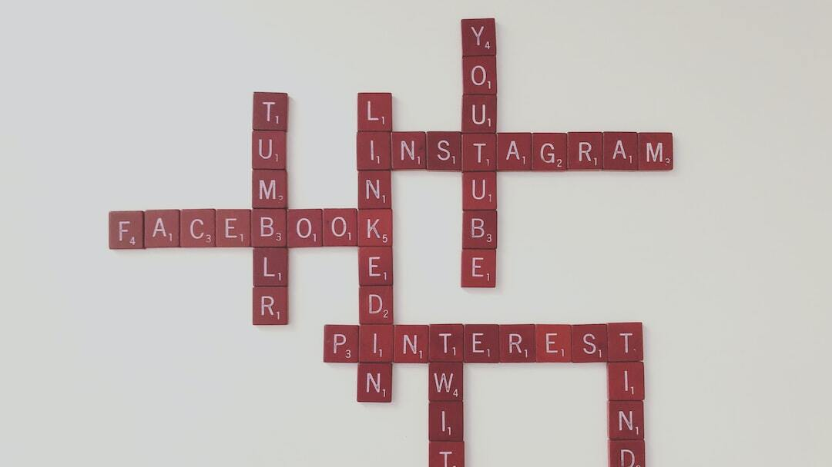
Famous Phishing Attacks
Notable Incidents
2013 Target Corporation Breach: Attackers gained access to Target’s network through a phishing email sent to a third-party vendor, leading to the theft of credit card information of 40 million customers.
2016 DNC Email Leak: Spear phishing emails targeted Democratic National Committee members, resulting in a significant leak of emails during the U.S. presidential election.
2020 Twitter Bitcoin Scam: High-profile Twitter accounts were compromised via a phone spear phishing attack, leading to a Bitcoin scam that tweeted fraudulent messages from these accounts.
Photo by Merakist on Unsplash

Slide 7
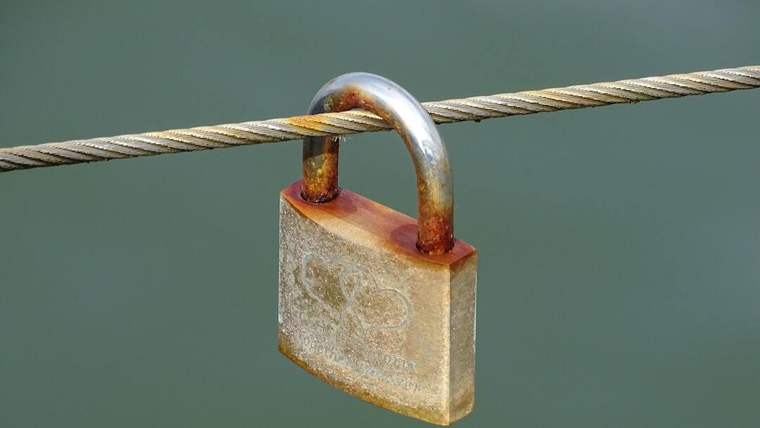
Phishing Prevention Strategies
Best Practices for Organizations
Employee Education: Regular training sessions to recognize phishing attempts and understand the risks involved.
Use Advanced Email Filtering: Implement sophisticated email filters that can detect and block phishing emails before they reach the user.
Implement Multi-Factor Authentication (MFA): MFA adds an extra layer of security, making it more difficult for attackers to gain unauthorized access even if they have stolen credentials.
Regularly Update and Patch Systems: Keeping software and systems up to date closes security vulnerabilities that phishers could exploit.
Establish Clear Security Policies: Define and communicate security policies and procedures for handling sensitive information and reporting suspected phishing attempts.
Conduct Regular Security Audits: Regular audits help identify and mitigate security risks, ensuring that preventive measures are effective and up to date.
Photo by Belinda Fewings on Unsplash

Slide 8
References
Cybersecurity & Infrastructure Security Agency (CISA): Phishing: Overview and Guidance. Retrieved from https://www.cisa.gov/phishing
Mike, H. (2015): Internet Security: How to Defend Against Attackers on the Web (2nd ed.). Jones & Bartlett Learning. https://online.vitalsource.com/books/9781284104301

