Slide 1
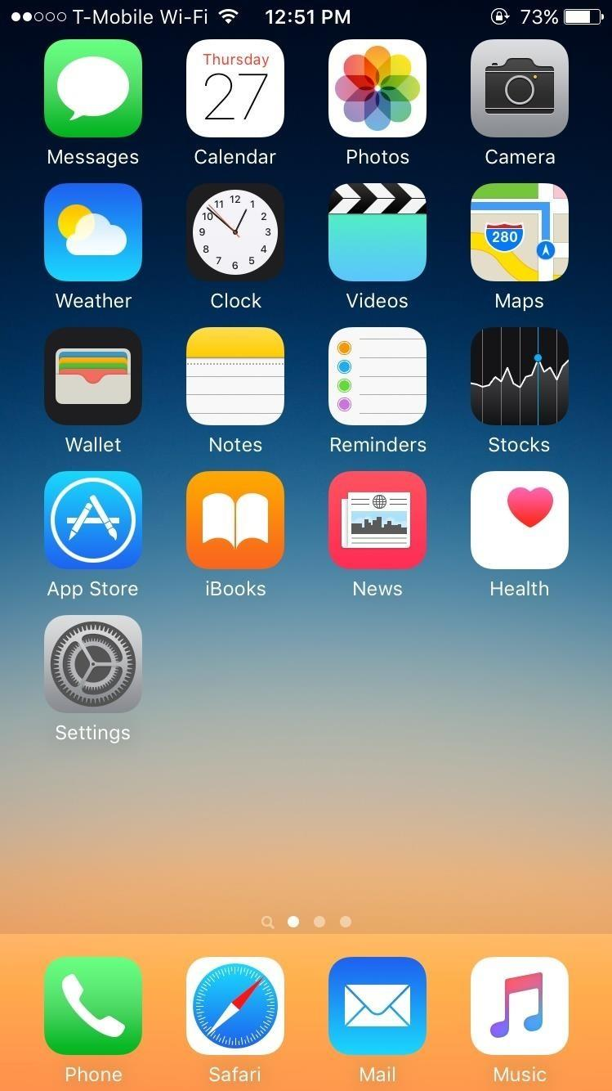

Don’t Get Robbed

Slide 2
Don’t Get Robbed
SELECT A LANGUAGE TO BEGIN:
English
Español
中文
عربى
Deutsch
François
日本

Slide 3
Don’t Get Robbed
CREATE AN ACCOUNT
CREATE AN ACCOUNT
First Name
First Name
Last Name
Last Name
E-mail
E-mail
Username
Username
Password
Password
SIGN UP
SIGN UP
< back

Slide 4
Don’t Get Robbed
CREATE AN ACCOUNT
John
Last Name
E-mail
Username
Password
SIGN UP
< back

Slide 5
Don’t Get Robbed
CREATE AN ACCOUNT
John
Smith
E-mail
Username
Password
SIGN UP
< back

Slide 6
Don’t Get Robbed
CREATE AN ACCOUNT
John
Smith
johnsmith@gmail.com
Username
Password
SIGN UP
< back

Slide 7
Don’t Get Robbed
CREATE AN ACCOUNT
John
Smith
johnsmith@gmail.com
john567
Password
SIGN UP
< back

Slide 8
Don’t Get Robbed
CREATE AN ACCOUNT
John
Smith
johnsmith@gmail.com
john567
*******h
SIGN UP
< back

Slide 9
Don’t Get Robbed
65%

Slide 10
Don’t Get Robbed
Welcome to your SafePack!
Next

Slide 11

First, turn on Bluetooth
Skip

Slide 12
First, turn on Bluetooth
Next

Slide 13

Slide to connect Bluetooth to SafePack
Skip

Slide 14
Slide to connect Bluetooth to SafePack
Next

Slide 15
Choose a personalized pin to access your SafePack
<
0
1
2
3
4
5
6
7
8
9
Next

Slide 16
Choose a personalized pin to access your SafePack
1
<
0
1
2
3
4
5
6
7
8
9
Next

Slide 17
Choose a personalized pin to access your SafePack
1
2
1
<
0
1
2
3
4
5
6
7
8
9
Next

Slide 18
Choose a personalized pin to access your SafePack
1
2
1
3
<
0
1
2
3
4
5
6
7
8
9
Next

Slide 19
Choose a personalized pin to access your SafePack
1
2
1
3
4
<
0
1
2
3
4
5
6
7
8
9
Next

Slide 20

Enter your fingerprint for Touch ID to access your SafePack
Skip

Slide 21
Enter your fingerprint for Touch ID to access your SafePack
Next

Slide 22




Main Pocket

Slide 23
Enter Your Pin
<
0
1
2
3
4
5
6
7
8
9
Next
< back

Slide 24
Enter Your Pin
1
<
0
1
2
3
4
5
6
7
8
9
Next
< back

Slide 25
Enter Your Pin
1
2
1
<
0
1
2
3
4
5
6
7
8
9
Next
< back

Slide 26
Enter Your Pin
1
2
1
2
3
1
<
0
1
2
3
4
5
6
7
8
9
Next
< back

Slide 27
Enter Your Pin
1
2
1
2
3
1
2
3
4
1
<
0
1
2
3
4
5
6
7
8
9
Next
< back

Slide 28

Success!
Next

Slide 29

Other Pockets
1
2
3
1
2
3

Slide 30
Other Pockets
1
2
3
1
2
3

Slide 31
Other Pockets
1
2
3
1
2
3

Slide 32
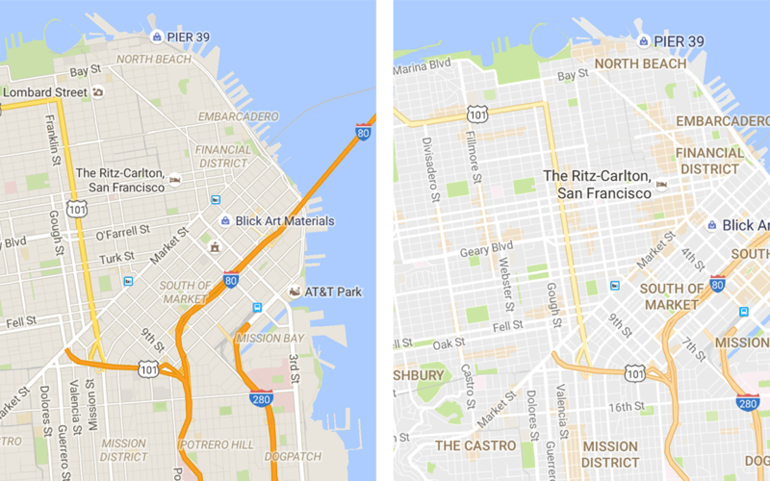


ALL

Slide 33
Settings
Bluetooth
Change Pin
Fingerprint
Languages
Alarm Volume
Help
Sign Out

Slide 34
Slide to connect
< back

Slide 35
< back

Slide 36
Don’t Get Robbed
Choose a language:
English
Español
中文
عربى
Deutsch
François
日本
< back

Slide 37
Enter your fingerprint for Touch ID to access your SafePack
< back

Slide 38
Enter Your New Pin
1
<
0
1
2
3
4
5
6
7
8
9
Next
< back

Slide 39
Confirm Your New Pin
1
<
0
1
2
3
4
5
6
7
8
9
Next
< back

Slide 40
Your pins do not match
Please re-enter your pin
Okay

Slide 41
Enter Your New Pin
1
2
1
2
3
1
<
0
1
2
3
4
5
6
7
8
9
Next
< back

Slide 42
Enter Your New Pin
1
2
1
<
0
1
2
3
4
5
6
7
8
9
Next
< back

Slide 43
Enter Your New Pin
1
2
1
2
3
1
<
0
1
2
3
4
5
6
7
8
9
Next
< back

Slide 44
Enter Your New Pin
1
2
1
2
3
1
2
3
5
1
<
0
1
2
3
4
5
6
7
8
9
Next
< back

Slide 45
Choose a personalized pin to access your SafePack
1
2
1
3
7
<
0
1
2
3
4
5
6
7
8
9
Next

Slide 46
Confirm Your New Pin
1
2
1
2
3
1
<
0
1
2
3
4
5
6
7
8
9
Next
< back

Slide 47
Confirm Your New Pin
1
2
1
<
0
1
2
3
4
5
6
7
8
9
Next
< back

Slide 48
Confirm Your New Pin
1
2
1
2
3
1
<
0
1
2
3
4
5
6
7
8
9
Next
< back

Slide 49
Confirm Your New Pin
1
2
1
2
3
1
2
3
5
1
<
0
1
2
3
4
5
6
7
8
9
Next
< back

Slide 50
Main Pocket

Slide 51
ALL

Slide 52
Slide to connect
< back

Slide 53
Slide to connect
< back

Slide 54
Slide to connect
< back

Slide 55
Enter your fingerprint for Touch ID to access your SafePack
< back

Slide 56
< back

Slide 57
Help
Map:
Locate your backpack
Turn on your backpack alarm
Lock all your backpack pockets
Main Pocket:
Unlock/lock your main backpack pocket
Other Pockets:
Select a specific backpack pocket and unlock/lock it
Settings:
Change and customize features
< back

Slide 58
Don’t Get Robbed
CREATE AN ACCOUNT
Login
First Name
Username
Last Name
Password
E-mail
Username
Next
Password
Create Account
SIGN UP

Slide 59
Don’t Get Robbed
CREATE AN ACCOUNT
Login
First Name
john567
Last Name
Password
E-mail
Username
Next
Password
Create Account
SIGN UP

Slide 60
Don’t Get Robbed
CREATE AN ACCOUNT
Login
First Name
john567
Last Name
ilove3750
E-mail
Username
Next
Password
Create Account
SIGN UP

Slide 61
Other Pockets
1
2
3
1
2
3

Slide 62
Other Pockets
1
2
3
1
2
3

Slide 63
Other Pockets
1
2
3
1
2
3

Slide 64
Other Pockets
1
2
3
1
2
3

Slide 65
< back

