Slide 1

Henna Mian, Saloni Shah, Jenny Shen, Zoe Barth
Notes:
Learning objective: To explore the city and culture of barcelona through its local flowers

Slide 2

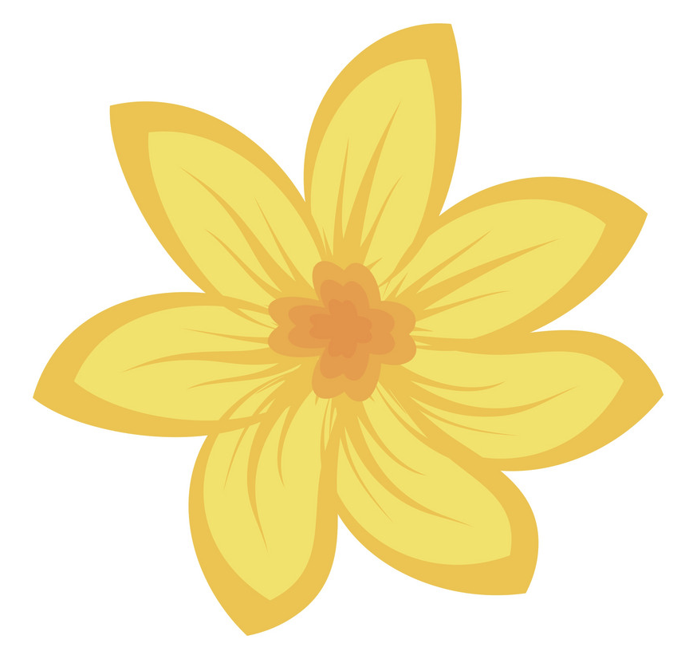
flor-mino

Slide 3
SELECT A LANGUAGE TO BEGIN:
English
Español
中文
عربى
Deutsch
François
日本

Slide 4
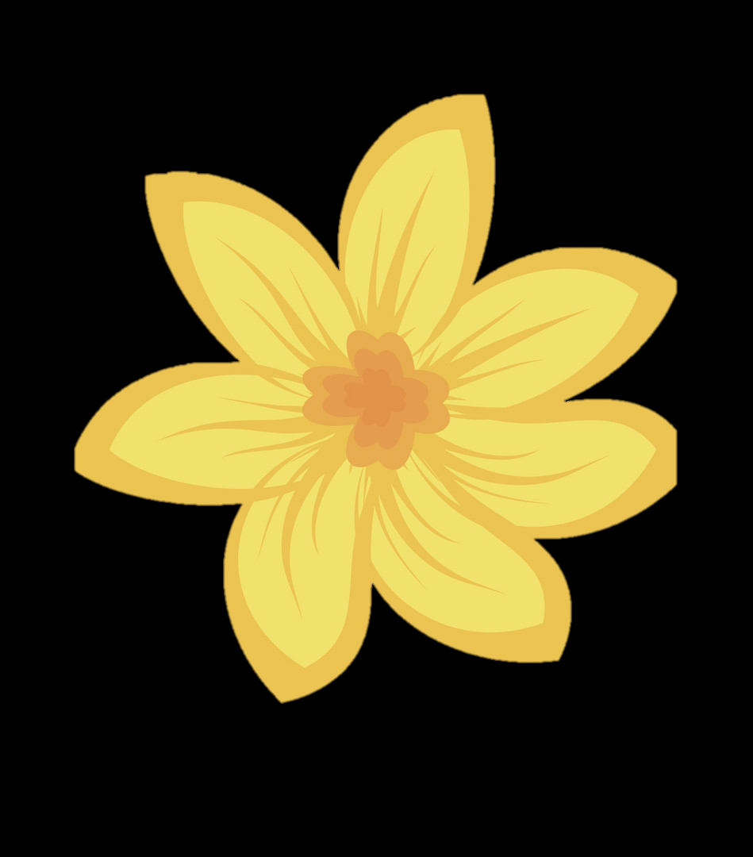
CREATE AN ACCOUNT
First Name
Last Name
E-mail
Username
Password
SIGN UP

Slide 5
WELCOME!
This app is designed to help you explore the city and culture of Barcelona through its local flowers. To start, try taking a picture of a flower.
Continue

Slide 6

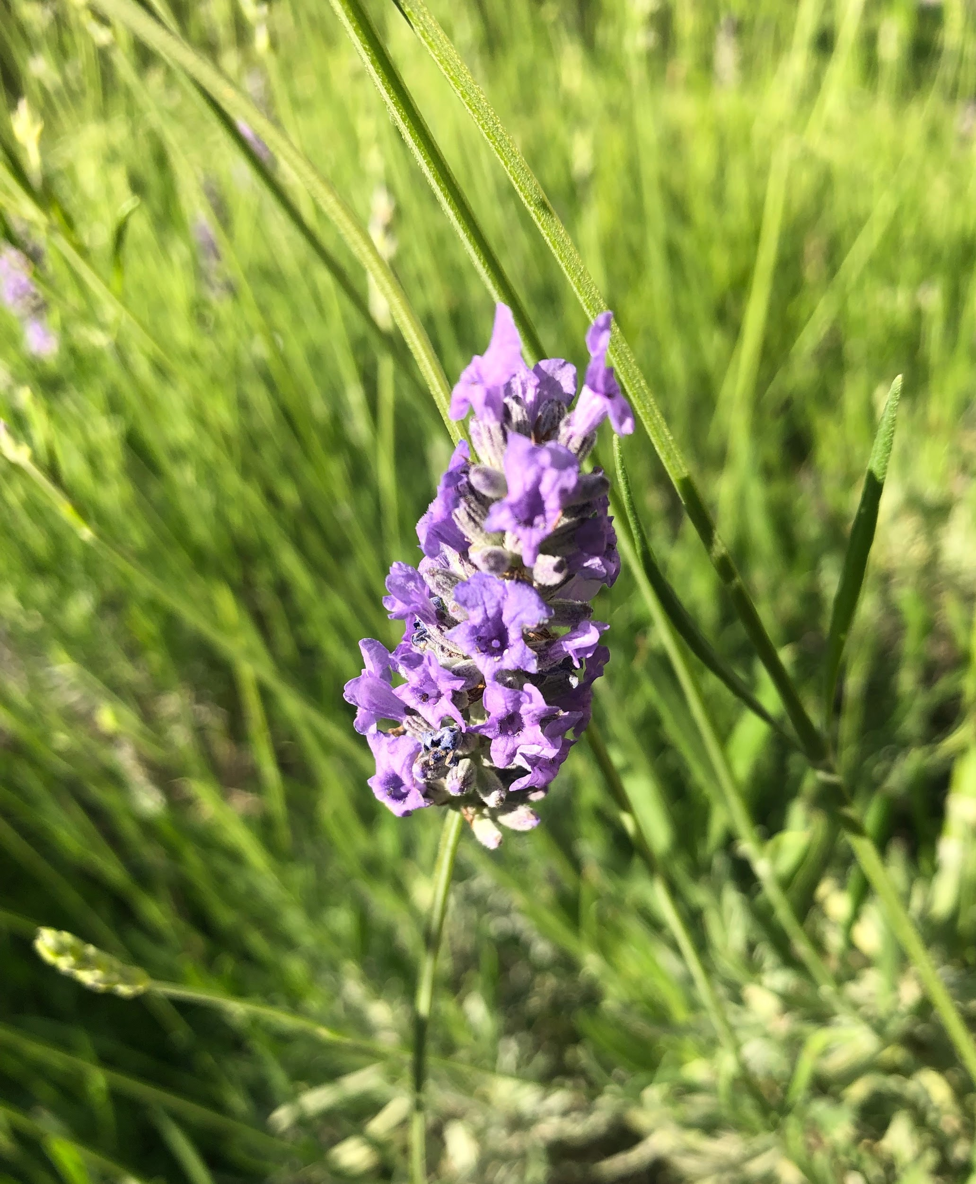





Slide 7
This is a Lavender Flower.
LEARN MORE
X

Slide 8
Lavender
Lavandula is the genus of 47 known species of flowering plants in the mint family, Lamiaceae.
Native to countries bordering the Mediterranean.
X
Lavender species are common in herb gardens for their fragrant leaves and attractive flowers.
Lavenders are small evergreen shrubs with gray-green hoary linear leaves. The purple flowers are sparsely arranged on spikes.
May bloom up to three times – in early May, June and late summer or early fall.
Known for their antiseptic and medicinal properties, lavender extracts and products long have been used as disinfectants, fresheners, and laundry and bath additives. Lavender essential oil is commonly used in aromatherapy.

Slide 9


Slide 10
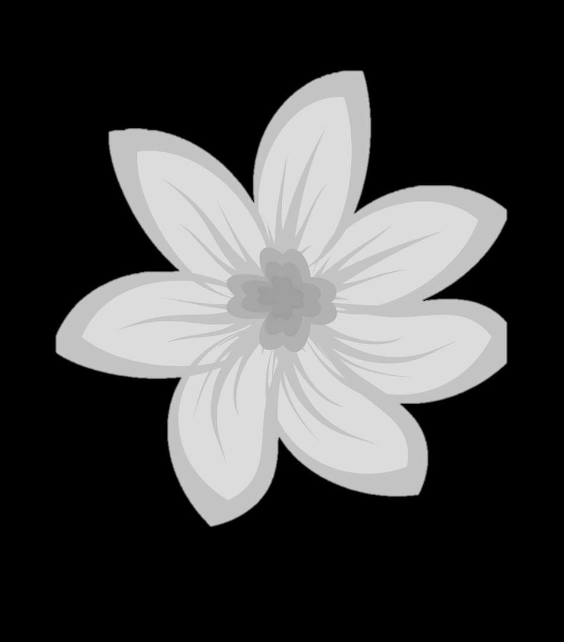
Your Flowers
Lavender
Anemone
Amaryllis
Carnation
Chrysanthemum
Daisy
Forget-Me-Not
Lupines
Orchid
Peony
Rhododendron
Tulip

Slide 11
Lavender
Lavandula is the genus of 47 known species of flowering plants in the mint family, Lamiaceae.
Native to countries bordering the Mediterranean.
X
Lavender species are common in herb gardens for their fragrant leaves and attractive flowers.
Lavenders are small evergreen shrubs with gray-green hoary linear leaves. The purple flowers are sparsely arranged on spikes.
May bloom up to three times – in early May, June and late summer or early fall.
Known for their antiseptic and medicinal properties, lavender extracts and products long have been used as disinfectants, fresheners, and laundry and bath additives. Lavender essential oil is commonly used in aromatherapy.

Slide 12
Your Flowers
Lavender
Anemone
Amaryllis
Carnation
Chrysanthemum
Daisy
Forget-Me-Not
Lupines
Orchid
Peony
Rhododendron
Tulip

Slide 13
Favorites
+

Slide 14
Select Your Favorite Flowers
Done
Lavender
Anemone
Amaryllis
Carnation
Chrysanthemum
Daisy
Forget-Me-Not
Lupines
Orchid
Peony
Rhododendron
Tulip

Slide 15
Select Your Favorite Flowers
Done
Lavender
Anemone
Amaryllis
Carnation
Chrysanthemum
Daisy
Forget-Me-Not
Lupines
Orchid
Peony
Rhododendron
Tulip

Slide 16
Favorites
+
Lavender

Slide 17
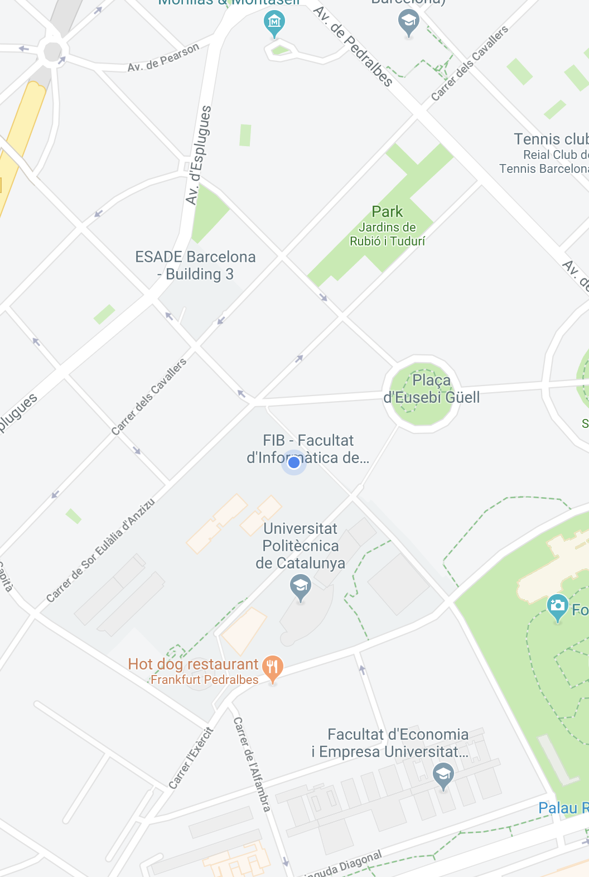


Slide 18
Flowers Found Here:
Purple Leaved Iris
Yellow Jasmine
Lavender
X

Slide 20
Lavender

Slide 21
Settings
Account
Language
Settings page
Notifications
Connect social media
FAQ’s
Report a Problem

