Slide 1
Hate speech detection using SVM, RFM and CNN model
Author : Heena Khan
Date : 04-10-2020

Slide 2
Introduction
Hate speech is currently a huge problem and is growing considerably
It particularly aﬀects marginalized communities, like minorities, women, people of color, and other vulnerable communities
There is exceptional increase in hate speech on Indian social media in last few years [1]
Facebook India 2018-19
2

Slide 3
Background
Recent years have seen an increasing number of research on hate speech detection, researchers have used diﬀerent classiﬁcation methodologies to identify social abuse.
Davidson et al. [2] used an automated approach to identify hate speech on the USA twitter dataset using lexicon from Hatebase, labeled hate speech, oﬀensive, and neither of them
Waseem and Hovy [3] worked on their dataset from USA twitter consisting of 16,914 tweets labeled as racist, sexist, or neither
De Gilbert et al. [4] introduced their data consisting of posts from a white supremacist forum labeled with Hate, No-Hate.
Hala Mulki et al. [5] introduced a dataset in Arabic for Hate speech and abusive language detection.
Ross et al. [6] created a Twitter dataset in German for the European refugee crisis, labeled as hate and Not
3

Slide 4

Background
There has been an ample number of researches been done to recognize hate speech on social media throughout America, Europe, and the Middle East.
A 2018 Workshop on Trolling, Aggression, and Cyberbully (TRAC) introduced a multilingual dataset in Hindi and English targeting state of Assam in India.
The model introduced in the TRAC paper by Kumar et al. [7] used LSTM method of classification and their accuracy was 35 percent.
In this paper, we will be implementing CNN, SVM, and RFM methods using the TRAC dataset to identify aggressive and non aggressive comments (hate speech)
4

Slide 5
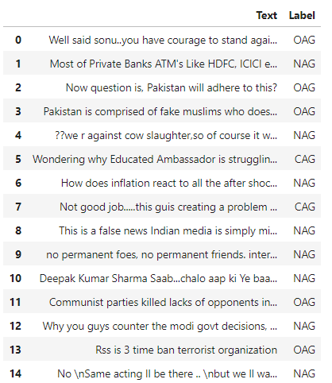
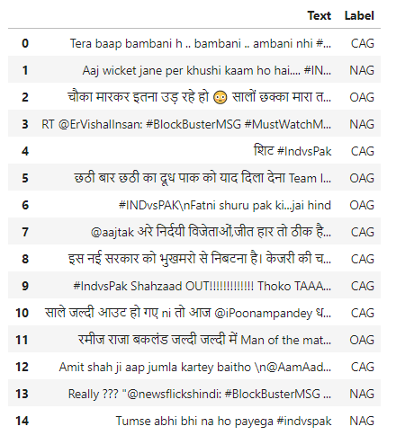
Methods
Labels: Overtly Aggressive (OAG), Covertly Aggressive (CAG), Non Aggressive (NAG)
Task 1 – Facebook English Task 2 – Twitter English.

Slide 6
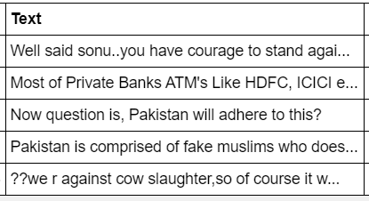
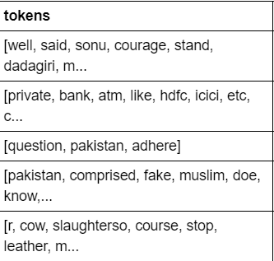
Methods - Data-preprocessing
Before
Resolving Class Imbalance issue
Remove Emoji
Remove Punctuation
Converting words like “can’t” to “can not”
Lower case
Remove Link
Word Lemmatization
Remove stop words
After
6

Slide 7
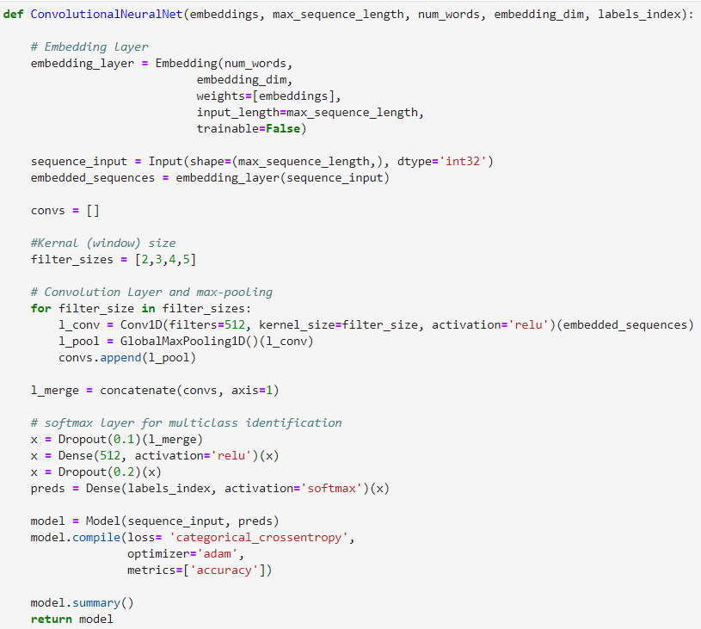
Methods – Convolutional Neural Network
The ﬁrst step is to generate feature embedding. Feature embedding for all words is constructed by through word embedding using word2vec.
Our Model is Inspired by Yoon Kim’s [8] Model. It consists of 4 layers, the embedding layer, the Convolutional layer, the max-pooling layer, and the soft-max output layer.
7

Slide 8
Methods – SVM and RFM
After the word processing and word tokenization, we used TF-IDF vectorizer to generate vectors
The n-gram features from each comment and weight them according to their TF-IDF values. [9]
We have also implemented SVM using Bag-of-words BOW.
RFM - Random Forest, like its name implies, consists of a large number of individual decision trees that operate as an ensemble. Each individual tree in the random forest spits out a class prediction and the class with the most votes becomes our model’s prediction [10]
SVM – Support Vector, are supervised learning models with associated learning algorithms that analyze data used for classification and regression analysis [9]

Slide 9
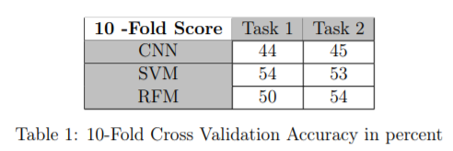
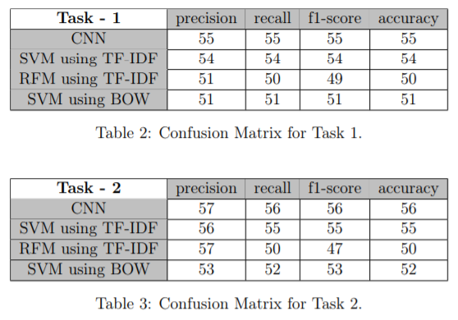
Results
10 –Fold Score
Precision, Recall, F1-score, Accuracy
9

Slide 10
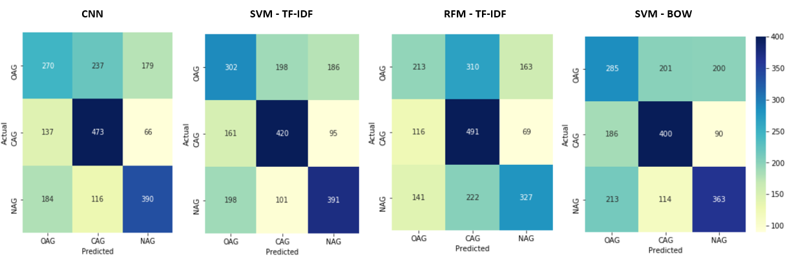
Results – Task 1
10

Slide 11
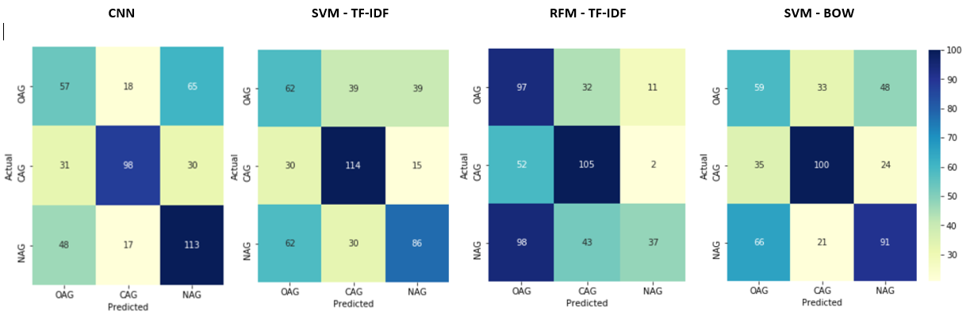
Results – Task 2
11

Slide 12
Conclusion
Since our dataset is consists of multi-lingual data using word embedding vectors as a feature is not suﬃcient
Our CNN, SVM, and RFM performed better than the LSTM model used in TRAC paper
Our SVM model performed better than CNN and RFM.
12

Slide 13
Future Work
We would like to implement and analyze the BERT model on the same dataset with different feature selection methods.
We will also use language lexicon and Hatebase lexicon to generate our features.
Currently, we are working only on English characters and removing Non-English characters. I would like to implement an encoder-decoder neural network model to translate Non-English characters into English before generating my features.
13

Slide 14
REFERENCES
David Gilbert. The vice - facebook in india is drowning in anti-muslim hate speech.
Thomas Davidson, Dana Warmsley, Michael Macy, and Ingmar Weber. Automated hate speech detection and the problem of offensive language. In Eleventh international aaai conference on web and social media, 2017.
Zeerak Waseem and Dirk Hovy. Hateful symbols or hateful people? predictive features for hate speech detection on twitter. In Proceedings of the NAACL student research workshop, pages 88–93, 2016
Ona de Gibert, Naiara Perez, Aitor García-Pablos, and Montse Cuadros. Hate speech dataset from a white supremacy forum. arXiv preprint arXiv:1809.04444, 2018.
Hala Mulki, Hatem Haddad, Chedi Bechikh Ali, and Halima Alshabani. L-hsab: A levantine twitter dataset for hate speech and abusive language. In Proceedings of the Third Workshop on Abusive Language Online, pages 111–118, 2019.
Björn Ross, Michael Rist, Guillermo Carbonell, Benjamin Cabrera, Nils Kurowsky, and Michael Wojatzki. Measuring the reliability of hate speech annotations: The case of the european refugee crisis. arXiv preprint arXiv:1701.08118, 2017.
Ritesh Kumar, Guggilla Bhanodai, Rajendra Pamula, and Maheshwar Reddy Chennuru. Trac-1 shared task on aggression identification: Iit (ism)@ coling’18. In Proceedings of the First Workshop on Trolling, Aggression and Cyberbullying (TRAC-2018), pages 58–65, 2018.
Yoon Kim. Convolutional neural networks for sentence classification. arXiv preprint arXiv:1408.5882, 2014.
Aditya Gaydhani, Vikrant Doma, Shrikant Kendre, and Laxmi Bhagwat. Detecting hate speech and offensive language on twitter using machine learning: An n-gram and tfidf based approach. arXiv preprint arXiv:1809.08651, 2018.
Susan Li. Towards data science - multi-class text classication with scikit-learn.
14

Slide 15
Thanks!
Any questions?

