Slide 1
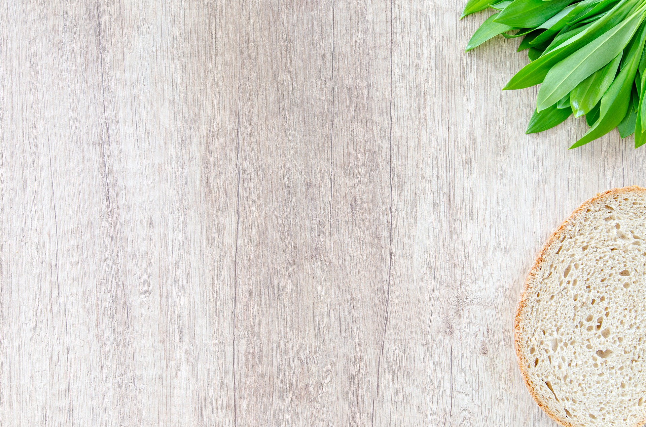
Food Recognition Software for a Web-App
Heena Khan
Luis Chunga
Steven Sheffey
James Phillips
Matthew Radice
Elijah Barbour
Mason Thieman
Team - Alcove

Slide 2
Introduction
We are going to implement a Food recognition software into a Web app
Food-101 dataset - This is challenging dataset consisting of 101,000 images of 101 different food classes. On purpose, the training images were not cleaned, and thus still contain some amount of noise. This comes mostly in the form of intense colors and sometimes wrong label.
We are using this dataset because it contains normal food images taken by a mobile phone rather than beautifully showcased food, this is the main requirement for our app

Slide 3
Motivation
Consumers waste approximately 41 million metric tonnes of food per year [1].
A proposed solution to this problem is a Free-Food Finding app developed by students at Middle Tennessee State University, which enables normal people to donate food which would otherwise go to waste.
But what makes a user to like and use an app regularly ?
An should be User Friendly
It should take Less Effort
To Make this app effortless and user friendly we are creating a neural network that can Identify food type. And the user will not have to fill the form for that.

Slide 4
Aims
This app requires manual input of information about the donated food, which makes the donation process tedious. In order to reduce the amount of work required to donate food, we propose the use of a Neural Network (NN) to automatically classify pictures of donated food.
This reduces the work required to donate food on the app, by automatically classifying images of donated food, and recommending potential labels to the donor.
Predicting the correct food type 100% of the time is of course ideal, but we are looking for reasonable result to predict most of our food with in top 10 prediction.

Slide 5
Aims Achieved
We were able to create a Software which recognizes almost all food item with in top 10 and most of the food item in top 5 and almost half of the food item in top 10.
We were able to implement this model into a web app that accepts and image and returns the food type.
Predicting the correct food type 100% of the time is of course ideal, but we were looking for reasonable result to predict most of our food and we were able to achieve that.

Slide 6
Research and Demo Creation
James
Research Gathering for Project
Introduction and Background sections in paper
Data set Comparison
Milestone
Assisted in Demo Creation

Slide 7
Project Paper Documentation
Elijah
Mathematical Execution of Paper
Research Gathering for Project
Milestone

Slide 8
Methods
Luis
Use MobileNet for small dataset.
Implemented MobileNet With entire dataset.
Implemented Interactive classification.
We wrote the Model architecture part in the paper for 50 and 25 classes.

Slide 9
Creating and Evaluating our Model
Steven
Decided model (NasNetMobile)
Implemented K-fold cross-validation
Configured lazy data loading
Dataset augmentation
K-fold support
Figure generation
Reviewed paper

Slide 10
Model visualization , Web app creation, Documentation and Management
Heena
Implemented Top5 and Top10 accuracies
Generated visualization.
Created the app using Flask, vanilla JavaScript, HTML and CSS.
Deployed our model to the web-app.
Wrote Methods and Result section of our paper
I have created the Readme page and the demo
Created Project Proposal reviewed and updated Milestones
Co-ordinated team meetings and Initiated work and strategies

Slide 11
Project presentation and Documentation
Mason
Presentation
Condensed results into a slide, as well as creating individual contribution slides.
Milestone Writing
Assisted in Project Proposal

Slide 12
Discussion
Matthew
Failed Miserably at contributing to network design
Researched network design
NASNet – Designing a search space so the complexity of the architecture is independent of the depth of the network and size of the input images [0]
Convolution Cells – This approach used convolution networks composed of 'cells' with identical structures but with different weights.
This is much faster than searching the entire network architectures.
The cell is more likely to generalize to other problems – good for our project.
The original NASNet was trained on a smaller image data-set, then using the best convolution cells trained on a larger image data-set on ImageNet.
Our network used the weights that were pre-trained on this ImageNet.
I now understand there is a set of weights that could achieve 100% accuracy on this task and that I will not be the one to find these weights.

Slide 13
References
[0] B. Zoph, V. Vasudevan, J. Shlens, and Q. V. Le, “Learning transferablearchitectures for scalable image recognition,” 2017

