Slide 1
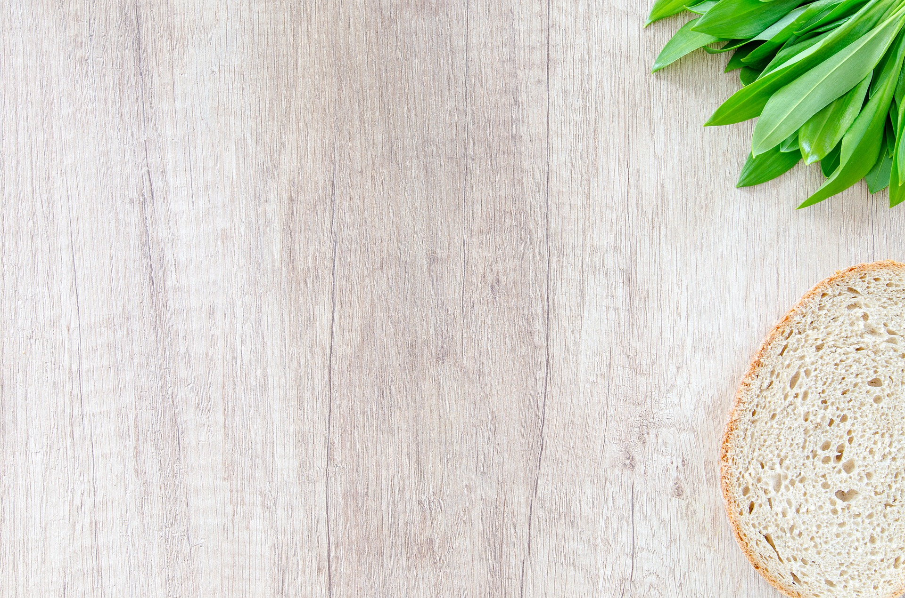
Food Recognition Software for a Web-App
Heena Khan
Luis Chunga
Steven Sheffey
James Phillips
Matthew Radice
Elijah Barbour
Mason Thieman
Team - Alcove

Slide 2
Introduction
This project uses convolutional neural network to generate a food recognition model for a Free-Food Finder webapp.
The model is trained on a very famous dataset Food-101 provided by Kaggle and originally from the research paper "Food-101 – Mining Discriminative Components with Random Forests" by Lukas Bossard.
This is challenging dataset consisting of 101,000 images of 101 different food classes. On purpose, the training images were not cleaned, and thus still contain some amount of noise. This comes mostly in the form of intense colors and sometimes wrong label.

Slide 3
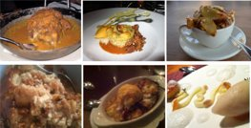
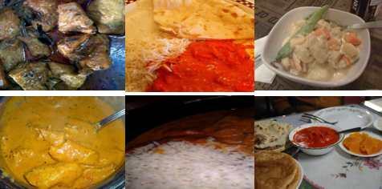
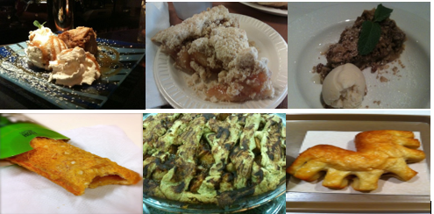
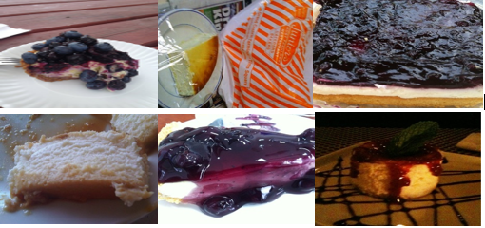
Dataset
This is how images in our dataset looks like. Even as a human, I think I’d struggle to classify them.
Bread Pudding
Chicken Curry
Apple Pie
Cheesecake

Slide 4
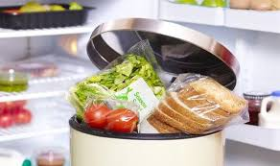
Motivation
Consumers waste approximately 41 million metric tons of food per year [1].
A proposed solution to this problem is a Free-Food Finding app developed by students at Middle Tennessee State University, which enables normal people to donate food which would otherwise go to waste.
But what makes a user to like and use an app regularly?
It should be User Friendly
It should take Less Effort
To make this app effortless and user friendly we propose the use of a Neural Network (NN) to automatically classify pictures of donated food that can reduce human effort.

Slide 5
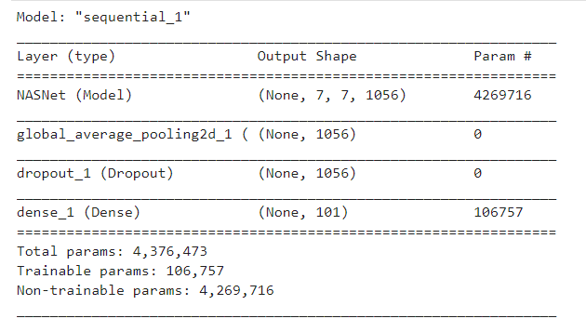
Methods
Model Architecture
NASNetMobile
Dataset augmentation
Random rotations and shifts
K-Fold cross validation
Validates model's ability to learn the dataset
Metrics
Top 1,5,10 accuracy
F1-score

Slide 6
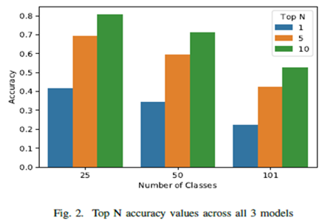
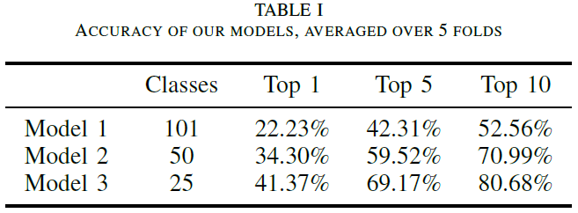
Results
We have created 3
Model-1 is trained on entire dataset, Model-2 is trained on 50 random classes and Model-3 is trained on 25 random classes
We have calculated Top1, Top5 and Top10 predictions accuracies for all three models.

Slide 7
Our Contributions

Slide 8
Research and Demo Creation
James
Research Gathering for Project
Abstract, Introduction, and Background sections in paper
Milestone
Provided Documentation for the Demo

Slide 9
Project Paper Documentation
Elijah
Mathematical Execution of Paper
Research Gathering for Project
Milestone

Slide 10
Research Methods
Luis
Implemented a model with MobileNet for small dataset.
5 classes
Implemented a model with MobileNet With entire dataset.
101 classes
Create Interactive classification.
Display top 1 and 5 prediction
Wrote the Model Architecture in the method section of the paper.

Slide 11
Experimental Design and Engineering
Steven
Designed experiment around K-fold cross-validation
Configured lazy data loading
Dataset augmentation
K-fold support
Figure generation
Paper review

Slide 12
Model visualization , Web app creation, Documentation and Team Management
Heena
Found Dataset and came up with overall aims
Created Project Proposal
Implemented Top5 and Top10 accuracies
Generated visualization like confusion matrix and accuracy plot for Top1-5-10.
Created the Web app
Wrote Methods and Result section of our paper
Created the demo walkthrough and the Readme page
Co-ordinated team meetings and Initiated work and strategies

Slide 13
Project presentation and Documentation
Mason
Presentation
Condensed relevant information from research paper into presentable slides, as well as creating individual contribution slides.
Milestone Writing

Slide 14
Research and Documentation
Matthew
Failed Miserably at contributing to network design
Researched network design
NASNet – Designing a search space so the complexity of the architecture is independent of the depth of the network and size of the input images
Convolution Cells – This approach used convolution networks composed of 'cells' with identical structures but with different weights.
This is much faster than searching the entire network architectures.
The cell is more likely to generalize to other problems – good for our project.
The original NASNet was trained on a smaller image data-set, then using the best convolution cells trained on a larger image data-set on ImageNet.
Our network used the weights that were pre-trained on this ImageNet.
I now understand there is a set of weights that could achieve 100% accuracy on this task and that I will not be the one to find these weights.

Slide 15
Let's look at our DEMO

