Slide 1
Loss functions and support vector machines (in the primal domain)
Hendrik Borras
Master seminar: „Machine learning“

Slide 2
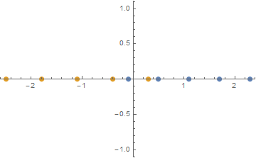
Loss function
Would like to have a function, that can:
Score how good a classifier is
Give our algorithm a way of working towards a better classifier (objective)
Point in to a direction where the classifier can get better
Is still robust to outliers
The decision on this function is normally non trivial
1D Toy data set

Slide 3
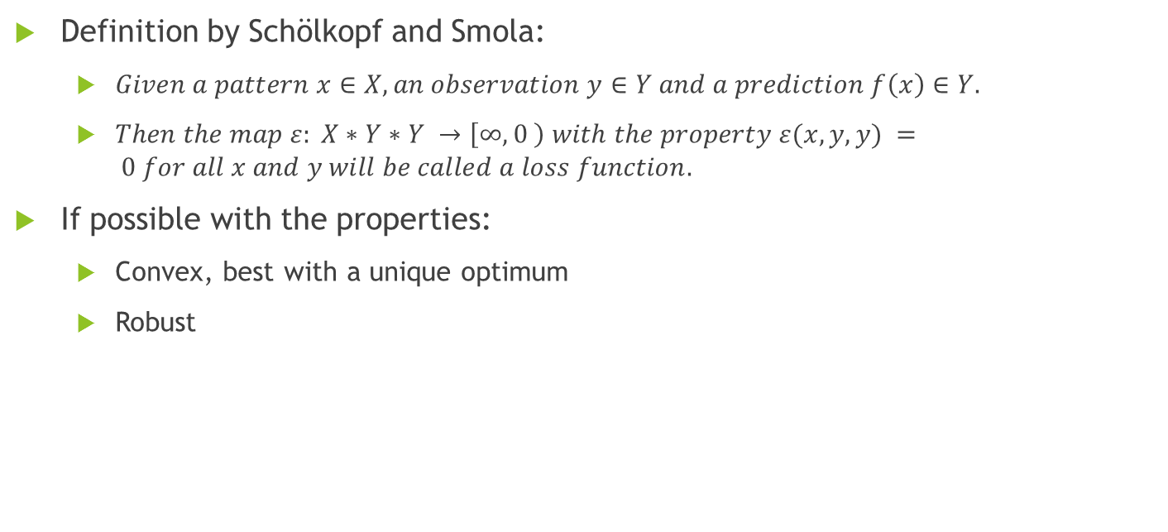
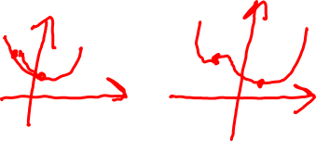
Loss function: Definition
Definition by Schölkopf and Smola:
$Given a pattern x∈X, an observation y∈Y and a prediction f\left(x\right)∈Y.$
$Then the map ε: X∗Y∗Y →\left[∞, 0 \right) with the property ε(x, y, y) = 0 for all x and y will be called a loss function.$
If possible with the properties:
Convex, best with a unique optimum
Robust
1D Toy data set

Slide 4
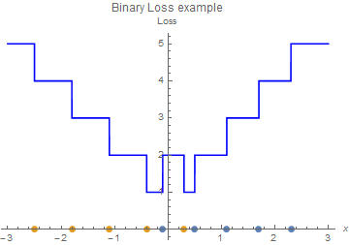
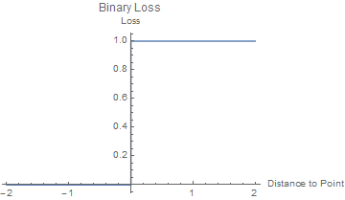
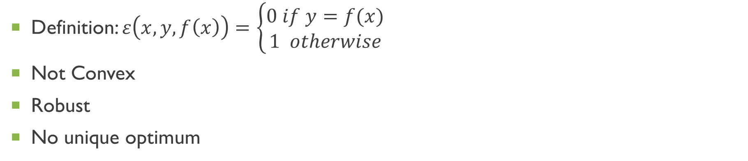
Loss function: Binary Loss
Definition: $ε\left(x,y,f\left(x\right)\right)=\left\{\begin{aligned}0 if y=f(x) \\ 1 otherwise\end{aligned}\right.$
Not Convex
Robust
No unique optimum

Slide 5
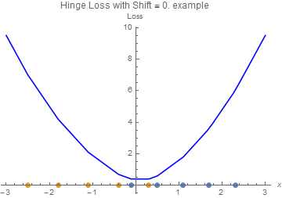
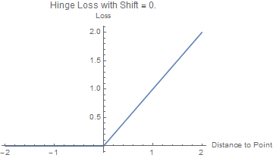
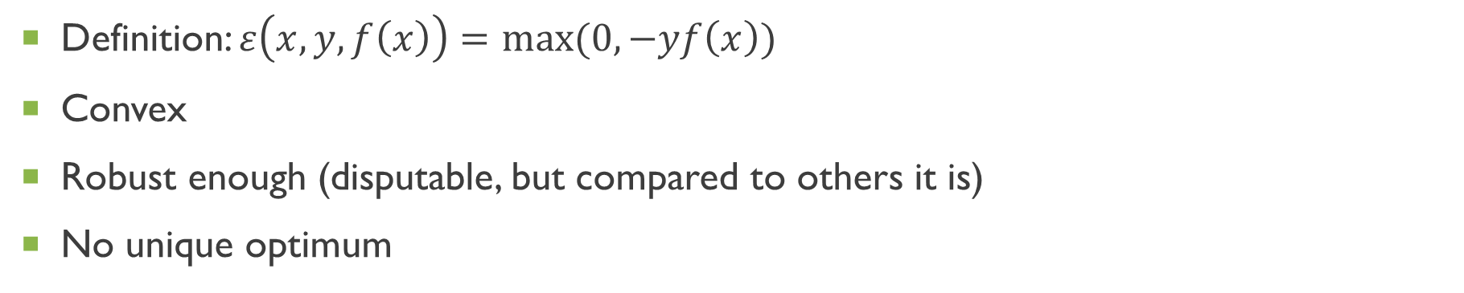
Loss function: Hinge / Soft Margin / L1 Loss
Definition: $ε\left(x,y,f\left(x\right)\right)=max(0,−yf\left(x\right))$
Convex
Robust enough (disputable, but compared to others it is)
No unique optimum

Slide 6
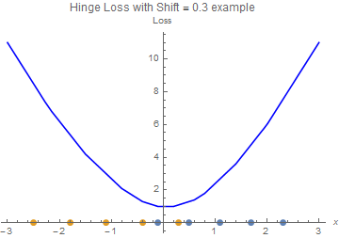
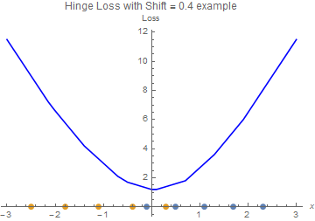
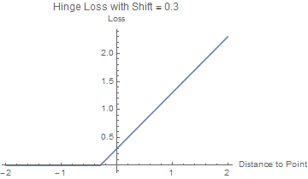
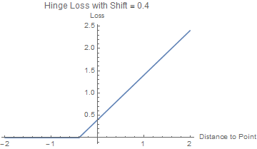
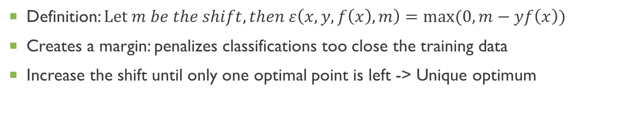
Loss function: Shifted Hinge Loss
Definition: $Let m be the shift, then ε\left(x,y,f\left(x\right),m\right)=max(0,m−yf\left(x\right))$
Creates a margin: penalizes classifications too close the training data
Increase the shift until only one optimal point is left -> Unique optimum

Slide 7
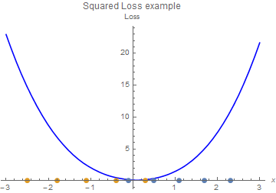
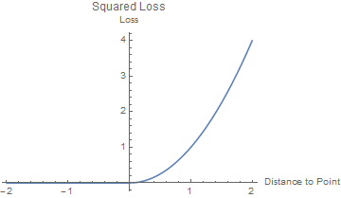
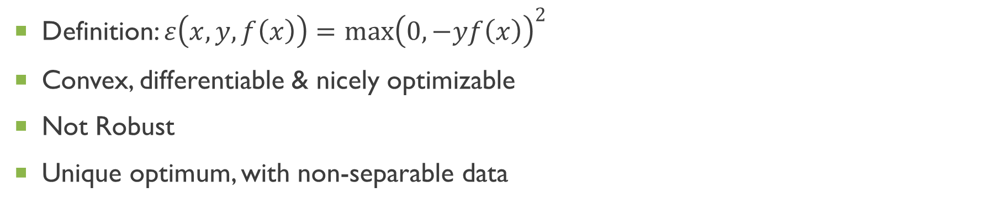
Loss function: Squared Hinge Loss / L2
Definition: $ε\left(x,y,f\left(x\right)\right)={\max\left(0,−yf\left(x\right)\right)}^{2}$
Convex, differentiable & nicely optimizable
Not Robust
Unique optimum, with non-separable data

Slide 8
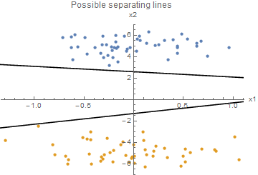
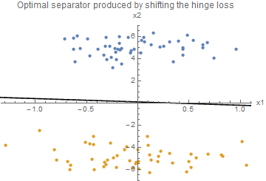
Loss function: Separating Classes
Now possible to easily find an optimal separator for separable data
Shifting the hinge loss works usually when there are no outliers
Shifting the hinge loss

Slide 9
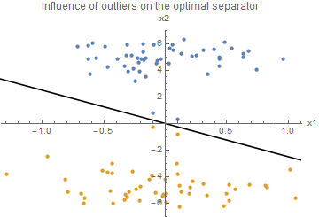
Loss function: Outliers
Loss functions are sensitive to outliers
This approach may overfit data easily
Adding outliers

Slide 10
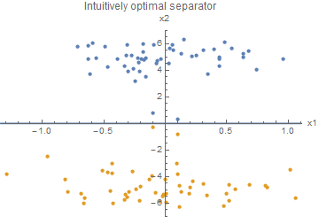
Support Vector Machine (SVM)
Problem statement:
Find the intuitively optimal separator
Be robust to outliers
Don’t overfit the data (regularization)
Give a measurement of how far apart the classes are (margin)
Tell how confident the classifier is with a classification
The algorithm should only use training data which is actually relevant

Slide 11
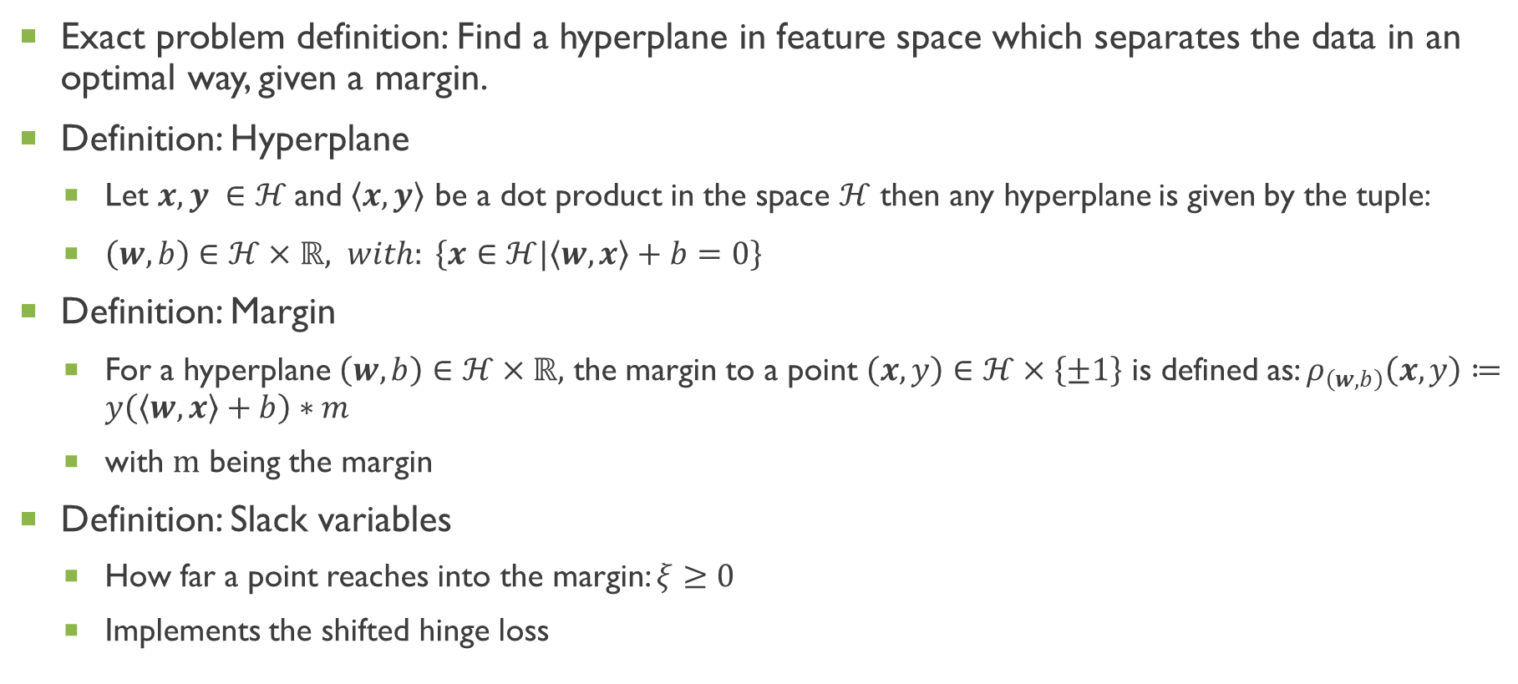
SVM: Finding hyperplanes to separate classes
Exact problem definition: Find a hyperplane in feature space which separates the data in an optimal way, given a margin.
Definition: Hyperplane
Let $x,y ∈ℋ$and $\left\langle x,y\right\rangle$ be a dot product in the space $ℋ$ then any hyperplane is given by the tuple:
$\left(w,b\right)∈ℋ×ℝ, with: \left\{x∈ℋ|\left\langle w,x\right\rangle +b=0\right\}$
Definition: Margin
For a hyperplane $\left(w,b\right)∈ℋ×ℝ,$ the margin to a point $\left(x,y\right)∈ℋ×\left\{±1\right\}$ is defined as: $ρ_{\left(w,b\right)}\left(x,y\right)≔y\left(\left\langle w,x\right\rangle +b\right)∗m$
with $m$ being the margin
Definition: Slack variables
How far a point reaches into the margin: $ξ≥0$
Implements the shifted hinge loss

Slide 12
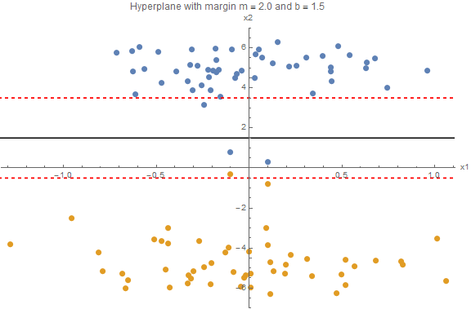







SVM: Finding hyperplanes to separate classes
$$ξ_{1}$$
$$w$$
$$m$$
$$ξ_{2}$$
$$ξ_{4}$$
$$b$$
$$ξ_{3}$$

Slide 13

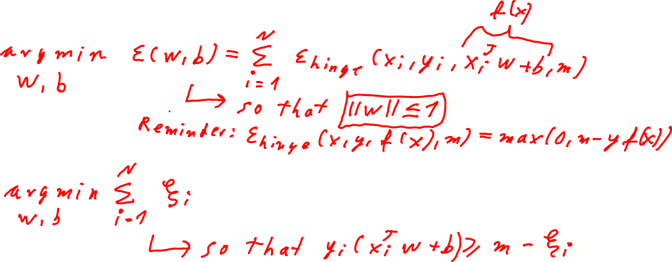
SVM: Fixed margin
Given the margin $m$
Use the hinge loss with $m$ as the shift
Minimize the loss
Minimize the slack

Slide 14

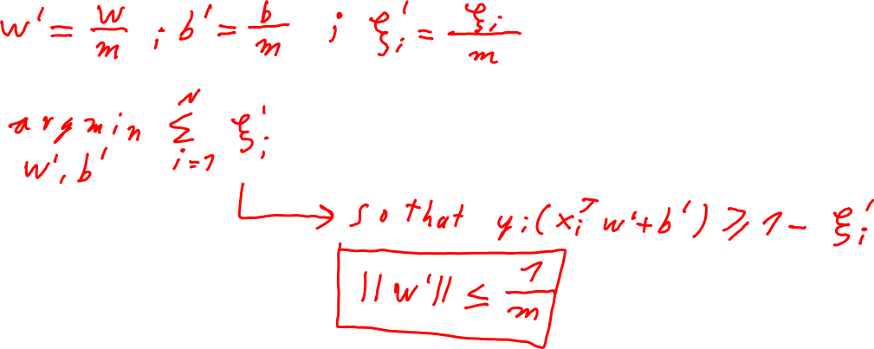
SVM: Fixed margin
Get rid of the $m^{′}s$
Minimize the same function

Slide 15
SVM: Refresh toy sample
$$w$$
$$m$$
$$b$$

Slide 16
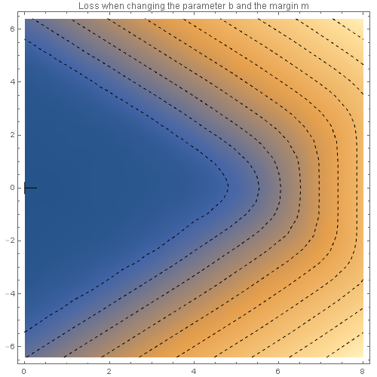
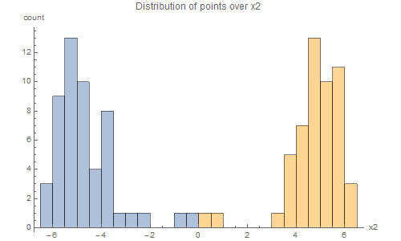
SVM: Version space
Heat map of the distribution of loss
For simplicity w is set to a constant and parallel to x2
b and m are varied
Histogram shows the distribution of points over x2
Version space
Hard margin SVM: tries to find the largest m on the version space boundary
Soft margin SVM: operates out of the version space
b (offset parameter)
m (margin)
Classifier with largest
margin in version space
Previous example

Slide 17
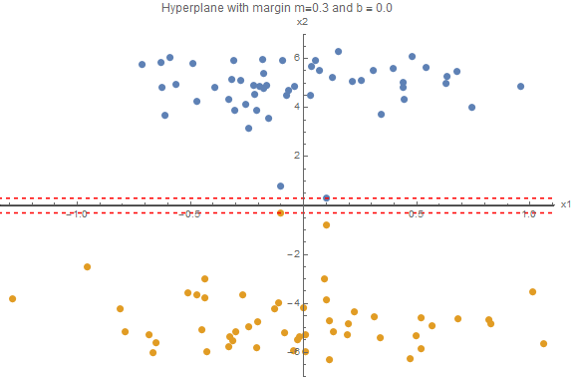
SVM: Toy sample – maximum margin in version space

Slide 18
SVM: Version space
Heat map of the distribution of loss
For simplicity w is set to a constant and parallel to x2
b and m are varied
Histogram shows the distribution of points over x2
Version space
Hard margin SVM: tries to find the largest m on the version space boundary
Soft margin SVM: operates out of the version space
b (offset parameter)
m (margin)
Classifier with largest
b in version space

Slide 19
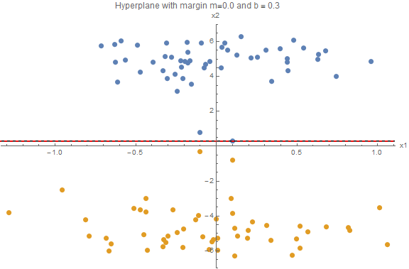
SVM: Toy sample – maximum b in version space

Slide 20
SVM: Version space
Heat map of the distribution of loss
For simplicity w is set to a constant and parallel to x2
b and m are varied
Histogram shows the distribution of points over x2
Version space
Hard margin SVM: tries to find the largest m on the version space boundary
Soft margin SVM: operates out of the version space
b (offset parameter)
m (margin)

Slide 21
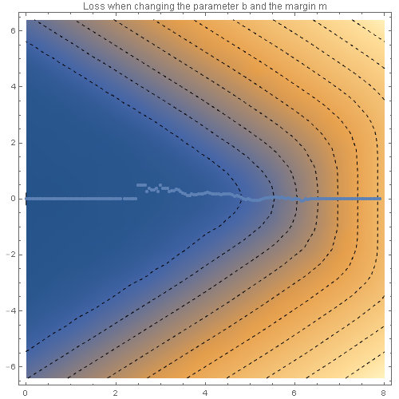
SVM: Version space
Heat map of the distribution of loss
For simplicity w is set to a constant and parallel to x2
b and m are varied
Histogram shows the distribution of points over x2
Version space
Hard margin SVM: tries to find the largest m on the version space boundary
Soft margin SVM: operates out of the version space
b (offset parameter)
m (margin)
Optimal b for a given m
b stagnates at 0

Slide 22
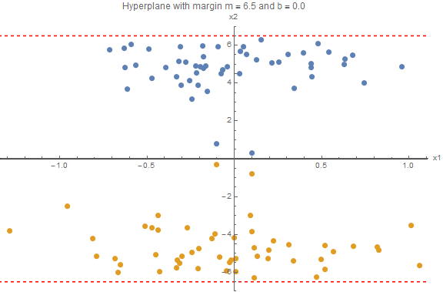
SVM: Toy sample – b stagnates at 0

Slide 23
SVM: Version space
Heat map of the distribution of loss
For simplicity w is set to a constant and parallel to x2
b and m are varied
Histogram shows the distribution of points over x2
Version space
Hard margin SVM: tries to find the largest m on the version space boundary
Soft margin SVM: operates out of the version space
b (offset parameter)
m (margin)
Margin encounters the
upper distribution first
Optimal b for a given m

Slide 24

SVM: Toy sample – Margin encounters the upper distribution first

Slide 25
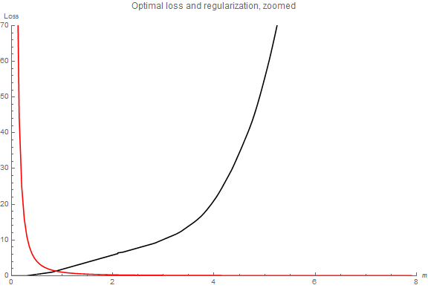
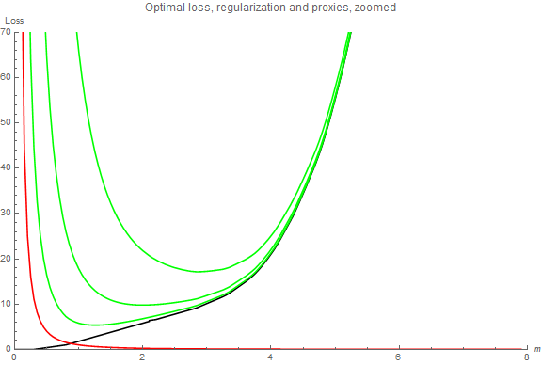
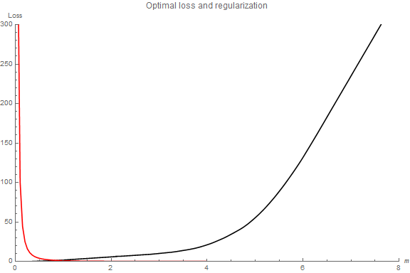
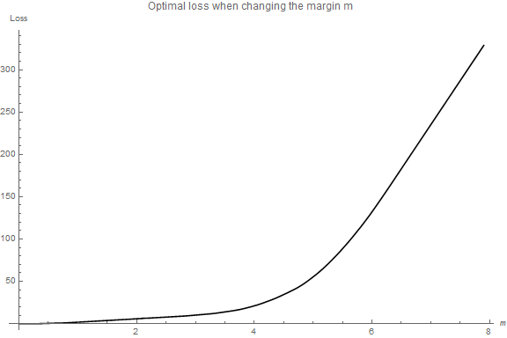
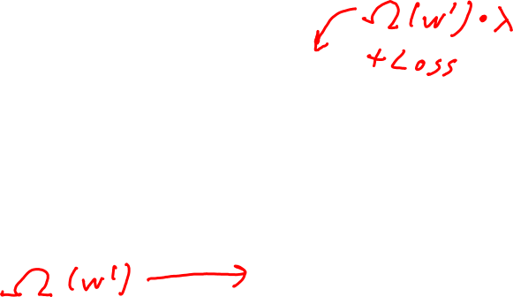
SVM: Automatic margin tuning (regularization)
If we let the loss be as small as possible overfitting is certain
Hand tuning the margin is not possible in general
How do we automatically trade off between a too big loss and a too small margin?

Slide 26
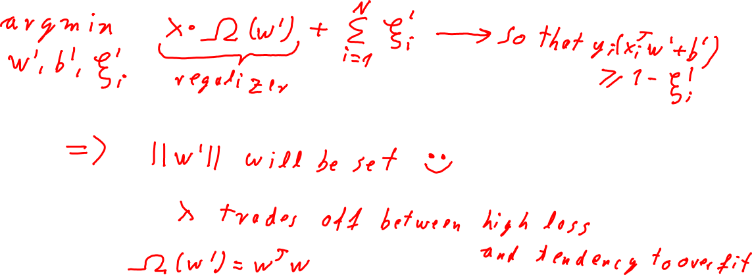
SVM: Automatic margin tuning (regularization)
Reformulate model

Slide 27
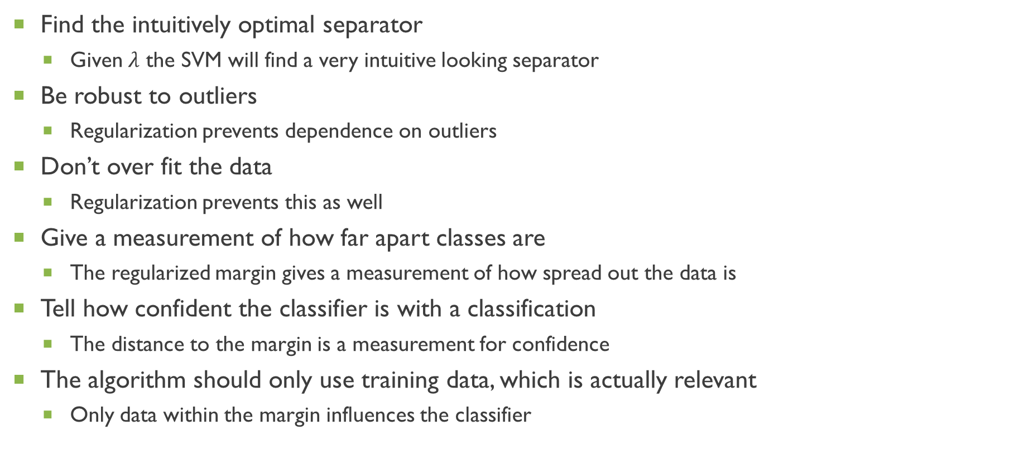
SVM: Checkpoint
Find the intuitively optimal separator
Given $λ$ the SVM will find a very intuitive looking separator
Be robust to outliers
Regularization prevents dependence on outliers
Don’t over fit the data
Regularization prevents this as well
Give a measurement of how far apart classes are
The regularized margin gives a measurement of how spread out the data is
Tell how confident the classifier is with a classification
The distance to the margin is a measurement for confidence
The algorithm should only use training data, which is actually relevant
Only data within the margin influences the classifier

Slide 28
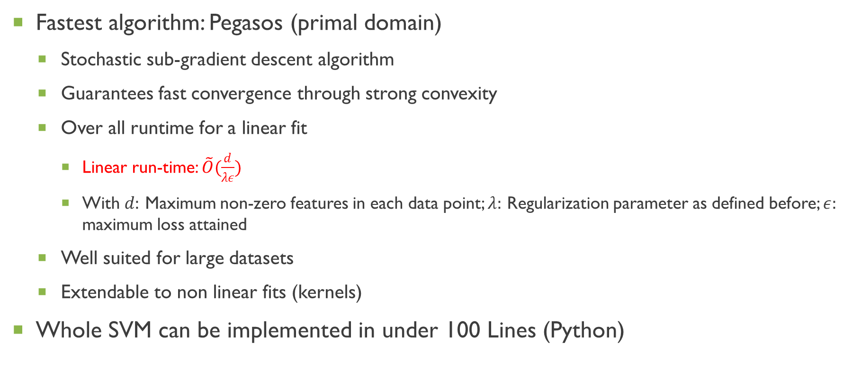
SVM: How fast can an optimal solution be found?
Fastest algorithm: Pegasos (primal domain)
Stochastic sub-gradient descent algorithm
Guarantees fast convergence through strong convexity
Over all runtime for a linear fit
Linear run-time: $\tilde{O}(\frac{d}{λε})$
With $d:$ Maximum non-zero features in each data point; $λ:$ Regularization parameter as defined before; $ε:$ maximum loss attained
Well suited for large datasets
Extendable to non linear fits (kernels)
Whole SVM can be implemented in under 100 Lines (Python)

Slide 29
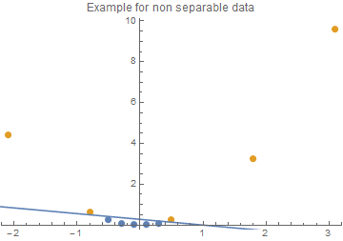
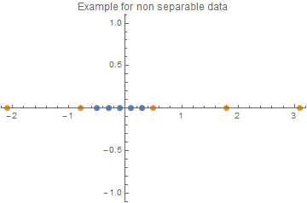
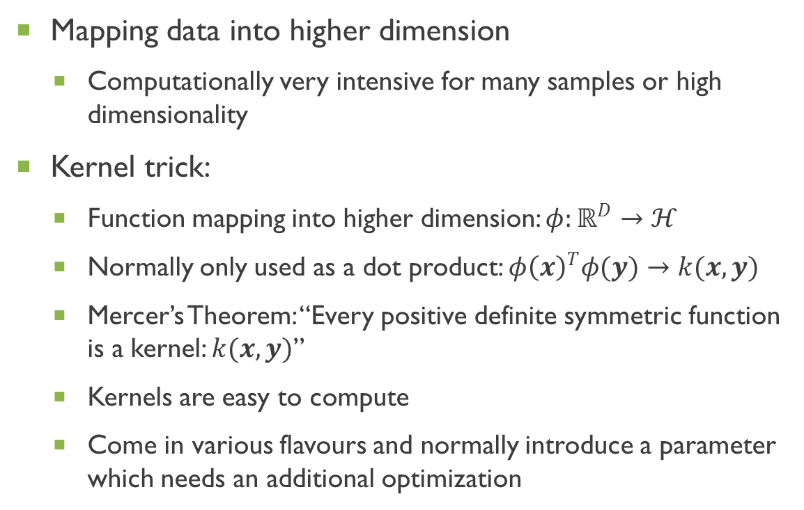
SVM: Non linear
Mapping data into higher dimension
Computationally very intensive for many samples or high dimensionality
Kernel trick:
Function mapping into higher dimension: $φ:ℝ^{D}→ℋ$
Normally only used as a dot product: ${φ\left(x\right)}^{T}φ(y)→k(x,y)$
Mercer’s Theorem: “Every positive definite symmetric function is a kernel: $k(x,y)$”
Kernels are easy to compute
Come in various flavours and normally introduce a parameter which needs an additional optimization

Slide 30
Summary: Loss functions & SVM
 | Loss Functions | Support Vector Machines
Benefits | Objective way to measure the quality of a classifier Optimization of classifiers becomes simpler | Finds a good classifier relatively fast Robust against outliers Regularization prevents overfitting Can be extended to use non linearity's
Challenges | Non robustness against outliers and easily overfitts | Very memory intensive as all training data needs to be iterated over No simple way of learning in an offline fashion
General notes
I only talked about the primal domain formulation of the SVM
The dual domain formulation uses a Lagrangian as optimizer and is useful when the number of features is far greater than the number of data points
It is usually not directly visible whether a library implements the primal or the dual domain formulation of the SVM

Slide 31
Thank you for your attention

Slide 32
Sources
Schölkopf, Bernhard, and Smola, Alexander J.. Learning with Kernels : Support Vector Machines, Regularization, Optimization, and Beyond. Cambridge, US: The MIT Press, 2001. ProQuest ebrary. Web. 13 December 2016.
Deep Vision Lecture (2016) by Prof. B. Ommer: https://hci.iwr.uni-heidelberg.de/compvis/teaching/deep_vision
Pattern Recognition Lecture (2012) by Prof. F. Hamprecht: https://hciweb.iwr.uni-heidelberg.de/people/fhamprec
SVMs in high energy physics: https://arxiv.org/pdf/1601.02809v1.pdf
Pegasos paper: http://www.cs.huji.ac.il/~shais/papers/ShalevSiSrCo10.pdf
Pegasos example code: https://gist.github.com/alextp/544203
All Plots were made with Wolfram Mathematica 10.2. Source code is available under: https://github.com/HenniOVP/Talk-Loss-and-SVMs

