Slide 1
IN4355
Machine Learning Samples
Yanbo Huang, Yu Liang and Bo Wang

Slide 2
Goal
Implement Mike’s blog samples using several different Machine Learning libraries
Notes:
Our project is implementing Mike’s blog samples using several different Machine Learning libraries. Meanwhile, combining the idea of functional programming when implementation

Slide 3
Libraries we used:
Scala - Mllib
R packages
Go - Golearn
Python - Scikit Learn
Python - Graphlab
Python - NLTK (Naive Bayes)
7. Python - Recommendation system
Notes:
Mllib, most of the code is written in functional programming way. Import R packages: high-order function. Rest: python, in this part, basic part of functional programming, map, reduce, filter and list comprehension. Recommendation system, not finished yet.

Slide 4
Project Structure:
/library
/img
readme.md
linear_regression.*
logistic_regression.*
knn.*
svm.*
…
Notes:
Library image folder, readme markdown instruction and important point, different machine learning samples

Slide 5
Readme Structure:
1. Overview of the library
2. Implement ML algorithms with this library
3. Model Evaluation
4. Combine with Functional Programming
Notes:
this is the project structure

Slide 6
Machine Learning with R

Slide 7

Notes:
R is free to use, open source, provide a whole pipeline from data wrangling to machine learning. In this hacking section, we covered over 14 R libraries in total, for example: caret, e1071 kernlab,
class, tm, stats, dplyr, ggplot2, these libraries are contributed by developers all around the world.

Slide 8
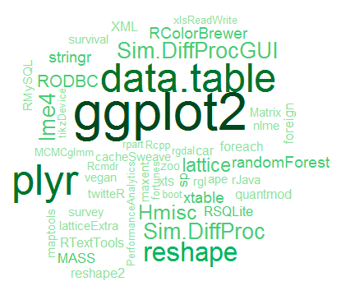
Notes:
R is extremely handy tool because it’s packages are available for the whole ML pipline, including data pre-processing, algorithms and visualization.We implemented 7 ML algorithms with R in total, including kmeans, linear regression, knn, naive bayes, pca, support vector machine etc..

Slide 9
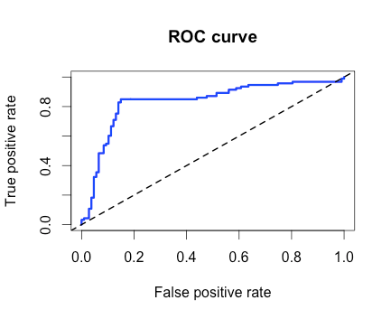
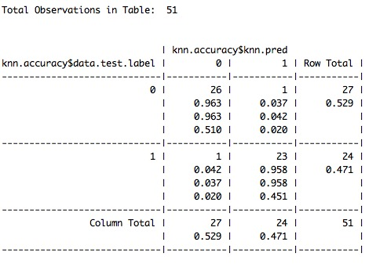
“R, at its heart, is a functional programming (FP) language”
——Hadley Wickham
Notes:
We also listed model evaluation methods with R, including accuracy, confusion matrix, precision & recall, cross validation, ROC & AUC.

Slide 10
R
sum(1:5)
head(c(1,2,3),1)
c(1,2,3)[1:3]
c(1,2,3)[-c(1,2)]
c(l1, l2)
rev(1:5)
Haskell
sum[1..5]
head [1,2,3]
take(3) [1,2,3]
drop(2) [1,2,3]
l1 ++ l2
reverse [1..5]

Slide 11
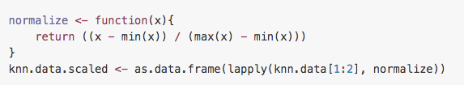
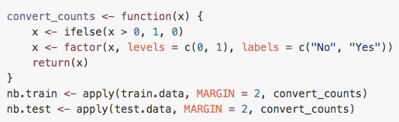
In Knn, we did feature scaling with this line of code:
In Naive Bayes, we need to transform all factor values from 0, 1 to No, Yes:

Slide 12
Machine Learning with Scikit-learn

Slide 13

Notes:
Scikit-learn is a Python module for machine learning built on top of SciPy and distributed under the 3-Clause BSD license.
The project was started in 2007 by David Cournapeau as a Google Summer of Code project, and since then many volunteers have contributed.

Slide 14
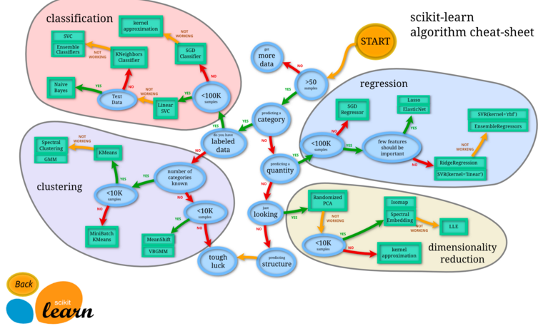
Notes:
With Scikit-Learn, we implemented linear regression, support vector machine, principle component analysis, naive bayes and knn algorithms.

Slide 15
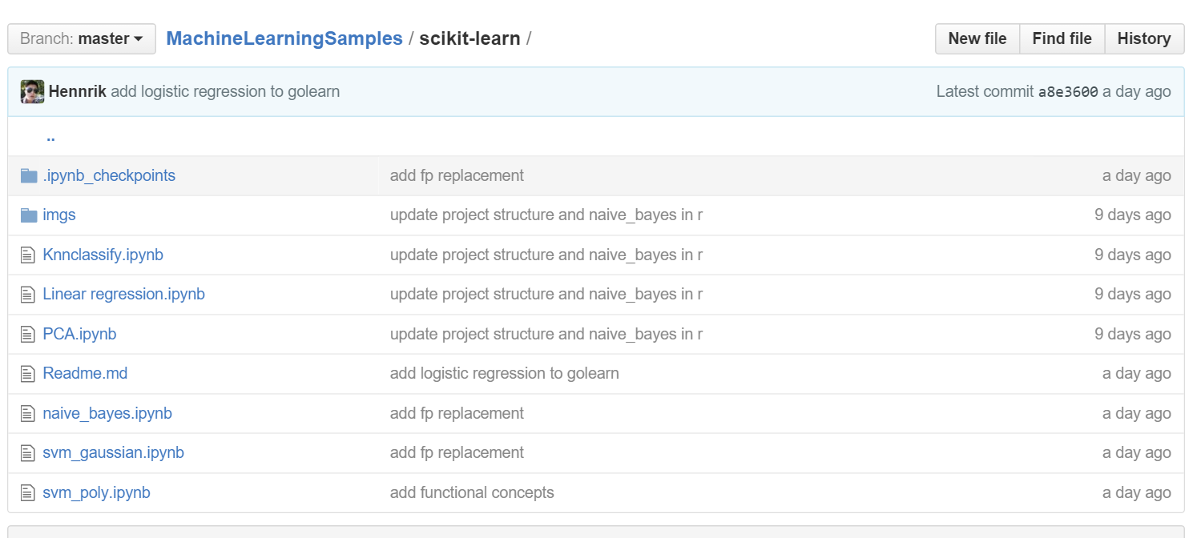
Example library: Scikit Learn

Slide 16
Example library: Scikit Learn
Map:
gammas = map(lambda x: 1.0/(2.0*x**2), sigmas)
filter:
dir_clean = filter(lambda x: (".DS_Store" not in x) and ("cmds" not in x), dir_content)
reduce:
FCR_min = reduce(lambda a,b: a if (a < b) else b, FCR)
list comprehension:
gammas = [ 1.0/(2.0*x**2) for x in sigmas ]

Slide 17
Problems we encountered
Library limitation.
Programming language challenge
Data pre-processing
Notes:
Some libraries are still under construction, they do not provide certain kinds of ML algorithms and Mllib may works well for large datasets or distribute system
Some language are not designed for functional programming.
Although some languages works efficient, it’s not easy to use these language for data pre-processing.

Slide 18
We will use more functional programming in the future !
Notes:
In sum, through the project, we have learned some basic machine learning algorithms and different machine learning libraries. But more important, we now understand the concept of functional programming better. continue use efficient and clear programming.

Slide 19



