Slide 1


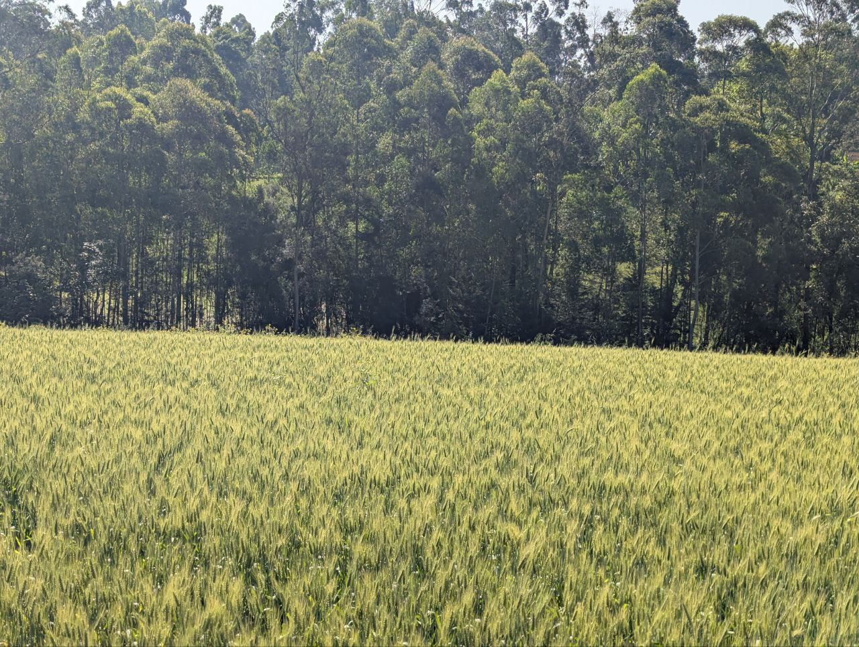
ICRISAT Data Hub
Federation-First Data Sharing and an AI-Ready Catalogue for ICRISAT Teams
July 2026
Authors:
Henok Desalegn, HaFAS Team

Slide 2
The Challenge: Fragmented Team Data
Current data-sharing situation
• Valuable datasets sit scattered across teams, laptops, and shared drives — hard to find, easy to duplicate
• Sharing needs technical skills, so most data never leaves the team that produced it
• No common catalogue: nobody knows what exists, who owns it, or whether it is open, internal, or restricted
Consequences
• Duplicated collection and processing effort across teams
• High-value compilations (e.g. DST nutrient-response trials) invisible beyond their owners
• Institutional memory lost when staff move on
• Institutional data unreachable by AI assistants and LLM-based tools
Need: zero-skill sharing, one catalogue, AI-ready access — without changing how teams work

Slide 3
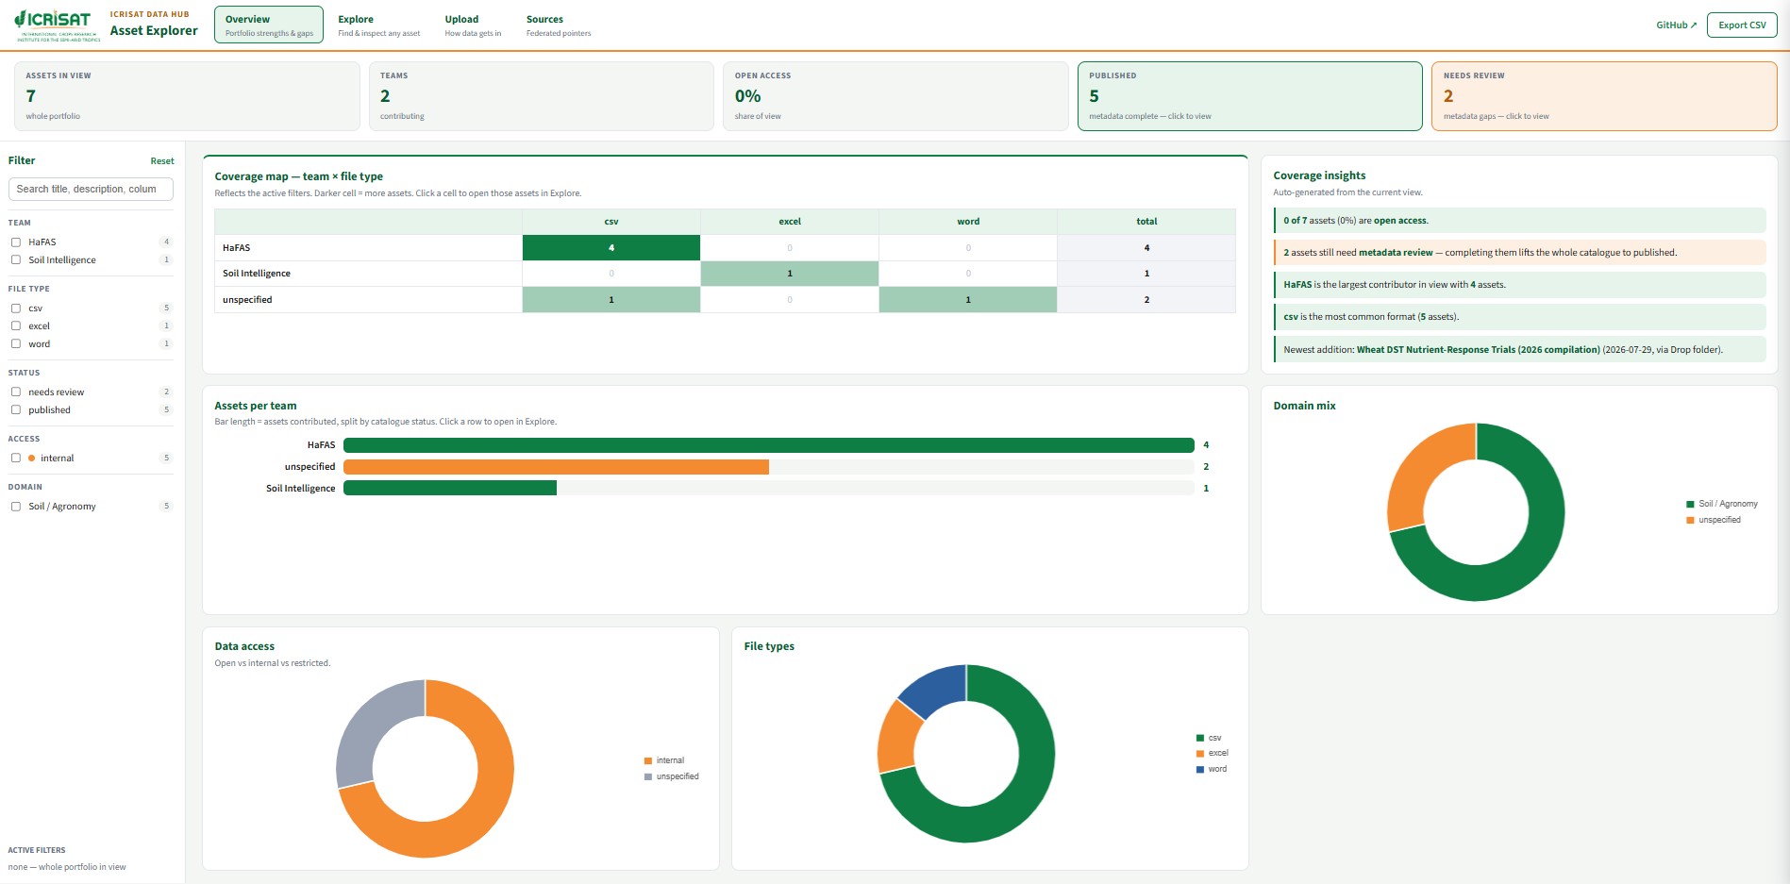
Our Solution: The ICRISAT Data Hub
Zero-skill upload — three ways in
• Drop folder, drag-&-drop web page (token-protected link), or a tiny .meta.yaml sidecar
Automated pipeline
• Reads CSV / Excel / Word, profiles every sheet, dedups by content hash, flags metadata gaps with a pre-filled review template
Federation-first
• External data registered as YAML pointers — the hub points to where it lives (CHIRPS, AClimate)
AI-ready by design
• MCP server lets any LLM search, inspect schemas, preview and query (read-only SQL), stdio or HTTP
Public dashboard
• ICRISAT-branded Asset Explorer on GitHub Pages →

Slide 4
System Architecture
Technology Stack
Data Flow
• Upload: FastAPI web app (token-gated) + folder watcher (watchdog)
• Pipeline: Python — pandas, openpyxl, python-docx, DuckDB
• Catalogue: SQLite + exported assets.json (CDH-style)
• AI access: MCP server (MCP 2.0 SDK), stdio + streamable HTTP
• Dashboard: Chart.js + vanilla JS on GitHub Pages; auto-refresh via GitHub Actions
• Deployment: local, cloudflared/ngrok tunnel, or Docker on Railway/Render
• Team drops a file (folder, web page, or with sidecar metadata)
• Pipeline reads and profiles every sheet; hash-dedups against the catalogue
• Asset registered in SQLite with status published or needs_review
• Catalogue exported to assets.json; dashboard data regenerated
• Dashboard updated on GitHub Pages (commit or GitHub Action)
• LLMs discover and query assets through the MCP server

Slide 5
User Interface: Public Dashboard — Portfolio Overview
Coverage & insights
• Team × file-type coverage matrix — click a cell to drill in
• Auto-generated insights: largest contributor, newest addition, review status
• Assets-per-team bars split by catalogue status
Charts
• Domain mix, data access (open / internal / restricted), file types
• KPI strip: assets, teams, open-access share, published, needs review — clickable
• Faceted filters with per-value counts; every figure computed from the catalogue

Slide 6
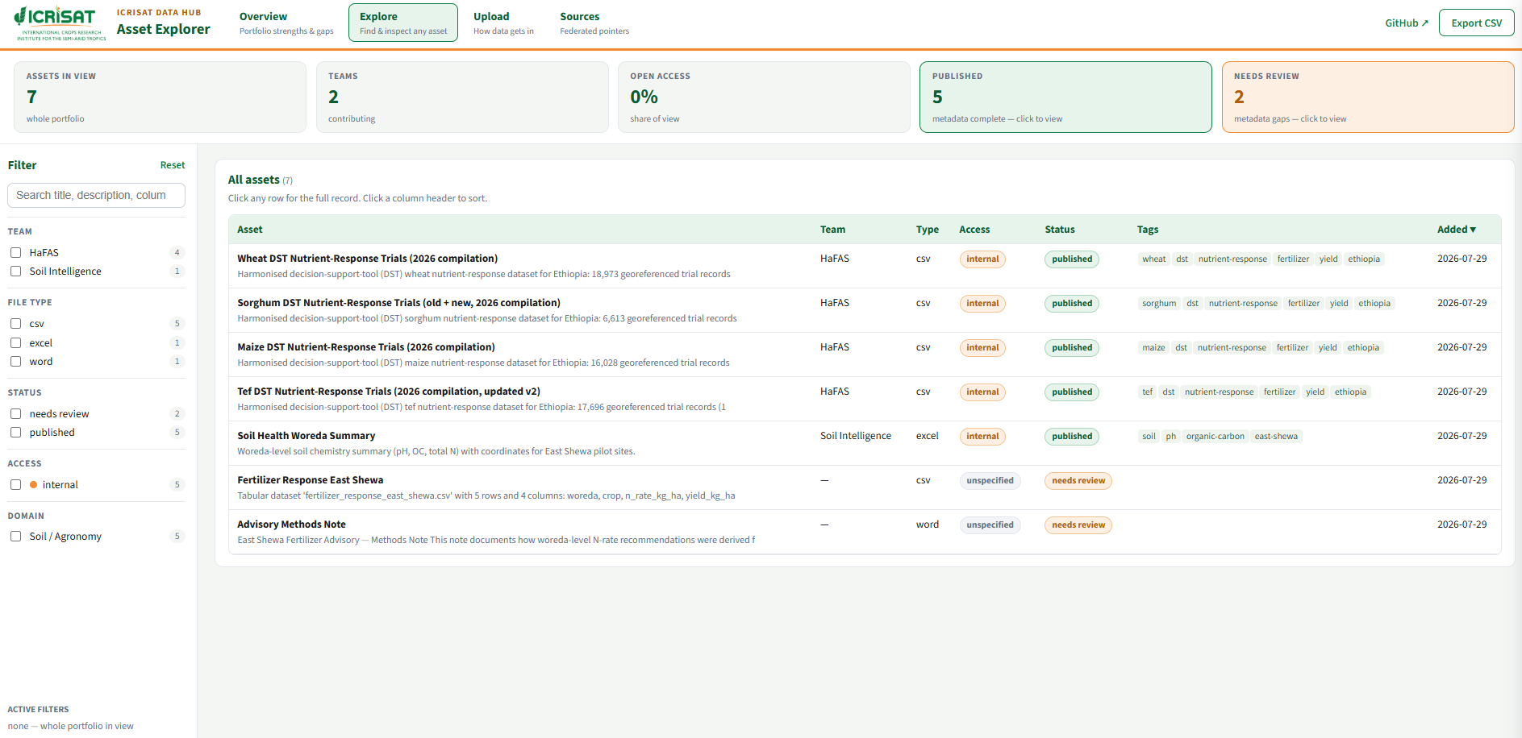
User Interface: Explore the Catalogue
Find any asset
• Full-text search across titles, descriptions, column names, tags, and document text
• Filter by team, file type, status, access, and domain
• Sortable table; Export CSV of the current view
Inspect before you download
• Row click opens a detail drawer: full metadata, provenance, and per-sheet schema
• Column names, data types, and sample values for every table
• Word documents show extracted text and outline
• Access badges make open vs internal vs restricted unmistakable

Slide 7
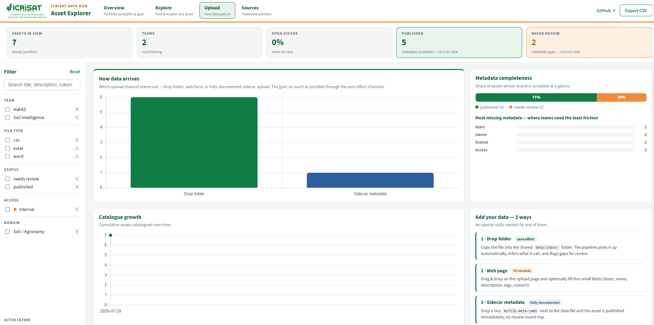
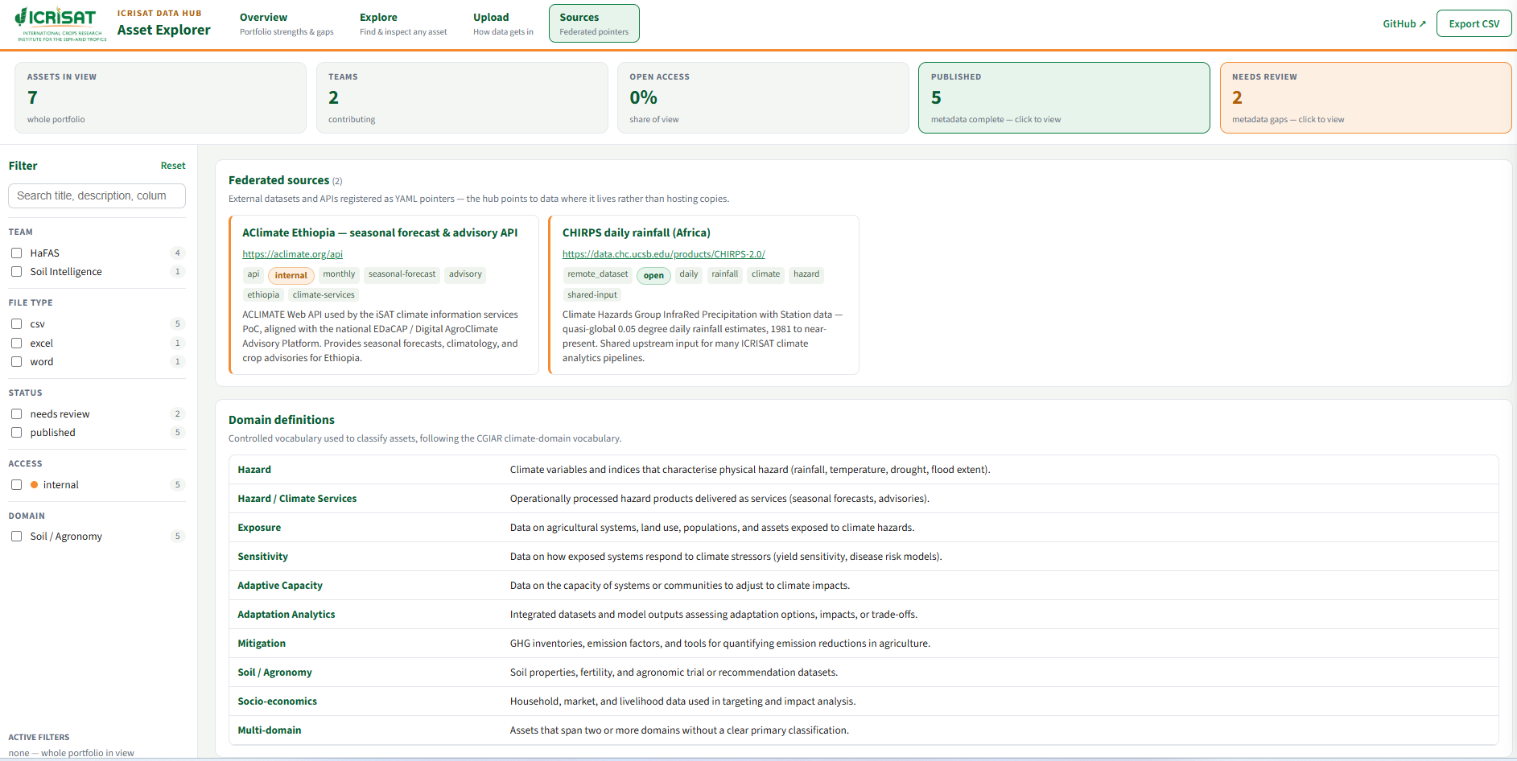
User Interface: Upload Channels & Federated Sources
Upload view
• How data arrives: drop folder vs web form vs documented sidecar
• Metadata-completeness bar and most-missing-fields ranking
• Catalogue growth timeline
Sources view
• Federated external datasets/APIs registered as YAML pointers
• Domain definitions from the controlled vocabulary

Slide 8
Core Implementation (Ingest Pipeline + MCP)
# src/hub/ingest/pipeline.py — one ingest path for every channel
def ingest_file(file_path, config, catalog, extra_metadata=None):
digest = sha256_of(file_path) # dedup by content hash
if catalog.has_hash(digest):
return {"ok": False, "reason": "duplicate"}
tables = read_file(file_path) # CSV | Excel (multi-sheet) | Word
meta = infer_metadata(file_path, tables) # filename, shape, columns
meta.update(load_sidecar_metadata(file_path)) # optional .meta.yaml
profile = profile_tables(tables, config) # schema + sample values
asset_id = catalog.add_asset(record, profile) # SQLite + assets.json
if incomplete: write_review_template(asset_id) # pre-filled YAML
# MCP tools exposed to any LLM (stdio + streamable HTTP)
TOOLS = ["list_assets", "search_assets", "get_asset", "preview_asset",
"query_asset", # read-only DuckDB SQL over CSV/Excel
"read_document", # extracted Word text
"list_sources", # federated YAML pointers
"get_catalog_summary"] # portfolio statistics

Slide 9
The Catalogue Today: First Assets Ingested
One week in — the pipeline already runs on real team data
• 7 assets catalogued from 2 teams (5 CSV, 1 Excel, 1 Word); 5 published, 2 completing metadata review
• 4 HaFAS DST nutrient-response compilations for Ethiopia (1990–2025):
• Wheat — 18,973 georeferenced trial records with N/P/K rates, treatments, and grain yield
• Tef — 17,696 records · Maize — 16,028 records · Sorghum — 6,613 records
• ≈ 59,300 trial records now searchable, previewable, and queryable by people and LLMs alike
Governance made visible
• Every asset carries team, owner, license, and access — open vs internal vs restricted is explicit, not assumed
• 2 federated sources registered as YAML pointers (CHIRPS daily rainfall; AClimate Ethiopia advisory API)
Next: onboard remaining teams, deploy the permanent upload link (Railway), extend readers to GeoTIFF/NetCDF/parquet

Slide 10
Expected Impact & Conclusion
Expected Benefits
Key Innovations
• Zero-friction sharing: any team member can publish a dataset in 30 seconds — no special skills
• One catalogue: what exists, who owns it, and its access terms are always known
• No more duplicate collection/processing; shared inputs registered once and reused
• Institutional data becomes AI-ready: LLM assistants answer questions directly from team data
• Clear open/internal/restricted governance supports data-policy compliance
• Federation-first: YAML pointers register external data without copying it
• Auto-infer + review-template metadata flow — gaps flagged, never blocking upload
• MCP server turns an institutional catalogue into LLM-consumable tools
• Deploy-anywhere: laptop, tunnel, or cloud container with the same codebase
• Aligned with the CGIAR Climate Data Hub asset-mapping approach and the Coalition of the Willing for soil and agronomy data sharing
The ICRISAT Data Hub turns scattered team files into a governed, AI-ready, federation-first catalogue — making ICRISAT's data as easy to share as it is to produce.

Slide 11

Citation:
Desalegn, H. 2026. ICRISAT Data Hub: Federation-First Data Sharing and an AI-Ready Catalogue for ICRISAT Teams. ICRISAT Working Paper.
Acknowledgements
The CGIAR Sustainable Farming Science Program forms a part of CGIAR's Research Portfolio, addressing key challenges in agri-food systems by fostering efficient production of nutritious foods and safeguarding the environment. This work was implemented by CGIAR researchers from ICRISAT in close partnership with the Ministry of Agriculture, the Ethiopian Institute of Agricultural Research, and Regional Agricultural Research Institutes. The hub design follows the CGIAR Climate Data Hub asset-mapping approach and supports the Coalition of the Willing for soil and agronomy data access, management, and sharing.
We thank all funders who supported this research through their contributions to the CGIAR Trust Fund: https://www.cgiar.org/funders/
Disclaimer
This working paper has not been peer reviewed. Any opinions stated herein are those of the author(s) and do not necessarily reflect the policies or opinions of ICRISAT, donors, or partners.

Slide 12

This publication is copyrighted by ICRISAT and licensed under a Creative Commons Attribution–NonCommercial 4.0 International License. Attribution must not suggest endorsement by ICRISAT or the author(s).
Key Words:
Data Hub; Federation; Data Catalogue; Model Context Protocol (MCP); AI-Ready Data; FAIR Data; Zero-Skill Upload
Alignment:
CGIAR Climate Data Hub asset-mapping approach · Coalition of the Willing for soil and agronomy data access, management and sharing · Ethiopian Ministry of Agriculture data-sharing policy
©2026 ICRISAT

