Slide 1
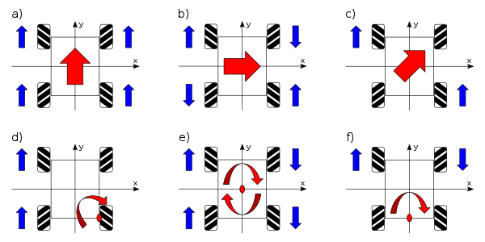
Motor directions:
Robot:
Direction:
Wheel dir.:
Not spinn:

Slide 2
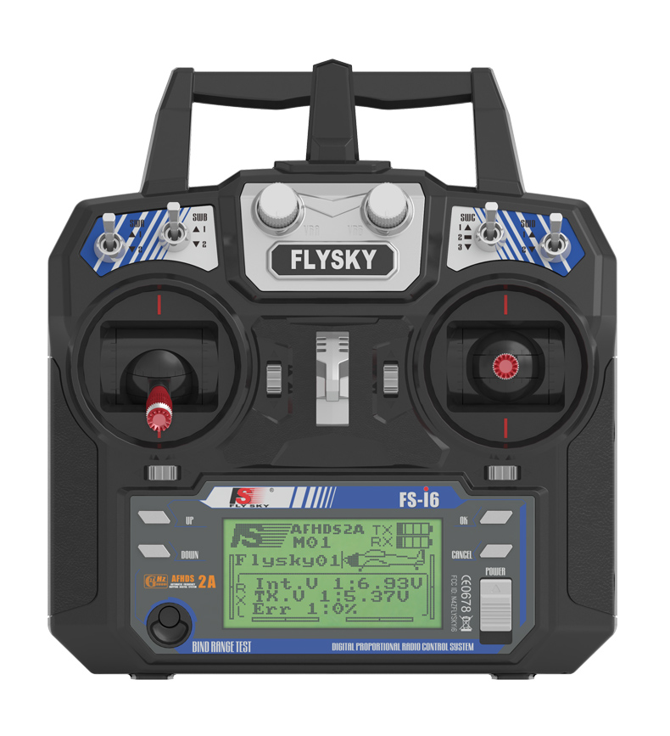
MODE 2
CH3
CH2
CH4
CH1

