Slide 1
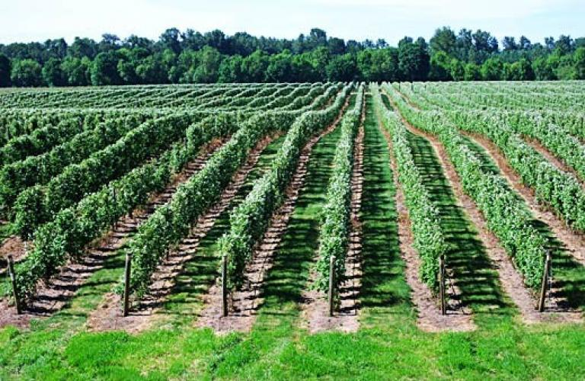
ProbeSchedule:
Latest Results
25 April 2019, 25/04/2019
By Henri Branken
MatogenAI

Slide 2
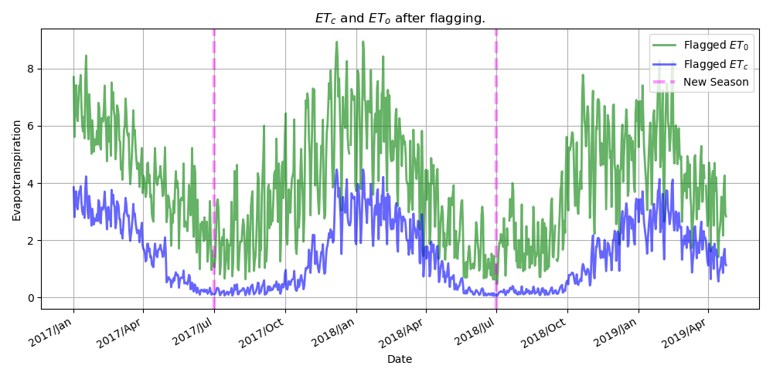
Results of API Updates

Slide 3
Results of API updates:
As a result of eto and etc data having much better integrity, I no longer flag consecutive etc entries that are identical.
I do, however, still flag for consecutive eto entries that are identical (more on this in a later slide).

Slide 4
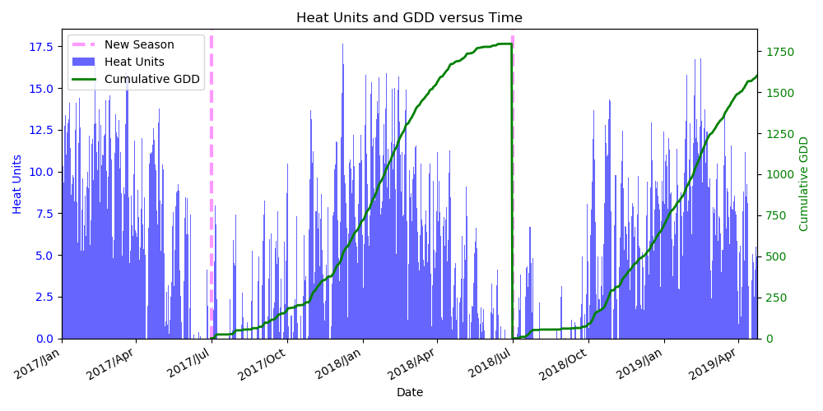
Bar Graph Rectified

Slide 5

Fine-tuning etcp deviation
By "etcp deviation" we mean the percentage deviation of etcp away from the expected crop water usage, etc.
Changing this ETCP_PERC_DEVIATION has a noticeable effect on the final results.
In the following we compare results if ETCP_PERC_DEVIATION is 30% and 50%.

Slide 6
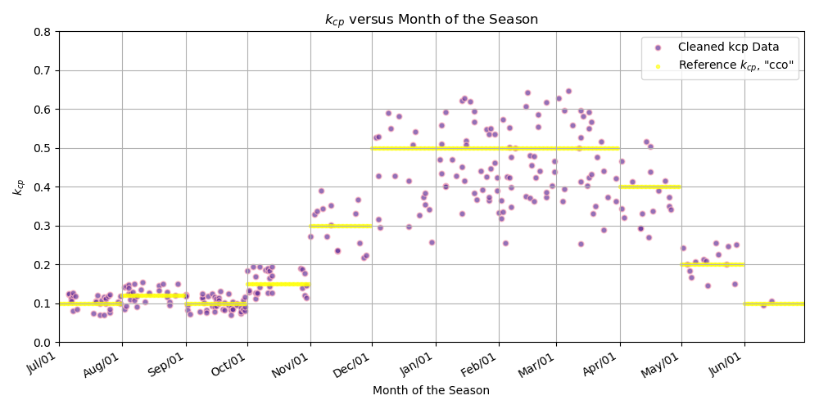
ETCP_PERC_DEVIATION = 30%

Slide 7
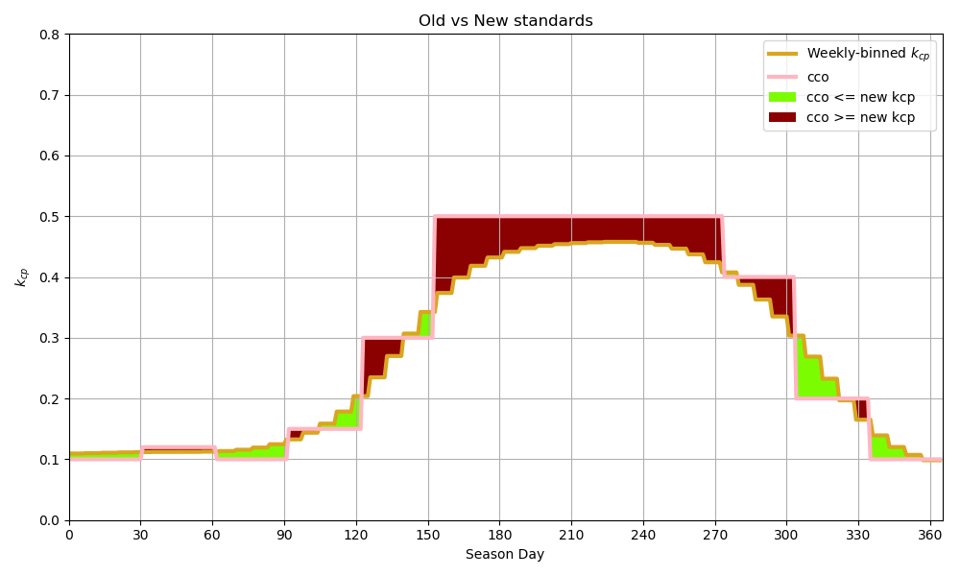
ETCP_PERC_DEVIATION = 30%

Slide 8
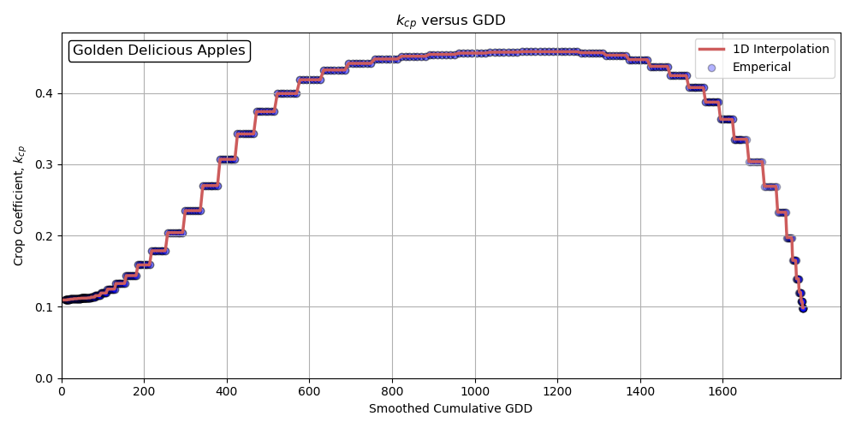
ETCP_PERC_DEVIATION = 30%

Slide 9
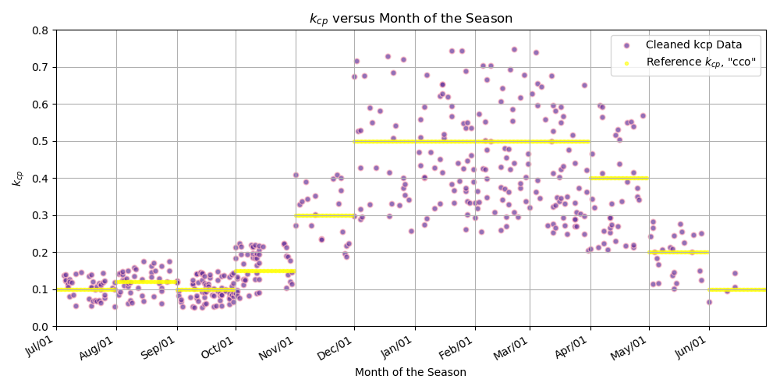
ETCP_PERC_DEVIATION = 50%

Slide 10
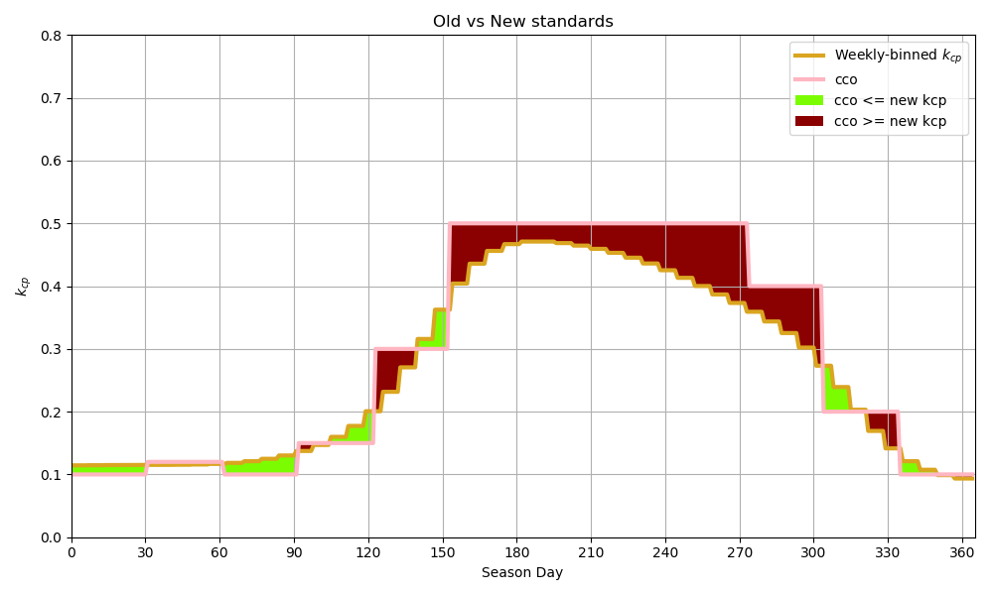
ETCP_PERC_DEVIATION = 50%

Slide 11
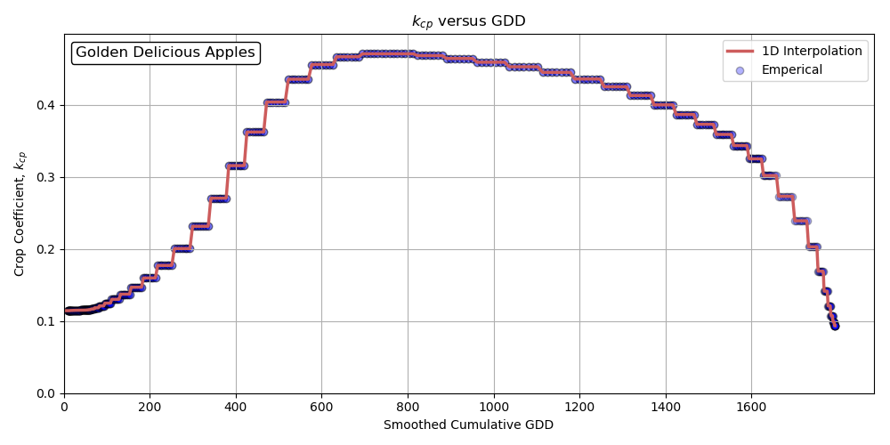
ETCP_PERC_DEVIATION = 50%

Slide 12
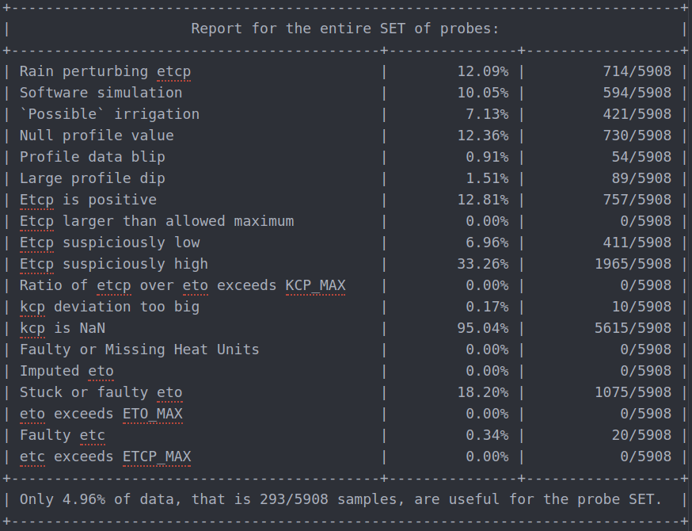

Left: 30%. Right: 50%.

Slide 13
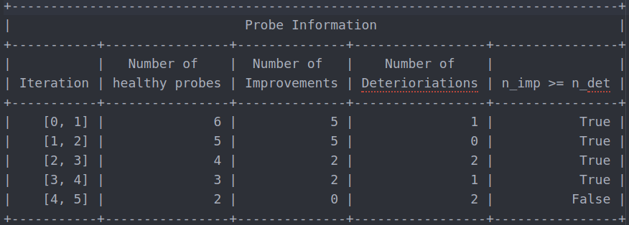
Additional (more sophisticated) Logic when Refining the kcp Trendline
For every iteration, verify whether the new smoothed trendline better approximates the majority of the probes' individual kcp datasets.

Slide 14
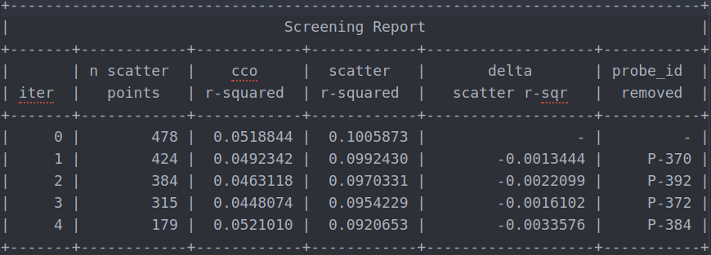
Complementary table to the previous one:
Notice how we succeeded in removing 4 "bad" Probes from the dataset.
Additionally, we also require the r-square between the trendline and scatter plot to decrease in order to proceed with a probe removal.
Keep in mind a smaller r-square value means a "better" trendline fit.

Slide 15
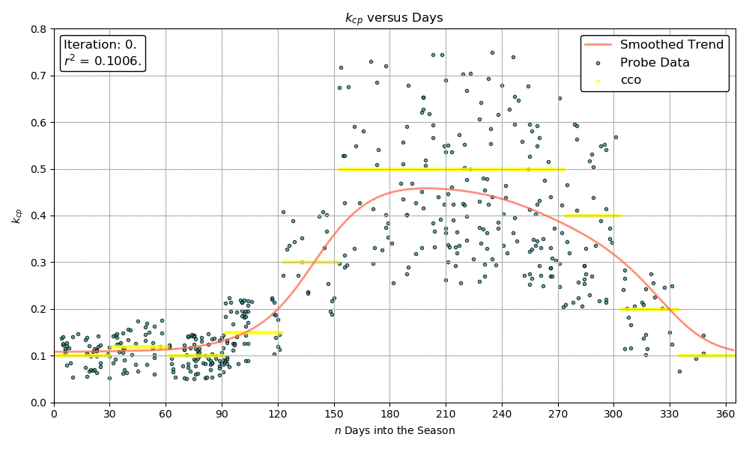
.gif Animation showing progression of trendline (Notice Upper-Left Annotations)
For the .pdf viewers, take a look at progression.gif

Slide 16
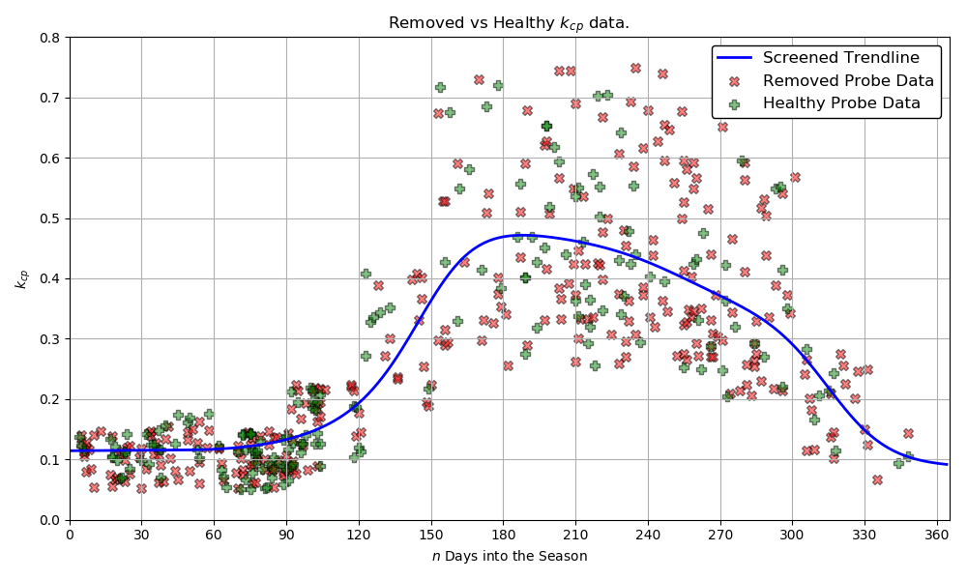
Comparing Removed versus Remaining datapoints.

Slide 17
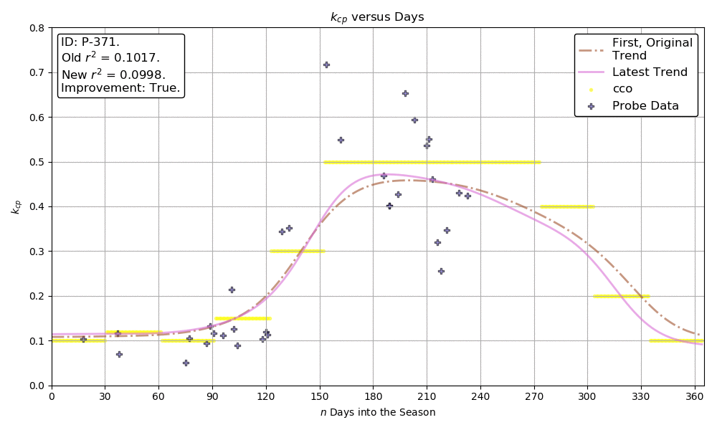
.gif Animation of remaining three "Healthy" Probes:
For the .pdf viewers, take a look at healthy.gif

Slide 18
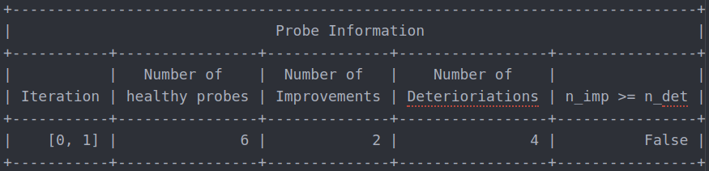
Previous 5 slides correspond to ETCP_PERC_DEVIATION = 50%
Results vary for different values of ETCP_PERC_DEVIATION.
Consider the following table when ETCP_PERC_DEVIATION = 30%.
Notice that we cannot even remove 1 probe.

Slide 19
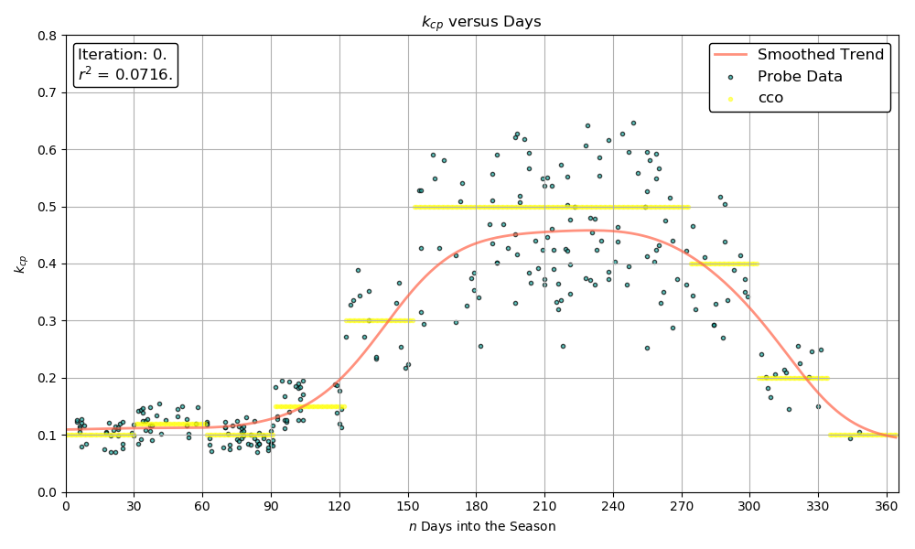
No .gif animation this time, because logic check is not satisfied at the first iteration.
Therefore we end up where we originally started.
(There is no change since the initial smoothed trendline.)

Slide 20
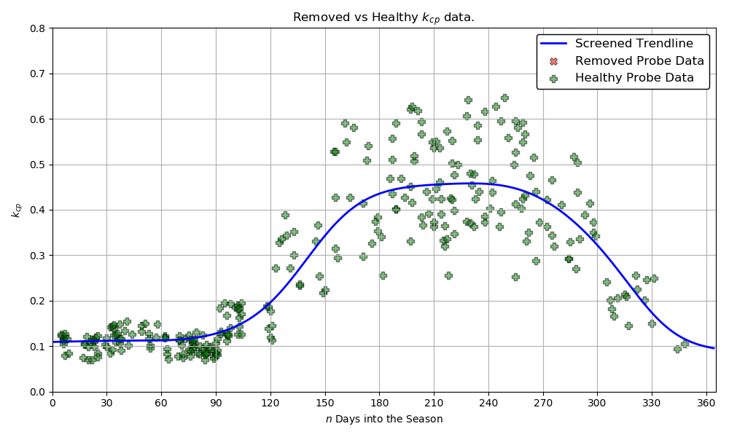
Comparing "Removed" versus Remaining datapoints for ETCP_PERC_DEVIATION = 30%.

Slide 21
Remaining Questions:
@Jac, are you still satisfied with RAIN_THRESHOLD = 2mm? (In other words, flag all samples for which rain > 2mm. See the next slide.)
Clearly, the results are sensitive depending on the value specified for ETCP_PERC_DEVIATION. Do you have a preferred value in the [30%; 50%] range of values?
What is an optimal API_START_DATE? Currently, the API_START_DATE is set to 2017-01-01.
I have coded the API_END_DATE to be equal to yesterday's date. (I assume this is acceptable?)

Slide 22
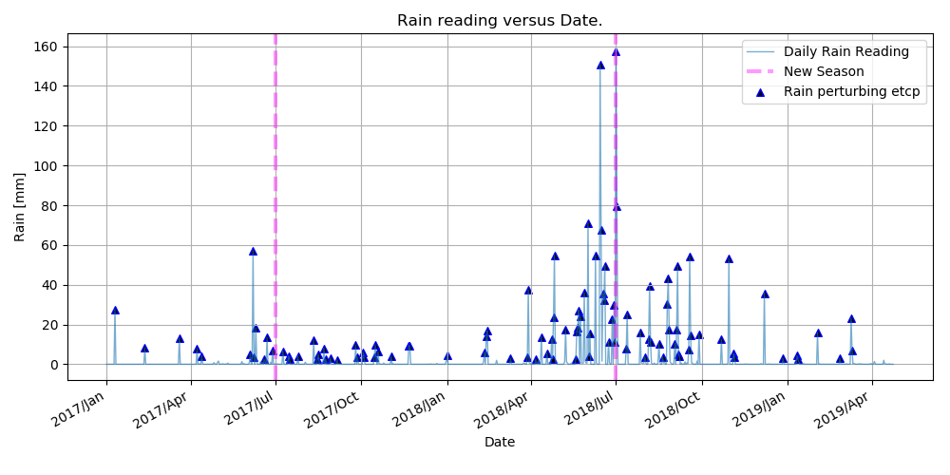
Flagged Rain Events (Ouplaas, Kromfontein):

Slide 23
Remaining Questions:
I make the assumption that Jac wants to apply this software to any set of probes satisfying the following condition:
  All the probes in the probe set (for a given cultivar) come from one hemisphere only, which can be either the Northern or Southern hemisphere. Therefore, the individual probe datasets have the "same season starting date" for the given cultivar.
  By extension of the above, the probes in the probe set cannot be a combination of Southern hemisphere and Northern hemisphere probes... In such a case the season starting date would differ for different probes, and the current coding would have to be extensively modified...
@Jac, please comment on the above.

Slide 24
To keep in mind:
The following parameters will vary depending on the specific cultivar we are considering:
  ETO_MAX (which is an educated guess)
  KCP_MAX (which is an educated guess)
  TEMPERATURE_BASE (educated guess or some theoretical value?)
  BEGINNING_SEASON_MONTH (will depend whether we are working with Northern or Southern hemisphere probes)
It is possible for consecutive eto entries that are identical to still be legitimate eto entries.
Despite the fact given above, I still flag any consecutive identical eto entries. I therefore err on the side of caution, rather than to err on the side of carelessness.

Slide 25
Time required for execution of scripts:
The total time required (starting from fetching the raw data via the API) to execute the scripts for the current set of 7 Probes on Henri's Laptop is:
  2 minutes and 15 seconds.

Slide 26
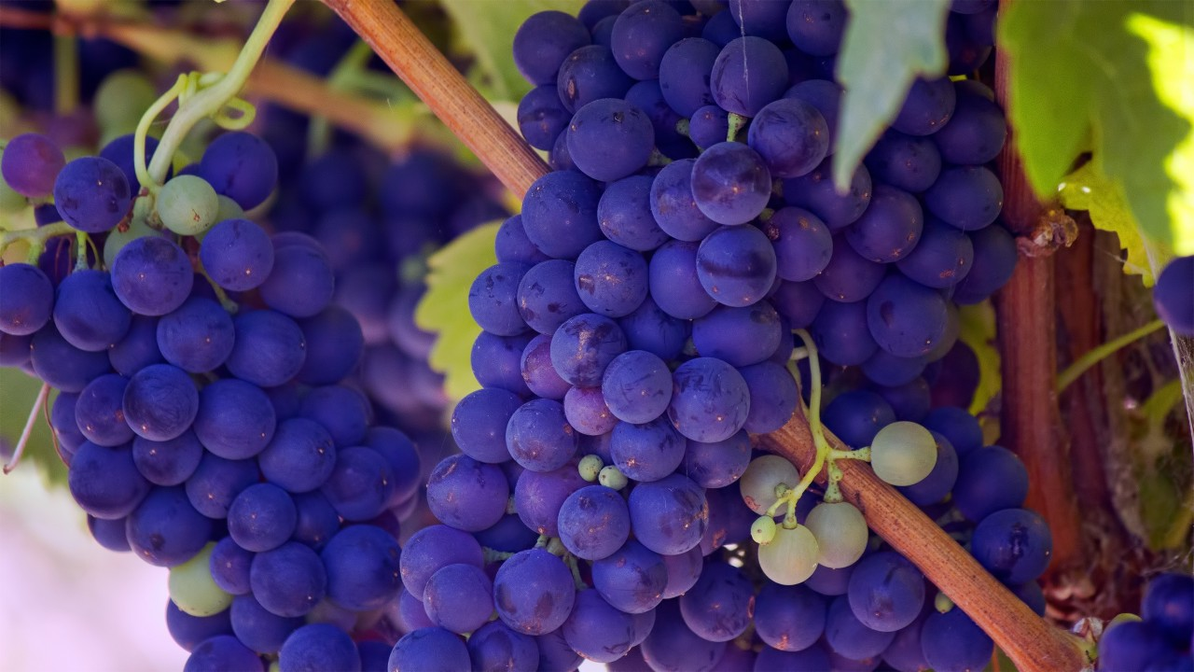
Thank You

