Slide 1

Algorithm Engineering: Presentation 1
Henri Dickel, Matija Miskovic & Lennart Uhrmacher

Slide 2
Our approach
Programming language: Java
Standard Java, Streams, no external libraries
Python for creating plots
Object-oriented implementation:
Every node is an Object
Each node holds the information about it's outgoing neighbors
class Node
{
String label;
List<Node> outNeighbors;
boolean deleted;
int visitIndex;
}

Slide 3
Our approach
Solver class that executes the main algorithm
One class for each algorithm:
Preprocessing
Is the graph a DAG?
Find first cycle
Log class for printing the result and debug information
All of these classes offer static methods

Slide 4
Our approach
Nodes are not actually deleted, only labeled:
for(Node node: cycle)
{
node.delete();
List<Node> S = dfvsBranch(graph, k - 1);
node.unDelete();
if(S != null)
{
S.add(node);
return S;
}
}

Slide 5
Finding the next cycle
Algorithm traverses the graph recursively (DFS)
Visited nodes get marked with an index
If a new visited node is already marked, a cycle is found
Running time is O(|V|) in the worst case, when each node is visited once
Will be replaced by BFS in the future

Slide 6
Finding the next cycle
A
cycleStartIndex: -1
cycle: ∅
D
B
C

Slide 7
Finding the next cycle
A
cycleStartIndex: -1
cycle: ∅
D
B
C

Slide 8
Finding the next cycle
A
cycleStartIndex: -1
cycle: ∅
visitIndex = 0
D
B
C

Slide 9
Finding the next cycle
A
cycleStartIndex: -1
cycle: ∅
visitIndex = 0
D
B
C

Slide 10
Finding the next cycle
A
cycleStartIndex: -1
cycle: ∅
visitIndex = 0
D
B
visitIndex = 1
C

Slide 11
Finding the next cycle
A
cycleStartIndex: -1
cycle: ∅
visitIndex = 0
D
B
visitIndex = 1
C

Slide 12
Finding the next cycle
A
cycleStartIndex: -1
cycle: ∅
visitIndex = 0
D
B
visitIndex = 1
C
visitIndex = 2

Slide 13
Finding the next cycle
A
cycleStartIndex: -1
cycle: ∅
visitIndex = 0
D
B
visitIndex = 1
C
visitIndex = 2

Slide 14
Finding the next cycle
A
cycleStartIndex: -1
cycle: ∅
visitIndex = 0
D
visitIndex = 3
B
visitIndex = 1
C
visitIndex = 2

Slide 15
Finding the next cycle
A
cycleStartIndex: -1
cycle: ∅
visitIndex = 0
D
visitIndex = 3
B
visitIndex = 1
C
visitIndex = 2

Slide 16
Finding the next cycle
A
cycleStartIndex: 1
cycle: B
visitIndex = 0
D
visitIndex = 3
B
visitIndex = 1
C
visitIndex = 2

Slide 17
Finding the next cycle
A
cycleStartIndex: 1
cycle: B
visitIndex = 0
D
visitIndex = 3
B
visitIndex = 1
C
visitIndex = 2

Slide 18
Finding the next cycle
A
cycleStartIndex: 1
cycle: B, D
visitIndex = 0
D
visitIndex = 3
B
visitIndex = 1
C
visitIndex = 2

Slide 19
Finding the next cycle
A
cycleStartIndex: 1
cycle: B, D
visitIndex = 0
D
visitIndex = 3
B
visitIndex = 1
C
visitIndex = 2

Slide 20
Finding the next cycle
A
cycleStartIndex: 1
cycle: B, D, C
visitIndex = 0
D
visitIndex = 3
B
visitIndex = 1
C
visitIndex = 2

Slide 21
Finding the next cycle
A
cycleStartIndex: 1
cycle: B, D, C
visitIndex = 0
D
visitIndex = 3
B
visitIndex = 1
C
visitIndex = 2

Slide 22
Finding the next cycle
A
cycleStartIndex: 1
cycle: B, D, C
visitIndex = 0
D
visitIndex = 3
B
visitIndex = 1
C
visitIndex = 2

Slide 23
Tarjan's Algorithm
Algorithm finds cyclic components in the graph
Cyclic component: set of nodes, which have any cyclic connection
Linear running time: O(|V| + |E|)
We used it once before the main algorithm

Slide 24
Tarjan's Algorithm
G
A
C
F
H
B
D
E
H

Slide 25
Tarjan's Algorithm
G
A
C
F
H
B
D
E
H

Slide 26
Tarjan's Algorithm
G
A
C
F
H
B
D
E

Slide 27
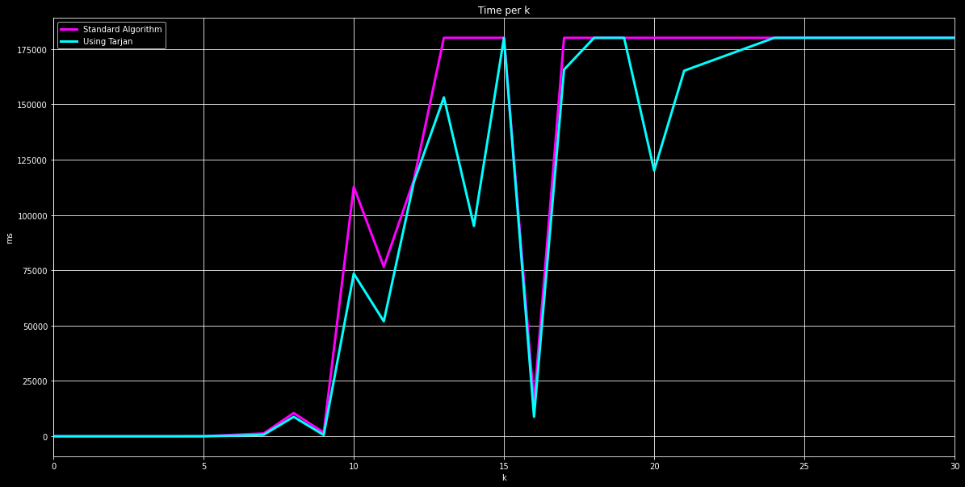
Tarjan's Algorithm - Performance

Slide 28
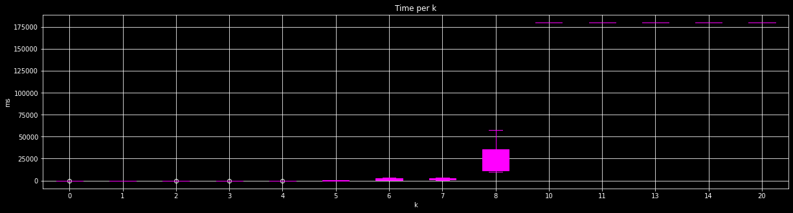
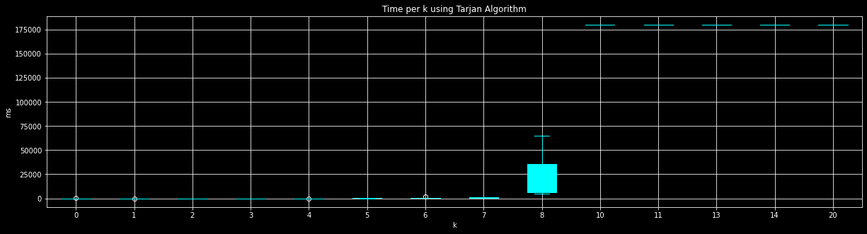
Tarjan's Algorithm - Synthetic

Slide 29
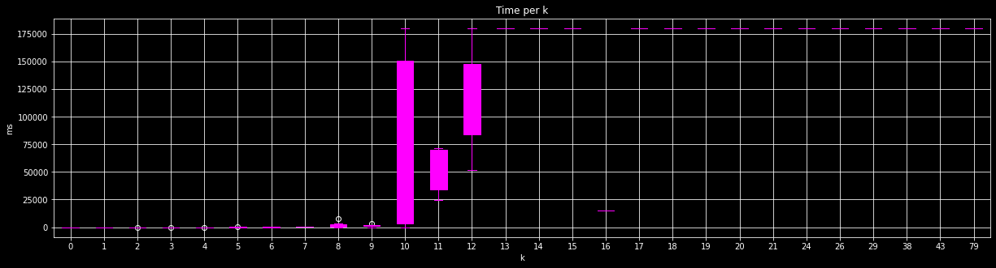
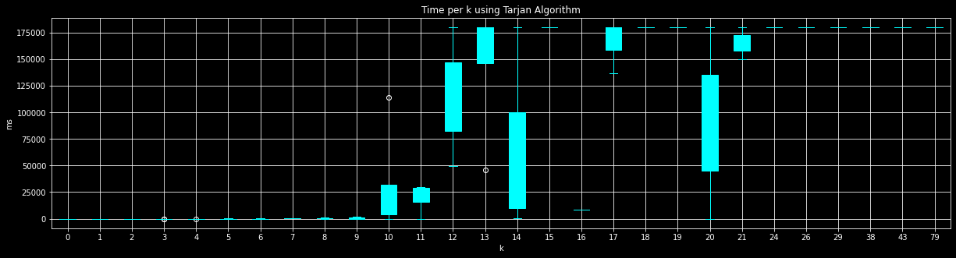
Tarjan's Algorithm - Complex

Slide 30
Calculation of min k
What is the worst case graph?
A fully connected graph
In fact, a fully connected graph is not the worst case:
if(m == n * (n - 1))
{
return k = n – 1;
}
Removing a single edge (a,b) => k = n – 2
Can we rule out even more cases with this approach?
Idea for min k: add as many edges as possible to a graph without creating a cycle

Slide 31
Calculation of min k
A
|V| = 4
|E| = 0
k = 0
|E| | k
0 | 0
1
2
3
4
5
6
7
8
9
10
11
12
B
C
D

Slide 32
Calculation of min k
A
|V| = 4
|E| = 1
k = 0
|E| | k
0 | 0
1 | 0
2
3
4
5
6
7
8
9
10
11
12
B
C
D

Slide 33
Calculation of min k
A
|V| = 4
|E| = 2
k = 0
|E| | k
0 | 0
1 | 0
2 | 0
3
4
5
6
7
8
9
10
11
12
B
C
D

Slide 34
Calculation of min k
A
|V| = 4
|E| = 3
k = 0
|E| | k
0 | 0
1 | 0
2 | 0
3 | 0
4
5
6
7
8
9
10
11
12
B
C
D

Slide 35
Calculation of min k
A
|V| = 4
|E| = 4
k = 0
|E| | k
0 | 0
1 | 0
2 | 0
3 | 0
4 | 0
5
6
7
8
9
10
11
12
B
C
D

Slide 36
Calculation of min k
A
|V| = 4
|E| = 5
k = 0
|E| | k
0 | 0
1 | 0
2 | 0
3 | 0
4 | 0
5 | 0
6
7
8
9
10
11
12
B
C
D

Slide 37
Calculation of min k
A
|V| = 4
|E| = 6
k = 0
|E| | k
0 | 0
1 | 0
2 | 0
3 | 0
4 | 0
5 | 0
6 | 0
7
8
9
10
11
12
B
C
D

Slide 38
Calculation of min k
A
|V| = 4
|E| = 7
k = 1
|E| | k
0 | 0
1 | 0
2 | 0
3 | 0
4 | 0
5 | 0
6 | 0
7 | 1
8
9
10
11
12
B
C
D

Slide 39
Calculation of min k
A
|V| = 4
|E| = 8
k = 1
|E| | k
0 | 0
1 | 0
2 | 0
3 | 0
4 | 0
5 | 0
6 | 0
7 | 1
8 | 1
9
10
11
12
B
C
D

Slide 40
Calculation of min k
A
|V| = 4
|E| = 9
k = 1
|E| | k
0 | 0
1 | 0
2 | 0
3 | 0
4 | 0
5 | 0
6 | 0
7 | 1
8 | 1
9 | 1
10
11
12
B
C
D

Slide 41
Calculation of min k
A
|V| = 4
|E| = 10
k = 2
|E| | k
0 | 0
1 | 0
2 | 0
3 | 0
4 | 0
5 | 0
6 | 0
7 | 1
8 | 1
9 | 1
10 | 2
11
12
B
C
D

Slide 42
Calculation of min k
A
|V| = 4
|E| = 11
k = 2
|E| | k
0 | 0
1 | 0
2 | 0
3 | 0
4 | 0
5 | 0
6 | 0
7 | 1
8 | 1
9 | 1
10 | 2
11 | 2
12
B
C
D

Slide 43
Calculation of min k
A
|V| = 4
|E| = 12
k = 3
|E| | k
0 | 0
1 | 0
2 | 0
3 | 0
4 | 0
5 | 0
6 | 0
7 | 1
8 | 1
9 | 1
10 | 2
11 | 2
12 | 3
B
C
D

Slide 44
Calculation of min k
|E| | k
0 | 0
1 | 0
2 | 0
3 | 0
4 | 0
5 | 0
6 | 0
7 | 1
8 | 1
9 | 1
10 | 2
11 | 2
12 | 3
1. max m = n * (n – 1)
2. min k = 0 if m ≤ n * (n – 1) / 2

Slide 45
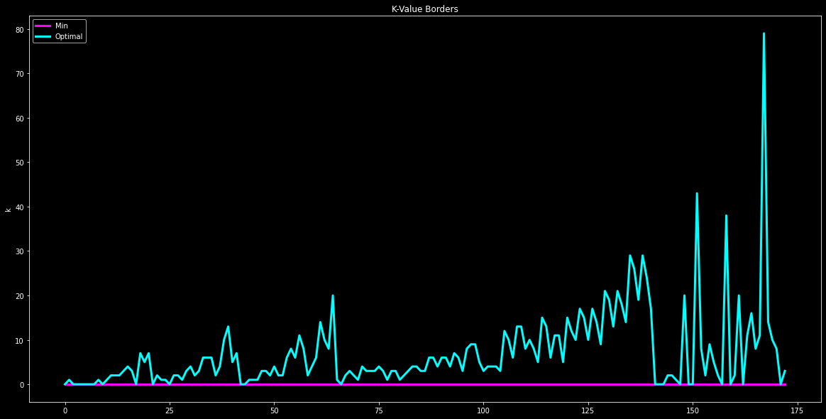
Calculation of min k

Slide 46
Performance
We set a timeout after 3 minutes for the plots
The best we could solve was k = 21
The algorithm was executed on an i9-9900K
Next time we will show the server performance too

Slide 47
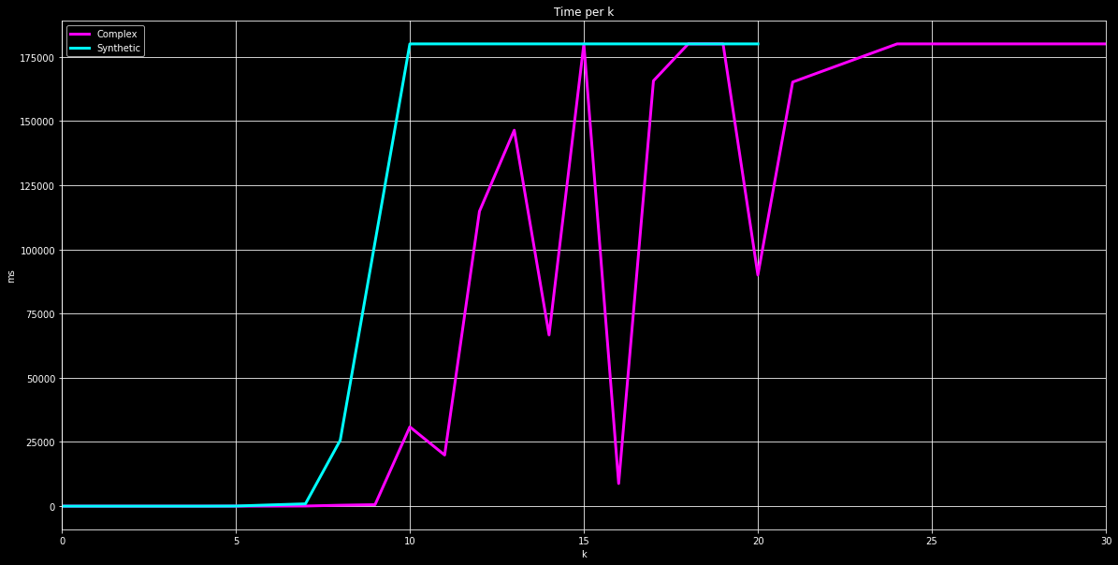
Performance – per k

Slide 48
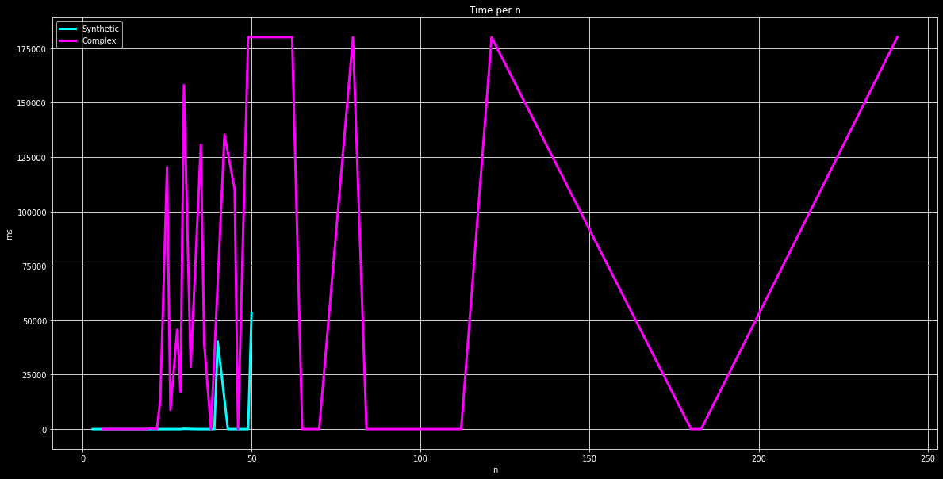
Performance – per n

Slide 49
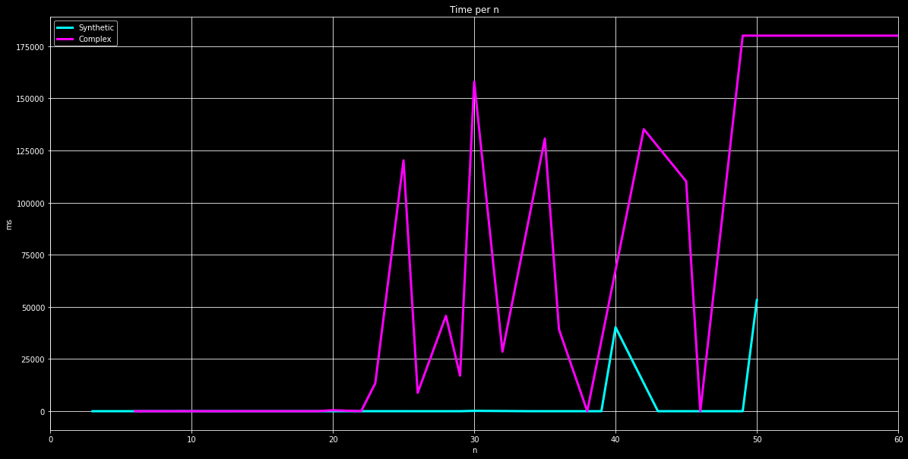
Performance – per n

Slide 50
Do you have any questions?

