Slide 1
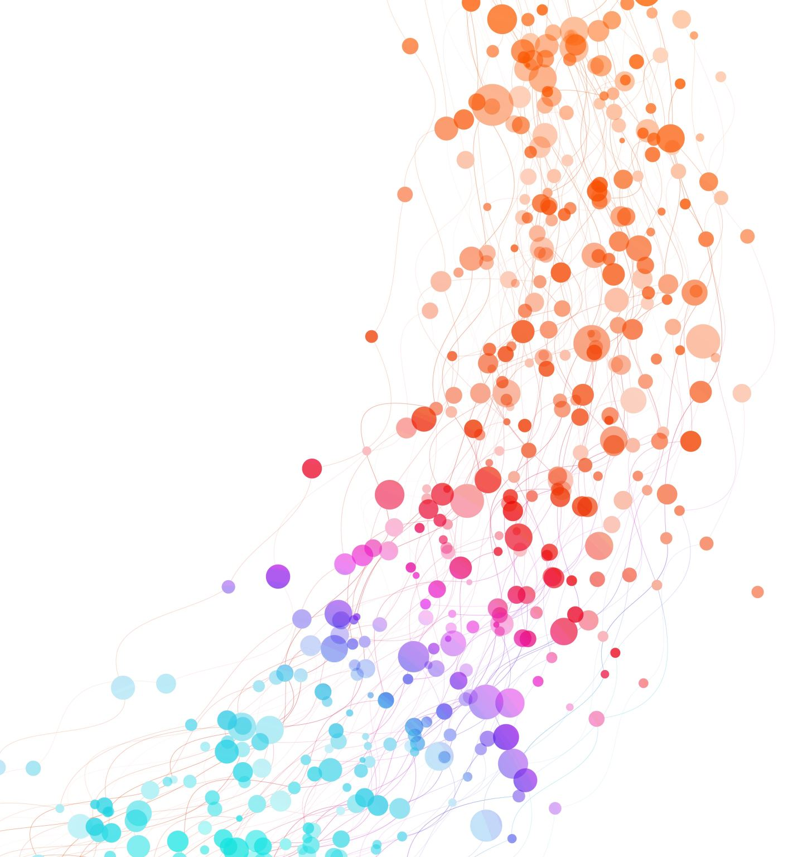
Algorithm Engineering: Milestone 2
Henri Dickel, Matija Miskovic & Lennart Uhrmacher

Slide 2
Introduction
1
Previous state:
Base search tree algorithm
Finding cycles to branch on with DFS
Preprocessing with Tarjan's Algorithm
Current state:
Reduction rules in preprocessing
Forbidden nodes
Flowers
Finding cycles with BFS

Slide 3
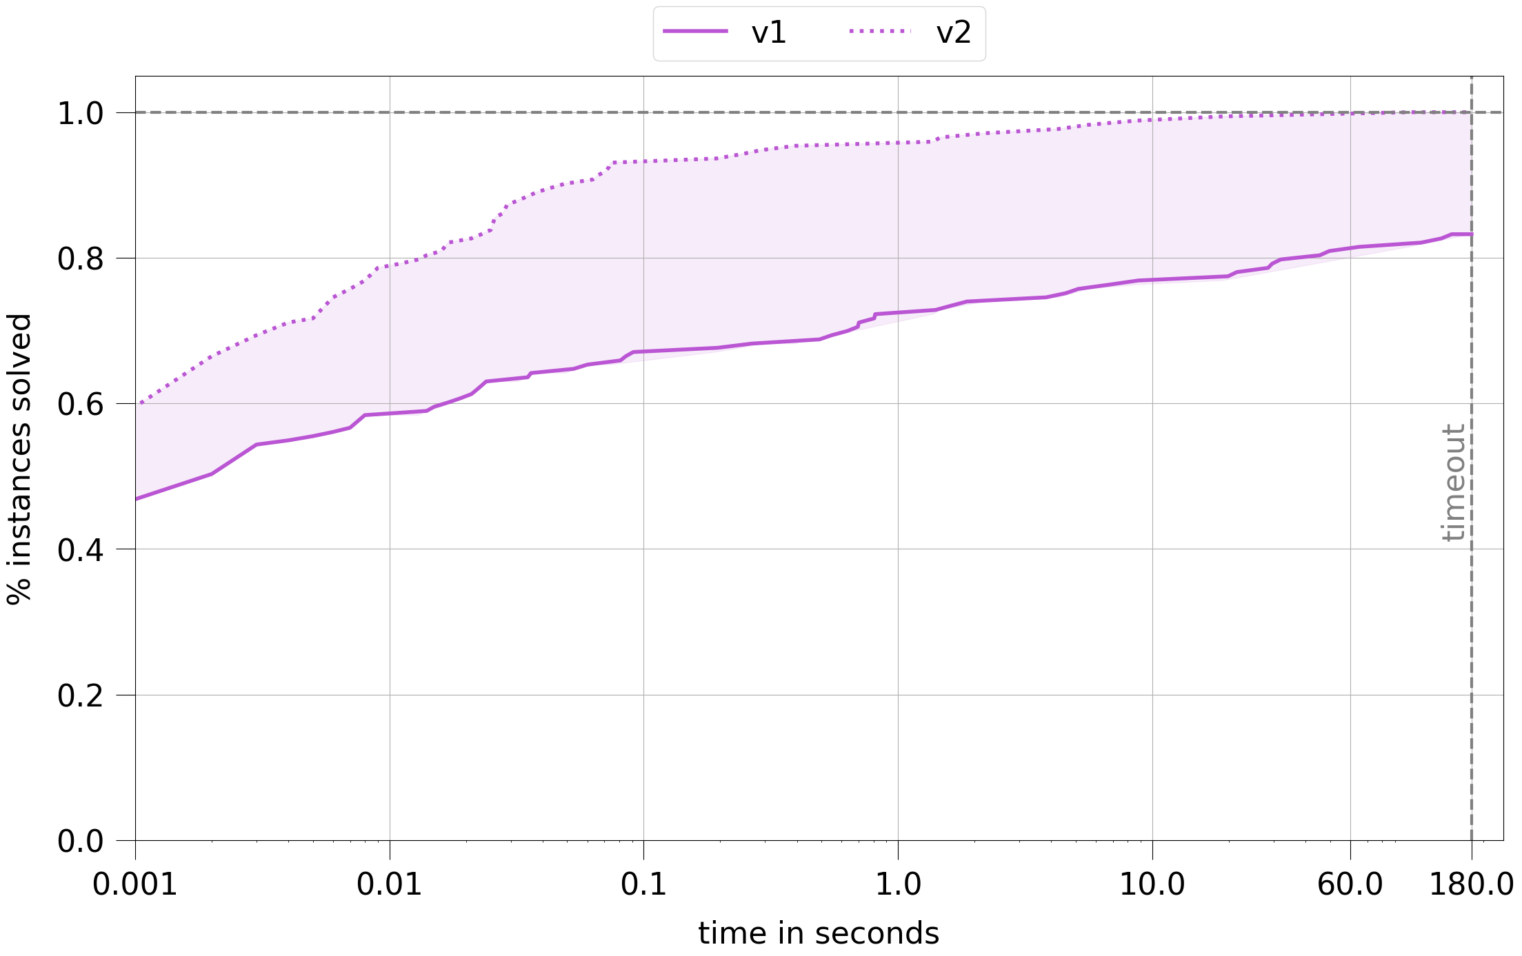
Introduction
2

Slide 4
Introduction
3
What will we do today?
Go through each new feature
Take a closer look on how it works
Analyze the importance of the feature

Slide 5
Reduction rules
4
Decomposition into cyclic components already used
Reduction rules:
Remove self edges
Chain rule
Remove trivial vertices
Advanced triangle reduction rule
Only used as preprocessing

Slide 6
Reduction rules
5
Advanced Triangle reduction rule:
A
B
C

Slide 7
Reduction rules
5
Advanced Triangle reduction rule:
A

Slide 8
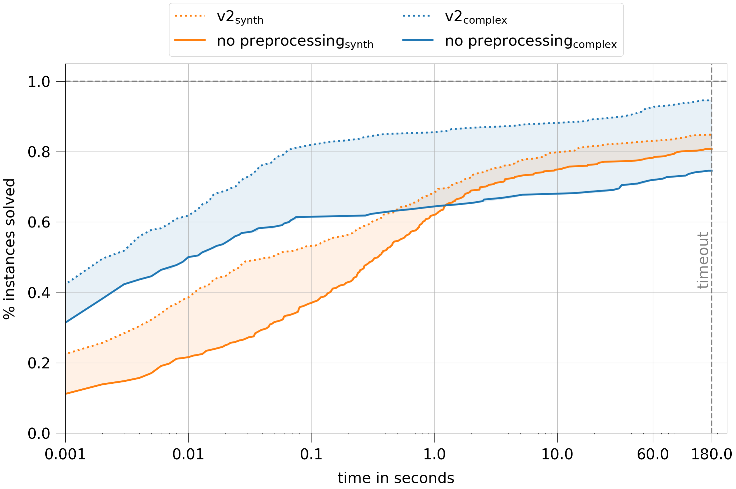
Reduction rules
6

Slide 9
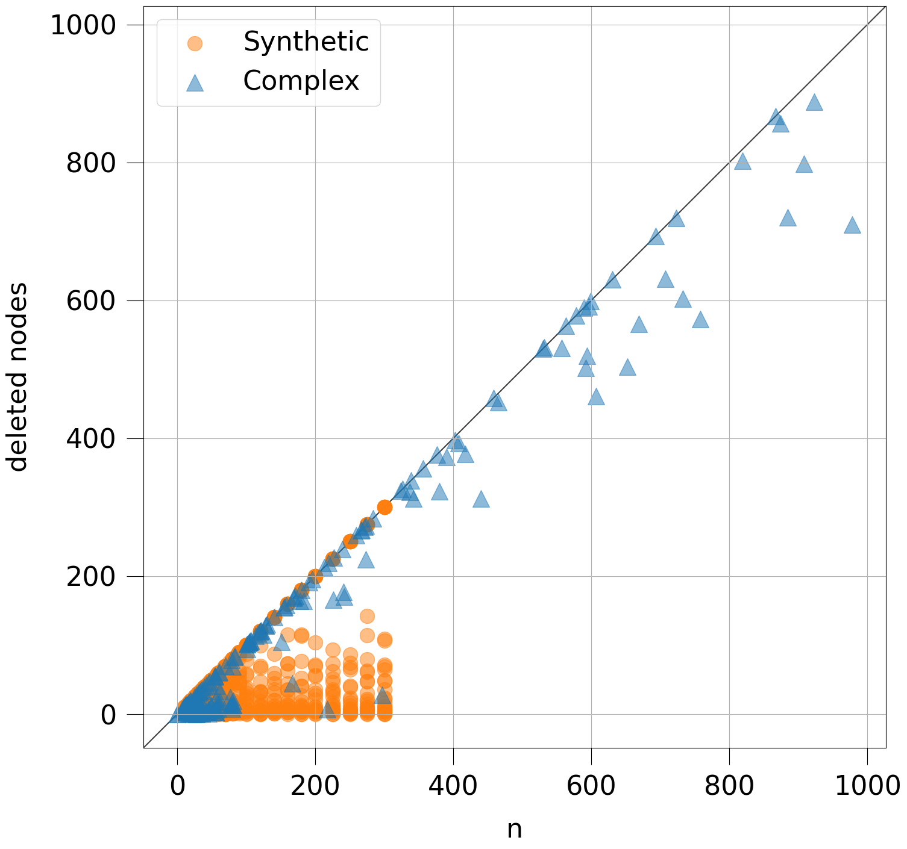
Reduction rules
7

Slide 10
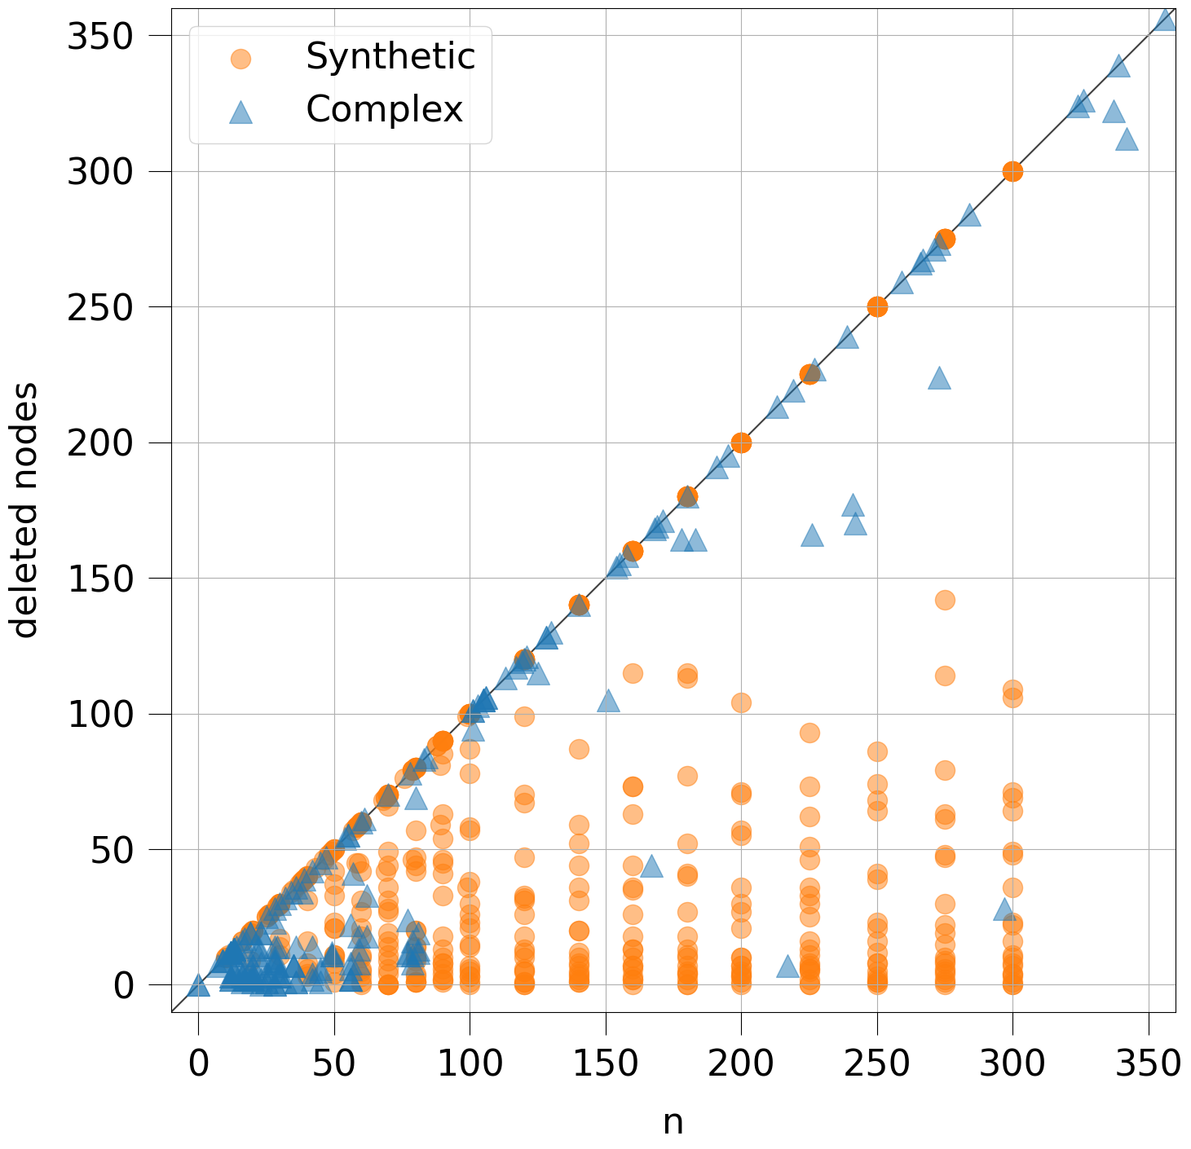
Reduction rules
7

Slide 11
Forbidden nodes
8
Forbidden node algorithm:
When a node is deleted, it is labeled as 'forbidden'
In further branching, 'forbidden' nodes can be skipped

Slide 12
Forbidden nodes
9
0
A
B
B
C
A
C
C
D
B
D
C
D
A
D

Slide 13
Forbidden nodes
9
0
A
B
B
C
A
C
C
D
B
D
C
D
A
D

Slide 14
Forbidden nodes
9
0
A
B
B
C
A
C
C
D
B
D
C
D
A
D

Slide 15
Forbidden nodes
9
0
A
B
B
C
A
C
C
D
B
D
C
D
A
D

Slide 16
Forbidden nodes
9
0
A
B
B
C
A
C
C
D
B
D
C
D
A
D

Slide 17
Forbidden nodes
9
0
A
B
B
C
A
C
C
D
B
D
C
D
A
D

Slide 18
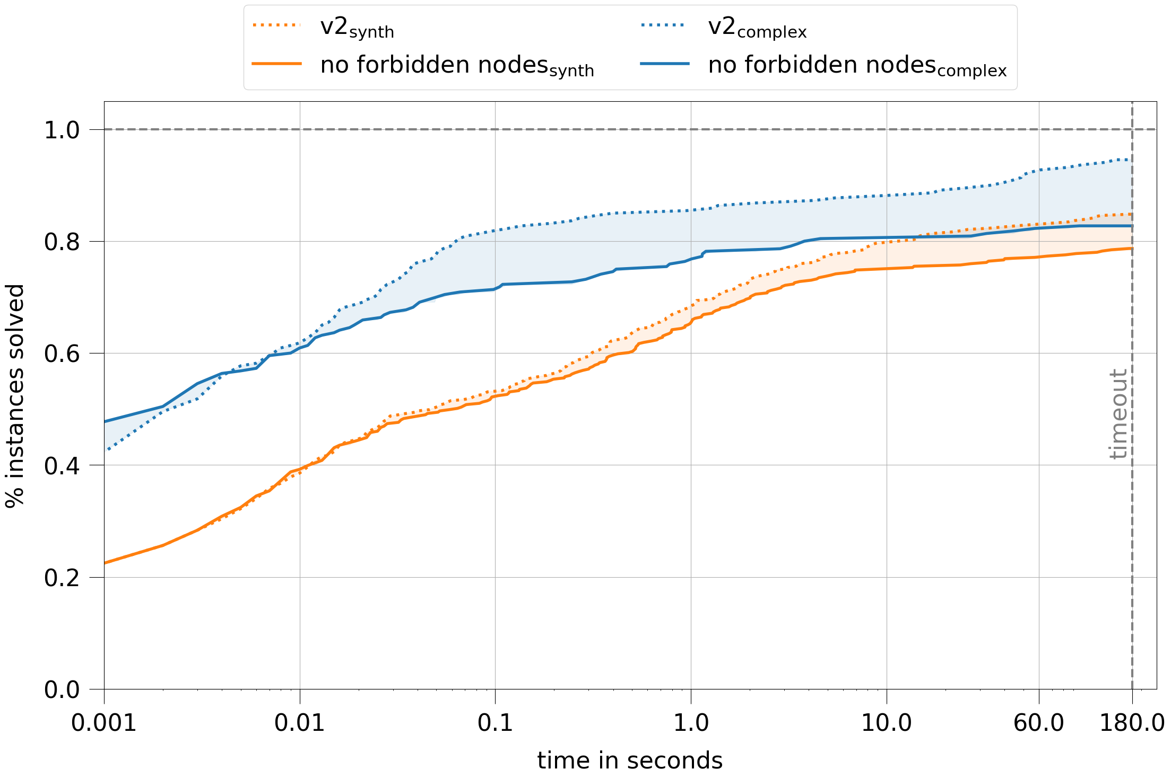
Forbidden nodes
10

Slide 19
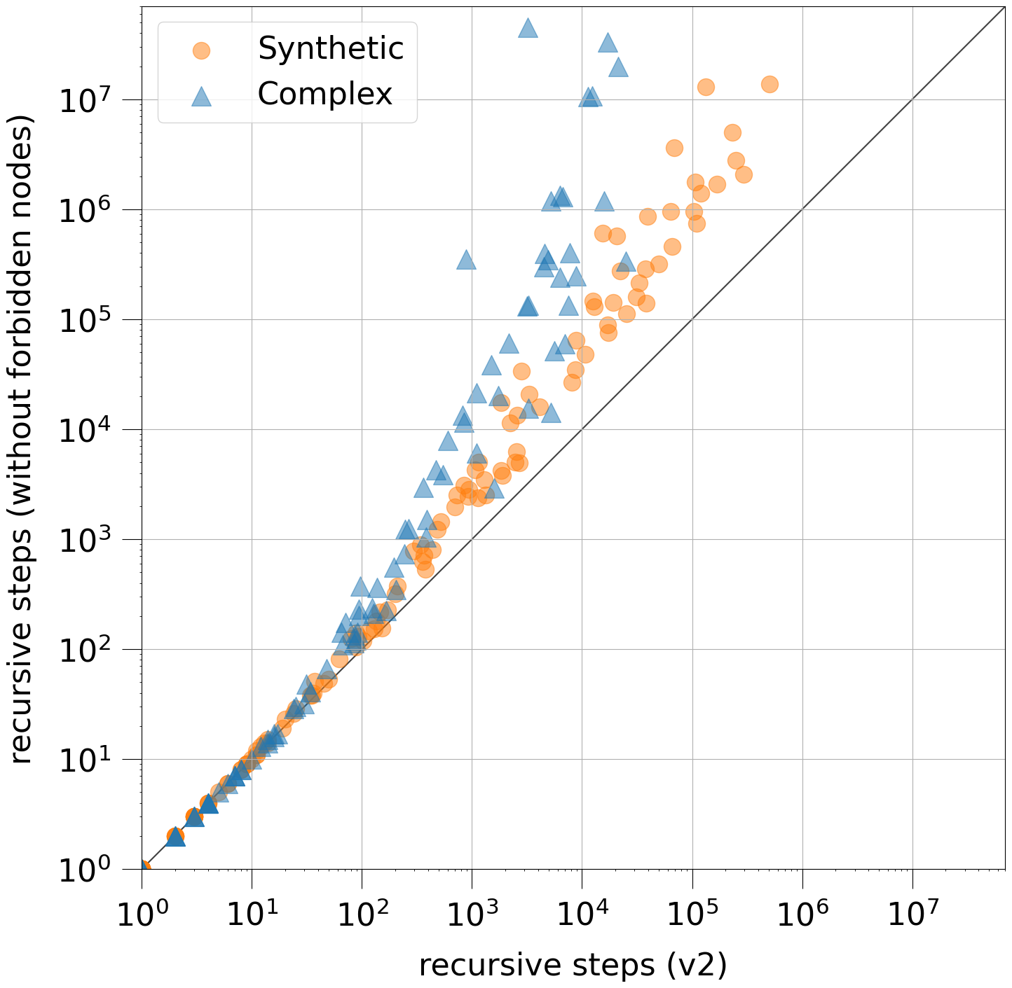
Forbidden nodes
11

Slide 20
Flowers
12
General idea: petal(V) = number of disjoint cycles connected in V
Approach from lecture:
Create graph
Calculate Max-Flow/Min-Cut with Ford-Fulkerson
Optimization: Don't create a new graph for every node

Slide 21
Flowers
13
Petal rule: when petal(V) > k, delete V and increase k by one
How do we use it:
Calculate petal-values for all nodes
Calculate for current k: are there nodes, that can be deleted with the petal rule? ➞ If yes, delete one and recalculate petal-values
When the amount of deleted nodes is higher that our current k, there is no solution for this k
Optimization: reduce petal-values by 1 instead of recalculating
When do we use it? For each k before we start branching

Slide 22
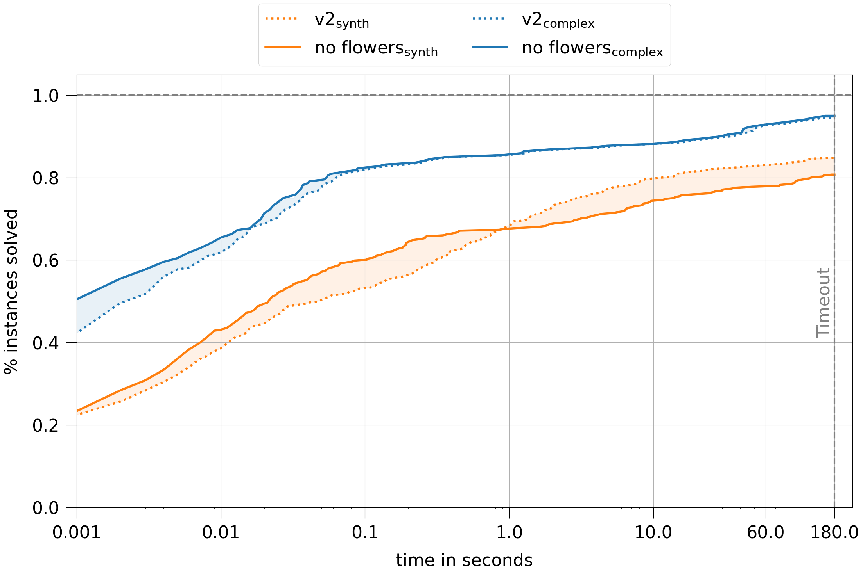
Flowers
14

Slide 23
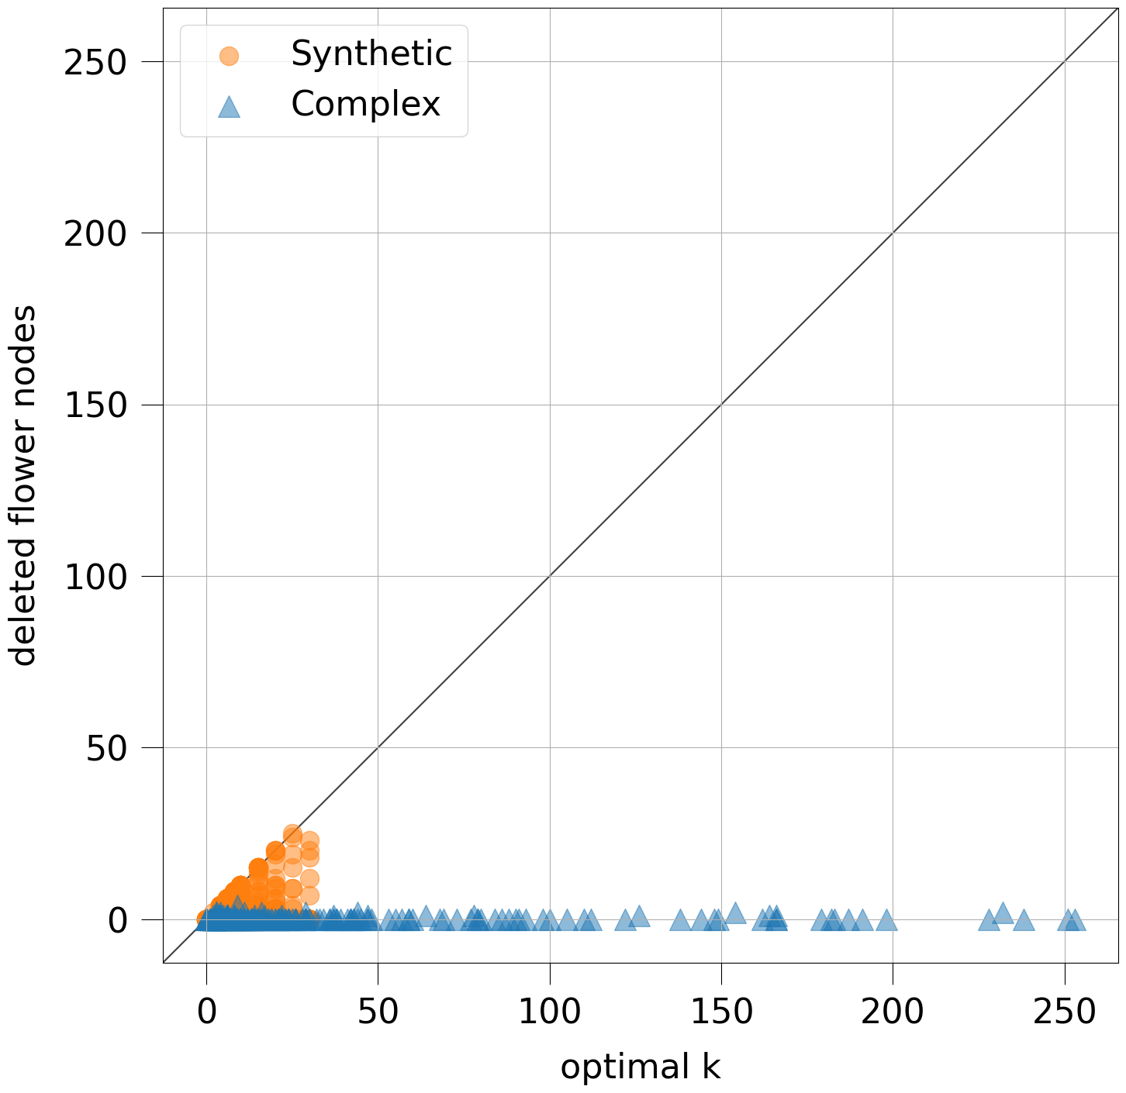
Flowers
15

Slide 24
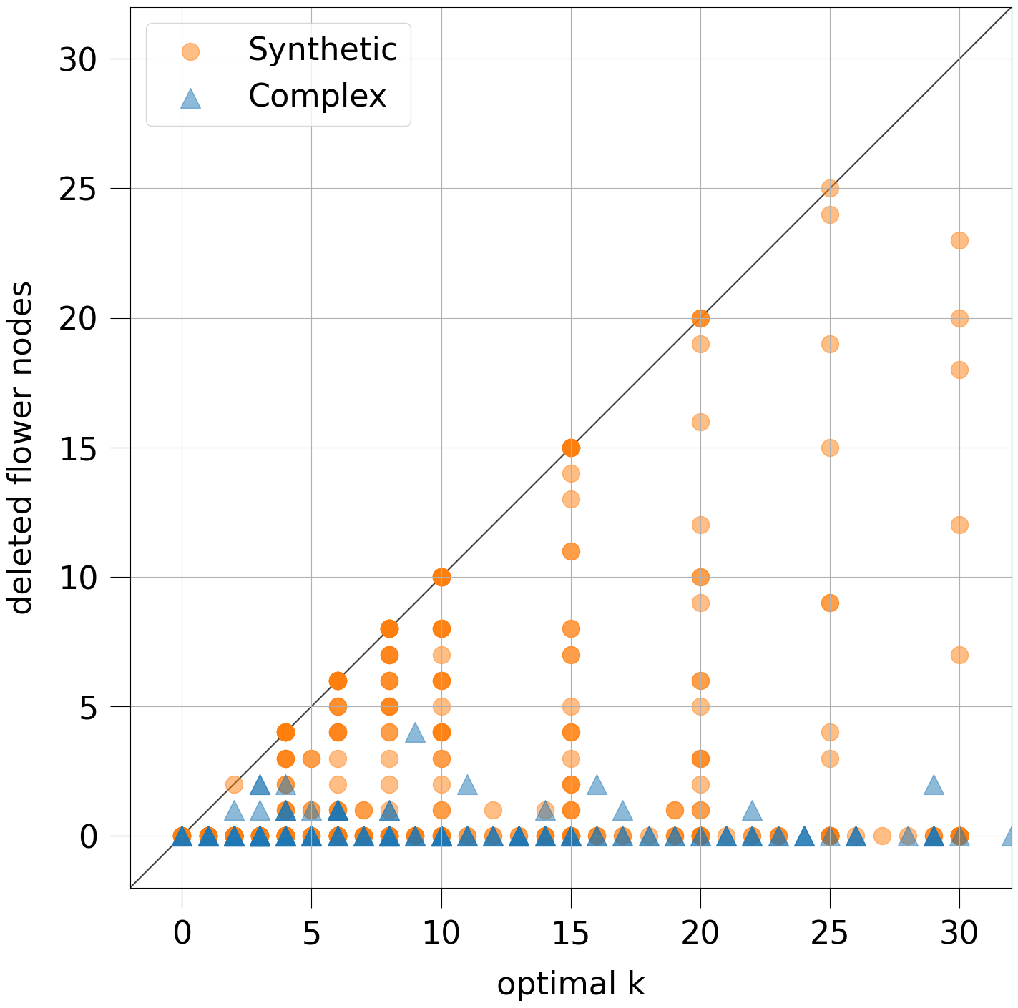
Flowers
15

Slide 25
Finding cycles
16
Forbidden nodes do affect the cycles in the graph:
A
E
F
B
D
C
G
A-B-C is the shortest cycle, but is it necessarily the best to branch on?

Slide 26
Finding cycles
16
Forbidden nodes do affect the cycles in the graph:
A
E
F
B
D
C
G
A-B-C is the shortest cycle, but is it necessarily the best to branch on?
➔ No, D-E-F-G branches only 2 instead of 3 times

Slide 27
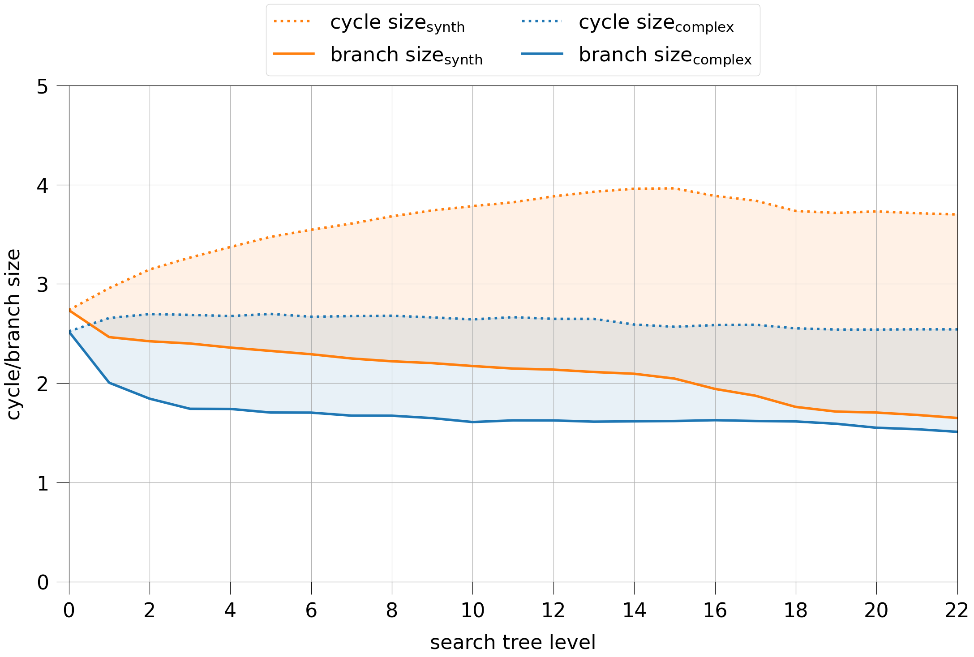
Finding cycles
17

Slide 28
Finding cycles with BFS
18
They can be found with breadth-first search
We tried out three approaches:
Full BFS: in every node of the search tree, run a BFS from every node of the graph and pick the best cycle ➔ always finds the best cycle, high runtime
Full BFS + (with caching): calculate the best cycle for every node only once in the beginning and update it, when their cycle is destroyed ➔ mostly finds the best cycle, medium runtime
Light BFS: In every node of the search tree, run a modified BFS on the graph that returns the first found cycle ➔ not always finds the best cycle, fast runtime
Light BFS was the best for a long time until we added 1 line of code for the improvement that I just showed you

Slide 29
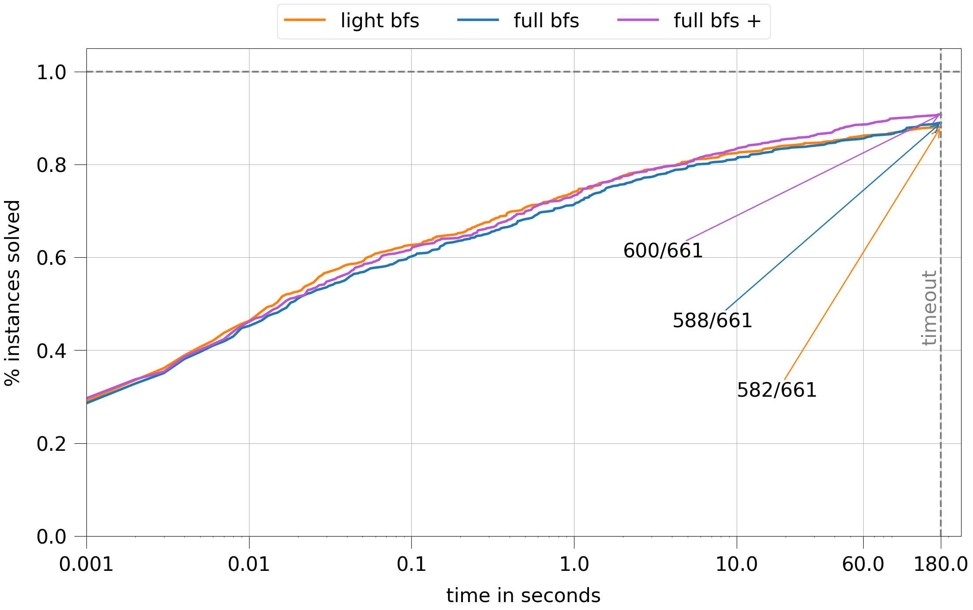
Finding cycles with BFS
19

Slide 30
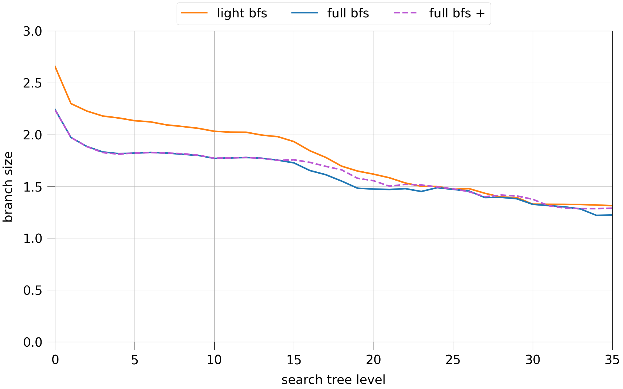
Finding cycles with BFS
20

Slide 31
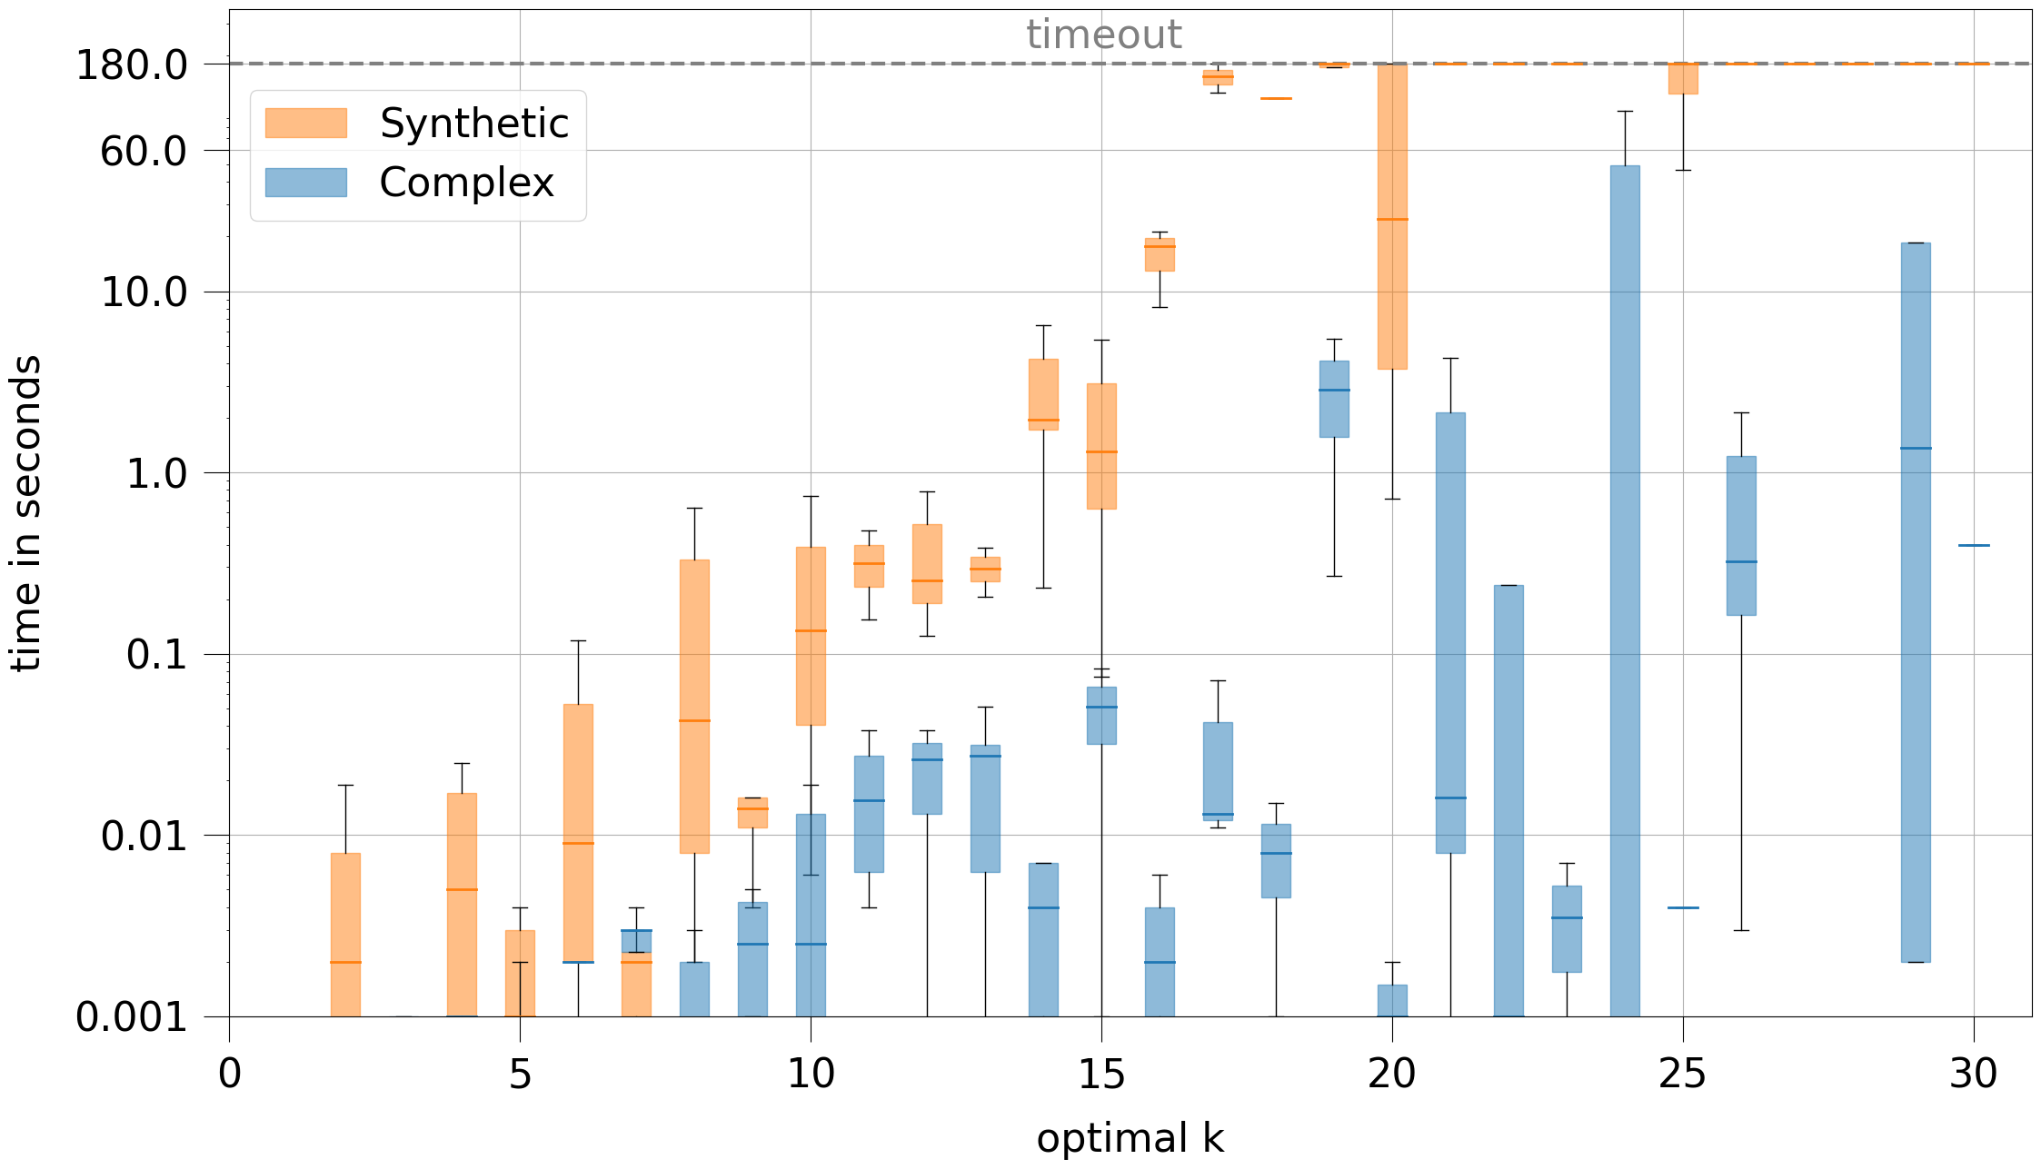
Summary
21

Slide 32
Summary & Outlook
22
Percentage solved: 88.1% (90.8%)
Synthetic: 84.8% (88.7%)
Complex: 94.6% (95.0%)
Goals for next milestone:
Use reductions, cyclic decomposition and flowers in branching
Improve and use the best BFS approach
Use lower bounds (from last lecture)

Slide 33
Do you have questions?
23

