Slide 1
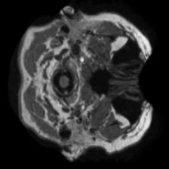
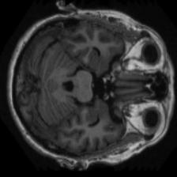
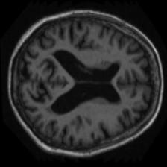
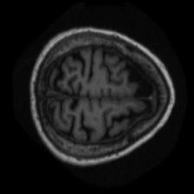
Decoding Alzheimer's: Advanced MRI Analysis Through Computer Vision Techniques
Data:
Atlas registered MRI scans sliced into 176 images, masked and not masked.
Scans from 412 individuals age 18 to 96 of which 100 are dignosed with mild to moderate AD
Challenges:
High number of images (~150,000) (demanding computational recources)
Low number of actually different samples (412)
Data imbalence
Roadmap:
Exploratory Data Analysis
Discover further potential challenges
Preprocessing
Goal: reduce computational load during training
Evaluation of which slices contain relevant data. E.g. train 176 simple models on the respective slices, then only keep top n slices where the accuracy was the highest.
See next slide

Slide 2
Decoding Alzheimer's: Advanced MRI Analysis Through Computer Vision Techniques
Roadmap:
Exploratory Data Analysis
Data Preprocessing
Implement Baseline Model: Use the average prediction from 10 EfficientNets on the 10 most relevant slices.
Weighted Prediction Aggregation
Replace EfficientNets with Transformer-based model
Remove the Classification Head from the model, concatenate the feature representations, and use a new Classification Head for prediction based on these feature representations.
Implement Attention into the Classification Head
Self Distillation of Training Labels
Implement other state-of-the-art methodologies
Must have
CV Model1
CV Model2
…
CV Model10
Predictions (3.-5.) or
feature representation (6.)
Nice to have
Prediction Aggregation (3.-5.) or Classification Head (6.)
Let’s see
Final Prediction

