Slide 1
Decoding Alzheimer's: Advanced MRI Analysis Through Computer Vision Techniques
by Henri Smidt
Notes:
First of all I would like to use this situation to thank you for giving me the opportunity to do this project on decoding alzheimers...

Slide 2

Why?
Early detection of dementia is crucial for an effective treatment.
Traditional methods are time consuming and prone to human error.
My research is supposed to help identifying potential cases quicker and thereby guiding understaffed medical professionals to focus on the most relevant cases.

Slide 3
Data
T1-weighted MRI scans from 416 individuals, 100 with AD
Corrected for head movement and spatially aligned to the Talairach and Tournoux atlas space
Combined template atlas from young and elderly subjects without dementia was used to minimize age biases
Versions with and without skull

Slide 4

Challenges
Data Imbalance with few individual instances
Large Data Volume & Computational Restrictions
MRI scans require significant memory resources
Single GPU with 14 GB memory capacity
Only 416 independent instances
Notes:
Briefly explain validation and test set: While training you have a validation set, that you use to test the model after every training iteration. If the results stop getting better it’s a sign that the model starts overfitting on the training data. Final evaluation is done on a separate test set to not cherry pick the model, that best suits the test set.

Slide 5
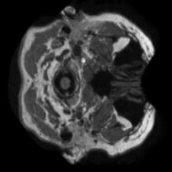
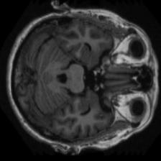
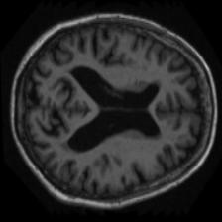
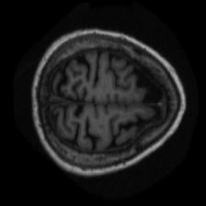
Preprocessing
Dividing MRI scans into 176 manageable slices
Combining 3 adjacent slices into a single 3-channel image
Advantages:
Reduces input size to a manageable level
Enables use of pretrained models and their learned features
Preserves some three-dimensional structural information
Slice 0, Slice 1, Slice 2
Slice 3, Slice 4, Slice 5
Slice 174,
Slice 175,
Slice 176
Notes:
To address the problem of MRI scans being very memory intensive..

Slide 6
Preprocessing
Advantages:
Further reduce the computational burden of a large dataset
Keep slices presumed to have diagnostic value
MobileVit-xs 1
F1-Score
MobileVit-xs 2
F1-Score
…
F1-Score
MobileVit-xs 59
F1-Score
3. Proceed only with best scoring slice groups
1. Train one model per slice group
2. Evaluate individual models
Notes:
In a second step to even further reduce the computational burden I have trained…

Slide 7
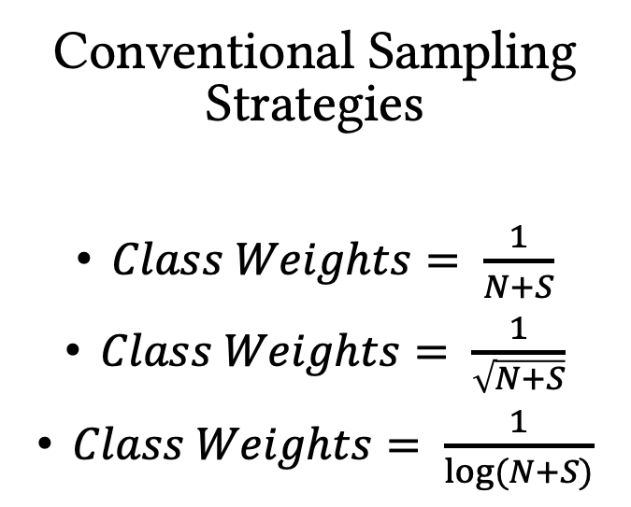
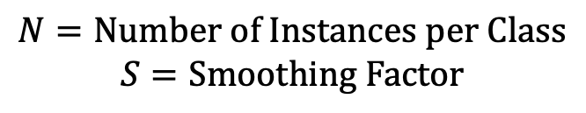
Sampling Methods
Conventional Sampling Strategies
$Class Weights= \frac{1}{N+S}$
$Class Weights= \frac{1}{\sqrt{N+S}}$
$Class Weights= \frac{1}{\log{(N+S)}}$
Custom Weights found by Random Search
20 Trainings with set of random weights
Average top 3 weights according to validation loss
$$N=Number of Instances per Class$$
$$S=Smoothing Factor$$
Notes:
The other mayor challenge I was facing was the unbalanced dataset. There are different strategies how you can deal with this, with the most common approach being using a sampling strategy. This means that in each training iteration a class can get over or undersampled according to a weight you give to a class.
weights
However, there are some issues with these conventional approaches which I am going to address later.
Another approach that I hope to be better is using custom weights
Now you might say, that random search does not sound like a very effective and systematic approach to finding a good set of weights..

Slide 8
316 Non Demented
70 Very Mild AD
28 Mild AD
2 Moderat AD
EfficientNet
Custom:0.83
Log: 0.79
Sqrt: 0.78
Inverse: 0.71
MobileVit
Custom:0.86
Log:0.78
Sqrt:0.75
Inverse:0.77

Slide 9
316 Non Demented
70 Very Mild AD
28 Mild AD
2 Moderat AD
EfficientNet
Custom:0.83
Log: 0.79
Sqrt: 0.78
Inverse: 0.71
Exp: 0
MobileVit
Custom:0.86
Log:0.78
Sqrt:0.75
Inverse:0.77
Exp: 0

Slide 10
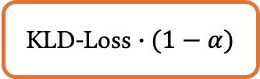
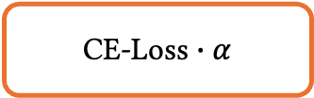
Self Distillation
Teacher Model
Predictions
Soft labels generated by the teacher model capture information nonexistend in the hard labels, such as data ambiguities.
Enhances generalization & robustness
Stabilizes training & prevents overfitting
KLD-Loss $∙(1−α)$
Student Model
Predictions
CE-Loss $∙α$
Reference Labels
Notes:
In reality there is a smooth transition between the classes

Slide 11
Prediction Fusion
EfficientNet-b2
(9.2 M parameters, CNN based)
CV Model1
CV Model2
…
CV Model10
MobileVit-s
(5.6 M parameters, ViT based)
predictions
Averaging
Final Prediction

Slide 12
Features Fusion
EfficientNet-b2
(9.2 M parameters, CNN based)
Feature size: 1408
MobileVit-s
(5.6 M parameters, ViT based)
Feature size: 160
CV Model1
CV Model2
…
CV Model10
feature maps
Classification Head
Input 1
Probability of class 1
Input 2
Probability of class 2
Input 3
Probability of class 3
Input 4
Probability of class 4
Final Prediction
predictions
feature map/
feature vector

Slide 13
Simple Feature Fusion Head
Advanced Feature Fusion Head
Attention Feature Fusion Head
Fully Connected Layer (Feature Size x Num Classes)
Fully Connected Layer (Feature Size x 256)
Batch Normalization
ReLU Activation
Dropout (0.5)
Fully Connected Layer (256 x 128)
Batch Normalization
ReLU Activation
Dropout (0.5)
Fully Connected Layer (128 x Num Classes)
Add Positional Encoding
Layer Normalization
Multi-Head Attention
Layer Normalization
Dropout (0.5)
Mean Across Sequence Dimension
Advanced Feature Fusion Head
Attention Mechanism

Slide 14
Results
Test set:
Non-demented: 41
Very mild dementia: 11
Mild dementia: 3
10 tests per strategy, each with a different seed
Hyperparameter search and sampling strategy evaluation was performed on a single slice group and just once.

Slide 15
Notes:
WEIGHTED F1

Slide 16
x
Aggregation of other slice models improves the performance
Sampling strategy improves EfficientNet based model significantly
Self Distillation weakened performance
Average F1 Score is generally very low
MobileVit strategies all on relatively high level compared to Efficientnet

Slide 17
Low overall score due to unability to predict mild AD
Change in score mostly for very mild AD

Slide 19
Improvements in classification of “mild dementia” class with MobileVit ensembles
Notes:
To see if the implementations are of some practical value..

Slide 20
Last but not least…
… it could serve as an initial screening tool.
Notes:
Looking into the actual predictions, I have seen, that the models struggle to distinguish between very mild ad and mild ad…
practical utility
particularly when medical professionals face time constraints.

Slide 22
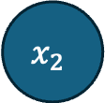
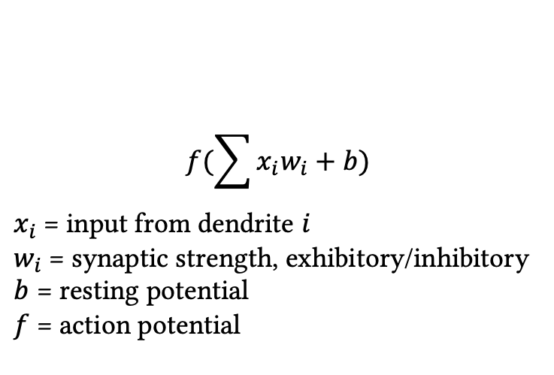
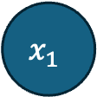


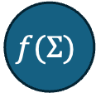
Background: Supervised Learning
$$x_{1}$$
$$w_{1}$$
$$f(Σ)$$
Input 1
Probability of class 1
Input 2
Probability of class 2
$$x_{2}$$
$$w_{2}$$
Input 3
Probability of class 3
$$f(\sum{x_{i}w_{i}+b)}$$
$x_{i}$= input from dendrite $i$
$w_{i}$= synaptic strength, exhibitory/inhibitory
$b$ = resting potential
$f$ = action potential
Input 4
Probability of class 4
predictions
feature map/
feature vector

