Slide 1
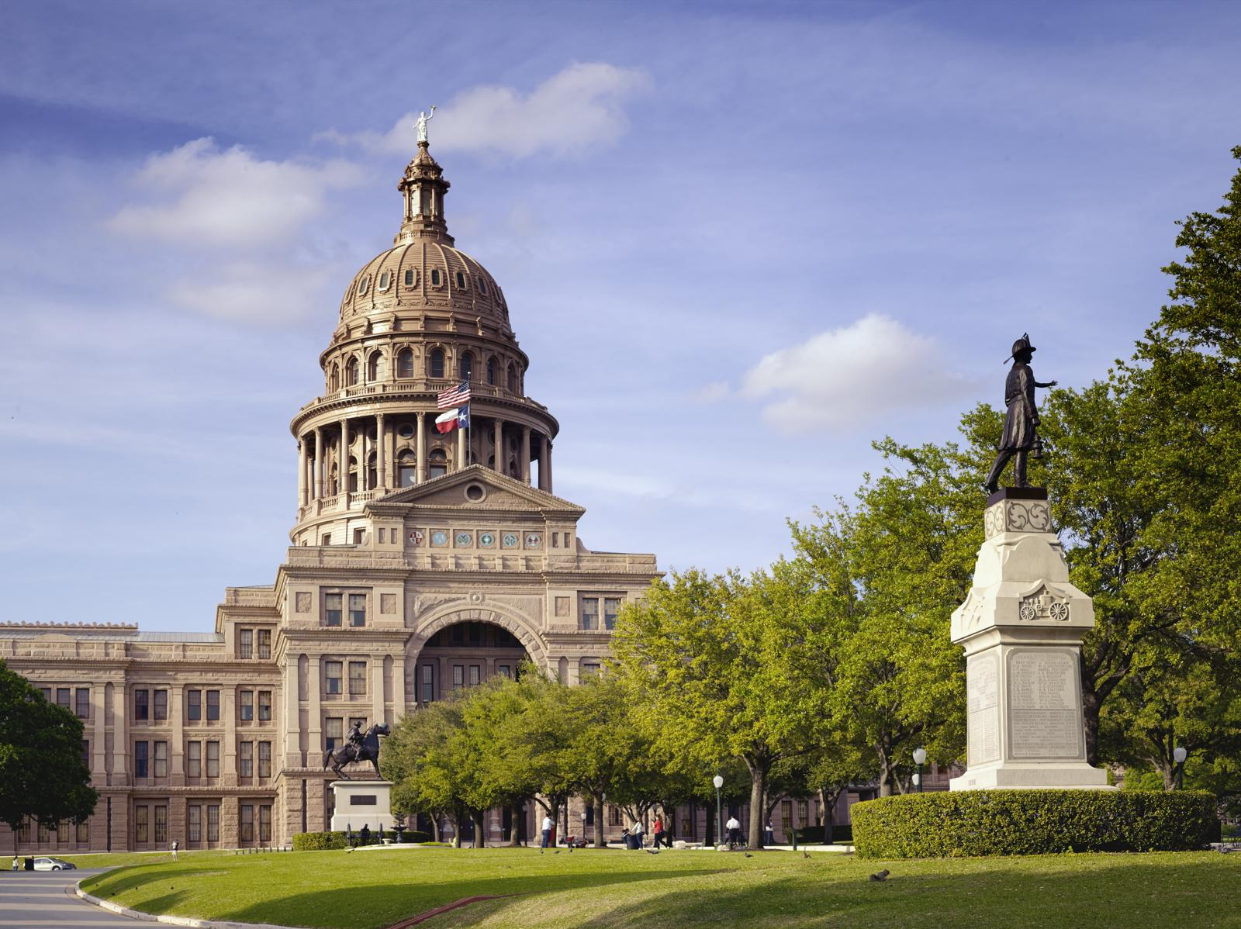
Texas State Capitol, Austin
T
e
x
a
s
LUTHERAN GRAMMAR SCHOOL
Texas
The Lone Star State. A place, its people, and one hard question.
Carol M. Highsmith · public domain · loc.gov
Maxim Hrehor
Lutheran Grammar School of J.A. Comenius · Kvinta
One star on the flag. Many stories behind it.
Maxim Hrehor · Kvinta · Lutheran Grammar School of J.A. Comenius
Slide 1/15

Slide 2
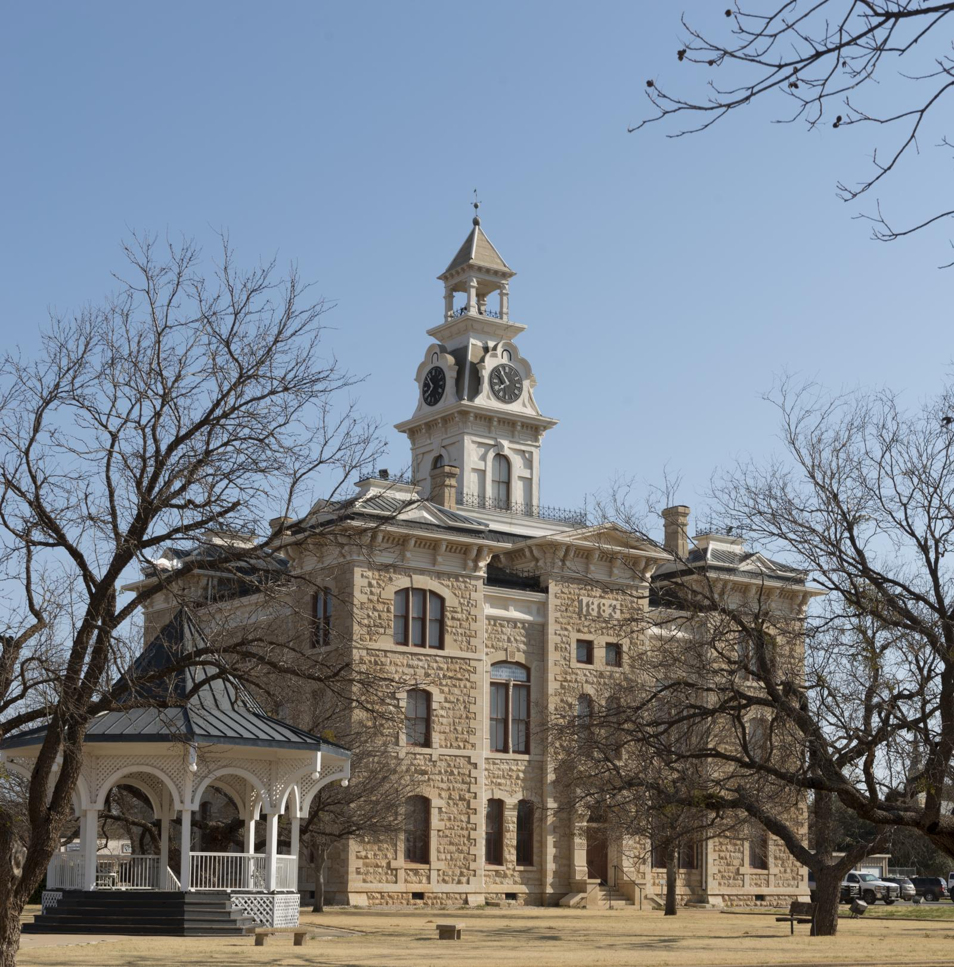
Shackelford County Courthouse, Albany
GEOGRAPHIC ORIENTATION
Texas at a glance
T
e
x
a
s
2nd
Austin
30 million+
Carol M. Highsmith · public domain · loc.gov
largest state, after Alaska
the capital
people, and still growing
Only Alaska covers more ground.
Maxim Hrehor · Kvinta · Lutheran Grammar School of J.A. Comenius
Slide 2/15

Slide 3
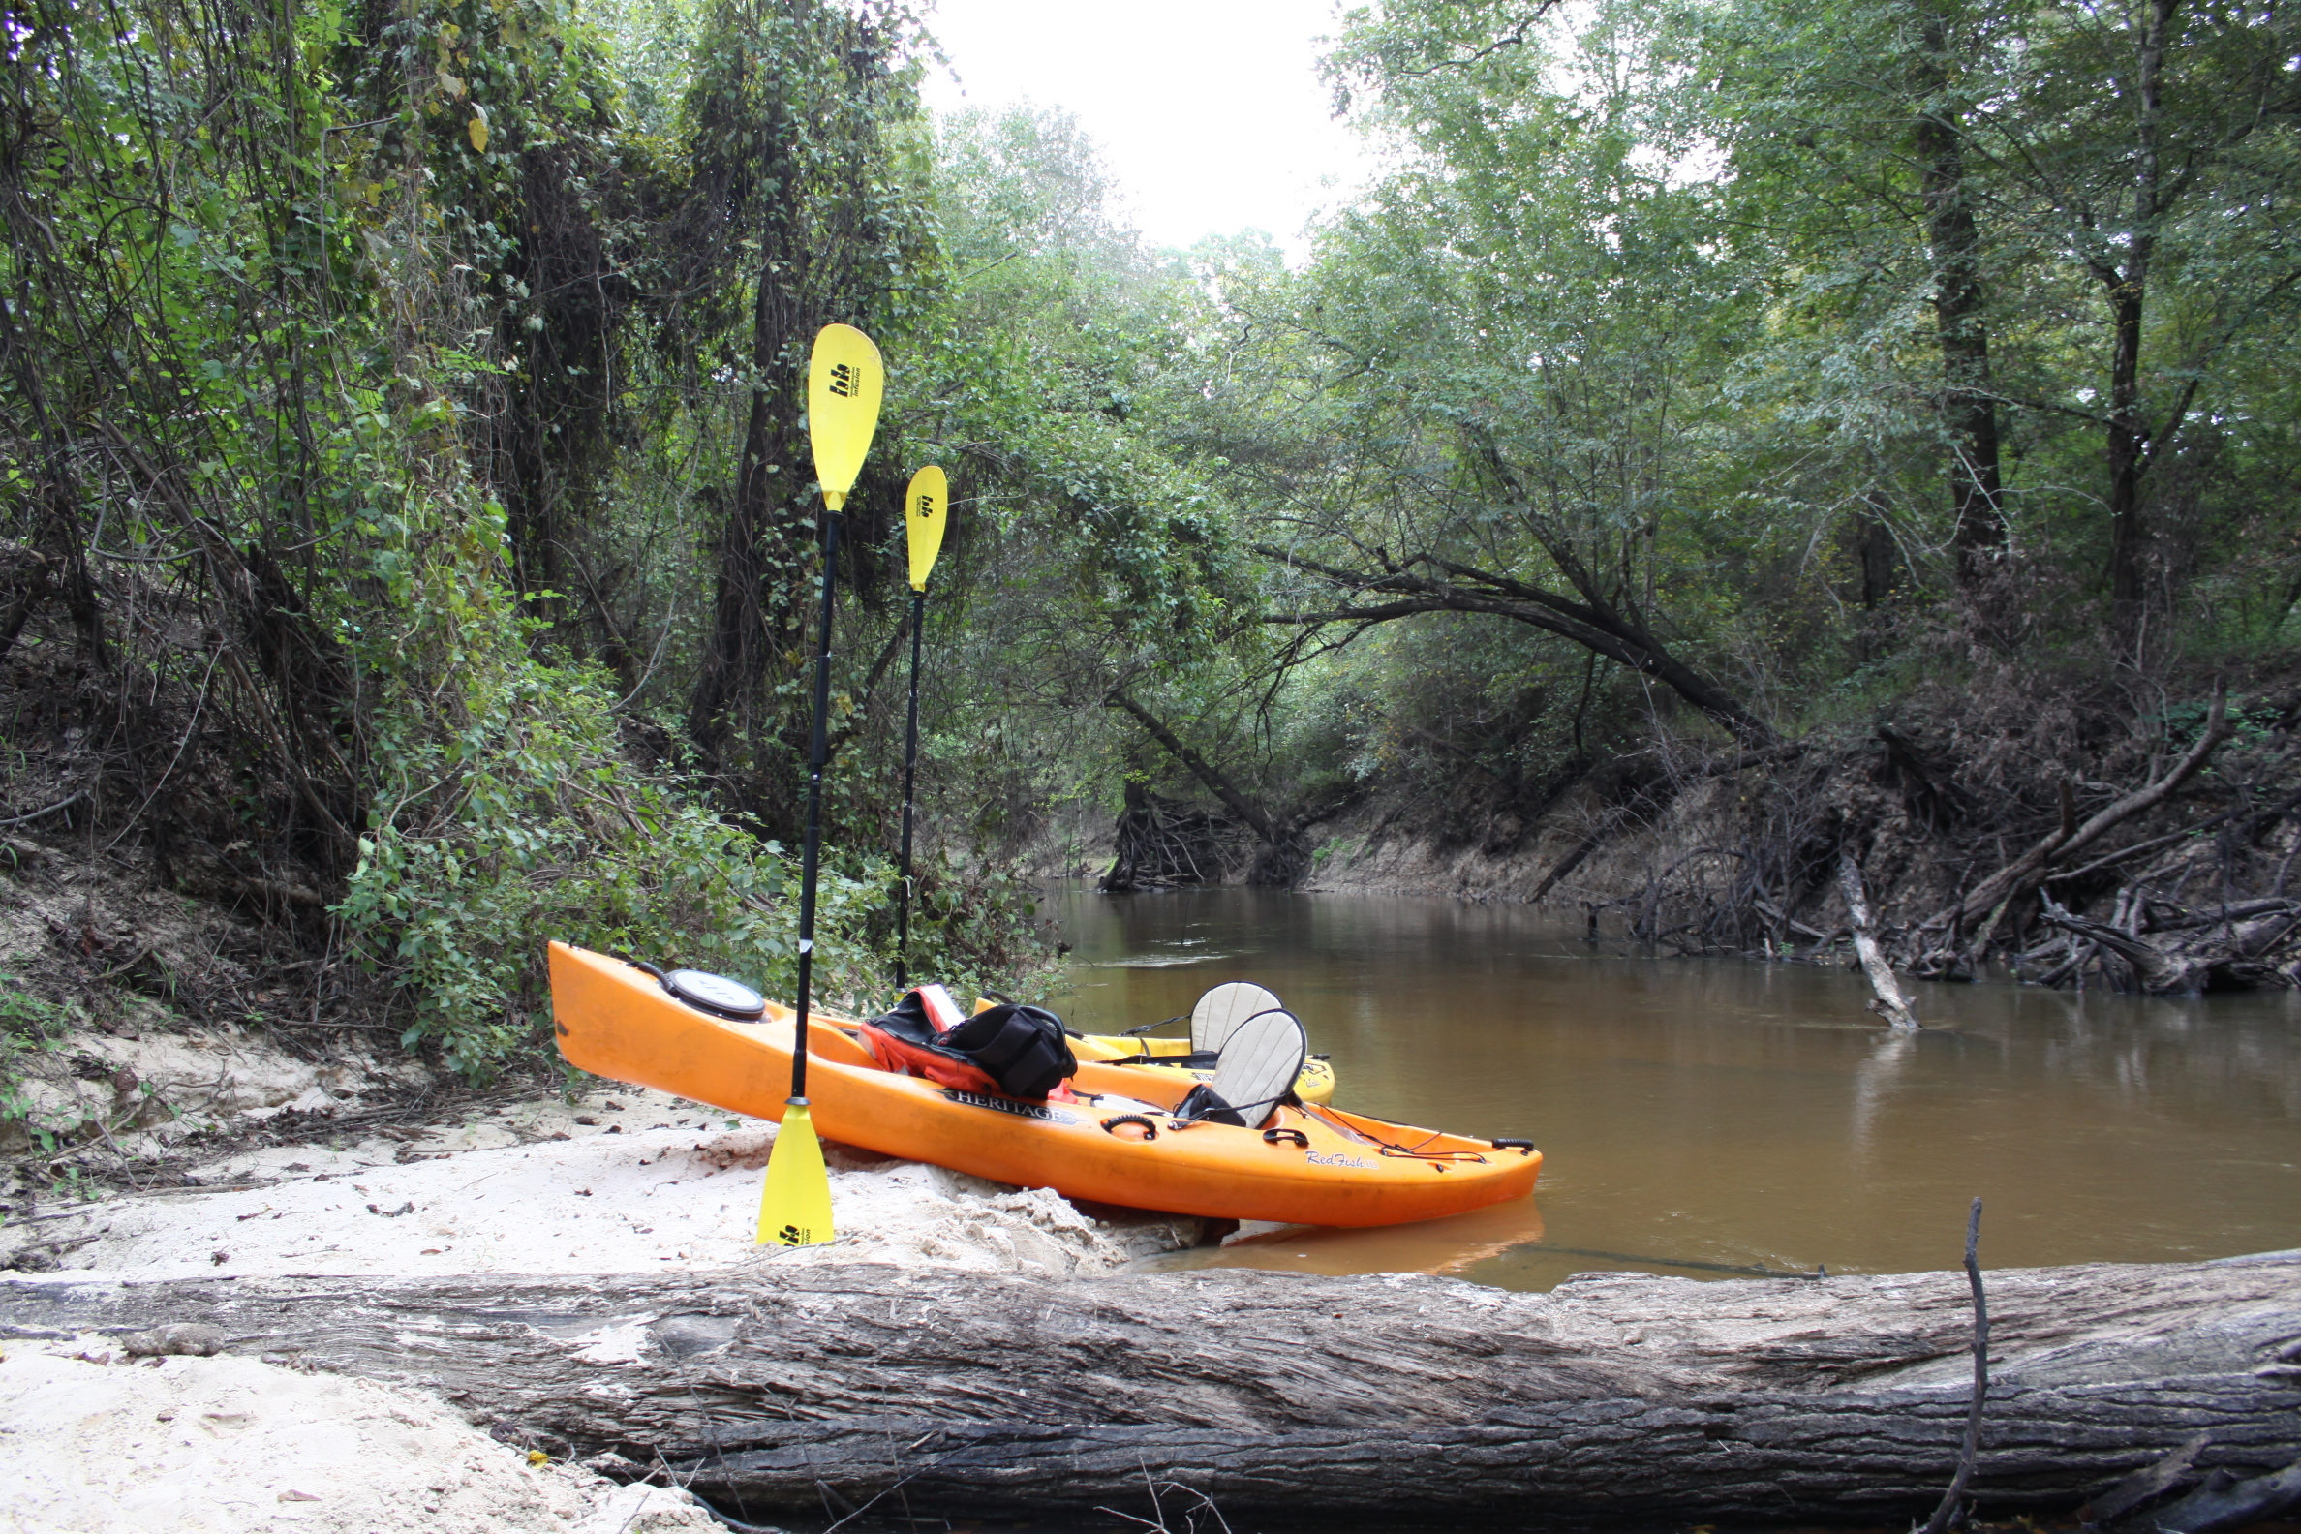
Big Thicket National Preserve
PHYSICAL GEOGRAPHY
Rain, pines, and the Gulf
T
e
x
a
s
The wet east
Pine woods and the Gulf coast get the most rain. Summers are hot and humid. Hurricanes can reach the shore.
National Park Service · public domain · nps.gov
The east gets the rain the west never sees.
Maxim Hrehor · Kvinta · Lutheran Grammar School of J.A. Comenius
Slide 3/15

Slide 4
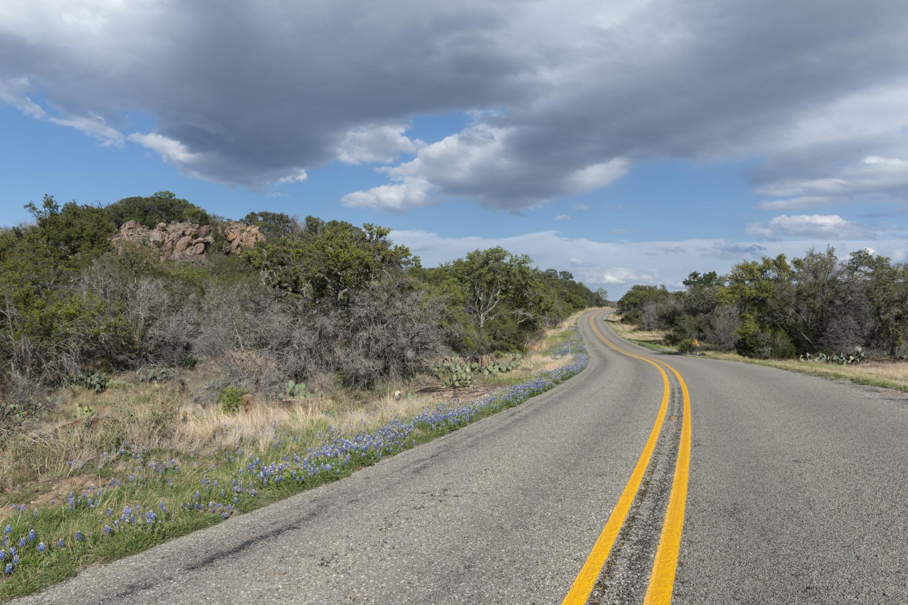
Texas Hill Country, near Burnet
PHYSICAL GEOGRAPHY
Rivers and rolling land
T
e
x
a
s
Hills and plains
The Hill Country sits between rivers and open plains. Winters are usually mild. Storms and a sudden cold can still arrive.
Carol M. Highsmith · public domain · loc.gov
The Hill Country rolls. It does not lie flat.
Maxim Hrehor · Kvinta · Lutheran Grammar School of J.A. Comenius
Slide 4/15

Slide 5
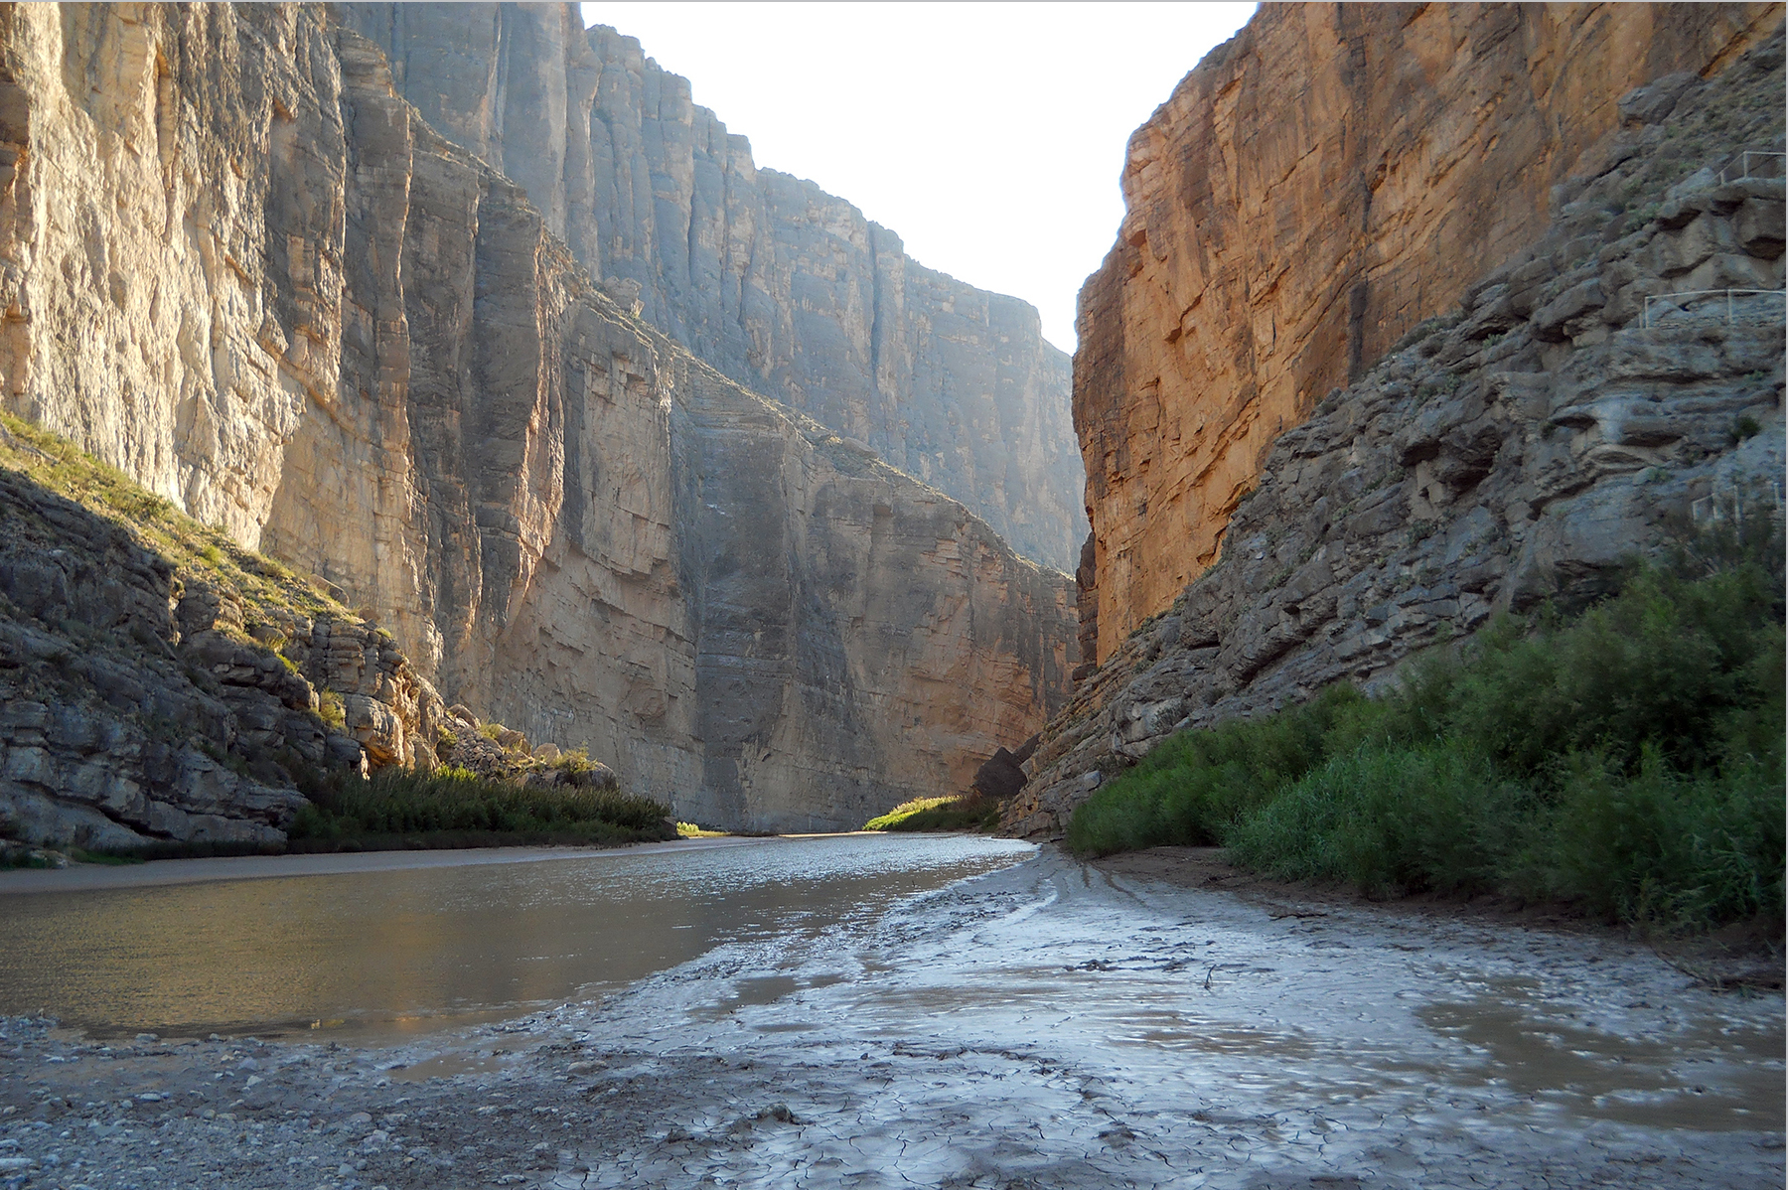
Santa Elena Canyon, Big Bend National Park
PHYSICAL GEOGRAPHY
Desert, canyons, little water
T
e
x
a
s
The dry west
Big Bend holds desert, canyons, and mountains. Days are very hot. Nights can be cold, and water is scarce.
National Park Service · public domain · nps.gov
Out here, water is the real border.
Maxim Hrehor · Kvinta · Lutheran Grammar School of J.A. Comenius
Slide 5/15

Slide 6
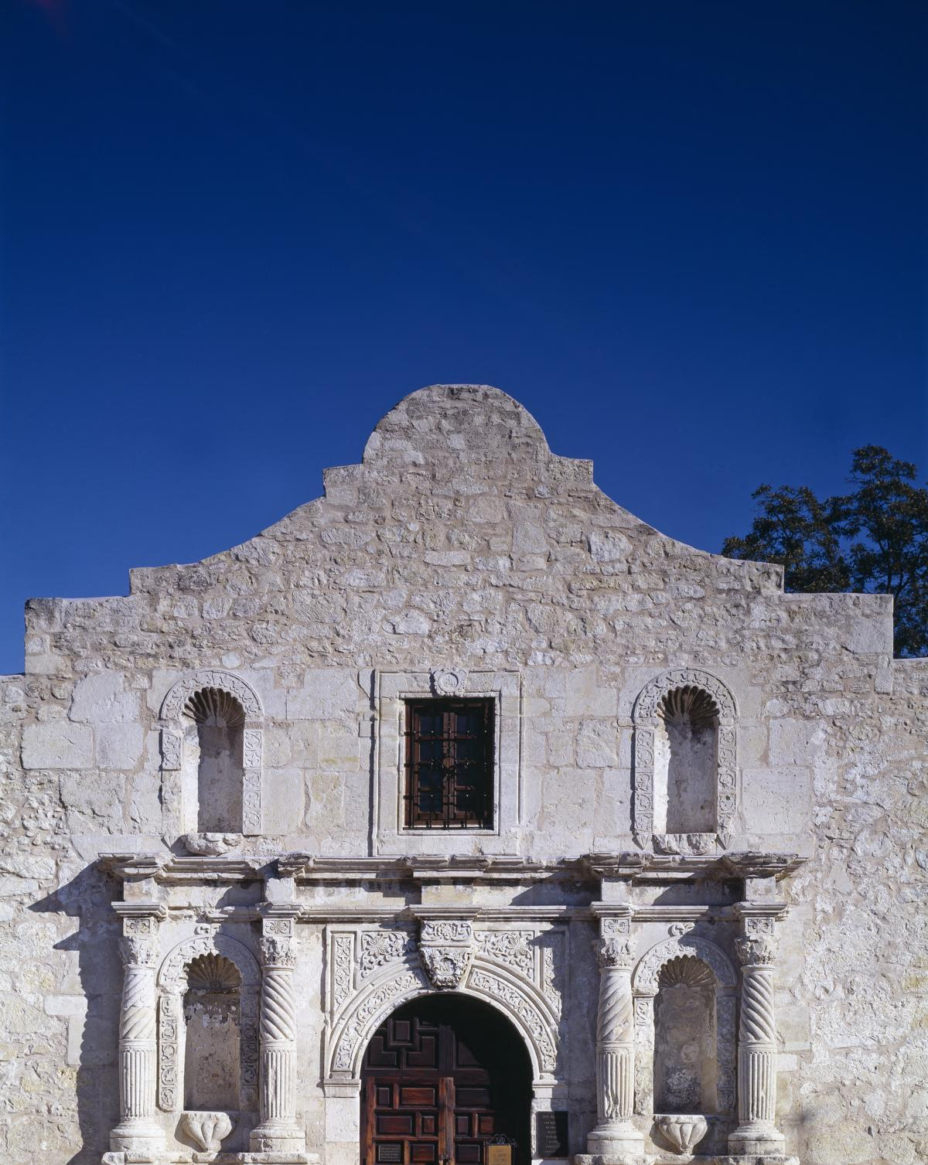
The Alamo, San Antonio
HISTORY
How Texas became Texas
T
e
x
a
s
First nations
Spain and Mexico
1836
1845
1901
Carol M. Highsmith · public domain · loc.gov
Caddo, Comanche, and Apache peoples lived here for centuries.
Missions came first. Later, Texas was part of Mexico.
Texas became an independent republic.
It joined the United States as the 28th state.
Oil at Spindletop changed the towns and the jobs.
A republic in 1836. A state in 1845.
Maxim Hrehor · Kvinta · Lutheran Grammar School of J.A. Comenius
Slide 6/15

Slide 7
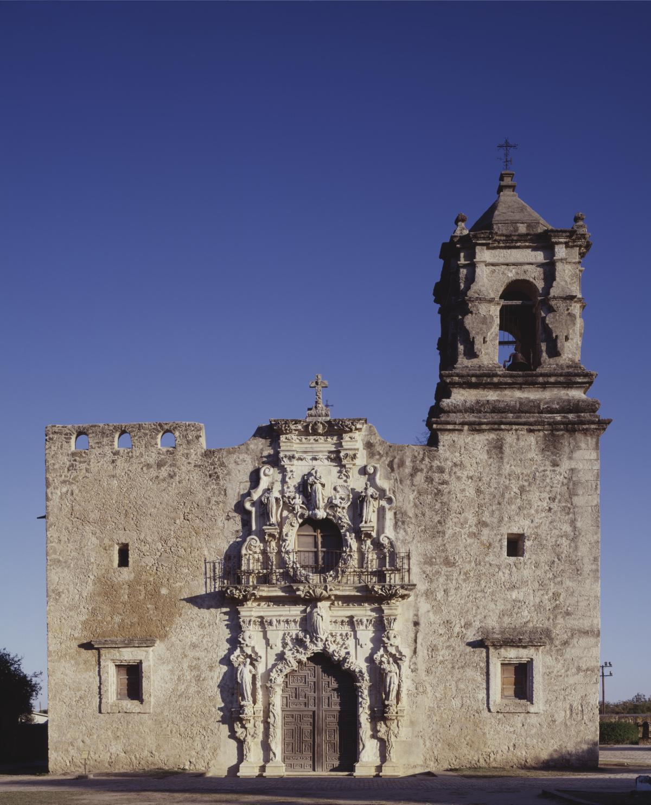
Mission San José, San Antonio
CULTURAL IDENTITY
Many stories, one star
T
e
x
a
s
More than one people
M
any nations knew this land before any flag. Spanish and Mexican families built towns and a Tejano culture that is still here. Later came Anglo settlers, African Americans, Czechs, and Germans. The Lone Star is one symbol, not the whole story.
Carol M. Highsmith · public domain · loc.gov
The Lone Star is a symbol, not the whole people.
Maxim Hrehor · Kvinta · Lutheran Grammar School of J.A. Comenius
Slide 7/15

Slide 8
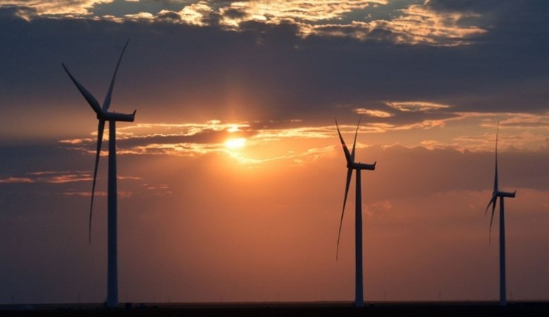
Pantex Wind Farm, Amarillo
ECONOMY
Oil, gas, and the wind
T
e
x
a
s
Energy
Texas produces oil and natural gas. It also leads the United States in wind power. That strength comes with a duty to use it carefully.
U.S. Department of Energy · public domain · energy.gov
Oil under the ground. Wind above it.
Maxim Hrehor · Kvinta · Lutheran Grammar School of J.A. Comenius
Slide 8/15

Slide 9
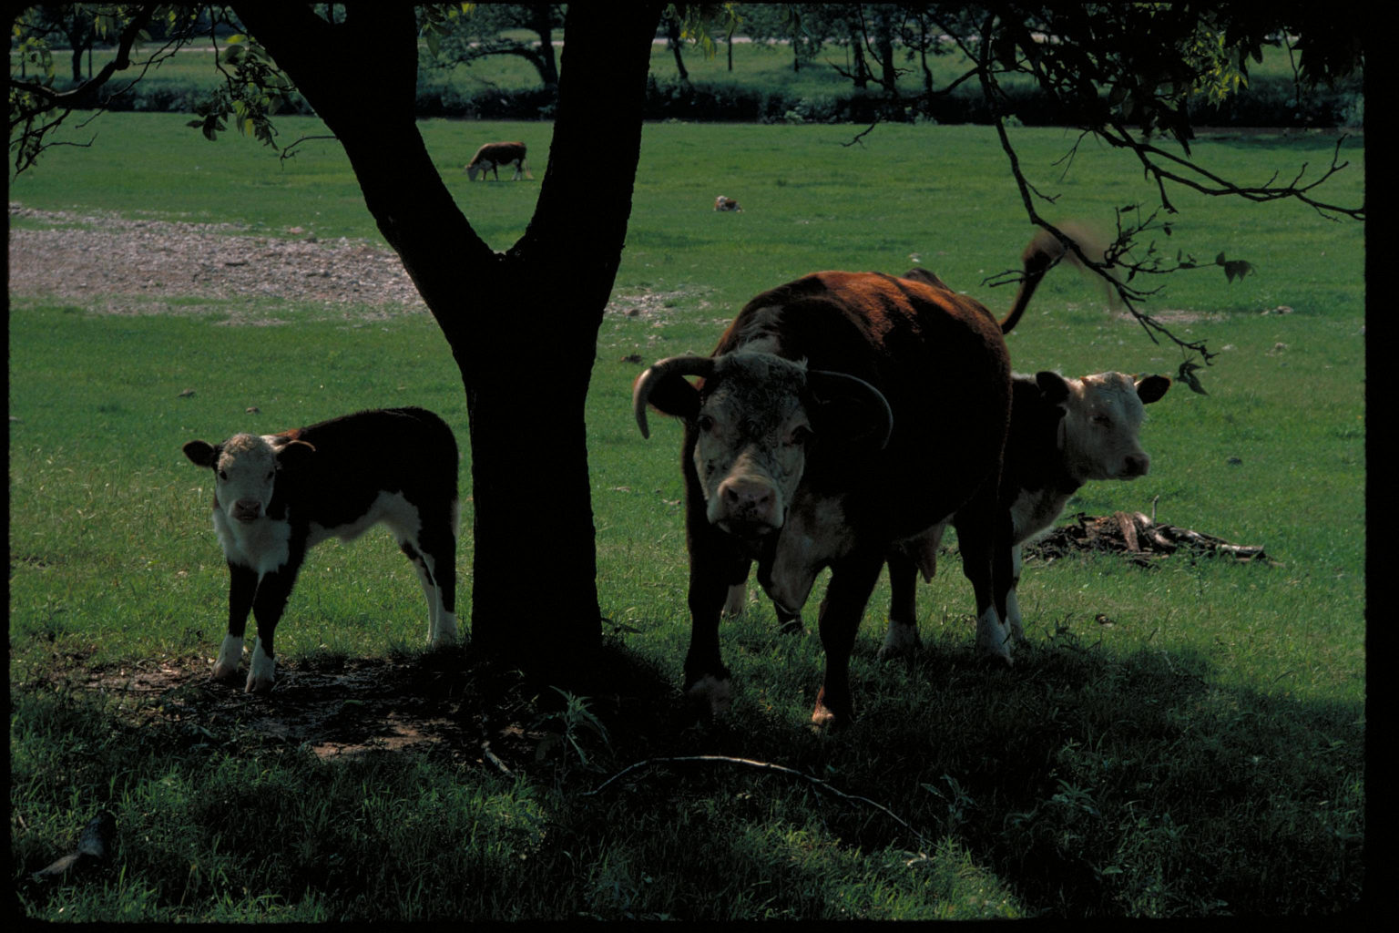
Lyndon B. Johnson National Historical Park
ECONOMY
Cities, ports, and ranches
T
e
x
a
s
Cities of ideas
Land and cattle
Austin builds technology. Houston runs a great port and the Johnson Space Center.
Cotton and cattle still matter. Ranches keep an older picture of Texas alive.
National Park Service · public domain · nps.gov
A ranch and a space center share one state.
Maxim Hrehor · Kvinta · Lutheran Grammar School of J.A. Comenius
Slide 9/15

Slide 10
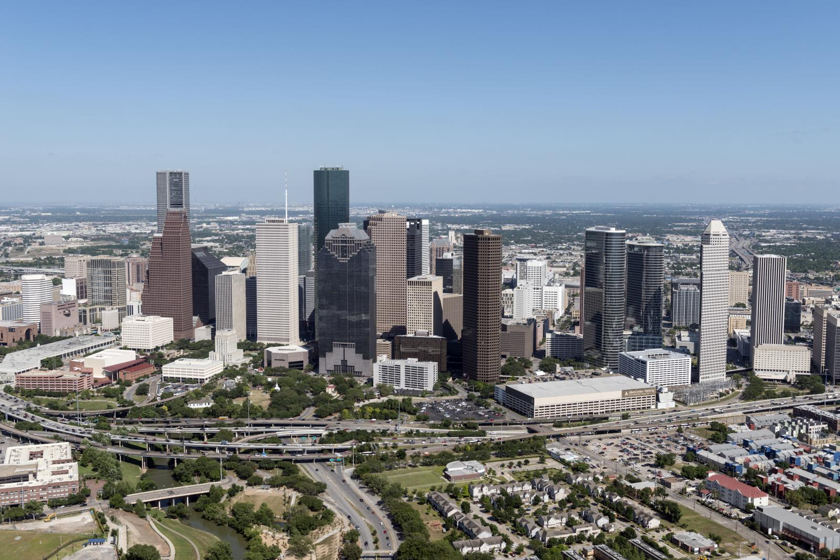
Houston
DEMOGRAPHICS AND SOCIETY
A state that keeps growing
T
e
x
a
s
Cities and open country
T
exas is home to more than 30 million people. Houston, Dallas, San Antonio, and Austin are huge, while much of the land is still ranches and small towns. About two in five residents are Hispanic or Latino. People move here for work, so schools and languages keep changing.
Carol M. Highsmith · public domain · loc.gov
About two in five Texans are Hispanic or Latino.
Maxim Hrehor · Kvinta · Lutheran Grammar School of J.A. Comenius
Slide 10/15

Slide 11
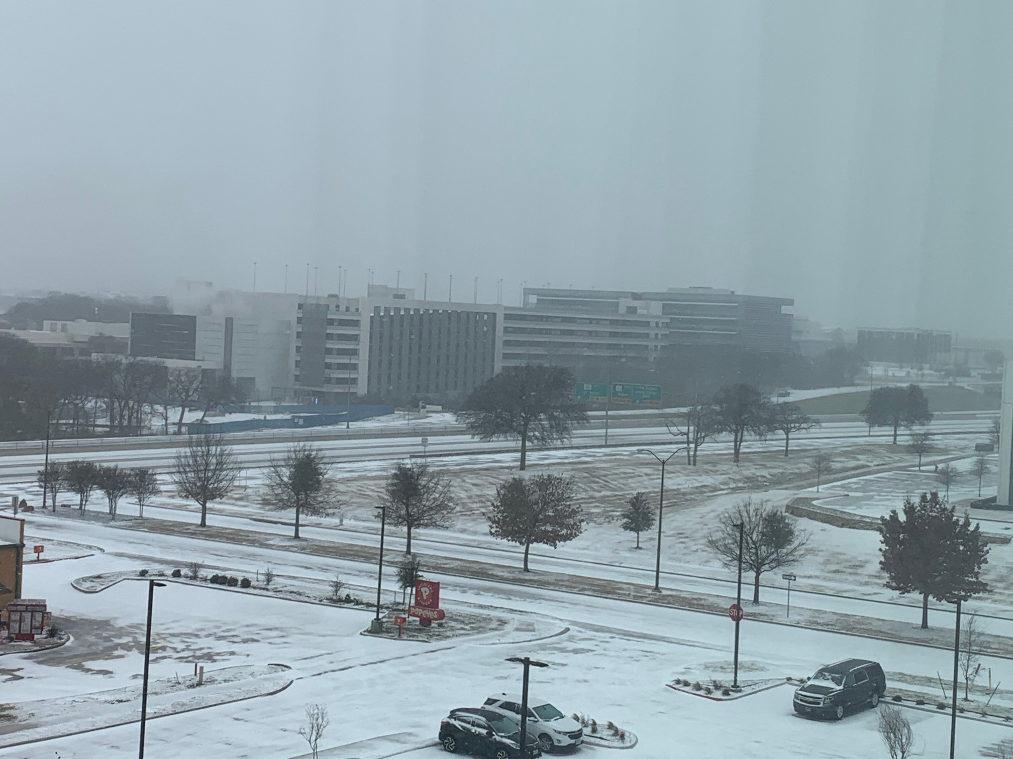
Dallas–Fort Worth
A CURRENT CHALLENGE
The week the power stopped
T
e
x
a
s
What happened
A fair next step
In February 2021, extreme cold froze equipment. Millions of homes lost heat. Most of the grid is run by ERCOT, not by the national networks.
Some want Texas to stay independent. Others want links to neighboring states. One practical step is to prepare plants and fuel lines for freezing weather.
National Weather Service · public domain · noaa.gov
In 2021, cold stopped the power.
Maxim Hrehor · Kvinta · Lutheran Grammar School of J.A. Comenius
Slide 11/15

Slide 12
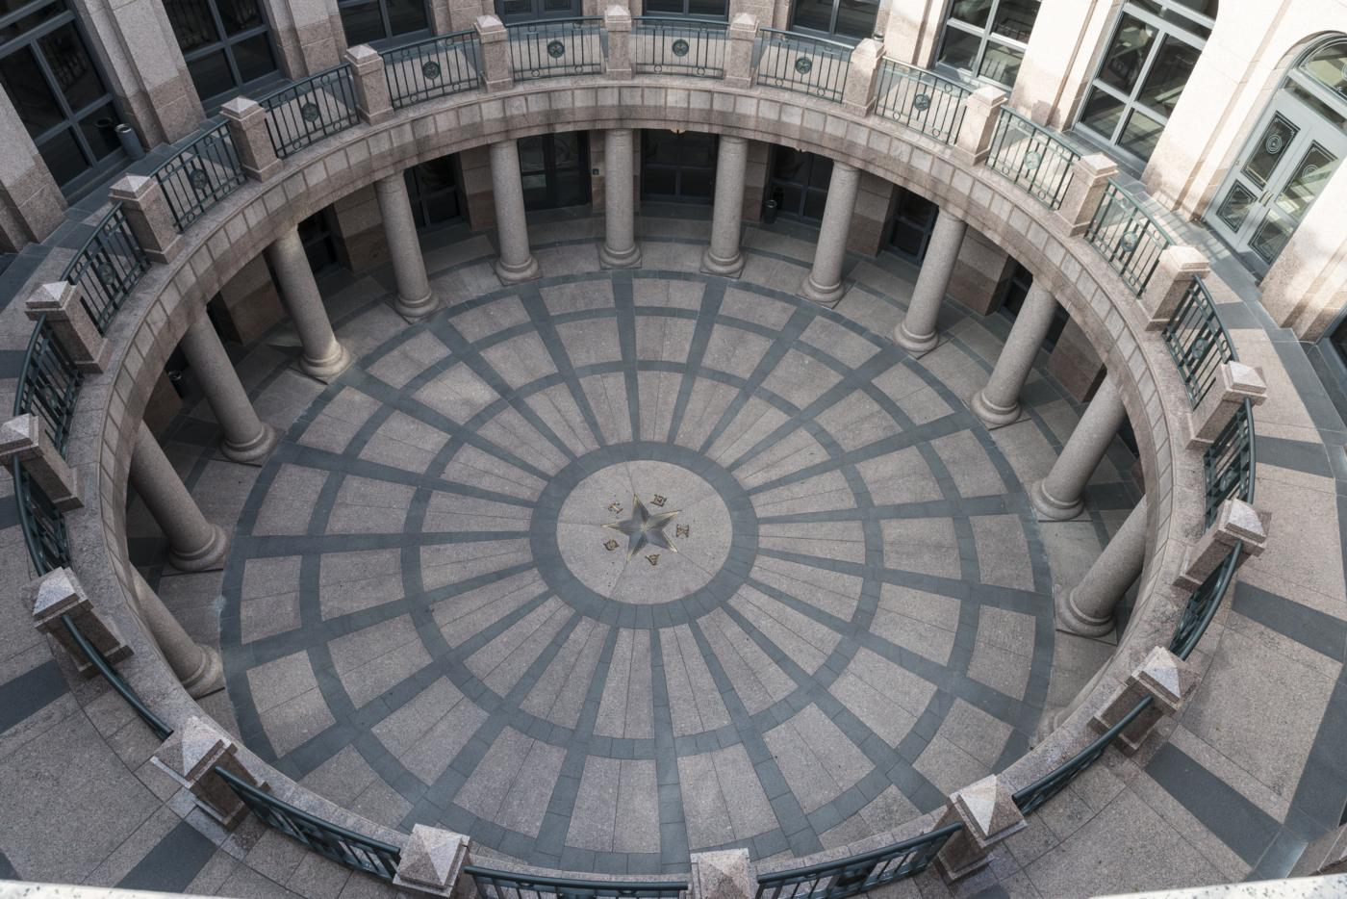
Texas State Capitol rotunda, Austin
EVIDENCE
Where these facts come from
T
e
x
a
s
Geography
History
Economy
Society
U.S. Census Bureau — population and communities
✓
Texas State Historical Association — the republic, 1845, and Spindletop
✓
Carol M. Highsmith · public domain · loc.gov
National Weather Service — climate and the February 2021 storm
✓
ERCOT public reports — how most of the Texas grid is organized
If it has no source, it is not a fact yet.
✓
Maxim Hrehor · Kvinta · Lutheran Grammar School of J.A. Comenius
Slide 12/15

Slide 13
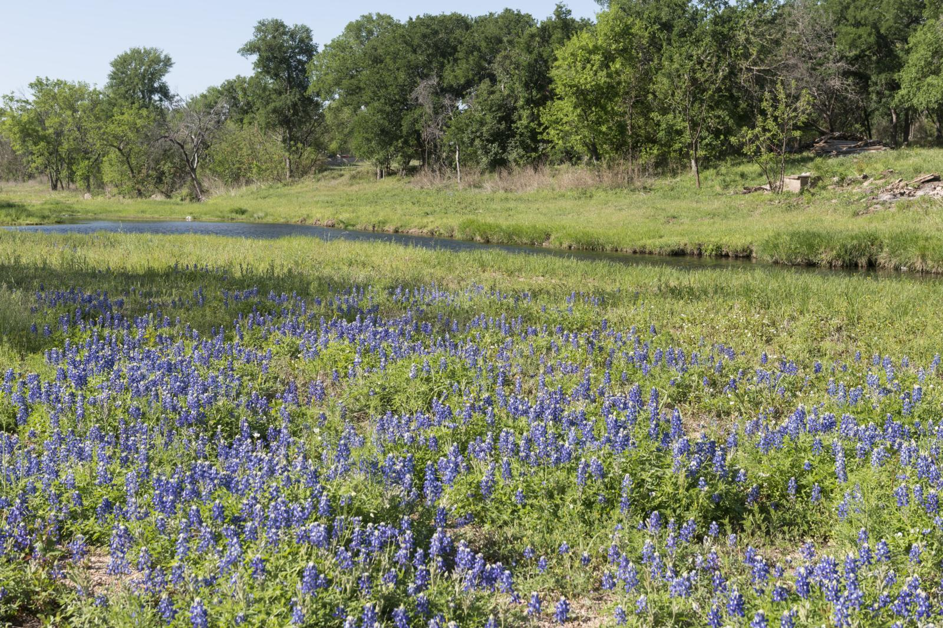
Marble Falls, Texas Hill Country
T
e
x
a
s
LUTHERAN GRAMMAR SCHOOL
Thank you
Ask me one question: a place, a date, or the winter storm.
Carol M. Highsmith · public domain · loc.gov
Maxim Hrehor
Lutheran Grammar School of J.A. Comenius · Kvinta
Leave me one question.
Maxim Hrehor · Kvinta · Lutheran Grammar School of J.A. Comenius
Slide 13/15

Slide 14
Texas Capitol rotunda, Austin
REFERENCES
Works cited
T
e
x
a
s
1. UNITED STATES. Census Bureau. QuickFacts: Texas [online]. Washington, D.C.: U.S. Census Bureau, 2025 [cit. 2026-11-10]. Available from: https://www.census.gov/quickfacts/Texas
2. NANCE, Joseph M. Republic of Texas. In: Handbook of Texas Online [online]. Austin: Texas State Historical Association [cit. 2026-11-10]. Available from: https://www.tshaonline.org/handbook/entries/republic-of-texas
3. WOOSTER, Robert and SANDERS, Christine Moor. Spindletop Oilfield. In: Handbook of Texas Online [online]. Austin: Texas State Historical Association [cit. 2026-11-10]. Available from: https://www.tshaonline.org/handbook/entries/spindletop-oilfield
Carol M. Highsmith · public domain · loc.gov
4. NATIONAL WEATHER SERVICE. February 2021: Historic Winter Storm and Arctic Outbreak [online]. Fort Worth: National Weather Service, 2021 [cit. 2026-11-10]. Available from: https://www.weather.gov/fwd/Feb-2021-WinterEvent
5. ELECTRIC RELIABILITY COUNCIL OF TEXAS. February 2021 Extreme Weather Event [online]. Austin: ERCOT, 2021 [cit. 2026-11-10]. Available from: https://www.ercot.com/news/february2021
A fact needs a record someone else can open.
Maxim Hrehor · Kvinta · Lutheran Grammar School of J.A. Comenius
Slide 14/15

Slide 15
Marble Falls, Texas Hill Country
REFERENCES
Photographs
T
e
x
a
s
1. HIGHSMITH, Carol M. Texas State Capitol, Austin [photograph]. Library of Congress, 2014 [cit. 2026-11-10]. loc.gov/item/2014632686. Public domain.
2. HIGHSMITH, Carol M. Shackelford County Courthouse, Albany [photograph]. Library of Congress, 2014 [cit. 2026-11-10]. loc.gov/item/2014631724. Public domain.
3. NATIONAL PARK SERVICE. Big Thicket National Preserve [photograph]. 2015 [cit. 2026-11-10]. npgallery.nps.gov. Public domain.
4. HIGHSMITH, Carol M. Texas Hill Country near Burnet [photograph]. Library of Congress, 2014 [cit. 2026-11-10]. loc.gov/item/2014633069. Public domain.
5. NATIONAL PARK SERVICE. Santa Elena Canyon, Big Bend [photograph]. 2012 [cit. 2026-11-10]. npgallery.nps.gov. Public domain.
6. HIGHSMITH, Carol M. The Alamo, San Antonio [photograph]. Library of Congress [cit. 2026-11-10]. loc.gov/item/2011630482. Public domain.
Carol M. Highsmith · public domain · loc.gov
7. HIGHSMITH, Carol M. Mission San José, San Antonio [photograph]. Library of Congress [cit. 2026-11-10]. loc.gov/item/2011631194. Public domain.
8. UNITED STATES. Department of Energy. Pantex Wind Farm, Amarillo [photograph]. 2022 [cit. 2026-11-10]. energy.gov. Public domain.
9. NATIONAL PARK SERVICE. Lyndon B. Johnson National Historical Park [photograph]. [cit. 2026-11-10]. npgallery.nps.gov. Public domain.
10. HIGHSMITH, Carol M. Houston [photograph]. Library of Congress, 2014 [cit. 2026-11-10]. loc.gov/item/2014632226. Public domain.
11. NATIONAL WEATHER SERVICE. Dallas–Fort Worth, February 2021 [photograph]. NOAA, 2021 [cit. 2026-11-10]. noaa.gov. Public domain.
12. HIGHSMITH, Carol M. Texas Capitol rotunda, Austin [photograph]. Library of Congress, 2014 [cit. 2026-11-10]. loc.gov/item/2014632081. Public domain.
Every picture names its place and its source.
13. HIGHSMITH, Carol M. Marble Falls, Texas Hill Country [photograph]. Library of Congress, 2014 [cit. 2026-11-10]. loc.gov/item/2014633113. Public domain.
Maxim Hrehor · Kvinta · Lutheran Grammar School of J.A. Comenius
Slide 15/15

