Slide 1
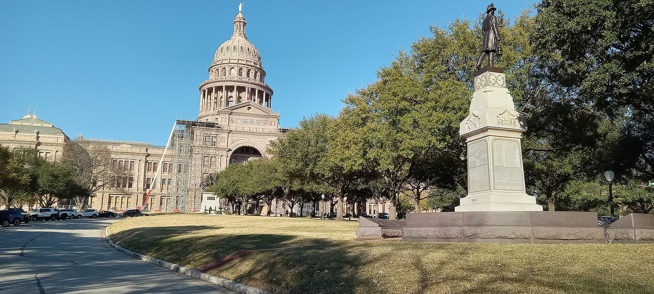
T
e
x
a
s
LUTHERAN GRAMMAR SCHOOL
Texas
The Lone Star State. A place, its people, and one hard question.
Texas State Capitol, Austin
CupWithSoda19 · CC BY-SA 4.0 · Wikimedia Commons
Maxim Hrehor
Lutheran Grammar School of J.A. Comenius · Kvinta
One star on the flag. Many stories behind it.
Maxim Hrehor · Kvinta · Lutheran Grammar School of J.A. Comenius
Slide 1/13

Slide 2
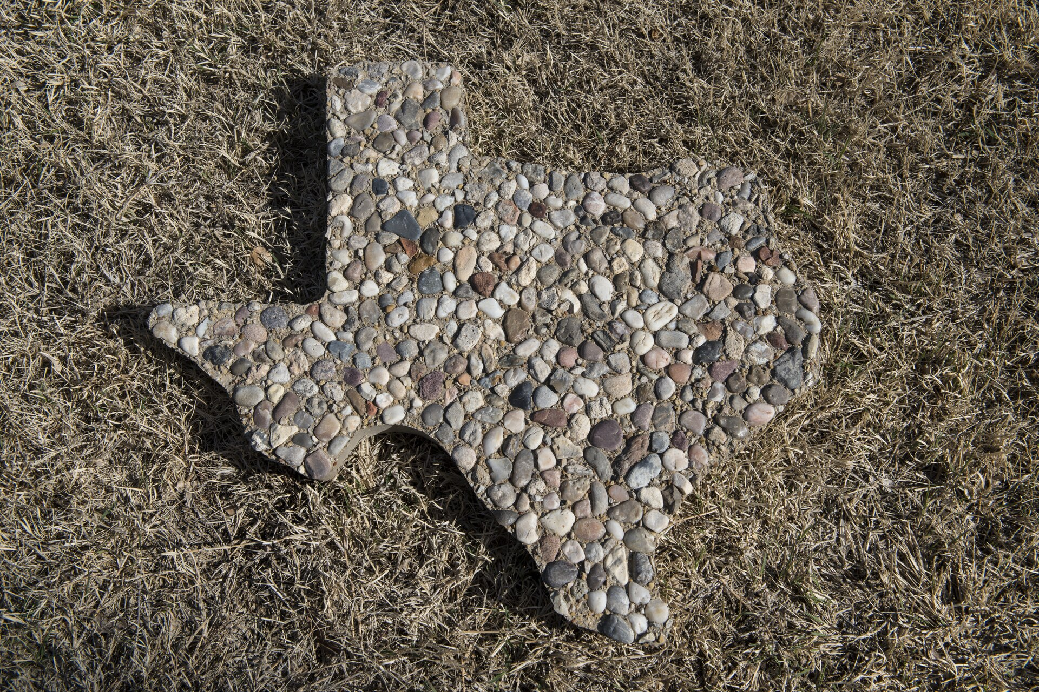
GEOGRAPHIC ORIENTATION
Texas at a glance
T
e
x
a
s
2nd
Austin
30 million+
largest state, after Alaska
the capital
people, and still growing
Shackelford County Courthouse, Albany
Carol M. Highsmith · public domain · Wikimedia Commons
Only Alaska covers more ground.
Maxim Hrehor · Kvinta · Lutheran Grammar School of J.A. Comenius
Slide 2/13

Slide 3
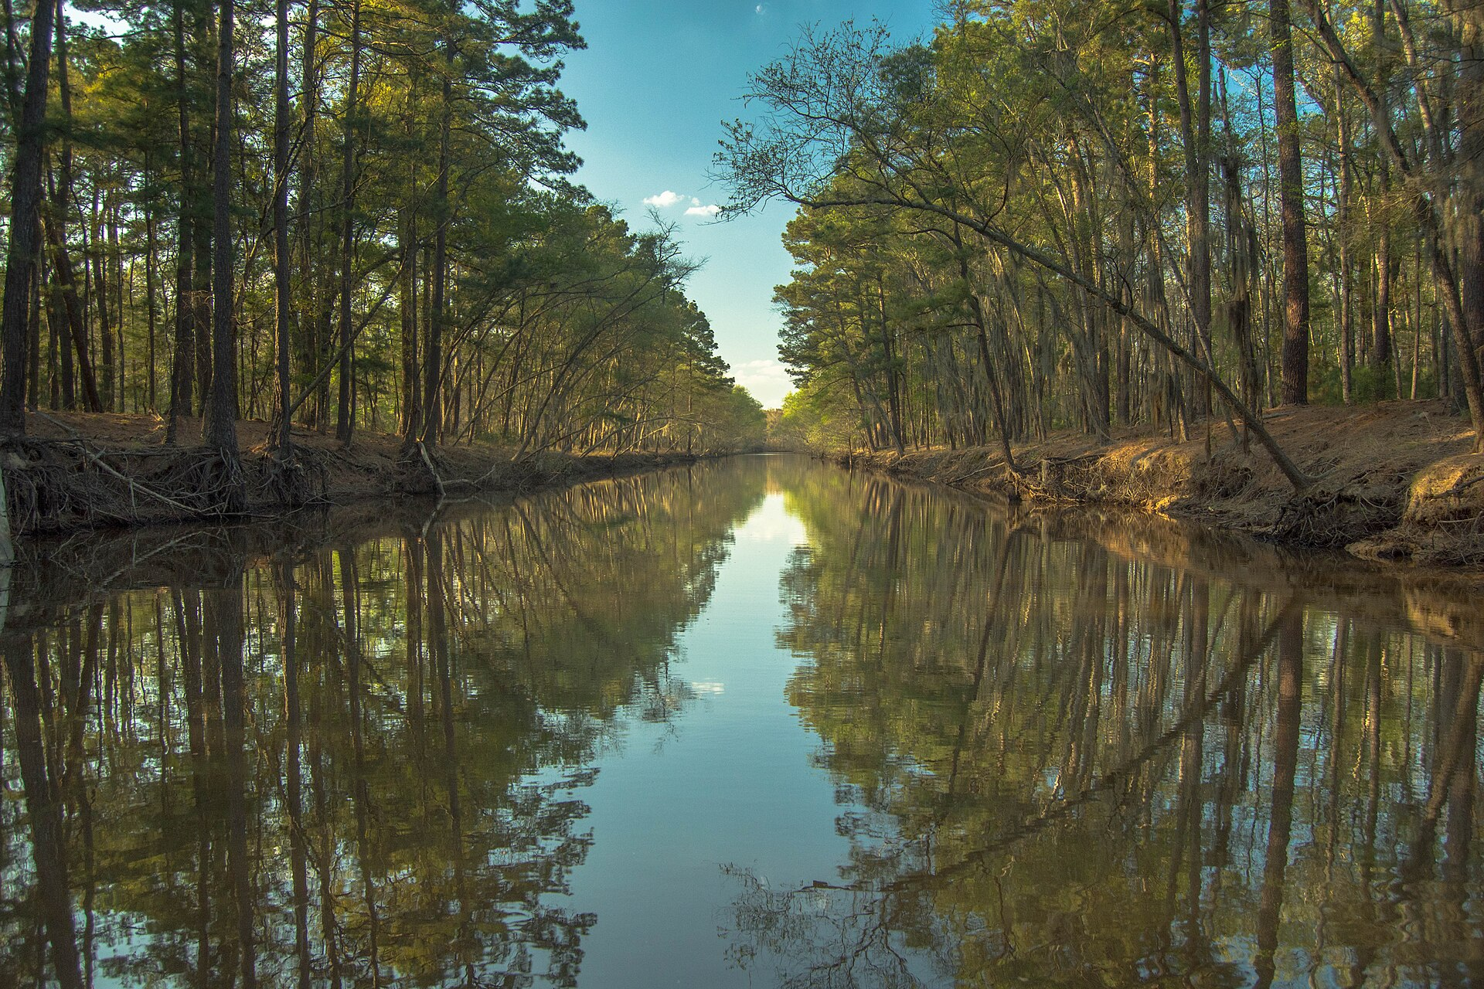
PHYSICAL GEOGRAPHY
Rain, pines, and the Gulf
T
e
x
a
s
The wet east
Pine woods and the Gulf coast get the most rain. Summers are hot and humid. Hurricanes can reach the shore.
Caddo Lake
Maciej Kraus · CC BY 2.0 · Wikimedia Commons
The east gets the rain the west never sees.
Maxim Hrehor · Kvinta · Lutheran Grammar School of J.A. Comenius
Slide 3/13

Slide 4
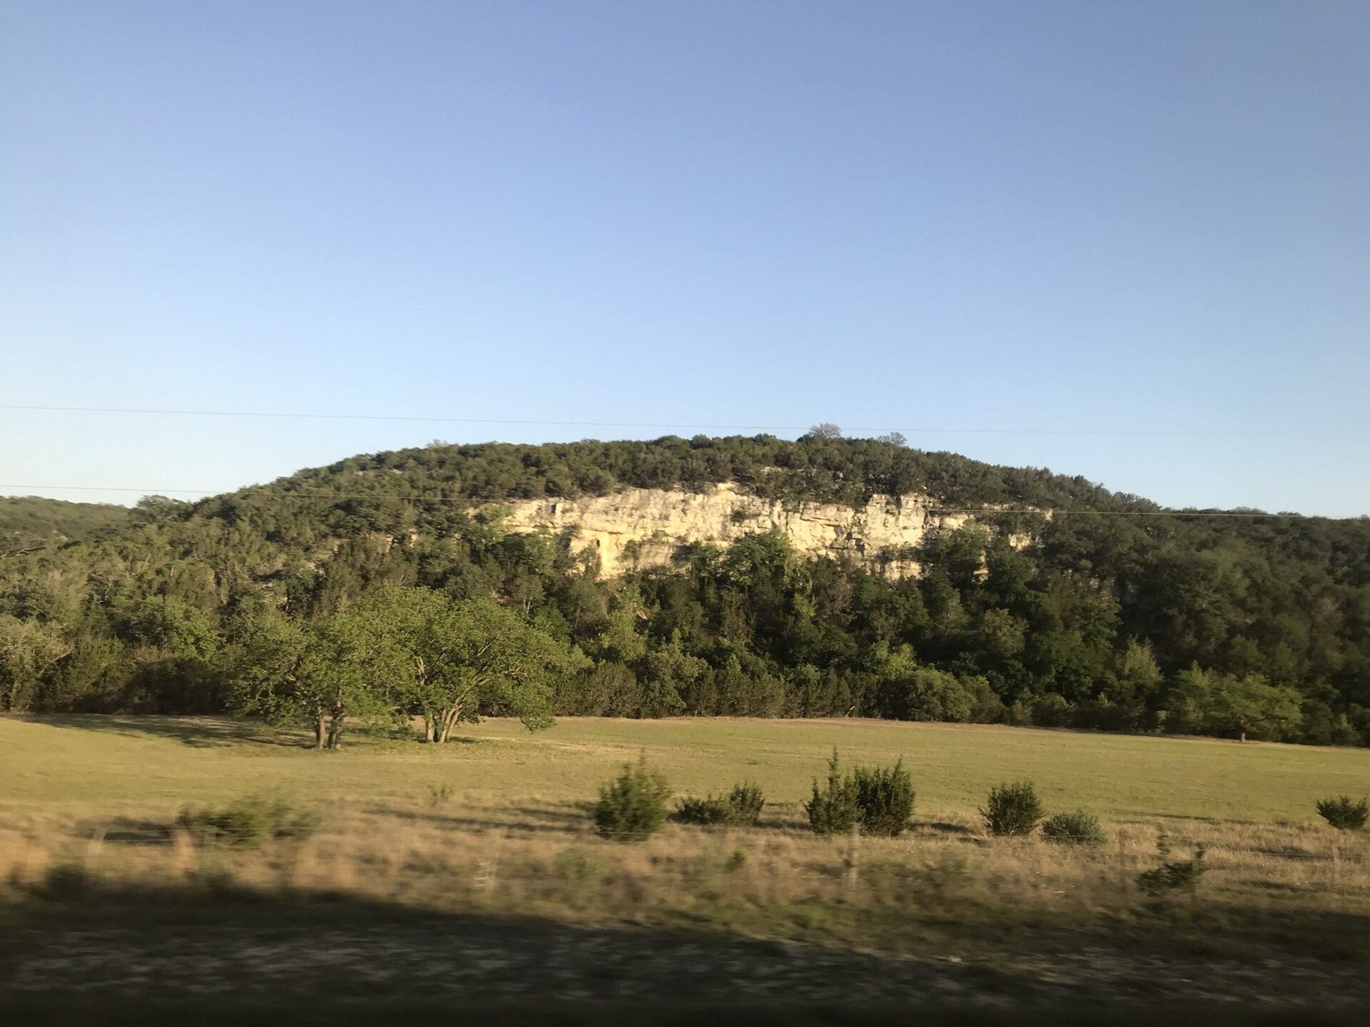
PHYSICAL GEOGRAPHY
Rivers and rolling land
T
e
x
a
s
Hills and plains
The Hill Country sits between rivers and open plains. Winters are usually mild. Storms and a sudden cold can still arrive.
Texas Hill Country, near Medina
Lorenzo The Snail · CC BY-SA 4.0 · Wikimedia Commons
The Hill Country rolls. It does not lie flat.
Maxim Hrehor · Kvinta · Lutheran Grammar School of J.A. Comenius
Slide 4/13

Slide 5
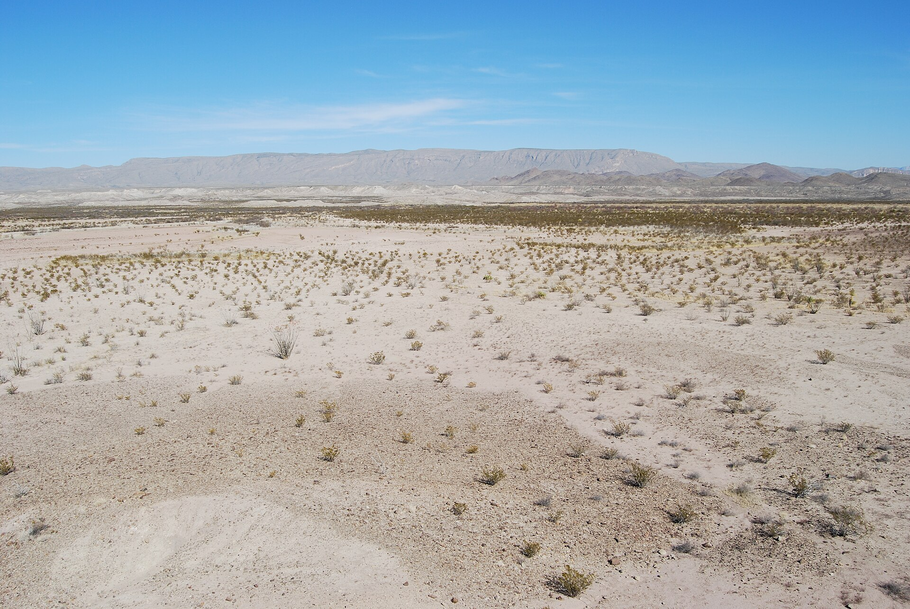
PHYSICAL GEOGRAPHY
Desert, canyons, little water
T
e
x
a
s
The dry west
Big Bend holds desert, canyons, and mountains. Days are very hot. Nights can be cold, and water is scarce.
Big Bend National Park
Martin Proll · public domain · Wikimedia Commons
Out here, water is the real border.
Maxim Hrehor · Kvinta · Lutheran Grammar School of J.A. Comenius
Slide 5/13

Slide 6
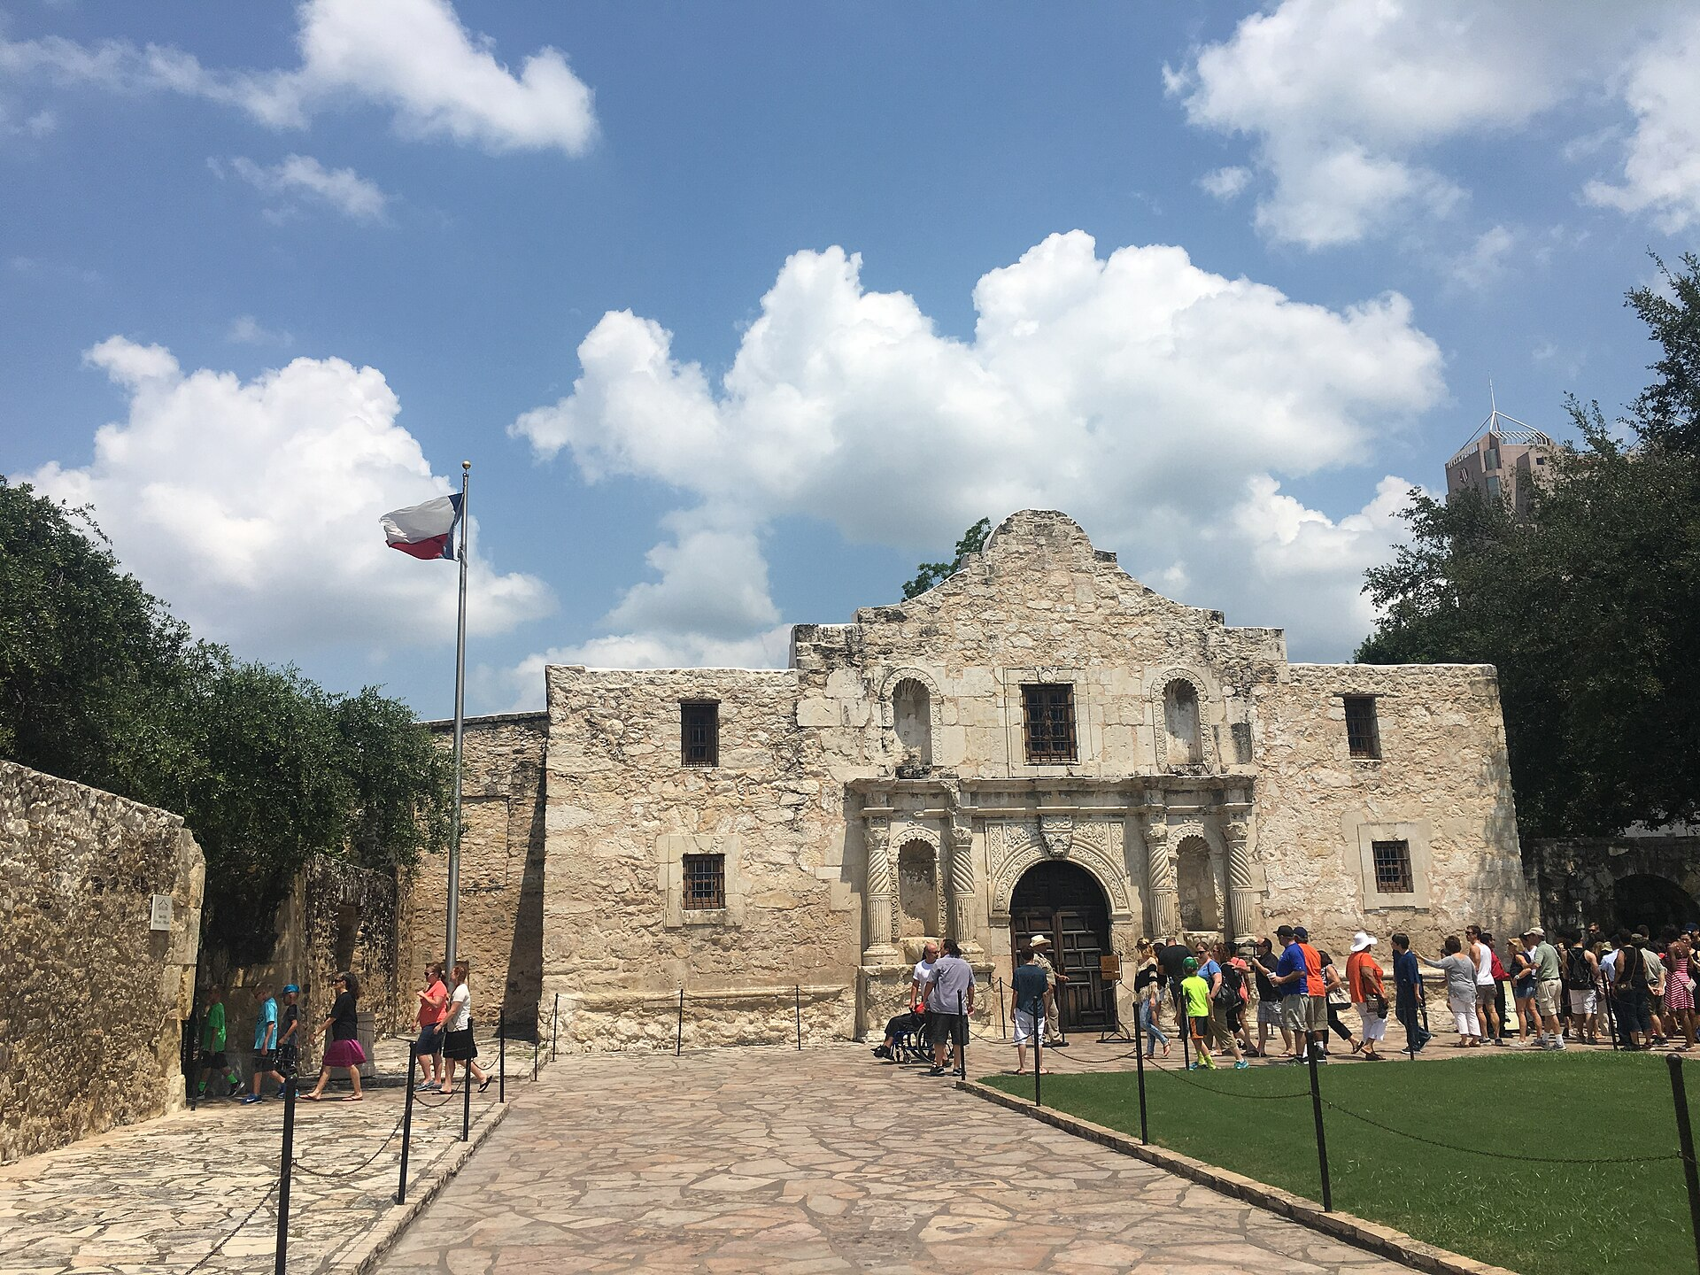
HISTORY
How Texas became Texas
T
e
x
a
s
First nations
Spain and Mexico
1836
1845
1901
Caddo, Comanche, and Apache peoples lived here for centuries.
Missions came first. Later, Texas was part of Mexico.
Texas became an independent republic.
It joined the United States as the 28th state.
Oil at Spindletop changed the towns and the jobs.
The Alamo, San Antonio
DatraxMada · CC BY-SA 4.0 · Wikimedia Commons
A republic in 1836. A state in 1845.
Maxim Hrehor · Kvinta · Lutheran Grammar School of J.A. Comenius
Slide 6/13

Slide 7
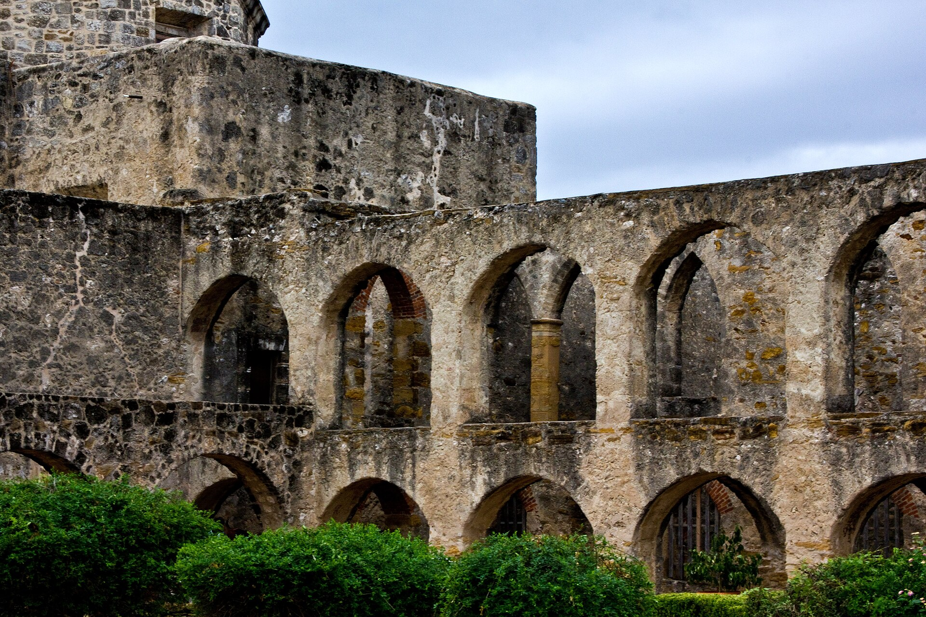
CULTURAL IDENTITY
Many stories, one star
T
e
x
a
s
More than one people
M
any nations knew this land before any flag. Spanish and Mexican families built towns and a Tejano culture that is still here. Later came Anglo settlers, African Americans, Czechs, and Germans. The Lone Star is one symbol, not the whole story.
Mission San José, San Antonio
Ashland Thomas · CC BY-SA 4.0 · Wikimedia Commons
The Lone Star is a symbol, not the whole people.
Maxim Hrehor · Kvinta · Lutheran Grammar School of J.A. Comenius
Slide 7/13

Slide 8
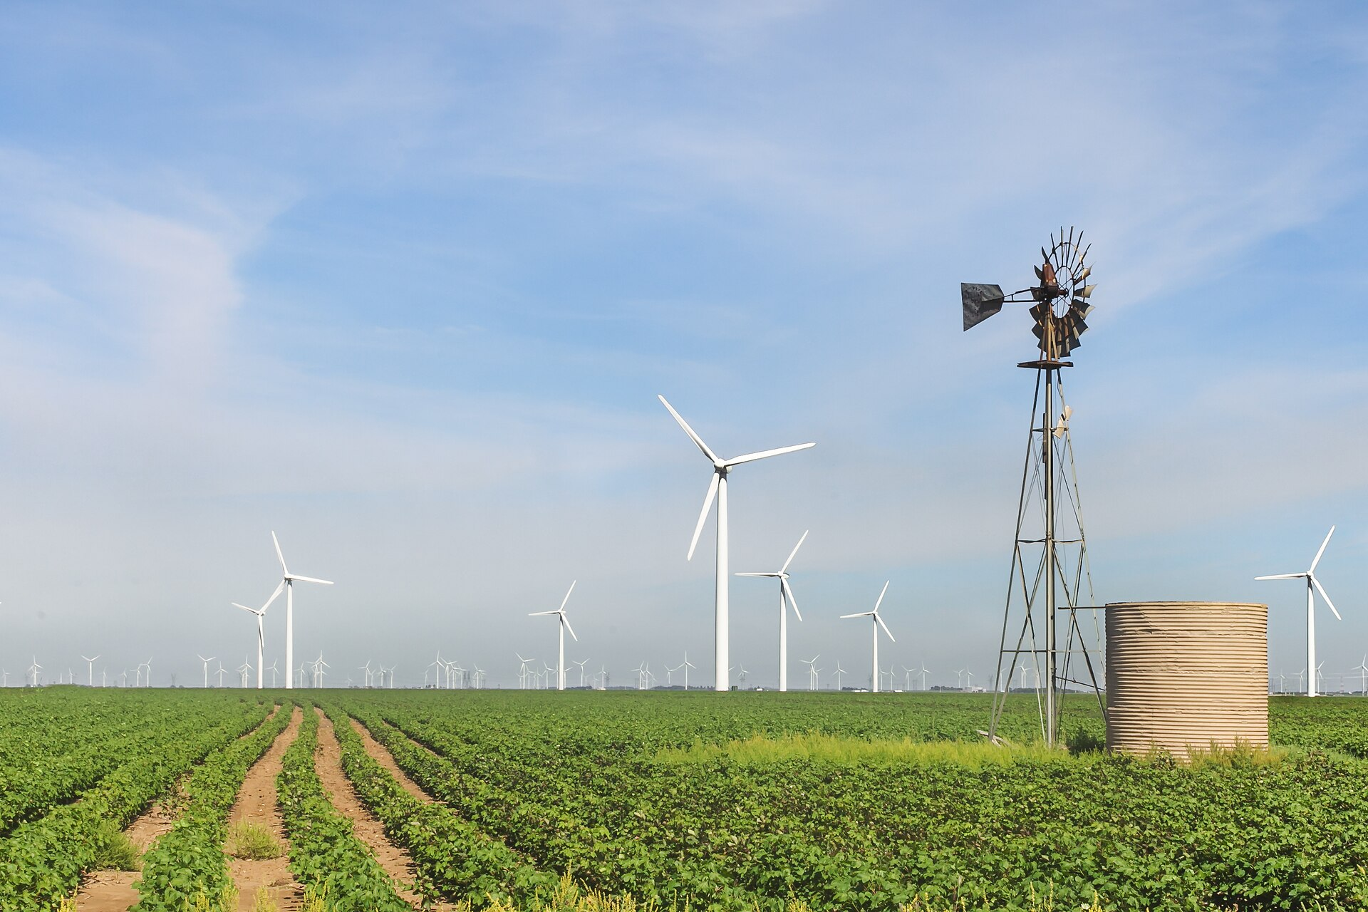
ECONOMY
Oil, gas, and the wind
T
e
x
a
s
Energy
Texas produces oil and natural gas. It also leads the United States in wind power. That strength comes with a duty to use it carefully.
Roscoe Wind Farm
Matthew T Rader · CC BY-SA 4.0 · Wikimedia Commons
Oil under the ground. Wind above it.
Maxim Hrehor · Kvinta · Lutheran Grammar School of J.A. Comenius
Slide 8/13

Slide 9
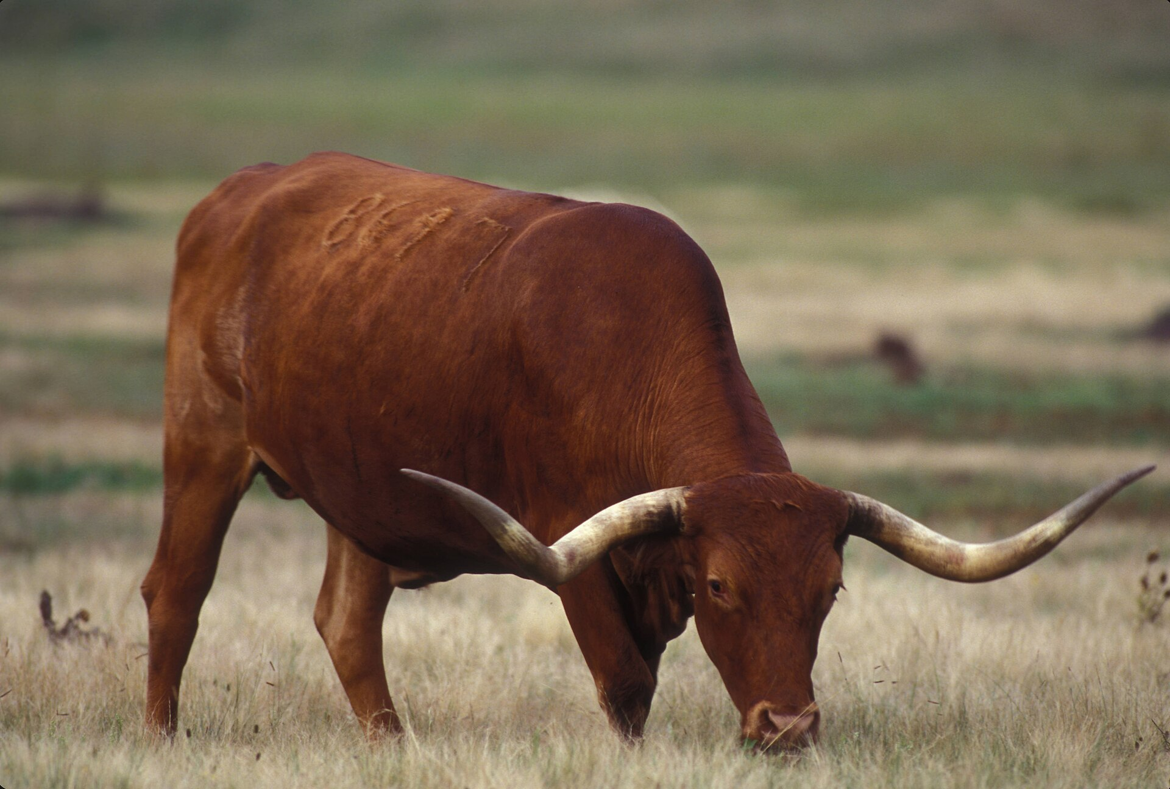
ECONOMY
Cities, ports, and ranches
T
e
x
a
s
Cities of ideas
Land and cattle
Austin builds technology. Houston runs a great port and the Johnson Space Center.
Cotton and cattle still matter. Ranches keep an older picture of Texas alive.
Texas Longhorn
U.S. Fish and Wildlife Service · public domain · Wikimedia Commons
A ranch and a space center share one state.
Maxim Hrehor · Kvinta · Lutheran Grammar School of J.A. Comenius
Slide 9/13

Slide 10
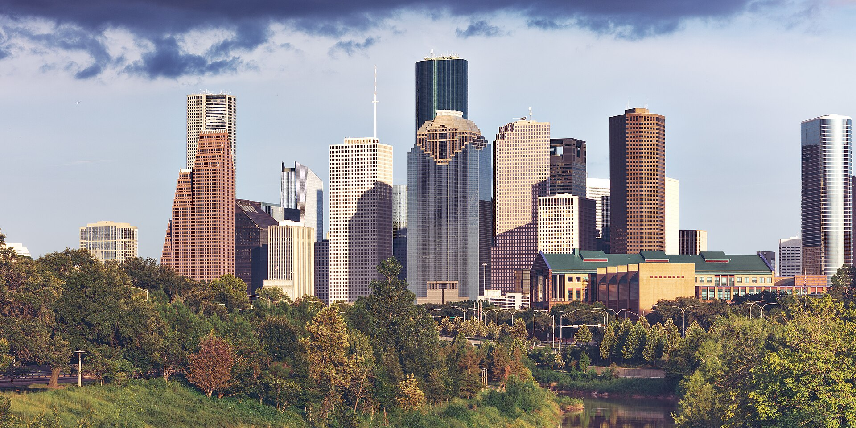
DEMOGRAPHICS AND SOCIETY
A state that keeps growing
T
e
x
a
s
Cities and open country
T
exas is home to more than 30 million people. Houston, Dallas, San Antonio, and Austin are huge, while much of the land is still ranches and small towns. About two in five residents are Hispanic or Latino. People move here for work, so schools and languages keep changing.
Downtown Houston
David Daniel Turner · CC BY 4.0 · Wikimedia Commons
About two in five Texans are Hispanic or Latino.
Maxim Hrehor · Kvinta · Lutheran Grammar School of J.A. Comenius
Slide 10/13

Slide 11
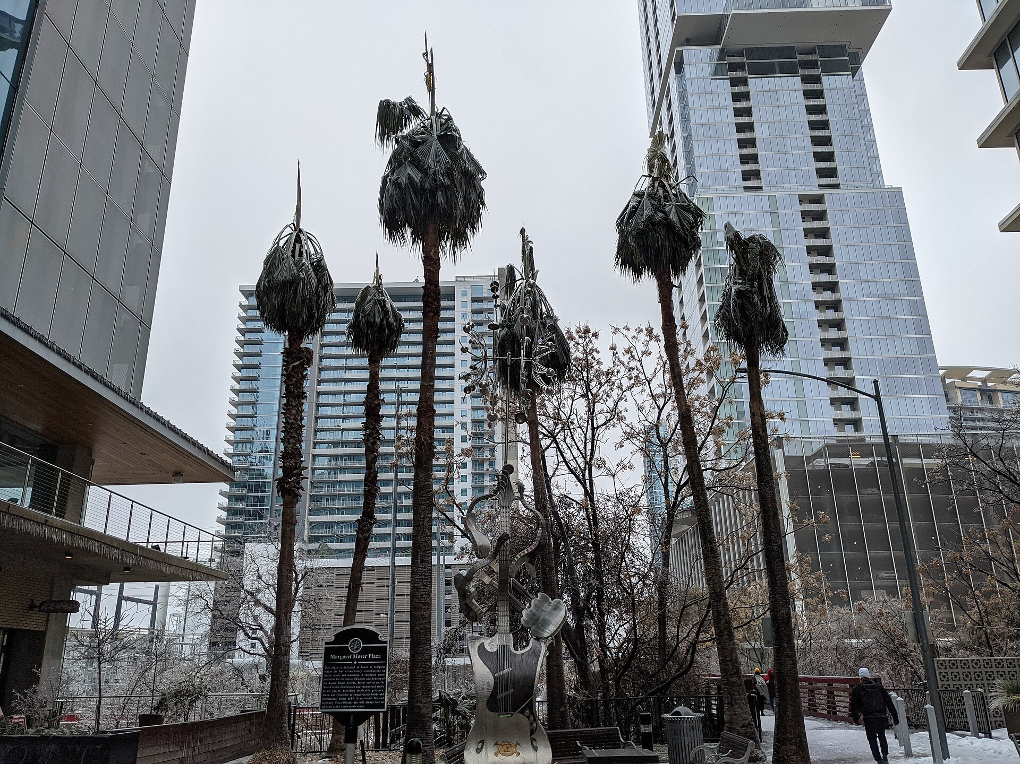
A CURRENT CHALLENGE
The week the power stopped
T
e
x
a
s
What happened
A fair next step
In February 2021, extreme cold froze equipment. Millions of homes lost heat. Most of the grid is run by ERCOT, not by the national networks.
Some want Texas to stay independent. Others want links to neighboring states. One practical step is to prepare plants and fuel lines for freezing weather.
Downtown Austin
Jno.skinner · CC BY-SA 4.0 · Wikimedia Commons
In 2021, cold stopped the power.
Maxim Hrehor · Kvinta · Lutheran Grammar School of J.A. Comenius
Slide 11/13

Slide 12
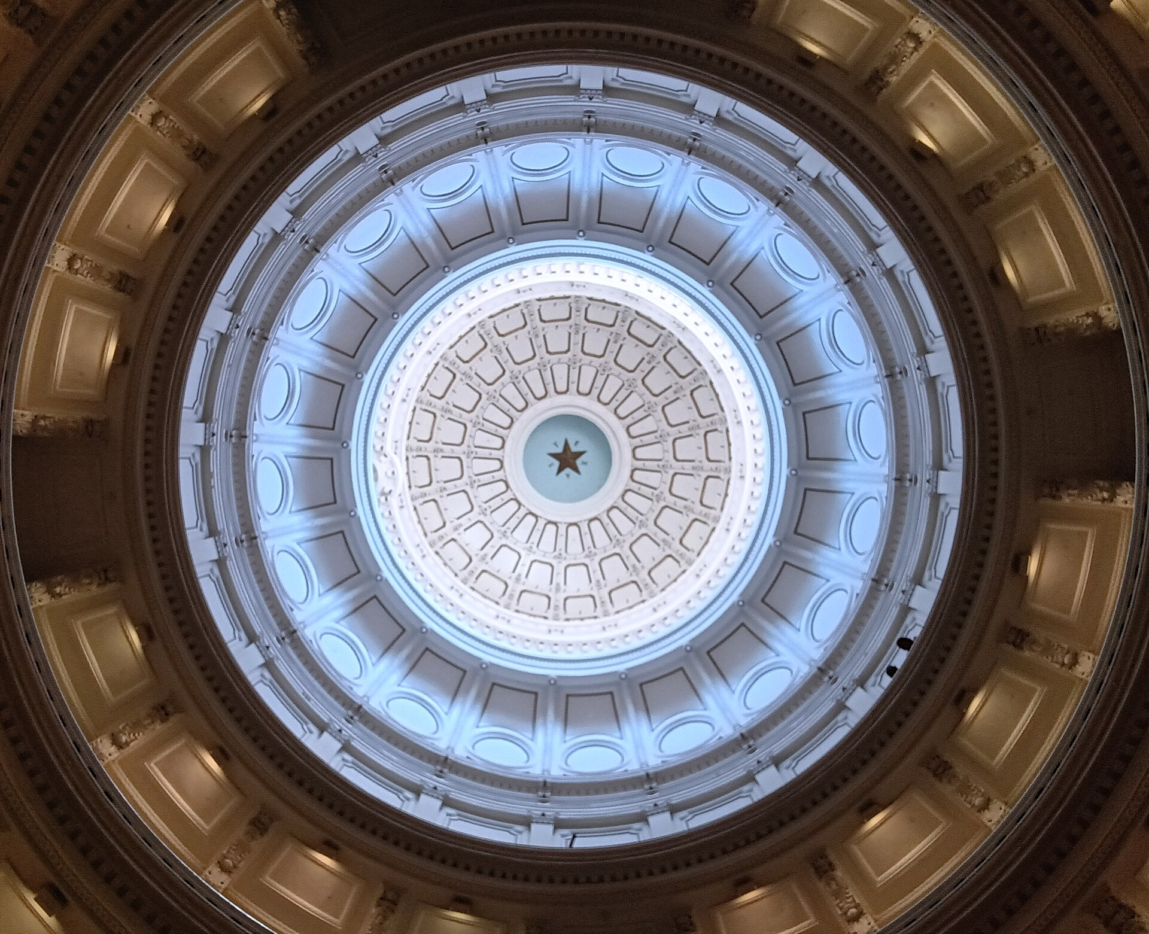
EVIDENCE
Where these facts come from
T
e
x
a
s
Geography
History
Economy
Society
U.S. Census Bureau — population and communities
✓
Texas State Historical Association — the republic, 1845, and Spindletop
✓
Texas State Capitol rotunda, Austin
National Weather Service — climate and the February 2021 storm
✓
Montysayshello · CC BY-SA 4.0 · Wikimedia Commons
If it has no source, it is not a fact yet.
ERCOT public reports — how most of the Texas grid is organized
✓
Maxim Hrehor · Kvinta · Lutheran Grammar School of J.A. Comenius
Slide 12/13

Slide 13
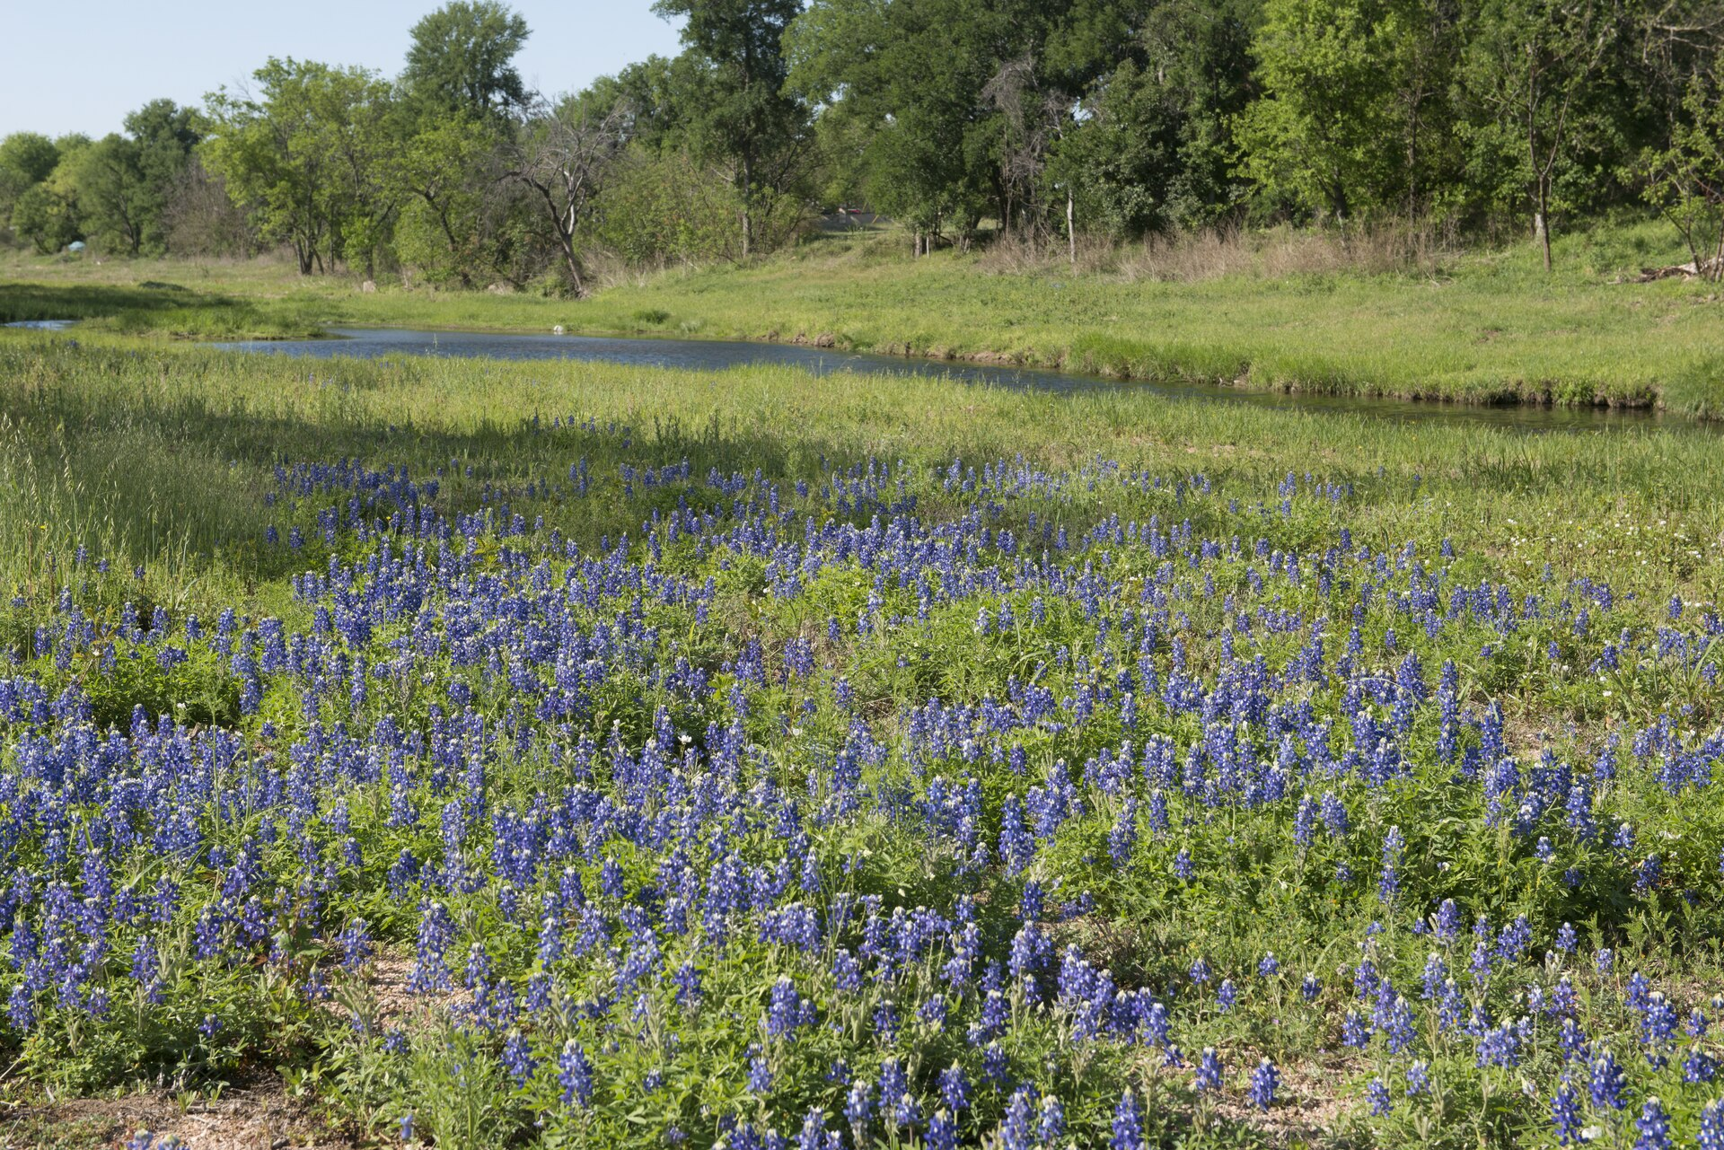
T
e
x
a
s
LUTHERAN GRAMMAR SCHOOL
Thank you
Ask me one question: a place, a date, or the winter storm.
Marble Falls, Texas Hill Country
Carol M. Highsmith · public domain · Wikimedia Commons
Maxim Hrehor
Lutheran Grammar School of J.A. Comenius · Kvinta
Leave me one question.
Maxim Hrehor · Kvinta · Lutheran Grammar School of J.A. Comenius
Slide 13/13

