Slide 1
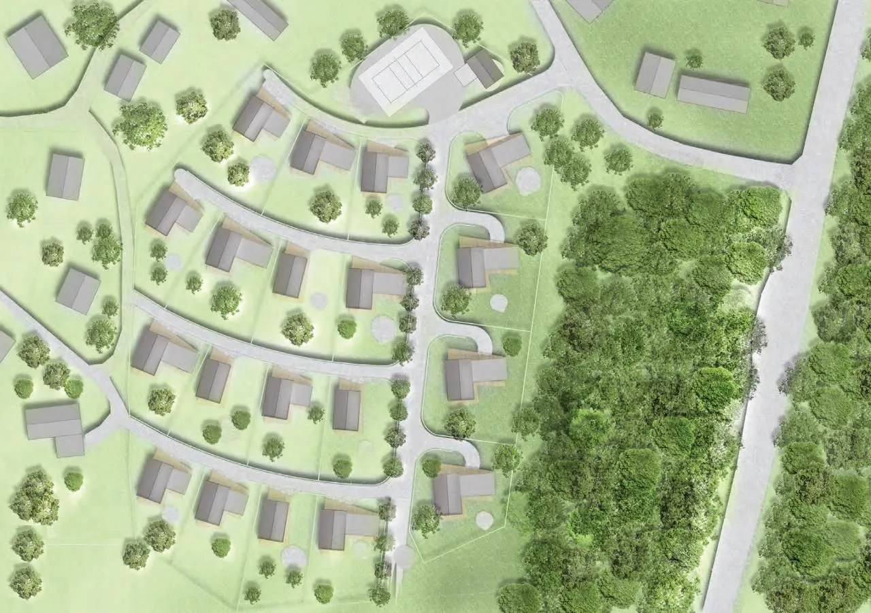
Frostwell
Honeydew
Blackrock
Sanoma

