Slide 1

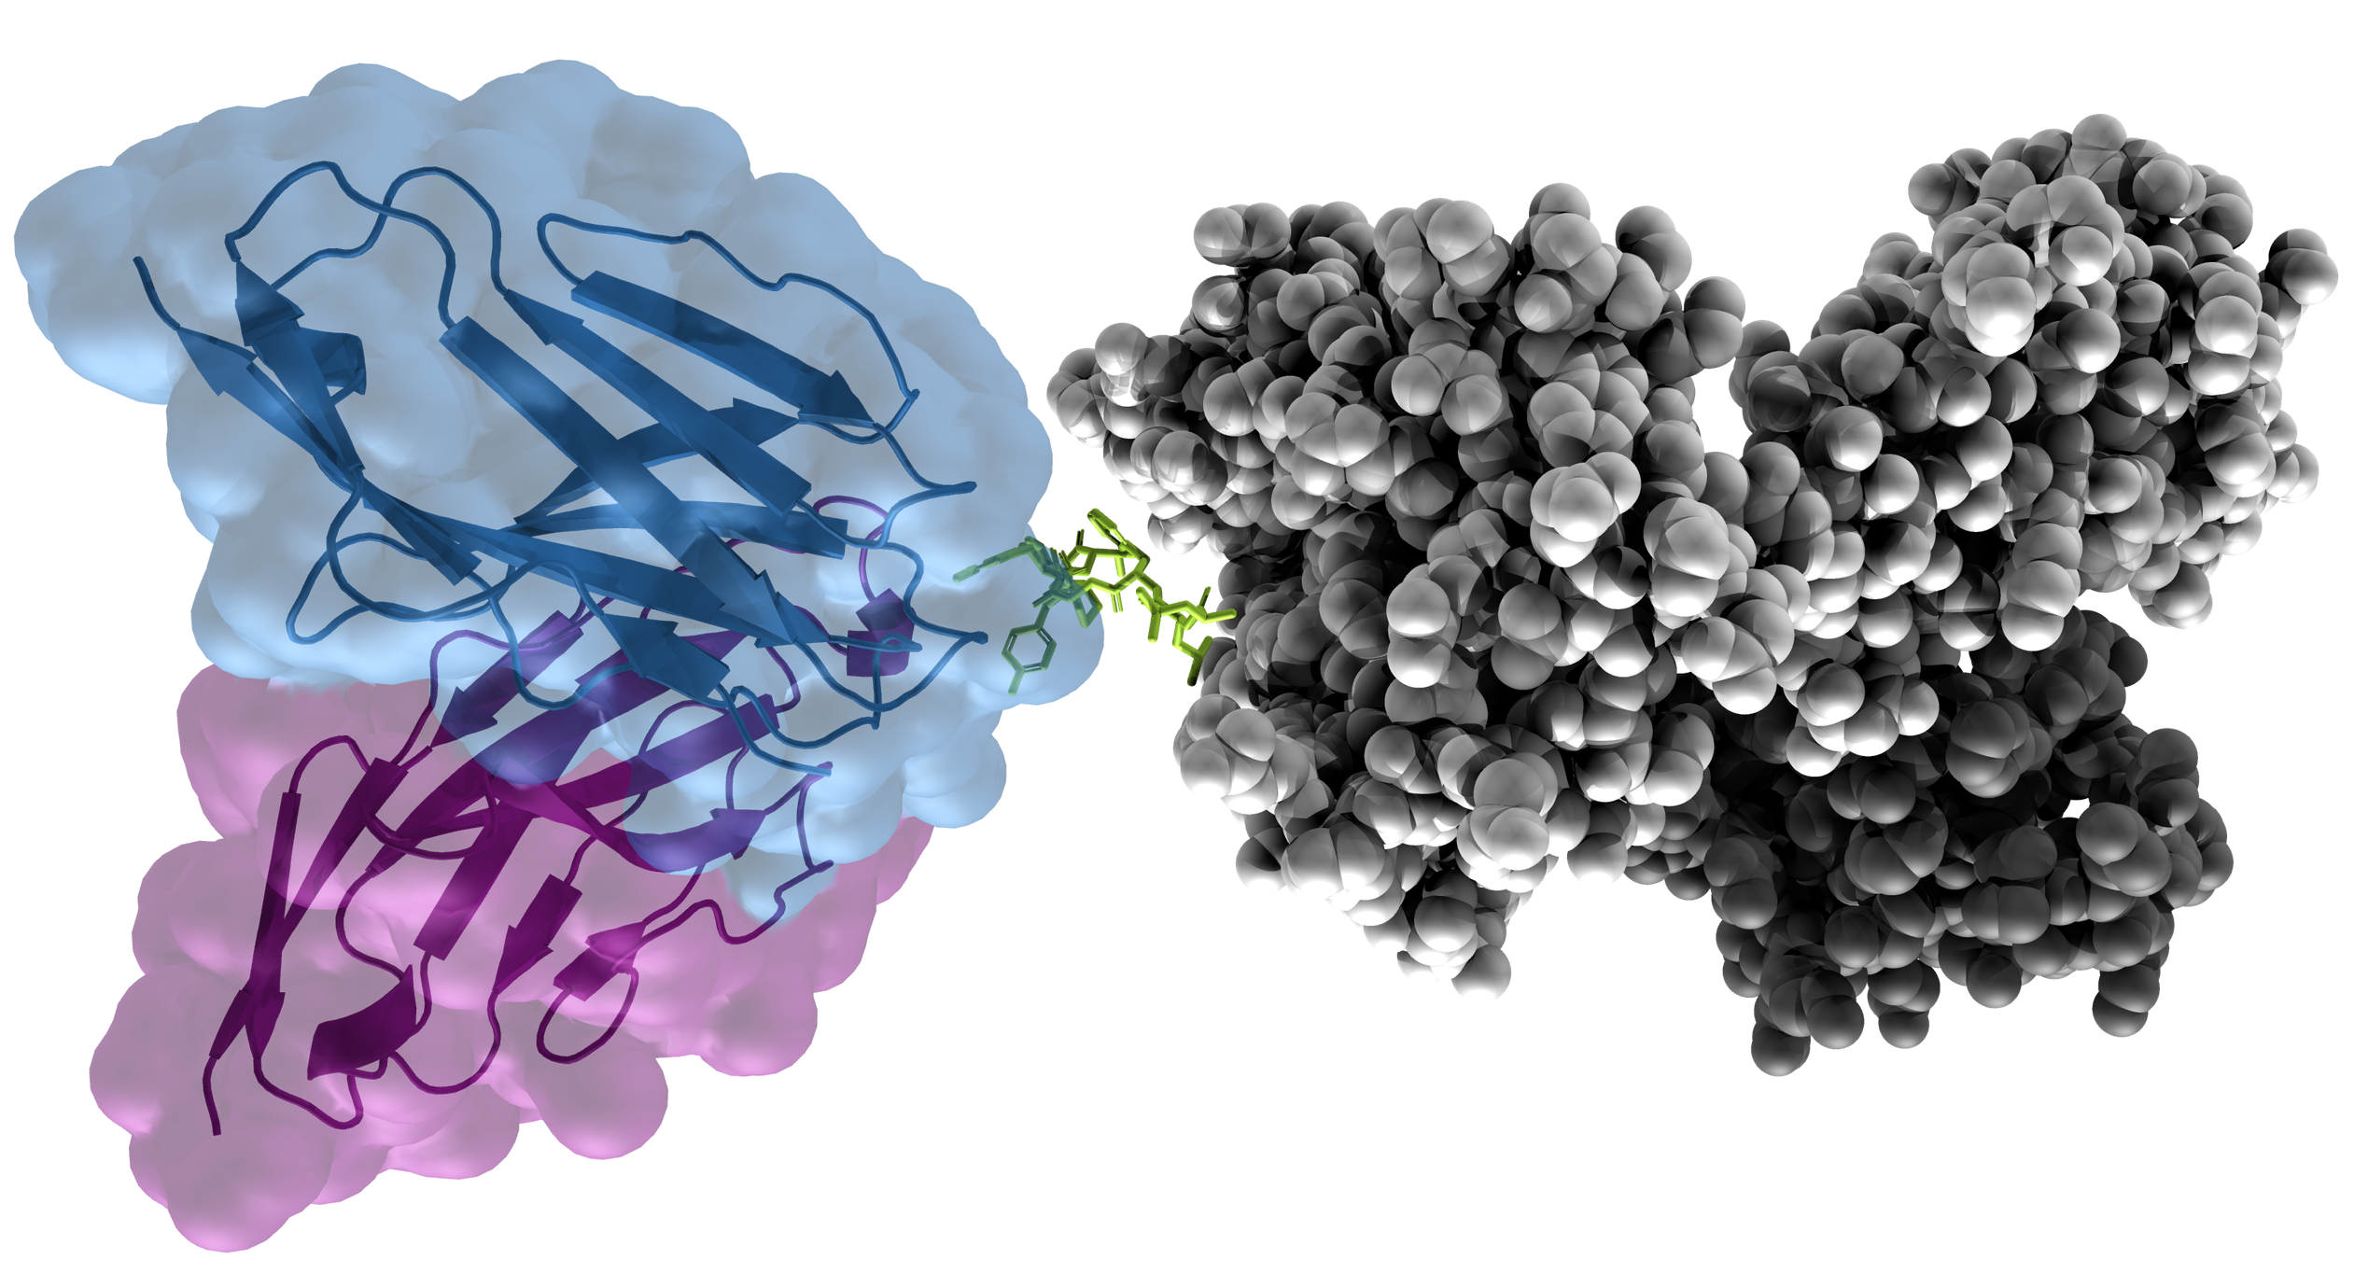
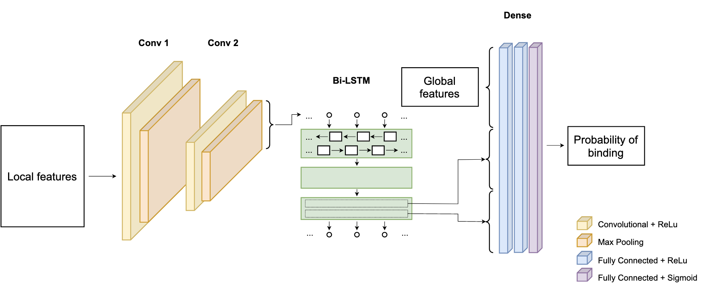
Prediction of TCR-pMHC interactions using molecular modeling and recurrent networks
Ella Hedeboe s211253, Henrietta Holze s215945, Christian Johansen s202770, Paul Simon s202592
https://github.com/HenriettaHolze/TCR-pMHC-prediction
Hex code color
#990000
#2F3EEA
Introduction
Adaptive immune system is a key element for fighting diseases
T cells are responsible for cell-mediated immune response
T cell receptors (TCR) bind to pMHC complexes (protein – Major Histocompatibility Complex) to trigger immune response
Problem: Predict TCR-pMHC binding
Input data [1]:
Protein sequence
Per-residue energy terms
Global energy term
Input dimensions:
x observations
y peptide positions
z channels, including sequence embedding and energy terms
Figure 1. Three dimension visualization of the TCR-pMHC complex. Blue: TCR-α, Purple: TCR-β, Green: Peptide, Grey: MHC.
Methods
Global energies
Per-residue energies
CNN
Bi-directional LSTM
FFNN
Output:
Probability of binding
Amino acid sequence
ESM (Transformer) [3]
Per-residue embedding
PCA
Figure 2. Pipeline for the data.
Figure 3. Architecture of the neural network.
Results
Table 1. Comparison between our results and the result from the Master Thesis authored by Ida Meitil [2].
Comparison with Ida [2]
 | AUC | MCC | Accuracy | Precision | Recall | F1
Our results
Ida Meitil’s results | 0.84 | 0.63 | 0.88 | 0.79 | 0.61 | 0.69
MCC on test
Confusion matrix
AUC plot
Discussion
High number of negative
BERT
Graph based approach
References
[1] Magnus H. Høie. (2021). T-cell binding prediction challenge (TCR-pMHC). Github repository, Link: https://github.com/CBH2021/tcr-pmhc
[2] Ida Kristine Sandford Meitil. (2021). Using deep learning for improving TCR homology modeling and its application to immunogenicity prediction [Master’s Thesis, DTU]
[3] Rives, A. et al. (2021). Biological structure and function emerge from scaling unsupervised learning to 250 million protein sequences. Proceedings of the National Academy of Sciences, 118(15).

