Slide 1

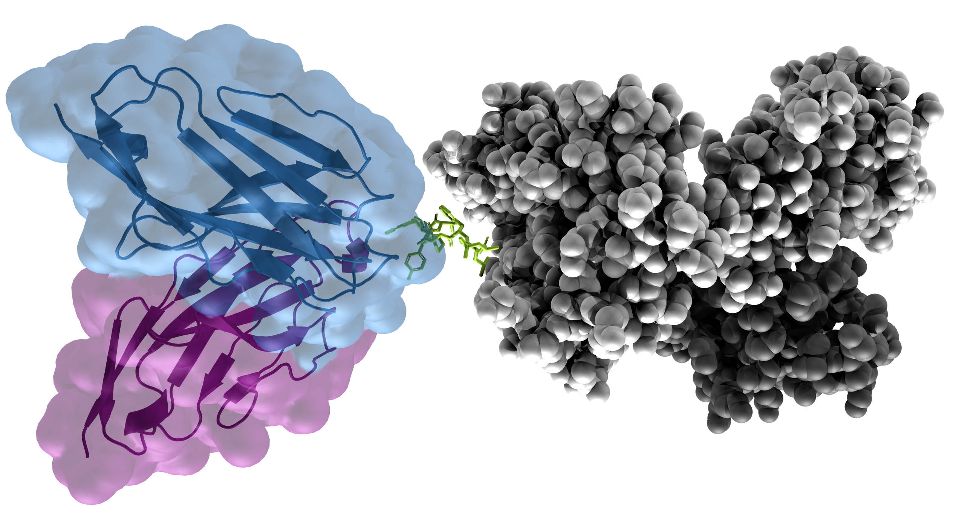
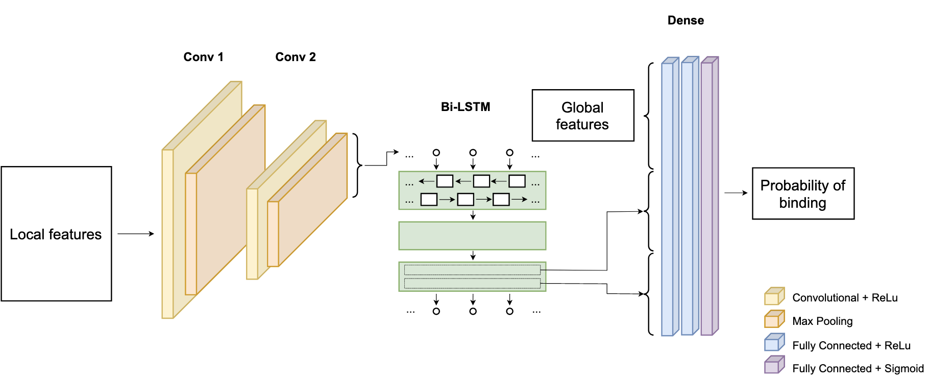
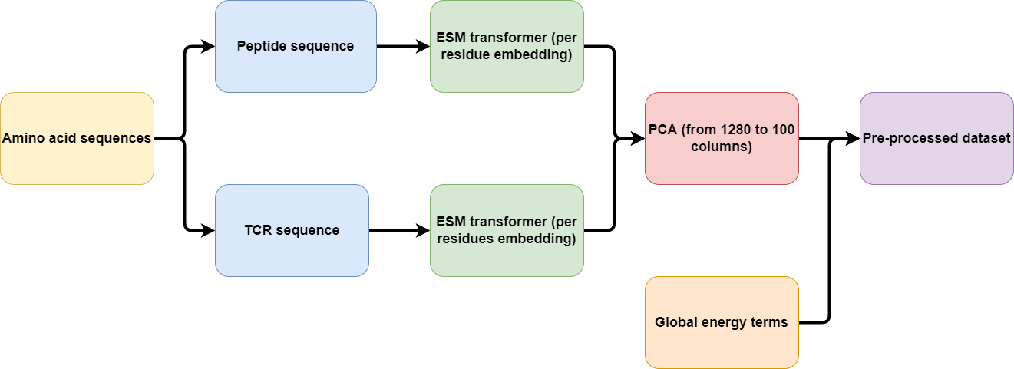
Prediction of TCR-pMHC interactions using molecular modeling and recurrent networks
Ella Hedeboe s211253, Henrietta Holze s215945, Christian Johansen s202770, Paul Simon s202592
https://github.com/HenriettaHolze/TCR-pMHC-prediction
Hex code color
#990000
#2F3EEA
Introduction
Recent advances within biological sequencing and deep learning methods have made it possible to investigate key interactions of the immune system computationally.
The adaptive immune system is a key element for fighting diseases and the T-cells are responsible for cell-mediated immune response via their surface T-cell receptors (TCR).
TCRs bind to peptide-Major Histocompatibility Complexes (pMHC) to form a complex that triggers an immune response.
Problem: Predict TCR-pMHC binding using molecular modeling and recurrent neural networks (RNN).
Figure 1. 3D-visualization of the TCR-pMHC complex. Blue: TCR-α, Purple: TCR-β, Green: Peptide, Grey: MHC.
Input data [1]
Protein sequence (one-hot-encoding)
Per-residue energy terms (one value per row)
Global energy terms (constant, one value per column)
Input dimensions
6913 observations (4180 training, 1526 validation, 1207 test)
419 peptide positions (zero-padding where sequences are shorter)
54 channels (including sequence embedding and energy terms)
Methods
Pre-processing with protein embedding
BLOSUM
ESM
Neural network architecture
Figure 2. Pipeline for the data.
Figure 3. Architecture of the neural network.
Results
Comparison with Ida [2]
Network architecture | AUC | MCC | Precision | Recall | F1
Vanilla architecture | 0.82 | 0.473 | 0.572 | 0.658 | 0.612
Improved architecture | 0.86 | 0.452 | 0.468 | 0.833 | 0.600
Improved architecture with BLOSUM encoding | 0.88 | 0.568 | 0.632 | 0.741 | 0.682
Improved architecture with ESM encoding | 0.9 | 0.612 | 0.676 | 0.753 | 0.712
MCC on test
Confusion matrix
AUC plot
Table 1. Comparison between the different networks that we constructed in this project
Discussion
High number of negative
BERT
Graph based approach
References
[1] Magnus H. Høie. (2021). T-cell binding prediction challenge (TCR-pMHC). Github repository, Link: https://github.com/CBH2021/tcr-pmhc
[2] Ida Kristine Sandford Meitil. (2021). Using deep learning for improving TCR homology modeling and its application to immunogenicity prediction [Master’s Thesis, DTU]
[3] Rives, A. et al. (2021). Biological structure and function emerge from scaling unsupervised learning to 250 million protein sequences. Proceedings of the National Academy of Sciences, 118(15).

