Slide 1




Futureverse: A Unifying Parallelization Framework in R for Everyone - Part 1
Henrik Bengtsson
University of California, San Francisco
R Foundation, R Consortium
@HenrikBengtsson
HenrikBengtsson
RaukR 2024, Visby, Sweden, June 12 & 17, 2024 (https://www.futureverse.org)

Slide 2
We parallelize software for various reasons
Parallel & distributed processing can be used to:
speed up processing (wall time)
lower memory footprint (per machine)
avoid data transfers (compute where data lives)
Other reasons, e.g. asynchronous UI

Slide 3
We parallelize software for various reasons
We may choose to parallelize on:
Your personal laptop or work desktop computer (single user)
A shared powerful computer (multiple users)
Across many computers, e.g. in the office or in the cloud
High-performance compute (HPC) cluster (multiple users) with a job scheduler, e.g. Slurm, Son of Grid Engine (SGE)

Slide 4
History - What’s Already Available in R?

Slide 5
R comes with built-in parallelization
library(DNAseq)
fq <- c("file1.fq", "file2.fq", "file3.fq") # In: FASTQ files
bam <- lapply(fq, align) # 3 hours
## [1] "file1.bam" "file2.bam" "file3.bam" # Out: BAM files
This can be parallelized on Unix & macOS (becomes non-parallel on Windows) as:
library(parallel)
bam <- mclapply(fq, align, mc.cores = 3) # 1 hour
To parallelize also on Windows, we can do:
library(parallel)
workers <- makeCluster(3)
bam <- parLapply(fq, align, cl = workers) # 1 hour

Slide 6
Things we need to be aware of

Slide 7
mclapply() - magic with problems
Pros:
• mclapply() works similarly to lapply()
• mclapply() comes with all R installations
• no need to worry about global variables and loading packages
Cons:
• Forked processing ⇒ not supported on MS Windows
• Forked processing ⇒ unstable with multi-threaded code & GUIs,
e.g. may core dump RStudio
• There are no mcapply(), mcsapply(), mcvapply(), …
• Errors have to be handled with exceptionally great care

Slide 8
⚠ Use forked processing with care!
R Core & mclapply() author Simon Urbanek (on R-devel, 2020):
“Do NOT use mcparallel() in packages except as a non-default option that user can set ... Multicore is intended for HPC applications that need to use many cores for computing-heavy jobs, but it does not play well with RStudio and more importantly you [as the developer] don't know the resource available so only the user can tell you when it's safe to use.”

Slide 9
parLapply() - takes some efforts
Pros:
• parLapply() works just like lapply()
• parLapply() comes with all R installations
• parLapply() works on all operating systems
Cons:
• Requires manually loading of packages on workers, e.g.
clusterEvalQ(workers, library(DNAseq))
• Requires manually exporting globals to workers, e.g.
clusterExport(workers, c("varA", "varB"))
• There are no parMapply(), parVapply(), …
• Errors have to be handled with great care

Slide 10
Error if we forget to load package on workers
library(DNAseq)
align_and_count <- function(fq) {
bam <- align(fq)
count_seqs(bam)
}
library(parallel)
workers <- makeCluster(3)
counts <- parLapply(fq, align_and_count, cl = workers)
## Error in checkForRemoteErrors(val) : 3 nodes produced
## errors; first error: could not find function "align"

Slide 11
Error if we forget to load package on workers
library(DNAseq)
align_and_count <- function(fq) {
bam <- align(fq)
count_seqs(bam)
}
library(parallel)
workers <- makeCluster(3)
clusterEvalQ(workers, library(DNAseq)) # <== Don’t forget!
counts <- parLapply(fq, align_and_count, cl = workers)

Slide 12
Design patterns found in packages

Slide 13
My “align them all” function
align_all <- function(fq) {
lapply(fq, align)
}
> fq <- c("file1.fq", "file2.fq", "file3.fq")
> bam <- align_all(fq)
> bam
[1] "file1.bam" "file2.bam" "file3.bam"

Slide 14
v1. A first attempt on parallel support
align_all <- function(fq, parallel = FALSE) {
if (parallel) {
bam <- mclapply(fq, align, mc.cores = detectCores()) ‎
} else {
bam <- lapply(fq, align) ‎
}
bam
}
> bam <- align_all(fq, parallel = TRUE)
> bam
[1] "file1.bam" "file2.bam" "file3.bam"

Slide 15
v2. A much better approach
align_all <- function(fq, parallel = FALSE) {
if (parallel) {
bam <- mclapply(fq, align) # let user decide on cores! 👍 ‎
} else {
bam <- lapply(fq, align) ‎
}
bam
}
> options(mc.cores = 4) ‎
> bam <- align_all(fq, parallel = TRUE)

Slide 16
v3. Yet another alternative
align_all <- function(fq, ncores = 1) {
if (ncores > 1) {
bam <- mclapply(fq, align, mc.cores = ncores)
} else {
bam <- lapply(fq, align)
}
bam
}
> bam <- align_all(fq, ncores = 4)

Slide 17
v4. Support also MS Windows
align_all <- function(fq, ncores = 1) {
if (ncores > 1) {
if (.Platform$OS.type == "windows") {
workers <- makeCluster(ncores) ‎
on.exit(stopCluster(workers)) ‎
clusterEvalQ(workers, library(somepkg)) ‎ ‎
bam <- parLapply(fq, align, cl = workers) ‎
} else {
bam <- mclapply(fq, align, mc.cores = ncores) ‎
}
} else {
bam <- lapply(fq, align) ‎
}
bam
}

Slide 18
More feature requests …
Can you please add support for AAA parallelization too?
While you’re at it, what about BBB parallelization?

Slide 19
v99: Phew … will this do?
align_all <- function(fq, parallel = "none") {
if (parallel == "snow") {
workers <- getDefaultCluster()
clusterEvalQ(workers, library(somepkg))
bam <- parLapply(fq, align, cl = workers)
} else if (parallel == "multicore") {
bam <- mclapply(fq, align)
} else if (parallel == "clustermq") {
bam <- clustermq::Q(align, fq, pkgs="somepkg")
} else if (parallel == ...) {
...
} else {
bam <- lapply(fq, align)
}
bam
}
What’s my test coverage now?

Slide 20
Some months later …
There is this new, cool DDD parallelization method … ?
…
Still there?

Slide 21
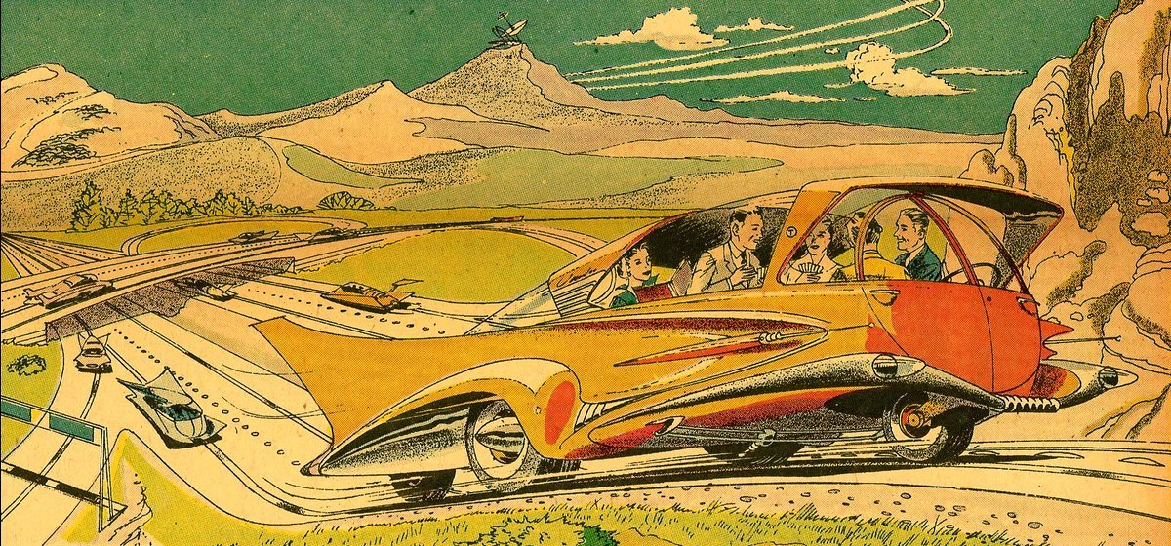
Welcome to the Future

Slide 22
Parallel frameworks reimplement common ideas
Parallel Map-Reduce APIs
parallel
mclapply(), parLapply(), …
foreach
foreach() %dopar% { … }
BiocParallel
bplapply(), …
...
Common needs, strategies & re-implementations:
Familiar map-reduce functions in a unified API
Multiple parallel backends to choose from
Efficient iteration & chunking
Loading of packages and globals to export
Handling of errors, warnings, and output

Slide 23
Idea: Collect common tasks in one place
Parallel Map-Reduce APIs
parallel
mclapply(), parLapply(), …
foreach
foreach() %dopar% { … }
BiocParallel
bplapply(), …
...
Future API
Unified low-level API
Multiple parallel backends to choose from
Loading of packages and globals to export
Handling of errors, warnings, and output
Protection against non-exportable globals
“Serves your low-level parallelization tasks
in a robust, standardized, consistent manner”

Slide 24

R package: future
"Write once, run anywhere"
100% cross-platform
Works with any type of parallel backends
A simple unified API
Easy to install (< 0.5 MiB total)
Very well tested, lots of CPU mileage
“Low friction”:
automatically exports global variables
automatically relays output, messages, and warnings
proper parallel random number generation (RNG)
Dan LaBar
@embiggenData

Slide 25
A Future is ...
A future is an abstraction for a value that will be available later
The state of a future is either unresolved or resolved
The value is the result of an evaluated expression
An R assignment:
v <- expr
Future API:
f <- future(expr)
v <- value(f)
v %<-% expr
Friedman & Wise (1976, 1977), Hibbard (1976), Baker & Hewitt (1977)

Slide 26
Example: Sum of 1:100
> slow_sum(1:100) # 2 minutes
[1] 5050
> a <- slow_sum(1:50) # 1 minute
> b <- slow_sum(51:100) # 1 minute
> a + b # 1275 + 3775
[1] 5050

Slide 27
Example: Sum of 1:50 and 51:100 in parallel
> library(future)
> plan(multisession) # parallelize on local computer
>
fa <- future( slow_sum( 1:50 ) ) # ~0 seconds
>
fb <- future( slow_sum(51:100) ) # ~0 seconds
>
mean(1:3)
[1] 2
>
a <- value(fa) # blocks until ready
b <- value(fb)
>
>
a + b # here at ~1 minute
[1] 5050

Slide 28
User chooses how to parallelize - many options
plan(sequential)
plan(multicore) # uses the mclapply() machinery
plan(multisession) # uses the parLapply() machinery
plan(cluster, workers = c("n1", "n2", "n3"))
plan(cluster, workers = c("n1", "m2.uni.edu", "vm.cloud.org"))
plan(batchtools_slurm) # on a Slurm job scheduler
plan(future.callr::callr) # locally using callr package
plan(future.mirai::mirai_multisession) # locally using mirai package
...

Slide 29
Parallelize on other machines is easy
> library(future)
> plan(cluster, workers = c("alice", "bob"))
>
fa <- future( slow_sum( 1:50 ) ) # ~0 seconds
>
fb <- future( slow_sum(51:100) ) # ~0 seconds
>
mean(1:3)
[1] 2
>
a <- value(fa) # blocks until ready
b <- value(fb)
>
>
a + b # here at ~1 minute
[1] 5050

Slide 30
Parallelize on other machines is easy
> library(future)
> plan(cluster, workers = c("alice", "bob", "carole", "dave"))
>
fa <- future( slow_sum( 1:50 ) ) # ~0 seconds
>
fb <- future( slow_sum(51:100) ) # ~0 seconds
>
mean(1:3)
[1] 2
>
a <- value(fa) # blocks until ready
b <- value(fb)
>
>
a + b # here at ~1 minute
[1] 5050

Slide 31
Parallelize on other machines is easy
> library(future)
> plan(cluster, workers = c("alice", "bob", "carole", "dave"))
>
fa <- future( slow_sum( 1:25 ) ) # ~0 seconds
> fb <- future( slow_sum(26:50 ) ) # ~0 seconds
> fc <- future( slow_sum(51:75 ) ) # ~0 seconds
> fd <- future( slow_sum(76:100) ) # ~0 seconds
> y <- value(fa) + value(fb) + value(fc) + value(fd)
> y # here at ~30 seconds
[1] 5050

Slide 32
Globals automatically identified (99% worry free)
Static-code inspection by walking the abstract syntax tree (AST):
x <- rnorm(n = 100)
f <- future({ slow_sum(x) })
Static-code inspection by walking the abstract syntax tree (AST):
x <- rnorm(n = 100) lobstr::ast( { slow_sum(x) } )
f <- future({ slow_sum(x) }) | █─`{`
|_____________| └─█─ slow_sum
| └─ x
=> globals & packages identified and exported to the worker:
- slow_sum() - a function (also searched recursively)
- x - a numeric vector of length 100
Comment: Globals & packages can also be specified manually;
f <- future({ slow_sum(x) }, globals = c("slow_sum", "x"))

Slide 33
Other frameworks need manual exports
With other parallel frameworks, you have to manually export the globals that need to be available on the parallel workers, e.g.
library(parallel)
cl <- makeCluster(2)
x <- rnorm(n = 100)
clusterExport(cl, c("slow_sum", "x"))
y <- clusterEvalQ(cl, { slow_sum(x) })
Conclusion: This is not needed when using Futureverse for parallelization
(except for rare, corner cases)

