Slide 1
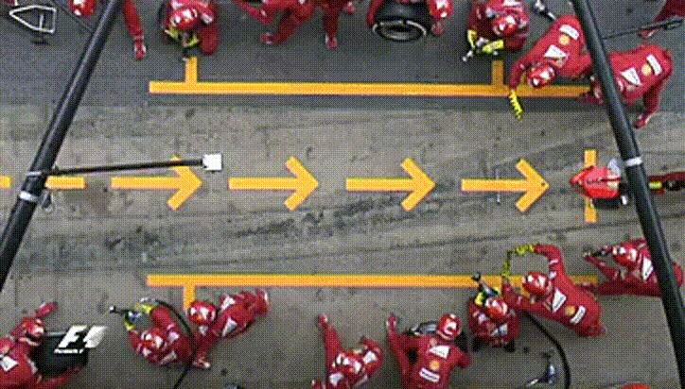




Future: Simple Parallel and Distributed Processing in R
Henrik Bengtsson
University of California
San Francisco
Acknowledgments:
Organizers, Volunteers, and Sponsors
R Core, CRAN, devels, and users!
R Consortium
Gábor Csárdi
@HenrikBengtsson
HenrikBengtsson
jottr.org
Notes:
Friday July 12, 2019 @ 12:24-12:42 (15 + 3 mins)
Room: Saint-Exupery (top floor)
Conference: useR!2019, Toulouse, France, July 9-12, 2019

Slide 2
We parallelize software for various reasons
Parallel & distributed processing can be used to:
speed up processing (wall time)
lower memory footprint (per machine)
avoid data transfers (compute where data lives)
Other reasons, e.g. asynchronous UI

Slide 3
Concurrency in R
X <- list(a=1:50, b=51:100, c=101:150)
y <- list()
y$a <- sum(X$a)
y$b <- sum(X$b)
y$c <- sum(X$c)
y <- list()
for (name in names(X)) {
y[[name]] <- sum(X[[name]])
}
y <- lapply(X, sum)

Slide 4
R comes with built-in parallelization
X <- list(a=1:50, b=51:100, c=101:150)
y <- lapply(X, slow_sum) # 3 minutes
This can be parallelized on Unix & macOS (becomes non-parallel on Windows) as:
library(parallel)
y <- mclapply(X, slow_sum, mc.cores=3) # 1 minute
To parallelize also on Windows, we can do:
library(parallel)
workers <- makeCluster(3)
clusterExport(workers, "slow_sum")
y <- parLapply(X, slow_sum, cl=workers) # 1 minute

Slide 5
PROBLEM: Different APIs for different parallelization strategies
Developer:
Which parallel API should I use?
What operating systems are users running?
- Hmm… It should work?!?
- Oh, I forgot to test on macOS.
I don’t have Windows; can’t be bothered
User:
- Weird, others say it works for them but for me it doesn't!?
I wish this awesome package could parallelize on Windows :(

Slide 6
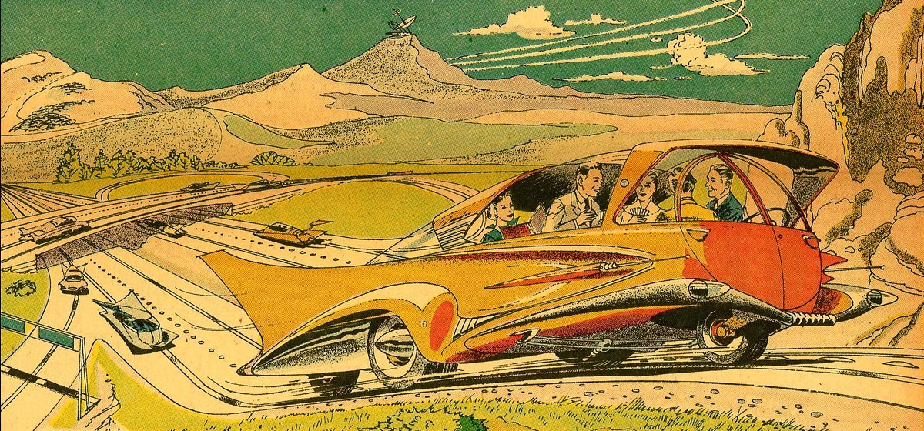
Welcome to the Future

Slide 7
A Future is ...
A future is an abstraction for a value that will be available later
The value is the result of an evaluated expression
The state of a future is either unresolved or resolved
An R assignment:
v <- expr
Future API:
f <- future(expr)
v <- value(f)
v %<-% expr
Friedman & Wise (1976, 1977), Hibbard (1976), Baker & Hewitt (1977)

Slide 8
Example: Sum of 1:100
> slow_sum(1:100) # 2 minutes
[1] 5050
> a <- slow_sum(1:50) # 1 minute
> b <- slow_sum(51:100) # 1 minute
> a + b
[1] 5050

Slide 9
Example: Sum of 1:50 and 51:100 in parallel
> library(future)
> plan(multiprocess)
>
fa <- future( slow_sum( 1:50 ) ) # ~0 seconds
>
fb <- future( slow_sum(51:100) ) # ~0 seconds
>
mean(1:3)
[1] 2
>
a <- value(fa) # may block until ready
[1] 1275
>
b <- value(fb)
[1] 3775
>
a + b
[1] 5050

Slide 10
Easy to parallelize on multiple machines ...
plan(sequential)
plan(multiprocess)
plan(cluster, workers=c("n1", "n2", "n3"))
plan(cluster, workers=c("n1", "m2.uni.edu", "vm.cloud.org"))
plan(future.callr::callr) # locally using callr
plan(batchtools_slurm) # on a Slurm job scheduler
Importantly, the end user decides on the above!

Slide 11
R package: future
"Write once, run anywhere"
A simple unified API ("interface of interfaces")
100% cross platform
Easy to install (< 0.5 MiB total)
Very well tested, lots of CPU mileage, production ready
Other strengths:
automatically exports global variables
automatically captures and relays:
  stdout
  conditions, e.g. messages and warnings
works with new future backends
future(), value(), %<-%, ...
future
parallel | globals | (listenv)

Slide 12

Building things using the core future blocks
f <- future(expr) # create future
r <- resolved(f) # check if done
v <- value(f) # wait & get result

Slide 13
A parallel version of lapply()
#' @importFrom future future value
parallel_lapply <- function(X, FUN, ...) {
# Create futures
fs <- lapply(X, function(x) future(FUN(x, ...))
# Collect their values
lapply(fs, value)
}
> plan(multiprocess)
> X <- list(a = 1:50, b = 51:100, c = 101:150)
> y <- parallel_lapply(X, slow_sum) # 1 minute
> str(y)
List of 4
$ a: int 1275
$ b: int 3775
$ c: int 6275

Slide 14
R package: future.apply
Futurized version of base R's lapply(), vapply(), replicate(), …
... on all future-compatible backends
Load balancing ("chunking")
Proper parallel random number generation
y <- lapply(X, slow_sum)
y <- future_lapply(X, slow_sum)
plan(multiprocess)
plan(cluster, workers=c("n1", "n2", "n3"))
plan(batchtools_slurm)
...
Other higher-level packages: foreach w/ doFuture, and furrr

Slide 15

Compliance validation of parallel backends
future.tests - an R Consortium-sponsored project for a single-point automatic validation of existing and new future backends

Slide 16

WISH: Progress bars?
ME:

Slide 17
Progress bars + parallel processing = complicated
How do we communicate progress from workers to main R?
A progress bar is displayed in our main R session
Our parallel code may be executed on external machines
???
n1.remote.org
internet
laptop
n2.remote.org
How to make sure it works the same everywhere?
Futures must work the same regardless how and if you parallelize
We don’t know how and where users will parallelize

Slide 18
Progress bars prevent inclusive design
Different packages display progress different
Progress is almost always presented as a progress bar
Progress presentation is frozen at development
User has little control over presentation
Screen readers struggle with progress bars in the terminal
|========== | 40%
“Inclusive Design is a methodology, ..., that enables and draws on the full range of human diversity. Most importantly, this means including and learning from people with a range of perspectives.” (Microsoft)

Slide 19
updates
Progress bars

Slide 20
Separate APIs for developers and users
API for Developers | API for End Users
p <- progressor(along=x) p() | with_progress({ expr })
Developer decides: where in the code progress updates should be signaled | User decides: if, when, and how progress updates are presented

Slide 21
Developer focuses on providing updates
Package code
slow_sum <- function(x) {
p <- progressor(along=x)
sum <- 0
for (k in seq_along(x)) {
Sys.sleep(1.0)
sum <- sum + x[k]
p(paste("Add", x[k]))
}
sum
}
User
> x <- 1:10
> y <- slow_sum(x)
> y
[1] 55
# progress updates
> with_progress(y <- slow_sum(x))
|======= | 40%
# <hint>R Core, please</hint>
> registerCallingHandlers(progress=...)
>
> y <- slow_sum(x)
|======= | 40%

Slide 22
User choses how progress is presented
# without progress updates
x <- 1:10
y <- slow_sum(x)
handlers(“beepr”)
with_progress(y <- slow_sum(x))
♫ ♪ ♪ ♪ … ♫
handlers(“txtprogressbar”)
with_progress(y <- slow_sum(x))
|========= | 40%
handlers(“progress”, “beepr”)
with_progress(y <- slow_sum(x))
[======>-----------] 40% Add 4
♫ ♪ ♪ ♪ … ♫
handlers(“progress”)
with_progress(y <- slow_sum(x))
[======>-----------] 40% Add 4
# Easy to develop new ones:
handlers(“rstudio”)
handlers(“shiny”)
handlers(“pushbullet”)

Slide 23
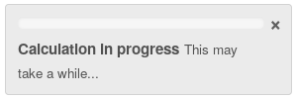
future + progressr - it just works
library(future.apply)
with_progress({
p <- progressor(along=x)
y <- future_lapply(x, function(i) {
p()
...
})
})
To be decided: Should future_lapply() and likes auto-signal progression?
with_progress({
y <- future_lapply(x, function(i) { ... })
})

Slide 24
progressr: Work in progress
Current resolution:
Progression conditions are relayed when futures complete
Progress updates within chunks are delayed
It’s possible to increase resolution for some backends:
Relay progress immediately while continue evaluating futures
Can be done for PSOCK cluster (aka multisession, cluster)
Also,
Possible to nest progress updates

Slide 25

Exciting news: future + “v2” = should work
CRAN package progress:
progress::progress_bar$new(...)
Gábor Csárdi has work in progress that will separate the Developer API and the End-user API; [“PARAPHRASING”]
  p <- progress::progress$new(...)
  p$tick() # signal progress update
This works because
futures are invariant
to progress implementation!

Slide 26

Take home: future = worry-free parallelization
"Write once, run anywhere" - your code is future proof
Global variables - automatically taken care of
Stdout, messages, warnings, progress - captured and relayed
User can leverage their compute resource, e.g. compute clusters
Atomic building blocks for higher-level parallelization APIs
100% cross platform code
[x] supports progress updates

Slide 27
Building a better future
I 💜 feedback, bug reports, and suggestions
@HenrikBengtsson
HenrikBengtsson/future
Thank you all!
Acknowledgments:
Organizers, Volunteers, and Sponsors
R Core, CRAN, devels, and users!
R Consortium
Gábor Csárdi

