Slide 1
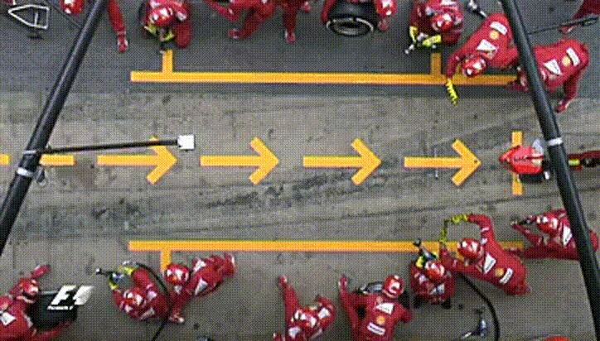




Future: Simple Parallel and Distributed Processing in R
Henrik Bengtsson
University of California
San Francisco
Acknowledgments:
Organizers, Volunteers, and Sponsors
R Core, CRAN, devels, and users!
R Consortium
Gábor Csárdi
@HenrikBengtsson
HenrikBengtsson
jottr.org
Notes:
Friday July 12, 2019 @ 12:24-12:42 (15 + 3 mins)
Room: Saint-Exupery (top floor)
Conference: useR!2019, Toulouse, France, July 9-12, 2019

Slide 2
We parallelize software for various reasons
Parallel & distributed processing can be used to:
speed up processing (wall time)
lower memory footprint (per machine)
Other reasons, e.g. asynchronous UI

Slide 3
Concurrency in R
X <- list(a=1:50, b=51:100, c=101:150)
y <- list()
y$a <- sum(X$a)
y$b <- sum(X$b)
y$c <- sum(X$c)
y <- list()
for (name in names(X)) {
y[[name]] <- sum(X[[name]])
}
y <- lapply(X, sum)

Slide 4
R comes with built-in parallelization
X <- list(a=1:50, b=51:100, c=101:150)
y <- lapply(X, slow_sum) # 3 minutes
This can be parallelized on Unix & macOS (becomes non-parallel on Windows) as:
library(parallel)
y <- mclapply(X, slow_sum, mc.cores=3) # 1 minute
To parallelize also on Windows, we can do:
library(parallel)
workers <- makeCluster(3)
clusterExport(workers, "slow_sum")
y <- parLapply(X, slow_sum, cl=workers) # 1 minute

Slide 5
PROBLEM: Different APIs for different parallelization strategies
Developer:
Which parallel API should I use?
What operating systems are users running?
I don’t have Windows; can’t be bothered
- Hmm… It should work?!?
- Oh, I forgot to test on macOS.
User:
I wish this awesome package could parallelize on Windows :(
- Weird, others say it works for them but for me it doesn't!?

Slide 6
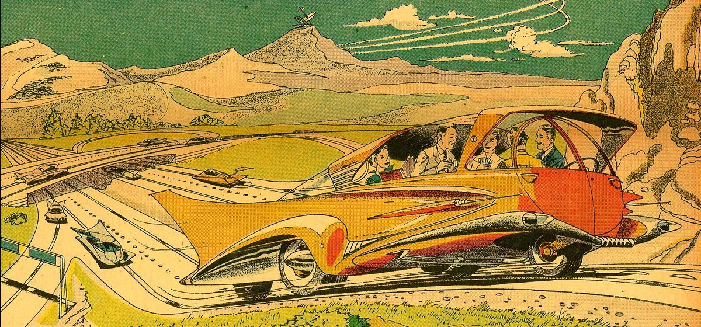
Welcome to the Future

Slide 7
R package: future
future
"Write once, run anywhere"
100% cross platform
A simple unified API
Easy to install (< 0.5 MiB total)
Very well tested, lots of CPU mileage
Other key strengths:
automatically exports global variables
automatically relays:
  stdout
  conditions, e.g. messages and warnings
works with any type of parallel backends

Slide 8
A Future is ...
A future is an abstraction for a value that will be available later
The value is the result of an evaluated expression
The state of a future is either unresolved or resolved
An R assignment:
v <- expr
Future API:
f <- future(expr)
v <- value(f)
v %<-% expr
Friedman & Wise (1976, 1977), Hibbard (1976), Baker & Hewitt (1977)

Slide 9
Example: Sum of 1:100
> slow_sum(1:100) # 2 minutes
[1] 5050
> a <- slow_sum(1:50) # 1 minute
> b <- slow_sum(51:100) # 1 minute
> a + b
[1] 5050

Slide 10
Example: Sum of 1:50 and 51:100 in parallel
> library(future)
> plan(multiprocess) # parallelize on local computer
>
fa <- future( slow_sum( 1:50 ) ) # ~0 seconds
>
fb <- future( slow_sum(51:100) ) # ~0 seconds
>
mean(1:3)
[1] 2
>
a <- value(fa) # blocks until ready
b <- value(fb)
>
>
a + b
[1] 5050

Slide 11
User chooses how to parallelize - many options
plan(sequential)
plan(multiprocess)
plan(cluster, workers=c("n1", "n2", "n3"))
plan(cluster, workers=c("n1", "m2.uni.edu", "vm.cloud.org"))
plan(batchtools_slurm) # on a Slurm job scheduler
plan(future.callr::callr) # locally using callr
...

Slide 12

Building things using the core future blocks
f <- future(expr) # create future
r <- resolved(f) # check if done
v <- value(f) # wait & get result

Slide 13
A parallel version of lapply()
#' @importFrom future future value
parallel_lapply <- function(X, FUN, ...) {
# Create futures
fs <- lapply(X, function(x) future(FUN(x, ...))
# Collect their values
lapply(fs, value)
}
> plan(multiprocess)
> X <- list(a = 1:50, b = 51:100, c = 101:150)
> y <- parallel_lapply(X, slow_sum) # 1 minute
> str(y)
List of 4
$ a: int 1275
$ b: int 3775
$ c: int 6275

Slide 14
R package: future.apply
Futurized version of base R's lapply(), vapply(), replicate(), …
... on all future-compatible backends
Load balancing ("chunking")
Proper parallel random number generation
y <- lapply(X, slow_sum)
y <- future_lapply(X, slow_sum)
plan(multiprocess)
plan(cluster, workers=c("n1", "n2", "n3"))
plan(batchtools_slurm)
...
Other higher-level packages: foreach w/ doFuture, and furrr

Slide 15

WISH: Progress bars?
ME:

Slide 16
Progress bars + parallel processing = complicated
How do we communicate progress from workers to main R?
A progress bar is displayed in our main R session
Our parallel code may be executed on external machines
???
n1.remote.org
internet
laptop
n2.remote.org
How to make sure it works the same everywhere?
Futures must work the same regardless how and if you parallelize
We don’t know how and where users will parallelize

Slide 17
Progress bars prevent inclusive design
Different packages display progress different
Progress presentation is frozen at development
User has little control over presentation
Screen readers struggle with progress bars in the terminal
|========== | 40%
“Inclusive Design is a methodology, ..., that enables and draws on the full range of human diversity. Most importantly, this means including and learning from people with a range of perspectives.” (Microsoft)

Slide 18
updates
Progress bars

Slide 19
Separate APIs for developers and users
API for Developers | API for End Users
p <- progressor(along=x) p() | with_progress({ expr })
Developer decides: where in the code progress updates should be signaled | User decides: if, when, and how progress updates are presented

Slide 20
Developer focuses on providing updates
Package code
slow_sum <- function(x) {
sum <- 0
for (k in seq_along(x)) {
Sys.sleep(0.1)
sum <- sum + x[k]
}
sum
}
User
> x <- 1:10
> y <- slow_sum(x)
> y
[1] 55
# progress updates
> with_progress(y <- slow_sum(x))
|======= | 40%
Package code
slow_sum <- function(x) {
p <- progressor(along=x)
sum <- 0
for (k in seq_along(x)) {
Sys.sleep(0.1)
sum <- sum + x[k]
p(paste("Add", x[k]))
}
sum
}

Slide 21
User choses how progress is presented
# without progress updates
x <- 1:10
y <- slow_sum(x)
handlers(“beepr”)
with_progress(y <- slow_sum(x))
♫ ♪ ♪ ♪ … ♫
handlers(“txtprogressbar”)
with_progress(y <- slow_sum(x))
|========= | 40%
handlers(“progress”, “beepr”)
with_progress(y <- slow_sum(x))
[======>-----------] 40% Add 4
♫ ♪ ♪ ♪ … ♫
handlers(“progress”)
with_progress(y <- slow_sum(x))
[======>-----------] 40% Add 4
# Easy to develop new ones:
handlers(“rstudio”)
handlers(“shiny”)
handlers(“pushbullet”)

Slide 22
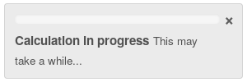
future + progressr - it just works
with_progress({
p <- progressor(along=x)
y <- future_lapply(x, function(i) {
p()
...
})
})
To be decided: Should future_lapply() and likes auto-signal progression?
with_progress({
y <- future_lapply(x, function(i) { ... })
})

Slide 23

Exciting news: future + “v2” = should work
CRAN package progress:
progress::progress_bar$new(...)
Gábor Csárdi has work in progress that will separate the Developer API and the End-user API; [“PARAPHRASING”]
  p <- progress$new(...)
  p$tick() # signal a progress condition
This works because
futures are invariant to
the progress implementation!

Slide 24

Take home: future = worry-free parallelization
"Write once, run anywhere" - your code is future proof
Global variables - automatically taken care of
Stdout, messages, warnings, progress - captured and relayed
User can leverage their compute resource, e.g. compute clusters
Atomic building blocks for higher-level parallelization APIs
100% cross platform code

Slide 25
Building a better future
I 💜 feedback, bug reports, and suggestions
@HenrikBengtsson
HenrikBengtsson/future
Thank you all!
Acknowledgments:
Organizers, Volunteers, and Sponsors
R Core, CRAN, devels, and users!
R Consortium
Gábor Csárdi

