Slide 1

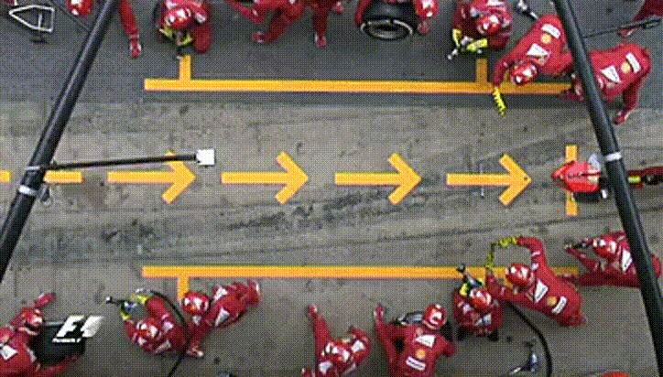
Futureverse:
Profile Parallel Code
?
?
Where
can we improve?
?
?
?
@HenrikBengtsson (University of California, San Francisco)
useR! 2022-06-22 (25 mins)
This talk was extended from 15 to 25 minutes, because one presenter couldn’t make our session.

Slide 2
Futureverse: Ecosystem for parallel & distributed computing in R
Core API:
future
Map-reduce API:
future.apply
furrr
doFuture, e.g.
  foreach
  plyr
  BiocParallel
Parallel backends:
parallel / parallelly
(local, remote, MPI, cloud)
future.callr (local)
future.batchtools
(HPC job schedulers)
…
Near-live progress updates:
progressr

Slide 3

60s: R package ‘future’
A simple, unifying solution for parallel APIs
"Write once, run anywhere"
100% cross-platform
Easy to install (< 0.5 MiB total)
Well tested, lots of CPU mileage, used in production
Things should “just work”
Correctness & reproducibility of the highest priorities
https://www.futureverse.org/

Slide 4
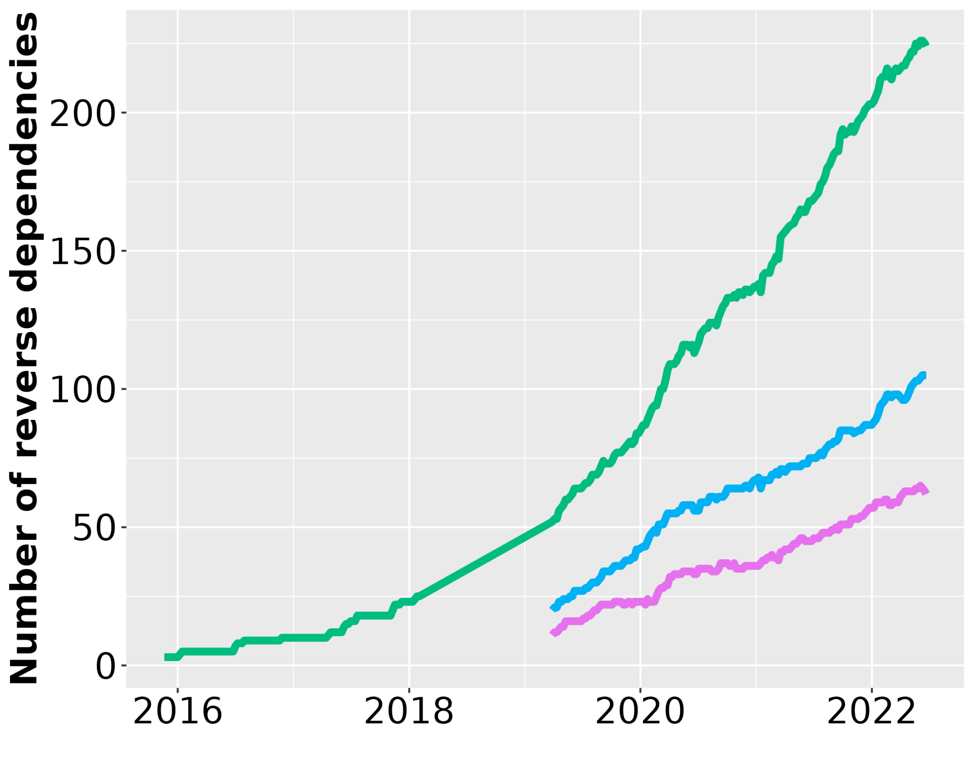
Rapid uptake & top-1% most downloaded
future
future.apply
furrr

Slide 5
Quick Examples of Parallelizing with Futures

Slide 6
60s: Evaluate R in the Background
# sequentially
x <- 7
y <- slow(x) # ~ 1 minute
z <- another(x) # ~ 0.5 minute
# in parallel
library(future)
plan(multisession) ‎
f <- future(slow(x)) # ~ 1 minute (in background) ‎
z <- another(x) # ~ 0.5 minute
y <- value(f) # => all done ~ 1 minute ‎

Slide 7
60s: Parallel Base-R Apply
# sequentially
x <- 1:20
y <- lapply(x, slow) # ~ 20 minutes
# in parallel
library(future.apply)
plan(multisession) # on 4-core laptop
y <- future_lapply(x, slow) # ~ 5 minutes

Slide 8
60s: Parallel Tidyverse Apply
# sequentially
library(purrr)
x <- 1:20
y <- map(x, slow) # ~20 minutes
# in parallel
library(furrr)
plan(multisession) # on 4-core laptop
y <- future_map(x, slow) # ~5 minutes

Slide 9
60s: User can parallelize anywhere
# sequentially
plan(sequential)
# On the local machine
plan(multisession)
plan(multisession, workers = 2)
# Ad-hoc cluster of local and remote machines
plan(cluster, workers = c(“pi”, “remote.server.org”))
# Via an HPC job scheduler (thousands of workers)
plan(batchtools_slurm)

Slide 10
Futureverse is unique
Exports “globals” automatically, i.e. objects and functions that are needed by parallel workers
Relays output & conditions signaled, i.e. errors, warning, messages, and standard output
Built-in statistically sound random numbers
Near-live progress updates - also from remote workers
You, as a developer, don’t have to think “parallel workers” - just which R expressions to parallelize

Slide 11
Profiling the parallel framework

Slide 12
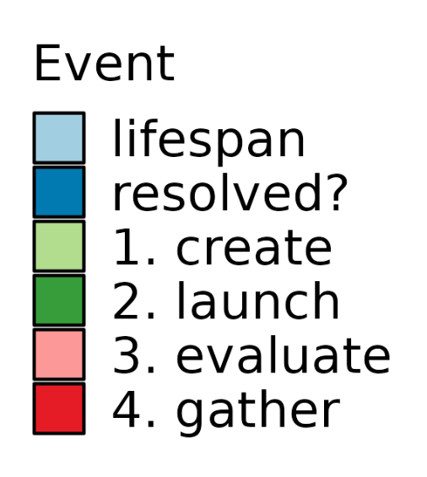
Adding a journaling system
Log events, e.g. creation,
launching, evaluation,
gathering of results
Timing information for now
(memory is tricky)
Work with any parallel backends
Near-zero overhead if not used
Tabular raw data
Textual & graphical presentation

Slide 13
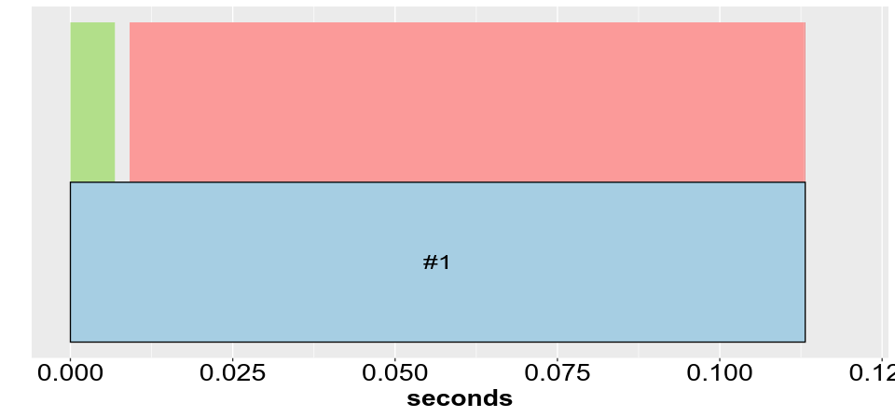
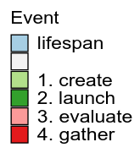
Profiling a sequential future
plan(sequential)
f <- future(slow(1))
v <- value(f)

Slide 14
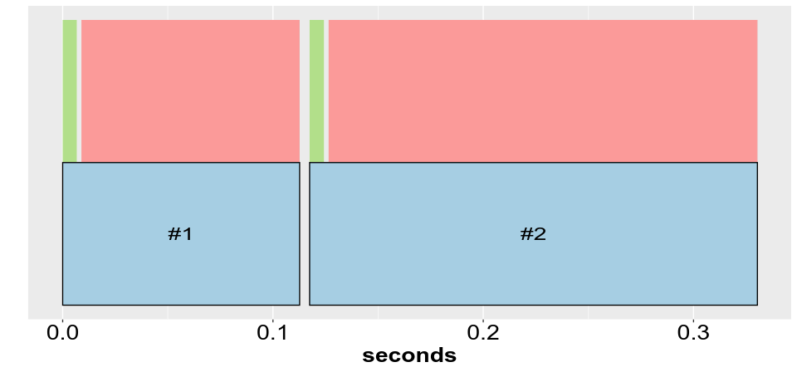
Profiling two sequential futures
plan(sequential)
fs <- lapply(1:2, function(x) future(slow(x))
vs <- value(fs)

Slide 15
Parallelization comes with overhead
Not “overhead”
We care about “evaluation”

Slide 16
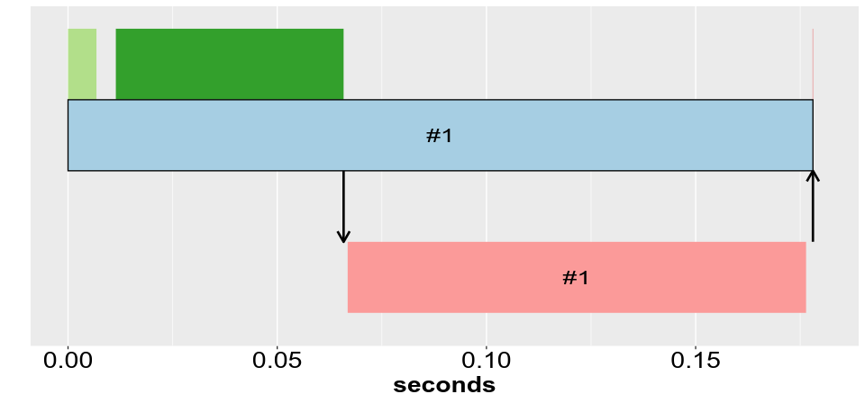
Profiling 1 future with 1 worker
plan(cluster, workers = 1)
f <- future(slow(1))
v <- value(f)
future()
value()

Slide 17
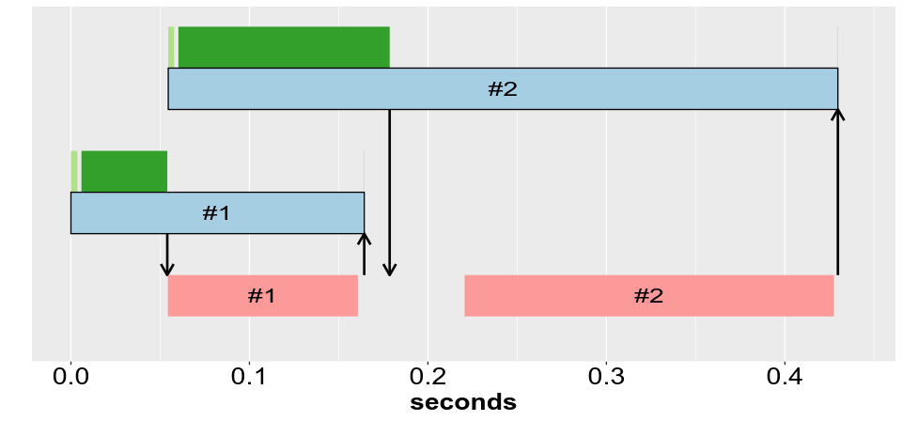
Profiling 2 futures with 1 worker
plan(cluster, workers = 1)
fs <- lapply(1:2, function(x) future(slow(x))
vs <- value(fs)
value()
future()
future()

Slide 18
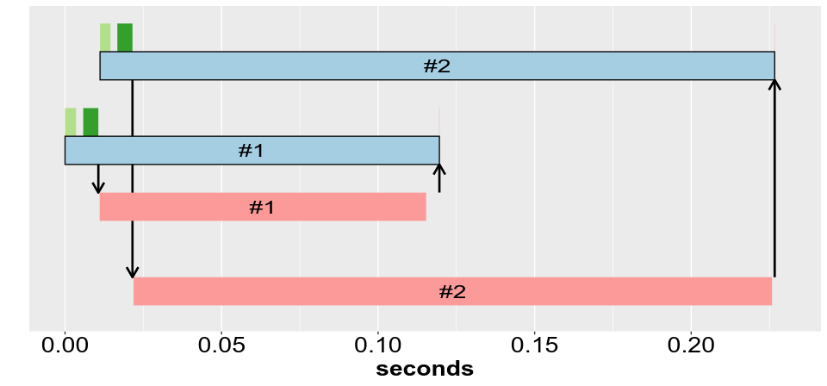
Profiling 2 futures with 2 workers
plan(cluster, workers = 2)
fs <- lapply(1:2, function(x) future(slow(x))
vs <- value(fs)

Slide 19
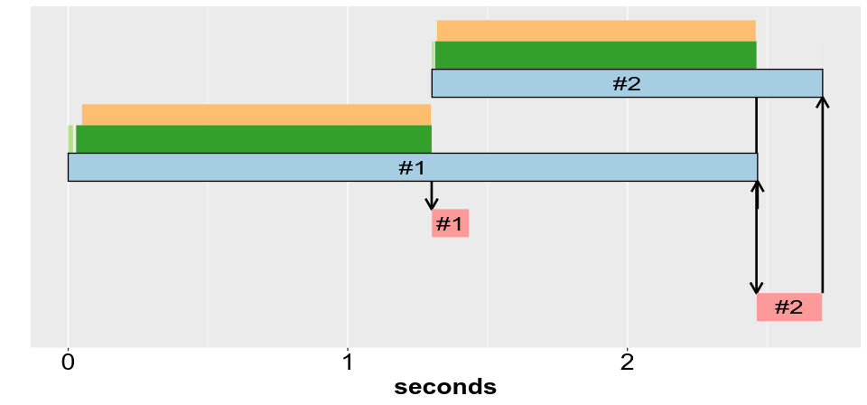
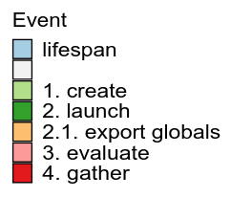
Exporting 800-MB object
plan(cluster, workers = 2); huge <- rnorm(100e6)
fs <- lapply(1:2, function(x) future(slow(x, huge))
vs <- value(fs)
sending data
sending data

Slide 20
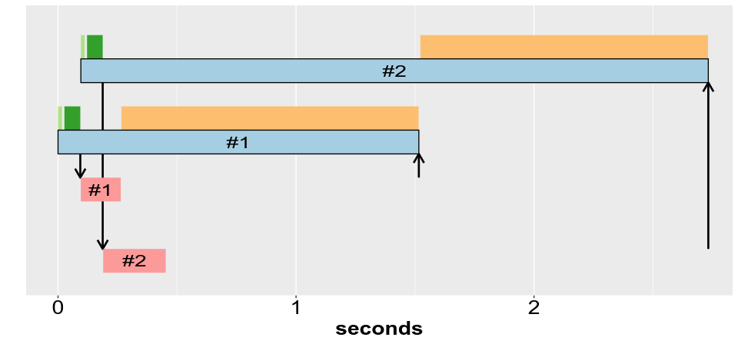
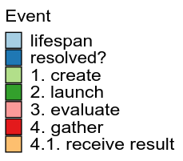
Returning 800-MB object
plan(cluster, workers = 2)
fs <- lapply(1:2, function(x) future(slow_huge_value(x))
vs <- value(fs)
receiving data
receiving data

Slide 21
Profiling ⇒ Improving Futureverse
On the roadmap:
caching of large globals on parallel workers
caching of large globals in a central, shared cache

Slide 22
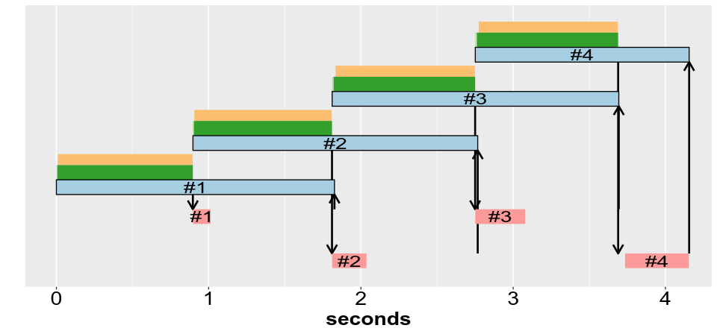
No cache: 800-MB export
plan(cluster, workers = 2); huge <- rnorm(100e6)
fs <- lapply(1:4, function(x) future(slow(x, huge))
vs <- value(fs)
By design: workers
are cleaned up all the time
wipe
wipe
wipe
wipe

Slide 23
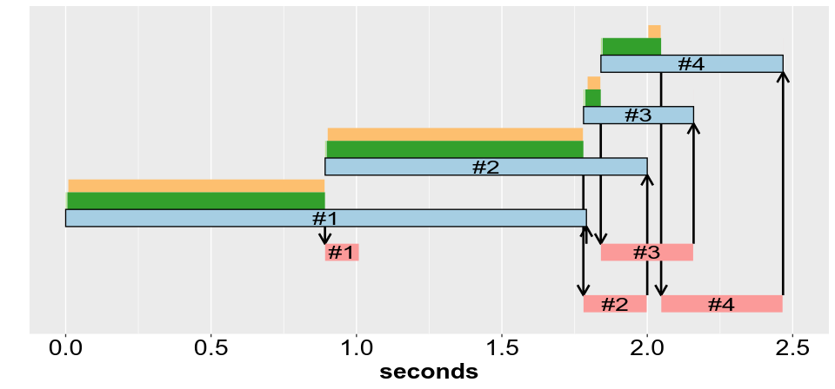
With cache: 800-MB export
already cached on worker

Slide 24
Thank you
More information:
Website & blog: https://www.futureverse.org
CRAN: https://cran.r-project.org/package=future
GitHub: https://github.com/HenrikBengtsson/future
Twitter: @HenrikBengtsson
Sponsored by:
Essential Open-Source Software program of
the Chan Zuckerberg Initiative (CZI EOSS #4)
R Consortium ISC grant (past)

