Slide 1
Categorical Data Analyses:
Logistic Regression & Loglinear Analysis

Slide 2
Overview
Logistic regression
  Binary and multinomial (Ch. 8)
  Examples:
    Predicting life satisfaction and lifestyle
Categorical analysis
  Chi-square & Loglinear analyses (Ch. 18)
  Examples:
    Sex, job satisfaction, and lifestyle (no DV)

Slide 3
Logistic regression
Binary and multinomial
When & why to use logistic regression
  Categorical DVs do not tend to have a linear relationship with predictors
How to assess
  …the model (LLR and deviance)
  …the predictors (OR and CIs)
Assumptions and trouble-shooting
  Assumptions should be checked, and problems should be dealt with
Slide <number>

Slide 4
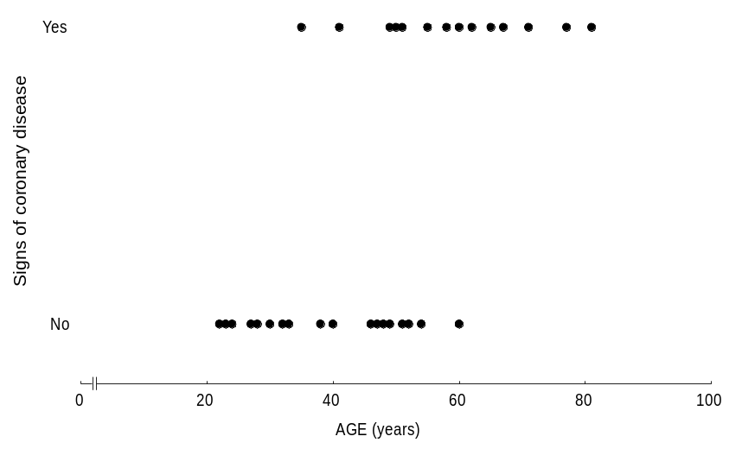
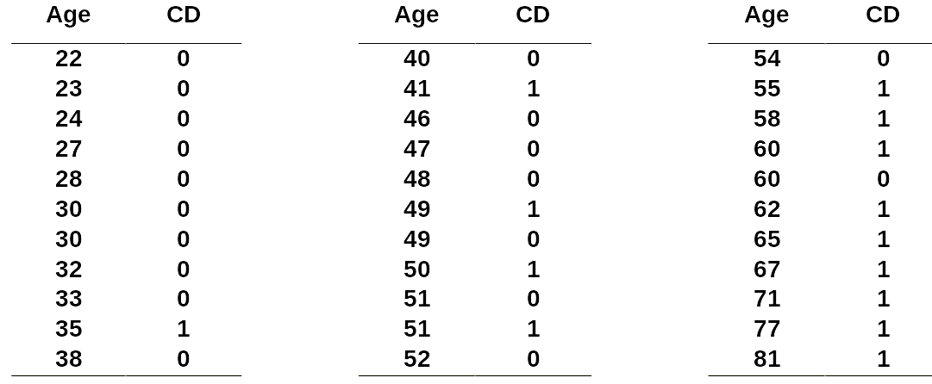
Nonlinear association between age and CD
Toon’s Show
Table 2 Age and signs of coronary heart disease (CD)

Slide 5
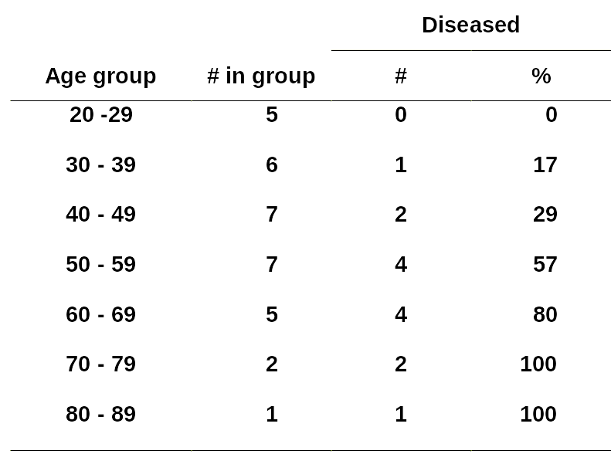
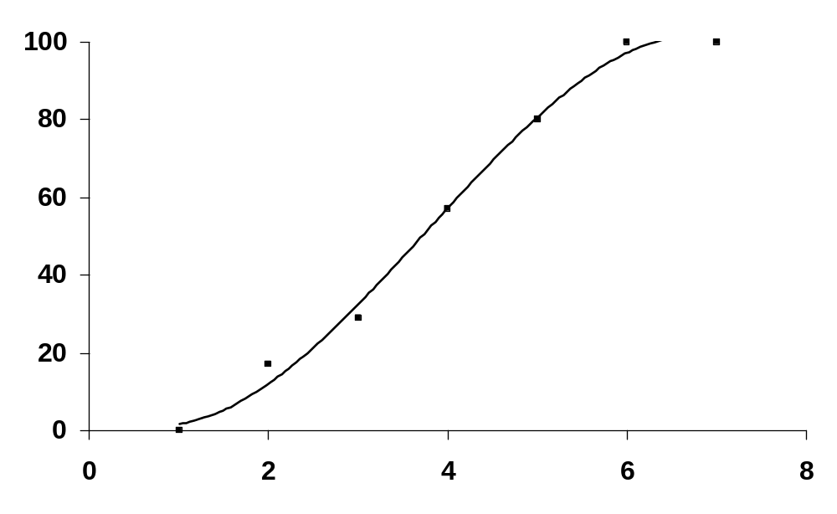
Nonlinear association between age and CD
Toon’s Show
Table 3 Age and signs of coronary heart disease (CD)

Slide 6
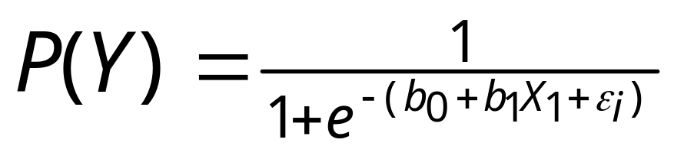
Equation with One Predictor
Toon and Andy Agree?
Toon:
Andy:
Outcome
  Predict the probability of the outcome occurring
a and bx (b₀ and b₁)
  Intercept of entire model; and slope (gradient) associated with individual predictors
Slide <number>

Slide 7
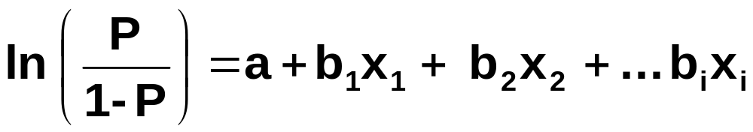
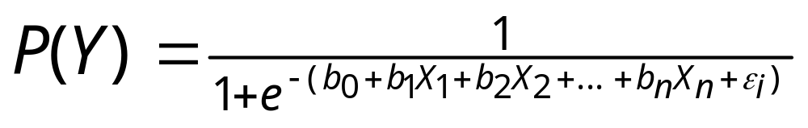
Equation with Multiple Predictors
Toon and Andy Agree?
Toon:
Andy:
Outcome
  We still predict the probability of the outcome occurring
Differences
  This part of the equation expands to accommodate additional predictors
Slide <number>

Slide 8
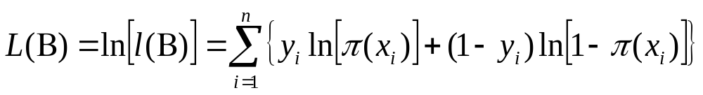
Assessing a Model
The log-likelihood statistic
Toon:
Andy:
N
log
−
likelihood
=
∑
[
ln
(
(
)
)
+
(
1
−
)
ln
(
1
−
(
)
)
]
Y
i
P
Y
i
Y
i
P
Y
i
i
=
1
  Analogous to the residual sum of squares
  It is an indicator of how much unexplained information there is after the model has been fitted.
  Large values indicate poorly fitting statistical models, but values are not comparable.
    Chi-square, AIC, BIC

Slide 9
Assessing Changes in Models
Deviance (a test of parsimony)
Toon:
Andy:
χ
2
=
[
−
]
2
LL
(
new
)
LL
(
)
baseline
(
=
−
)
df
k
k
new
baseline
It is possible to compare the difference (deviance) between the log-likelihoods of nested models.
  null (intercepts only), main effects, higher-order interactions, saturated, etc.

Slide 10
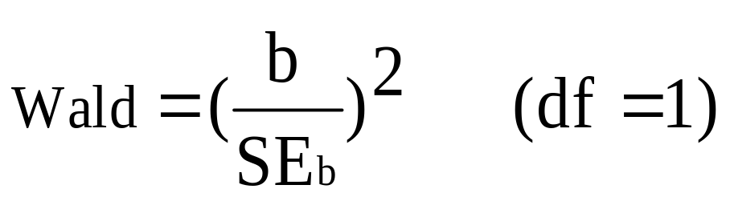
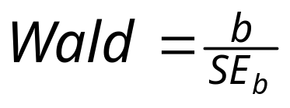
Assessing Predictors
The Wald Statistic
Toon:
Andy:
Toon’s version tested using chi-square; Andy’s version tested using z-distribution
Tests the null hypothesis that b = 0.
Wald statistic is biased when b is large.
  Better to look at odds ratios.
Slide <number>

Slide 11
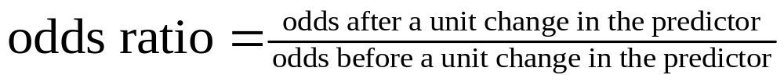
Assessing Predictors:
Odds Ratio
Toon:
Andy:
Indicates the change in odds resulting from a unit change in the predictor.
  OR > 1: Predictor ↑, Probability of outcome occurring ↑.
  OR < 1: Predictor ↑, Probability of outcome occurring ↓.
Slide <number>

Slide 12
Assumptions
Logistic regression
Linearity (in the logit)
  There should be a linear relationship between any continuous predictor and the logit of the outcome
    This can be tested by examining the interaction between the continuous predictor and its log transformation
Independence of errors (observations)
  Durbin-Watson
Absence of multicollinearity, multivariate outliers and influential cases
  VIF, standardized residuals, DFBeta, leverage

Slide 13
R U ready?
Does lifestyle predict job satisfaction similarly for males and females?
Job satisfaction (high/low), lifestyle (dull, routine, and exciting), and sex (female/male)…sound familiar?
  1500 participants, lots of missing values.

Slide 14
Set, Import, and Inspect
setwd("C:/…/Analyzing in R_Stats II_2015")
logex <- read.spss("logreg.sav“,to.data.frame=T)
head(logex)
id age sex satjob educ hours life income
1 1 43 1 2 11 35 2 17
2 2 44 1 2 16 21 3 18
3 3 43 2 1 16 45 3 18
4 4 45 2 2 15 20 0 22
5 5 78 2 NA 17 -1 3 0
6 6 83 1 NA 11 -1 2 0

Slide 15
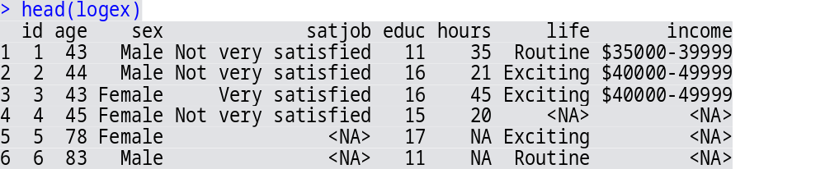
Set, Import, and Inspect
…with value labels
logex <- read.spss("logreg.sav“,to.data.frame=T, use.value.labels = T)
head(logex)

Slide 16
VIM
Visualization and Imputation of Missing values
Install and load
install.packages(“VIM")
library(VIM)
Import data
  Ensure that categorical measures are listed as factors

Slide 17
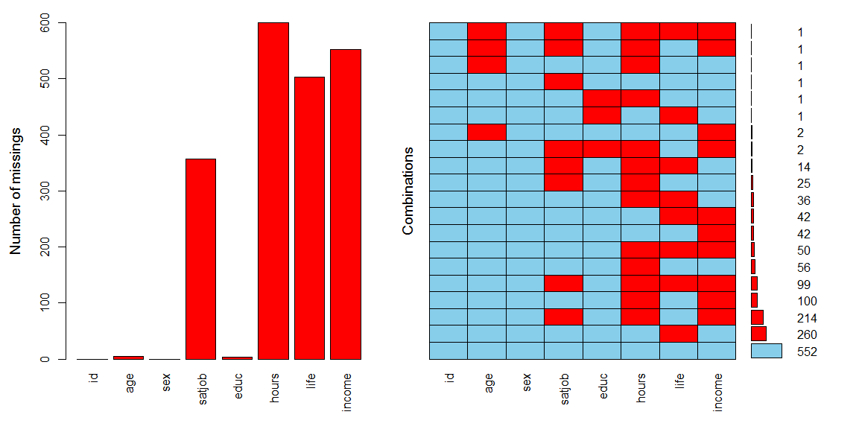
miss<- aggr(logex, numbers = T, prop = F) miss

Slide 18
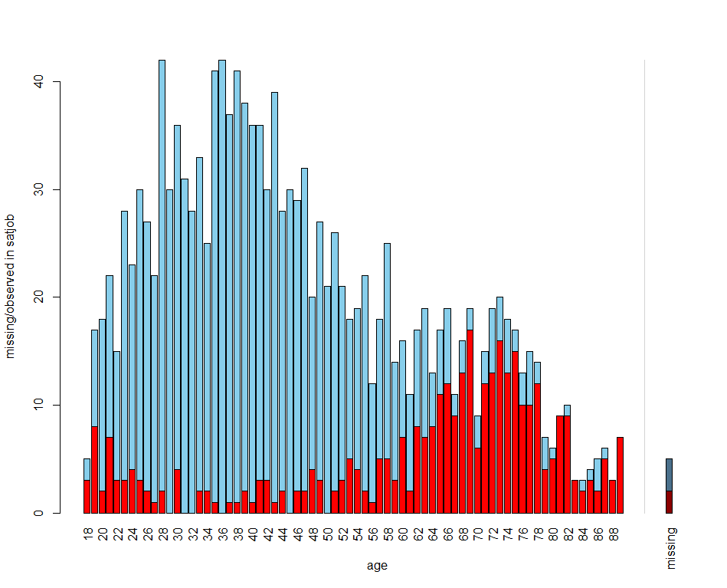
miss2<- logex[ ,c(“age”,”satjob”)] histMiss(miss2)

Slide 19
R U really ready?
Does lifestyle predict job satisfaction similarly for males and females?
Job satisfaction (high/low), lifestyle (dull, routine, and exciting), and sex (female/male)…sound familiar?
  1500 participants, lots of missing values.
I limit the analyses to the 754 participants with all three measures.
  Alternative strategies to dealing with missing values will be addressed in the SEM course.

Slide 20
Extract subset()
Select valid cases and relevant variables
logex1sub<-subset(logex1, satjob != FALSE & life != FALSE, select=c("id", "sex", "satjob", "life"))
Check
head(logex1sub)
nrow(logex1sub)
> head(logex1sub)
id sex satjob life
1 1 Male Not very satisfied Routine
2 2 Male Not very satisfied Exciting
3 3 Female Very satisfied Exciting
7 7 Female Very satisfied Routine
9 9 Male Very satisfied Exciting
10 10 Female Very satisfied Exciting
> nrow(logex1sub)
[1] 754

Slide 21
Extract complete.cases & na.omit
Select relevant variables
logex1 <- logex[,c(1,3,4,7)]
Use complete.cases()
logex1sub2 <- logex1[complete.cases(logex1),]
Use na.omit()
logex1sub3 <- na.omit(logex1)

Slide 22
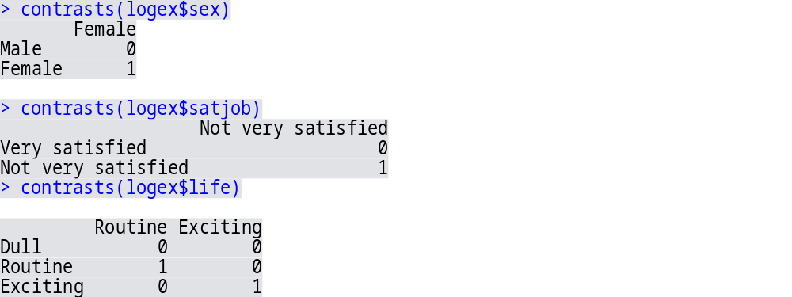
Contrast settings?
More on this next week...
Default is dummy coding
What are the reference groups?

Slide 23
Perform logistic regression
Sex and lifestyle as predictors of job satisfaction
logmodel1 <- glm(satjob ~ sex + life, data = logexsub, family = binomial())
Examine the model diagnostics
  Not the output (yet)!
Note: The default of glm() is listwise deletion, so I could have also simply used the original data file, but…

Slide 24
Diagnostic tests in the car () package
Independence of errors (Durbin-Watson)
dwt(logmodel1)
lag Autocorrelation D-W Statistic p-value
1 -0.01427466 2.027084 0.742
Multicollinearity (VIF)
vif(logmodel1)
GVIF Df GVIF^(1/(2*Df))
sex 1.003113 1 1.001555
life 1.003113 2 1.000777

Slide 25
Model Diagnostics pp 338-341 in FMF
Examine standardized residuals (outliers)
  5% of cases should have residuals > 2, 1% should have residuals > 2.5, and none > 3.
Examine DFBetas (influential cases)
  effect on coefficients after deleting observation
  No values should be above 1
Calculate leverage (influential cases)
  (# predictors + 1) / sample size
  Are any values larger than 2x or 3x this value?

Slide 26
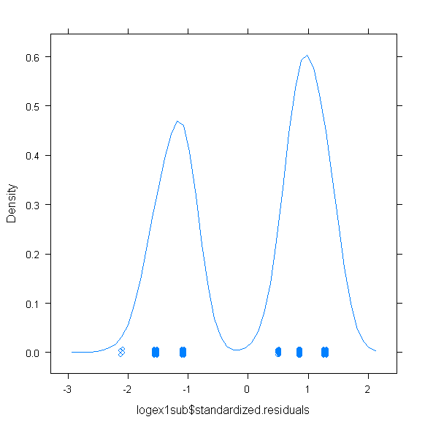
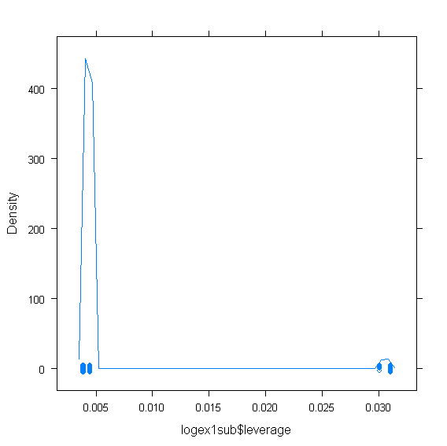
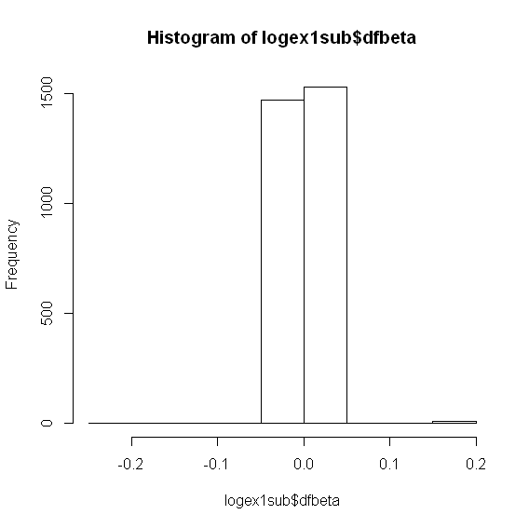
Diagnostic plots
Leverage -> 3/754
[1] 0.00397878
4 participants reporting satisfaction with dull job

Slide 27
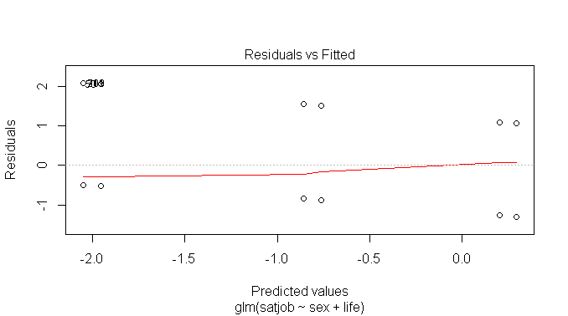
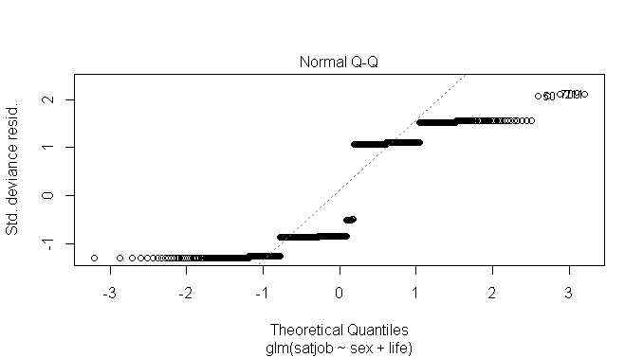
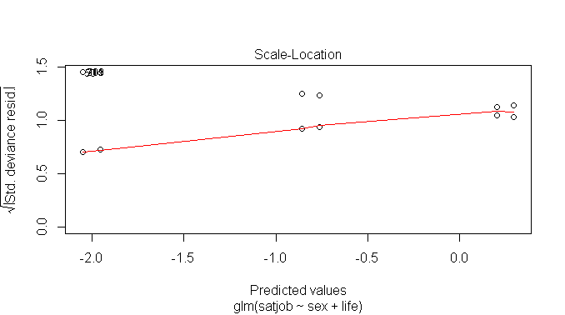
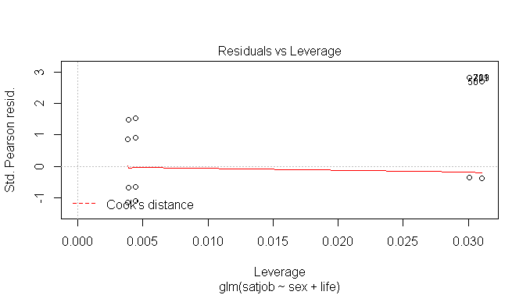
plot(logmodel1)

Slide 28
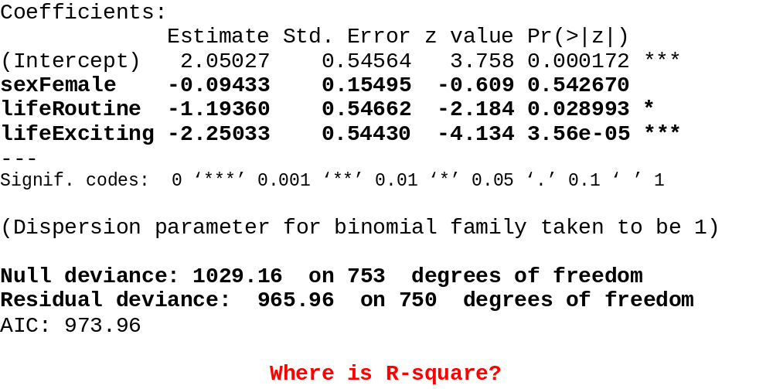
summary(logmodel1)

Slide 29
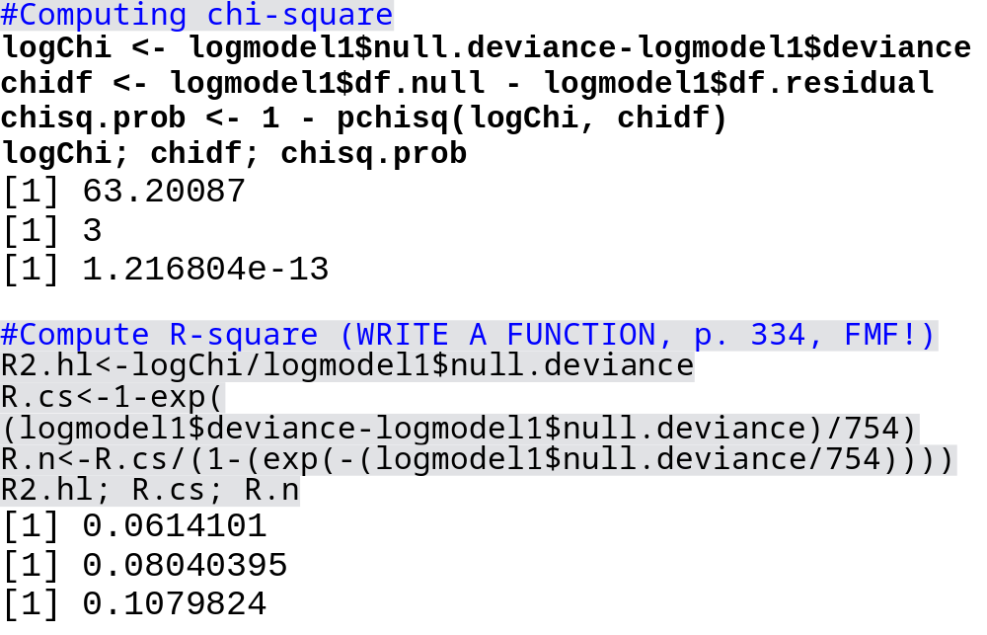
Assess model fit: χ² & R²

Slide 30
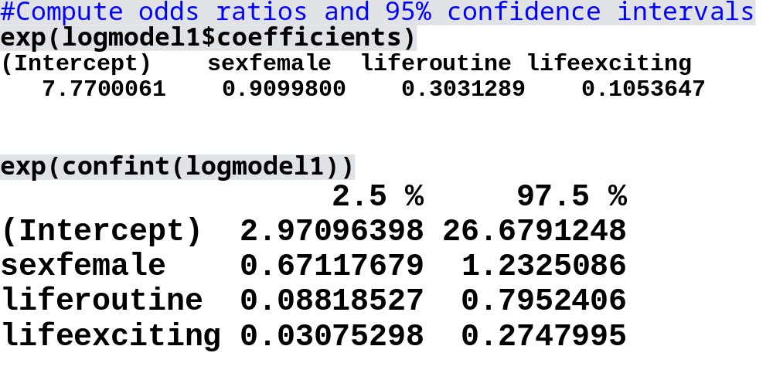
Assess predictors: ORs & CIs
1/.303 = 3.30 1/.105 = 9.52

Slide 31
Do individuals with routine & exciting lifestyles differ on job satisfaction?
relevel
logex$life <- relevel(logex$life, ref = 2)
Perform analysis w/ alternative reference group
logmodel1alt <- glm(satjob ~ sex + life, data = logex, family = binomial())
The reference group is now routine lifestyle
summary (logmodel1alt)

Slide 32
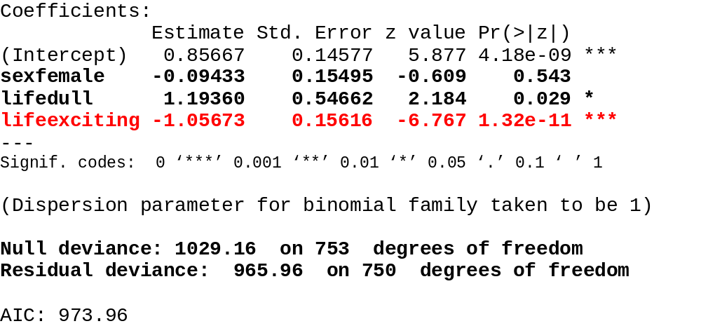
summary(logmodel1alt)

Slide 33
Perform hierarchical regression
Main effects model (previous)
logmodel1 <- glm(satjob ~ sex + life, data = logex, family = binomial())
Interactional model
logmodel2 <- glm(satjob ~ sex * life, data = logex, family = binomial())
summary(logmodel2)

Slide 34
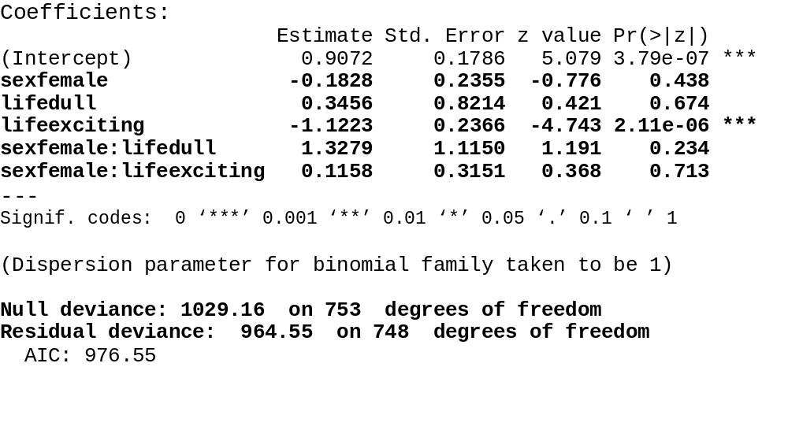
summary(logmodel2)

Slide 35
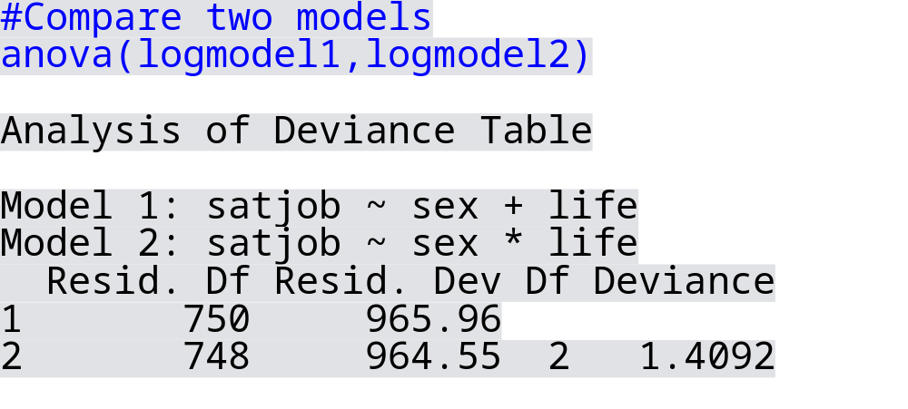
Model Comparison
Parsimony rules!
> logChi1; chidf1; chisq.prob1
[1] 1.409211
[1] 2
[1] 0.4943036
ns, interactions did not
significantly contribute

Slide 36
Multinomial logistic regression

Slide 37
Multinomial logistic regression
A simple extension?
Multinomial logistic regression can be used when the DV has 3 or more unordered categories.
Has same assumptions as binary logistic regression, plus…
  IIA (Independence of Irrelevant Alternatives)
    The odds of choosing A over B should not depend on whether some other alternative C is present or absent.
    Hausman-McFadden test (1984) Small-Hsiao test (1985)

Slide 38
Multinomial logistic regression
Restructure and perform
Several packages can be used to perform multinomial logistic regression models (multinom, mlogit, mnlogit, vgam)
mlogit() is most flexible, but requires data to be in “its own” long format.
  mlogit.data creates new data frame referencing the outcome variable
newDataFrame<-mlogit.data(oldDataFrame, choice = “outcome”, shape = “wide”)

Slide 39
Install and Load
install.packages("mlogit")
# necessary for multinomial logistic regression
install.packages("car")
“Companion for Applied Regression”
library(car)
library(mlogit)

Slide 40
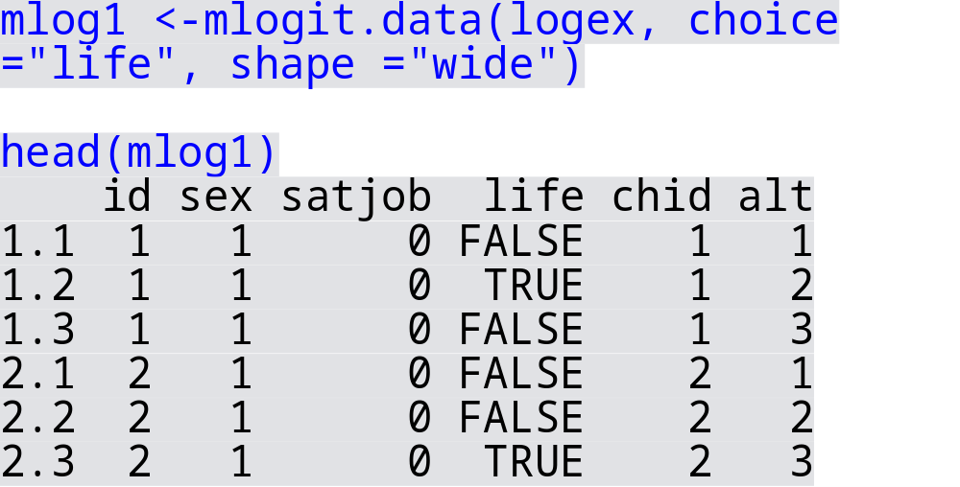
Long format

Slide 41
Perform multinomial logistic regression
Sex and job satisfaction as predictors of lifestyle
mlogmodel1<-mlogit(life ~ 1 | sex + satjob, data = mlog1, reflevel = 1)
Diagnostics not straightforward☹
  Best option? Examine/evaluate diagnostics from all possible binary logistic regression models
    In this case, 3 binary logistic regressions
…examine the output
summary(mlogmodel1)

Slide 42
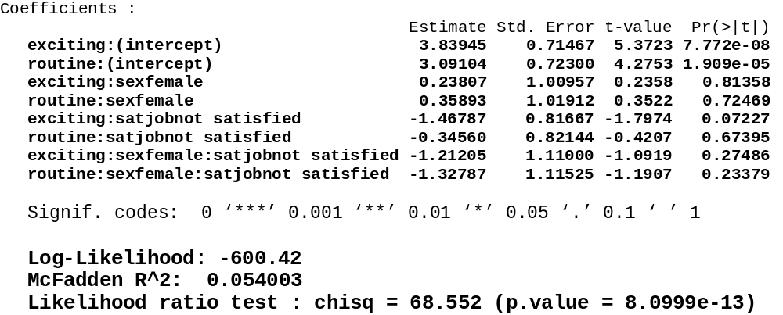
summary(mlogmodel1)

Slide 43
Perform regression again with alternative reflevel
mlogmodel2<-mlogit(life ~ 1 | sex + satjob, data = mlog1, reflevel = 2)
Examine the output
summary(mlogmodel2)

Slide 44
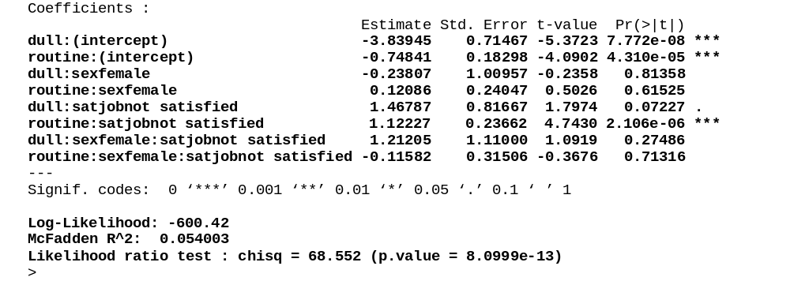
summary(mlogmodel2)
OR = 3.07

Slide 45

Summary
Logistic regression
Evaluating models & estimates
  Chi-square determines model fit; LLR (deviance) used for model comparisons; ORs and CIs used to assess individual predictors
Assumptions/Diagnostics
  Fewer than MLR (multiple linear regression), but it is still an important issue to check a-priori and to potentially deal with post-hoc
    Multinomial logistic regression = piecewise
Some new concepts (R functions), but a high degree of consistency with MLR

Slide 46
Chi-square and Loglinear Analyses

Slide 47
No DV? No Problem!
Chi-square (bivariate)
Loglinear analyses (multivariate)
  Assumptions, contingency tables, model comparisons (backward elimination)
Example
  Job satisfaction, lifestyle, and sex
Slide <number>

Slide 48
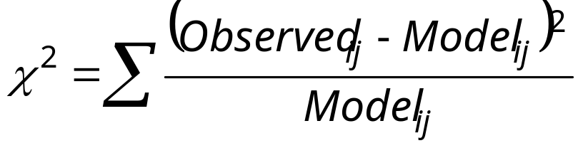
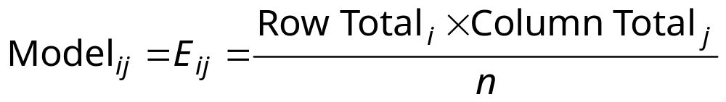
Pearson’s Chi-Square Test
Andy:
The ‘model’ is based on ‘expected frequencies’.
  Calculated for each of the cells in the contingency table.
  n is the total number of observations.
Test statistic
  Checked against a distribution with (r − 1)(c − 1) degrees of freedom.
  The test distribution is approximate so in small samples use Fisher’s exact test.

Slide 49
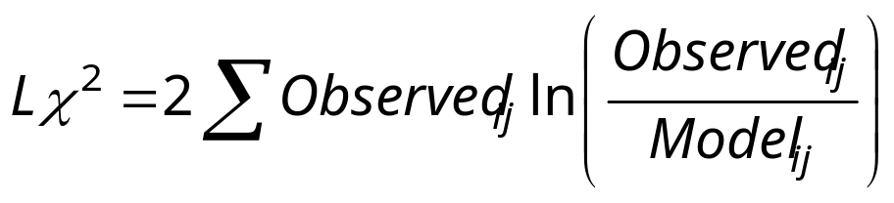
Likelihood Ratio Statistic
Andy:
An alternative to Pearson’s chi-square,
  based on maximum-likelihood theory.
  Creates an “optimal” model (probability of obtaining the observed set of data is maximized), and this model is compared to the probability of obtaining those data under the null hypothesis
Test statistic
  Has a chi-square distribution with (r − 1)(c − 1) degrees of freedom.
  Preferred to the Pearson’s chi-square when samples are small.

Slide 50
Statistical Assumptions
No distributional assumptions, but there are a few things to watch out for…
Independence of observations:
  All cases contribute equally (once): N = # of cases
  Same as MLinR and MLogR
Ratio of cases to variables
  5x the # of cases to cells in the design
Adequacy of expected values
  All expected values are >1 & 80% >5

Slide 51
R U ready?
How are lifestyle, job satisfaction, and sex associated?
Job satisfaction (high, low, lifestyle (dull, routine, and exciting), and sex (female, male)…sound familiar?
  1500 participants, lots of missing values.
I limit the analyses to the 754 with all three measures.

Slide 52
Install and Load
install.packages("gmodels")
install.packages("MASS")
library(gmodels)
library(MASS)

Slide 53
χ² = CrossTable()
Options, options, options…
Default (Χ²)
CrossTable(logex$satjob, logex$life, chisq = TRUE)
Add and suppress statistics (sresid)
CrossTable(logex$satjob, logex$life, chisq = TRUE, expected = TRUE, prop.c = FALSE, prop.r = FALSE, prop.t = FALSE, prop.chisq = FALSE, sresid = TRUE, format = "SPSS")
Add and suppress statistics (asresid)
CrossTable(logex$satjob, logex$life, chisq = TRUE, expected = TRUE, prop.c = FALSE, prop.r = FALSE, prop.t = FALSE, prop.chisq = FALSE, asresid = TRUE, format = "SPSS")

Slide 54
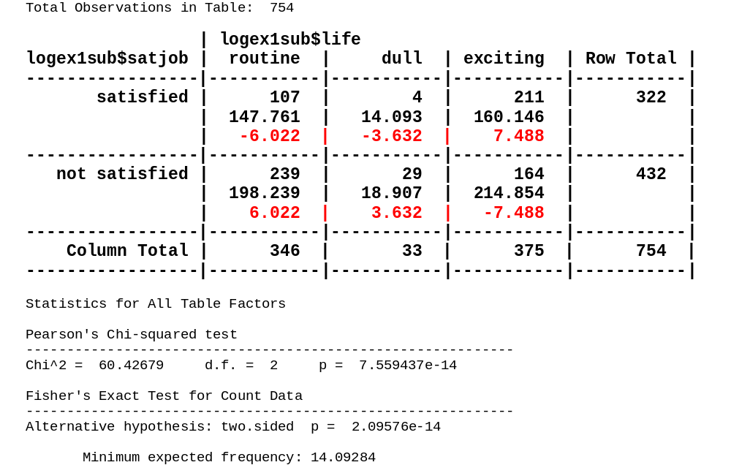
CrossTable

Slide 55
Hierarchical loglinear analysis
Start with saturated model, and eliminate nonsignificant parameters until the most parsimonious model is identified.
  Sometimes easier said than done…
Requires contingency table
  xtabs()
Requires model comparisons
  anova()
Requires subsequent post-hoc analyses
  CrossTable()

Slide 56
Step 1: Create Contingency table
xtabs(~ classifying variables, data.frame)
llinx<-xtabs(~ satjob + life + sex, data = logex1sub)

Slide 57
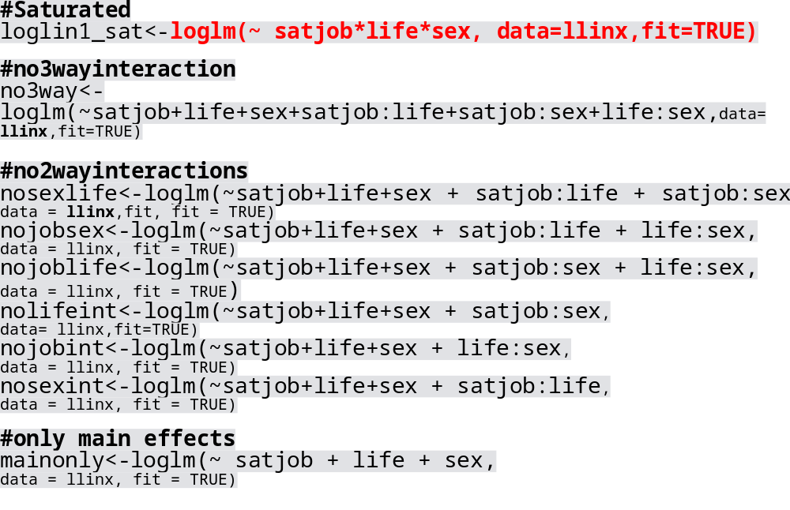
Step 2: Specify Models

Slide 58
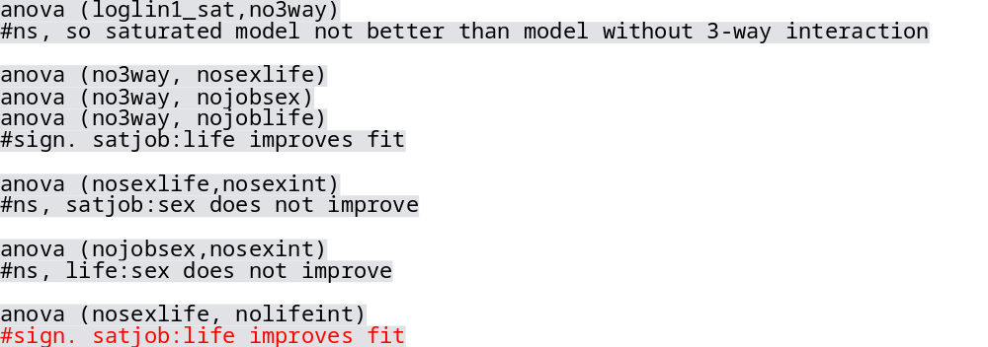
Step 3: Compare models anova ()…for nested models
Most parsimonious model:
satjob:life + main effects

Slide 59
Step 4: Post-hoc contingency tables
Create subsets
table(logex1sub$satjob, logex1sub$life, logex$sex)
xtabs(~sex + satjob + life, data = logex)
justmales = subset(logex1sub, sex ==“male")
justfemales = subset(logex1sub, sex ==“female")
Perform chi-square
CrossTable(justmales$satjob, justmales$life, asresid = TRUE, prop.t=FALSE, prop.r=FALSE, prop.c=FALSE, prop.chisq=FALSE, format = "SPSS")

Slide 60
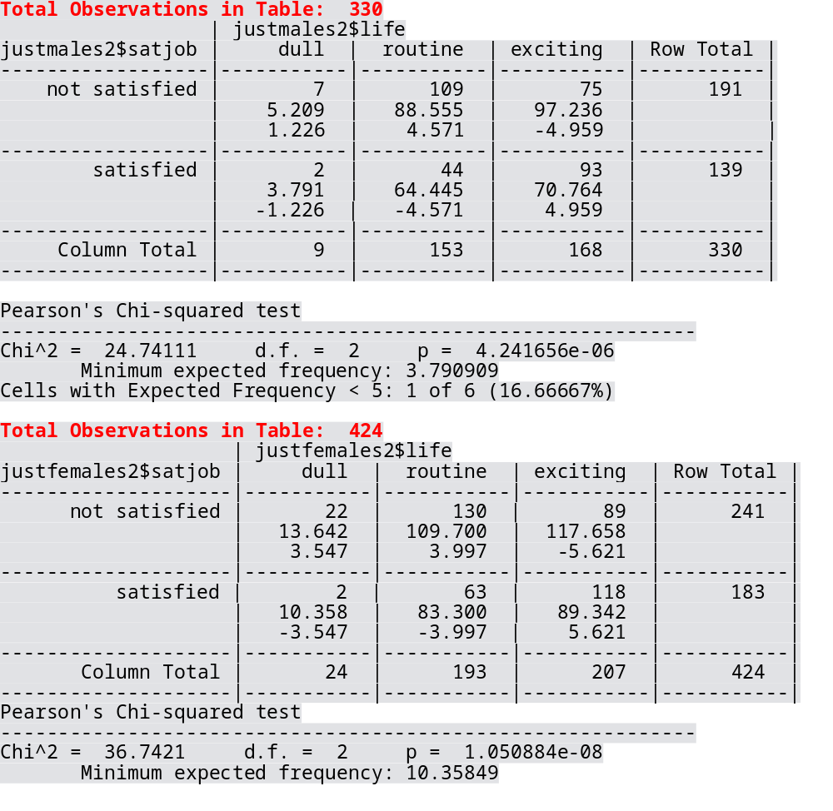
Life:Satjob
Males
Females

Slide 61
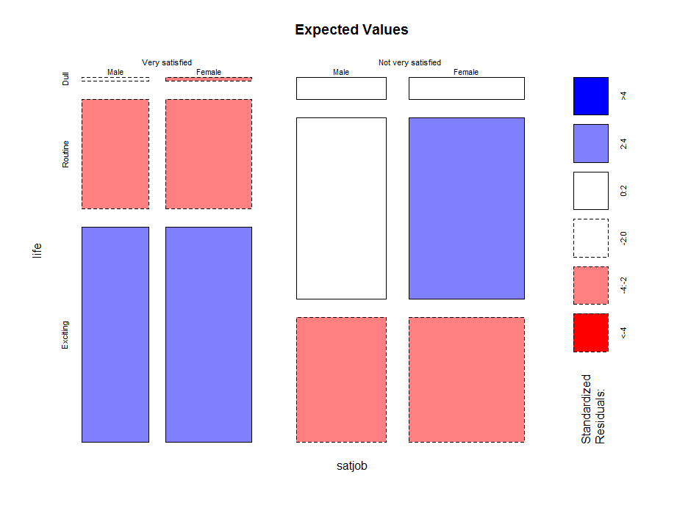
Mosaic plot mosaicplot(nosexint$fit, shade = TRUE, main = "Expected Values")
Red is negative (less likely); Blue is positive (more likely)

Slide 62
Summary
Loglinear analyses
Hierarchical analyses require several steps
  Objective: Identify most parsimonious model
Post-hoc analyses
  Chi-squares and mosaic plots
Raw data and contingency tables
  The latter requires a bit more “Runderstanding”

