Slide 1
SQL Project
Henrik Söder & Tiago Mateus

Slide 2
Project Overview
Analyze &Cleaning
Questions
Answers
SQL connection
Notes:
Analyze the code and Data Cleaning;
Populate our sample;
Formulate our questions;
Build the diagram relationships and create our SQL DB;
Answer our questions;

Slide 3
Questions
What is the USP for Ironhack? Does the job guarantee badge make a difference in the users rating for job support after the course?
How did the number of comments at Ironhack evolve?
Are Ironhack’s students getting more satisfied over the years ?

Slide 4
Technical Process & Challenges
Libraries imported: pandas, regex and requests.
Data cleaning: dropped a table columns, rows and cleaned it's values.
Challenge: assigning primary and foreign keys on SQL.

Slide 5
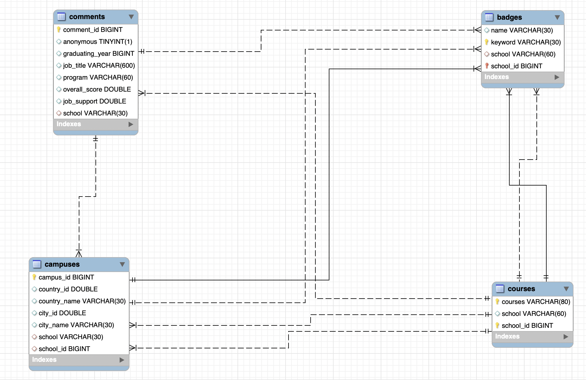

Slide 6

Conclusion & Insights
Available online
Flexible classes
Verified outcomes
Notes:
What is the USP for Ironhack? Does the job guarantee badge make a difference in the users rating for job support after the course?
we understood that what can distinguish ironhack from other schools might be found on the badges /features it has: available online, flexible classes and verified outcomes.
So what does ironhack doesnt have that other do? What is it missing?

Slide 7
Conclusion & Insights
Ironhack | 4,69 | -
App-academy | 4,5 | Job Guarantuee
Designlab | 4,26 | Job Guarantuee
springboard | 4,51 | Job Guarantuee
Notes:
So we questioned the importance of the Job guarantee badge and deepdived into it.
Job guarantee only provides a refund if your not provided with a job, but even tho ironhack does not have badge the students are more happy about the job support than on all of the other schools
This means that the job guarantee badge is not important at all for the result of the job search

Slide 8
Comments per year
of ironhack
Notes:
The next question regarded the total amount of comments, where we can see a big decrease in 2018. Another decrease happend in 2020 where we can assume that this is caused by the covid 19 pandemic. Since we now have an overview for all the comments we wanted to know how happy thoose students were about the year

Slide 9
Overall score per year
of ironhack
Notes:
As we can see we have a decrease in the overall experience rating of the students at 2021.

Slide 10
Overall score per year
of ironhack
Notes:
Looking at the trendline we can see that the prediction for the next two years is not looking good so we wanted to find out what was the issue for the unhappyness of the students. After deepdiving into the year 2021 we found out that a specific person startet his work at ironhack at this year.

Slide 11

Overall score per year
of ironhack
Notes:
FRED ! After he startet his work in 2021 we have a huge increase of unhappy students at ironhack

Slide 12
Overall score per year
after fred starter to work
0,5
Notes:
Only looking the years he worked at ironhack we can see that the overall score dropped by about 0,5 points.

Slide 13
Percentage of anonymous students
at ironhack
Notes:
Furthermore we wanted to find out more about the percentege of sutdents that wanted to stay anonymous at their feedback comments. Comparing this again with fred we can see

Slide 14
Percentage of anonymous students
at ironhack
83%
Notes:
Comparing this again with fred we can see that after he started working there was a increase of 83!!!!% for students that want to stay anonymous.
After wsn

Slide 15
Questions
What is the USP for Ironhack? Does the job guarantee badge make a difference in the users rating for job support after the course?
How did the number of comments at Ironhack evolve?
Are Ironhack’s students getting more satisfied over the years ?
Is fred the reason for ironhack students unhappyness ?
Notes:
After considering the awnsers of the questions we will present our results to diogo later on and he will decide how to procceed with fred

Slide 16
Fred’s Disgrace
Thanks everyone!
Henrik Söder & Tiago Mateus

