Slide 1


SABRE: An uncertainty-aware semantic–behavioural–knowledge triage framework for adaptive ransomware detection
Presented by Henry Kabuye
Principal Supervisor: Dr Biju Issac
Secondary Supervisor: Dr Neera Jeyamohan

Slide 2
SABRE
Semantic
Detector
An uncertainty-aware multi-agent semantic–behavioural–knowledge triage framework for adaptive ransomware detection
Behavioural
Detector
Combines semantic, behavioural, and knowledge detectors
Uses Monte Carlo Dropout uncertainty in the decision process
Supports AUTO-CONTAIN, ESCALATE, and ALLOW triage actions
Knowledge
Detector
Decision
Layer
Risk + uncertainty → action

Slide 3
Agenda
1
Problem
Why ransomware detection needs uncertainty-aware decision support
2
Framework
How SABRE combines three detectors with a score-level triage layer
3
Data & evaluation
RDset and RanSMAP as complementary semantic and behavioural settings
4
Results
Detection, calibration, and policy behaviour
5
Explainability
Feature importance and semantic counterfactuals
6
Takeaways
Operational contribution, limitations, and next steps

Slide 4
Why this problem matters
Operational ransomware defence is not just classification; it is a decision problem.
Challenge
Risk of standard ML
SABRE idea
Ransomware evolves through polymorphism, obfuscation, and behavioural drift.
Static or behavioural evidence can be uneven in quality across samples.
Point predictions alone do not tell us when autonomous action is safe.
Aggressive thresholds risk false positives and unnecessary containment.
Conservative thresholds push too much work to analysts.
Out-of-distribution behaviour can make confidence misleading.
Use uncertainty as an operational control variable
High risk + low uncertainty → AUTO-CONTAIN
High risk or high uncertainty → ESCALATE
Otherwise → ALLOW

Slide 5
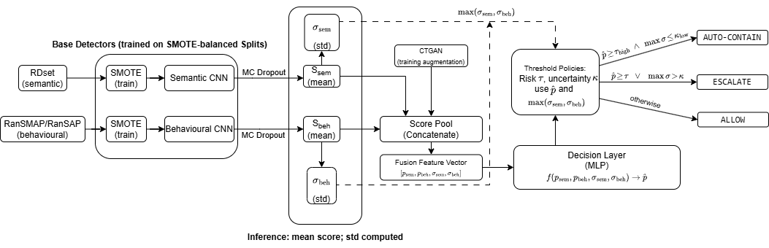
SABRE framework
CTGAN augments the score space used by the decision layer; SMOTE addresses feature-level class imbalance.

Slide 6
Datasets and evaluation setup
Semantic setting
Behavioural setting
Knowledge setting
RDset
RanSMAP / RanSAP
MITRE ATT&CK + threat intel features
23-dimensional feature vector
Trained on labelled ransomware TTPs
138,047 PE samples with 57 structured static attributes
Attributes encoded into text-like strings and embedded
Used to train the semantic detector
Hypervisor-level storage and memory activity windows
Sliding-window statistics: variance, entropy, access counts
Used to train the behavioural detector
Adaptive T
SMOTE
CTGAN
MLP
MC Dropout (converges, max T=50)
Feature-level balance
Score-space augmentation
Decision layer

Slide 7


Uncertainty-aware triage policy
Core rules
AUTO-CONTAIN If and
ALLOW
AUTO-
CONTAIN
ESCALATE if
Uncertainty k
ALLOW otherwise
ALLOW
ESCALATE
Axis-aligned thresholds preserve interpretability and auditability.
Max uncertainty ensures either detector can veto autonomous action.
Main deployment goal: conservative routing of ambiguous cases.
Risk t

Slide 8
Per-agent performance (balanced eval)
Accuracy
The semantic setting is almost perfectly separable on RDset.
The behavioural detector scores 0.6209 AUC on balanced RanSMAP (0.5680 acc); the knowledge agent achieves 0.9953 AUC on RansKnow.
This asymmetry motivates uncertainty-aware triage: the knowledge agent provides strong complementary signal when behavioural evidence is ambiguous.
AUC
1.0000
1.0000
0.5680
RDset accuracy
RDset AUC
RanSMAP acc (balanced)
0.9650
0.6209
0.9953
RansKnow accuracy
RanSMAP AUC
RansKnow AUC

Slide 9
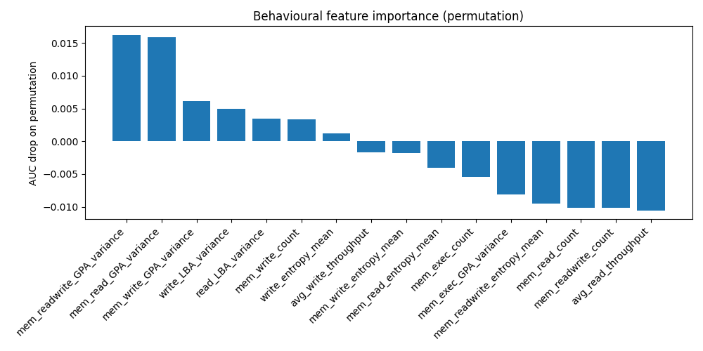
Permutation-based feature importance for the behavioural detector, measured as the drop in AUC after permuting each feature independently. Variance- and entropy-driven memory access statistics dominate, indicating that behavioural discrimination relies on irregularity patterns rather than raw activity volume.

Slide 10
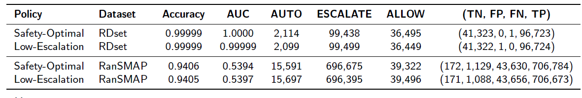
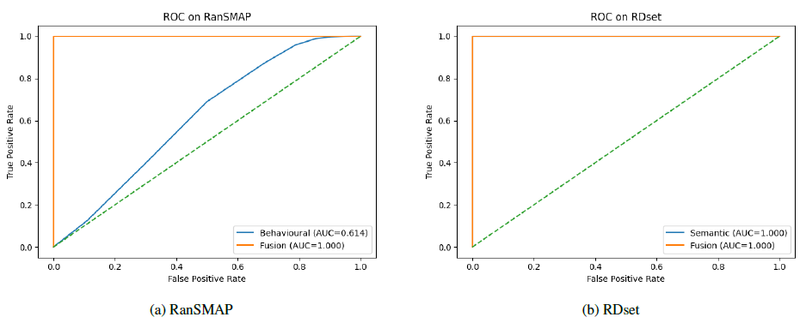
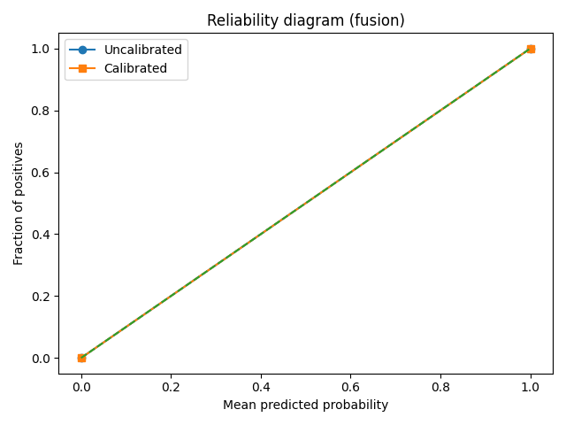
ROC curves for the evaluated settings. Left: RanSMAP, where behavioural signals are difficult to separate and decision-layer performance remains modest. Right: RDset, where the semantic detector already saturates and near-perfect discrimination is preserved.

Slide 11
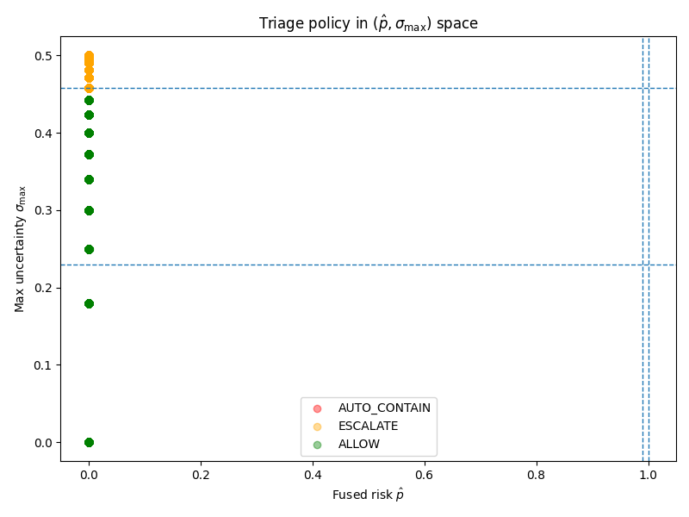
Triage policy geometry in the (𝑝̂, 𝜎max) space. Horizontal and vertical thresholds correspond to the analytical decision
rules partitioning the space into ALLOW, ESCALATE, and AUTO-CONTAIN regions. Uncertainty
acts as a stabilising control variable, limiting overconfident automatic containment.

Slide 12
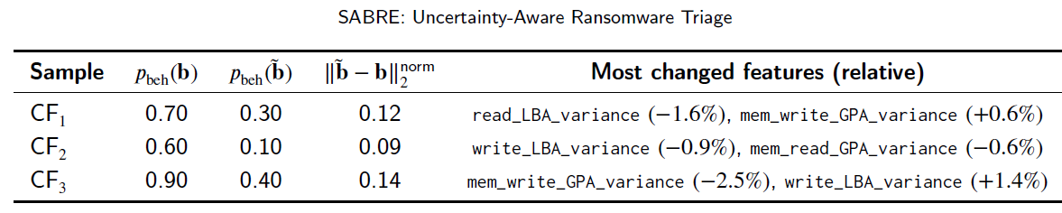
Explainability: what drives the detectors?
Behavioural detector
Semantic detector
Permutation importance highlights dispersion-related telemetry features.
Most influential examples: read/write LBA variance and memory GPA variance.
Counterfactuals show only small relative changes can push a high-risk sample below the target threshold.
Interpretation: the model relies on irregularity patterns rather than raw activity volume.
Gradient saliency highlights embedding directions tied to entropy and PE structural irregularities.
Permutation importance in latent space is consistent with gradient magnitude patterns.
Across 50 borderline-malicious samples, semantic counterfactuals flipped labels with small perturbations.
Mean counterfactual norm: 3.27; observed flip success: 100% in the evaluated sample set.
Representative behavioural counterfactuals
3.27
0.49
100%
Mean $||Delta z||_2$
Target threshold
Flip success
Counterfactual norms describe local sensitivity, not formal adversarial robustness guarantees.

Slide 13
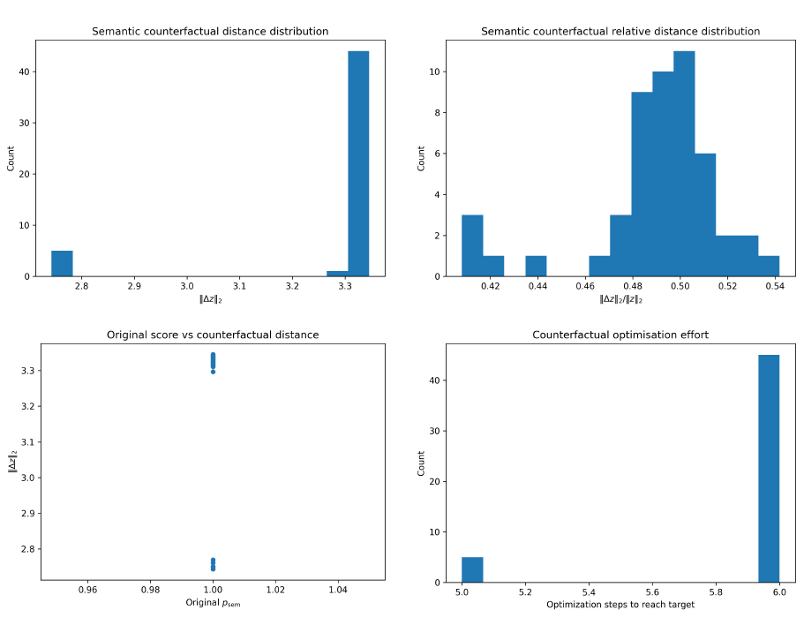
Semantic counterfactual diagnostics for 𝑁 = 50 borderline-malicious samples. (Top-left) Distribution of counterfactual
distance ‖Δ𝑧‖2. (Top-right) Distribution of relative distance ‖Δ𝑧‖2∕‖𝑧‖2. (Bottom-left) Relationship between original semantic score 𝑝_sem and ‖Δ𝑧‖2. (Bottom-right) Optimisation steps required to reach the target 𝜃 = 0.49.

Slide 14
Main contribution, limitations, and future work
Main contribution
Limitations & next steps
SABRE’s practical value is a transparent uncertainty-aware decision process that links predictive risk to analyst escalation and automated response.
RDset and RanSMAP are complementary, not matched multimodal views.
Adaptive MC Dropout (convergence-based T, max T=50) mitigates fixed-T bias; static T=10 available for reproducibility.
Counterfactuals are continuous-space explanations, not executable attack transformations.
Future work: matched multimodal datasets, richer behavioural models, broader threshold stability analysis.
Works especially well when evidence quality differs across detectors.
Supports selective automation instead of all-or-nothing autonomous action.
Makes uncertainty operational rather than merely descriptive.
Bottom line
The triage layer is modular and can be recalibrated or upgraded without redesigning the whole system.

Slide 15
Thank you
Questions?
SABRE combines semantic, behavioural, and knowledge evidence with uncertainty-aware triage.
Its strongest contribution is not uniform accuracy gains, but safer decision routing under uneven evidence quality.
That makes it practically relevant for ransomware response settings where incorrect automation is costly.
Suggested discussion prompts
Why use uncertainty in the triage layer instead of only for calibration?
How would SABRE change with matched static + runtime datasets?
What would make the behavioural component stronger in future work?

