Slide 1




Agentic SABRE
An Uncertainty-Aware Multi-Agent Framework for Adaptive Ransomware Detection
Henry Kabuye · PhD Student · Northumbria University
Principle Supervisor: Dr. Biju Issac
Secondary Supervisor: Dr. Neera Jeyamohan
Semantic · Behavioural · Knowledge agents — Decision MLP — Triage Policy
NEW: Per-Agent Peer Consultation + Expert Feedback Loop
LinkedIn

Slide 2
Agenda
1
Problem
Why ransomware detection needs an Agentic approach
2
Framework
How SABRE combines two detectors with a score-level triage layer
3
Data & evaluation
RDset and RanSMAP as complementary semantic, behavioural and Discourse settings
4
Results
Uncertainty-Aware Triage Policy Results
5
Peer Consultation & Feedback loop
Inference, Analyst, Feedback Log and Retrain MLP
6
Conclusion & Future work
Operational contributions, limitations, and Future work

Slide 3
Why Ransomware Detection Needs an Agentic Approach
Ransomware is operationally diverse
  Polymorphism, obfuscation and behavioural drift defeat static signatures
  Runtime behaviour is noisy and imbalanced across real deployments
Standard ML gives point predictions — no uncertainty signal
  Aggressive threshold → false positives, unnecessary containment, ops disruption
  Conservative threshold → missed threats, analyst overload
  Out-of-distribution samples make confidence values misleading
Three independent evidence streams: static PE · runtime behaviour · threat intel
  No single modality dominates across all sample types
  Heterogeneous datasets — no matched multi-modal view per executable
SABRE’s answer: fuse all three agents under an uncertainty-aware triage policy that makes uncertainty operational, not merely descriptive

Slide 4
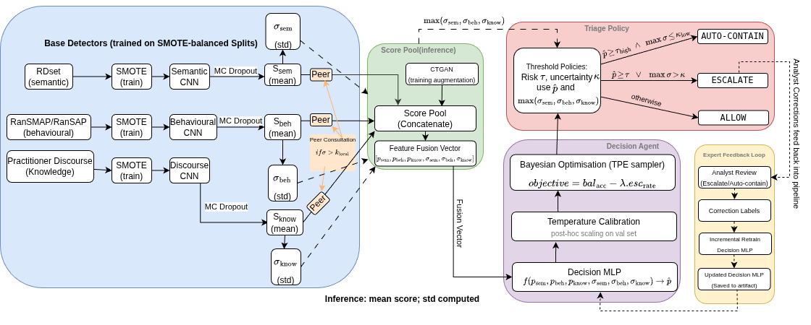
Three Agent Architecture
Semantic (RDset · 138K PE) · Behavioural (RanSMAP · 2K telemetry) · Knowledge (RansKnow · 200 MITRE ATT&CK) → MC Dropout UQ → Peer Consultation → 6-D Score Pool → Decision MLP → TPE Bayesian Optimisation Policy

Slide 5
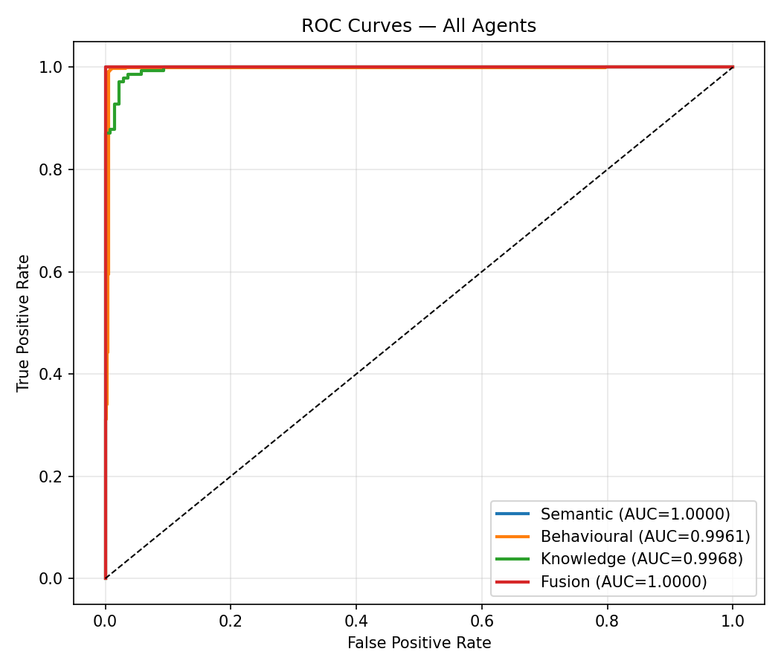
Evaluation Results: Agents & Fused System
Agent | Train N | Natural Acc / AUC | Balanced Acc / AUC | Notes
Semantic | 138,047 | 100.0% / 1.000 | 100.0% / 1.000 | Static PE embeddings (384-D BERT)
Behavioural | 751,588 ‡ | 99.6% / 99.9% | 99.6% / 0.996 | 596:1 imbalance → SMOTE + StandardScaler
Knowledge | 200 | 97.4% / 99.8% | 96.5% / 0.995 | MITRE ATT&CK features (23-D)
Fused System | All | 97.2% bal. acc | 100% TPR / 94.7% prec | 0 false negatives on 4,000-sample eval
99.6 %
Beh. Natural
0.996
Beh. Balanced AUC
‡ 751,588 samples (596:1 imbalance) → SMOTE + StandardScaler; evaluated on 150,318-sample natural-dist test. Balanced col = 1,000 per class (equal split). Fusion: 5.6% FPR (112/2,000 benign), 0 false negatives.
0.995
Know. AUC
97.2 %
Fused Bal. Acc

Slide 6
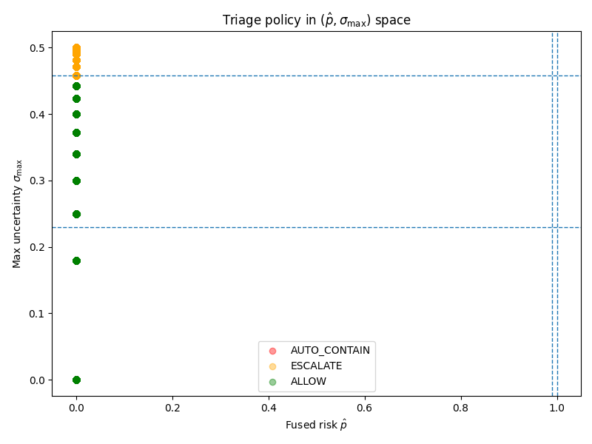
Uncertainty-Aware Triage Policy
AUTO-CONTAIN
ESCALATE
ALLOW
p̂ ≥ τ_high (0.905)
AND σ_max ≤ κ_low (0.195)
p̂ ≥ τ (0.396)
OR σ_max > κ (0.196)
otherwise
High-confidence ransomware:
automated host isolation
Uncertain or suspicious:
route to SOC analyst
Low risk, low uncertainty:
no automated action
Design rationale: max(σ) ensures either agent can veto autonomous action · Axis-aligned thresholds preserve interpretability & auditability · Thresholds tuned by Bayesian optimisation — TPE (Tree-structured Parzen Estimator) via Optuna, 300 trials, objective: balanced accuracy − λ · escalation rate
Policy results (4,000-sample eval): 97.2% balanced accuracy · 100% TPR · 5.6% FPR · 0 false negatives
NEW — Per-Agent Policies: each agent also has its own κ_local threshold; if σ_agent > κ_local the orchestrator triggers peer consultation before fusion

Slide 7
Peer Consultation & Expert Feedback Loop
Feature 1 — Per-Agent Peer Consultation
  Each agent has a κ_local threshold alongside the global triage policy
  If σ_agent > κ_local → orchestrator adjusts p using inverse-uncertainty-weighted scores of self + both peers
  Uncertainty values (σ) are never modified; consulted flag + raw_prob stored per result
  Default κ_local = 1.0 → consultation never fires (backwards-compatible with Crane baseline)
Feature 2 — Expert Feedback Loop
  ESCALATE / AUTO-CONTAIN results carry a UUID sample_id for analyst tracking
  Analysts submit corrections via the ‘Feedback’ tab in the live dashboard
  Corrections stored in append-only JSON log (timestamp, scores, σ, expert label, reasoning)
  When N ≥ 20 corrections: ‘Trigger Retrain’ enabled — incremental MLP retrain with 3× upweighted feedback rows
  Operator promotes updated model manually or via --promote flag; TPE re-tunes κ_local
Inference
→ sample_id
→
Analyst
Correction
→
Feedback Log
(JSON, N records)
→
Retrain MLP
+ Re-tune κ_local

Slide 8
Conclusions & Future Work
Main Contributions
  Uncertainty-aware 3-agent triage pipeline: static PE · runtime behaviour · threat intel
  Fused system: 97.2% balanced accuracy, 100% TPR, 94.7% precision on 4,000-sample evaluation
  Operational policy linking p̂ and σ to AUTO-CONTAIN / ESCALATE / ALLOW — tuned by Bayesian optimisation (TPE, Optuna)
  NEW: Per-agent peer consultation — adjusts uncertain scores before fusion, σ unchanged
  NEW: Expert feedback loop — analyst corrections drive incremental MLP retraining + policy re-tune
Limitations
  Three independent datasets — no matched multi-modal view per executable instance
  Behavioural AUC 0.996 balanced (after StandardScaler); 0.621 pre-scaler — StandardScaler was the key fix
  5.6% FPR on default policy (112 / 2,000 benign) — mitigated by escalation to analyst
Future Work
  Unified multi-modal dataset for true joint semantic + behavioural + knowledge evaluation
  Online learning from real-world SOC analyst actions and SOAR integration
  Adaptive per-agent κ_local tuning driven by live feedback statistics
LinkedIn
Bottom line: SABRE makes uncertainty operational, not merely descriptive — and now closes the loop with expert-in-the-loop retraining
Notes:
(SOAR) Security Orchestration, Automation, and Response

