Slide 1


SABRE: An Uncertainty-Aware Modular
Semantic–Behavioural Triage Framework for Adaptive Ransomware Detection
Henry Kabuye · Biju Issac · Neera Jeyamohan
Northumbria University
CRANE AI-Cyber SIG | June 2026

Slide 2
Agenda
  The Problem — why binary detection fails in practice
  SABRE Architecture — two complementary detection agents
  Triage Policy — operationalising uncertainty as a control variable
  Results — where SABRE works and where it struggles
  Explainability — making decisions auditable
  SABRE-II — learned fusion and Bayesian policy optimisation
  Conclusions & Discussion
15 min talk · 5 min Q&A

Slide 3
Ransomware Defence Is a Decision Problem
Current detectors give a binary answer — but deployment demands more
  False automated containment = operational disruption (FP cost)
  Missed detection = encryption, data loss, ransom payment (FN cost)
  Novel families and obfuscated variants degrade confidence silently
  Analyst workload spikes when every alert demands manual review
What is missing from the state of practice:
  Principled uncertainty — how confident is the detector, and why?
  Actionable triage — automated on confident cases, escalated on uncertain ones
  Modality-aware fusion — semantic PE signals ≠ runtime telemetry signals
SABRE operationalises uncertainty as a control variable for safer deployment

Slide 4
SABRE: Two Complementary Detection Agents
  Semantic Agent
    Input: PE file → section names → sentence transformer (384D)
    Detects structural packing and obfuscation patterns
  Behavioural Agent
    Input: 10-second telemetry windows → 16D features
    Storage: LBA variance, write entropy, throughput
    Memory: GPA variance, page counts, entropy
  Uncertainty Quantification
    Monte Carlo Dropout (T=10 passes) per agent
    Each agent outputs: prediction p̂ + uncertainty σ
  Score fusion → triage policy → AUTO-CONTAIN / ESCALATE / ALLOW

Slide 5
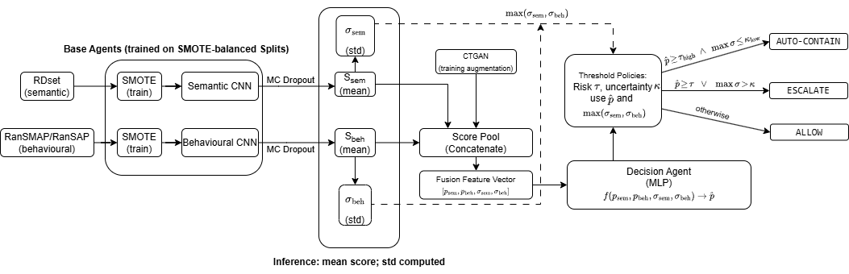

Slide 6
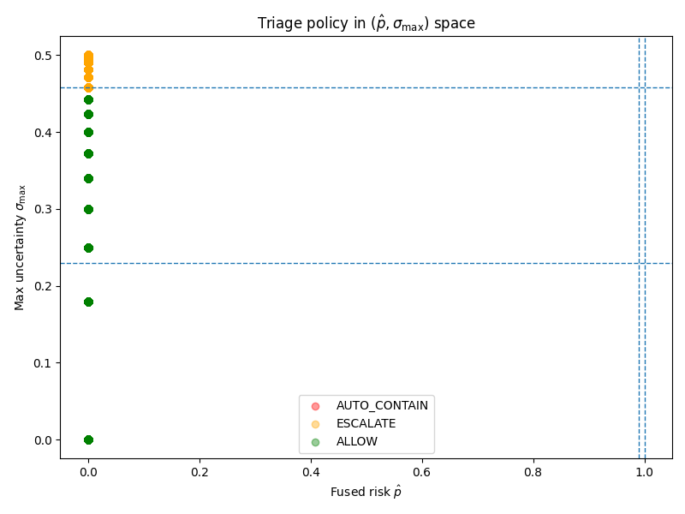
Operationalising Uncertainty: The Triage Policy
Three-way decision (not binary):
  AUTO-CONTAIN
    p̂ ≥ τ_high AND σ_max ≤ κ_low
    High confidence ransomware → act immediately
  ESCALATE
    p̂ ≥ τ AND σ_max > κ (uncertain but suspicious)
    OR p̂ high but evidence conflicts across agents
    → Route to analyst; uncertainty is the trigger
  ALLOW
    Confident benign prediction → pass through
Key insight: uncertainty gates automation —
the system knows when NOT to act autonomously

Slide 7
Results: Where SABRE Works and Where It Struggles
Semantic setting (RDset — 138K PE files):
  Semantic agent: AUROC 0.996 — strong PE separation
  PE structural features discriminate clearly
Behavioural setting (RanSMAP — 35,857 windows, 15 hardware configs):
  Behavioural agent: AUROC 0.963 (random split)
  Family holdout: AUROC drops to 0.706 for unseen families
  Concurrent execution (AESCrypt + REvil): detection rate 1.5%
Why does this matter?
  Weaker behavioural evidence → σ_beh rises → ESCALATE fires
  Uncertainty correctly identifies where the model is least reliable
  Novel families not seen at training → higher σ → analyst review
The gap between settings is not a failure — it is informative

Slide 8
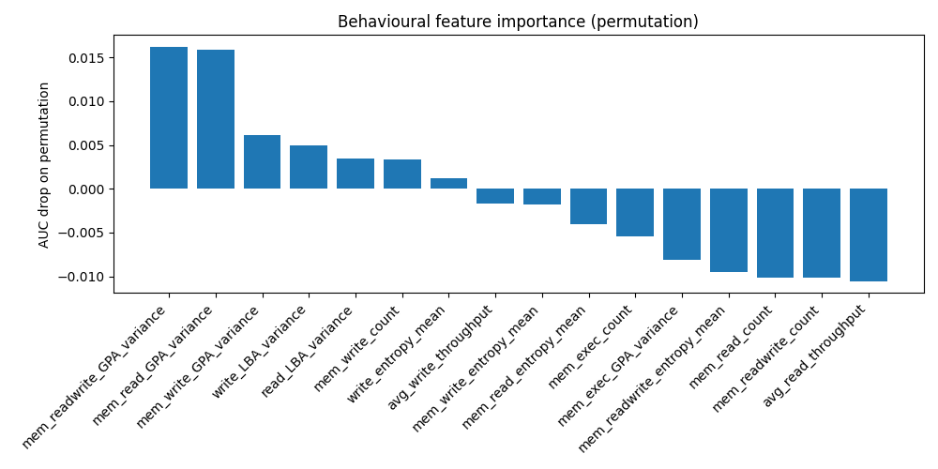
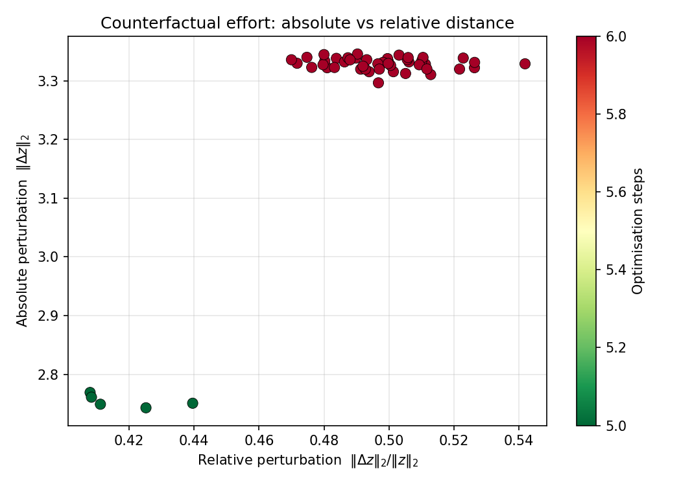
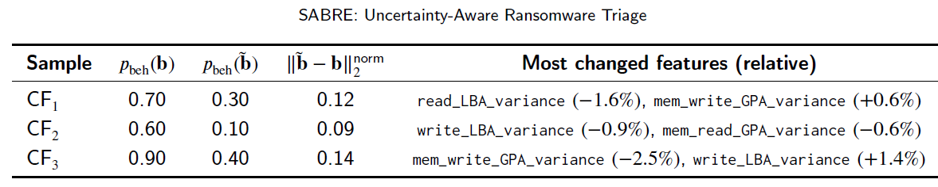
Explainability: Making Decisions Auditable
Behavioural — Permutation Feature Importance:
  write_entropy_mean: top driver — ransomware encrypts → max entropy
  write_LBA_variance: sequential writes across entire disk
  mem_write_GPA_variance: broad memory pages written uniformly
Semantic — Counterfactual Diagnostics:
  For borderline PE files: minimal embedding shift to flip verdict
  Short L₂ distance → closer to decision boundary → escalate
  Supports audit: 'why was this file flagged?’
Current operational practice:
  Antivirus/EDR: threshold-based scores, no principled uncertainty
  SABRE adds: σ as a first-class decision variable + XAI audit trail
  Analyst can see WHY a sample was escalated, not just THAT it was

Slide 9
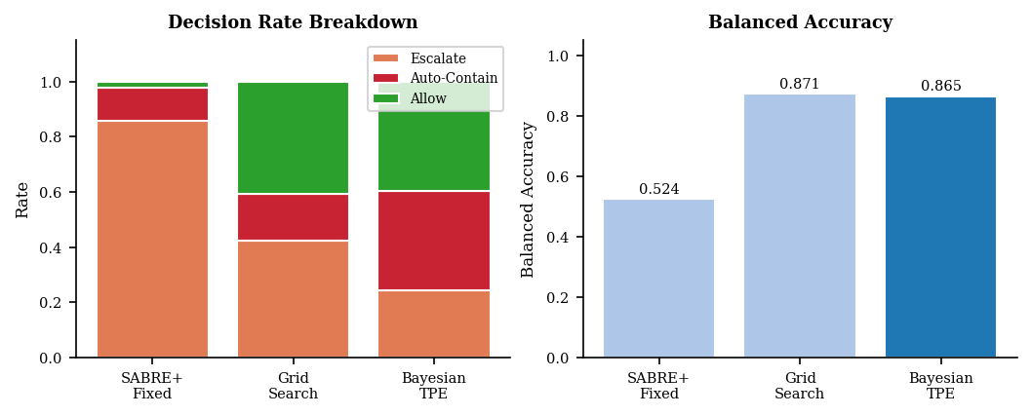
SABRE-II: Learned Fusion & Bayesian Policy
SABRE (this abstract)
SABRE-II (current work)
  Mean score fusion (equal weights)
  Fixed hand-tuned triage thresholds τ, κ
  2 agents: Semantic + Behavioural
  MC Dropout uncertainty per agent
  AUROC 0.963 (random), 0.706 (family holdout)
  Decision MLP replaces mean fusion
    ECE: 0.094 → 0.018 (calibration gain)
  CTGAN score-space augmentation
  Bayesian TPE policy optimisation (300 trials)
    Balanced acc: 0.525 → 0.866
    Escalation rate: 85% → 25% (Bayesian vs fixed)
  Peer Consultation: prevents knowledge collapse
  AUROC 0.975 (random), 0.980 (temporal)
→

Slide 10
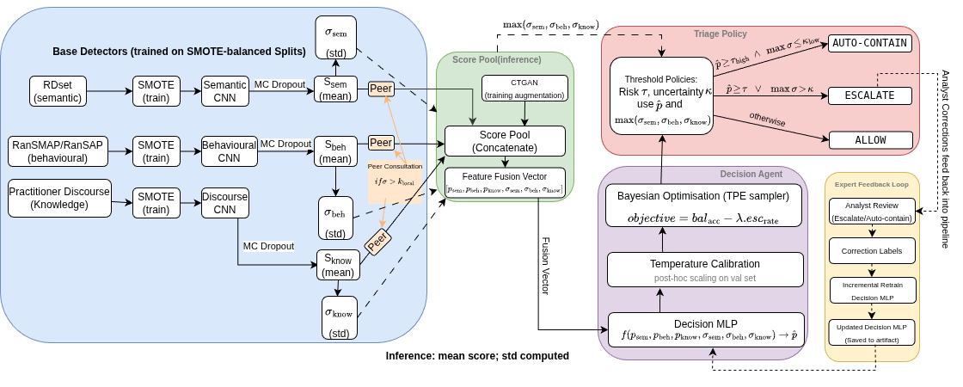
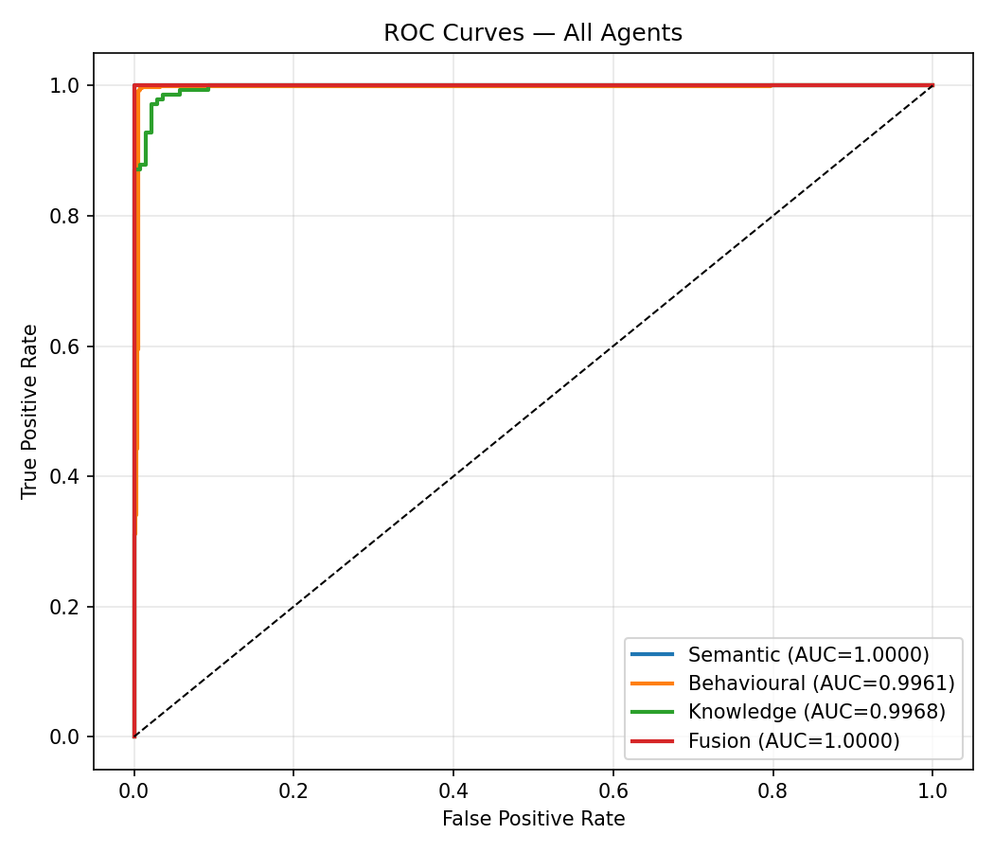

Slide 11
Conclusions
SABRE makes uncertainty operational — not merely descriptive
  Triage converts (p̂, σ) → actionable decision: automate vs escalate vs allow
  Uncertainty correctly identifies hardest cases: novel families, concurrent execution
  XAI (feature importance, counterfactuals) supports analyst audit
  SABRE-II: learned fusion + Bayesian policy reduces unnecessary escalation by 70%
Publications:
  ESWA (Expert Systems With Applications) — under review, 2nd revision
  IEEE TIFS — SABRE+ submitted; SABRE-II in preparation
Questions welcome on:
  Triage threshold design and cost-sensitivity
  Generalisation to unseen ransomware families (family holdout results)
  Comparison with operational EDR/AV uncertainty practices

