Slide 1
Distribution of EV Charging Stations
Modeling & Simulation
Group WG_21
Diogo Silva (202004288)
Henrique Silva (202007242)
Tiago Branquinho (202005567)

Slide 2
Simulation Problem
Description
Challenge:
Growing adoption of electric vehicles (EVs)
Recharging infrastructure efficiency in Porto
Waiting times and peak demand
Problem scope:
Optimal placement - location of charging stations within a city
Adequate capacity - charging points per station
Key objectives:
Minimize waiting times - especially during rush hours
Balance demand/supply across regions
Optimize infrastructure - varying traffic flows and user behavior
Notes:
The goal of our simulation is to address the growing demand for electric vehicles
And to study the efficiency of the recharging infrastructure in Porto
Our scope is the optimal distribution of the charging stations across different regions of the City, based on dynamic traffic flows and user behavior
So that we can minimize waiting times, balancing demain and supply across those regions

Slide 3
Simulation Model
Variables
Charging station capacity - charging points per region
Vehicle battery levels - to determine charging needs
Traffic patterns - influenced by time of day (rush hour, lunch, etc.).
Region vehicles - based on population, income, EV adoption
Vehicle speed - average speed of all vehicles traveling
Simulation Components:
Regions (nodes) - city areas with charging stations
Roads (edges) - distances between regions
Clock/time - simulates daily traffic flow dynamics
Notes:
These are the variables we used, so we have taken into account
We also take into account the number of vehicles of each regions and their speed
Regarding the simulation components, we have regions, which act as nodes and represent charging stations
And straight line roads which act as edges
We also have a clock which helps us simulate dynamic daily traffic flow patterns

Slide 4
Simulation Model
Performance Metrics
Average waiting time - time EVs wait for a charging point
Regional imbalance - standard deviation regarding charger utilization across regions
Stress level - demand per region available chargers
Objectives
Evaluate system efficiency and understand how to:
reduce waiting times
prevent station overcrowding
ensure reliable access
stress_level = (available_chargers / chargers) + ⲁ * (queue / chargers)

Slide 5
Simulation Model
Scenarios
Scenario 1 - Current Infrastructure:
baseline simulation
existing station locations and capacities
Scenario 2 - Increased EV Demand:
future growth in the EV market
detect infrastructure bottlenecks
Scenario 3 - Varying Station Capacities:
adjusting the capacity of region stations
based on previous scenario needs
Goal:
explore diverse conditions and strategies
identify optimal station placement and capacity
ensure charger availability at all times:
while minimizing the investment needed

Slide 6
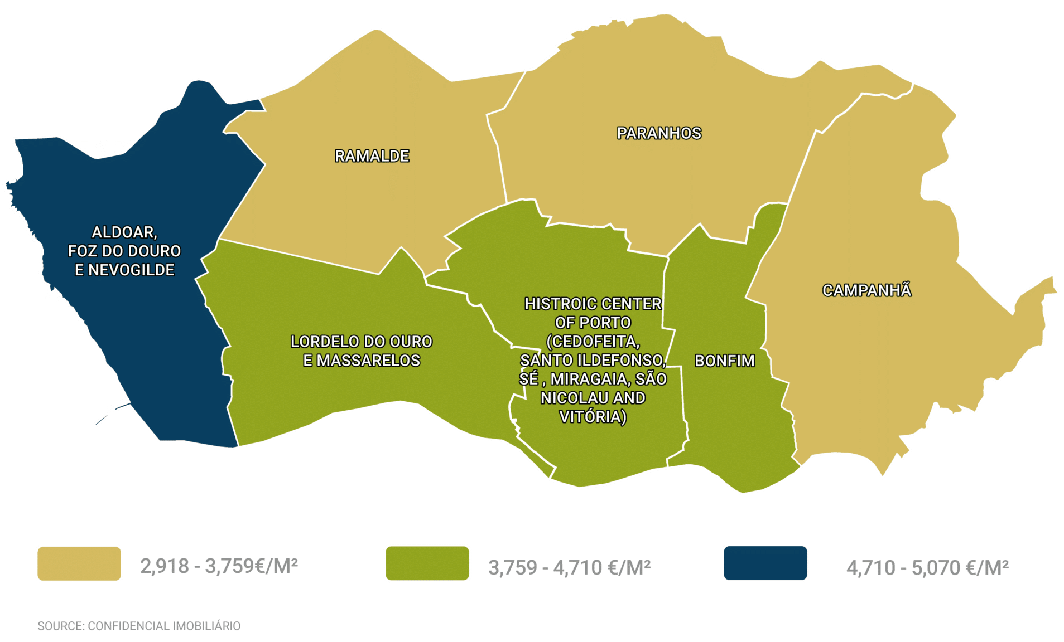
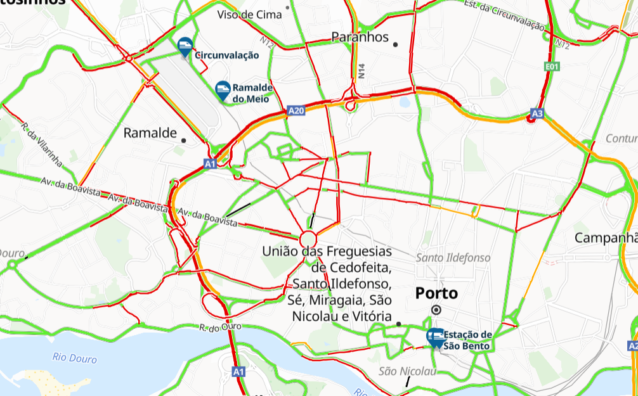
Implementation Details
Computing Data Estimates
Region Traffic
Traffic intensities for each region
City graph to calculate region values:
edges - roads/connections with different traffic weights
Car Seeding
EV generation for each region pre-simulation
Based on regional income distribution and affordability
Car tier filtering:
percentage of income willing to be spent

Slide 7
Implementation Details
Simulation Flow
Simulation Logic
Day divided into segments (rush hour, lunch, …)
Step execution:
1 step = 1 minute
car/region updates
Visualization refreshed at each step:
vehicle locations
region metrics
Car Logic
States - idle, traveling, charging, in-queue, etc.
Actions based on day time:
likelihood of traveling
Movement:
average velocity
battery depletion
Region selection:
for traveling
for charging
Home charging:
option to leave halfway
Region Logic
Charging system:
cars either charge or wait - availability
Metric calculation and updates, tracking:
wait time for queued cars
average car autonomy
charger utilization
cars currently in region

Slide 8
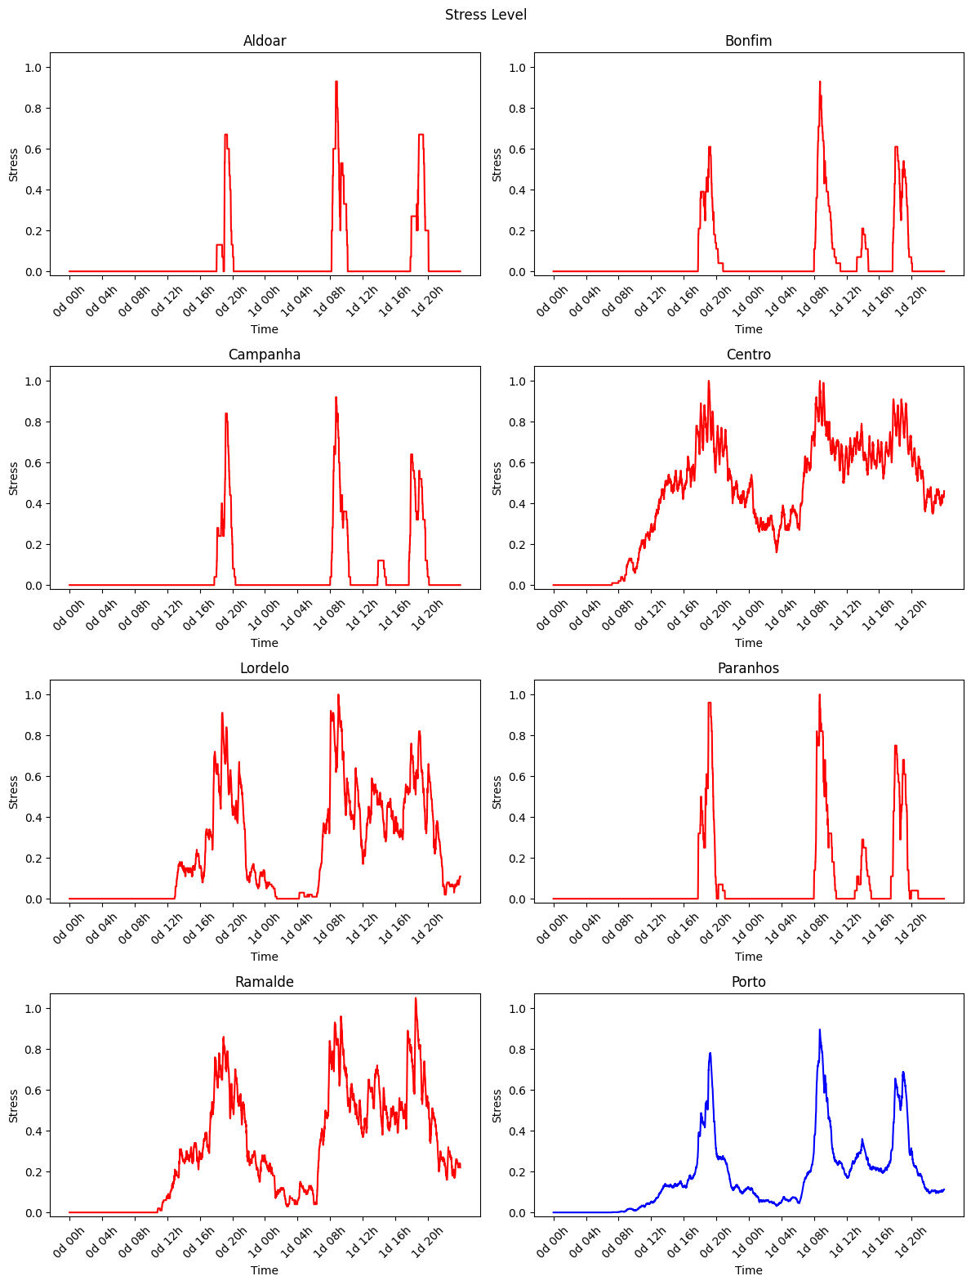
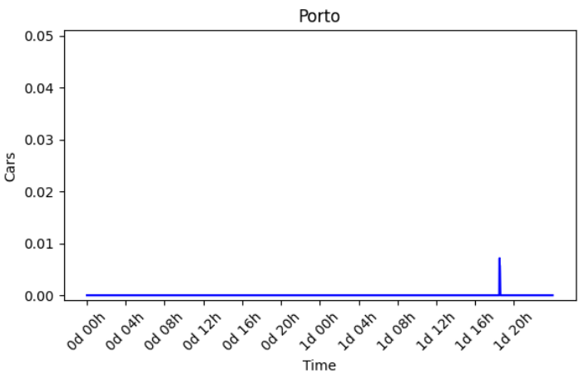
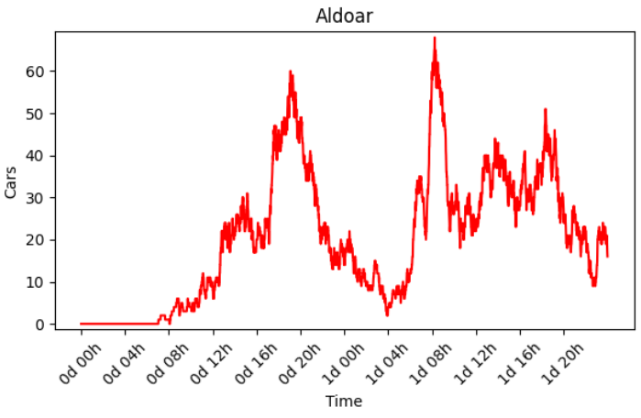
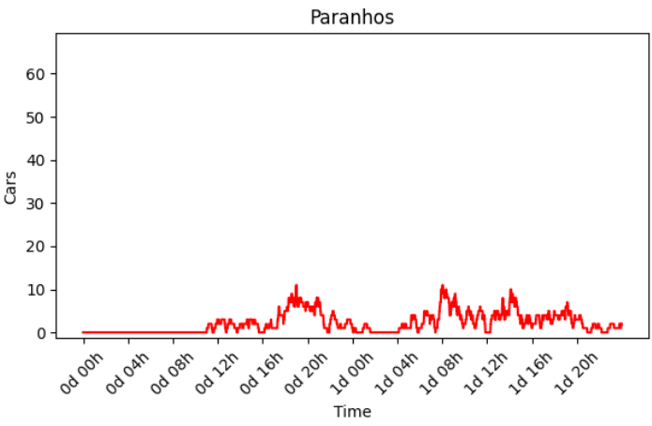
Results and Discussion - Scenario 1
Stress levels
Average Queue Size
Home charging (Aldoar vs Paranhos)

Slide 9
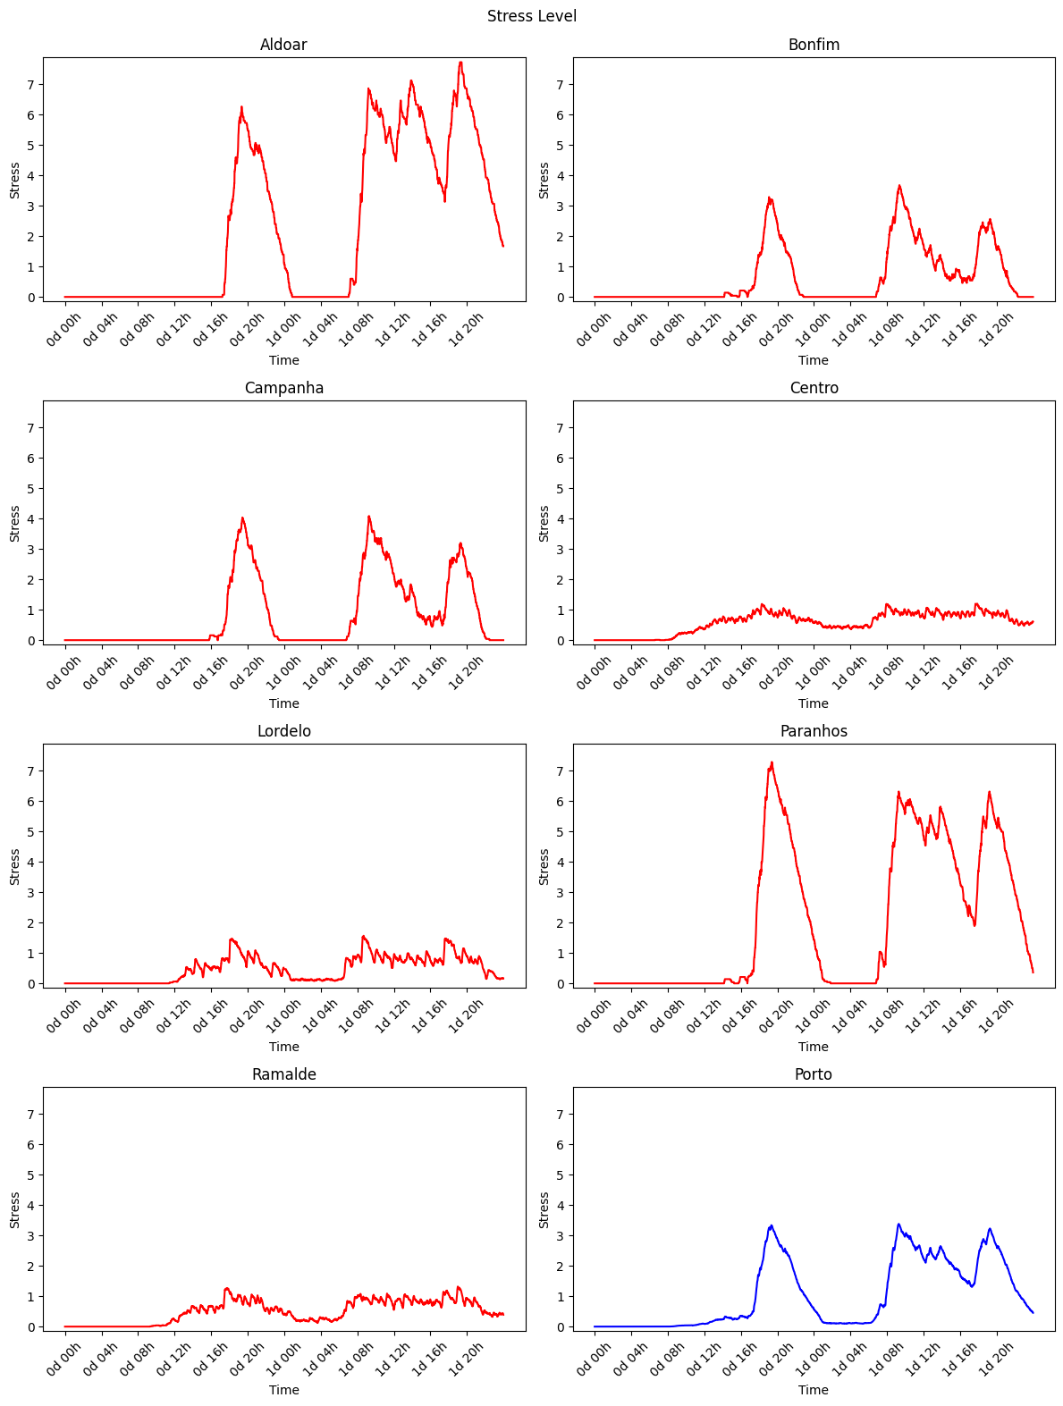
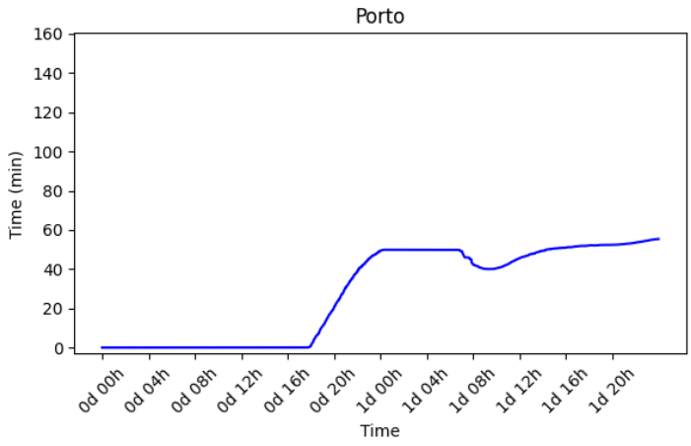
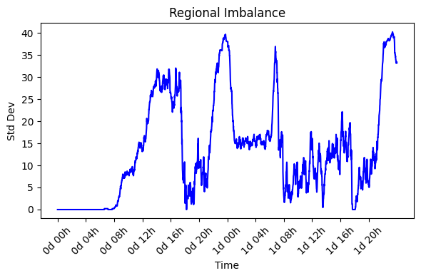
Stress levels
Results and Discussion - Scenario 2
Average Queue Wait Time
Regional Imbalance
(charger utilization)

Slide 10
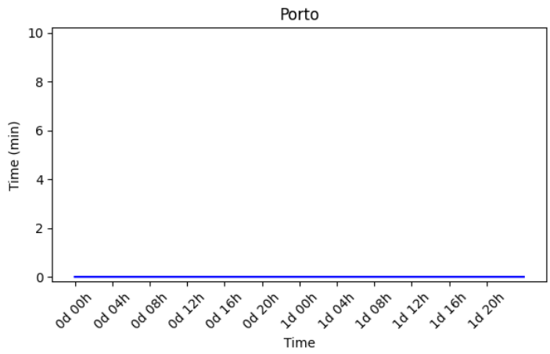
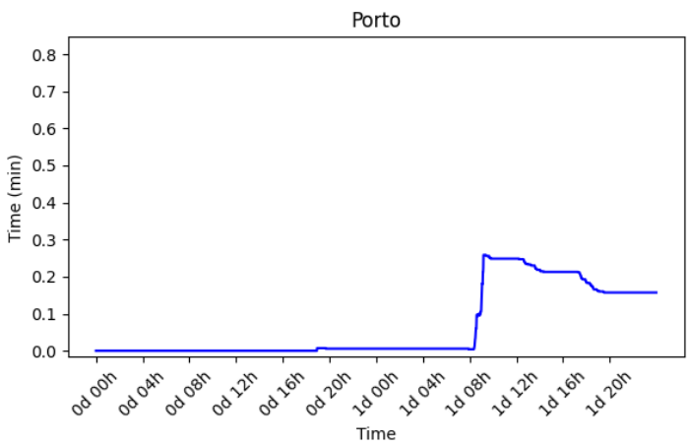
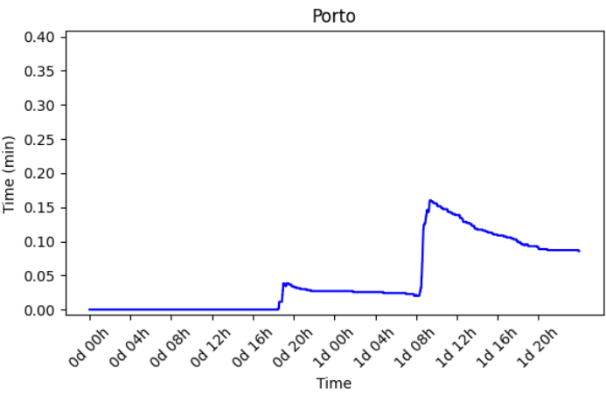
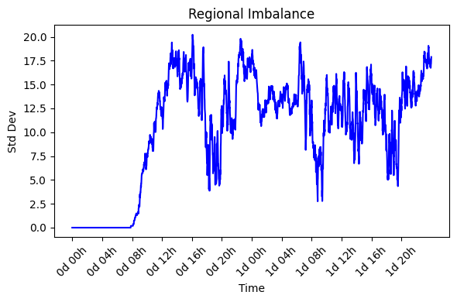
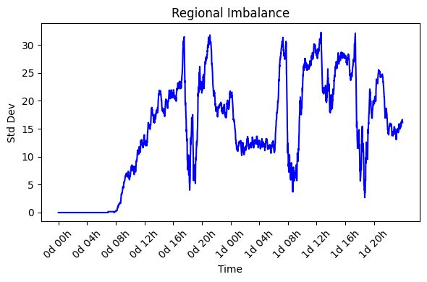
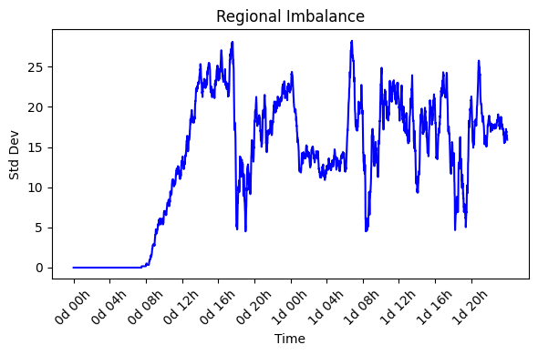
Results and Discussion - Scenario 3
Outer-focused investment
Inner-focused investment
Balanced investment

Slide 11
